Slide 1
Some of the newest SW technologies at W3C: RDFa1.1 and R2ML
Benelux Semantic Web Meetup, Amsterdam
2010-11-24
Ivan Herman, W3C

Slide 2
RDFa

Slide 3
What is RDFa?
For RDF people, it sounds very simple:
  RDFa is a serialization of RDF embedded in XHTML, HTML, or XML in general

Slide 4
So why bother? Why should we care? Why is that of any importance?

Slide 5
RDFa may become the single biggest source of RDF triples on the Web after direct database access!

Slide 6
Data for a Web of Data
Apart from relational databases, most of the data on the Web are in… (X)HTML content
New content is generated every day
How would one get structured data from that information?

Slide 7
Authors of the “traditional Web”…
Do not generate RDF/XML files separately
  RDF/XML is complex
  it requires a separate storage, generation, etc mechanism
    that is also valid for, e.g., Turtle
    even when authoring with, say, Emacs, creating an extra file is a load

Slide 8
Solution
Add extra structured content to the (X)HTML pages
Let processors extract those and turn into RDF

Slide 9
Existing approaches
Microformats
  reuses HTML attributes like @class, @title
  separate vocabularies (address, CV, …)
  difficult to mix microformats (no concept of namespaces)
  possible to transform via, e.g., XSLT + GRDDL, but all transformations are vocabulary dependent

Slide 10
Existing approaches
Microdata
  adds new attributes to HTML5 to express metadata
  can use URI-s, it also fixes some vocabulary mappings (e.g., to Dublin Core elements)
  works for simpler usages, not well suited for complex vocabularies
  has no notion of datatypes, namespaces
  but generic processing becomes possible to generate RDF

Slide 11
Existing approaches
RDFa
  adds new (X)HTML/XML attributes
  has namespaces and URIs at its core; i.e., mixing vocabulary is just as easy as in RDF
  complete flexibility for using Literals or URI Resources
  is a complete serialization of RDF
  generic processing becomes possible to generate RDF

Slide 12
RDFa is a complete bridge between the Web of Documents and the Web of Data

Slide 13
Therefore…
It is very important for RDF experts to
  know RDFa
  parse it alongside Turtle, RDF/XML or other
  when appropriate, generate RDFa pages

Slide 14
What does RDFa look like ?

Slide 15
Main principles of RDFa
RDFa means “RDF in attributes”. I.e.,:
  all RDF contents are defined through XML attributes (no elements)
  the XML/HTML tree structure is used
  many of the attributes are defined by RDFa
    some attributes (@href, @rel) are also reused
  if possible, the text content is also reused (for literals) as well as @href values

Slide 16
What does this mean in practice?
The same (X)HTML file:
  is used, unchanged, by browsers
    they ignore attributes they do not know
  can be used by specialized processors (or APIs) to extract RDF triples

Slide 17
Before getting into details…
The current Recommendation is RDFa 1.0
There is an RDFa1.1 in the making, almost ready
I will talk about RDFa1.1 and warn when the feature is not available in RDFa1.0

Slide 18
XML or (X)HTML?
XHTML+RDFa
HTML5+RDFa
SVG
1.2
ODF
…
RDF Core 1.1
(valid for any XML)
Formally:
  RDFa WG defines Core and XHTML
  HTML WG defines HTML5
we will use XHTML examples

Slide 19
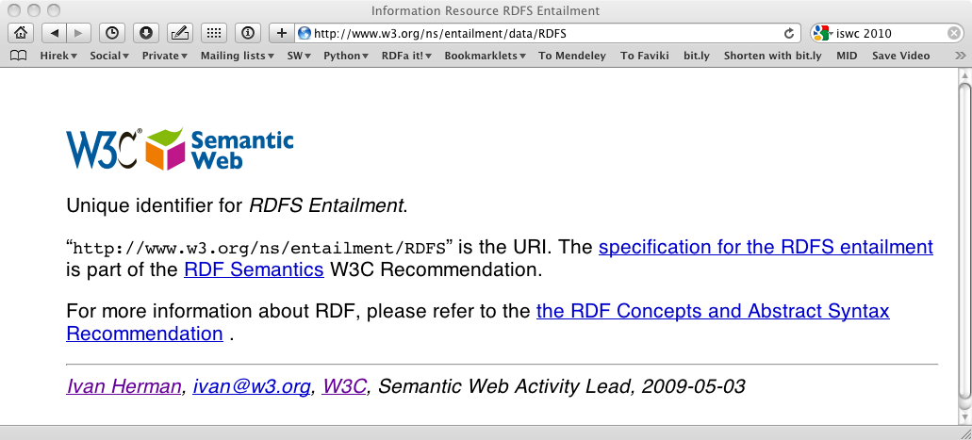
A typical usage pattern
A browser usually asks for an HTML content:

Slide 20
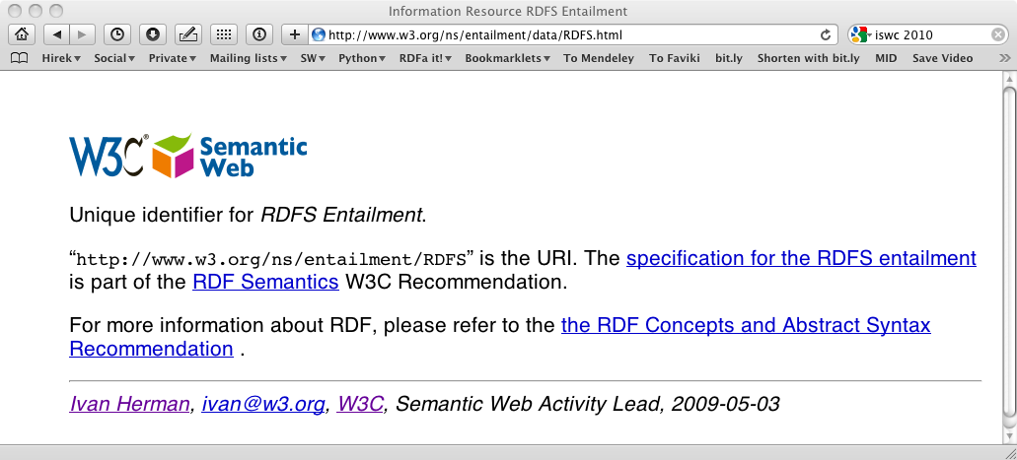
A typical usage pattern
Via content negotiations this goes to:

Slide 21
A typical usage pattern
Via content negotiations this goes to:

Slide 22
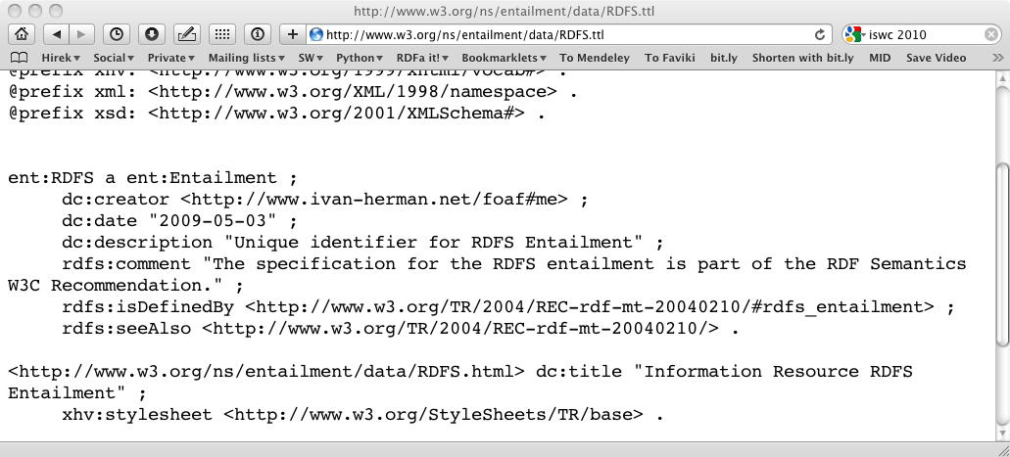
A typical usage pattern
But a client could ask for, say, Turtle:

Slide 23
Where does the Turtle content come from?
The triples are embedded in the HTML file
  a client may know how to extract RDF triples directly from that file; or
  an online “distiller” service is used; or
  the server is set up to generate the Turtle file automatically

Slide 24
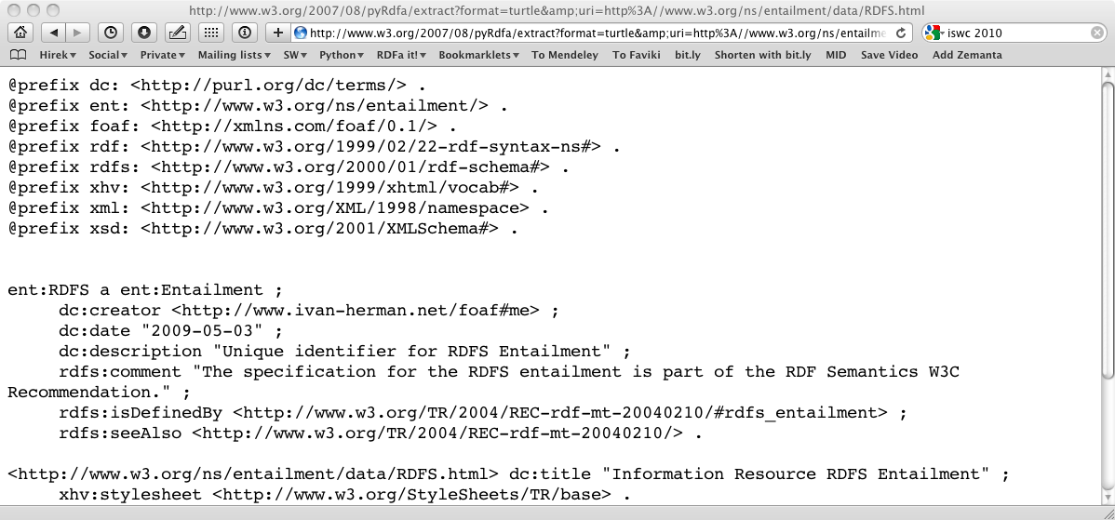
For example, use an online service…

Slide 25
… or set up the server…
RewriteEngine On
RewriteBase /ns/entailment/data/
RewriteRule RDFS.ttl
/2007/08/pyRdfa/extract?format=turtle&amp;
uri=http://www.w3.org/ns/entailment/data/RDFS.html [L]

Slide 26
The important point: the content is created only once

Slide 27
Enough talk; how does it work?

Slide 29
The source and generated RDF…
<p about="http://www.w3.org/ns/entailment/RDFS"
property="http://purl.org/dc/terms/description">
Unique identifier for <em>RDFS Entailment</em>.</p>

Slide 30
The source and generated RDF…
<p about="http://www.w3.org/ns/entailment/RDFS"
property="http://purl.org/dc/terms/description">
Unique identifier for <em>RDFS Entailment</em>.</p>
<http://www.w3.org/ns/entailment/RDFS>
… .

Slide 31
The source and generated RDF…
<p about="http://www.w3.org/ns/entailment/RDFS"
property="http://purl.org/dc/terms/description">
Unique identifier for <em>RDFS Entailment</em>.</p>
<http://www.w3.org/ns/entailment/RDFS>
<http://purl.org/dc/terms/description>
… .

Slide 32
The source and generated RDF…
<p about="http://www.w3.org/ns/entailment/RDFS"
property="http://purl.org/dc/terms/description">
Unique identifier for <em>RDFS Entailment</em>.</p>
<http://www.w3.org/ns/entailment/RDFS>
<http://purl.org/dc/terms/description>
"Unique identifier for RDFS Entailment." .

Slide 34
The source and generated RDF…
<a about="http://www.w3.org/ns/entailment/RDFS"
rel="http://www.w3.org/2000/01/rdf-schema#seeAlso"
href="http://www.w3.org/TR/2004/REC-rdf-mt-20040210/">
RDF Semantics.
</a>

Slide 35
The source and generated RDF…
<a about="http://www.w3.org/ns/entailment/RDFS"
rel="http://www.w3.org/2000/01/rdf-schema#seeAlso"
href="http://www.w3.org/TR/2004/REC-rdf-mt-20040210/">
RDF Semantics.
</a>
<http://www.w3.org/ns/entailment/RDFS>
….

Slide 36
The source and generated RDF…
<a about="http://www.w3.org/ns/entailment/RDFS"
rel="http://www.w3.org/2000/01/rdf-schema#seeAlso"
href="http://www.w3.org/TR/2004/REC-rdf-mt-20040210/">
RDF Semantics.
</a>
<http://www.w3.org/ns/entailment/RDFS>
<http://www.w3.org/2000/01/rdf-schema#seeAlso>
… .

Slide 37
The source and generated RDF…
<a about="http://www.w3.org/ns/entailment/RDFS"
rel="http://www.w3.org/2000/01/rdf-schema#seeAlso"
href="http://www.w3.org/TR/2004/REC-rdf-mt-20040210/">
RDF Semantics.
</a>
<http://www.w3.org/ns/entailment/RDFS>
<http://www.w3.org/2000/01/rdf-schema#seeAlso>
<http://www.w3.org/TR/2004/REC-rdf-mt-20040210/> .

Slide 38
Is that it?

Slide 39
What we have is… NTriples in HTML
The combination of @about with @rel/@property and possibly @href covers most of we need…
But this is too complex for authors

Slide 40
Just compare
<http://www.w3.org/ns/entailment/RDFS>
<http://purl.org/dc/terms/description>
"Unique identifier for RDFS Entailment." .
<http://www.w3.org/ns/entailment/RDFS>
<http://www.w3.org/2000/01/rdf-schema#seeAlso>
<http://www.w3.org/TR/2004/REC-rdf-mt-20040210/> .
with
@prefix rdfs: <http://www.w3.org/2000/01/rdf-schema#> .
@prefix dc: <http://purl.org/dc/terms/> .
<http://www.w3.org/ns/entailment/RDFS>
rdfs:seeAlso
<http://www.w3.org/TR/2004/REC-rdf-mt-20040210/> ;
dc:description "Unique identifier for RDFS Entailment." .

Slide 41
The “Turtle” aspects of RDFa
Use compact URI-s when possible
Make use of XML structure for
  shared subjects
  shared predicates
  create blank nodes
  …

Slide 42
Compact URIs (“CURIE”s)
Just like in Turtle:
  define a prefix via @prefix
  use prefix:reference to abbreviate a URI

Slide 43
CURIE definition and usage
<html>
…
<p about="http://www.w3.org/ns/entailment/RDFS"
property="http://purl.org/dc/terms/description">
Unique identifier for <em>RDFS Entailment</em>.</p>
…
</html>
can be replaced by:
<html prefix="dc: http://purl.org/dc/terms/">
…
<p about="http://www.w3.org/ns/entailment/RDFS"
property="dc:description">
Unique identifier for <em>RDFS Entailment</em>.</p>
…
</html>

Slide 44
Some details on @prefix
Can be anywhere in the XML tree and is valid for the whole sub-tree
  i.e., the html element is not the only place to have it
The same @prefix attribute can hold several definitions:
  prefix="dc: http://purl.org… rdfs: http://…"

Slide 45
Some details on @prefix
An alternative (deprecated) syntax is
  xmlns:dc="http://purl.org/dc/terms/"
CURIEs and “real” URIs can be mixed
  if an attribute value can be interpreted as a CURIE, fine
  alternatively, it is considered as a URI
CURIEs can be used on RDFa attributes only!
  e.g., not for @href

Slide 46
RDFa 1.0 Warnings on CURIEs
In RDFa 1.0
  only the xslt:XXX syntax is usable
  CURIEs on @about can only be used with the syntax: about="[pref:ref]"
  Only CURIEs can be used on, e.g., @property or @rel (no fallback on URIs)

Slide 47
Sharing subjects
The basic principle: @about is inherited by children nodes
  i.e., no reason to repeat it

Slide 48
Shared subject example
<html prefix="dc: http://purl.org/dc/terms/
rdfs: http://www.w3.org/2000/01/rdf-schema#">
…
<body about="http://www.w3.org/ns/entailment/RDFS">
…
<p property="dc:description">
Unique identifier for <em>RDFS Entailment</em>.</p>
<p>…<a rel="rdfs:seeAlso"
href="http://www.w3.org/TR/2004/REC-rdf-mt-20040210">
RDFS Semantics</a>…</p>

Slide 49
… yielding
@prefix rdfs: <http://www.w3.org/2000/01/rdf-schema#> .
@prefix dc: <http://purl.org/dc/terms/> .
<http://www.w3.org/ns/entailment/RDFS>
rdfs:seeAlso
<http://www.w3.org/TR/2004/REC-rdf-mt-20040210/> ;
dc:description "Unique identifier for RDFS Entailment.".

Slide 50
Subjects, and objects, and subjects again…

Slide 51
The rules until now
What we said is:
  @about sets the subject
  @href sets the object
But that is not always good enough
  we do not always want active links (i.e., the “a” element)

Slide 52
We may not always want links…
The RDFa @resource attribute is equivalent to @href
  it sets the object, just like @href
  but it is ignored by a browser, i.e., not a link!
  e.g.,:
<span about="http://www.ivan-herman.net/foaf#me">
<span rel="rdfs:seeAlso"
resource="http://www.ivan-herman.net/foaf">
Activity Lead</span>
</span>

Slide 53
“Chaining”
Here is what we would like to have in RDFa
<http://www.w3.org/ns/entailment/RDFS>
dc:creator <http://www.ivan-herman.net/foaf#me> .
<http://www.ivan-herman.net/foaf#me>
foaf:mailbox <mailto:ivan@w3.org> ;
foaf:workplaceHomepage <http://www.w3.org> .

Slide 54
“Chaining”
A straightforward way:
<body about="http://www.w3.org/ns/entailment/RDFS">
…
<address>
<span rel="dc:creator"
resource="http://www.ivan-herman.net/foaf#me"/>
<span about="http://www.ivan-herman.net/foaf#me">
<a rel="foaf:mailbox"
href="mailto:ivan@w3.org">ivan@w3.org</a>,
<a rel="foaf:workplaceHomepage"
href="http://www.w3.org">W3C</a>
</span>
</address>

Slide 55
“Chaining”
A straightforward way:
<body about="http://www.w3.org/ns/entailment/RDFS">
…
<address>
<span rel="dc:creator"
resource="http://www.ivan-herman.net/foaf#me"/>
<span about="http://www.ivan-herman.net/foaf#me">
<a rel="foaf:mailbox"
href="mailto:ivan@w3.org">ivan@w3.org</a>,
<a rel="foaf:workplaceHomepage"
href="http://www.w3.org">W3C</a>
</span>
</address>

Slide 56
“Chaining”: objects become subjects…
An alternative:
<body about="http://www.w3.org/ns/entailment/RDFS">
…
<address>
<span rel="dc:creator"
resource="http://www.ivan-herman.net/foaf#me">
<a rel="foaf:mailbox"
href="mailto:ivan@w3.org">ivan@w3.org</a>,
<a rel="foaf:workplaceHomepage"
href="http://www.w3.org">W3C</a>
</span>
</address>

Slide 57
Chaining means
@resource (or @href) becomes a subject for the sub-tree
This feature is a bit like in RDF/XML

Slide 58
Some extra features

Slide 59
Some extra features we do not have time for…
Blank nodes can be created using “_:XX”
Datatypes for literals can be set
Shorthand for RDF types
An API is being defined for Web Applications

Slide 60
Some extra features we do not have time for…
Prefix declarations can be collected in a separate file and referred to via a @profile attribute
  the “profile file”
  RDFa1.0 warning: this is an RDFa1.1 feature!

Slide 61
“Term” declarations
A profile file can also define a term:
  assign a URI to a simple string
The term can be used directly by authors, without prefixes

Slide 62
Term Example
Say, file “http://ex.org/prof” defines a mapping:
  "desc" → "http://purl.org/dc/terms/description"

Slide 63
Term Example
<html prefix="dc: http://purl.org/dc/terms/
rdfs: http://www.w3.org/2000/01/rdf-schema#">
…
<body profile="http://ex.org/prof.html" about="…">
…
<p property="desc">
Unique identifier for <em>RDFS Entailment</em>.</p>
yields
@prefix dc: <http://purl.org/dc/terms/> .
<…> <http://purl.org/dc/terms/description>
"Unique identifier for RDFS Entailment."

Slide 64
Terms are important…
Usage of CURIEs and URIs is intuitive for RDF people…
It is not for average HTML authors!
Profile files can be published by major publishers:
  Dublin Core, FOAF, …
  FaceBook, Google, …
… and users can simply refer to the profiles

Slide 65
Publishing RDFa
RDFa gives an easy way of publishing RDF data on the Web
Often, the same RDF data is available in different formats, including RDFa
  it is up to the client to choose which one to use
  Web Applications would rely on RDFa, though…

Slide 66
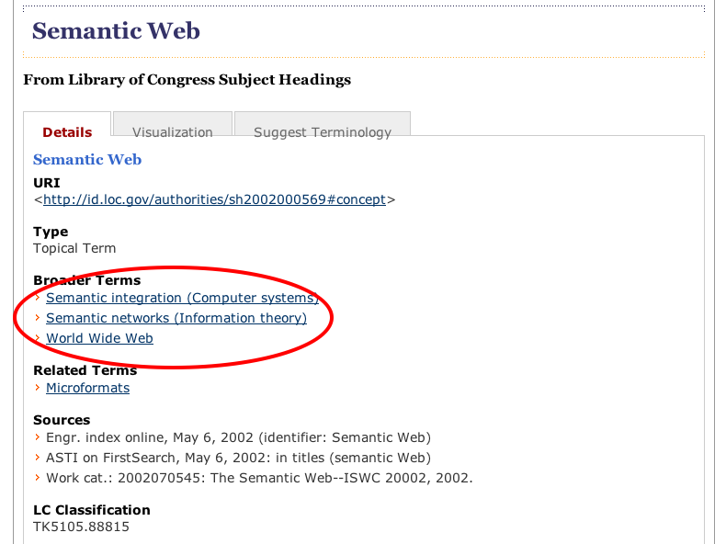
LOC example

Slide 67
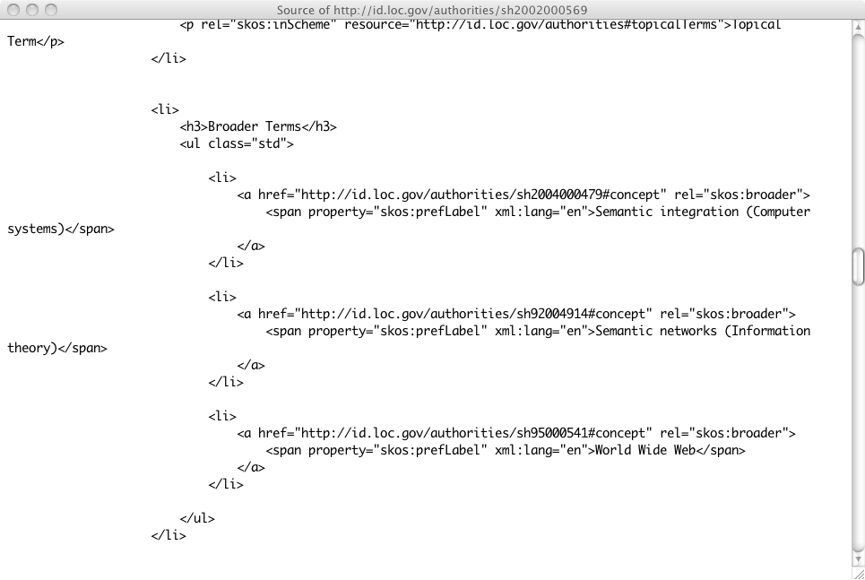
LOC example

Slide 68
Consuming RDFa
Various search engines begin to consume RDFa
  Google, Yahoo, …
    they may specify which vocabularies they “understand”
    this is still an evolving area
Facebook’s “social graph” is based on RDFa

Slide 69
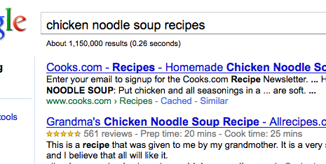
Google’s rich sniplet
Embedded metadata (in microformat or RDFa) is used to improve search result page
  at the moment only a few vocabularies are recognized, but that will evolve over the years

Slide 70
Effects of, e.g., Google
A number of popular sites publish RDFa as part of their normal pages:
  Tesco, BestBuy, Slideshare, The London Gazette, Newsweek, O’Reilly Catalog, the White House…
  Creative Commons snippets are in RDFa

Slide 71
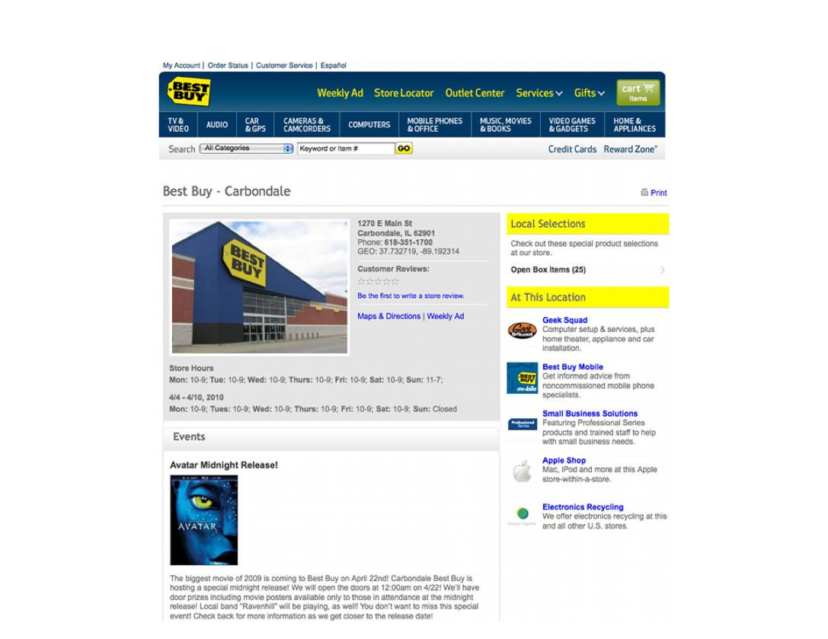
BestBuy Example for RDFa Usage
Courtesy of Jay Myers, BestBuy, SemTech2010 Presentation

Slide 72
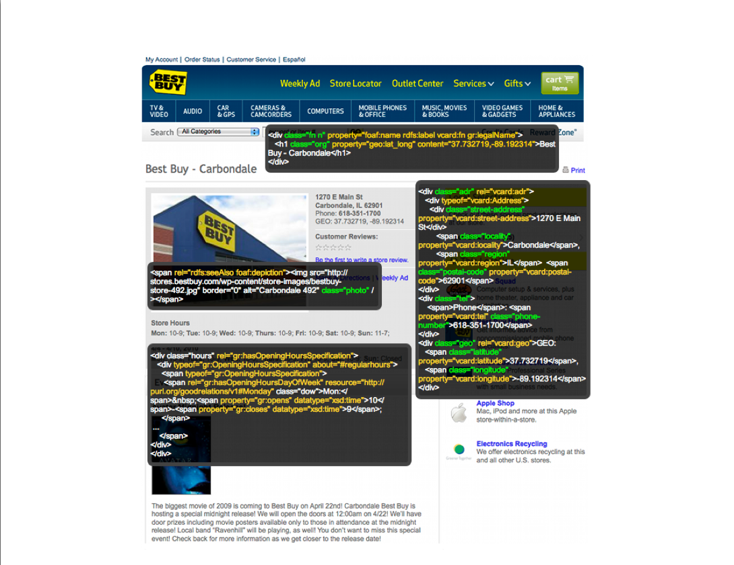
BestBuy Example for RDFa Usage
Courtesy of Jay Myers, BestBuy, SemTech2010 Presentation

Slide 73
Effects on BestBuy
Reported in a BestBuy blog:
  GoodRelations+RDFa improved Google rank tremendously
  30% increase in traffic on BestBuy store pages
  Yahoo observes a 15% increase in click-through rate
Not bad…

Slide 74
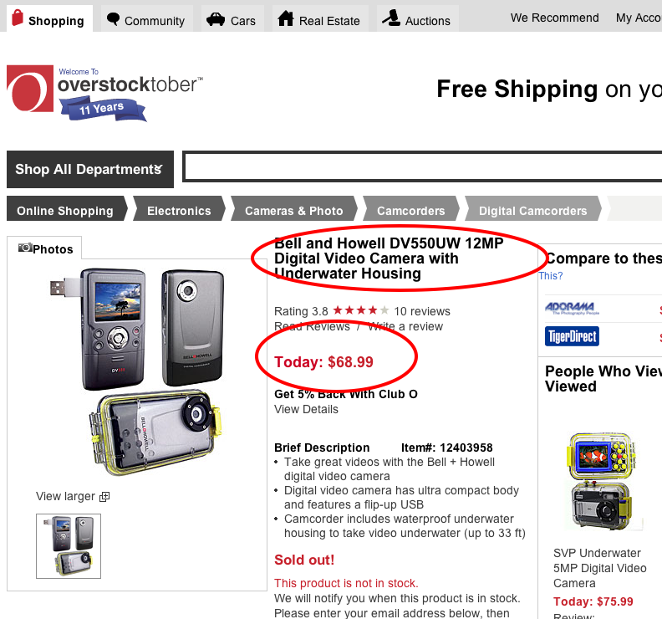
Overstock.com example

Slide 75
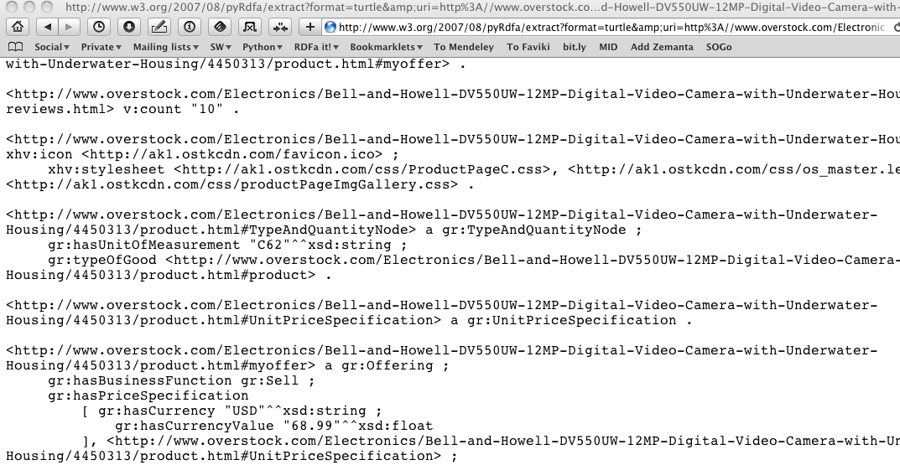
Overstock.com example

Slide 76
R2RML

Slide 77
Bridge to relational databases: R2RML
Data on the Web are mostly stored in databases
“Bridges” are being defined:
  a layer between RDF and the relational data
    RDB tables are “mapped” to RDF graphs, possibly on the fly
    different mapping approaches are being used
  a number RDB systems offer this facility already (eg, Oracle, OpenLink, …)
R2RML is W3C’s evolving standard in this area

Slide 78
What R2RML does
It defines how a table is mapped on RDF
  is defined in term of an RDB schema
    each row is mapped on a common subject
    column headers yield predicates
    each cell is mapped on an object
  different tables within the same database are also linked in the graph

Slide 79


What R2RML processor does
An R2RML processor has access to:
  an RDB schema
  an R2RML instance
  a database governed by the schema
… and produces an RDF graph
RDB Schema
R2RML Processing
Tables
R2RML Instance

Slide 80
A bookshop example
ISBN | Author | Title | Publisher | Year
0006511409X | id_xyz | The Glass Palace | id_qpr | 2000
ID | Name | Homepage
id_xyz | Ghosh, Amitav | http://www.amitavghosh.com
The Glass Palace
a:title
http://…isbn/000651409X
2000
a:year
a:author
a:name
a:homepage
Ghosh, Amitav
http://www.amitavghosh.com

Slide 81
A bookshop example
ISBN | Author | Title | Publisher | Year
0006511409X | id_xyz | The Glass Palace | id_qpr | 2000
ID | Name | Homepage
id_xyz | Ghosh, Amitav | http://www.amitavghosh.com
The Glass Palace
a:title
http://…isbn/000651409X
2000
a:year
a:author
a:name
a:homepage
Ghosh, Amitav
http://www.amitavghosh.com

Slide 82
A bookshop example
ISBN | Author | Title | Publisher | Year
0006511409X | id_xyz | The Glass Palace | id_qpr | 2000
ID | Name | Homepage
id_xyz | Ghosh, Amitav | http://www.amitavghosh.com
The Glass Palace
a:title
http://…isbn/000651409X
2000
a:year
a:author
a:name
a:homepage
Ghosh, Amitav
http://www.amitavghosh.com

Slide 83
A bookshop example
ISBN | Author | Title | Publisher | Year
0006511409X | id_xyz | The Glass Palace | id_qpr | 2000
ID | Name | Homepage
id_xyz | Ghosh, Amitav | http://www.amitavghosh.com
The Glass Palace
a:title
http://…isbn/000651409X
2000
a:year
a:author
a:name
a:homepage
Ghosh, Amitav
http://www.amitavghosh.com

Slide 84
Step 1: transform “Person Table”
ISBN | Author | Title | Publisher | Year
0006511409X | id_xyz | The Glass Palace | id_qpr | 2000
ID | Name | Homepage
id_xyz | Ghosh, Amitav | http://www.amitavghosh.com
:P_Table rdf:type rr:TriplesMap ;
rr:subjectMap [
rr:termtype "BlankNode" ;
rr:column "ID" ;
] ;
rr:predicateObjectMap [
rr:predicateMap [
rr:predicate a:name
];
rr:objectMap [
rr:column "Name"
]
] ;
rr:predicateObjectMap [
rr:predicateMap [
rr:predicate a:homepage
];
rr:objectMap [
rr:column "Homepage" ;
rr:termtype "IRI"
]
] ;
The Glass Palace
a:title
http://…isbn/000651409X
2000
a:year
a:author
a:name
a:homepage
Ghosh, Amitav
http://www.amitavghosh.com

Slide 85
Step 2: transform “Book Table”
ISBN | Author | Title | Publisher | Year
0006511409X | id_xyz | The Glass Palace | id_qpr | 2000
ID | Name | Homepage
id_xyz | Ghosh, Amitav | http://www.amitavghosh.com
:B_Table rdf:type rr:TriplesMap ;
rr:subjectMap [
rr:value [
rr:prefix "http://...isbn/" ;
rr:column "ISBN" ;
]
];
rr:predicateObjectMap [
rr:predicateMap [
rr:predicate a:title
];
rr:objectMap [
rr:column "Title"
]
] ;
rr:predicateObjectMap [
rr:predicateMap [
rr:predicate a:year
];
rr:objectMap [
rr:column "Year" ;
]
] ;
The Glass Palace
a:title
http://…isbn/000651409X
2000
a:year
a:author
a:name
a:homepage
Ghosh, Amitav
http://www.amitavghosh.com

Slide 86
Step 3: “bind” the two tables
ISBN | Author | Title | Publisher | Year
0006511409X | id_xyz | The Glass Palace | id_qpr | 2000
ID | Name | Homepage
id_xyz | Ghosh, Amitav | http://www.amitavghosh.com
:B_Table a rr:TriplesMap ;
...
rr:refPredicateObjectMap [
rr:refPredicateMap [
rr:predicate a:author
];
rr:refObjectMap [
rr:parentTriplesMap :P_Table ;
rr:joinCondition
"{child}.Author = {parent}.ID"
]
]
].
The Glass Palace
a:title
http://…isbn/000651409X
2000
a:year
a:author
a:name
a:homepage
Ghosh, Amitav
http://www.amitavghosh.com

Slide 87
Further R2RML features
There are some additional features
  assign a datatype to a literal object
  more complicated object assignments (e.g., for a specific column the object is a cell of another column)
:B_Table rdf:type rr:TriplesMap ;
...
rr:predicateObjectMap [
...
rr:objectMap [
rr:column "Year" ;
rr:datatype xsd:year
]
] ;

Slide 88
Further R2RML features: logical table
Back to our example:
:B_Table rdf:type rr:TriplesMap ;
rr:subjectMap [
rr:value [
rr:prefix "http://...isbn/" ;
rr:column "ISBN" ;
]
];
ISBN | …
0006511409X | …
http://…isbn/000651409X

Slide 89
Further R2RML features: logical table
An alternative could have been to use SQL
  generate a “logical table”
  all other definitions are on that logical table
Would be an overkill for our example, but can be very powerful for complicated cases!
:B_Table rdf:type rr:TriplesMap ;
rr:SQLQuery "Select
("http://…isbn/" || ISBN) AS id,
Author, Title, Publisher, Year
from b_table " ;
ISBN | …
0006511409X | …
id | …
http://…isbn/0006511409X | …
:B_Table rdf:type rr:TriplesMap ;
…
rr:subjectMap [
ff:column "id"
];
http://…isbn/000651409X

Slide 90
R2RML Direct Mapping
A R2RML processor might be complex
  includes an SQL engine, for example
  fine when bound to big RDB systems
An alternative: generate an crude RDF Graph
  no transformations, links among tables only, etc.
  it is the equivalent of a “Null” R2RML, i.e., no need to specify one
That graph can be processed further with RDFS, rules, etc
This is also properly defined, referred to as “Direct Mapping”

Slide 91
Direct mapping of the bookshop tables
ISBN | Author | Title | Publisher | Year
0006511409X | id_xyz | The Glass Palace | id_qpr | 2000
ID | Name | Homepage
id_xyz | Ghosh, Amitav | http://www.amitavghosh.com

Slide 92
Direct mapping of the bookshop tables
ISBN | Author | Title | Publisher | Year
0006511409X | id_xyz | The Glass Palace | id_qpr | 2000
ID | Name | Homepage
id_xyz | Ghosh, Amitav | http://www.amitavghosh.com
0006511409X
<Book#ISBN>
The Glass Palace
<Book#Title>
<Book/ISBN=0006511409#_>
2000
<Book#Year>
<Book#Author>

Slide 93
Direct mapping of the bookshop tables
ISBN | Author | Title | Publisher | Year
0006511409X | id_xyz | The Glass Palace | id_qpr | 2000
ID | Name | Homepage
id_xyz | Ghosh, Amitav | http://www.amitavghosh.com
0006511409X
<Book#ISBN>
The Glass Palace
<Book#Title>
<Book/ISBN=0006511409#_>
2000
<Book#Year>
<Book#Author>
<Author/ID=id_xyz#_>
<Author#Name>
<Author#Homepage>
Ghosh, Amitav
http://www.amitavghosh.com

Slide 94
Direct graph must be transformed
0006511409X
<Book#ISBN>
The Glass Palace
<Book#Title>
<Book/ISBN=0006511409#_>
2000
<Book#Year>
<Book#Author>
<Author/ID=id_xyz#_>
<Author#Name>
<Author#Homepage>
Ghosh, Amitav
http://www.amitavghosh.com
Property names should be mapped
URI-s should be minted
Literals should be replaced by URI-s
The Glass Palace
a:title
http://…isbn/000651409X
2000
a:year
a:author
a:name
a:homepage
Ghosh, Amitav
http://www.amitavghosh.com

Slide 95
Transformation with SPARQL 1.1
0006511409X
<Book#ISBN>
The Glass Palace
<Book#Title>
<Book/ISBN=0006511409#_>
2000
<Book#Year>
<Book#Author>
<Author/ID=id_xyz#_>
<Author#Name>
<Author#Homepage>
CONSTRUCT {
?id a:title ?title ;
a:year ?year ;
a:author _:x .
_:x a:name ?name ;
a:homepage ?hp .
}
WHERE {
?book
<Book#ISBN> ?isbn ;
<Book#Title> ?title ;
<Book#Year> ?year ;
<Book#Author> ?author .
?author
<Author#Name> ?name ;
<Author#Homepage ?homepage .
BIND (IRI(fn:concat("http://...",?isbn)) AS ?id)
BIND (IRI(?homepage) AS ?hp)
}
Ghosh, Amitav
http://www.amitavghosh.com
The Glass Palace
a:title
http://…isbn/000651409X
2000
a:year
a:author
a:name
a:homepage
Ghosh, Amitav
http://www.amitavghosh.com

Slide 96

Thank you for your attention
These slides are also available on the Web:
http://www.w3.org/2010/Talks/1124-Amsterdam-IH/

