Slide 1
A year on the Semantic Web @ W3C (with more details on RDFa)
Pontifícia Universidade Católica do Rio de Janeiro, 2010-10-25
Ivan Herman, W3C

Slide 2
The past…
Some technologies have been finalized:
OWL 2
Rule Interchange Format (RIF)

Slide 3
The present…
Technical work is going on
SPARQL 1.1
RDFa 1.1
RDB2RDF
“Community” contacts at W3C are also happening with
health care and life science community
financial world, e.g., XBRL
(digital) library world
eGovernment

Slide 4
The (possible) future
Finalize the present
Possible new technical activities:
provenance
revision of RDF
…

Slide 5
OWL 2

Slide 6
OWL 2
A small revision of the 2004 version of OWL
Some new features:
keys
extended datatypes facilities
e.g., numerical intervals without relying on XML Schemas
property chains
the “uncle” example can now be formulated in OWL
profiles
…
Better documents, clearer structures
Notes:
also: syntactic sugar for, eg, disjoint classes or negative property assertions;

Slide 7
It was a slightly stormy process…
There were misunderstanding between the “core” RDF and the OWL communities
“does OWL abandon RDF?”
will there be an OWL 2 Full specification at all?
Luckily, all those were really just misunderstandings

Slide 8
The overall structure has not changed
RDF/XML
Func. Syntax
OWL/XML
M‘ter syntax
Turtle
OWL Ontology
mapping
syntax
ontology structure
RDF graph
semantics
mapping
Direct Semantics
correspondence theorem
(for DL subset)
RDF Based Semantics

Slide 9
OWL 2 profiles
OWL 2 maintains the OWL Full and OWL DL “duality”
But OWL Lite has been replaced by “profiles”:
syntactic restrictions to OWL
restricted facilities ⬄ better reasoning performance
Goal is to make lighter OWL reasoners possible

Slide 10
OWL profiles
OWL Full
OWL DL
OWL EL
OWL RL
OWL QL

Slide 11
An example: OWL RL
Goal: to be implementable through rule engines
Usage follows a similar approach to RDFS:
merge the ontology and the instance data into an RDF graph
use the rule engine to add new triples (as long as it is possible)
then, for example, use SPARQL to query the resulting (expanded) graph
This application model is very important for RDF based applications

Slide 12
What can be done in OWL RL?
Many features are available:
identity of classes, instances, properties
subproperties, subclasses, domains, ranges
union and intersection of classes (though with some restrictions)
property characterizations (functional, symmetric, etc)
property chains
keys
some property restrictions

Slide 13
Rule Interchange Format (RIF)

Slide 14
Why rules on the Semantic Web?
Some conditions may be complicated in ontologies (ie, OWL)
e.g., Horn rules: (P1 & P2 & …) → C
In many cases applications just want 2-3 rules to complete integration
I.e., rules may be an alternative to (OWL based) ontologies

Slide 15
Things you may want to express
An example from a bookshop domain:
“I buy a novel with over 500 pages if it costs less than $20”
something like (in an ad-hoc syntax):
{
?x rdf:type p:Novel;
p:page_number ?n;
p:price [
p:currency p:$;
rdf:value ?z
].
?n > "500"^^xsd:integer.
?z < "20.0"^^xsd:double.
}
=>
{ <me> p:buys ?x }

Slide 16
RIF (Rule Interchange Format)
The goals of the RIF:
define simple rule language(s) for the Semantic Web
define interchange formats for rule based systems
RIF defines several “dialects” of languages
some are geared towards production rule systems, for example
i.e., RIF is not bound to RDF only
RIF is also a general framework to define/interchange rule languages

Slide 17
RIF Core
The simplest RIF “dialect”
A Core document is
some directives like import, prefix settings for URIs, etc
a sequence of logical implications
can use the familiar datatypes and operators
has the notion of “anonymous” resources, a bit like blank nodes

Slide 18
RIF Syntaxes
RIF defines
a “presentation syntax”
a bit like the functional syntax for OWL
a standard XML syntax to encode and exchange the rules
there is a note for expressing Core in RDF
just like OWL is represented in RDF

Slide 19
Remember the what we wanted from Rules?
{
?x rdf:type p:Novel;
p:page_number ?n;
p:price [
p:currency p:$;
rdf:value ?z
].
?n > "500"^^xsd:integer.
?z < "20.0"^^xsd:double.
}
=>
{ <me> p:buys ?x }

Slide 20
The same with RIF Presentation syntax
Document (
Prefix …
Group (
Forall ?x ?n ?z (
<me>[p:buys->?x] :-
And(
?x rdf:type p:Novel
?x[p:page_number->?n p:price->_abc]
_abc[p:currency->p:$ rdf:value->?z]
External(pred:numeric-greater-than(?n "500"^^xsd:integer))
External(pred:numeric-less-than(?z "20.0"^^xsd:double))
)
)
)
)

Slide 21
A word on the syntax
The RIF Presentation syntax is… only syntax
It can express more than what RDF needs
Hopefully, a syntax will emerge with
close to one of the RDF syntaxes with a better integration of rules
can be mapped on Core implementations

Slide 22
Usage of rule with RDF
A system gets
a set of RIF Core rules in some syntax
data in RDF
new RDF triples are generated
Sounds familiar? Remember OWL RL?

Slide 23
What about OWL RL?
OWL RL stands for “Rule Language”…
OWL RL is in the intersection of RIF Core and OWL
inferences in OWL RL can be expressed with rules
the rules are precisely described in the OWL spec
there are OWL RL implementations that are based on RIF
An application may also “declare” a subset of OWL RL rules it uses and let a RIF engine do the rest…

Slide 24
SPARQL 1.1

Slide 25
SPARQL as a unifying point
Application
SPARQL Endpoint
SPARQL Endpoint
SPARQL Construct
SPARQL Construct
Triple store
SPARQL Processor
Database
RDFa
NLP Techniques
GRDDL, RDFa
SQL⬄RDF
RDF Graph
Relational
Database
HTML
Unstructured Text
XML/XHTML

Slide 26
SPARQL 1.1: filling some missing features
Update, i.e., to change the RDF store
remove or add triples
Nested queries (i.e., SELECT within a WHERE clause)
Negation (MINUS, and a NOT EXIST filter)
Aggregate functions in SELECT (SUM, MIN, MAX…)
Property path expressions (?x foaf:knows+ ?y)
Basic federated queries
Combination with entailment regimes (RDFS, OWL, RIF)

Slide 27
SPARQL 1.1 and RDFS/OWL/RIF
SPARQL Engine with entailment
RDF Data
RDFS/OWL/RIF data
entailment
SPARQL Pattern
RDF Data with extra triples
SPARQL Pattern
Query result
pattern matching

Slide 28
SPARQL as a unifying point
Application
SPARQL Endpoint
SPARQL Endpoint
SPARQL Construct
SPARQL Construct
Triple store
SPARQL Processor
Database
RDFa
NLP Techniques
GRDDL, RDFa
SQL⬄RDF
RDF Graph
Relational
Database
HTML
Unstructured Text
XML/XHTML

Slide 29
SPARQL 1.1 as a unifying point
Application
SPARQL Endpoint
SPARQL Endpoint
SPARQL Construct
SPARQL Construct
Triple store
SPARQL Update
SPARQL Processor
SPARQL Update
Database
OWL Reasoning
RDFa
NLP Techniques
GRDDL, RDFa
SQL⬄RDF
RDF Graph
Relational
Database
RIF Reasoning
HTML
Unstructured Text
XML/XHTML

Slide 30
Revision of RDF?

Slide 31
History
RDF has been published in 2004
Significant deployment since then
implementation experiences
users’ experiences
Some cracks, missing functionalities, etc, came to the fore

Slide 32
The question
Shall we
live with the issues and go on with our lives?
dump it and start all over again?
do some minimal changes?

Slide 33
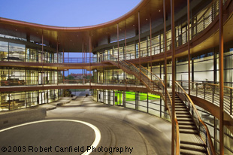
The W3C “RDF Next Step” Workshop
W3C organized a Workshop in June 2010
32 submissions, 28 accepted, 18 were presented at the workshop
2 busy days at Stanford, courtesy of NCBO

Slide 34
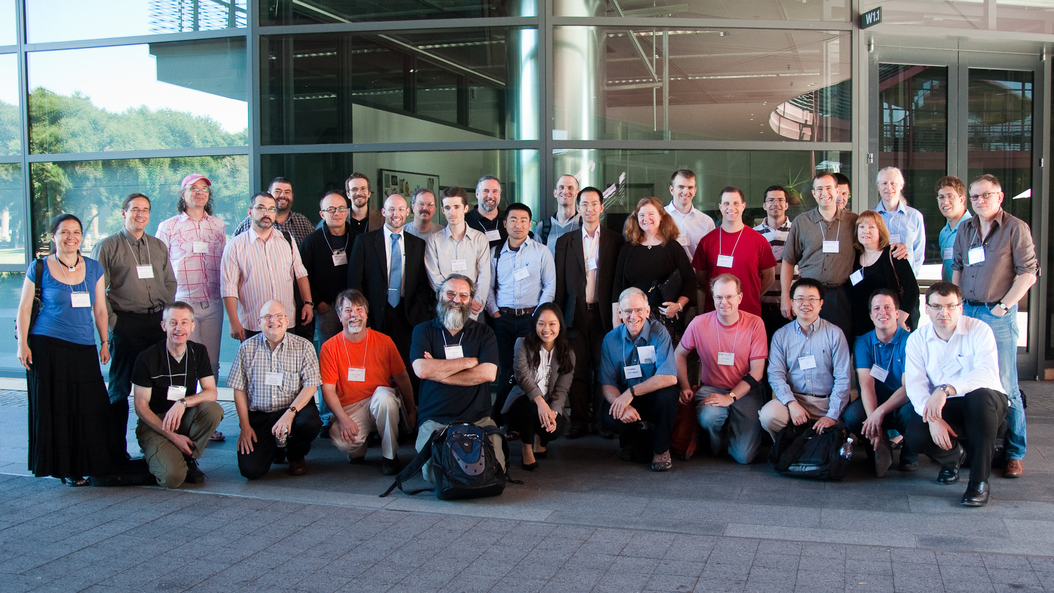

Slide 35
What we did…
Try to answer the question: live with it, redo it, mend it…
if something has to be changed, what is it and with what priority?
Give a list of possible work items, with priorities

Slide 36
The general feeling…
Yes, it is probably o.k. to touch some issues
But we have to be very careful not to send the wrong signal to adopters, tool providers, etc.
I.e.: keep the changes to the minimum

Slide 37
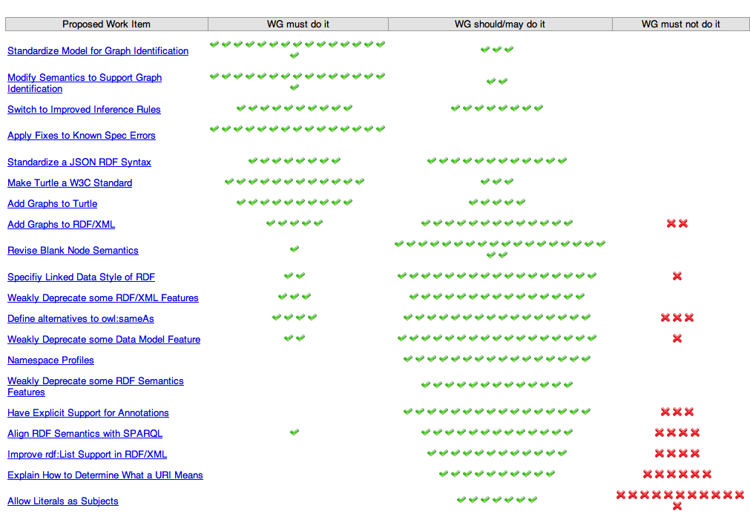
The straw poll result

Slide 38
Follow up
Workshop report published:
http://www.w3.org/2009/12/rdf-ws/Report.html
W3C Team began working on chartering
…but felt the larger community should be asked
A questionnaire was published in August 2010
http://www.w3.org/2002/09/wbs/1/rdf-2010/results
And, of course, lots of discussion on various fora

Slide 39
“Main Charter candidates”

Slide 40
The obvious issues
There are some errata that have to be taken care of
exact relationship to IRI-s
more flexible references to XML versions
etc

Slide 41
“Graph identification”
A.k.a. “named graphs”, “quoted graphs”, “knowledge bases”
Is on the top of all priority lists…
But the semantics is not absolutely clear
e.g., are we talking about a mutable or immutable collection of triples?
maybe we have two different concepts here…

Slide 42
Turtle serialization syntax
We have a stable “team submission”, widely used by the community
another top priority item…
Additional syntax should be added for graph identification

Slide 43
JSON serialization syntax
Is essential for Web Developers
It may not be a complete syntax; to be decided as we go
e.g., no blank nodes, only syntax for Skolemized nodes
The syntax may also include tools for lists, graph identification, etc.

Slide 44
Deprecation
Some features may be deprecated: reification, containers, …
Unclear what “deprecation” means in this context
old RDF graphs should not become invalid…

Slide 45
Reconcile semantics documents
A number of semantics extensions and features have appeared in Recommendations since
rdf:plainLiteral
“finite” versions of RDF(S) semantics as part of the SPARQL 1.1 entailment regimes
bridge between URI-s as strings and RDF resources in POWDER
Probably useful to reconcile these in one place for wider and easier adoption

Slide 46
“Secondary Charter candidates”

Slide 47
Bnode Skolemization
General guidelines for bnode Skolemization
e.g., define a scheme of the form
http://bnode.w3.org/{uuid}
… that could be used by some syntaxes, ie, consumers would know that this is, in fact, an anonymous node
There are a number of Recommendation that rely on Skolemization (e.g., SPARQL)

Slide 48
Harmonize plain literal management
We currently have plain literal, xsd:string, rdf:plainLiteral…
it leads to, e.g., convoluted SPARQL queries
These should be harmonized

Slide 49
RDFa (a mini tutorial…)

Slide 50
What is RDFa?
For RDF people, it sounds very simple:
RDFa is a serialization of RDF embedded in XHTML, HTML, or XML in general

Slide 51
So why bother? Why should we care? Why is that of any importance?

Slide 52
RDFa may become the single biggest source of RDF triples on the Web after direct database access!

Slide 53
Data for a Web of Data
Apart from relational databases, most of the data on the Web are in… (X)HTML content
New content is generated every day
How would one get structured data from that information?

Slide 54
Authors of the “traditional Web”…
Do not generate RDF/XML files separately
RDF/XML is complex
it requires a separate storage, generation, etc mechanism
that is also valid for, e.g., Turtle
even when authoring with, say, Emacs, creating an extra file is a load

Slide 55
Solution
Add extra structured content to the (X)HTML pages
Let processors extract those and turn into RDF

Slide 56
RDFa
adds new (X)HTML/XML attributes
has namespaces and URIs at its core; i.e., mixing vocabulary is just as easy as in RDF
is a complete serialization of RDF
generic processing becomes possible to generate RDF

Slide 57
RDFa is a complete bridge between the Web of Documents and the Web of Data

Slide 58
Therefore…
It is very important for RDF experts to
know RDFa
parse it alongside Turtle, RDF/XML or other
when appropriate, generate RDFa pages

Slide 59
What does RDFa look like ?

Slide 60
Main principles of RDFa
RDFa means “RDF in attributes”. I.e.,:
all RDF contents are defined through XML attributes (no elements)
the XML/HTML tree structure is used
many of the attributes are defined by RDFa
some attributes (@href, @rel) are also reused
if possible, the text content is also reused (for literals) as well as @href values

Slide 61
What does this mean in practice?
The same (X)HTML file:
is used, unchanged, by browsers
they ignore attributes they do not know
can be used by specialized processors (or APIs) to extract RDF triples

Slide 62
Before getting into details…
The current Recommendation is RDFa 1.0
There is an RDFa1.1 in the making, almost ready
I will talk about RDFa1.1 and warn when the feature is not available in RDFa1.0

Slide 63
XML or (X)HTML?
XHTML+RDFa
HTML5+RDFa
SVG
1.2
ODF
…
RDF Core 1.1
(valid for any XML)
Formally:
RDFa WG defines Core and XHTML
HTML WG defines HTML5
we will use XHTML examples

Slide 64
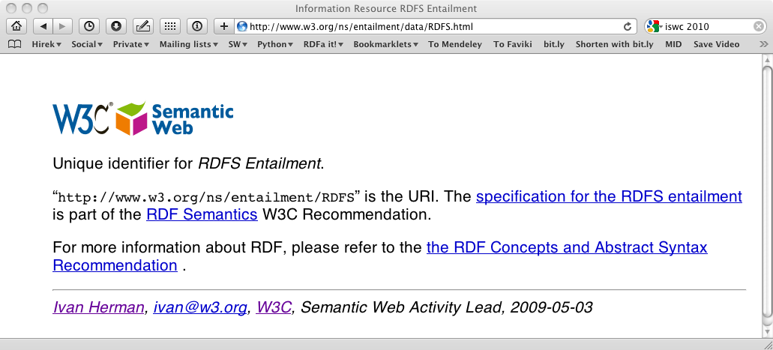
A typical usage pattern
The client asks for HTML

Slide 65
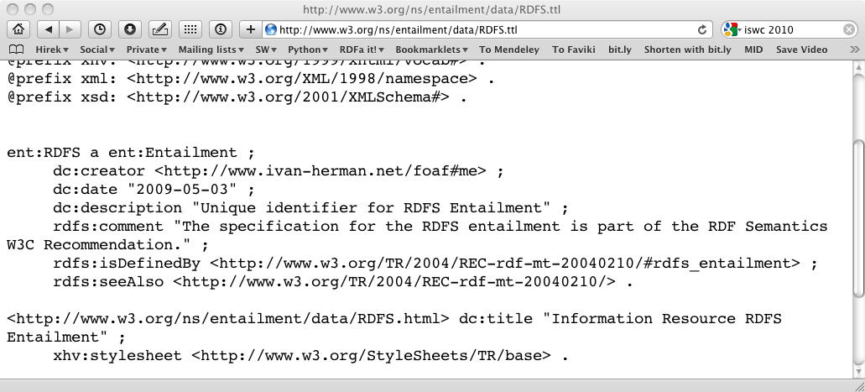
A typical usage pattern
But a client could ask for, say, Turtle:

Slide 67
The source and generated RDF…
<p about="http://www.w3.org/ns/entailment/RDFS"
property="http://purl.org/dc/terms/description">
Unique identifier for <em>RDFS Entailment</em>.</p>

Slide 68
The source and generated RDF…
<p about="http://www.w3.org/ns/entailment/RDFS"
property="http://purl.org/dc/terms/description">
Unique identifier for <em>RDFS Entailment</em>.</p>
<http://www.w3.org/ns/entailment/RDFS>
… .

Slide 69
The source and generated RDF…
<p about="http://www.w3.org/ns/entailment/RDFS"
property="http://purl.org/dc/terms/description">
Unique identifier for <em>RDFS Entailment</em>.</p>
<http://www.w3.org/ns/entailment/RDFS>
<http://purl.org/dc/terms/description>
… .

Slide 70
The source and generated RDF…
<p about="http://www.w3.org/ns/entailment/RDFS"
property="http://purl.org/dc/terms/description">
Unique identifier for <em>RDFS Entailment</em>.</p>
<http://www.w3.org/ns/entailment/RDFS>
<http://purl.org/dc/terms/description>
"Unique identifier for RDFS Entailment." .

Slide 72
The source and generated RDF…
<a about="http://www.w3.org/ns/entailment/RDFS"
rel="http://www.w3.org/2000/01/rdf-schema#seeAlso"
href="http://www.w3.org/TR/2004/REC-rdf-mt-20040210/">
RDF Semantics.
</a>

Slide 73
The source and generated RDF…
<a about="http://www.w3.org/ns/entailment/RDFS"
rel="http://www.w3.org/2000/01/rdf-schema#seeAlso"
href="http://www.w3.org/TR/2004/REC-rdf-mt-20040210/">
RDF Semantics.
</a>
<http://www.w3.org/ns/entailment/RDFS>
….

Slide 74
The source and generated RDF…
<a about="http://www.w3.org/ns/entailment/RDFS"
rel="http://www.w3.org/2000/01/rdf-schema#seeAlso"
href="http://www.w3.org/TR/2004/REC-rdf-mt-20040210/">
RDF Semantics.
</a>
<http://www.w3.org/ns/entailment/RDFS>
<http://www.w3.org/2000/01/rdf-schema#seeAlso>
… .

Slide 75
The source and generated RDF…
<a about="http://www.w3.org/ns/entailment/RDFS"
rel="http://www.w3.org/2000/01/rdf-schema#seeAlso"
href="http://www.w3.org/TR/2004/REC-rdf-mt-20040210/">
RDF Semantics.
</a>
<http://www.w3.org/ns/entailment/RDFS>
<http://www.w3.org/2000/01/rdf-schema#seeAlso>
<http://www.w3.org/TR/2004/REC-rdf-mt-20040210/> .

Slide 76
Is that it?

Slide 77
What we have is… NTriples in HTML
The combination of @about with @rel/@property and possibly @href covers most of we need…
But this is too complex for authors

Slide 78
Just compare
<http://www.w3.org/ns/entailment/RDFS>
<http://purl.org/dc/terms/description>
"Unique identifier for RDFS Entailment." .
<http://www.w3.org/ns/entailment/RDFS>
<http://www.w3.org/2000/01/rdf-schema#seeAlso>
<http://www.w3.org/TR/2004/REC-rdf-mt-20040210/> .
with
@prefix rdfs: <http://www.w3.org/2000/01/rdf-schema#> .
@prefix dc: <http://purl.org/dc/terms/> .
<http://www.w3.org/ns/entailment/RDFS>
rdfs:seeAlso
<http://www.w3.org/TR/2004/REC-rdf-mt-20040210/> ;
dc:description "Unique identifier for RDFS Entailment." .

Slide 79
The “Turtle” aspects of RDFa
Use compact URI-s when possible
Make use of XML structure for
shared subjects
shared predicates
create blank nodes
…

Slide 80
Compact URIs (“CURIE”s)
Just like in Turtle:
define a prefix via @prefix
use prefix:reference to abbreviate a URI

Slide 81
CURIE definition and usage
<html>
…
<p about="http://www.w3.org/ns/entailment/RDFS"
property="http://purl.org/dc/terms/description">
Unique identifier for <em>RDFS Entailment</em>.</p>
…
</html>
can be replaced by:
<html prefix="dc: http://purl.org/dc/terms/">
…
<p about="http://www.w3.org/ns/entailment/RDFS"
property="dc:description">
Unique identifier for <em>RDFS Entailment</em>.</p>
…
</html>

Slide 82
Some details on @prefix
Can be anywhere in the XML tree and is valid for the whole sub-tree
i.e., the html element is not the only place to have it
The same @prefix attribute can hold several definitions:
prefix="dc: http://purl.org… rdfs: http://…"

Slide 83
Some details on @prefix
An alternative (deprecated) syntax is
xmlns:dc="http://purl.org/dc/terms/"
CURIEs and “real” URIs can be mixed
if an attribute value can be interpreted as a CURIE, fine
alternatively, it is considered as a URI
CURIEs can be used on RDFa attributes only!
e.g., not for @href

Slide 84
RDFa 1.0 Warnings on CURIEs
In RDFa 1.0
only the xslt:XXX syntax is usable
CURIEs on @about can only be used with the syntax: about="[pref:ref]"
Only CURIEs can be used on, e.g., @property or @rel (no fallback on URIs)

Slide 85
Sharing subjects
The basic principle: @about is inherited by children nodes
i.e., no reason to repeat it

Slide 86
Shared subject example
<html prefix="dc: http://purl.org/dc/terms/
rdfs: http://www.w3.org/2000/01/rdf-schema#">
…
<body about="http://www.w3.org/ns/entailment/RDFS">
…
<p property="dc:description">
Unique identifier for <em>RDFS Entailment</em>.</p>
<p>…<a rel="rdfs:seeAlso"
href="http://www.w3.org/TR/2004/REC-rdf-mt-20040210">
RDFS Semantics</a>…</p>

Slide 87
… yielding
@prefix rdfs: <http://www.w3.org/2000/01/rdf-schema#> .
@prefix dc: <http://purl.org/dc/terms/> .
<http://www.w3.org/ns/entailment/RDFS>
rdfs:seeAlso
<http://www.w3.org/TR/2004/REC-rdf-mt-20040210/> ;
dc:description "Unique identifier for RDFS Entailment.".

Slide 88
Subjects, and objects, and subjects again…

Slide 89
The rules until now
What we said is:
@about sets the subject
@href sets the object
But that is not always good enough
we do not always want active links (i.e., the "a" element)

Slide 90
We may not always want links…
The RDFa @resource attribute is equivalent to @href
it sets the object, just like @href
but it is ignored by a browser, i.e., not a link!
e.g.,:
<span about="http://www.ivan-herman.net/foaf#me">
<span rel="rdfs:seeAlso"
resource="http://www.ivan-herman.net/foaf">
Activity Lead</span>
</span>

Slide 91
“Chaining”
Here is what we would like to have in RDFa
<http://www.w3.org/ns/entailment/RDFS>
dc:creator <http://www.ivan-herman.net/foaf#me> .
<http://www.ivan-herman.net/foaf#me>
foaf:mailbox <mailto:ivan@w3.org> ;
foaf:workplaceHomepage <http://www.w3.org> .

Slide 92
“Chaining”
A straightforward way:
<body about="http://www.w3.org/ns/entailment/RDFS">
…
<address>
<span rel="dc:creator"
resource="http://www.ivan-herman.net/foaf#me"/>
<span about="http://www.ivan-herman.net/foaf#me">
<a rel="foaf:mailbox"
href="mailto:ivan@w3.org">ivan@w3.org</a>,
<a rel="foaf:workplaceHomepage"
href="http://www.w3.org">W3C</a>
</span>
</address>

Slide 93
“Chaining”
A straightforward way:
<body about="http://www.w3.org/ns/entailment/RDFS">
…
<address>
<span rel="dc:creator"
resource="http://www.ivan-herman.net/foaf#me"/>
<span about="http://www.ivan-herman.net/foaf#me">
<a rel="foaf:mailbox"
href="mailto:ivan@w3.org">ivan@w3.org</a>,
<a rel="foaf:workplaceHomepage"
href="http://www.w3.org">W3C</a>
</span>
</address>

Slide 94
“Chaining”: objects become subjects…
An alternative:
<body about="http://www.w3.org/ns/entailment/RDFS">
…
<address>
<span rel="dc:creator"
resource="http://www.ivan-herman.net/foaf#me">
<a rel="foaf:mailbox"
href="mailto:ivan@w3.org">ivan@w3.org</a>,
<a rel="foaf:workplaceHomepage"
href="http://www.w3.org">W3C</a>
</span>
</address>

Slide 95
Chaining means
@resource (or @href) becomes a subject for the sub-tree
This feature is a bit like in RDF/XML

Slide 96
Some extra features

Slide 97
Some extra features we do not have time for…
Blank nodes can be created using “_:XX”
Datatypes for literals can be set
Shorthand for RDF types
An API is being defined for Web Applications
Prefix definitions can be put into a separate “profile” file
e.g., Google may define which prefixes it understands

Slide 98
Publishing RDFa
RDFa gives an easy way of publishing RDF data on the Web
Often, the same RDF data is available in different formats, including RDFa
it is up to the client to choose which one to use
Web Applications would rely on RDFa, though…

Slide 99
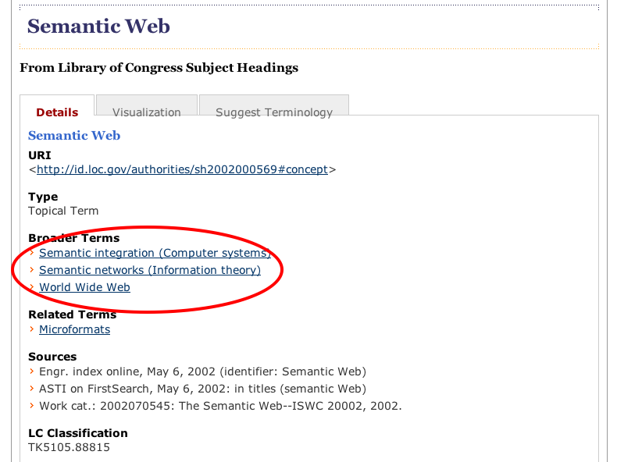
LOC example

Slide 100
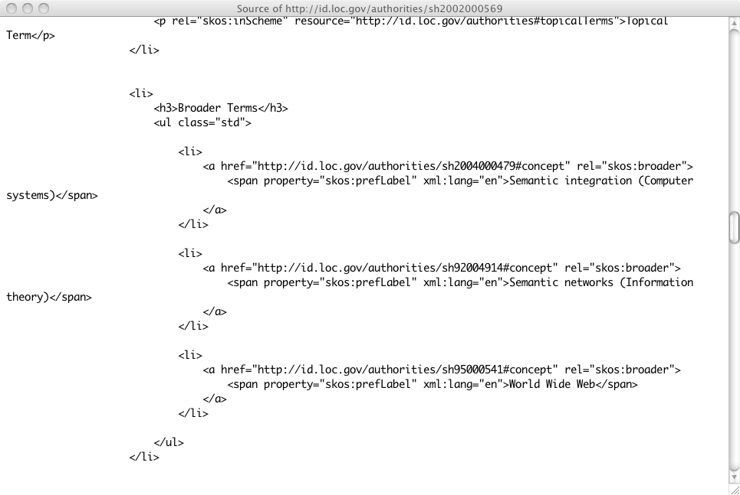
LOC example

Slide 101
Consuming RDFa
Various search engines begin to consume RDFa
Google, Yahoo, …
they may specify which vocabularies they “understand”
this is still an evolving area
Facebook’s “social graph” is based on RDFa

Slide 102
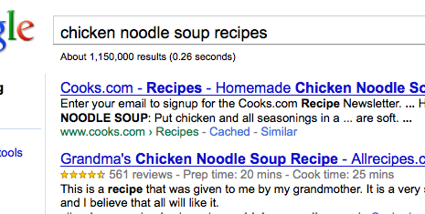
Google’s rich sniplet
Embedded metadata (in microformat or RDFa) is used to improve search result page
at the moment only a few vocabularies are recognized, but that will evolve over the years

Slide 103
Effects of, e.g., Google
A number of popular sites publish RDFa as part of their normal pages:
Tesco, BestBuy, Slideshare, The London Gazette, Newsweek, O’Reilly Catalog, the White House…
Creative Commons snippets are in RDFa

Slide 104
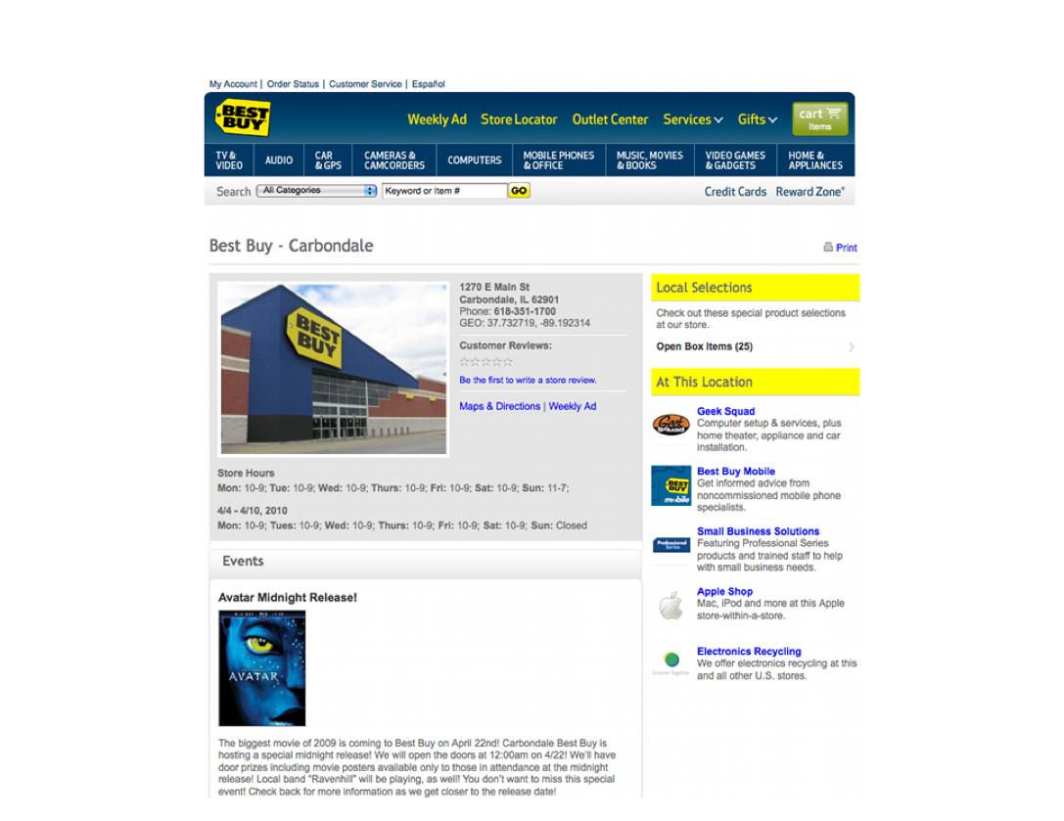
BestBuy Example for RDFa Usage
Courtesy of Jay Myers, BestBuy, SemTech2010 Presentation

Slide 105
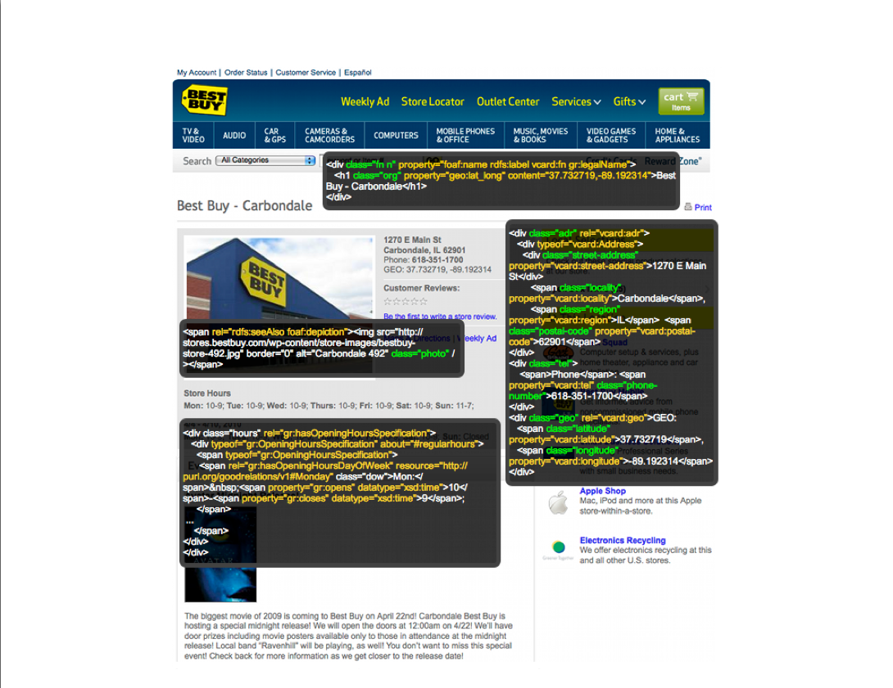
BestBuy Example for RDFa Usage
Courtesy of Jay Myers, BestBuy, SemTech2010 Presentation

Slide 106
Effects on BestBuy
Reported in a BestBuy blog:
GoodRelations+RDFa improved Google rank tremendously
30% increase in traffic on BestBuy store pages
Yahoo observes a 15% increase in click-through rate
Not bad…

Slide 107
That is all I have time for…
There are many issues that were not discussed
provenance, linked data, open government initiatives, applications, open R&D issues, …
There is work for everyone!

Slide 108

Thank you for your attention!
These slides are also available on the Web:
http://www.w3.org/2010/Talks/1025-Rio-IH/

