Slide 1
What is W3C?
PRISM Forum, Stockholm, Sweden
May 19, 2010
Ivan Herman, W3C

Slide 2

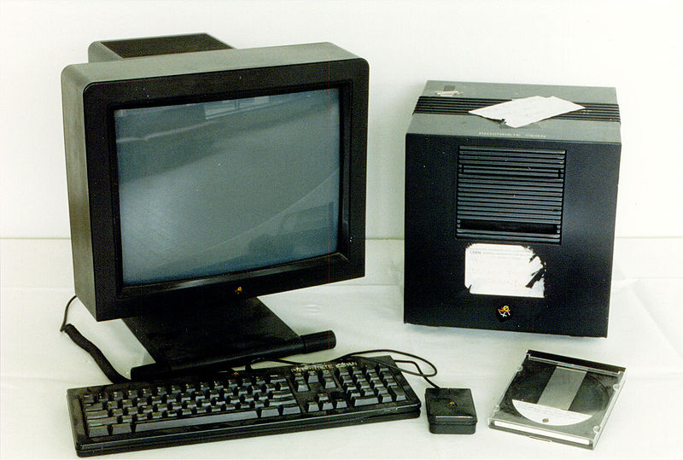
A bit of history…
The Web was created in 1990
Technically, it was a combination of a few concepts:
a network protocol (HTTP)
universal naming on the internet (URI)
a markup language for documents with hyperlinking (HTML)
Around 1993 it caught up like bushfire…

Slide 3
Why?
Technically, it was the right set of choices
The technology was free for everyone
does anyone remembers gopher?
There were vendor neutral standards for each of the technology pieces
developers could rely on independent specifications, without any vendor lock-in

Slide 4
I.e., development of the Web needs free and open technologies
And this is exactly what W3C is all about!
The place where international, free and open technologies for the World Wide Web are developed

Slide 5
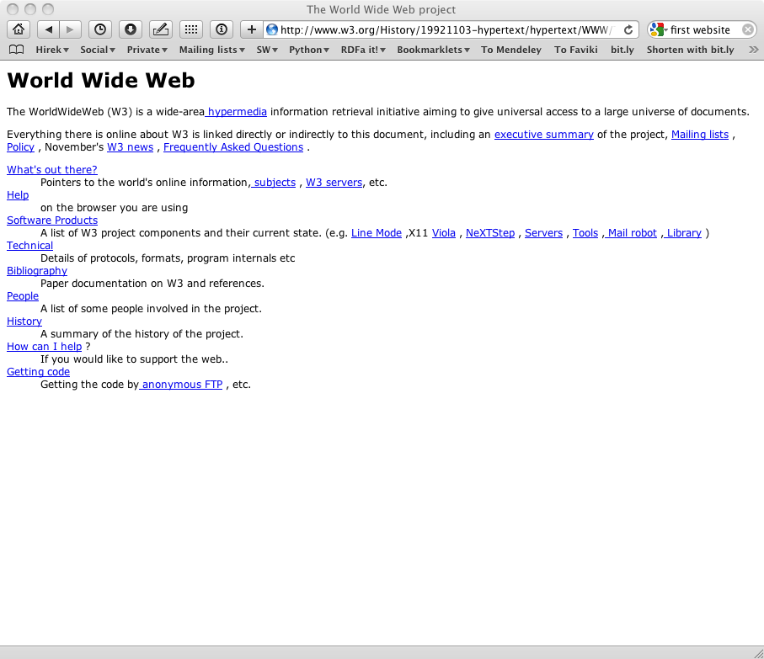
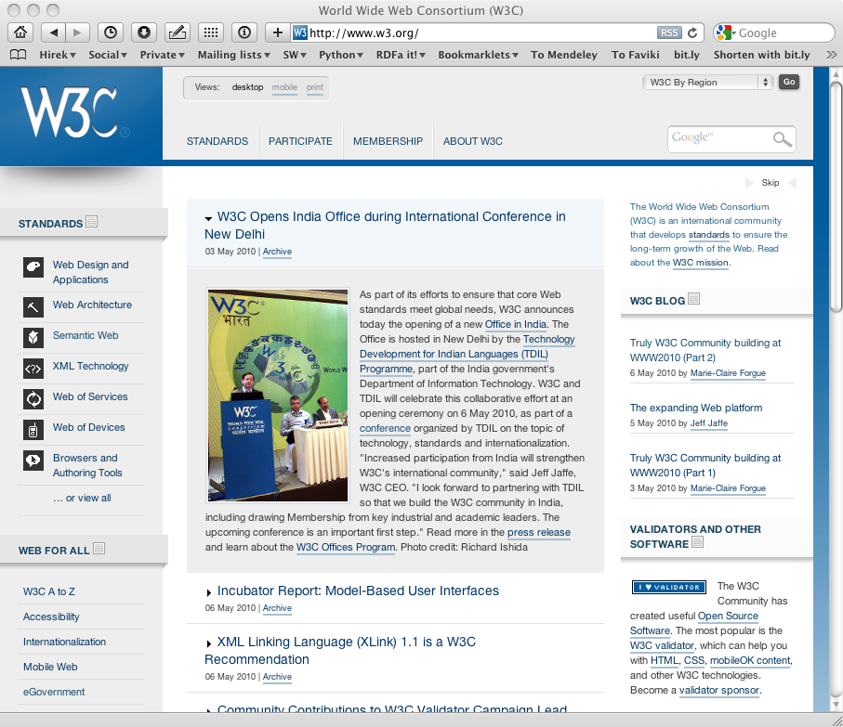
But technology has changed…
In the old days, it was simple
HTTP + HTML + URI = Web
But the Web has evolved a lot

Slide 6
New technological evolutions
A more interactive, richer Web
HTML5 with video, audio, graphics
Web Applications
A more diverse environment
used on computers, mobile devices, home appliances
used in different countries, languages, character sets
used by healthy and disabled, old and young, …

Slide 7
New technological evolutions (cont)
A Web of Data (a.k.a. Semantic Web)
huge databases, datasets are available on the Web
they should be combined, linked, analyzed on Web scale
Web technologies used by specific communities as core infrastructure
digital libraries and publications
governmental organizations (“eGovernment”)
health care, drug discovery, life sciences
…

Slide 8
Result: W3C’s activities have diversified
In terms of technologies:
mobile web, graphics, video, audio, semantics…
accessibility, internationalization
In terms of constituencies:
core Web developers (browsers, tool providers, etc)
major Web user communities (“verticals”)

Slide 9
Lots of technologies developed at W3C…
One Web
Web Applications
Ubiquitous Web
Web Services
Semantic Web
Social Web
HTML
MWI
SOAP
OWL
eGovt
XHTML
SMIL
SRGS
MTOM
SKOS
MW4D
CSS
SVG
SSML
PLS
WSDL
GRDDL
P3P
Web Apps
Video
WS-CDL
RDFa
APPEL
XForms
VoiceXML
WS-A
POWDER
XML Sig
XMLHTTPRequest
Geolocation
RIF
XML Enc
MathML
CDF
EMMA
InkML
Life Sciences
XKMS
Web Accessibility / Internationalization / Device Independence / Mobile Access
XML, Namespaces, Schemas, XQuery/XPath, XLink, DOM, XML Base, XPointer, RDF/XML, SPARQL
XML Infoset, RDF(S) Graph
Web Architectural Principles
URI/IRI, HTTP
Internet

Slide 10
But there are also “community” groups
Groups concentrating on a specific community
Not necessarily developing standards, but playing a vital role nevertheless

Slide 11
Good example: HCLS Interest Group
Originally chartered in 2005
Re-chartered in 2008
Chairs: Scott Marshall and Susie Stephens
Over 100 participants, and mailing list of >600
Information about the group:
http://www.w3.org/2001/sw/hcls/
http://esw.w3.org/topic/HCLSIG
Notes:
Liaison…

Slide 12
Mission of HCLS IG
Develop, advocate for, and support the use of Semantic Web technologies for
Biological science
Translational medicine
Health care
Drug development process
…

Slide 13
HCLS Activities
Document use cases and guidelines
Implement a selection of the use cases as proof-of-concept demonstrations
Develop high-level vocabularies
Disseminate information about the group’s work at government, industry, and academic events

Slide 14
HCLS IG Task Forces
BioRDF
look at database integration structures and usage
Linking Open Drug Data
make major databases available to the Web of Data
Clinical Observations Interoperability
model for the re-use of common observation models across the clinical trials and clinical practice contexts

Slide 15
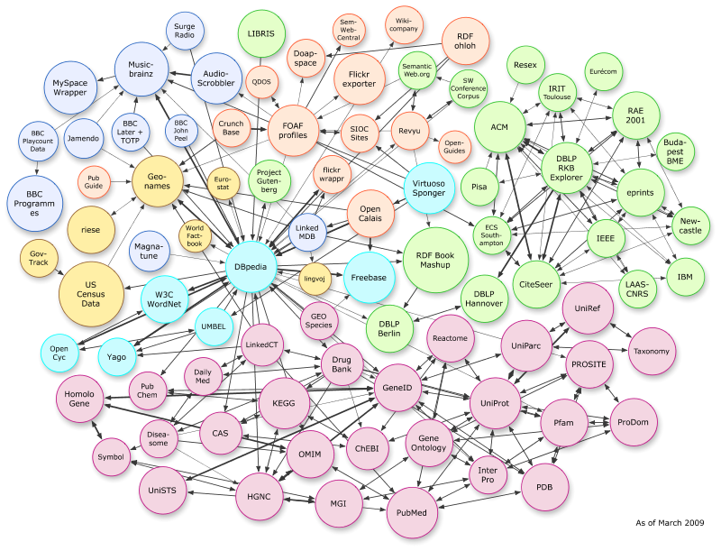
Linked Open Drug Data

Slide 16
HCLS IG Task Forces (cont)
Scientific Discourse
Semantic Web platform for biomedical discourse
Translational Medicine Ontology
high level patient-centric ontology for the pharmaceutical industry
Terminology
extract Semantic Web representations from existing, standard medical record terminologies, e.g. UMLS

Slide 17
Future Plans for an HCLS IG
Promoting and enhancing the Translational Medicine Ontology
Creation of an ontology for sharing information about drugs with collaborators
Make more data sources available in RDF
Extend policy/security in patient recruitment scenarios
Explore hosting of a vocabulary server
Strengthen ties with regulatory authorities, HL7, CDISC

Slide 18
How is that done at W3C?
W3C is a membership organization
it has members (334 today) from all over the globe
companies, universities, public institutions, …
W3C itself has a small staff (cca. 50)

Slide 19























Membership from all over the World…

Slide 20
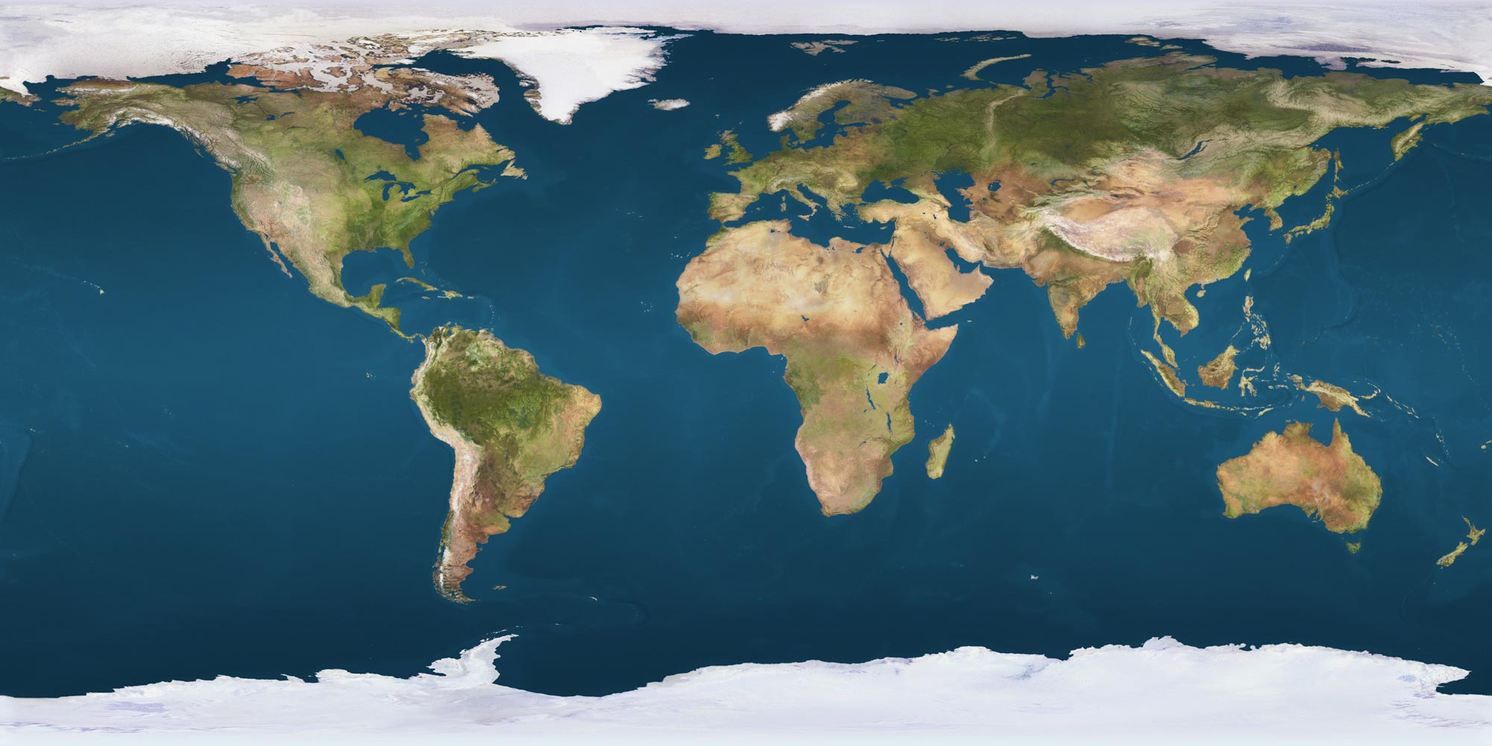
W3C is international
Three “hosts” (in the US, France, and Japan)
18 “offices”

Slide 21
Technology creation at W3C
It is done by groups, with members delegating experts
altogether, we are talking about 6-700 experts from around the globe
each group has also a staff from W3C
Strong relationships among groups when technology requires it

Slide 22
There is also a public scrutiny
The public can comment at specific points in the process
For standards, groups must take all comments into account
the number of comments can be in the hundreds...

Slide 23
Life of a group
Regular telecons (usually once a week)
Possible 1-2 face-to-face meetings a year
Lots of email discussions
Editorial to get everything properly written down
Average life-span: 2-3 years

Slide 24
Summary
W3C is the place where
open standard technologies are developed for the Web
specific communities can work on their own, specific usage of Web technologies

Slide 25

Thank you for your attention!
These slides are also available on the Web:
http://www.w3.org/2010/Talks/0519-Prism-IH/

