Slide 1
The challenge of describing neuroscience: the Neuroscience Information Framework
What are we doing and what have we learned?
Maryann Martone, Ph. D.
University of California, San Diego
Karen Skinner, Ph. D.
National Institutes on Drug Abuse

Slide 2
NIF Team
Amarnath Gupta, UCSD, Co Investigator
Jeff Grethe, UCSD, Co Investigator
Gordon Shepherd, Yale University
Perry Miller
Luis Marenco
David Van Essen, Washington University
Erin Reid
Paul Sternberg, Cal Tech
Arun Rangarajan
Hans Michael Muller
Giorgio Ascoli, George Mason University
Sridevi Polavarum
Anita Bandrowski, NIF Curator
Fahim Imam, NIF Ontology Engineer
Karen Skinner, NIH, Program Officer
Lee Hornbrook
Kara Lu
Vadim Astakhov
Xufei Qian
Chris Condit
Stephen Larson
Sarah Maynard
Bill Bug
Karen Skinner, NIH

Slide 3
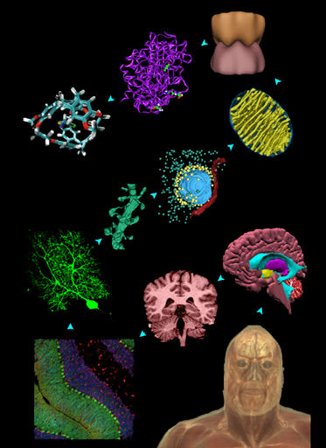
Society for Neuroscience
> 35,000 members
Neurobiology
Neuroanatomy
Neuropsychology
Neurophsyiology
Neuropharmacology
Neurochemistry
Neurobehavior
Neuroethology
Computational neuroscience
Developmental neuroscience
Clinical neuroscience
Molecular neuroscience
Neurotechnology

Slide 4
What does this mean?
3D Volumes
2D Images
Surface meshes
Tree structure
Ball and stick models
Little squiggly lines
Data
People
Information systems

Slide 5
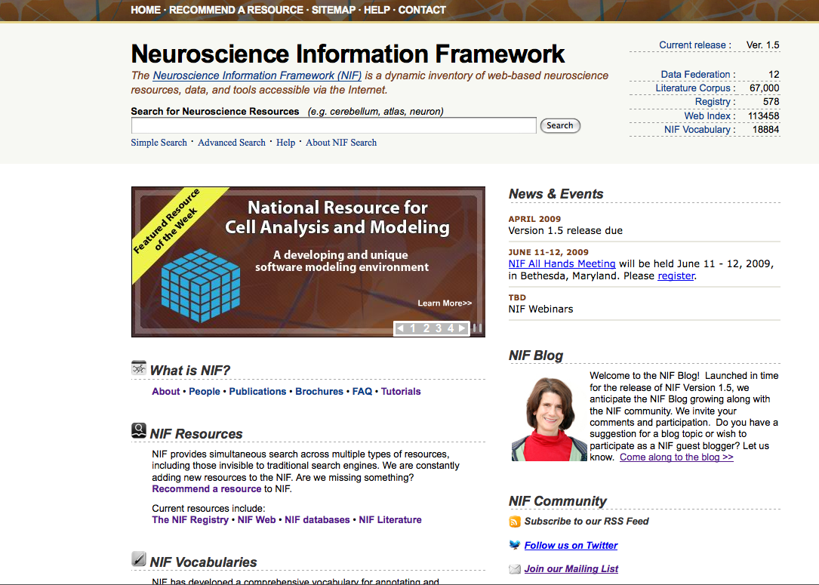
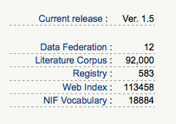
The Neuroscience Information Framework: Discovery and utilization of web-based resources for neuroscience
Provides access to neuroscience resources on the web
Provides simultaneous search of multiple types of information, organized by category
Databases, literature, web pages
Supported by an expansive ontology for neuroscience
Utilizes advanced technologies to search the “hidden web”, i.e., information that can’t be found by Google
Text mining tools for literature
Database mediators
UCSD, Yale, Cal Tech, George Mason, Washington Univ
http://neuinfo.org
Supported by NIH Blueprint

Slide 6
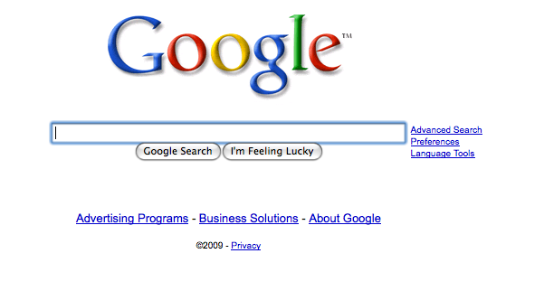
History of NIF
Outgrowth of Society for Neuroscience Neuroinformatics Committee
Neuroscience Database Gateway: a catalog of neuroscience databases
“Didn’t I fund this already?”
“Why can’t I have a Google for neuroscience”
“Easy”, comprehensive, pervasive
Phase I-II: Funded by a broad agency announcement from the Blueprint
2005-2008 Led by Dan Gardner
Next phase: Sept 2008
How can we provide a consistent and easy to implement framework for those who are providing resources, e. g., data, and those looking for resources
Both humans and machines

Slide 7
NIF in action

Slide 8
Guiding principles of NIF
Builds heavily on existing technologies (BIRN, open source tools)
Information resources come in many sizes and flavors
Framework has to work with resources as they are, not as we wish them to be
Federated system; resources will be independently maintained
No single strategy will work for the current diversity of neuroscience resources
Trying to design the framework so it will be as broadly applicable as possible to those who are trying to develop technologies
Interface neuroscience to the broader life science community
Take advantage of emerging conventions in search and in building web communities

Slide 9
Registering a Resource to NIF
Level 1
NIF Registry: high level descriptions from NIF vocabularies supplied by human curators
Level 2
Access to deeper content; mechanisms for query and discovery
Level 3
Direct query of web accessible database
Automated registration
Mapping of database content to NIF vocabulary by human

Slide 10
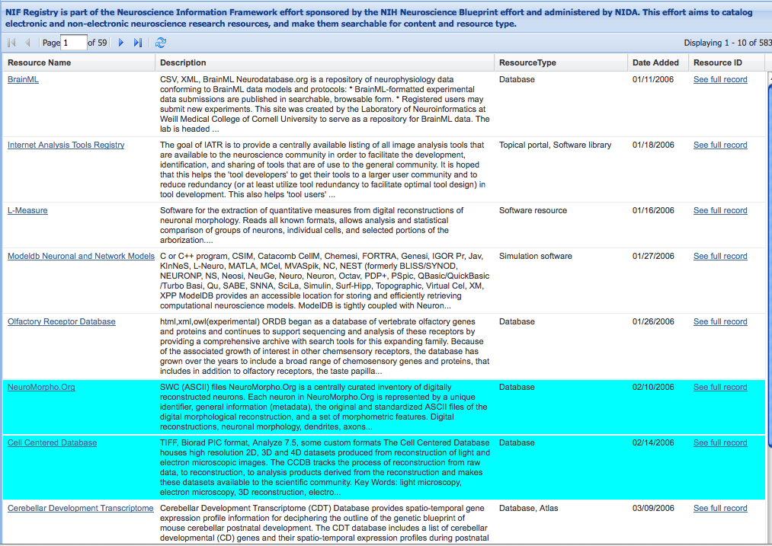
The NIF Registry
Human-curated
Nominated by self or other
Mostly non-commercial
Neuroscience “relevant”
~1000 waiting to be added

Slide 11
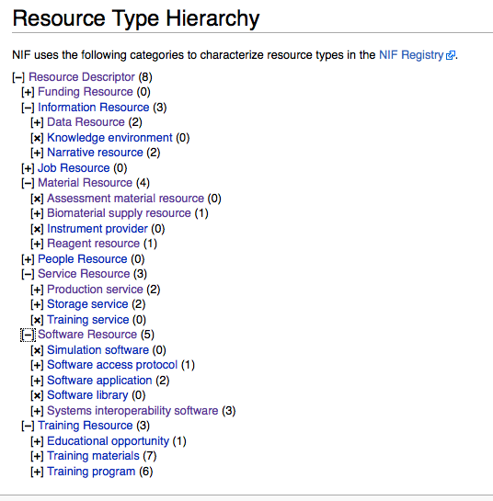
Consistent Resource Vocabulary
Working with NCBC (Biomedical Resource Ontology) and NITRC to come up with single resource ontology and information model
Reconciling current versions; moving forward jointly
Same classes, different views
Peter Lyster, Csongor Nyulas, David Kennedy, Maryann Martone, Anita Bandrowski

Slide 12
“Google” for Neuroscience

Slide 13
Characterizing a resource
Originally, NIF was conceived as a catalog of neuroscience resources characterized by a controlled vocabulary
Neuroscience Database Gateway (NDG): SFN
Neurogateway.org (NIF phase II)
Resources are complex things; simple annotation is not sufficient for resource discovery
Allen Brain Atlas: atlas, algorithms, software tools, data

Slide 14
Level 3
Deep query of federated databases
Register schema with NIF
Expose views of database
Map vocabulary to NIFSTD
Currently works with relational and XML databases
RDF capability planned for NIF 2.0 (Sept 2009)
Databases also annotated according to data type and biological area
Lot of content not obvious just from direct query
GENSAT and GFP

Slide 15
What do I do now?

Slide 16
Level 2: DISCO
DISCO involves a collection of files that reside on each participating resource.
The files are maintained locally by the resource developers and are “harvested” by the central DISCO server.
In this way, central NIF capabilities can be updated automatically as NIF resources evolve over time.
The developers of each resource choose which DISCO capabilities their resource will utilize
Luis Marenco, Perry Miller, Yale University

Slide 17
Find images of corticspinal tract?
NIF system allows easy search over multiple sources of information
Can it improve accuracy of search?
Well known difficulties in search
Inconsistent and sparse annotation of scientific data
Many different names for the same thing
No standards for data exchange or annotation at the semantic level
Lack of standards in data annotation require a lot of human investment in reconciling information from different sources

Slide 18
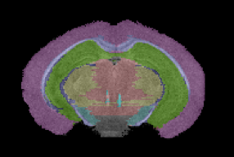
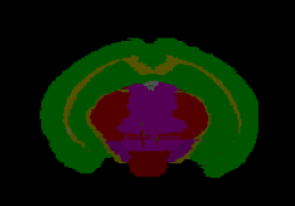
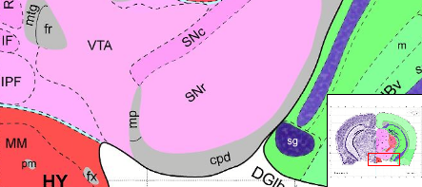
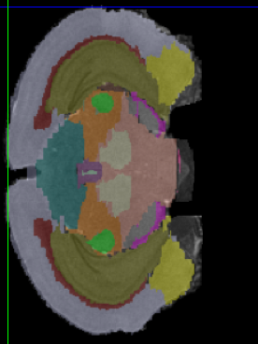
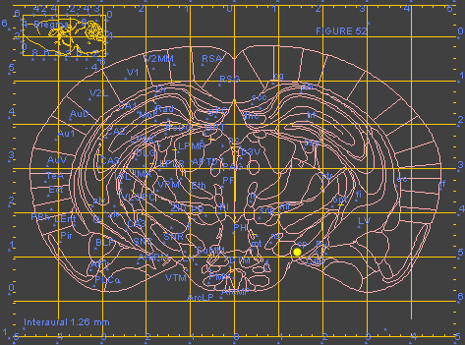
Corticospinal tract
Internal capsule
Cerebral peduncle
Terminology is used inconsistently; there are many names for the same structure

Slide 19
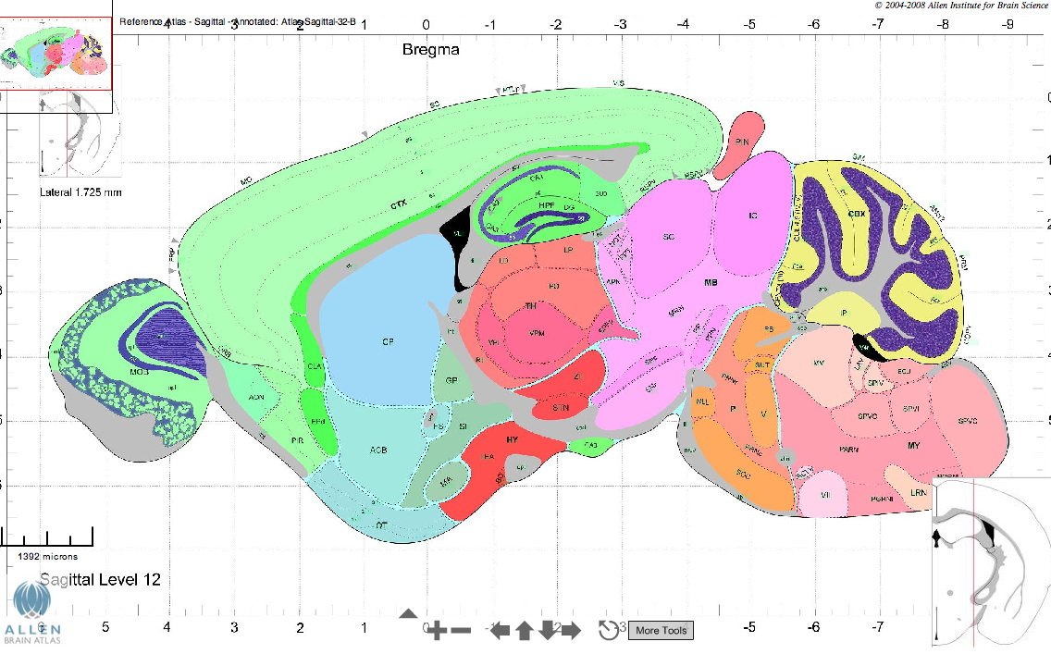
Barriers to data integration
What genes are found in the cerebral cortex
That depends on your definition of cerebral cortex

Slide 20
Cerebral Cortex
Atlas | Children | Parent
Genepaint | Neocortex, Olfactory cortex (Olfactory bulb; piriform cortex), hippocampus | Telencephalon
ABA | Cortical plate, Olfactory areas, Hippocampal Formation | Cerebrum
MBAT (cortex) | Hippocampus, Olfactory, Frontal, Perirhinal cortex, entorhinal cortex | Forebrain
MBL | Doesn’t appear
GENSAT | Not defined | Telencephalon
BrainInfo | frontal lobe, insula, temporal lobe, limbic lobe, occipital lobe | Telencephalon
Brainmaps | Entorhinal, insular, 6, 8, 4, A SII 17, Prp, SI | Telencephalon

Slide 21
Data annotation
Need vocabularies/ontologies/terminologies for providing pointers to data
Definitions are key: don’t care what you call it, as long as we know (and the machine knows) what you mean
For search, need to have many synonyms
Readily accessible and easy to understand
For data providers, religious wars are not always an issue
Space, stuff in the space, significance of space
“Just tell me what to call it, and I’ll call it that!”

Slide 22
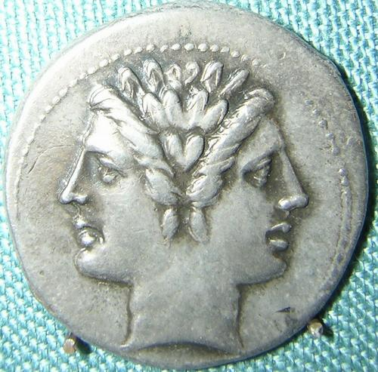
Building the NIF Vocabularies
NIF Basic:
Daniel Gardner held a series of workshops with neuroscientists to obtain sets of terms that are useful for neuroscientists
Provides a practical view into the way that neuroscientists describe their data
Encoded in NeuroML
Good human-centered view, but not very useful within information systems
NIFSTD (NIF Standard)
Bill Bug built a set of expanded vocabularies using the structure of the BIRNLex and the import of existing terminological resources
Tried to adhere to ontology best practices as we understood them
Built from existing resources when possible
Standardized to same upper ontology: BFO
Provides enhanced coverage of domains in NIF Basic
Encoded in OWL DL
Provides mapping to source terminologies, including NIF Basic
Provides synonyms, lexical variants, abbreviations

Slide 23
Modular ontologies for neuroscience
NIFSTD
Organism
Macroscopic
Anatomy
Cell
NS Dysfunction
Quality
Molecule
Subcellular Anatomy
NS Function
Resource
Investigation
Macromolecule
Gene
Techniques
Instruments
Molecule Descriptors
Reagent
Protocols
NIF1.1
http://purl.org/nif/ontology/nif.owl
Single inheritance trees with minimal cross domain and intradomain properties
Orthogonal: Neuroscientists didn’t like too many choices
Human readable definitions (not complete yet)
Bill Bug

Slide 24
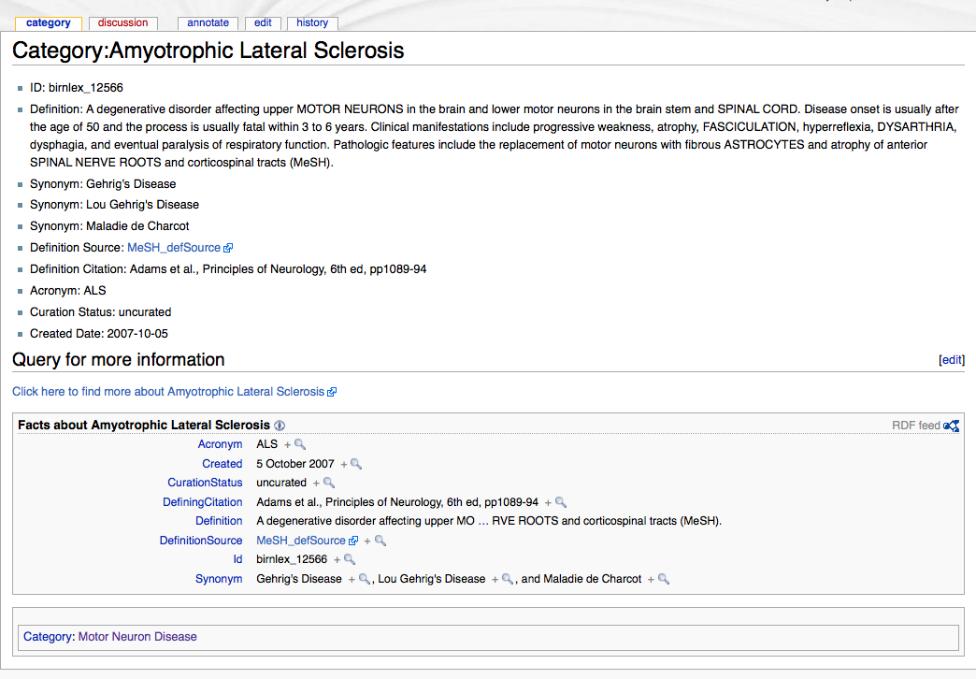
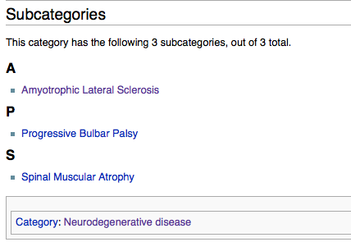

Slide 25
To Map or Not to Map: Integration of multiple ontologies
Different strategies for merging multiple ontologies
NIF has incorporated many foundational ontologies recommended by OBO
Inevitable period of co-evolution
Each class is named by a unique numerical ID
Human-readable string: rdfs: label
Imported ontologies: class name remains the same; new label sometimes applied
Problem on the web: No standards for URI’s
Adapted ontologies: NIF generates a new class name (numerical identifier) and maintains a mapping to source ID’s
Extensions to any ontology: nif_ext27

Slide 26
How NIFSTD is used in NIF
Level 1: Controlled vocabulary for describing type of resource and content
Database, Image, Parkinson’s disease
Entity-mapping of database and data content
Search: Mixture of mapped content and string-based search
Originally used strict mappings
“You can search for anything you want as long as it’s a Purkinje cell”
Different parts of NIF use the vocabularies in different ways
Utilize synonyms, parents, children to refine search
Establishes categories for searching the literature

Slide 27
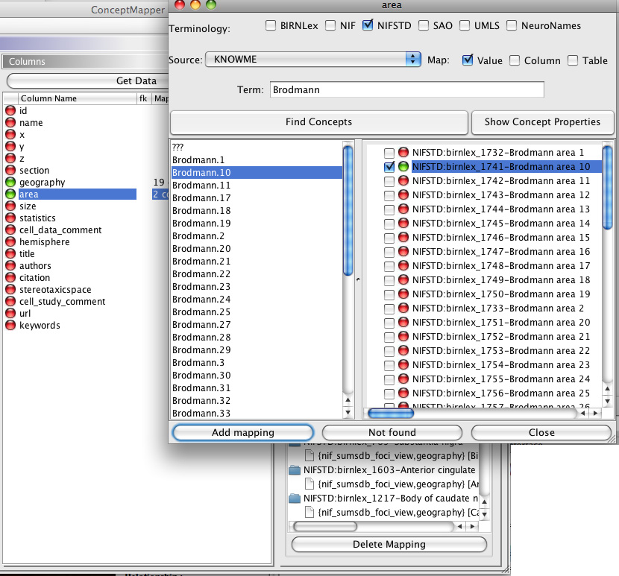
Source Mapping
Asserting identity with ontology entity
Takes care of nonstandard representation
Map database table names, field names and values
Also done with text, images, etc

Slide 28
Concept-based search
Brodmann area 3
Brodmann.3

Slide 29
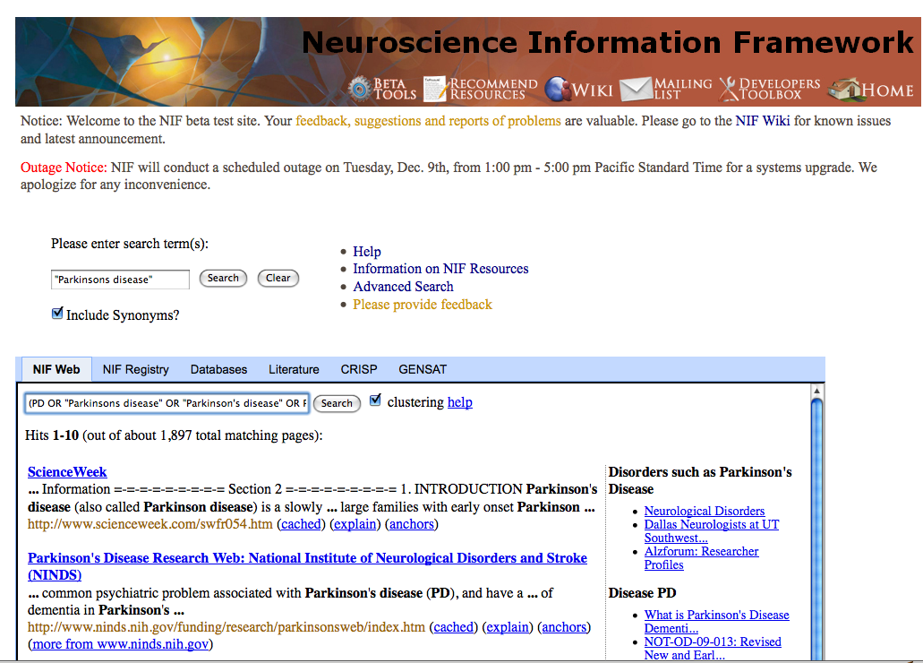
“Concept-based search”
Searches for synonyms, abbreviations and lexical variants
“Parkinsons disease” = PD OR "Parkinsons disease" OR "Parkinson's disease" OR Parkinson's OR "Parkinson syndrome" OR "Parkinson disease" OR "Paralysis Agitans" OR "Parkinson's syndrome"

Slide 30
Advanced Search

Slide 31
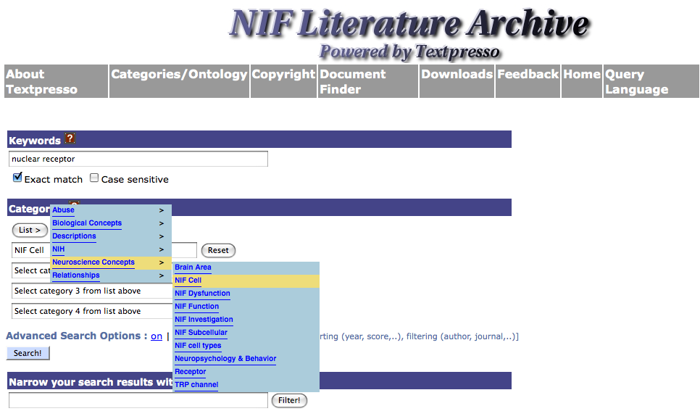
“Find articles on nuclear receptors in nerve cells”
NIF vocabularies are available as Textpresso “buckets”
Paul Sternberg, Hans Michael Muller, Arun Rangarajan

Slide 32
NIFSTD: Building Community Ontologies
Building ontologies is difficult even for limited domains, never mind all of neuroscience
Found best practices to be useful to constrain the problem
Want to maximize utility by others
What can neuroscientists contribute to existing efforts?
Need process to move from less formal to more formal
Strategy:
Build core lexicon (NeuroLex)
Concepts and definitions, independent of any formalism
Simple single inheritance and non-controversial hierarchies
Each module covers only a single domain
NIFSTD: standardize modules under same upper ontology
NIFPlus:
Create intra-domain and more useful hierarchies using properties and restrictions (inferred)
Only way to keep bookkeeping straight
Brain partonomy
Neurons by neurotransmitter
Resource ontology
NIF Bridge
Bridge two or more domains using a standard set of relations

Slide 33
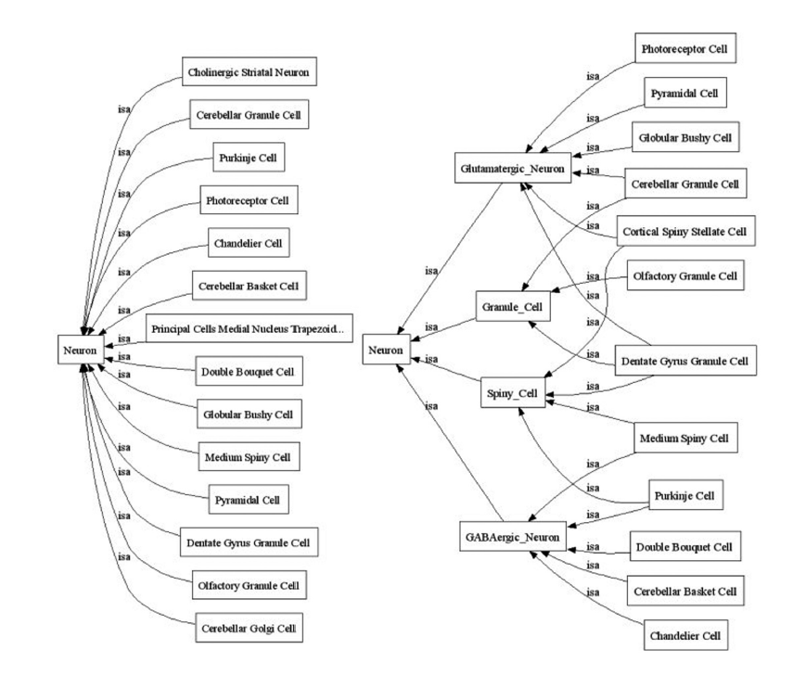
Have defined a standard set of properties for nerve cells to be used to generate inferred hierarchies

Slide 34
Anatomy
Cell Type
Cellular
Component
Small
Molecule
CNS
Neuron
Neuro-
transmitter
Transmembrane
Receptor
Purkinje
Cell
Dentate
Nucleus
Neuron
Expressed in
GABA
GABA-R
Cytoarchitectural
Part of
Cerebellar Cortex
Cpllection of
Deep Cerebellar
Nuclei
Presynaptic
density
Terminal Axon
Bouton
Purkinje
Cell Layer
Dentate
Nucleus
Transmitter
Vesicle
Located in
“Bridge files”

Slide 35
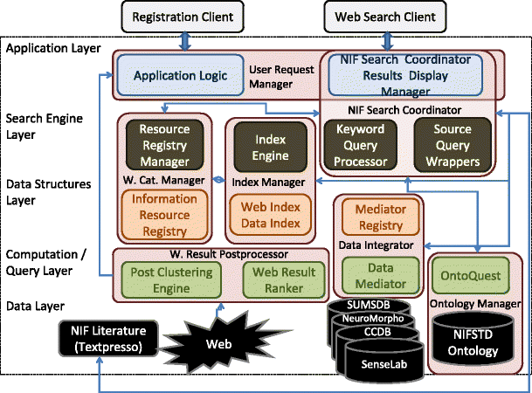
NIF Architecture
Gupta et al., Neuroinformatics, 2008 Sep;6(3):205-17

Slide 36
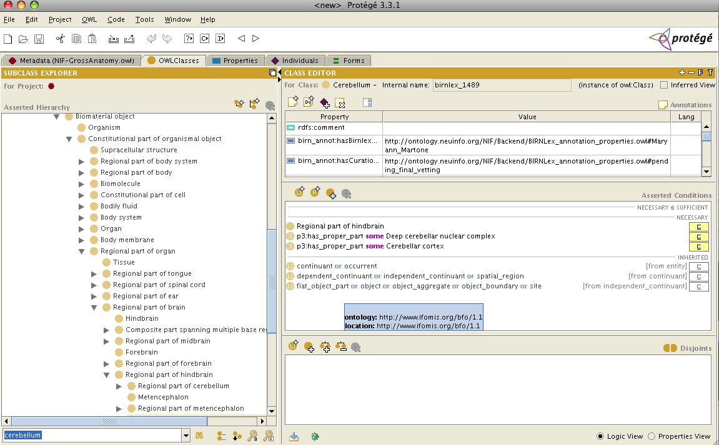
Getting the community involved
NIF vocabularies provide a semantic layer between neuroscience data and information systems
Adhering to best practices promulgated by ontology community important and generally makes thing easier for knowledge engineers
But, they need to be understood and utilized by neuroscientists
Vocabularies need to be readily accessible
Modifying and contributing to the vocabularies needs to be easy
When annotating data, need to be able to add classes quickly; can’t wait for usual ontology update cycle
Ontology tools are very difficult to use for non-ontologists and don’t lend themselves well to community development

Slide 37
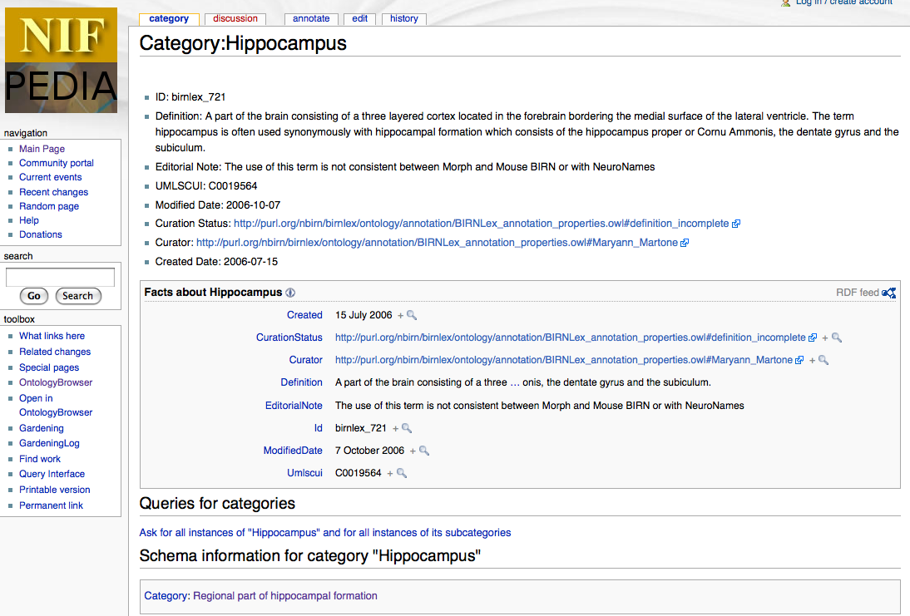
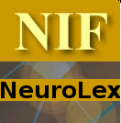
NeuroLex Wiki
http://neurolex.org
Stephen Larson

Slide 38
NeuroLex
Lexicon not a “pedia”
Focus on definitions, synonyms and distinguishing criteria rather than everything that is known or is potentially interesting
Semantic Media Wiki and some extensions
Each concept in NIF is a Wiki page
Removes barriers for domain experts who need to contribute and comment on content
Accounts are encouraged but not required
By far my favorite tool for working with ontologies
Working with the International Neuroinformatics Coordinating Facility to help shape and expand vocabularies

Slide 39
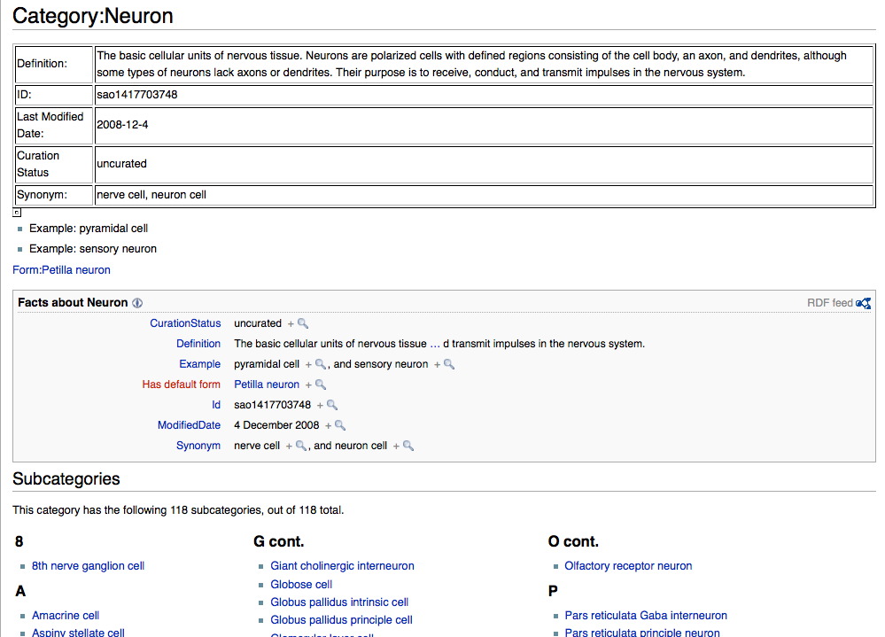
Easy to add and delete classes, synonyms, definitions
Easy to modify existing entries
Easy to navigate hierarchies and generate custom views, e.g., all brain regions and their definitions
Can set up templates to simplify input

Slide 40
Whither the wiki?
We are still trying out different workflows and strategies for the Wiki
Neurolex → NIFSTD (curated process); NIFSTD → Neurolex
Don’t think it’s a good tool for deep ontology building
Keeping things in sync is a problem
Excellent for adding categories, definitions, synonyms etc
Something very satisfying about leaving knowledge behind very visibly
Interested vs co-opted parties might need different mechanisms: that’s OK

Slide 41
NIF in practice
NIF 1.5: Major upgrade
Challenges moving forward
Usability
User interfaces for search and display
Comprehensibility
I’ve got my results; what do they mean?
As number of resources increases, presentation of content in a meaningful way becomes more challenging
Many databases are very complicated and making a view that is comprehensible to a naïve user is difficult
Adoption
Will neuroscientists be willing to work within a framework?

Slide 42
Musings from the NIF: 1
Getting communities to appreciate, develop, adopt and use common vocabularies which enable searching across the data and resources of the community is difficult
"The nice thing about standards is that we have so many of them."
Community hasn’t yet agreed upon a standard system of identifiers for concepts, and maintaining that system
Misunderstandings about ontologies
The value of making resources discoverable is not appreciated
Most resource providers are willing to share, but not to go out of the way to make their resources discoverable and integrateable
Data and paper generation most valued
The problem is particularly acute for literature (although perhaps that is changing on a small scale)
Web communities need to follow best practices in describing and organizing their resources and making them discoverable
Best practices, particularly as promulgated by research scientists within their laboratories, have not kept pace with opportunities
Web communities need to offer formal training in the nature of the best practices and their use, and to embrace them as an integral part of research projects conducted by the community.
Task is too large for a single community; would like better models of cooperation and collaboration
-from Karen Skinner, NIH

Slide 43
What are 5 things you can do to make your resource more accessible?
Use standard vocabularies
Have stable identifiers
Allow domain name rather than IP access
For general information results and data should be accessible using a static (i.e. non session based or stateless) URL
Database access privileges should not be dropped during database maintenance

Slide 44
Musings from the NIF 2…
No single approach, technology, philosophy, tool, platform will solve everything
Each has its advantages and disadvantages
Developing resources (tools, databases, data) that are interoperable is an act of will
Decisions can be made at the outset that will make it easier or harder to integrate
We get mad when commercial providers don’t make their products interoperable
Many times the choice of terminology is based on expediency or who taught you biology rather than deep philosophical differences
The spatial dimension is also key
If using a standard is appropriate, then use it
Machine vs human/Top down vs bottom up?
Both
What can I do as a biologist to make it easier for machines to do what they do well?
Access
Context
Make my knowledge available: annotations with consistent and clear definitions in machine processable form
Metadata
Sometimes we formalize the classes; sometimes the properties

Slide 45
