Slide 1
Enhanced Publications UC
Enhanced publication: aggregate of
  Paper/book
  Chapters
  Datasets
  Images/videos
  …
Owner: Maurice Vanderfeesten, SURF Foundation
Goal
  1. Link scientific publications to related materials
  2. reuse schemas/vocs; search and reused of EPs
Target audience: libraries, publishers, researchers
Schemas: DCTypes, OAI-ORE, DCTerms, FOAF

Slide 2
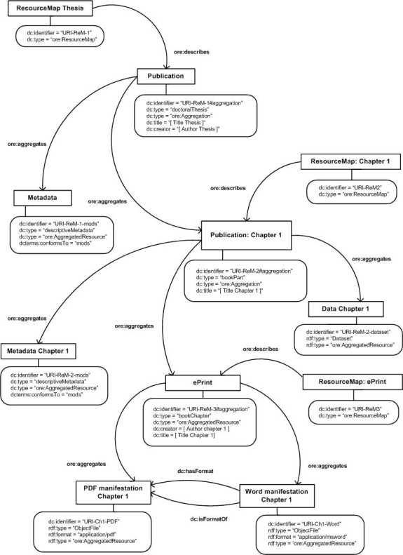

Slide 3
Enhanced Publications UC
… but what about annotation of the actual content? E.g. concepts measured in dataset?
… else only very little added on top of ORE
Cluster with: Citation Scientific Data UC

