Slide 1
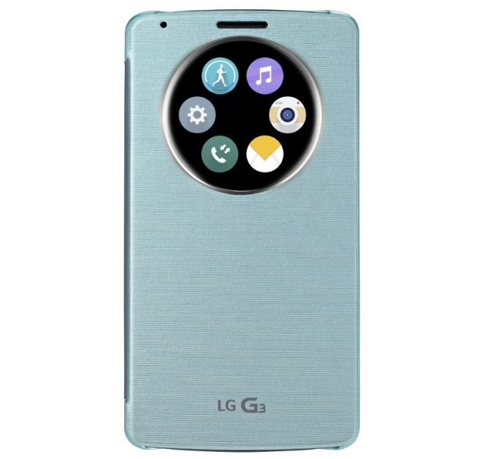
CSS Extensions for a Round Display
Oct. 29, 2014
Dong-Young Lee and Hyojin Song
{dongyoung.lee, hyojin22.song}@lge.com
LG Electronics

Slide 2
Background
New devices with a round screen are emerging.
LG G Watch R, Moto 360, LG G3 (when the cover is closed), etc.
The web was designed for a rectangular screen.
Especially CSS.

Slide 3
1. Detecting a Round Screen (Media Query)
“device-radius” property
Inspired by “border-radius”
Supports many shapes include rectangle, circle, ellipse, rectangle with round corners, etc.
[1]
[2]
UA not supporting device-radius
UA supporting device-radius
[1]:
[2]:

Slide 4
1. Detecting a Round Screen (JavaScript)
New property of the Screen object
radius: {1000px | 50%}
(New) property of the body element
document.body.border-radius: {1000px | 50%}

Slide 5
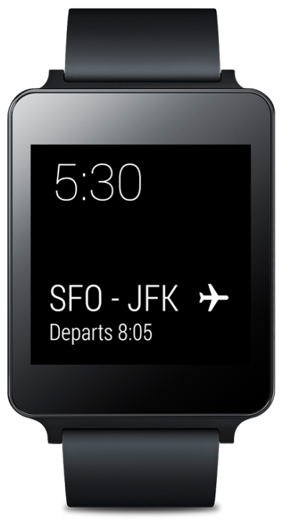
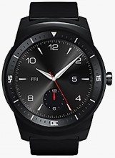
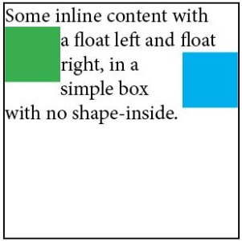
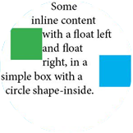
2. Content Alignment
Fitting contents inside the screen.

Slide 6
2. Content Alignment
Extend the “shape-inside” property
Add a value “display”
ABCDEF
GHIJKLM
NOPQRS TUVWXY
ABCD EFGHIJK LMNOPQ RSTUV
shape-inside: circle (50% at 50%, 50%);
shape-inside: display;
?
shape-inside: display;
ABCDEFGHIJ
ABCDEFG HIJ

Slide 7
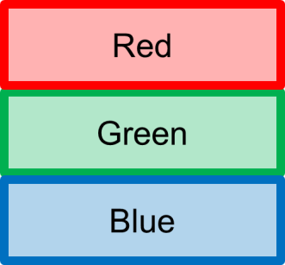
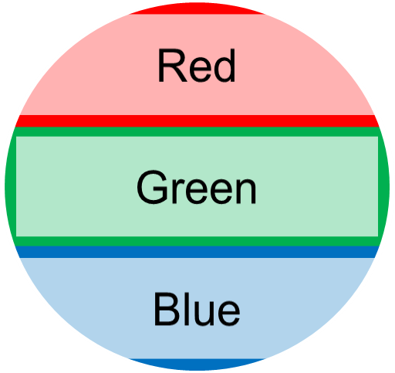
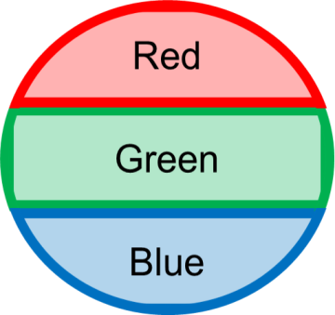
3. Border
Broken border at the display edge.

Slide 8
3. Border
New “border-shape” property
“display” or “nodisplay” (default)
border-shape: nodisplay;
border-shape: display;

Slide 9
4. Layout
Elements are often placed along a circle (or concentric circles).
Polar coordinates are useful.

Slide 10
4. Layout
Polar coordinates
“polar-angle” and “polar-distance”
With “position: polar”
<body style=“position: polar;”>
<div id=“circle1” style=“polar-angle: 0deg; polar-distance: 20%”></div>
<div id=“circle1” style=“polar-angle: 90deg; polar-distance: 50%”></div>
<div id=“circle1” style=“polar-angle: 225deg; polar-distance: 100%”></div>
</body>

Slide 11
Summary
Minimal extensions to CSS to support a round display.
Detecting a round display
Alignment
Border
Layout: polar coordinates

