Slide 1
Semantic Web Technologies for Assessing Clinical Trials Eligibility
Vipul Kashyap, Eric Prud’hommeaux, Helen Chen, Jyotishman Pathak, Rachel Richesson and Holger Stenzhorn,
AMIA Annual Symposium, San Francisco
November 17, 2009

Slide 2
Outline
Developers of this Demonstration
The Healthcare and Lifesciences Ecosystem
Use Cases and Functional Requirements
What is the Semantic Web?
Demo
Conclusions and Next Steps

Slide 3
Developers of this Demonstration
Clinical Observation Interoperability (COI) Task Force http://esw.w3.org/topic/HCLS/ClinicalObservationsInteroperability
Members from CDISC, clinical trial researchers and healthcare IT researchers
Notes:
2/13/2009
3
The mission of the Semantic Web Health Care and Life Sciences Interest Group, part of the Semantic Web Activity, is to develop, advocate for, and support the use of Semantic Web technologies for biological science, translational medicine and health care. These domains stand to gain tremendous benefit by adoption of Semantic Web technologies, as they depend on the interoperability of information from many domains and processes for efficient decision support.
The group will:
Document use cases to aid individuals in understanding the business and technical benefits of using Semantic Web technologies.
Document guidelines to accelerate the adoption of the technology.
Implement a selection of the use cases as proof-of-concept demonstrations.
Explore the possibility of developing high level vocabularies.
Disseminate information about the group's work at government, industry, and academic events.

Slide 4
Healthcare and Life Sciences Ecoystem: Current State
Characterized by silos with uncoordinated
supply chains leading to inefficiencies in the system
Patients,
Public
Patients
National Institutes
Of Health
FDA
Center for
Disease
Control
Pharmaceutical
Companies
Hospitals
Payors
Universities,
Academic Medical
Centers (AMCs)
Clinical Research
Organizations (CROs)
Hospitals
Doctors
Biomedical Research
Clinical Practice
Patients
Patients
Clinical Trials/Research
Clinical Practice

Slide 5
Healthcare and Life Sciences Ecosystem: Goal State
NIH
(Research)
FDA
CDC
Universities,
AMCs
Pharmaceutical
Companies
Patients, Public
CROs
Hospitals
Doctors
Payors
From FDA, CDC
The ability to share and exchange clinical observations is a critical enabler
Critical to bring down the cost of healthcare in the US!

Slide 6
Use Cases and Functional Requirements
X identifies the Use Cases, Systems and Functional Requirement under consideration of the
COI Task Force
Based on the Functional Requirements Specification developed by EHRVA/HIMSS

Slide 7
Use Case – Patient Screening
PROBLEM:
Same construct in 2 different representations….
-
-
Research Coordinator
selects protocol for patient
Clinical
Research
Protocol
screening:
Eligibility Criteria:
-
Inclusion
-
Exclusion
EMR DATA
Meds
Procedures
Research
Diagnoses
Demographics
Coordinator
views list of
patients and
selects which
ones to approach
in person for
Patient MR #
Potentially
# Criteria
Criteria #1
No Criteria #2
Criteria #3
…
evaluation and
Eligible for
Met / Total
(Pass/Fail/
(Pass/Fail/
(Pass/Fail/
recruitment.
Protocol
Criteria in
Researcher
Researcher
Researcher
Protocol
Needs to
Needs to
Needs to
Evaluate)
Evaluate)
Evaluate)
0011111
Yes
6/8 criteria
Pass
Pass
Pass
…
met
0022222
No
3/8 criteria
Pass
Fail
Pass
…
Clinical
met
Evaluation and
0033333
Yes
5/8 criteria
Pass
Pass
Fail
…
Recruitment
met
…
…
…
…
…
…
…
Notes:
2/13/2009
7
Goals:
Show that Semantic Web technologies can be used to bridge the gap between the two
Map across formats
Reuse existing data
Develop a proof of concept application that demonstrates the feasibility of that approach

Slide 8
Examples: Drug Class in Research Protocols
monotherapy with metformin, insulin secretagogue, or alpha-glucosidase inhibitors and a low dose combination of all
Long term insulin therapy
Therapy with rosiglitazone (Avandia) or pioglitazone (Actos), or extendin-4 (Byetta), alone or in combination
corticosteroids
weightloss drugs e.g., Xenical (orlistat), Meridia (sibutramine), Acutrim (phenylpropanol-amine), or similar medications
nonsteroidal anti-inflammatory drugs
Use of warfarin (Coumadin), clopidogrel (Plavix) or other anticoagulants
Use of probenecid (Benemid, Probalan), sulfinpyrazone (Anturane) or other uricosuric agents
Notes:
2/13/2009
8

Slide 9
Prescription Information in EMR
NDC Code
"132139","131933","98630 ","GlipiZIDE-Metformin HCl 2.5-250 MG Tablet","54868079500 ",98630,"2.5-250 ","TABS","","MG "," ","15","GlipiZIDE-Metformin HCl ","","GlipiZIDE-Metformin HCl 2.5-250 MG Tablet“
"132152","131946","98629 ","GlipiZIDE-Metformin HCl 2.5-500 MG Tablet","54868518802 ",98629,"2.5-500 ","TABS","","MG "," ","15","GlipiZIDE-Metformin HCl ","","GlipiZIDE-Metformin HCl 2.5-500 MG Tablet“
"132407","132201","98628 ","GlipiZIDE-Metformin HCl 5-500 MG Tablet","54868546702 ",98628,"5-500 ","TABS","","MG "," ","15","GlipiZIDE-Metformin HCl ","","GlipiZIDE-Metformin HCl 5-500 MG Tablet“
"132642","132436","C98630 ","GlipiZIDE-Metformin HCl TABS","54868079500 ",98630,"","TABS",""," "," ","15","GlipiZIDE-Metformin HCl ","","GlipiZIDE-Metformin HCl TABS"
Notes:
2/13/2009
9
Original data
Another challenge.
One data base (NDC) code → Drug ontology → RxNorm

Slide 10
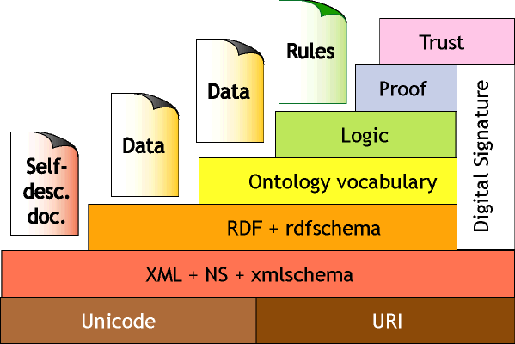
What is the Semantic Web?
[Tim Berners Lee, XML-2000 Conference]

Slide 11
What is the Semantic Web?
“Mr. X”
“T1”
“Mr. X”
“T2”
name
recording_time
name
recording_time
Patient
(id = URI1)
systolicBP
SystolicBP
Measurement1
Patient
(id = URI1)
systolicBP
SystolicBP
Measurement2
magnitude
VSORRES
120
key
130
VSTESTCD
units
VSORRESU
SnomedCodeForSystolicBP
NCITCodeForSYSBP
mmHg
mmHg
EMR Data
Clinical Trials Data

Slide 12
What is the Semantic Web?
“mmHg”
“NCITCodeForSYSBP”
“T2”
“Mr. X”
recording_time
name
SystolicBP
Measurement2
Patient
(id = URI1)
systolicBP
“T1”
magnitude
130
recording_time
SystolicBP
Measurement1
magnitude
120

Slide 13
Semantics-enabled shareable open source models of Clinical Data
Open
Source
Clinical
Models
DCM
SDTM
BRIDG
Snomed
MedDRA
NCIT
…..
Clinical Trial 1
Healthcare Provider 1
Clinical Trial 2
Healthcare Provider 2
Clinical
Observations
Clinical
Observations
…
…
Clinical Trial M
Healthcare Provider N

Slide 14
Clinical Observations Interoperability
Clinical Trial
Eligibility
Patient
Characteristics
Construct:
Research
Protocols
EMR
Data/Knowledge source:
SDTM
DCM/RIM
Semantic Model:
CDISC
HL7
Standards Development Organization:
Notes:
2/13/2009
14
Placeholder for semantic model for healthcare practices (HL7 contributes; EHR cooldn be one; local…) Key is that semantic model represents constructs not data model
I will have to justify why we used SDTM…
PROBLEMS:
Data is not stored only in form of the CDISC SDTM but also in HL7 DCM form
Concepts in SDTM domain do not always have one-one mapping to HL domain
Drug prescription coded in different drug codes (RxNorm and NDC)
Data is not stored as RDF but in conventional relational databases
What this becomes is an example of data integration.

Slide 15
Semantic Web Technologies
RDF (Resource Description Framework)
OWL (Web Ontology Language)
RIF (Rule Interchange Format)
N3 (Notation 3)
SPARQL (Query Language for RDF)
Notes:
OWL
The web ontology language OWL1 is an extension of RDF/RDFS, essentially by adding a
number of elementary constructs for expressing basic statements such as class formation
(Class), classification (Individual), attribution (DatatypeProperty), association
(ObjectProperty), equality (EquivalentClasses and SameIndividual) and
others. OWL allows the expression of subsumption rules such as
isRentalCar(X) ⇒ isCar(X)
in the form of SubClassOf statements, such as
SubClassOf(RentalCar, Car)
but it does not allow the expression of more complex derivation rules, e.g. for defining
derived property predicates such as
hasFather(X, Y), hasBrother(Y, Z) ⇒ hasUncle(X, Z)
Positive logic programs without negation and without function symbols (also called
‘Datalog’), corresponding to Definite Horn Logic, and OWL DL, corresponding to a
two-valued Description Logic, are not reducible to each other (Grosof et al., 2003).
______________________________________________________________________________________________________________________________________________
Notation 3 (N3) is an alternative syntax for expressing RDF statements.
This is the specification of the Notation3 language, of internet Media Type text/n3. Normative parts of the specification are thus, non-normative parts and comments thus.
This is a language which is a compact and readable alternative to RDF's XML syntax, but also is extended to allow greater expressiveness. It has subsets, one of which is RDF 1.0 equivalent, and one of which is RDF plus a form of RDF rules.
This document is a specification of the language suitable for those familiar with the general concepts. The developer learning N3 is invited to try the A tutorial, while implementers looking for for a particular detail of the definition of the logic are steered toward the operational semantics. There is also a list of other N3 resources.
This language has ben developed in the context of the Semantic Web Interest Group. Comments on this document should be sent to public-cwm-talk@w3.org
The aims of the language are
to optimize expression of data and logic in the same language,
to allow RDF to be expressed,
to allow rules to be integrated smoothly with RDF,
to allow quoting so that statements about statements can be made, and
to be as readable, natural, and symmetrical as possible.
The language achieves these with the following features:
URI abbreviation using prefixes which are bound to a namespace (using @prefix) a bit like in XML,
Repetition of another object for the same subject and predicate using a comma ","
Repetition of another predicate for the same subject using a semicolon ";"
Bnode syntax with a certain properties just put the properties between [ and ]
Formulae allowing N3 graphs to be quoted within N3 graphs using { and }
Variables and quantification to allow rules, etc to be expressed
A simple and consistent grammar.
____________________________________________________________________________________________________________________________________________________________________________
RDF is a directed, labeled graph data format for representing information in the Web. This specification defines the syntax and semantics of the SPARQL query language for RDF. SPARQL can be used to express queries across diverse data sources, whether the data is stored natively as RDF or viewed as RDF via middleware. SPARQL contains capabilities for querying required and optional graph patterns along with their conjunctions and disjunctions. SPARQL also supports extensible value testing and constraining queries by source RDF graph. The results of SPARQL queries can be results sets or RDF graphs.

Slide 16
Demonstration: Methods
Developed semantic models for:
clinical trial based upon SDTM
clinical practice based upon RIM/DCM
Encoded Eligibility queries using:
The SDTM model
SPARQL queries
Storage of Clinical Data from a real world clinic in a relational database
Mappings
Mappings between clinical trials and clinical practice constructs
Use of drug ontology to facilitate mappings on drug concepts
Mapping of RIM/DCM model to a relational database schema
Query Transformation:
Translation of an SDTM SPARQL Query into DCM/RIM SPARQL query
Translation of DCM/RIM query into SQL query
Execution of the SQL query against the relational database
Notes:
Scope includes defining con
Mapping between SDTM & DCM (SPARQL)
Translated (using SWObjects) the SPARQL query in SDTM to SPARQL statement in HL7 DCM
Example – weight loss drug… (Properties used from Drug Onotology to derive)

Slide 17
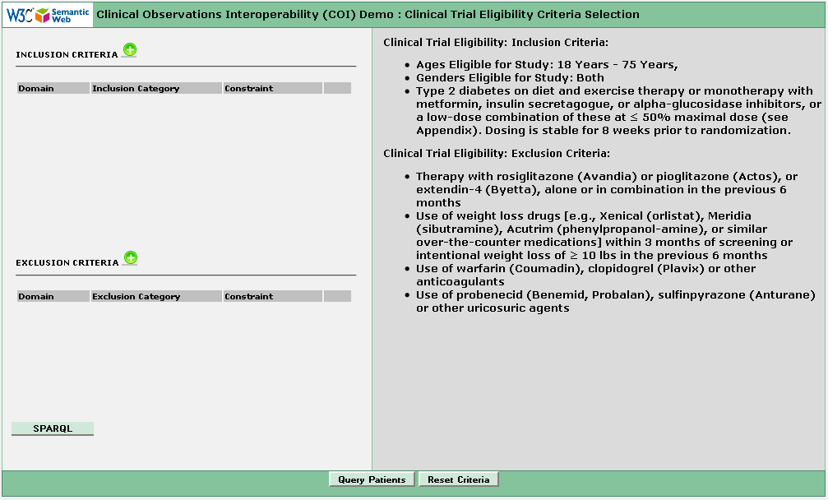
COI Demo – Clinical Trial Eligibility Criteria

Slide 18
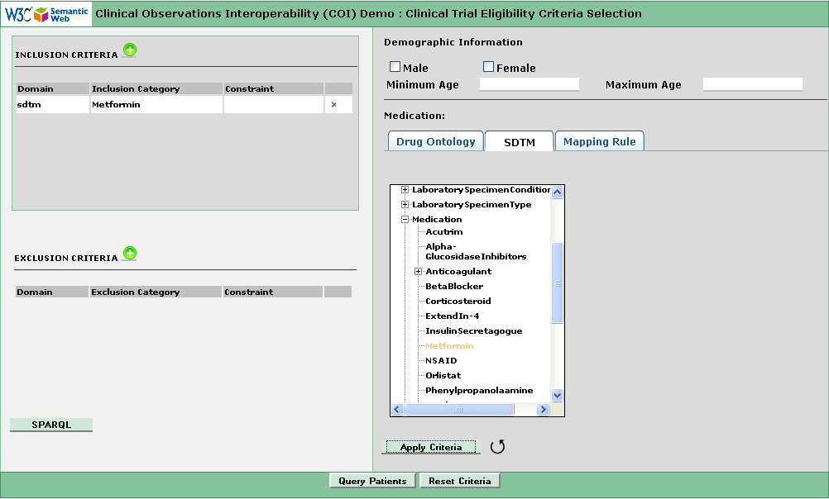
COI Demo – Selecting Inclusion Criteria
Inclusion in SDTM ontology
SDTM clinical trial ontology

Slide 19
Criteria in SPARQL
?medication1 sdtm:subject ?patient ; spl:activeIngredient ?ingredient1 .
?ingredient1 spl:classCode 6809 .
OPTIONAL {
?medication2 sdtm:subject ?patient ; spl:activeIngredient ?ingredient2 . ?ingredient2 spl:classCode 11289 .
} FILTER (!BOUND(?medication2))
metformin
anticoagulant
Exclusion Criteria

Slide 20
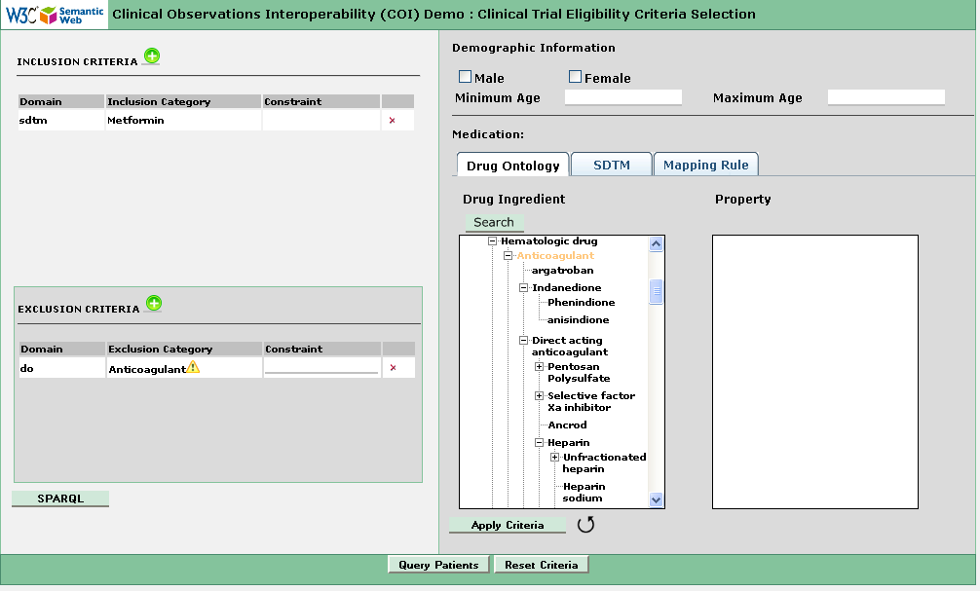
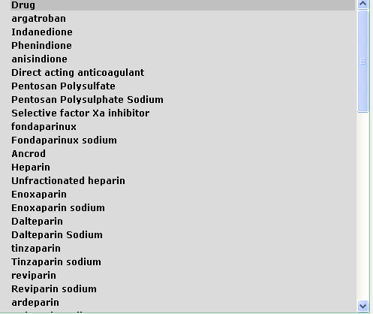
COI Demo – Drug Ontology Inference
Subclasses of “anticoagulant”
Drug ontology
Exclusion in Drug ontology

Slide 21
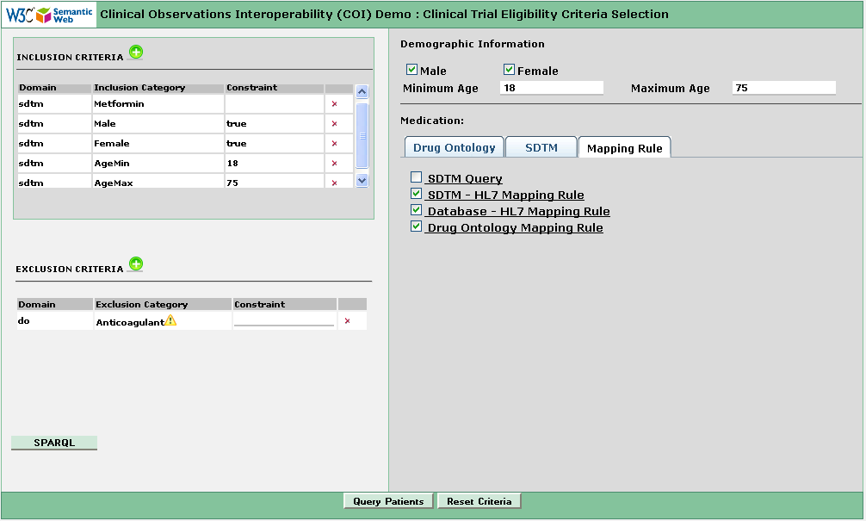
COI Demo – Selecting Mapping Rules
#check all drugs that "may_treat obese"
{?A rdfs:subClassOf ?B; rdfs:label ?D.
?B a owl:Restriction;
owl:onProperty :may_treat;
owl:someValuesFrom :C0028754}
=>
{?D a :WeightLoseDrug}.

Slide 22
Mapping Between CT and Patient Record
Drug Ontology
CT
MechanismOfAction
C1299007
metformin,
insulin secretagogue
GeneralDrugType
C0050393
nonsteroidal anti-inflammatory
alpha-glucosidase inhibitors
C0066535
drugBank: DB00331
RxNORM: 6809
C0025598
anticoagulants
uricosuric agents
NDC:54868079500: GlipiZIDE-Metformin HCl 2.5-250 MG Tablet
NDC: 54868518802: GlipiZIDE-Metformin HCl 5-500 MG Tablet
NDC:54868079500:GlipiZIDE-Metformin HCl TABS

Slide 23
Pushing Query to Database
SPARQL in SDTM ontology to SPARQL in HL7 ontology
SPARQL in HL7 ontology to SQL in EMR database
List of eligible patients
EMR
CT Eligibility
HL7 DCM/RIM
SPARQL
SPARQL
SQL

Slide 24
SDTM to HL7 Transformation
Clinical Trial Ontology
sdtm:Medication
sdtm:dosePer- Administration
{ ?x a sdtm:Medication ; sdtm:dosePer- Administration ?y } => { ?x hl7:Substance- Administration ;
hl7:doseQuantity ?y }
hl7:Substance- Administration
hl7:doseQuantity
Clinical Practice Ontology

Slide 25
HL7 to EMR Database Transformation
SPARQL in Clinical Practice Ontology
hl7:Substance- Administration
hl7:doseQuantity
{ hl7:substanceAdministration [
a hl7:SubstanceAdministration ;
hl7:consumable [
hl7:displayName ?takes ;
spl:activeIngredient [
spl:classCode ?ingred
]
] ;} => { {
?indicItem Item_Medication:PatientID ?person;
Item_Medication:PerformedDTTM ?indicDate ;
Item_Medication:EntryName ?takes .
.}
Item_Medication:EntryName ?takes .
Medication:ItemID ?indicItem;
SQL to EMR Database

Slide 26
SQL to Database
SELECT patient.id AS patient, patient.DateOfBirth AS dob, sexEntry_gen0.EntryName AS sex, indicItem_gen1.EntryName AS takes, indicItem_gen1.PerformedDTTM AS indicDate
FROM Person AS patient
INNER JOIN Sex_DE AS sexEntry_gen0 ON sexEntry_gen0.id=patient.SexDE
INNER JOIN Item_Medication AS indicItem_gen1 ON indicItem_gen1.PatientID=patient.id
INNER JOIN Medication AS indicMed_gen2 ON indicMed_gen2.ItemID=indicItem_gen1.id
INNER JOIN Medication_DE AS indicDE_gen5 ON indicDE_gen5.id=indicMed_gen2.MedDictDE
INNER JOIN NDCcodes AS indicCode_gen6 ON indicCode_gen4.ingredient=6809 AND indicCode_gen6.NDC=indicDE_gen5.NDC

Slide 27
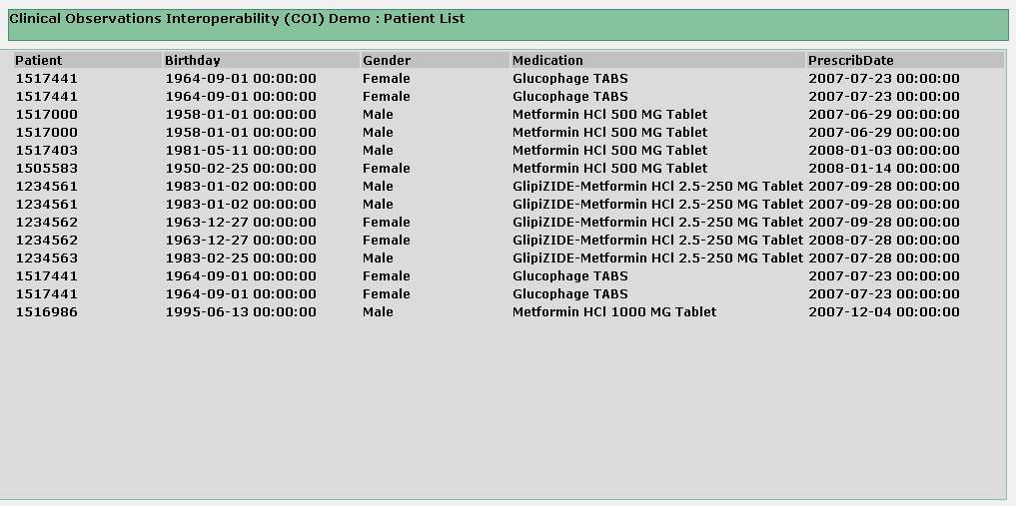
COI Demo – Getting Right Patients

Slide 28
COI Demo – Evolving
coi svn:
http://code.google.com/p/coi/source/checkout
Public access:
http://hcls.deri.org/coi/demo/

Slide 29
Conclusions
Benefits of Semantic Web Approach:
Unambiguious conceptual model for seperate domains without early commitment to a common model.
Reusable/Configurable mapping rules
Late binding of coding systems, models and database schema.
Query Transformation approach reflecting real time discovery and integration needs
Need to design and instantiate interoperability architecture for mutliple cross-industry use cases
Need to align with industry standards, e.g., information models, vocabularies
Imperfection in information models and vocabularies needs to be accepted and improved iteratively. Not a good idea to wait for perfection! Let‘s try to demonstrate incremental value ..

Slide 30
Acknowledgements
Major developers:
Helen Chen
Holger Stenzhorn
Eric Prud’hommeau
Other supporters
Jennifer Fostel
Bo Anderssen
Kerstin Forsberg
M. Scott Marshall
Tom Oniki
Dr. Parsa Mirhaji, University of Texas Health Science Center at Houston, Center for Biosecurity and Public Health Informatics Research (sample data)
W3C Interest Group on the Semantics for the Healthcare and Life Sciences (HCLS)
Special Thanks to Dr. John Glaser from Partners Healthcare
for support for this work within Partners Healthcare!

