Slide 1
Presentation API for non-screen Devices Demo
Oct, 29 2014
NTT Communications
Saki Homma

Slide 2
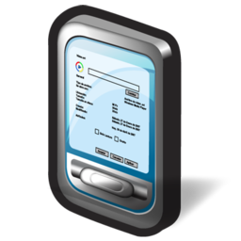
Communicate with non-screen devices
Web Application
Non-screen Devices

Slide 3
Communicate with Sony Action Cam
urn
navigator.presentation
.startSession('urn:schemas-sony-com:service:ScalarWebAPI:1')
.then(function(session) {…});
SSDP, Camera Remote API
Camera
session.onmessage = function(mesg) {
showLiveView(mesg);
}
session.postMessage("getLiveView");
device-specific method

Slide 4
Demo Architecture
JS Library
Browser
Presentation API shim
WebSocket
Device-specific
communication
Device Driver module
XHR
(SONY Camera Remote API)
Camera
(SONY
HDR-AS100v)
Node

Slide 5
Requirements
Indicates the filtering rule for which UA discover
By web app with dedicated API (JS or internal).
Browser discover all kinds of devices and notify web app.
Communicate various devices
With the modules provide by the 3rd vendor (i.e. device manufacturer)
With the modules provided by browser vendor

