Slide 1
W3C eGovernment Interest Group Launch Workshop
31 October – 1 November 2011

Slide 2
Agenda: Monday 31 October
09:00-09:30 - Introductions by Participants and Observers
09:30-10:00 - Introductions and Goals of the Meeting
10:00-10:30 - View from the Government and Stakeholders, What Is More Important, What Is Missing, What the Future Could Bring to eGov
10:30-10:45 - Break
10:45-12:30 - Reports from Open Government Data Camp
12:30-14:00 - Lunch
14:00-14:30 - Reports from World Bank
14:30-16:30 - Open Government Data Practices and Policies
16:30-16:45 - Break
16:30-17:30 - Accessibility
18:30-21:00 - Networking/Dinner

Slide 3
Agenda: Tuesday 1 November
09:00-10:00 – Social Media
10:00-10:45 – Data Licensing
10:45-11:00 - Break
11:00-12:30 - Community Directory and Resources
12:30-14:00 - Lunch
14:00-15:00 - Education and Outreach
15:00-15:15 - Break
15:15-17:00 - Future of eGovernment at W3C: Summary and Actions
18:30-21:00 - Networking/Dinner

Slide 4
Logistics
Face to face
Virtual via teleconference
IRC
http://www.w3.org/Project/IRC/ OR
http://irc.w3.org/?channels=egov
Please volunteer to help scribe
Open discussion around topics

Slide 5
Procedures
Open discussion around topics in order to lead to
Sharing of best practices and ideas
Requirements for another W3C standards group
Recommendations or papers
Projects
Off-topic discussions welcome via note cards at tables or in IRC with “CARD” preceding comment
All note cards will be discussed during that day
Have an idea for a project or action use a note card and put it in “space”
In IRC put “ACTION” preceding the comment
All actions will be discussed as part of the overall actions and plans
Participate, enjoy, relax, and engage!

Slide 6
Introductions
Please introduce yourself
Name, organization, and job
What challenges are you facing at work that you hope this workshop will help you solve?
What successes have you had that you want to share?
What is one thing about you that we probably don’t know?
Notes:
In person: Dave McAlister, Yoseuke Funahasi, Bede McCall, Phil Archer, Hadley Beeman, John Erickson, Jeanne Holm
Virtual: Anne Fitzgerald, Gannon Dick, Jose Alonso,
Observer: Taisuke Fukuno, Daniel Dladky, Geoffrey Creighton, Rigo Wenning, Thomas Roessler, Judy Brewer, Jason Kiss, Mark Crawford, Mohamed Zergaoui, J. Alan Bird, Tony Rahman, Virginie Galindo, Karen Myers, Victor Klinstov, Cheng-Hung Lee, Tkim Berners-Lee, Larry Masinter, Armin Halier, Matthew Yates

Slide 7
Today’s Plan
Sessions on open discussion following a provocation, reflection, and/or action approach
Provocation of challenges in establishing and sustaining eGovernment activities
Analyze how those could be addressed and give examples of success
Create actions that the Group should take to be most effective
Feel free to brainstorm
If you have an idea to bring up later or we go too far off topic, put up a note card
If you have an idea for a project or action, put it up in space

Slide 8
Major Topics
The Group will be creating a resource of government data examples, standards, and policies in the areas of
Government data
Social media
Accessibility
Data licensing
Community directory
Education and outreach

Slide 9
Goals and Objectives (9:30-10:00)
W3C Introduction (Phil Archer)
W3C eGov Interest Group Introduction (Jeanne Holm, David McAllister, Sandro Hawke)

Slide 10
W3C eGov Intent
The W3C eGovernment Interest Group was chartered in June 2008 (re-chartered in June 2011) recognizing that governments throughout the world needed assistance and guidance in achieving the promises of electronic government through technology and the Web.
The group and its efforts fill a distinct gap in the Web and technology standards space focusing on the unique and diverse needs and issues that governments throughout the developed and developing World face in enabling electronic service and information delivery and providing opportunities for discovery, interaction and participation.
This meeting will bring together government officials, computer scientists, civic activists, and academics specializing in both technical and legal eGovernment issues, leaders in the Web standards community, as well as a wide range of companies providing products and services in the government marketplace.

Slide 11
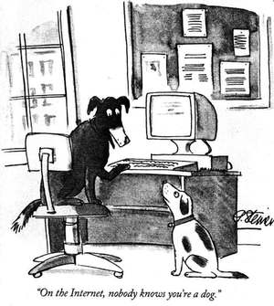
Break (10:30-10:45) Courtesy http://www.ag.gov.au/archived/Sig/images/dale3.jpg

Slide 12
Trending Thoughts (10:45-11:30)
View from the Government and Stakeholders
Knowledge Foundation: http://vimeo.com/21711338
European Commissioner VP Kroes: http://www.youtube.com/watch?feature=player_embedded&v=gBUpUD4l1Wo
What Is More Important?
What Is Missing?
What the Future Could Bring to eGov?

Slide 13
Reports from Open Government Data Camp (11:30-12:30)
All participants join in who attended OGD Camp in Warsaw to highlight
Key learnings
Best ideas and implementations
Biggest challenges
Biggest opportunities

Slide 14
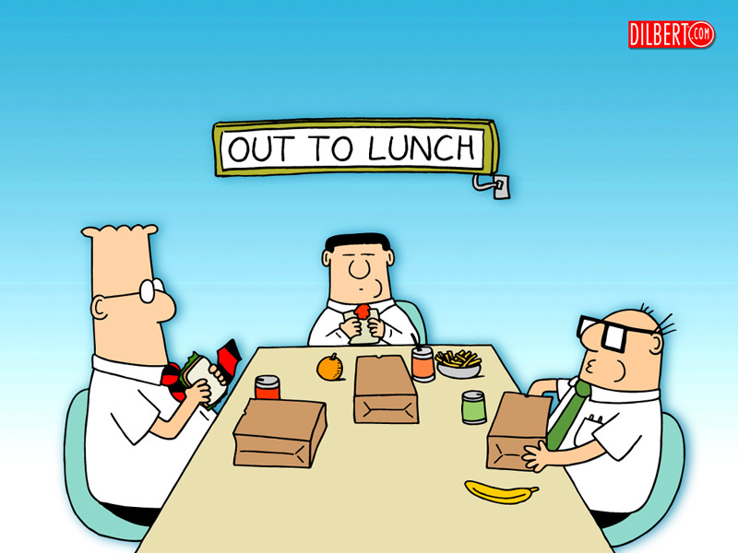
Lunch: 12:30-14:00

Slide 15
Ice Breaker
What is your favorite website and why?

Slide 16
Reports from World Bank and WWW Foundation (14:00-14:30)
Jose Alonso on World Bank and WWW Foundation activities and charters

Slide 17
Open Government Data Practices and Policies (14:30-16:30)
Chair: Hadley Beeman
Presentations from everyone present about their activities

Slide 18
Weather Forecast App from Gannon Dick
The weather forecast is now in the 7 day window, so I'll put the weather part of my "Personal Regional Address Book of Public Sector Information"[1] web application live. The data coverage area is Santa Clara County, CA. For the very short term of TPAC, only some of the links work on the website, but everything works on a local copy (in TPAC.zip). The purpose is to give small developers hints for direct access methods to the data without a Private Sector Gatekeeper. The subject is more interesting lately with the successful launch of a European navigation satellite.
The page includes links for Public Sector Information, including
Merged Weather and Sun (Civil Twilight) Forecasts. In the US, the Authorities do not merge these, or have not gotten around to it yet. It is a logical thing to do since the data is both Multi-National (as in many Nations) and International (everywhere in between, including the "High Seas"[2]). The merged format (into dwml weather) has XSD validation (the revised schema is in the TPAC.zip file). There is more weather data available, temperatures, probabilities of precipitation, etc. besides the text forecast shown.
Santa Clara County runs a Foreign Trade Zone. Information on the FTZ as well as UN LOCODE data for California is provided.
Links to datasets of Points of Interest are provided in the following categories ... (Natural Features, Civil Features, Schools and Water Quality Monitoring Stations)
Current Air Quality status for Santa Clara County.
Direct links to population data and social statistics for California, Santa Clara County and the City of Santa Clara (San Jose is the County Seat).
http://www.rustprivacy.org/2011/phase/tpac2011/

Slide 20
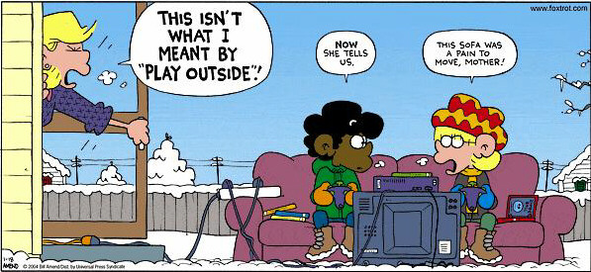
Break (16:30-16:45) Courtesy http://www.jeffiscool.com/pictures/Foxtrot/foxtrot_playoutside.JPG

Slide 21
Accessibility (16:45-17:30)
Making datasets and data tools accessible?
Creating apps and visualizations that work in multiple ways

Slide 22
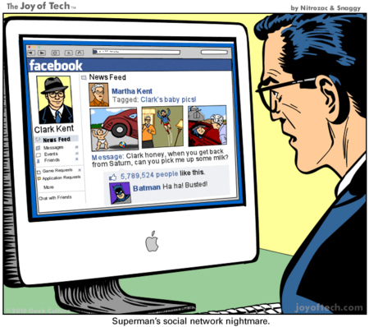
Social Media Discussion
What are your favorite social network and social media products and platforms and why?

Slide 23
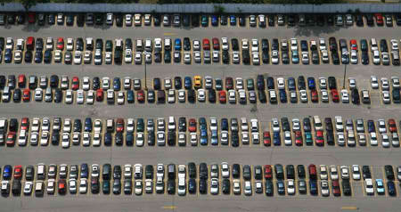
Collect Cards from the Parking Lot
Items to add from today’s discussions?

Slide 24
Summary and Actions
To evolve from today’s discussions…

