Slide 1
The Whole of Government Approach:
Models and Tools for EGOV Strategy & Alignment
Adegboyega Ojo
(in collaboration with T. Janowski and E. Estevez)
United Nations University
ao@iist.unu.edu
Notes:
The concept of EGOV4d and the framework are the result of research we carried out
Choice between presenting a single research line in depth, or an overview of the program with several research lines all contributing to a common objective. The second was chosen as it better depicts the impact that can be created through research and capacity building in one chosen ICT application area.

Slide 2
overview
1. | THE WG APPROACH
2. | APPLICATION OF THE WG APPROACH TO IT STRATEGY MANAGEMENT (WG-ITSM)
3. | TOOLS FOR WG-ITSM
4. | APPLICATION OF WG-ITMS TOOLSET IN MACAO

Slide 3
What is WG approach?
Whole-of-Government denotes public services agencies working across portfolio boundaries to achieve a shared goal and an integrated government response to particular issues [Christensen et al 2007].
They can focus on policy development, program management, and service delivery.
WG processes may be broadly and comprehensively applied, or may be highly specific, or targeted.
WG processes may be informal or formal. That is, they may either carry authority or consist of nothing more than a ‘gentlemen’s agreement’.

Slide 4
Rationale for WG
The rationale for WG approach include:
delivery of holistic responses to policy issues, particularly the problems that transcend agency boundaries (so-called Wicked problems);
providing administrative solutions to the problem of departmentalism;
providing incentives for departments to look beyond their narrow interests;
enabling seamless services; and
reducing duplication across departments
[Moseley 2009]

Slide 5
Example 1 – Australia
Defines WG strategies to entail deliberate action, usually, but not always, on the part of government, to facilitate cross-departmental and inter-organizational cooperation in the development and implementation of a particular public policy and/or the delivery of services.
Presents rationale for WG approach to include:
In Australia, fragmentation and lack of coordination across agencies (and levels of government) responsible for delivering government services, has been identified as a major problem.
There is a belief that certain practices designed to increase integration, can be employed in the policy development and implementation cycle that will increase the likelihood of nationally consistent and more holistic and effective policy outcomes.
Parties involved - divisions under Health and Ageing department.
[Hunt 2005, Whole of Government - Does Working Together Work?]

Slide 6
Example 2 – public sector reform
Addressing the negative side effects of New Public Management:
so-called “pillarization” of the public sector
too much focus on performance management
single-purpose organization
structural devolution
at the expense of horizontal integration.
Responding to the need for information sharing due to:
security risks
crisis and disaster management

Slide 7
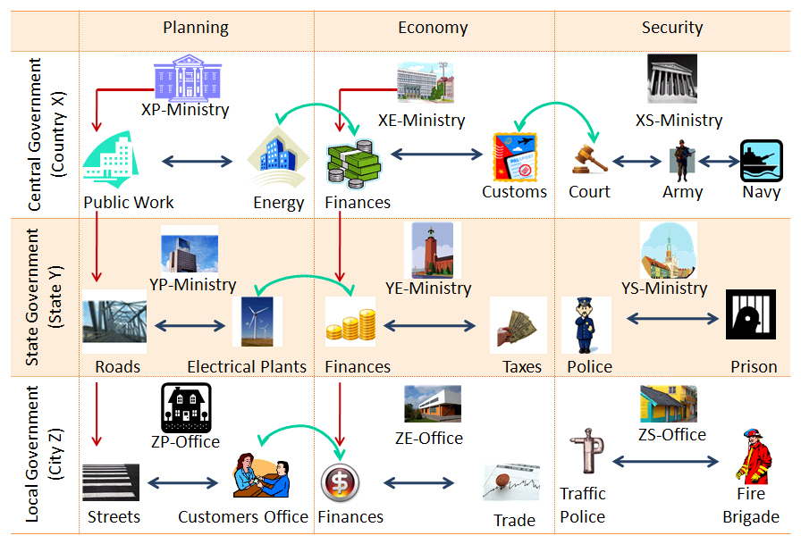
WG network - example
Consider a typical view of government - different administrative levels and sectors/lines of business.
Networks can be formed at different levels [Hunt 2005]
Intradepartmental
Interdepartmental
Intergovernmental
Inter-sectoral
It results in a functional rather than organizational view of government.

Slide 8
overview
1. | THE WG APPROACH
2. | APPLICATION OF THE WG APPROACH TO IT STRATEGY MANAGEMENT (WG-ITSM)
3. | TOOLS FOR WG-ITSM
4. | APPLICATION OF WG-ITMS TOOLSET IN MACAO

Slide 9
Defining IT Strategy Management
ITSM is an integral part of the strategic management system of any organization involving:
development of IT strategies to meet performance targets,
development of IT-related capabilities to enable IT strategy implementation and
IT performance management to monitor and control the implementation.
Typically, the government’s IT management function is concerned with making sure that IT:
delivers value to citizens, businesses and the public at large
supports business and administrative processes towards operational excellence
enables collaboration in government and compliance with government regulations; and
supports organizational growth and the acquisition of IT skills and competences.

Slide 10
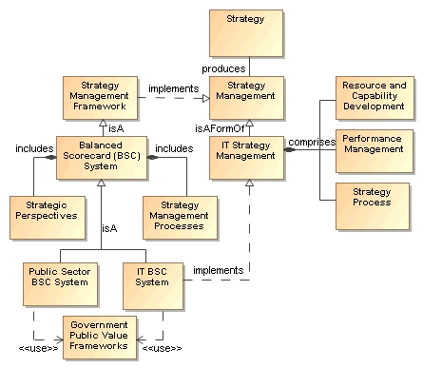
Conceptual model for ITSM

Slide 11
Defining WG-ITSM
When we combine ITSM with the WG concept, there are two possible interpretations:
Applying WG principles and processes to improve the ITSM practice in government, or
The involves developing a virtual IT organization across the government, with no specific application goal. This definition makes any developed WG IT capability latent until applied.
Developing the ITSM practice that inherently supports WG initiatives in government.
This requires the support from a virtual IT organization indicated in the first definition.
Therefore we consider WG-ITSM to include both the creation of a virtual IT organization in government and the strategic application of this organization in furthering WG initiatives.

Slide 12
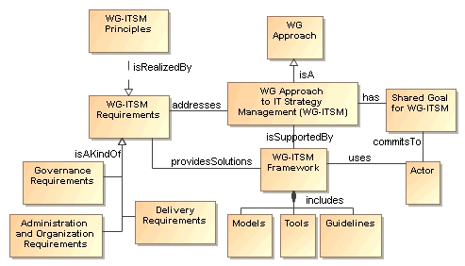
WG-ITSM model

Slide 13
Examples of WG-ITSM programs
Governments are searching for better coordination, control and regulations mechanisms for technology-related policies and strategies:
Two notable programs
US Performance and Results Act (GPRA, 93) and Clinger-Cohen Act (96) requiring performance-based and result-oriented decision-making in IT by all federal agencies.
AGIMO comprehensive reform process on the Australian Government’s use of Information and Communication Technology (ICT).
Substance of these programs
GPRA requires connecting IT investments to stakeholders and mandates cooperation between agencies on IT investments
AGIMO stipulates greater coordination and horizontal government approach to ICT policies
There are some evidence that about one-third of OECD countries are attempting to “centralize” ICT-related policies.

Slide 14
overview
1. | THE WG APPROACH
2. | APPLICATION OF THE WG APPROACH TO IT STRATEGY MANAGEMENT (WG-ITSM)
3. | TOOLS FOR WG-ITSM
4. | APPLICATION OF WG-ITMS TOOLSET IN MACAO

Slide 15
WG-ITSM toolset
The framework consists of models and tools:
Models prescribing the adopted approach:
strategy management activity
IT strategy development process
coordination and integration of IT strategies
A toolset supporting the use of the models:
A toolkit and a set of templates to support the IT strategy process
A markup language to describe strategies
A web-based application for integrated strategy management

Slide 16
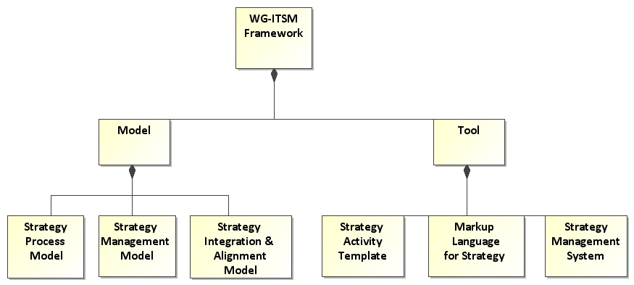
Toolset Components

Slide 17
Toolset Components description
ID | ELEMENT | DESCRIPTION
C1 | Strategy Management Model | Specifies the core elements of an IT strategy and the relationship among them.
C2 | Strategy Process Model | Prescribes the major steps in an IT Strategy development process
C3 | Strategy Integration and Alignment Model | Provides mechanisms for integrating elements of different strategies and techniques for aligning them
C4 | Strategy Toolkit and Templates | A detailed guideline on how to implement the strategy process in practice
C5 | Strategy Markup Language (smXML, StratML) | An XML language for representing, exchanging and integrating strategic plans
C6 | Strategy Management System | A software tool for documenting, analyzing, integrating and reporting strategic plans

Slide 18
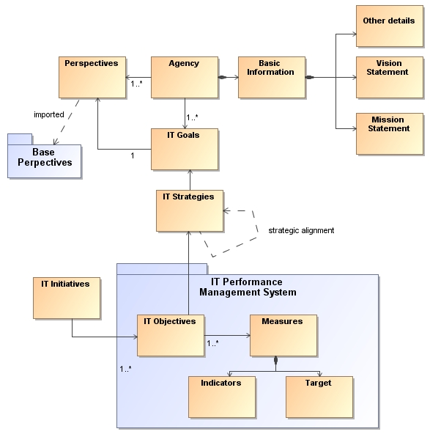
Component 1 – strategy model
The Strategy Management Model:
Applies the Balanced Scorecard System
Perspectives define major areas of concerns
Organizes IT strategies around IT goals, associated with perspectives stemming from the vision statement
Prescribes linkages between IT strategies associated with different perspectives to achieve alignment
Provides the object model for the design of the smXML Language (C5)

Slide 19
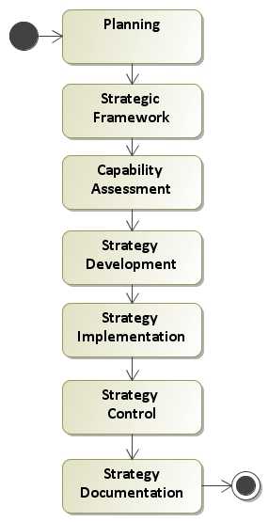
Component 2 – strategy process
ID | Step | Description
S1 | Planning | Approve, commit, identify stakeholders, mobilize resources, schedule activities
S2 | Strategic Framework | Revisit organizational vision, IT vision and goals, revisit IT mission
S3 | Capability Assessment | Evaluate technical, organizational and managerial aspects of IT
S4 | Strategy Development | Discuss, learn, and decide on strategies through SWOT using S2, and S3
S5 | Strategy Implementation | Determine actions from strategies, prioritize them for time and resources
S6 | Strategy Control | Develop and monitor strategy performance measures
S7 | Strategy Documentation | Document, communicate and disseminate strategies

Slide 20
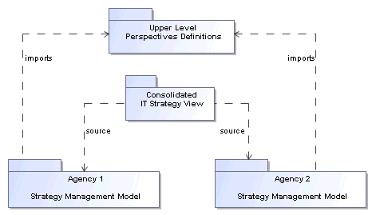
Component 3 – integration model
The integration model works as follows:
Perspectives are used as a basis for integrating strategies across agencies
High-level perspectives (as upper-level ontologies) are agreed by agencies
High-level perspectives are associated with agency-level perspectives
Consolidation across agencies is carried out based on high-level perspectives
This integration model is being extended to support the use of semantic tags

Slide 21
Component 3 – alignment model
The alignment model:
Adapts the Strategic Alignment Model of [Henderson and Venkatraman, 1990] to suit alignment problems in government
Maps alignment domains to pairs of 1) strategic or external issues and 2) internal supporting processes and infrastructures
Provides an alignment process
Supported by Toolkit and Extension to the Strategy Management System

Slide 22
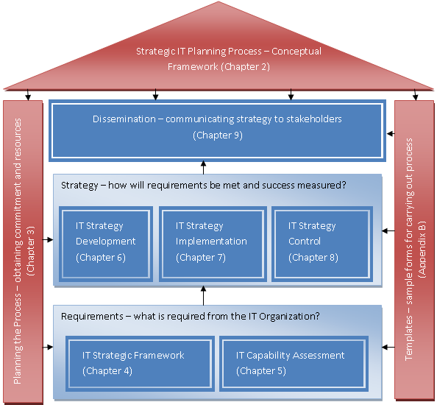
Component 4 – toolkit and templates
The toolkit supports:
Development of IT Strategy Processes
IT Strategy practice to satisfy COBIT control objectives
The IT Balanced Scorecard (IT-BSC) method
The Templates provides instruments for:
Stakeholders analysis,
Capability assessment,
IT visioning and goal setting,
Strategy development,
Elaboration of objectives and
Strategy mapping

Slide 23
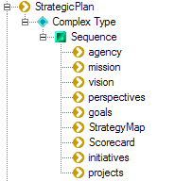
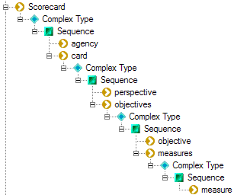
Component 5 – markup languages
Provides XML Language for ITSM (smXML):
Underlying object model is based on the Strategy Management Model (C1)
Developed to enable integration of strategies across government
Provides representations for strategic plans and scorecards
Covers the main elements of StratML
Elements include: Organization, Mission, Vision, Perspective, Goal, Strategy, Objective, Initiative, Project, Measures
Also supports StratML as alternative format

Slide 24
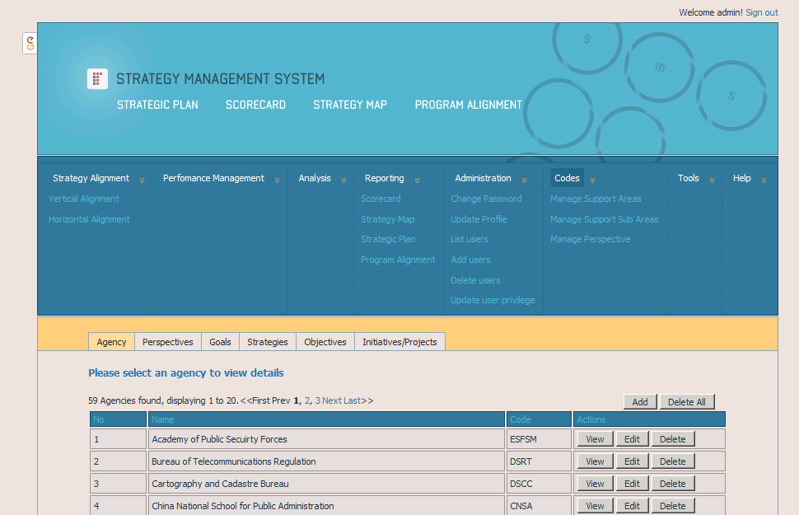
Component 6 – strategy management system
SMS is a software tool that supports:
Centralized management of IT strategies including integration and alignment
Development, analysis and reporting of strategies by individual agencies
Specific features:
documenting IT strategy elements and maintaining IT strategy database
generating formatted IT strategies and scorecard documents
representing agency IT strategies in smXML and StratML
analyzing vertical and horizontal alignment between strategies

Slide 25
overview
1. | THE WG APPROACH
2. | APPLICATION OF THE WG APPROACH TO IT STRATEGY MANAGEMENT (WG-ITSM)
3. | TOOLS FOR WG-ITSM
4. | APPLICATION OF WG-ITMS TOOLSET IN MACAO

Slide 26
Use of toolset in Macao
MSARG has since 1999 pursued two major programs for administrative improvement:
Public Administration Reform Program aimed at improvements in internal government management and public service delivery.
Technology-enabled Transformation of Government through E-Government
Both programs include:
Restructuring administrative processes and eliminating information islands through better coordination, organizational interoperability and governance frameworks; and
Streamlining and integrating government information infrastructure for instance through technical and managerial standards and the use of shared components in the development of agency portals and electronic public services.

Slide 27
Project context
The application of the WG-ITSM framework was carried out within the context of the 2nd Phase of the e-Macao Program from 2006 to 2008, under the Strategic IT Planning Project.
The objectives of the project include:
to facilitate the provision of the necessary leadership and guidance framework for coordinating IT strategic management practices in Macao; and
to develop the ITSM capacity in government agencies in support of their individual missions and of the overall socio-economic goals of the government.

Slide 28
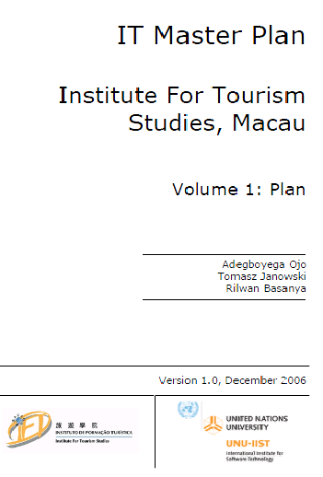
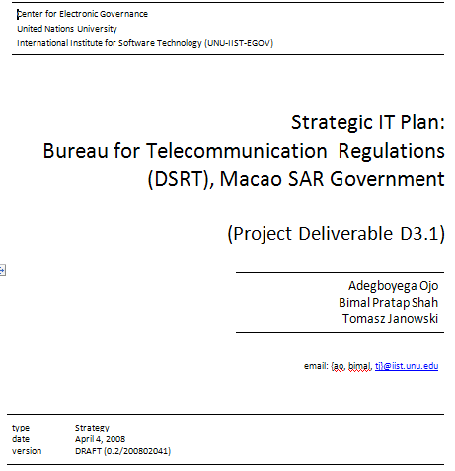
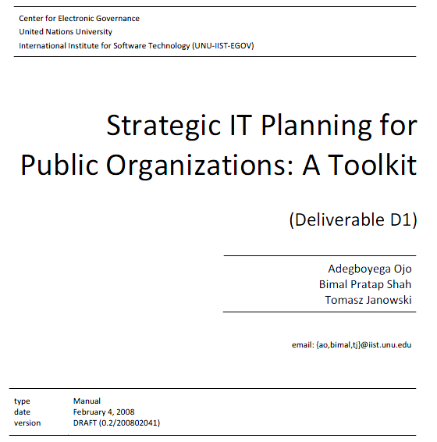
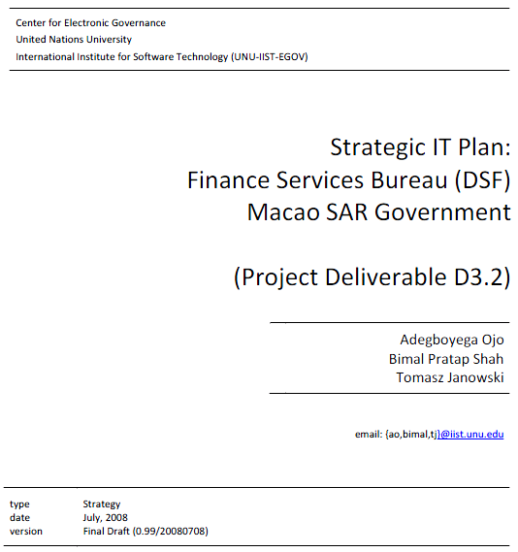
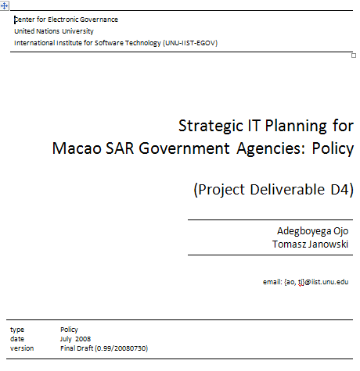
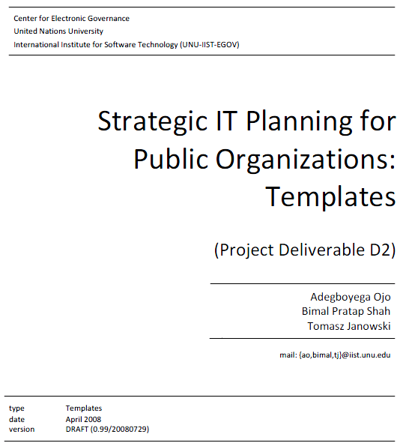
Toolset applications – OUTPUTS for MACAO

Slide 29
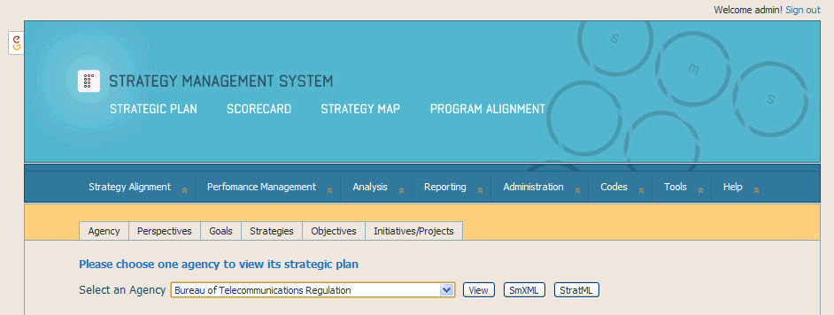
Example – generating strategy from SMS

Slide 30
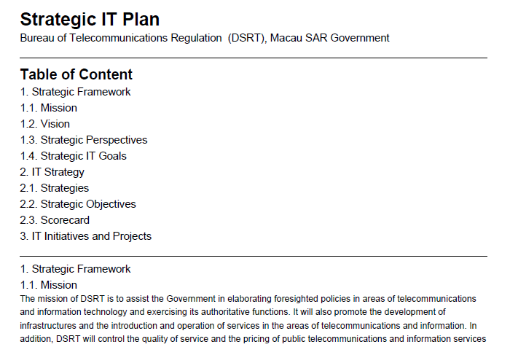
Example – strategy doc generated from SMS

Slide 31
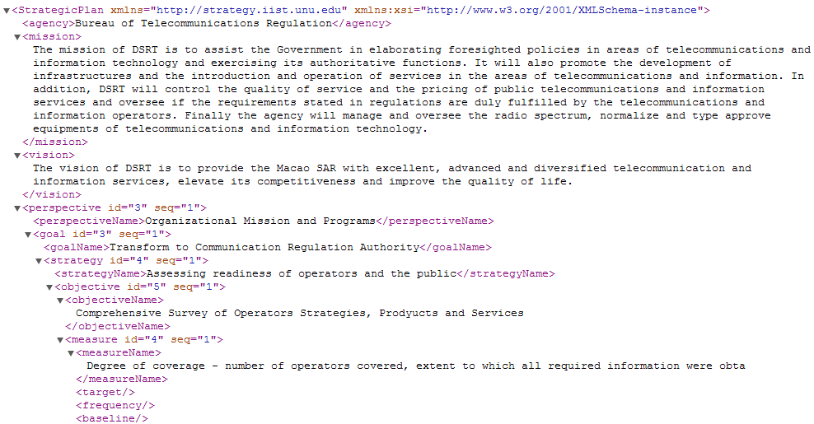
Example – generated STRATEGY IN “sMxml”

Slide 32
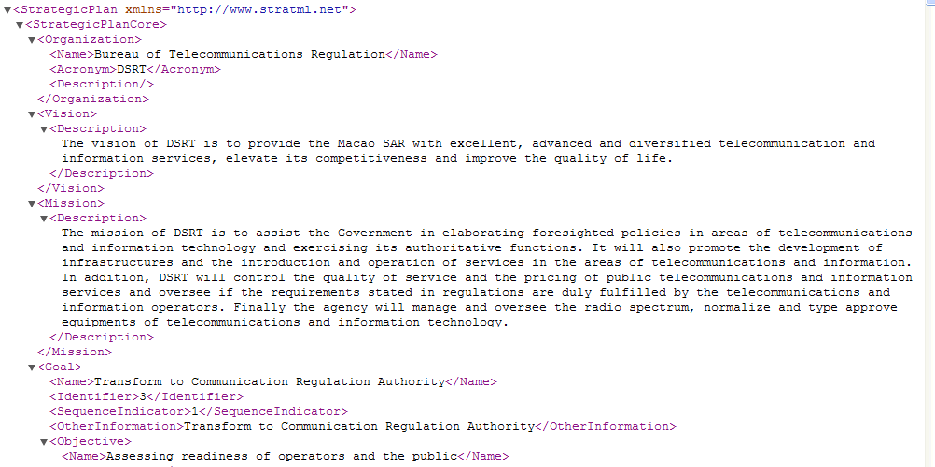
Example – generated STRATEGY IN “stratml”

Slide 33
Concluding remarks
Implementation of SMS still in pilot phase in Macao, however a few countries have indicated in interest in using the application.
We hope to further develop the analytical aspects of the SMS application to suggest common themes in strategies beyond consolidation through perspectives.

Slide 34
Thanks for listening!
Questions?
Adegboyega OJO
ao@iist.unu.edu

