Slide 1

HTML5 Security Realities
Brad Hill, PayPal
bhill@paypal-inc.com @hillbrad
W3Conf: Practical standards for web professionals
21 -22 February 2013
San Francisco
Notes:
First, let me apologize that my slides aren’t very pretty – it’s tough to share a stage with so many of the most talented front-end engineers in the world and be the security person. But to that point, we’ve seen a ton of really amazing stuff here so far, yesterday, this morning, and with more to come. I think it’s safe to say that all the developers in the room are really excited about the possibilities of HTML5 and the Open Web Platform. But there is one group of people that isn’t so excited about all of this: the security community.

Slide 2

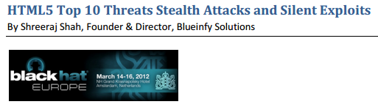



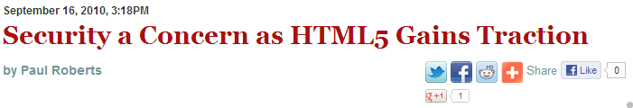

“The reason that the Web browser is the principal entry point for malware is the number of choices that a browser offers up to whomever is at the other end. Evolving technologies like HTML5 promise to make this significantly worse.” – Dan Geer
Notes:
Almost since HTML5 was born, you can’t go to a security conference or read the security tech press without finding HTML5 at the top of almost every list of threats. It’s framed it as part of an out-of-control spiral of complexity on the web that’s going to leave everyone vulnerable to more malware, more application-level compromises and more enterprise risk. Now, security people are grumpy by nature. We are constantly warning people of dangers ahead, and we’re making a better living than ever because nobody ever listens. So, when it comes to HTML5, should you listen?
Well, I’m here to say that no, in this case you shouldn’t. I’ve been working on Web technologies and in security since 1994, and despite hearing about Lulzsec or Chinese hackers on the news every week, the security state of the Web today is better than it has ever been. In particular, we’ve made very large advancements in the last few years, largely due to the rapid advancement of HTML5 and the Open Web Platform, and I think the next few years are going to continue that positive trajectory.

Slide 3
In the next 30 minutes:
Show you real code using new standards to:
Solve Script Injection Vulnerabilities
Build Secure Mashups
HTML5 is a big step forward in security for the Web platform
Notes:
At the last W3Conf I gave a talk with Scott Stender of iSEC Partners where we talked at a high level about some the ways HTML5 is changing security for modern web apps and what to be aware of. This time I want to show some real code on how to use new standards to tackle two of the biggest problems in Web security: solving Script Injection, and building secure mashups.
Along the way, I hope I’ll convince you, and maybe, if some security people are watching, them, that HTML5 is a big step forward in security for the Web platform.

Slide 4
Solving
Script
Injection
Notes:
So, not to lack ambition, let’s tackle the biggest security problem on the Web first: Script Injection, also known as Cross-Site Scripting or XSS.

Slide 5
Script Injection, also known as Cross-Site Scripting or XSS, is the most common Web Application vulnerability.
In 2007, WhiteHat estimated that 90% of sites were vulnerable.
Notes:
This is the most common vulnerability on the Web – some studies have estimated its prevalence at 90%, and I believe that. One of the things HTML, of any version, is not good at is separating data and code, so any dynamic application tends to have script injection issues unless you’ve specifically architected your app to avoid them.

Slide 6
XSS in a nutshell:
If somebody else’s code gets to run in your WebApp, it’s not your WebApp anymore.
+ Same-Origin Policy = XSS anywhere on your domain is XSS everywhere on your domain.
Notes:
I hope that most everyone who’s a web developer today already has some idea of what XSS is, but in a nutshell:
If somebody else gets to run code in your WebApp, it’s not your WebApp anymore. And the Same-Origin Policy for JavaScript means that if there is an XSS vulnerability anywhere on your domain, everything on your domain is vulnerable. The attackers can take advantage of a single weakness to run amok in the browser, impersonate your users, and do anything they can do.

Slide 7
Current defenses:
Input filtering
Strip dangerous characters and tags from user data
Output encoding
Encode user data so it isn’t treated as markup
“HTML5 broke my XSS filter!”
Notes:
Script Injection has been a known problem since 2001, and we’ve come up with some server-side best defensive practices to prevent it: Input filtering, where we attempt to strip dangerous characters or tags from user input before we use it in markup, and Output encoding where we attempt to encode user data so that it isn’t treated as markup by the browser.
And one of the oldest security complaints about HTML5 is that it is going to break many existing XSS filters. If you have a blacklist filter that tries to strip specific tags and event handler attributes, HTML5 introduces a large number of new tags and features that won’t match your old rules.

Slide 8
YES.
html5sec.org lists a dozen new XSS vectors
in new tags and attributes in HTML5.
But your filter was already broken.
Notes:
And, yes, this is true, and introducing new security risks into existing legacy systems is something we try really hard to avoid as we build new standards. But you know what? Every single blacklist filter for HTML4 is already broken. How can I be so confident? Because things like this:

Slide 9
</a/style='-=\a&#x5c;b expr\65 ss/* \&#x2a/ion(URL='javascript:&#x25;5cu0&#48; 64ocum&#x25;5cu0&#48;64ocum&#x25;5cu0&#48;65nt.writ&#x25;5cu0&#48;65(1)' )'>
Notes:
And this:

Slide 10
1;--<?f><x:!μ!:x\/style=`b&#x5c;65h\0061vio\r:url(#def&#x61ult#time2)';'`/onbegin=&#x5b�=\u00&#054;1le&#114t&#40&#x31)&#x5d&#x2f/&#xy,z\>
Notes:
Get interpreted as valid script in HTML4 in some browsers and can be used to mount attacks! Does your filter block those? How many browsers did you test it in?

Slide 11
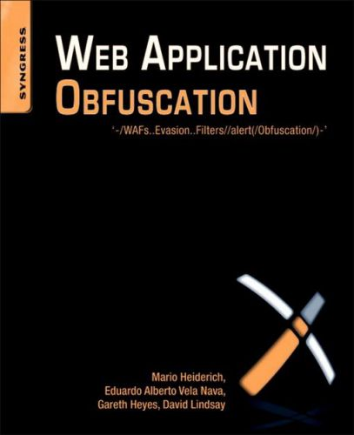
Notes:
Those examples are from a book called Web Application Obfuscation by Gareth Heyes, Mario Heidrich, Eduardo Vela Nava and David Lindsay. An ENTIRE 280 PAGE BOOK full of stuff like that. Those examples I showed you are only the shore of a Lovecraftian continent of horror.

Slide 12
XSS Filters Were Doomed
Filters are a server-side attempt to simulate the client-side parser and execution environment.
But…
Every browser parser operated differently
The algorithms were secret
Every browser had proprietary features, tags and syntax
Accepting bad markup was a feature
Notes:
How could they fill 280 pages with this stuff, and why are all of our XSS filters broken? They work in very limited contexts, but in a broader sense, they were doomed from the start, because an XSS filter is a server-side attempt to simulate the client-side parsing and execution environment, but before HTML5, every browser did this differently, how they did it was a secret, browsers were chock-full of proprietary features, tags and syntax, and accepting bad markup was actually considered a feature, in the tradition of Postel’s Law.

Slide 13
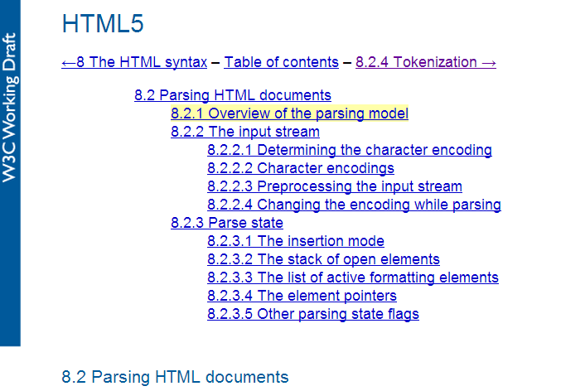
Notes:
This is all to say that the security improvements of HTML5 start at the very foundations, because HTML5 t’s the first version of HTML to specify a normative state machine for parsing, including handling error conditions. Yes, there are new tags and new syntax, but if you want to know how browsers are going to parse markup, for the first time you can find out, and you can have some reasonable confidence that different browsers are going to act in a mostly consistent manner.

Slide 14
Generously coercing a shambling mound of line noise into an application is no longer a competitive feature.
Notes:
The result of standardizing parsing is that generously coercing shambling mounds of random line noise into an application is no longer a competitive feature! And this is an insight and an outcome that doesn’t just apply to parsing –

Slide 15
By standardizing the technology for building Rich Web Applications, HTML5 began a fundamental shift in the security posture of the Web as a platform.
Notes:
By standardizing the technology for building Rich Web Applications, HTML5 began a fundamental shift in the security posture of the Web as a platform.
One of the biggest false charges leveled against HTML5 is that it’s insecure because it’s “more complex than HTML4.” But that’s not the right comparison to make. HTML4 was never by itself the platform of the Web. The Rich Web Application has been with us for a decade, but it was built in terms of plugins – in Java, Flash and ActiveX.

Slide 16
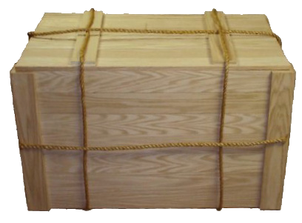







Notes:
If you’re the creator of one of these proprietary rich web app platform whether browser or plugin, you need to attract developers, so you live or die by how much you let developers do, not by how many security restrictions you put on them. You compete for developers and once you have them they’re locked in. If you’re not happy with Java’s security record, you have to re-write your whole application to switch. If you’re a user, you can’t switch – you have to take it or leave it. On the contrary, if I was using an HTML5 app and my browser had a security record like Java, I could switch in a second, and the app developers wouldn’t have to change anything.

Slide 17
Proprietary platforms compete for developers by offering features.
Open platform implementers compete for users by offering quality.
Notes:
So the incentives of the Open Web Platform are different than they’ve been: Proprietary platforms compete for developers by offering features, and they can keep them because switching costs are high. On an open platform, switching costs are low, so implementers have to compete for users by offering them quality, which includes security.

Slide 18
Back to Solving Script Injection
And now,
Notes:
But enough soap box ranting – we were talking about solving script injection.

Slide 19
New and Better Anti-XSS Approaches
Even if we now have some hope of simulating the browser parser for HTML5…
Not easy, definitely not future-proof.
Misses client-only data flows.
Why not get help from the client?
Notes:
And even though we finally have some hope of an accurate simulation of the browser in HTML5, that’s still not a great strategy. It’s complex, it’s not future-proof, and it misses what’s called DOM XSS, vulnerabilities through data flows that can’t be filtered at the server because the server never sees them.
If script injection is a security issue at the client layer, why not solve it in the client?

Slide 20





Content Security Policy
6.0
X-Content-Security-Policy
6.0 6.0
X-WebKit-CSP
10
(sandbox only)
25
HTTP header to enforce, in the client, a least-privilege environment for script and other content.

Slide 21
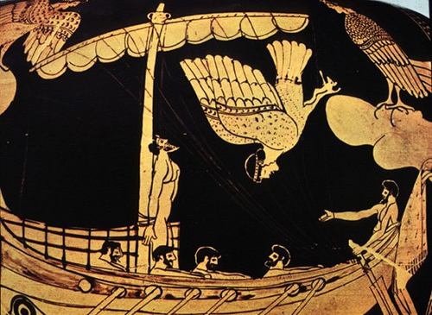
Notes:
Maybe you remember the scene in the Odyssey where they’re about to sail past the Sirens. Odysseus knows that he’ll go mad from the siren’s song, so he orders his crew to tie him to the mast and, whatever he says later, not to untie him.
That’s kind of what CSP does. It lets an app tell the browser to tie it to the mast.

Slide 22
Content-Security-Policy:
default-src 'self';
object-src 'none';
img-src https://uploads.example-board.net
https://cdn.example-board.com
data:;
script-src https://code.example-board.net
https://www.google-analytics.com;
frame-src *.youtube.com;
report-uri https://www.example-board.net/cspViolations.xyz
Notes:
This is an example of a CSP header, and you can see it’s pretty straightforward. We just list the origins that are allowed to load content.
The difficult part here is that to get the full benefit, you can’t use inline script or css, and that’s pretty problematic for existing apps.

Slide 23
Content Security Policy 1.0
default-src Everything
script-src Scripts
object-src Plugins
style-src CSS
img-src Images
media-src Audio + Video
frame-src Frame content
font-src Fonts
connect-src Script-loaded content (e.g. XHR)
sandbox Same as HTML5 iframe sandbox
reporturi Violation reporting
Notes:
We can …
And CSP has a reporting feature, which makes deployment much easier, because you can measure what’s going to happen and build correct policies before you start enforcing them.

Slide 24
The catch…
CSP enforces code / data separation
This means:
NO inline script or css
NO eval, even in libraries
(can be disabled, but sacrifices many of the benefits of CSP)

Slide 25
<script> function doSomething ()… </script>
<button onClick="doSomething()">
Click Here!</button>

Slide 26
<!--myPageScript.js-->
function doSomething ()…
Document.addEventListener(‘DOMContentLoader', function() { for var b in document.querySelectorAll('.clickme‘)) e.addEventListener('click', doSomething); });
<!--myPageContent.html-->
<script src="myPageScript.js"></script>
<button class="clickme">Click Here!</button>

Slide 27
Coming soon in CSP 1.1
Whitelisting of inline scripts and CSS
More granular origins
Better control of plugins and media types
Control and reporting for reflected XSS filters
META tag support
https://dvcs.w3.org/hg/content-security-policy/raw-file/tip/csp-specification.dev.html
Notes:
So in CSP 1.1, we are working to fix this, by allowing whitelisting of inline scripts and css, along with other features like controlling the types of plugins that can run, and adding reporting to existing browser anti-XSS filters.
So this is a great start on preventing XSS attacks that you can start using today, but there’s one other up and coming technology I want to touch on – and that’s HTML templates.

Slide 28
Templating
Templating is one of the oldest and most widely used Web application construction patterns.
But it is a hive of XSS villainy because it has never been a first-class feature in the client.

Slide 29
HTML Templates
New spec in progress in the WebApps WG:
https://dvcs.w3.org/hg/webcomponents/raw-file/tip/spec/templates/index.html
Declare templates as first-class client-side objects for increased performance, reduced XSS risk.
Notes:
So HTML templates are a new spec under development in the WebApps Working Group that allow you to declare templates as first-class client-side objects. Instead of dynamically building markup using strings concatenation and innerHTML, we’ll have a pattern that has the potential to be both faster and offer much better security against script injection.

Slide 30
With CSP and a careful application architecture XSS can be solved today.
In the near future it will be possible using more familiar and better performing idioms.
Notes:
What this boils down to is that:

Slide 31
Secure
Mashups
“HTML5 and CORS give new
ways to bypass the Same-Origin Policy!”
Notes:
OK, so we’ve solved XSS, which is a pretty good day’s work– but I also promised I’d show you how to build secure mashups in HTML5 – another thing that security folks like to say can’t be done.

Slide 32
A “mashup” incorporates content from multiple origins under different administrative control.
Today, more apps than not are authenticated mashups: ads, analytics, federated login
How did we do this before HTML5?
Notes:
So what’s a mashup? It’s when you include content from multiple sites in a single app. And I think we’re all familiar with anonymous mashups, like putting Craigslist apartment listings onto a Google map, but what a lot people probably don’t think about is that almost every major app today is part mashup – and moreover, they’re authenticated mashups. With features like advertising, analytics and federated login, we’re sharing authenticated user data across origins at most places we visit on the Web.

Slide 33
Flash, with crossdomain.xml
<?xml version="1.0"?>
<!--https://www.foo.com/crossdomain.xml-->
<cross-domain-policy>
<allow-access-from
domain=“www.example-analytics.com"/>
</cross-domain-policy>
Notes:
So Flash allows us to do this, using a policy file called crossdomain.xml, which defines ACLs for foreign SWFs. This policy file lets SWFs loaded from www.example-analytics.com to make requests, with cookies, and read the results, from www.foo.com.

Slide 34
Jan’s Rule:
“Give someone an ACL, and they’ll put in a *.”
Notes:
But we security folks are kind of cynical, we’ve seen it all. And my friend Jan recently quippped:
Give someone an ACL and they’ll put in a *.
So what happens if you put a * in crossdomain.xml?

Slide 35

A “*” in your master crossdomain.xml policy means your users’ information is vulnerable to any malicious SWF, anywhere on the Web
Notes:
Oops.. If you put * in your master policy file, you just allowed any malicious SWF anywhere on the Internet to access all your user’s information. Game over. So that’s not great…

Slide 36
I can’t use Flash on iOS anyway… What about HTML-only methods?

Slide 37
<script src=“foreignOrigin">
Same-Origin Loophole
example-2.com
Browser
Origin=example.com
<script src=
https://example-2.com/x.js>
example.com
(function( window,
undefined ) {…
Notes:
And the answer is that, since the beginning of the Same-Origin Policy, there’s always been a loophole. If I load content, and it sources script from another domain, that script becomes part of my application, effectively allowing us to read that information across domains and use this as a communication channel.

Slide 38
AKA – “JSONP”
“JSON with padding”
<script src=“example.com/jsonp?callback=foo”>
Returns JSON data “padded” with a call to the function you specified.
You hope…it’s still script!

Slide 39
This pattern injects somebody else’s code into your application.
Remember what the definition of XSS was?
Notes:
But still, everyone thinks this is OK. We security people warn that this is dangerous, but nobody thinks anything bad is going to happen, they trust the people they’re getting this script from.
Until two weeks ago…

Slide 40
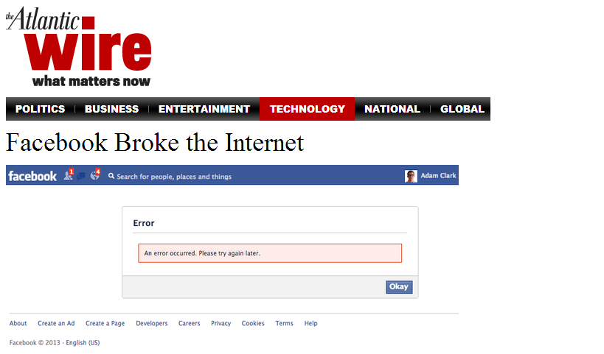
Notes:
When Facebook broke the Internet. Did anyone see this? If you went to any of thousands of sites on the web, instead of seeing that site, you got a Facebook error page instead. Do you want to see the one line of code the broke the Internet?

Slide 41
<script src="//connect.facebook.net/en_US/all.js">
</script>
Notes:
Well, this is the mashup pattern for Facebook Connect. So one bug here, and your application is at its mercy.
But still, this was just a bug, it wasn’t an attack.

Slide 42
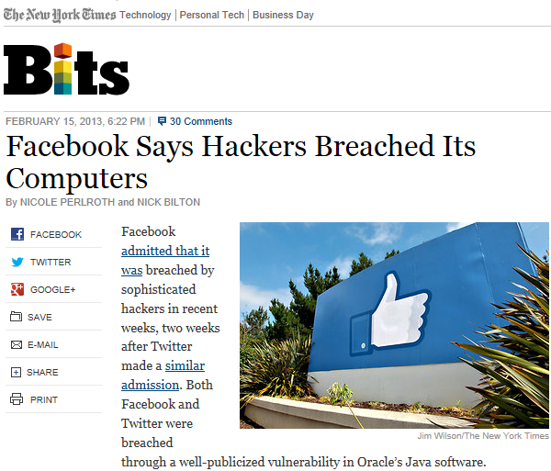
Notes:
Hmm… This is what Facebook had to say, just a week after the connect fiasco.
Now these aren’t related and I’m sure that Facebook has really good security measures in place to make sure that a compromise of a developer workstation doesn’t propagate out to impact code on the live site, but it should give you pause.
The more we use insecure patterns like script src to connect the web, the more fragile we make it, and the more we make an individual API \a single point of failure for the security of huge parts of the web, the harder the bad guys are going to try to exploit it.

Slide 43

We can build it better.
We have the technology.

Slide 44







Cross-Origin Resource Sharing (CORS)
22
5.1
3.2
15
15
2.1
10
7
Voluntarily relax the Same-Origin Policy with an HTTP header to allow permissioned sharing on a resource-by-resource basis
Access-Control-Allow-Credentials: true
Access-Control-Allow-Origin: someorigin.com

Slide 45
CORS Client Example
var xhr = new XMLHttpRequest();
xhr.open(method, xDomainUrl, true);
xhr.withCredentials = true;
xhr.onload = function() {
var responseText = xhr.responseText; validatedResponse = validate(responseText); };
xhr.onerror = function() {
console.log('There was an error!'); };
xhr.send();

Slide 46
The difference:
Script src gives you code you have no choice but to TRUST
CORS gives you data you can VERIFY
Notes:
Script src gives you code that you have to trust, but CORS gives you data that you can validate.

Slide 47
What about the * in CORS?
* cannot be used for a resource that supports credentials.
* in Access-Control-Allow-Origin gives other origins only the same view they already have from their own server.
Access-Control-Allow-Origin: *
is actually one of the safest ways to use CORS!
Notes:
And it doesn’t introduce any new Cross-Site Request Forgery attack surface.

Slide 48
What if you need data from somebody who doesn’t publish a CORS API?

Slide 49
sandboxed iframes
and
postMessage
23
5.1
4.2
15
2.1
10
7
23
5.1
4.2
16
12.1
2.1
8
7

Slide 50
trusted.mydomain.com/foo.html
<iframe sandbox=“allow-scripts” src=“integration.mydomain.com/wrapLogin.html
”>
</iframe>
By using a different domain name, many benefits of the sandbox can be achieved, even in browsers that don’t support it.

Slide 51
integration.mydomain.com/wrapLogin.html
<html>
<script src=“foreigndomain.com/login.js”>
</script>
<script>
window.parent.postMessage(loginName,
“trusted.mydomain.com”);
</script>
</html>

Slide 52
trusted.mydomain.com/foo.html
<iframe sandbox=“allow-scripts” src=“untrusted.mydomain.com/untrusted.html”>
</iframe>
<script>
window.addEventListener("message", receiveMessage, false);
receiveMessage = function(event) {
if(event.origin == “untrusted.mydomain.com”) {
var data = sanitizeData(event.data);
}
<script>
Notes:
And so, in just a few lines of code, we’ve locked our legacy mashup into a strong sandbox, and only let it pass notes. If it breaks or gets hacked, it can’t reach out and affect rest of our application.

Slide 53
But wait, there’s more! What if you do this to your own code?
Notes:
But there’s more to this than I first realized….I mentioned this pattern for safe mashups at the last W3Conf in 2011, and I’m sure I’m wasn’t the first to have done so, but I didn’t realize how important it was until I saw a talk by Devdatta Akhwe at last year’s USENIX Security.
In one of those brilliant insights that seems obvious once you’ve heard it, Devdatta realized that this wasn’t just a useful trick for legacy mashups – that it is actually a fundamental building block allowing privilege separation in HTML5 applications.

Slide 54
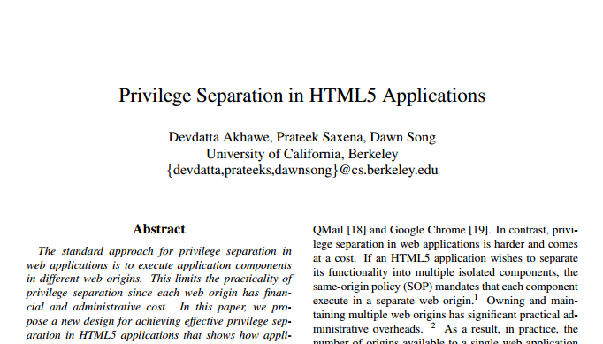
http://www.cs.berkeley.edu/~devdatta/papers/LeastPrivileges.pdf
Notes:
What he said was basically, what if I treat my own code, and the libraries I host on my own domain, as being just as potentially dangerous as that foreign mashup? After all, if I’m building a complex app with tens of thousands of lines of JavaScript code, surely there are some latent bugs in there.
And actually, the vast majority of that code doesn’t even need to do sensitive things like access the user’s cookie or perform transactions. We can apply the same architectural principles of privilege separation we use for architecting browsers or operating systems to our HTML5 applications using this iframe plus postMessage pattern.

Slide 55

Hackers HATE Him!!!!
Reduce your Trusted Computing Base by 95% with this one simple HTML5 trick!!!
Notes:
And he found that, for real-world applications using off-the-shelf libraries, by changing just a few lines of code, it was possible to reduce the trusted computing base of these applications by 95%, isolating all of those latent bugs into strong, browser-provided, same-origin sandboxes.
So go check out this paper. If people pay attention to it, I think it has the potential to be one of the most important computer security papers of the decade and hugely reshape the risk profile of client-side WebApps.

Slide 56
Summary: HTML5
HTML5 and the Open Web Platform are improving the security of the Web ecosystem.
Rich Web Apps are not new, and HTML5 offers big security improvements compared to the proprietary plugin technologies it’s actually replacing.
Notes:
I could go on about many more features, but I think that’s a pretty good start. I hope I’ve convinced you that HTML5 and the Open Web Platform are improving the security of the Web ecosystem. Rich Web Apps aren’t new, and HTML5 offers big security improvements compared to the proprietary plugin technologies it’s actually replacing.

Slide 57
Summary: Script Injection
Script Injection, aka XSS, can be a solved problem with proper application architecture and new client-side technologies.
Avoid incomplete server-side simulation, solve it directly in the client environment:
Content Security Policy
HTML Templates

Slide 58
Summary: Mashups
Use CORS to get (and validate) data, not code
Use iframes and postMessage to isolate legacy mashup APIs
Treat your own code like a mashup: Use the Same-Origin Policy as a powerful privilege separation technique for secure application architecture in HTML5
https://github.com/devd/html5privsep

Slide 59
Ongoing work in WebAppSec WG:
Content Security Policy 1.1
User Interface Security to Kill Clickjacking
Sub-Resource Integrity
More important work underway in the Web Cryptography WG

Slide 60
public-webappsec-request@w3.org Thank you! Questions?
Brad Hill, PayPal
bhill@paypal-inc.com @hillbrad
W3Conf: Practical standards for web professionals
21 -22 February 2013
San Francisco

