Slide 1

Social networking task force
Jeff Jaffe
14 May 2012

Slide 2

What we’ve done
Tried to identify specific standards opportunities
Decided we first needed to create an architecture block diagram to show relationships
  Made some progress
Liaison calls with Open Social
Initial ideas on next steps

Slide 3
Today
Ann Bassetti: Block diagram, scenarios, narrative
Jeff Jaffe: Standardization possibilities
Steve Holbrook: Workshop opportunities
Discussion

Slide 4
Desired output
Work plan for block diagram
  With specific comments
Guidance on proposed standards activities
Consensus on workshop scoping

Slide 5
Ann Bassetti:
Block diagram
Scenarios
Narratives
...

Slide 6
DRAFT
Social headlights task force:
DIAGRAMS, SCENARIOS, ...
Teams & Contributors
Federated Social Web XG / Community Group
Social Business Community Group
Social Headlights Task Force
Particular thanks to:
Lloyd Fassett
Rich Rogers
David Robinson
Alberto Manuel
Blaine Cook
Ruinan Sun
Laurent Walter Goix
Virginie Galindo
Stéfane Fermigier
Evan Prodromou
Steve Holbrook
Harry Halpin
Jeff Jaffe
... apologies to anyone overlooked!
Ann Bassetti
14 May 2012

Slide 7
DRAFT
Social headlights task force:
DIAGRAMS, SCENARIOS, ...
What we're asking & doing
Seeking to determine:
Essential components of "social networking"
Relationships between parts
Characteristic scenarios and narratives
Basis set and tests
What technologies and standards exist?
Where was that work done?
Is more needed?
Should W3C play a role?
Ann Bassetti
14 May 2012

Slide 8
DRAFT
Social headlights task force:
DIAGRAMS, SCENARIOS, ...
Essential components?
A question covering such a large area…
Methodology
  Criss-crossing the social web principles
  Listing all the components
  Classifying them
    Into groups, by standardization body, by technology
→ Here is the result …
Ann Bassetti
14 May 2012

Slide 9

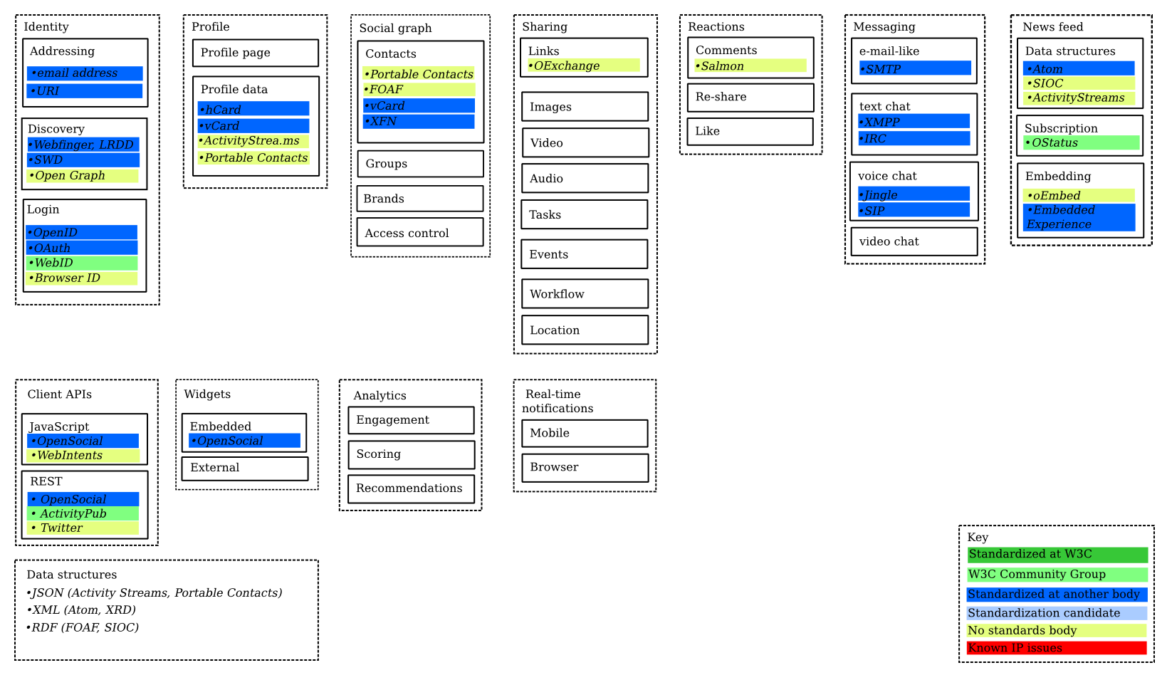
What are essential components of
"social networking" or "social web"?
Harry Halpin, Evan Prodromou
based on work in Federated Social Web group

Slide 10
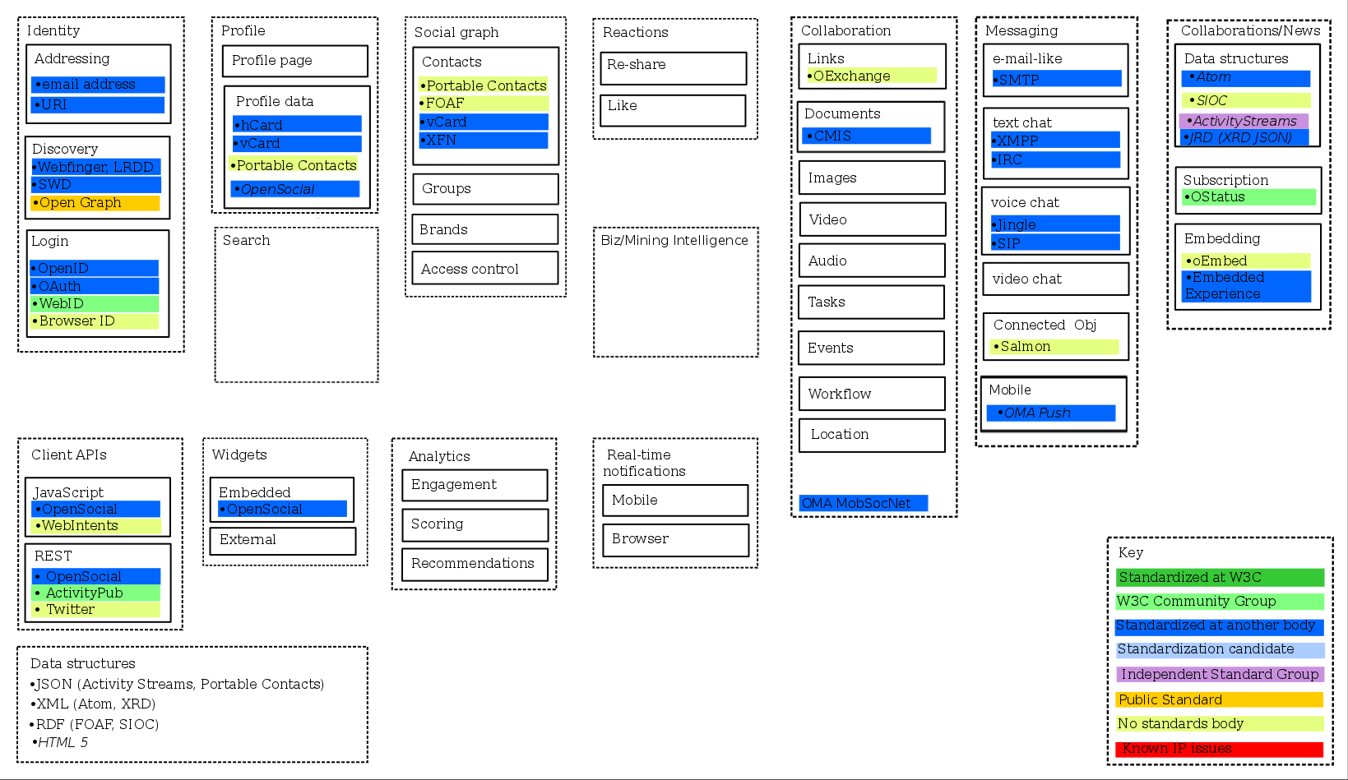
David Robinson additions
(annotations by Ann Bassetti)
was called 'news'
was called 'sharing'
moved "Activity Stteams" from here
*NOTE: needs to be checked to make sure I found all additions and changes

Slide 11
Human interactions
Ann Bassetti additions
Sharing
Messaging
Group Dynamics
(e.g., Community, Team)
Newsfeed
Reactions
Key
Standardized at W3C
W3C Community Group
Standardized at another body
Standardization candidate
No standards body
Known IP issues
Text
E-mail like
SMTP
Data structures
Atom
SIOC
ActivityStreams
Comments
Salmon
Links
OExchange
Create
Text chat (includes 1:1 and 1:multiple; also includes "Live Chat" such as with Helpline person)
XMPP
IRC
Re-share
Images
Join / Un-join
Subscription
OStatus
Video
End / Close
Like / rating
Audio
Membership list(s)
Embedding
oEmbed
Embedded Experience
Recommendations
Tasks
Voice chat
Jingle
STP
Group list(s)
Tags
Events
Distribution list(s)
About the human *
Alerts / Notifications
Workflow
Routing
Signatures
Video chat
Identity
Given/family name
Username(s)
Assigned number(s) (e.g., governmental)
....
Social Graph
Profile
Contacts
Portable Contacts
FOAF
vCard
XFN
Profile page ??
Forward / reply (might be part of others or part of 'Sharing")
Profile data
hCard
vCard
ActivityStrea.ms
Portable Contacts
...
Location
Ubiquitous attributes
Bookmarks
Threaded discussions (e.g., bulletin board; includes "Idea Generation / Jam")
Threading
Sorting (by 'likes', 'most recent',...)
Hyperlinks
Variable device display
Variable security settings
...
Groups
Status
Presence
Microblog
Addressing
snail mail address
email address
URI
Brands
Presence
Access control ??
Location
*Note: inside corporate firewall one has professional
profile, separate from one's personal profile.
Skills
Technical foundations
Client APIs
Widgets
Analytics
Real-time Notifications
Login credentials
OpenID
OAuth
WebID
Browser ID
Data structures
JSON (Activity Streams, Portable Contacts)
XML (Atom, XRD)
RDF (FOAF, SIOC)
JavaScript
OpenSocial
WebIntents
Embedded
OpenSocial
Engagement
Mobile
External
Scoring
Browser
REST
OpenSocial
ActivityPub
Twitter
Recommendations
Discovery
Webfinger, LRDD
SWD
Open Graph
Content 'structures'
Wiki
Blog
HTML+
Microblog
Trends

Slide 12
Human interactions
All contributions merged; no technologies
Sharing / Collaboration
Messaging
Group Dynamics
(e.g., Community, Team)
Collaboration / Newsfeed
Reactions
E-mail like
Comments
Text
Text chat (includes 1:1 and 1:multiple; also includes "Live Chat" such as with Helpline person)
Data structures
Re-share
Create
Document
Subscription
Like / rating
Links
Join / Un-join
Embedding
End / Close
Recommendations
Images
Voice chat
Alerts / Notifications
Tags
Video
Membership list(s)
Video chat
Group list(s)
Audio
Forward / reply (might be part of others or part of 'Sharing")
Tasks
Distribution list(s)
About the human *
Events
Identity
Given/family name
User name(s)
Assigned number(s) (e.g., governmental)
....
Social Graph
Profile
Workflow
Routing
Signatures
Connected objects
Contacts
Profile page ??
Mobile
Ubiquitous attributes
Groups
Profile data
Location
Threading
Sorting (by 'likes', 'most recent',...)
Hyperlinks
Variable device display
Variable security settings
Search
Biz/Mining Intelligence (??)
...
Brands
Presence
Bookmarks
Access control ??
Location
Status
Presence
Microblog
Addressing
snail mail address
email address
URI
Skills
Technical foundations
* Note: professional profile, inside corporate firewall,
is separate from one's personal profile.
Client APIs
Widgets
Analytics
Real-time Notifications
Login credentials
Data structures
Content
'structures'
Wiki
Blog
HTML+
Microblog
JavaScript
Embedded
Engagement
Mobile
Discovery
REST
External
Scoring
Browser
Recommendations
Trends

Slide 13
Adding technologies, standards, and who is doing. (Not complete)
Human interactions
Sharing / Collaboration
Messaging
Group Dynamics
(e.g., Community, Team)
Collaboration / Newsfeed
Reactions
Key
Standardized at W3C
W3C Community Group
Standardized at another body
Standardization candidate
Independent standard group
Public standard
No standards body
Known IP issues
E-mail like
SMTP
Comments
Salmon
Text
Create
Data structures
Atom
SIOC
ActivityStreams
JRD (XRD, JSON)
Document
CMIS
Text chat (includes 1:1 and 1:multiple; also "Live Chat" such as with Helpline person)
XMPP
IRC
Re-share
Join / Un-join
Links
OExchange
End / Close
Like / rating
Subscription
OStatus
Membership list(s)
Recommendations
Images
Group list(s)
Embedding
oEmbed
Embedded Experience
Video
Voice chat
Jingle
STP
Distribution list(s)
Audio
Tasks
Video chat
Alerts / Notifications
Events
Forward / reply (might be part of others or part of 'Sharing")
Workflow
Routing
Signatures
Threaded discussions (e.g., bulletin board; includes "Idea Generation / Jam")
Location
Bookmarks
Status
Presence
Microblog
Connected objects
Salmon
OMA MobSocNet
Mobile
OMA Push

Slide 14
Adding technologies, standards, and who is doing. (Not complete)
Key
Standardized at W3C
W3C Community Group
Standardized at another body
Standardization candidate
Independent standard group
Public standard
No standards body
Known IP issues
About the human *
Identity
Given/family name
User name(s)
Assigned number(s) (e.g., governmental)
....
Social Graph
Profile
Contacts
Portable Contacts
FOAF
vCard
XFN
Profile page ??
Profile data
hCard
vCard
ActivityStreams
Portable Contacts
OpenSocial
Groups
Addressing
snail mail address
email address
URI
Brands
Presence
Access control ??
Location
*Note: inside corporate firewall one has professional
profile, separate from one's personal profile.
Skills

Slide 15
Adding technologies, standards, and who is doing. (Not complete)
Key
Standardized at W3C
W3C Community Group
Standardized at another body
Standardization candidate
Independent standard group
Public standard
No standards body
Known IP issues
Technical foundations
Client APIs
Widgets
Analytics
Real-time Notifications
Login credentials
OpenID
OAuth
WebID
Browser ID
Data structures
JSON
  Activity Streams
  Portable Contacts
XML
Atom
XRD
RDF
  FOAF
  SIOC
HTML5
Content
'structures'
Wiki
Blog
HTML+
Microblog
JavaScript
Embedded
Engagement
Mobile
REST
External
Scoring
Browser
Recommendations
Discovery
Webfinger, LRDD
SWD
Open Graph
Trends

Slide 16
Adding technologies, standards, and who is doing. (Not complete)
Key
Standardized at W3C
W3C Community Group
Standardized at another body
Standardization candidate
Independent standard group
Public standard
No standards body
Known IP issues
Ubiquitous attributes
Threading
Sorting (by 'likes', 'most recent',...)
Hyperlinks
Variable device display
Variable security settings
Search
Biz/Mining Intelligence (??)
...

Slide 17
"Mobile" equilibrium of social network specifications
Laurent Walter Goix contribution
OMA MobSocNet
OpenSocial
OMA Push
OStatus
OExchange
ActivityStreams
WebFinger
Portable Contacts
OpenID
Key
Standardized at W3C
W3C Community Group
Standardized at another body
Standardization candidate
Independent standard group
Public standard
No standards body
Known IP issues
Salmon
Host-Meta
PubSubHubbub
XRD/S

Slide 18
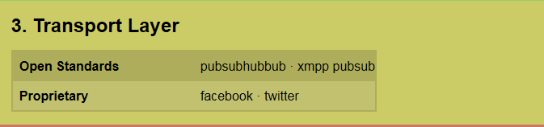
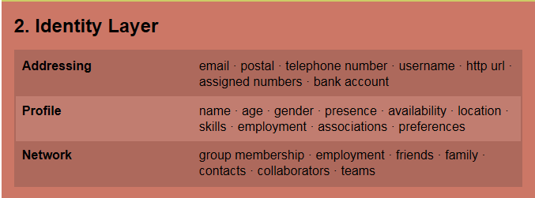
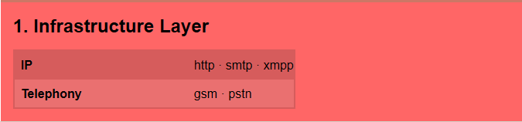
Layer view
Blaine Cook contribution (Not complete.)

Slide 19
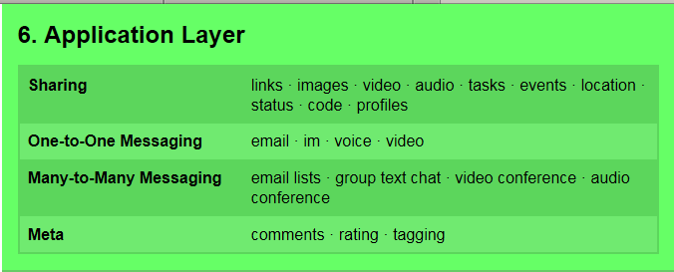
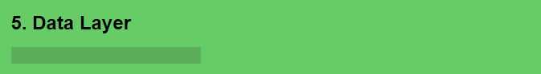
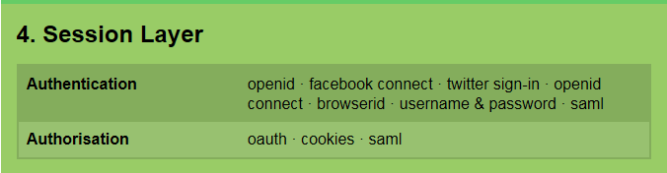
Layer view, continued
(lots here; not finished)

Slide 20
DRAFT
Social headlights task force:
DIAGRAMS, SCENARIOS, ...
Additional perspectives
Having described the social web components by categories, making sure everything is there…
  Human interaction
  About the human
  Ubiquitous attributes
  Technical foundations
We may want to organize items in a different way
  to identify relationships
  to identify the Basis Set
  to identify essential tests
Ann Bassetti
14 May 2012

Slide 21
DRAFT
Social headlights task force:
DIAGRAMS, SCENARIOS, ...
Scenarios & Narratives
Scenarios are the activities that drive the diagram.
What is the canonical set of social networking scenarios? Examples:
  Update personal information
  Explore a social graph
  Share information
  Provide a reaction
  ...
Can we write narratives to describe each scenario?
  Samples: http://www.w3.org/wiki/SocialWebHeadlightsTaskForce
Ann Bassetti
14 May 2012

Slide 22
DRAFT
Social headlights task force:
DIAGRAMS, SCENARIOS, ...
Basis set
"Basis Set" = the irreducible list of 5-10 components that are the top-level description of the block diagram
  Example: in the OSI model, the basis set is 7 layers
Initial proposed social networking basis set:
  Identity and addressing (includes profile)
  Data (text, documents, etc.)
  Sharing infrastructure (events, location, status)
  Linking to more information (posting, hyperlinks, search)
  Group dynamics (create groups, membership lists, social graph)
  Transport / messaging
  "Feeds" management
  Reactions
Ann Bassetti
14 May 2012

Slide 23
DRAFT
Social headlights task force:
DIAGRAMS, SCENARIOS, ...
Tests
How to test if we have the correct Basis Set:
If, every time we describe a scenario:
  it uses the basis set; and
  these technology categories are used in roughly the same way each time
... then we have correctly described the underlying technology.
  Example: With data communications, every time a message is sent, it goes through the 7 layers in approximately the same way
Ann Bassetti
14 May 2012

Slide 24
DRAFT
Social headlights task force:
DIAGRAMS, SCENARIOS, ...
Current work summary
Multiple efforts on how to represent a complicated subject area, including:
  Component parts
  Relationships
  Scenarios
  Tests
  Standards to-date
  Who's doing what
... toward answering "what, if anything, would best
role of W3C?"
Ann Bassetti
14 May 2012

Slide 25
Jeff Jaffe:
Standardization possibilities

Slide 26
Standardization possibilities
Within the social space there are many potential areas for standardization
  The block diagram helps clarify
  Some are already underway elsewhere
  Some have not started and could be opportunities for W3C
But we also ask whether there are unique opportunities for W3C
  Here’s one!

Slide 27
Developers want common APIs to get at social data
Sites who want to be part of a standardized social web can share social data in "near real-time" via server-to-server federation --- but many do not.
Today, several sites use OpenSocial
Other, significant sites open their APIs to developers, but do not use any standard
Developers are forced to customize applications to individual sites
But every social site sits on top of a browser
Browsers can get access to social data and provide a standard social view (APIs) to developers

Slide 28
How would this work?
For example, users could download their profile data into their browser
  Don’t they want to own their profile data?
A standard browser API could make this available uniformly across applications
  Contact information
  APIs to manage this information
  Protocols to socialize this with other sites
  Data formats
  Candidate specs exist as starting points
This could be repeated for other information in the social world

Slide 29
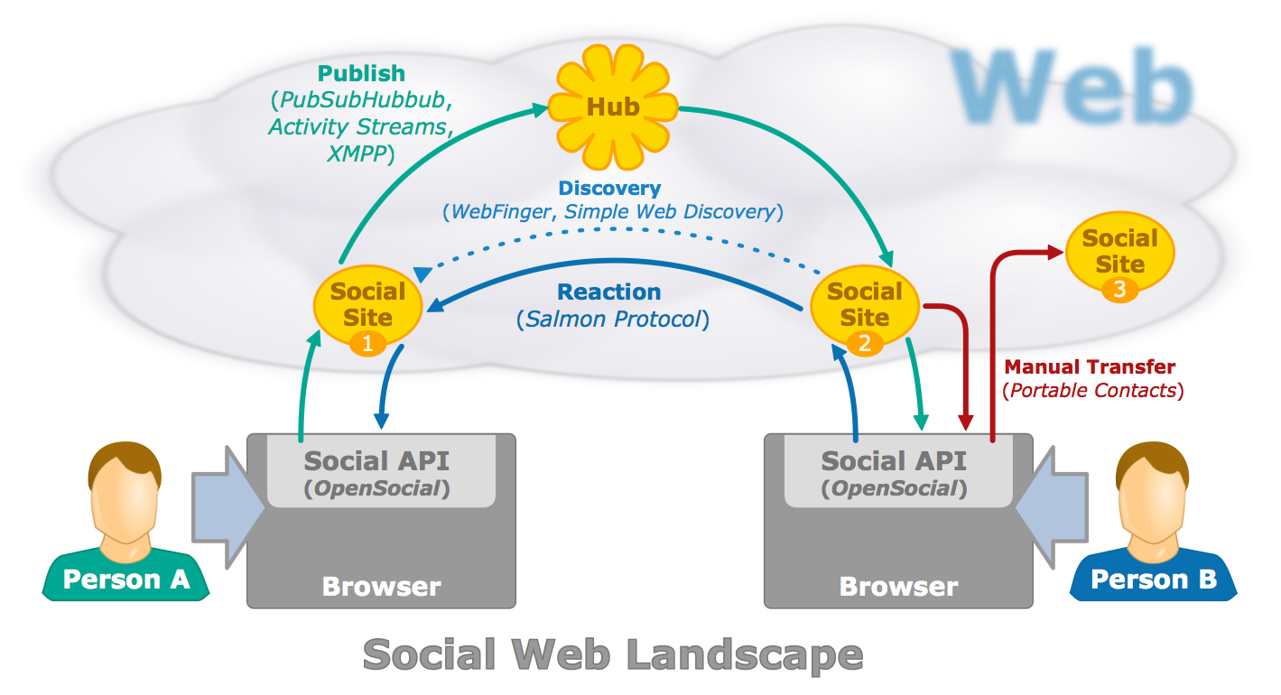
Putting it all together
http://www.w3.org/Talks/Deck/identity/identity-hub-api.svg

Slide 30
Steve Holbrook:
Workshop Opportunities

Slide 31
Discussion
Questions?
Reactions?
Suggestions?
Want to help?

Slide 32
The following slides are a revision proposal, that was sent after the W3C presentation.
It was not considered due Social Headlights disbanded.

Slide 33
The social block– alignment in the social interaction
Conversation
About the Human
Collaboration
About the Human
Identity
Profile
Identity
Profile
Groups
Social Graph
Presence
Social Graph
Presence
Sharing
Addressing
Reputation
Addressing
Reputation
Reactions
Search & Analytics
Organization
World
World can be other organization, or the same organization the human belongs to

Slide 34

The social block – the components
About the Human
Who you are, how you identify yourself and what you pretend to be.
Identity
Addressing
Unique identification attributes about the human.

Contact details (e-mail, instant messaging … ).
Profile
Reputation
What attributes about the human are available to identify him. Presence status (on-line / off-line …).
85 %
Perceived evaluation taken by members of the social graph.
Social Graph
Social network type, network type and network connections around particular domains (may exist different networks for different domains).

Slide 35

The social block – the components
Human Interactions
What you do. How do you express. How do you react. Where you belong. What work you carry.
Messaging
Sharing
Conversations can be synchronous or asynchronous around a topic.
Accepting an object to be shared in order others can take action if they want to.
Group Dynamics
✓
Reactions
Communities of interest or practice, interacting around a particular domain.
★
Expressing a feeling about an object , making an opinion or making an evaluation.
Collaboration
Work being carried towards a goal that must be achieved. Work can be structured or unstructured.

Slide 36
The social block – the components
Ubiquitous attributes
Search and Analytics
??????
Look for knowledge, gather feedback, get trends, spot patterns, sentiments, learn.
I have a doubt about what the other attributes mean (see the social block diagram attributes) I separated the search and analytics

Slide 37
The social stack – the components
Human interactions
Sharing
Messaging
Group Dynamics
(e.g., Community, Team)
Collaboration
Reactions
Text
E-mail like
Data structures
Comments (includes forward / reply)
Document
Text chat (includes 1:1 and 1:multiple; also includes "Live Chat" such as with Helpline person)
Group management
Create
Join / Un-join
End/close
Subscription
Links
Embedding
Re-share
Images
Alerts / Notifications
Like / rating
Video
Membership list(s)
Recommendation
Voice chat
Group list(s)
Tasks
Tags
Audio
Video chat
Distribution list(s)
Execution engines
Workflow
Case Management
Routing (?)
Signatures
Events
Location
Connected objects
Bookmarks
About the human *
Microblog
Ubiquitous attributes
Identity
Given/family name
User name(s)
Assigned number(s) (e.g., governmental)
....
Social Graph
Profile
Contacts
Profile page ??
Are we forgetting other means used by disabled people?
Threading
Sorting (by 'likes', 'most recent',...)
Hyperlinks
Variable device display
Variable security settings
Groups
Profile data
Brands
Presence
Status
Access control ??
Location
Addressing
snail mail address
email address
URI
Reputation
Skills
Search and Analytics
Search
Business Intelligence
Mining
* Note: professional profile, inside corporate firewall, is separate from one's personal profile.
Security ?

