Slide 1
IMPORTANT: Instructions
Please read carefully the Instructions for the "Web Accessibility is Smart Business" Presentation at www.w3.org/WAI/presentations/bcase/
for an introduction, tips, and permission to use.
The Notes section for each slide contains important information. Make sure you can read the Notes. On this slide, the notes start with “[NOTES SECTION: This is where the important information is…]”
Copyright © 2011 W3C® (MIT, ERCIM, Keio)
See www.w3.org/Consortium/Legal/ipr-notice
Notes:
[NOTES SECTION This is where the important information is: for each slide.]
---
Note to presenters: Please read carefully the Instructions for the "Web Accessibility is Smart Business" Presentation at www.w3.org/WAI/presentations/bcase/

Slide 2
Web Accessibility is Smart Business
Developed with material from the
W3C Web Accessibility Initiative (WAI)
www.w3.org/WAI/
DRAFT Updated 1 February 2011
Notes:
[@@qa note: check if image descriptions in ppt for all? &/or need to add to notes?]
Welcome!
For the next [@@later] minutes, I’d like to share with you why web accessibility is smart business. I’ll point out the benefits of accessibility and ways to keep costs down, to help you realize a high return from investing in accessibility.
---
[Please leave this here in case the first slide gets deleted:
Please read the Instructions for the "Web Accessibility is Smart Business" Presentation at www.w3.org/WAI/presentations/bcase/]
Note to presenters: Remember that some people may not be able to see the slides, for example, people who are blind or people listening to an audio-only recording of the presentation. Make sure that you say all of the information that is on each slide. See Advice for Presenters at www.w3.org/WAI/presentations/#presenters

Slide 3
[wise investment in accessibility]
If you could double your
conversion rate in 3 months,
what would it be worth to you? $€¥________
If you could increase your natural
search engine traffic by 50%,
what would it be worth to you? $€¥________
Add those numbers together,
and you’ve a starting point for a
wise investment in accessibility.
$€¥________
+
=
Notes:
[read slide text]
This presentation looks at why the benefits of accessibility far outweigh any costs, and how you realize such returns on investment in accessibility.
[introducing next slide:] To start with, accessibility gets you more website visitors. And accessibility enables more people to use your website.
---
Notes to presenters: Change the currency symbol to the one(s) common to your audience.
Visual note: The slide title is hidden off the slide. It’s there to help presenters, but is not visible to the audience.

Slide 4
[Accessibility quote]
Accessibility is about
designing your website
so that more people
can use it effectively
in more situations.
People with disabilities,
and others…
— Shawn Lawton Henry,
W3C Web Accessibility Initiative (WAI)
Notes:
[read slide text]
[introducing next slide:] There are millions of people with disabilities.
---
Quote source: Several places, such as “Understanding Web Accessibility” http://www.uiaccess.com/understanding.html
Visual note: The slide title is hidden off the slide. It’s there to help presenters, but is not visible to the audience.

Slide 5
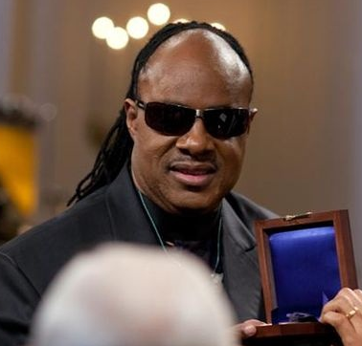


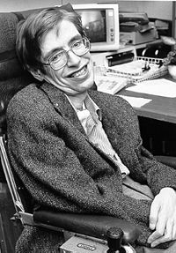


[photos]
Notes:
[@@EOWG action: get more ethnic & geographic diversity]
A primary focus of accessibility is making the web work for people with the widest range of abilities. Including:
* people who cannot move their arms or hands well [image 1] - like Michael J. Fox, an actor, who has Parkinson's
* and people who cannot move them at all [image 2] – like Stephen Hawking, renowned theoretical physicist, who has ALS
* people who are hard of hearing [image 3] – like Pete Townshend, of the rock band The Who
* and who are Deaf [image 4] – like Linda Bove, an actress
* people with cognitive disabilities - like Henry Winkler, known at “The Fonz” and Cher, who have dyslexia [image 5]
* people with low vision and people who are blind [image 6] – like Stevie Wonder, the musician
Accessibility reaches these users.
[introducing next slide:] The number of people who benefit from accessibility is significant.
---
Notes to presenters:
If there are other people with disabilities that your audience is more likely to recognize, respect, or relate to, include them in this slide, and delete those who will resonate less with your audience. Consider, for example, local celebrities or business leaders.
It is often effective to include people with “hidden disabilities” to illustrate that the audiences for accessibility is larger than many people are aware of.
You can find lists of people with disabilities by searching the Web for “famous people with disabilities”; add your audience’s country or ethnicity to the search to get more relevant results.
If you have time, consider telling brief stories about peoples’ accomplishments.
[Images from top left, clockwise: Stevie Wonder, Michael J. Fox, Linda Bove and Henry Winkler, Stephen W. Hawking, Pete Townshend, Cher]
Images sources and permissions:
http://en.wikipedia.org/wiki/File:Petetownshend.jpg
http://en.wikipedia.org/wiki/File:Michael_J_Fox_Tracy_Pollan2.jpeg
http://en.wikipedia.org/wiki/File:Stephen_Hawking.StarChild.jpg
http://en.wikipedia.org/wiki/File:Stephen_Hawking_050506.jpg
http://en.wikipedia.org/wiki/File:Barack_Obama_presents_Stevie_Wonder_with_Gershwin_Award_2-25-09.jpg
http://muppet.wikia.com/wiki/File:Linda-henrywinkler.jpg
http://en.wikipedia.org/wiki/File:Cher_in_Paris,_2006_(2).jpg
Visual note: The slide title is hidden off the slide. It’s there to help presenters, but is not visible to the audience.

Slide 6
[Market quote]
Of computer users age 18 to 64,
57%
benefit from accessible technology
due to difficulties and impairments
— Forrester Research, Inc.
%
Notes:
A Forrester Research study found that among US computer users age 18 to 64, a certain percent are likely to directly or indirectly benefit from accessible technology due to difficulties and impairments that may impact computer use.
Guesses at what percent?
57% (which was 74.2 million in 2003)
Accessibility reaches these users.
---
Quote and statistics source: The Market for Accessible Technology http://www.microsoft.com/enable/research/phase1.aspx
This along with other statistics is linked from Resources for Developing a Web Accessibility Business Case for Your Organization at www.w3.org/WAI/bcase/resources
Although statistics are available for some issues relating to accessibility in other countries, there are few studies that cover the broad range of benefits from accessibility.
Visual note: The slide title is hidden off the slide. It’s there to help presenters, but is not visible to the audience.

Slide 7
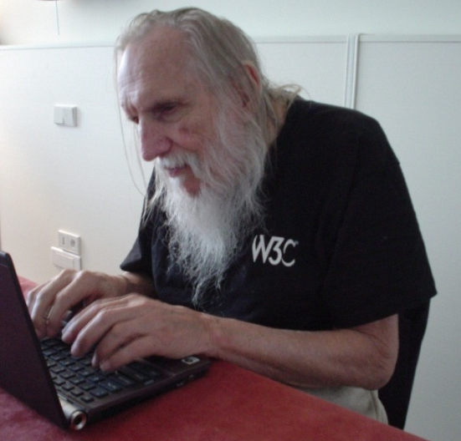
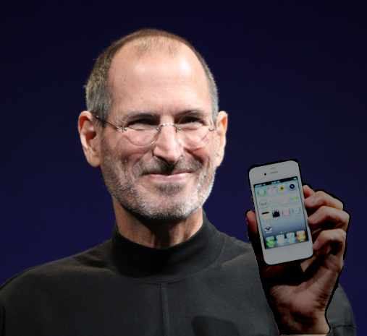
[photo old computer user]
Notes:
Accessibility makes your website work better for older users. For example, many older users need large font and high color contrast in order to read text.
Here’s a photo of William, an 84-year old [@@slh consider flow, maybe add phrase or maybe 2 sentences about embracing computers]
Steve Jobs, Apple CEO, turned 55 in 2010.
More and more older users are using your website on mobile devices.
---
Image 1: Copyright 2008 Shawn Lawton Henry. Permission granted to use for web accessibility presentations, provided you include the copyright notice.
Image 2: Matt Yohe http://en.wikipedia.org/wiki/File:Steve_Jobs_Headshot_2010-CROP.jpg
Visual note: The slide title is hidden off the slide. It’s there to help presenters, but is not visible to the audience.

Slide 8
Aging population, 65+
United Nations globally forecasts
from 7.6% in 2010 to 16.2% in 2050
Europe to 29%
US to 20%
Japan to 40%
Notes:
The UN estimates that the global population of people aged 65 years ands older will grow from 7.6% in 2010 to 16.2% in 2050. The estimates for Europe are 29%; US 20%; and Japan 40% in 2050.
---
UN Reference: Population Division of the Department of Economic and Social Affairs of the United Nations Secretariat - World Population Prospects: The 2008 Revision
http://www.un.org/esa/population/publications/wpp2006/wpp2006.htm
These and other statistics available from "Web Accessibility for Older Users" Presentation available from www.w3.org/WAI/presentations/ageing/
---
Note to presenters: Customize with statistics relevant to your audience. Some other statistics available from "Web Accessibility for Older Users" Presentation available from www.w3.org/WAI/presentations/ageing/
Visual description: There is a chart derived from a spreadsheet that maybe identified as an Excel file. The chart is unlabeled in the slide and generally shows an increase in time.
The chart does not have labels because it is intended to provide a general image, rather than specific data. However, it is derived from the following real data:
Year 2010 7.6% of population will be 65+ years; 1.5% will be 80+ years
Year 2020 9.3% of population will be 65+ years; 1.9% will be 80+ years
Year 2030 11.7% of population will be 65+ years; 2.3% will be 80+ years
Year 2040 14.2% of population will be 65+ years; 3.3% will be 80+ years
Year 2050 16.2% of population will be 65+ years; 4.3% will be 80+ years

Slide 9
Accessibility reaches more users
Notes:
Accessibility helps you reach the expanding market of older people.
[introduction to next slide] Accessibility also helps you reach people without disabilities in many different situations.
---
(For more on this, see “Web Accessibility and Older People: Meeting the Needs of Ageing Web Users” at http://www.w3.org/WAI/older-users/ )
---
Note to presenters: Include http://www.w3.org/WAI/older-users in your handout or other form of providing additional information to attendees.

Slide 10
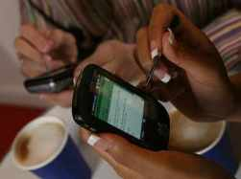
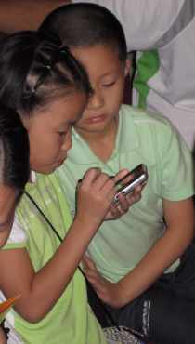
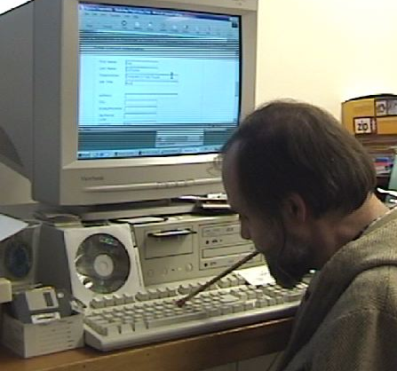
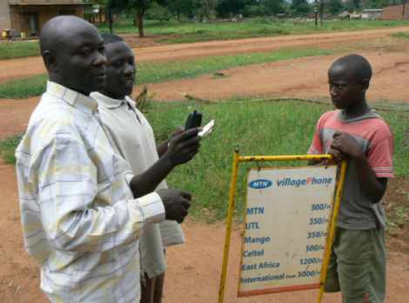
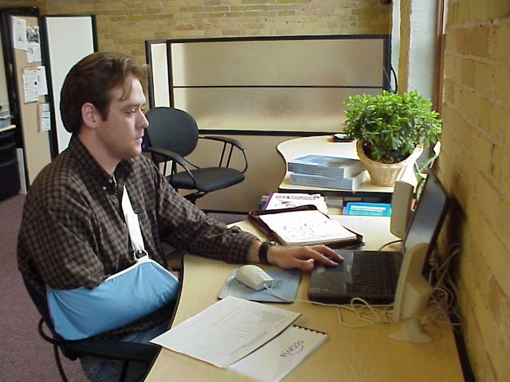
[Reach people in more situations]
Notes:
For example:
[image 1:] Carl uses a mouthstick to type. His arms don’t work because of polio. Carl can use accessible websites without a mouse.
[image 2:] Accessibility also makes it possible for people to use websites effectively without a keyboard. Websites that are accessible work better on mobile devices.
Accessible websites are coded well and therefore will work better with emerging technologies.
[image 3:] Accessible websites work better for new web users, and for infrequent web users.
Accessible website work better for people who are not fluent in the language of the website, and for people of low literacy.
[image 4:] Accessible website work better for people with older hardware, software, and web technologies.
Accessible website work better for people with low bandwidth connections. Low bandwidth and expensive bandwidth is a major factor for many users throughout the world, including in remote areas of developed countries.
[image 5:] Accessible websites work better for people who break their arms, lose their glasses, or have other “temporary disabilities”.
Disabilities can be caused by illness, accident, or disease, and everyone is subject to these throughout their lives.
Accessibility reaches these users.
---
See “Web Content Accessibility and Mobile Web: Making a Web Site Accessible Both for People with Disabilities and for Mobile Devices” at http://www.w3.org/WAI/mobile/
Visual note: The slide title is hidden off the slide. It’s there to help presenters, but is not visible to the audience.
Note to presenters: Include http://www.w3.org/WAI/mobile in your handout or other form of providing additional information to attendees.
Note to presenters: Consider including statistics relevant to your audience; for example, people may be surprised at the number of people with limited bandwidth in their own country.
Image descriptions & copyrights & permissions:
Image 1: Person typing with stick in mouth. Copyright 2000 Shawn Lawton Henry. Permission granted to use for web accessibility presentations, provided you include the copyright notice.
Image 2: Fingernails, stylus, coffee http://www.flickr.com/photos/29881930@N00/2085854035/
Image 3: Kids using stylus on mobile phone. http://www.flickr.com/photos/padday/1477982441/in/photostream/
Image 4: Adults and boy in remote area with old mobile phone. Ken Banks, kiwanja.net, http://www.flickr.com/photos/kiwanja/3170261536/
Image 5: Person at computer with arm in a sling. Copyright 2000 Shawn Lawton Henry. Permission granted to use for web accessibility presentations, provided you include the copyright notice.

Slide 11
Increased usability for all
Web Accessibility Guidelines (WCAG 2.0)
Make text readable and understandable.
Make content appear and operate
in predictable ways.
Help users avoid and correct mistakes.
  Give users enough time to read and use content.
  Help users navigate and find content.
  Make all functionality keyboard accessible.
Notes:
[@@later change to match new at a glance]
Accessibility increases usability for all your potential users. Let’s look at some accessibility guidelines from the Web Content Accessibility Guidelines 2.0. [read slide]
“Power users” after often faster using keyboard shortcuts instead of the mouse. Many older users with limited fine motor control have difficulty using a mouse. And speech input is usually more effective with keyboard commands.
All of these guidelines makes website work better specifically for people with disabilities. And they also improve usability for all users, including those without disabilities.
----
Note to presenters: For short presentations, it might be good to cut this slide.

Slide 12
Web Accessibility is Smart Business
Notes:
Because of all the users accessibility reaches, it is smart business.
Let’s look at a specific example of how accessibility makes websites better.

Slide 13
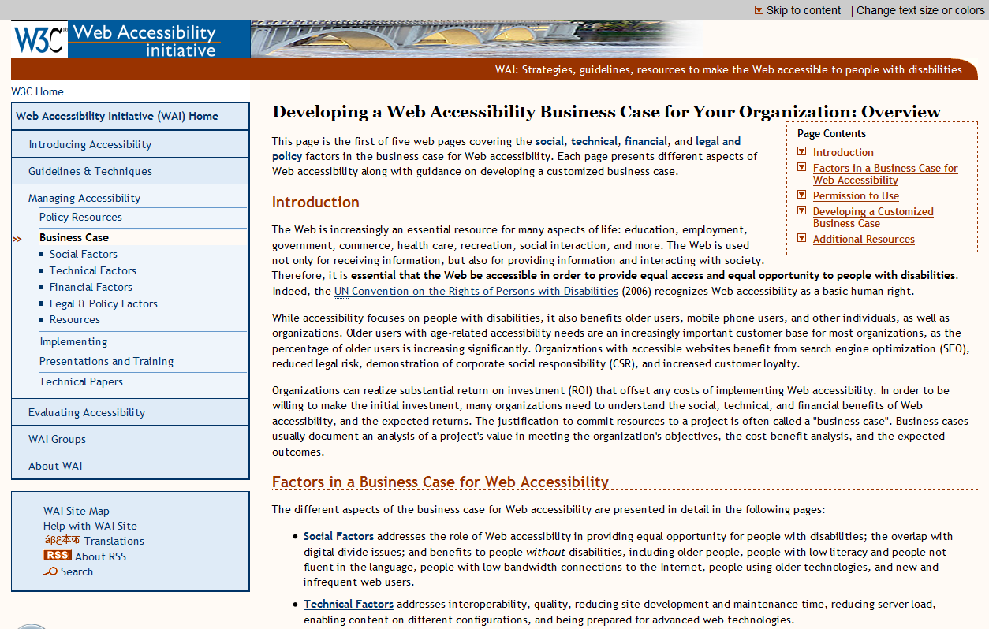

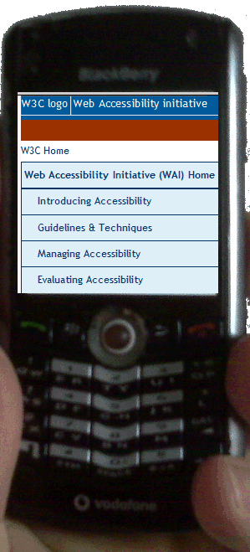
for example: alternative text for images
[@@ instead of a logo, a “Buy Now” button]
Notes:
A basic accessibility requirement is to provide a text alternative for images, buttons, audio, and other non-text content. The text is in the web page code so you usually don’t see it.
In some browsers, you can see the alt text when you hover over an image.
Perhaps you once used the web with a mobile phone that did not display images and so you relied on the alt text. Many people around the world still do.
---
Image 1: screen capture of web page (WAI home page) with logos at top left
Image 2: screen capture of logo image with alt text “Web Accessibility Initiative (WAI) logo” showing from mouse hover
Image 3: mobile phone with web page with alt text “W3C” and ““Web Accessibility Initiative (WAI) logo” from http://www.flickr.com/photos/bearpark/2743790306/

Slide 14
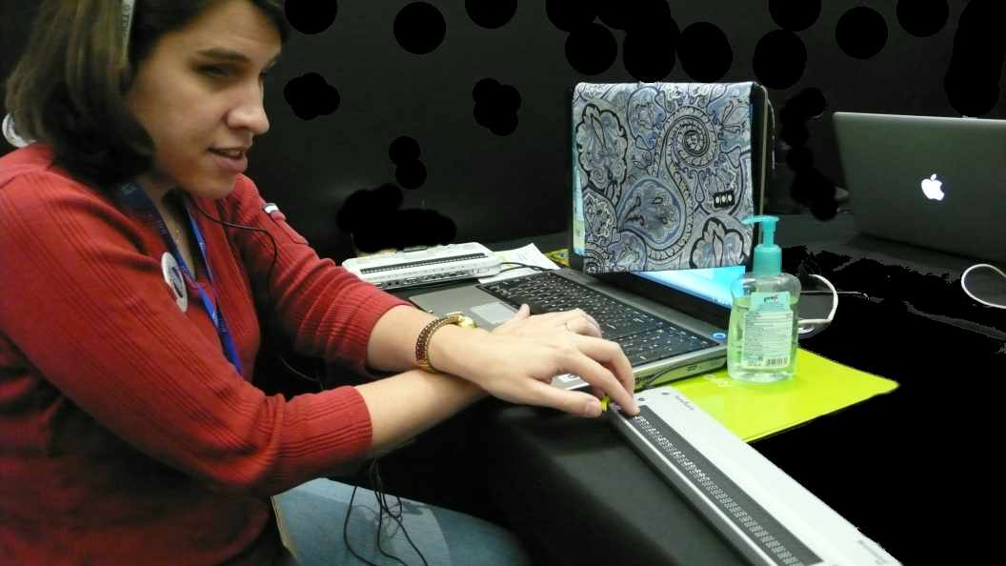
Alternative text usage
Notes:
Screen readers read aloud information from the web page. They are used by people who are blind, people with dyslexia, and others.
People who are blind and also deaf can get the information from the screen reader through a dynamic braille display.
Screen readers can’t tell what an image is. Instead, they read the alternative text for the visual image.
---
Image: [@@ref ask for permission to use photo, from photographer & Desiree http://www.flickr.com/photos/swiss-miss/3362181125 OR use one from Sharron]

Slide 15
Alternative text benefits
People who
are blind, blind and deaf
turn off images to lower bandwidth charges
in a rural area with low bandwidth who turned off images to speed download
… and …
Technologies that can’t see images, such as search engines. SEO
Notes:
There are many benefits to alternative text benefits: [read slide]
---
Image: dynamic braille display http://en.wikipedia.org/wiki/File:Refreshable_Braille_display.jpg

Slide 16
Search Engine Optimization
Make sure that your <title> elements and
ALT attributes are descriptive and accurate.
Make a site with a clear hierarchy and text links.
Offer a site map to your users...
Keep the links to a reasonable number.
Write pages that clearly and accurately
describe your content.
Try to use text instead of images
to display important names, content, or links.
Check for broken links and correct HTML.
Notes:
Improving accessibility improves search engine optimization.
For example, here are Google’s Design and content guidelines; Google tells webmasters: “Following these guidelines will help Google find, index, and rank your site.”
[read guidelines]
Do these sound familiar? Each of these is a best practice for accessibility.
Accessibility helps you reach more users through search engines.
---
From: http://www.google.com/support/webmasters/bin/answer.py?hl=en&answer=35769#1
Note to presenters: For short presentations, it might be good to cut this slide.

Slide 17
OK . . . but what does it cost?
Notes:
[read slide]
Of course it depends on your situation. @@HERE@@
[@@ change that there is some cost – although some things are fairly low cost.
MAYBE YOU”RE ALREADY doing some of these things! Especially if you’re already doing usability. Or if you have good coders that are already following best practices for code markup. :-)
Some low cost, and once ... once it's folded into your development tools and practice/process, then minimized... Also if doing from beginning of projects.
Maybe point to business case section on how to minimize costs.]
---
In some cases the basics of accessibility cost essentially nothing.
Many aspects of accessibility are technically simple.

Slide 18

Technically simple
Provide alt text
Markup headings, lists, form elements, tables
Use good page titles, good link wording
Use sufficient color contrast, color coding
Don’t cause seizures
Enable keyboard access (without the mouse)
…
Notes:
If your authoring tool supports accessibility, these things are relatively easy to do: [read slide text]. If you do them when the web page is being developed or redesigned, it will take a miniscule amount of additional time.
There is some initial investment in training designers, developers, and content authors to do these things. And if you need to upgrade to an authoring tool that supports accessibility, that would require some capital investment.
---
[decorative image: mouse with red X over it]

Slide 19
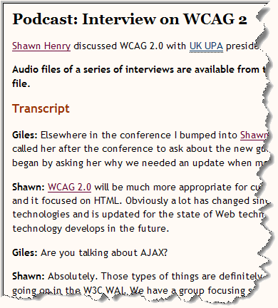
Transcripts for audio (podcasts, videos)
Notes:
[@@SAZ has problems with this first sentence] Only a few aspects of accessibility require ongoing costs. Providing transcripts and captions for audio and video is one of those. [@@SAZ likes this:]However, even that costs way less than most people assume. For example, you can get good transcripts for less than $1.00 UCD per minute of audio.
And the return on that investment is clear.
---
Reference for “less than $1.00 UCD per minute of audio”: Transcription Services
http://www.uiaccess.com/transcripts/transcript_services.html
Note to presenters:
[decorative image: part of transcript]

Slide 20
Transcripts for audio (podcasts, videos)
Cost: often less than $1.00/minute of audio
Benefits:
  People who might not listen to the audio or watch the video – deaf or hard of hearing, busy, language, bandwidth, environment, …
  More traffic to your info, e.g., SEO –
  search engines can index the transcript,
  not the audio or video
— Transcripts on the Web: Getting people to your podcasts and videos
Notes:
There are many benefits of transcripts:
With a transcript, you’ll get people who might not listen to the audio or watch the video:
People who are deaf or hard of hearing.
People who won't spend the time to listen to the audio or watch the video, but will skim a transcript.
People who have difficulty processing auditory information, for example, because of cognitive disability.
People who are not proficient in the language who find it easier to read than listen.
People with low bandwidth connections who don't want to download the larger audio or video file.
People who pay for bandwidth usage and thus don't want to download the larger audio or video file. This is often an issue with phones and other mobile devices.
People who cannot play the audio because they are in a noisy environment and they can't hear it.
People who cannot play the audio because they are in a quiet environment and they don't want to disturb others.
Accessibility with transcripts reaches these users.
And you’ll get more traffic to your info:
SEO - search engine optimization. Search engines can index the transcript, not the audio or video.
It's easier for people to link to a transcript than some audio or video files.
It's easier for people to pull a quote from a text file than try to create one from the audio or video.
---
From Transcripts on the Web: Getting people to your podcasts and videos
www.uiaccess.com/transcripts/transcripts_on_the_web.html
[decorative image: part of transcript]

Slide 21
[SEO example]
We saw a significant increase in SEO referrals when we launched… transcripts.
CNET captioning video drove
30% increase in Google hits
Notes:
For example, Justin Eckhouse of CNET said: “We saw a significant increase in SEO referrals when we launched an HTML version of our site, the major component of which was our transcripts.” CNET’s captioning video drove a reported 30% increase in Google hits.
Accessibility with transcripts reaches users through search engines.
---
Quote 1: Resources for Developing a Web Accessibility Business Case for Your Organization www.w3.org/WAI/bcase/resources
Quote 2: Pat Brogan & Kevin Erler http://teachingcommons.cdl.edu/access/docs_multi/documents/CaptioningExperts.ppt
Visual note: The slide title is hidden off the slide. It’s there to help presenters, but is not visible to the audience.

Slide 22
OK ! …How do we do it?
A few tips . . .
Notes:
[@@slh update now that costs are inbetween benefits]
These are just some of many benefits to accessibility and some of the reasons investment in accessibility yields high returns.
Reasons enough that accessibility is smart business. Want to do it now?
A few tips…

Slide 23
[Tips]
Include accessibility from the very beginning of any project – in project requirements, procurement, usability, graphic design, SEO, . . .
Ensure authoring tools meet ATAG 2.0
Make WCAG 2.0 Level AA a clear requirement, including when procuring websites
Include real users throughout development process
When updating, include current best practices
Use resources from www.w3.org/WAI/
Notes:
Include accessibility from the very beginning of any project – in project requirements, procurement, usability, graphic design, SEO, . . .
Ensure authoring tools meet ATAG 2.0. Check out websites developed with the tool, evaluate templates in content management systems, etc…
Make WCAG 2.0 Level AA a clear requirement, including when procuring websites. When checking out potential website developers, check out how accessible their previous work is.
Include real users throughout your development process – including people with disabilities.
When updating, include current best practices. Whenever you do update your website, take a look at current best practices for accessibility.
Use resources from www.w3.org/WAI/ There you’ll find all sorts of helpful information such as: Improving the Accessibility of Your Website, Implementation Plan for Web Accessibility, Developing Organizational Policies on Web Accessibility, and Involving Users in Web Projects for Better, Easier Accessibility.
These tips and resources help you maximize the benefits and realize the high returns from web accessibility.
---
Visual note: The slide title is hidden off the slide. It’s there to help presenters, but is not visible to the audience.

Slide 24
[L&G quote]
Doubled the number of visitors seeking quotes and buying financial products online,
cut maintenance costs by two thirds,
increased natural search traffic by 50%.
— Caroline Fawcett,
Legal & General Group (L&G)
Customer Experience Director
Notes:
For example, when the Legal & General Group (L&G) updated their website to be accessible, they saw significant increase in conversion rate and SEO. Their Customer Experience Director said [read slide].
Imagine what your numbers could be…
---
Quote source: www.w3.org/WAI/bcase/legal-and-general-case-study
Visual note: The slide title is hidden off the slide. It’s there to help presenters, but is not visible to the audience.

Slide 25
Your Own Business Case www.w3.org/WAI/bcase
  Social factors 
  Financial factors 
  Technical factors 
  Legal & policy factors 
  Resources – statistics, case studies 
Notes:
To learn more about this, check out WAI’s business case document. It presents benefits and costs of web accessibility, and includes guidance on incorporating these factors into a specific organization's business case.
Social factors
Essential for Equal Opportunity
Digital divide
CSR corporate social responsibility
Financial factors
Increases potential use by more people, expands potential market share
Increases findability with search engine optimization (SEO)
Increases potential use in more situations
Increases usability
Increases positive image
Direct Cost Savings
Decreases potential for high legal expenses
Decreases cost of alternative format materials
Decreases cost of translating
Decreases personnel costs
technical factors
Technical factors
Reduce Site Development and Maintenance Time
Reduce Bandwidth Use and Server Load
Enable Content on Different Configurations
Be Prepared for Advanced Web Technologies
Have High Quality Websites
Legal and policy factors
Risk of significant legal costs
Risk of negative impact on the organization's reputation
Resources
Case Studies of Accessibility Improvements
Statistics on People with Disabilities and Web Use
Accessibility Improving Search Engine Optimization
Example for ROI calculations
Cautionary Tales of Inaccessibility – examples of lawsuits
Soon you too can be realizing the many benefits of web accessibility.

Slide 26
Source Material
Web Accessibility Initiative (WAI)
Web Accessibility is Smart Business.
Shawn Lawton Henry, ed.
Copyright © 2010 W3C® (MIT, ERCIM, Keio).
www.w3.org/WAI/presentations/
bcase/Overview
Notes:
Note that this presentation is based on material provided by the W3C Web Accessibility Initiative (WAI) Education and Outreach Working Group.
---
Note to presenters: Remember to credit this presentation as source material for your presentation, as described at www.w3.org/WAI/presentations/#permission and www.w3.org/WAI/presentations/bcase/#permission
In handouts, include the reference:
This presentation is based on slides from the Web Accessibility Initiative (WAI): Web Accessibility is Smart Business. Shawn Lawton Henry, ed. Copyright © 2010 W3C® (MIT, ERCIM, Keio). Status: DRAFT Updated August 2010. www.w3.org/WAI/presentations/bcase/Overview

Slide 27
About this presentation
Please read carefully the
Instructions for the "Web Accessibility is Smart Business" Presentation at www.w3.org/WAI/presentations/Web_Accessibility_Introduction
for an introduction, tips, and permission to use.
Please send any feedback and suggestions for improving these presentation materials to
wai-eo-editors@w3.org
Copyright © 2010 W3C® (MIT, ERCIM, Keio)
See www.w3.org/Consortium/Legal/ipr-notice
Notes:
[slide is hidden in some software so it will not display]

