Slide 1
Tutorial on Semantic Web
Ivan Herman, W3C
Last update: 2012-04-09
Notes:
This is just a generic slide set. Should be adapted, reviewed, possibly with slides removed, for a specific event. Rule of thumb: on the average, a slide is a minute…

Slide 2
WARNING TO THE READER!
This is an evolving slide set. This means:
  it changes frequently
  there may be bugs, inconsistencies
  it may try to reflect the latest view of technology evolution but that is often a moving target
“Frozen” versions are instantiated for a specific presentation, and those become stable

Slide 3
Introduction

Slide 4
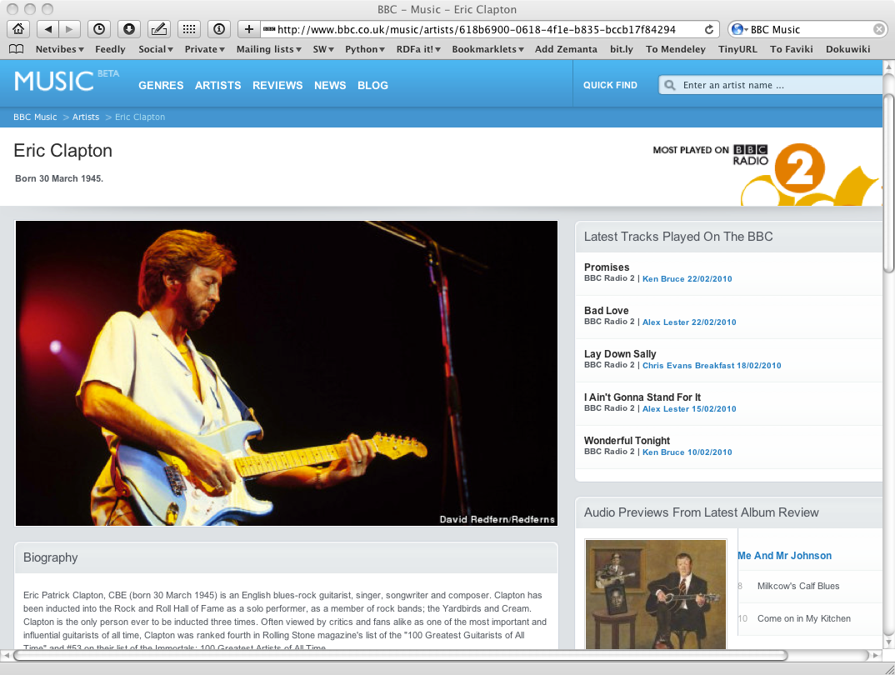

Slide 5
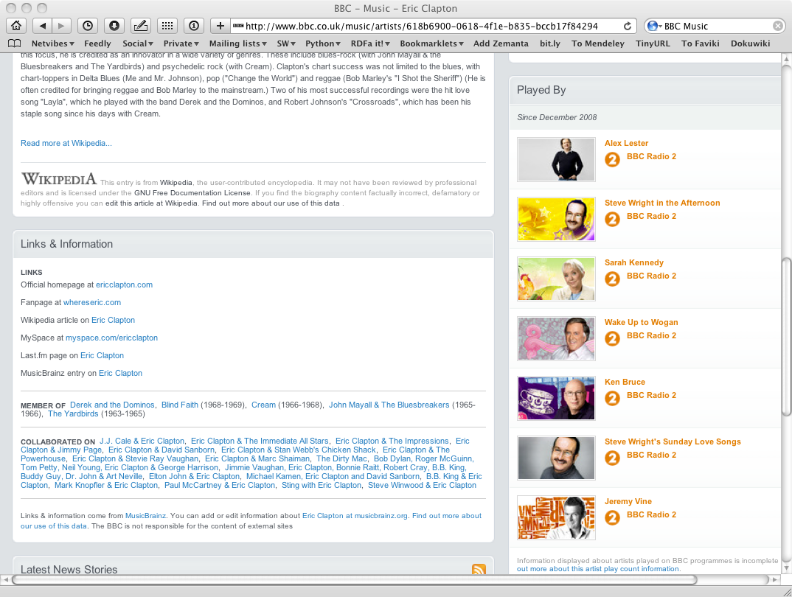

Slide 6
How to build such a site 1.
Site editors roam the Web for new facts
  may discover further links while roaming
They update the site manually
And the site gets soon out-of-date ☹

Slide 7
How to build such a site 2.
Editors roam the Web for new data published on Web sites
“Scrape” the sites with a program to extract the information
  Ie, write some code to incorporate the new data
Easily get out of date again… ☹

Slide 8
How to build such a site 3.
Editors roam the Web for new data via API-s
Understand those…
  input, output arguments, datatypes used, etc
Write some code to incorporate the new data
Easily get out of date again… ☹

Slide 9
The choice of the BBC
Use external, public datasets
  Wikipedia, MusicBrainz, …
They are available as data
  not API-s or hidden on a Web site
  data can be extracted using, e.g., HTTP requests or standard queries

Slide 10
In short…
Use the Web of Data as a Content Management System
Use the community at large as content editors

Slide 11
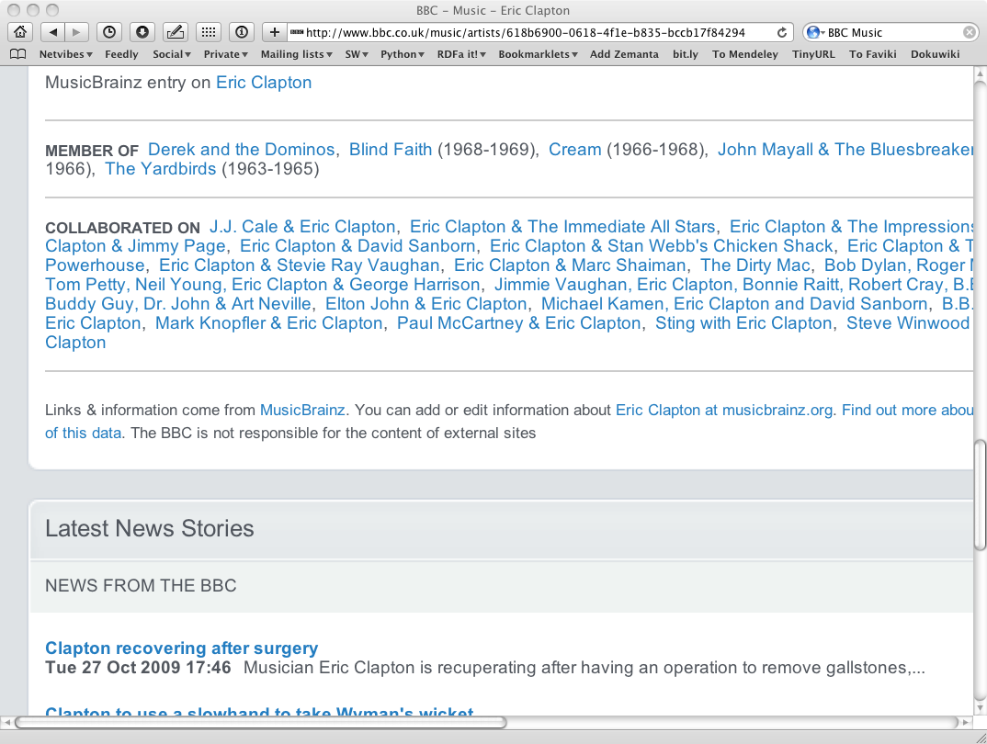
And this is no secret…

Slide 12
Data on the Web
There are more an more data on the Web
  government data, health related data, general knowledge, company information, flight information, restaurants,…
More and more applications rely on the availability of that data

Slide 13
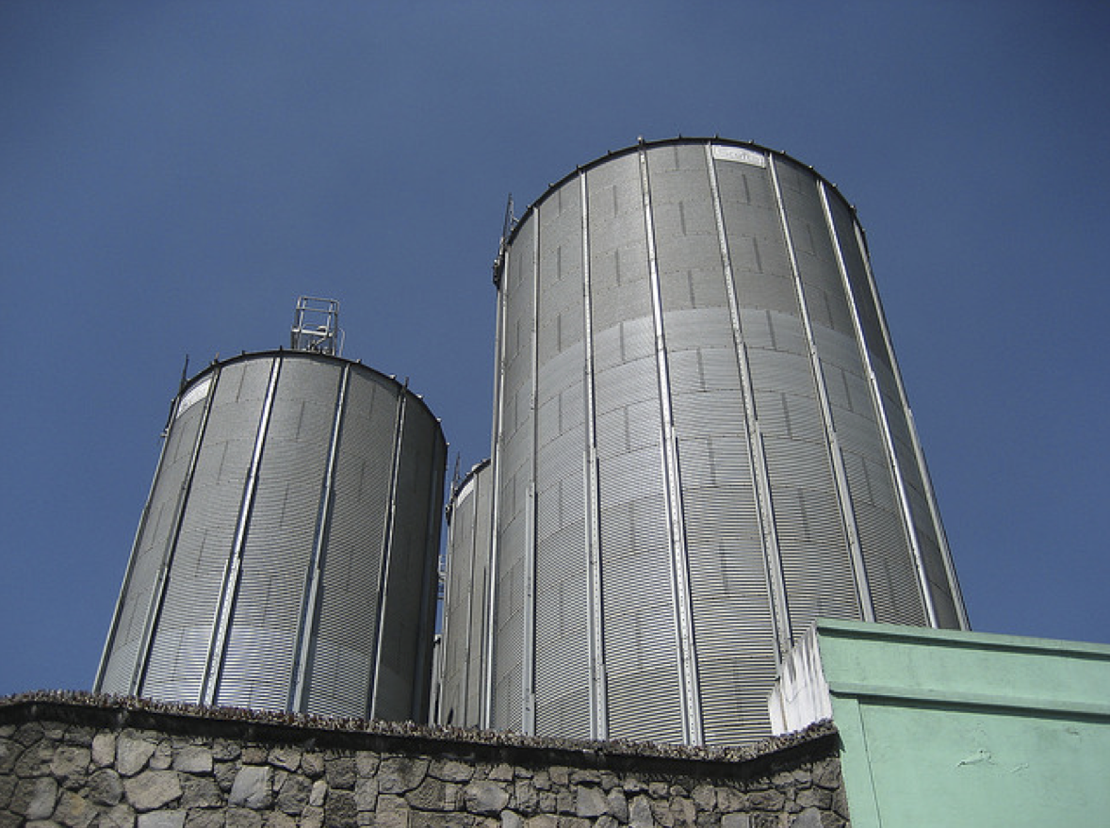
But: we do not want that!
Photo credit “nepatterson”, Flickr

Slide 14
Imagine…
A “Web” where
  documents are available for download on the Internet
  but there would be no hyperlinks among them

Slide 15
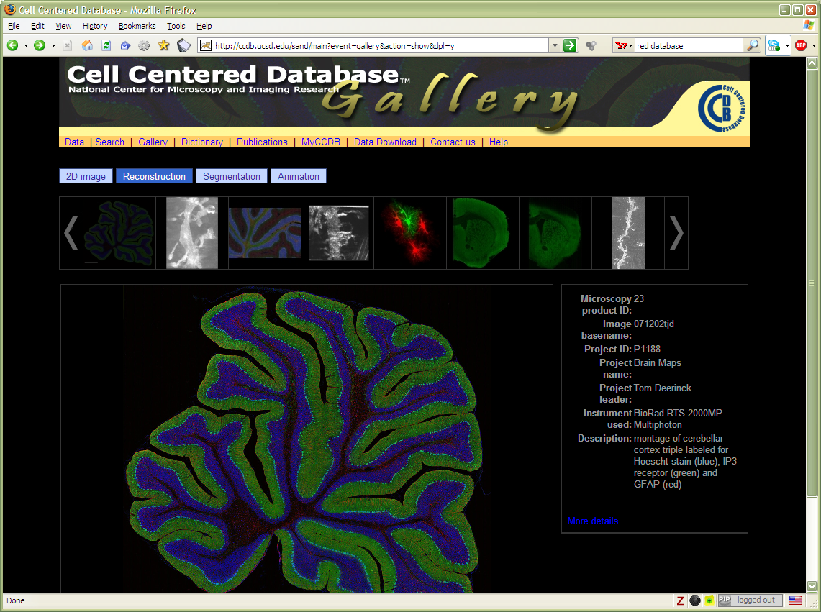
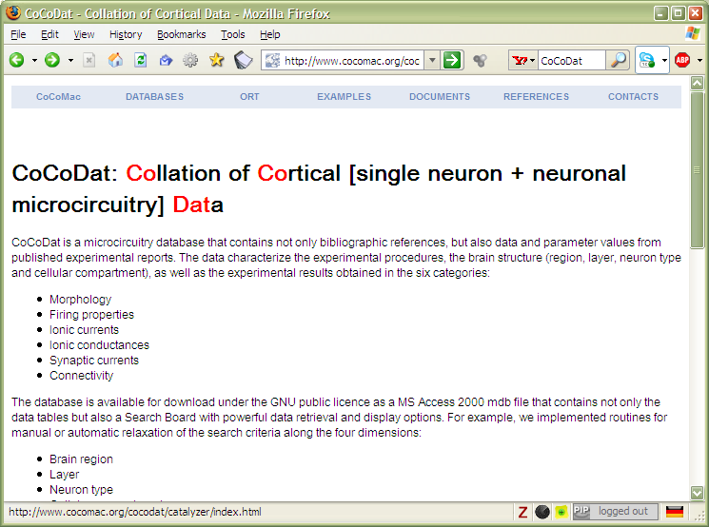
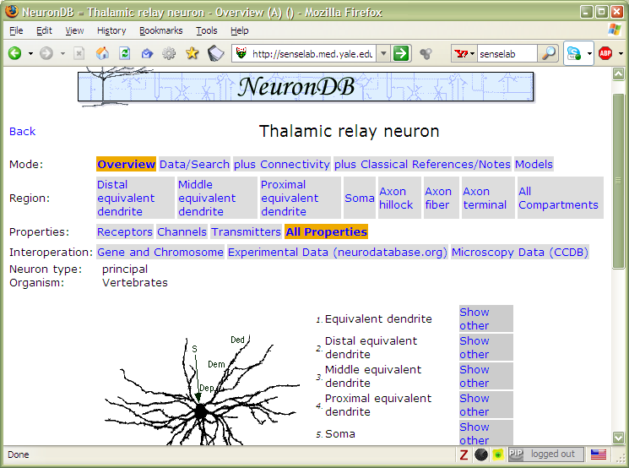

Slide 16
Data on the Web is not enough…
We need a proper infrastructure for a real Web of Data
  data is available on the Web
    accessible via standard Web technologies
  data are interlinked over the Web
  ie, data can be integrated over the Web
This is where Semantic Web technologies come in

Slide 17
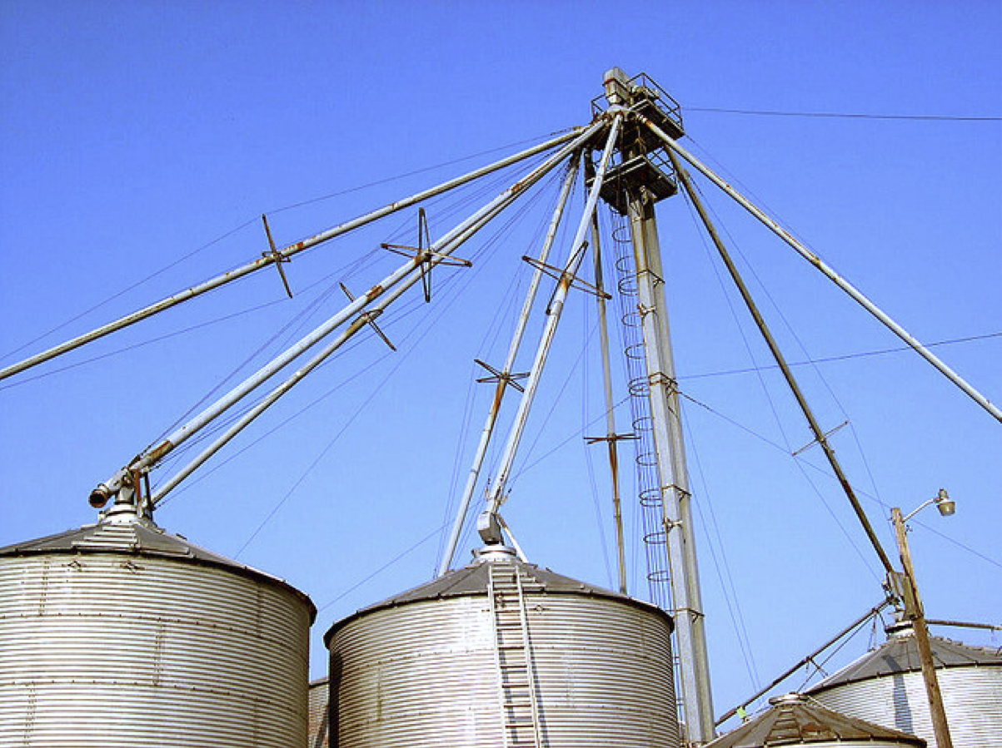
This is what we want!
Photo credit “kxlly”, Flickr

Slide 18
In what follows…
We will use a simplistic example to introduce the main Semantic Web concepts

Slide 19
The rough structure of data integration
Map the various data onto an abstract data representation
  make the data independent of its internal representation…
Merge the resulting representations
Start making queries on the whole!
  queries not possible on the individual data sets

Slide 20


Slide 21
A simplified bookstore data
(dataset “A”)
ISBN | Author | Title | Publisher | Year
0006511409X | id_xyz | The Glass Palace | id_qpr | 2000
ID | Name | Homepage
id_xyz | Ghosh, Amitav | http://www.amitavghosh.com
ID | Publisher’s name | City
id_qpr | Harper Collins | London

Slide 22
1st: export your data as a set of relations
a:title
The Glass Palace
http://…isbn/000651409X
2000
a:year
a:publisher
London
a:city
a:author
Harper Collins
a:p_name
a:name
a:homepage
Ghosh, Amitav
http://www.amitavghosh.com

Slide 23
Some notes on the exporting the data
Relations form a graph
  the nodes refer to the “real” data or contain some literal
  how the graph is represented in machine is immaterial for now

Slide 24


Slide 25
Another bookstore data
(dataset “F”)
 | A | B | C | D
1 | ID | Titre | Traducteur | Original
2 | ISBN 2020286682 | Le Palais des Miroirs | $A12$ | ISBN 0-00-6511409-X
3
4
5
6 | ID | Auteur
7 | ISBN 0-00-6511409-X | $A11$
8
9
10 | Nom
11 | Ghosh, Amitav
12 | Besse, Christianne

Slide 26
2nd: export your second set of data
http://…isbn/000651409X
Le palais des miroirs
f:original
f:titre
f:auteur
http://…isbn/2020386682
f:traducteur
f:nom
f:nom
Ghosh, Amitav
Besse, Christianne

Slide 27
3rd: start merging your data
The Glass Palace
a:title
http://…isbn/000651409X
2000
a:year
a:city
a:publisher
London
Harper Collins
a:p_name
a:author
a:name
http://…isbn/000651409X
a:homepage
f:original
Le palais des miroirs
Ghosh, Amitav
http://www.amitavghosh.com
f:titre
f:auteur
http://…isbn/2020386682
f:traducteur
f:nom
Ghosh, Amitav
f:nom
Besse, Christianne

Slide 28
3rd: start merging your data (cont)
The Glass Palace
a:title
http://…isbn/000651409X
2000
a:year
a:publisher
Same URI!
London
a:city
Harper Collins
a:p_name
a:author
a:name
http://…isbn/000651409X
a:homepage
f:original
Le palais des miroirs
Ghosh, Amitav
http://www.amitavghosh.com
f:titre
f:auteur
http://…isbn/2020386682
f:traducteur
f:nom
Ghosh, Amitav
f:nom
Besse, Christianne

Slide 29
3rd: start merging your data
The Glass Palace
a:title
http://…isbn/000651409X
2000
a:year
a:city
a:publisher
London
Harper Collins
a:p_name
a:author
f:original
a:name
f:auteur
a:homepage
Le palais des miroirs
Ghosh, Amitav
http://www.amitavghosh.com
f:titre
http://…isbn/2020386682
f:traducteur
f:nom
Ghosh, Amitav
f:nom
Besse, Christianne

Slide 30
Start making queries…
User of data “F” can now ask queries like:
  “give me the title of the original”
    well, … « donnes-moi le titre de l’original »
This information is not in the dataset “F”…
…but can be retrieved by merging with dataset “A”!

Slide 31
However, more can be achieved…
We “feel” that a:author and f:auteur should be the same
But an automatic merge doest not know that!
Let us add some extra information to the merged data:
  a:author same as f:auteur
  both identify a “Person”
  a term that a community may have already defined:
    a “Person” is uniquely identified by his/her name and, say, homepage
    it can be used as a “category” for certain type of resources

Slide 32
3rd revisited: use the extra knowledge
The Glass Palace
a:title
http://…isbn/000651409X
2000
a:year
f:original
Le palais des miroirs
a:publisher
f:titre
London
a:city
Harper Collins
a:p_name
a:author
http://…isbn/2020386682
f:auteur
r:type
f:traducteur
a:name
http://…foaf/Person
r:type
f:nom
a:homepage
f:nom
Besse, Christianne
Ghosh, Amitav
http://www.amitavghosh.com

Slide 33
Start making richer queries!
User of dataset “F” can now query:
  “donnes-moi la page d’accueil de l’auteur de l’original”
    well… “give me the home page of the original’s ‘auteur’”
The information is not in datasets “F” or “A”…
…but was made available by:
  merging datasets “A” and datasets “F”
  adding three simple extra statements as an extra “glue”

Slide 34
Combine with different datasets
Using, e.g., the “Person”, the dataset can be combined with other sources
For example, data in Wikipedia can be extracted using dedicated tools
  e.g., the “dbpedia” project can extract the “infobox” information from Wikipedia already…

Slide 35
Merge with Wikipedia data
The Glass Palace
a:title
http://…isbn/000651409X
2000
a:year
f:original
Le palais des miroirs
a:publisher
f:titre
London
a:city
Harper Collins
a:p_name
a:author
http://…isbn/2020386682
f:auteur
r:type
f:traducteur
a:name
http://…foaf/Person
r:type
f:nom
a:homepage
r:type
f:nom
Besse, Christianne
Ghosh, Amitav
http://www.amitavghosh.com
foaf:name
w:reference
http://dbpedia.org/../Amitav_Ghosh

Slide 36
Merge with Wikipedia data
The Glass Palace
a:title
http://…isbn/000651409X
2000
a:year
f:original
Le palais des miroirs
a:publisher
f:titre
London
a:city
Harper Collins
a:p_name
a:author
http://…isbn/2020386682
f:auteur
r:type
f:traducteur
a:name
http://…foaf/Person
r:type
f:nom
a:homepage
r:type
f:nom
w:isbn
Besse, Christianne
Ghosh, Amitav
http://www.amitavghosh.com
foaf:name
w:reference
http://dbpedia.org/../The_Glass_Palace
w:author_of
http://dbpedia.org/../Amitav_Ghosh
w:author_of
http://dbpedia.org/../The_Hungry_Tide
w:author_of
http://dbpedia.org/../The_Calcutta_Chromosome

Slide 37

Merge with Wikipedia data
The Glass Palace
a:title
http://…isbn/000651409X
2000
a:year
f:original
Le palais des miroirs
a:publisher
f:titre
London
a:city
Harper Collins
a:p_name
a:author
http://…isbn/2020386682
f:auteur
r:type
f:traducteur
a:name
http://…foaf/Person
r:type
f:nom
a:homepage
r:type
f:nom
w:isbn
Besse, Christianne
Ghosh, Amitav
http://www.amitavghosh.com
foaf:name
w:reference
http://dbpedia.org/../The_Glass_Palace
w:author_of
http://dbpedia.org/../Amitav_Ghosh
w:born_in
w:author_of
http://dbpedia.org/../Kolkata
http://dbpedia.org/../The_Hungry_Tide
w:long
w:lat
w:author_of
http://dbpedia.org/../The_Calcutta_Chromosome

Slide 38
Is that surprising?
It may look like it but, in fact, it should not be…
What happened via automatic means is done every day by Web users!
The difference: a bit of extra rigour so that machines could do this, too

Slide 39
It could become even more powerful
We could add extra knowledge to the merged datasets
  e.g., a full classification of various types of library data
  geographical information
  etc.
This is where ontologies, extra rules, etc, come in
  ontologies/rule sets can be relatively simple and small, or huge, or anything in between…
Even more powerful queries can be asked as a result

Slide 40

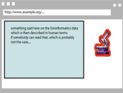


What did we do?
Applications
Manipulate
Query
…
Map,
Expose,
…
Data represented in abstract format
Data in various formats

Slide 41

What did we do? (alternate view)
Web of Data Applications
Stand Alone Applications
Browser Applications
Query and Update
Common “Graph” Format &
Common Vocabularies
Inferencing
“Bridges”
Data on the Web

Slide 42
The abstraction pays off because…
… the graph representation is independent of the exact structures
… a change in local database schema’s, XHTML structures, etc, do not affect the whole
  “schema independence”
… new data, new connections can be added seamlessly

Slide 43
The network effect
Through URI-s we can link any data to any data
The “network effect” is extended to the (Web) data
“Mashup on steroids” become possible

Slide 44
So where is the Semantic Web?
The Semantic Web provides technologies to make such integration possible!
Hopefully you get a full picture at the end of the tutorial…

Slide 45

The Basis: RDF

Slide 46
RDF triples
Let us begin to formalize what we did!
  we “connected” the data…
  but a simple connection is not enough… data should be named somehow
  hence the RDF Triples: a labelled connection between two resources

Slide 47
RDF triples (cont.)
An RDF Triple (s,p,o) is such that:
  “s”, “p” are URI-s, ie, resources on the Web; “o” is a URI or a literal
    “s”, “p”, and “o” stand for “subject”, “property”, and “object”
  here is the complete triple:
(<http://…isbn…6682>, <http://…/original>, <http://…isbn…409X>)
RDF is a general model for such triples (with machine readable formats like RDF/XML, Turtle, N3, RDFa, Json, …)

Slide 48
RDF triples (cont.)
RDF triples are also referred to as “triplets”, or “statements”
The “p” is sometimes referred to as “predicate”

Slide 49
RDF triples (cont.)
Resources can use any URI
  http://www.example.org/file.html#home
  http://www.example.org/f.xml#xpath(//q[@a=b])
  http://www.example.org/form?a=b&c=d
RDF triples form a directed, labeled graph (the best way to think about them!)

Slide 50
A simple RDF example (in RDF/XML)
http://…isbn/2020386682
f:titre
f:original
http://…isbn/000651409X
Le palais des miroirs
<rdf:Description rdf:about="http://…/isbn/2020386682">
<f:titre xml:lang="fr">Le palais des mirroirs</f:titre>
<f:original rdf:resource="http://…/isbn/000651409X"/>
</rdf:Description>
(Note: namespaces are used to simplify the URI-s)

Slide 51
A simple RDF example (in Turtle)
http://…isbn/2020386682
f:titre
f:original
http://…isbn/000651409X
Le palais des miroirs
<http://…/isbn/2020386682>
f:titre "Le palais des mirroirs"@fr ;
f:original <http://…/isbn/000651409X> .

Slide 52
A simple RDF example (in RDFa)
http://…isbn/2020386682
f:titre
f:original
http://…isbn/000651409X
Le palais des miroirs
<p about="http://…/isbn/2020386682">The book entitled
“<span property="f:title" lang="fr">Le palais des mirroirs</span>”
is the French translation of the
“<span rel="f:original" resource="http://…/isbn/000651409X">Glass
Palace</span>”</p> .

Slide 53
URI-s play a fundamental role
URIs made the merge possible
URIs ground RDF into the Web
  information can be retrieved using existing tools
  this makes the “Semantic Web”, well… “Semantic Web”

Slide 54
RDF/XML principles
http://…isbn/2020386682
f:titre
f:original
http://…isbn/000651409X
Le palais des miroirs
Encode nodes and edges as elements or literals:
«Element for http://…/isbn/2020386682»
«Element for original»
«Element for http://…/isbn/000651409X»
«/Element for original»
«/Element for http://…/isbn/2020386682»
«Element for http://…/isbn/2020386682»
«Element for titre»
Le palais des mirroirs
«/Element for titre»
«/Element for http://…/isbn/2020386682»

Slide 55
RDF/XML principles (cont.)
http://…isbn/2020386682
f:titre
f:original
http://…isbn/000651409X
Le palais des miroirs
Encode the resources (i.e., the nodes):
<rdf:RDF xmlns:rdf="http://www.w3.org/1999/02/22-rdf-syntax-ns#">
<rdf:Description rdf:about="http://…/isbn/2020386682">
«Element for original»
<rdf:Description rdf:about="http://…/isbn/000651409X"/>
«/Element for f:original»
</rdf:Description>
<rdf:RDF>

Slide 56
RDF/XML principles (cont.)
http://…isbn/2020386682
f:titre
f:original
http://…isbn/000651409X
Le palais des miroirs
Encode the properties (i.e., edges) in their own namespaces:
<rdf:RDF xmlns:rdf="http://www.w3.org/1999/02/22-rdf-syntax-ns#"
xmlns:f="http://www.editeur.fr"">
<rdf:Description rdf:about="http://…/isbn/2020386682">
<f:original>
<rdf:Description rdf:about="http://…/isbn/000651409X"/>
</f:original>
</rdf:Description>
<rdf:RDF>

Slide 57
Examples of RDF/XML “simplifications”
Object references can be put into attributes
Several properties on the same resource
<rdf:Description rdf:about="http://…/isbn/2020386682">
<f:original rdf:resource="http://…/isbn/000651409X"/>
<f:titre>
Le palais des mirroirs
</f:titre>
</rdf:Description>
There are other “simplification rules”, see the “RDF/XML Serialization” document for details

Slide 58
“Internal” nodes
Consider the following statement:
  “the publisher is a «thing» that has a name and an address”
Until now, nodes were identified with a URI. But…
…what is the URI of «thing»?
London
a:city
a:publisher
http://…isbn/000651409X
Harper Collins
a:p_name

Slide 59
One solution: create an extra URI
The resource will be “visible” on the Web
  care should be taken to define unique URI-s
<rdf:Description rdf:about="http://…/isbn/000651409X">
<a:publisher rdf:resource="urn:uuid:f60ffb40-307d-…"/>
</rdf:Description>
<rdf:Description rdf:about="urn:uuid:f60ffb40-307d-…">
<a:p_name>HarpersCollins</a:p_name>
<a:city>HarpersCollins</a:city>
</rdf:Description>

Slide 60
Internal identifier (“blank nodes”)
<rdf:Description rdf:about="http://…/isbn/000651409X">
<a:publisher rdf:nodeID="A234"/>
</rdf:Description>
<rdf:Description rdf:nodeID="A234">
<a:p_name>HarpersCollins</a:p_name>
<a:city>HarpersCollins</a:city>
</rdf:Description>
<http://…/isbn/2020386682> a:publisher _:A234.
_:A234 a:p_name "HarpersCollins".
Internal = these resources are not visible outside
London
a:city
a:publisher
http://…isbn/000651409X
Harper Collins
a:p_name

Slide 61
Blank nodes: the system can do it
Let the system create a “nodeID” internally (you do not really care about the name…)
<rdf:Description rdf:about="http://…/isbn/000651409X">
<a:publisher>
<rdf:Description>
<a:p_name>HarpersCollins</a:p_name>
…
</rdf:Description>
</a:publisher>
</rdf:Description>
London
a:city
a:publisher
http://…isbn/000651409X
Harper Collins
a:p_name

Slide 62
Same in Turtle
<http://…/isbn/000651409X> a:publisher [
a:p_name "HarpersCollins";
…
].
London
a:city
a:publisher
http://…isbn/000651409X
Harper Collins
a:p_name

Slide 63
More on blank nodes
Blank nodes require attention when merging
  blanks nodes with identical nodeID-s in different graphs are different
  implementations must be careful…
Many applications prefer not to use blank nodes and define new URIs “on-the-fly”
From a logic point of view, blank nodes represent an “existential” statement
  “there is a resource such that…”

Slide 64
RDF in programming practice
For example, using Python+RDFLib:
  a “Graph” object is created
  the RDF file is parsed and results stored in the Graph
  the Graph offers methods to retrieve (or add):
    triples
    (property,object) pairs for a specific subject
    (subject,property) pairs for specific object
    etc.
  the rest is conventional programming…
Similar tools exist in Java, PHP, etc.

Slide 65
Python example using RDFLib
# create a graph from a file
graph = rdflib.Graph()
graph.parse("filename.rdf", format="rdfxml")
# take subject with a known URI
subject = rdflib.URIRef("URI_of_Subject")
# process all properties and objects for this subject
for (s,p,o) in graph.triples((subject,None,None)) :
do_something(p,o)

Slide 66
Merge in practice
Environments merge graphs automatically
  e.g., in Python+RDFLib, the Graph can load several files
  the load merges the new statements automatically

Slide 67
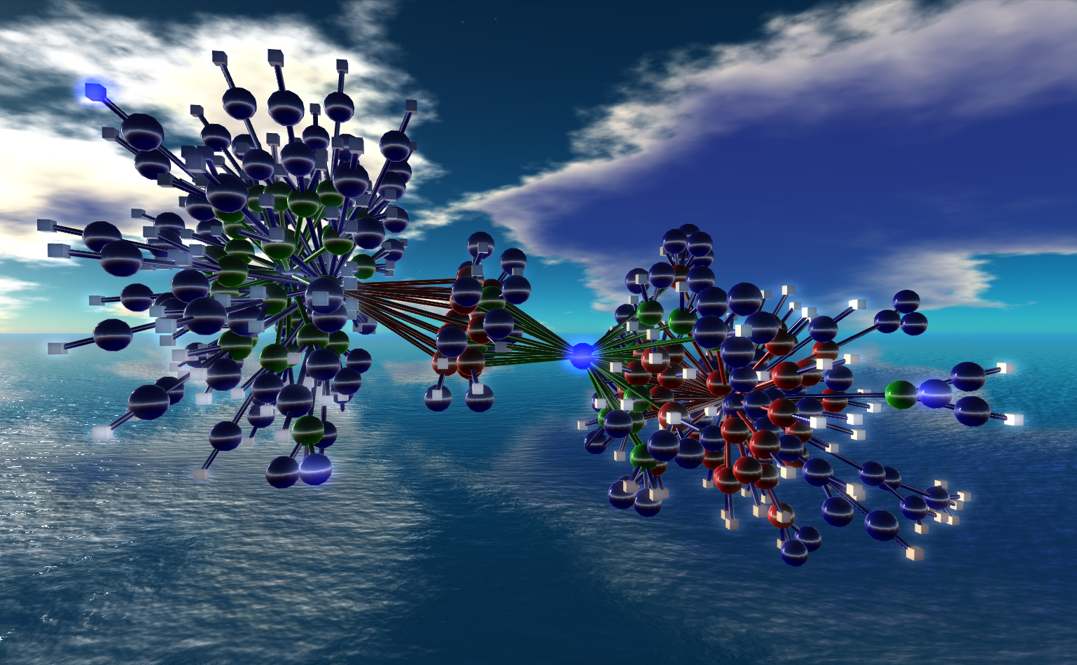
One level higher up:
RDFS, Datatypes
Nexus Simulation Credit Erich Bremmer

Slide 68
Need for RDF schemas
First step towards the “extra knowledge”:
  define the terms we can use
  what restrictions apply
  what extra relationships are there?
Officially: “RDF Vocabulary Description Language”
  the term “Schema” is retained for historical reasons…

Slide 69
Classes, resources, …
Think of well known traditional vocabularies:
  use the term “novel”
  “every novel is a fiction”
  “«The Glass Palace» is a novel”
  etc.
RDFS defines resources and classes:
  everything in RDF is a “resource”
  “classes” are also resources, but…
  …they are also a collection of possible resources (i.e., “individuals”)
    “fiction”, “novel”, …

Slide 70
Classes, resources, … (cont.)
Relationships are defined among resources:
  “typing”: an individual belongs to a specific class
    “«The Glass Palace» is a novel”
    to be more precise: “«http://.../000651409X» is a novel”
  “subclassing”: all instances of one are also the instances of the other (“every novel is a fiction”)
RDFS formalizes these notions in RDF

Slide 71
Classes, resources in RDF(S)
rdfs:Class
rdf:type
http://…isbn/000651409X
rdf:type
#Novel
RDFS defines the meaning of these terms
  (these are all special URI-s, we just use the namespace abbreviation)

Slide 72
Schema example in RDF/XML
The schema part:
<rdf:Description rdf:ID="Novel">
<rdf:type rdf:resource="http://www.w3.org/…/rdf-schema#Class"/>
</rdf:Description>
The RDF data on a specific novel:
<rdf:Description rdf:about="http://…/isbn/000651409X">
<rdf:type rdf:resource="http://…/bookSchema.rdf#Novel"/>
</rdf:Description>

Slide 73
An aside: typed nodes in RDF/XML
A frequent simplification rule: instead of
<rdf:Description rdf:about="http://...">
<rdf:type rdf:resource="http://..../something#ClassName">
...
</rdf:Description>
use:
<yourNameSpace:ClassName rdf:about="http://...">
...
</yourNameSpace:ClassName>
ie:
<a:Novel rdf:about="http://…/isbn/000651409X">
...
</a:Novel>

Slide 74
Further remarks on types
A resource may belong to several classes
  rdf:type is just a property…
  “«The Glass Palace» is a novel, but «The Glass Palace» is also an «inventory item»…”
  i.e., it is not like a datatype!
The type information may be very important for applications
  e.g., it may be used for a categorization of possible nodes
  probably the most frequently used RDF property…
(remember the “Person” in our example?)

Slide 75
Inferred properties
#Fiction
rdf:type
rdf:subClassOf
http://…isbn/000651409X
rdf:type
#Novel
(<http://…/isbn/000651409X> rdf:type #Fiction)
is not in the original RDF data…
…but can be inferred from the RDFS rules
RDFS environments return that triple, too

Slide 76
Inference: let us be formal…
The RDF Semantics document has a list of (33) entailment rules:
  “if such and such triples are in the graph, add this and this”
  do that recursively until the graph does not change
The relevant rule for our example:
If:
uuu rdfs:subClassOf xxx .
vvv rdf:type uuu .
Then add:
vvv rdf:type xxx .

Slide 77
Properties
Property is a special class (rdf:Property)
  properties are also resources identified by URI-s
There is also a possibility for a “sub-property”
  all resources bound by the “sub” are also bound by the other
Range and domain of properties can be specified
  i.e., what type of resources serve as object and subject

Slide 78
Properties (cont.)
Properties are also resources (named via URI–s)…
So properties of properties can be expressed as… RDF properties
  this twists your mind a bit, but you can get used to it
For example, (P rdfs:domain C) means:
  P is a property
  C is a class
  when using P, I can infer that the “subject” is of type C

Slide 79
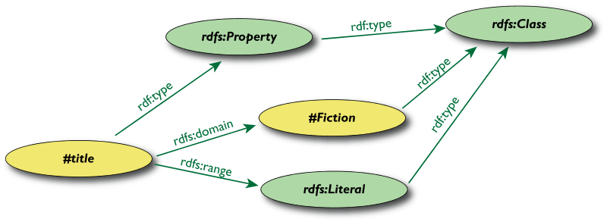
Property specification example

Slide 80
Property specification serialized
In RDF/XML:
<rdf:Property rdf:ID="title">
<rdfs:domain rdf:resource="#Fiction"/>
<rdfs:range rdf:resource="http://...#Literal"/>
</rdf:Property>
In Turtle:
:title
rdf:type rdf:Property;
rdfs:domain :Fiction;
rdfs:range rdfs:Literal.

Slide 81
What does this mean?
Again, new relations can be deduced. Indeed, if
:title
rdf:type rdf:Property;
rdfs:domain :Fiction;
rdfs:range rdfs:Literal.
<http://…/isbn/000651409X> :title "The Glass Palace" .
then the system can infer that:
<http://…/isbn/000651409X> rdf:type :Fiction .

Slide 82
Literals
Literals may have a data type
  floats, integers, booleans, etc., defined in XML Schemas
  full XML fragments
(Natural) language can also be specified

Slide 83
Examples for datatypes
<rdf:Description rdf:about="http://…/isbn/000651409X">
<page_number rdf:datatype="http://...#integer">543</page_number>
<publ_date rdf:datatype="http://...#gYear">2000</publ_date>
<price rdf:datatype="http://...#float">6.99</price>
</rdf:Description>
<http://…/isbn/000651409X>
:page_number "543"^^xsd:integer ;
:publ_date "2000"^^xsd:gYear ;
:price "6.99"^^xsd:float .

Slide 84
Examples for language tags
<rdf:Description rdf:about="http://…/isbn/000651409X">
<title xml:lang="en">The Glass Palace</title>
<fr:titre xml:lang="fr">Le palais des mirroirs</fr:titre>
</rdf:Description>
<http://…/isbn/000651409X>
:title "The Glass Palace"@en ;
fr:titre "Le palais des mirroirs"@fr .

Slide 85
XML literals in RDF/XML
XML Literals
  makes it possible to “include” XML vocabularies into RDF:
<rdf:Description rdf:about="#Path">
<axsvg:algorithmUsed rdf:parseType="Literal">
<math xmlns="...">
<apply>
<laplacian/>
<ci>f</ci>
</apply>
</math>
</axsvg:algorithmUsed>
</rdf:Description/>

Slide 86
A bit of RDFS can take you far…
Remember the power of merge?
We could have used, in our example:
  f:auteur is a subproperty of a:author and vice versa
  (although we will see other ways to do that…)
Of course, in some cases, more complex knowledge is necessary (see later…)

Slide 87
Vocabularies
RDFS makes it possible to define vocabularies:
  collection of properties and classes
  relationships among those and to terms in other vocabularies
Some examples:
  Dublin Core terms: creator, date, …
  FOAF terms: characterization of persons
  Good Relations: eCommerce terms
  Creative Commons: copyright classes, license relations, …
  schema.org terms: events, organizations, places, reviews, …
  …

Slide 88
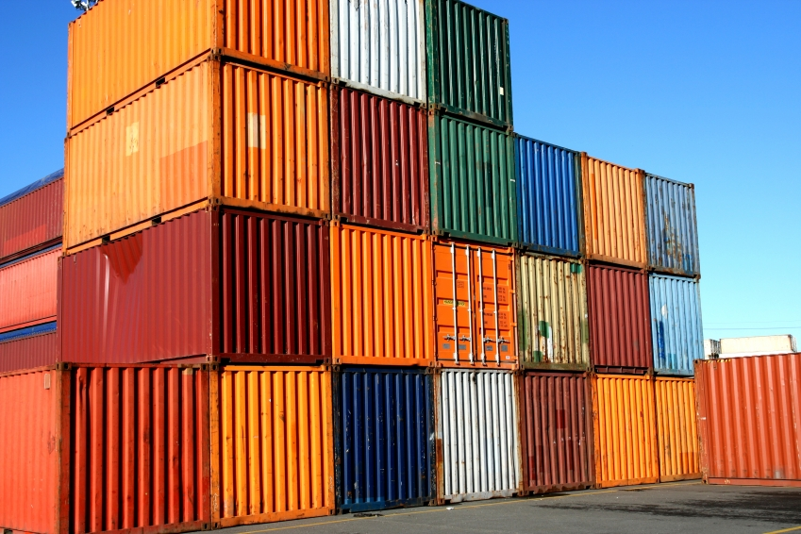
Some predefined structures…
(collections, containers)

Slide 89
Predefined classes and properties
RDF(S) has some predefined classes and properties
These are not new “concepts” in the RDF Model, just resources with an agreed semantics
Examples:
  collections (a.k.a. lists)
  containers: sequence, bag, alternatives
  reification
  rdfs:comment, rdfs:seeAlso, rdf:value

Slide 90
Collections (lists)
We could have the following statement:
  “The book inventory is a «thing» that consists of
  <http://…/isbn/000651409X>,
  <http://…/isbn/000XXXX>, …”
But we also want to express the constituents in this order
Using blank nodes is not enough

Slide 91
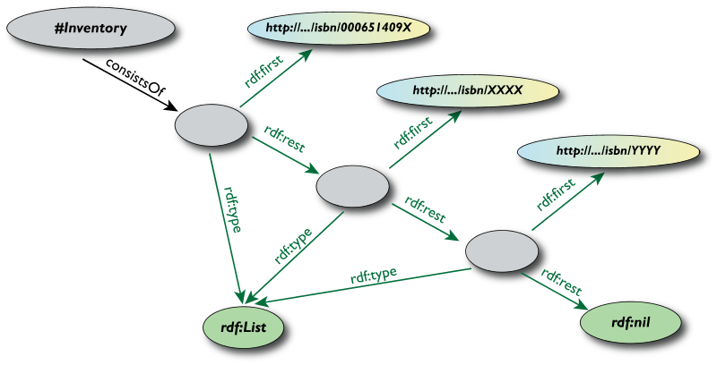
Collections (lists) (cont.)
Familiar structure for Lisp programmers…

Slide 92
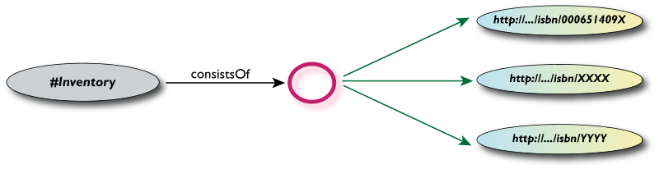
The same in RDF/XML and Turtle
<rdf:Description rdf:about="#Inventory">
<a:consistsOf rdf:parseType="Collection">
<rdf:Description rdf:about="http://.../isbn/000651409X"/>
<rdf:Description rdf:about="http://.../isbn/XXXX"/>
<rdf:Description rdf:about="http://.../isbn/YYYY"/>
</a:consistsOf>
</rdf:Description>
:Inventory a:consistsOf
(<http://.../isbn/000651409X> <http://.../isbn/XXXX> ...) .

Slide 93
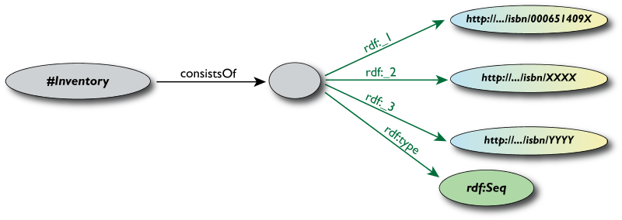
Sequences
Use the predefined:
  RDF Schema class Seq
  RDF properties rdf:_1, rdf:_2, …
The agreed semantics is of a sequential containment

Slide 94
Sequences serialized
In RDF/XML:
<rdf:Description rdf:about="#Inventory">
<a:consistsOf>
<rdf:Description>
<rdf:type rdf:resource="http:...rdf-syntax-ns#Seq">
<rdf:_1 rdf:resource="http://.../isbn/000651409X">
...
</rdf:Description>
</a:consistsOf>
</rdf:Description/>
In Turtle:
:Inventory
a:consistsOf [
rdf:type <http:...rdf-syntax-ns#Seq>;
rdf:_1 <http://.../isbn/000651409X>;
...
].

Slide 95
Sequences (simplified RDF/XML)
<rdf:Description rdf:about="#Inventory">
<a:consistsOf>
<rdf:Seq>
<rdf:li rdf:resource="http://.../isbn/000651409X">
...
</rdf:Seq>
</a:consistsOf>
</rdf:Description/>

Slide 96
Other containers
Also defined in RDFS
  rdf:Bag
    a general bag, no particular semantics attached
  rdf:Alt
    agreed semantics: only one of the constituents is “valid”
Note: these containers are incompletely defined semantically; it is better not to use them…
  use repeated predicates for bags
  use lists for sequences

Slide 97
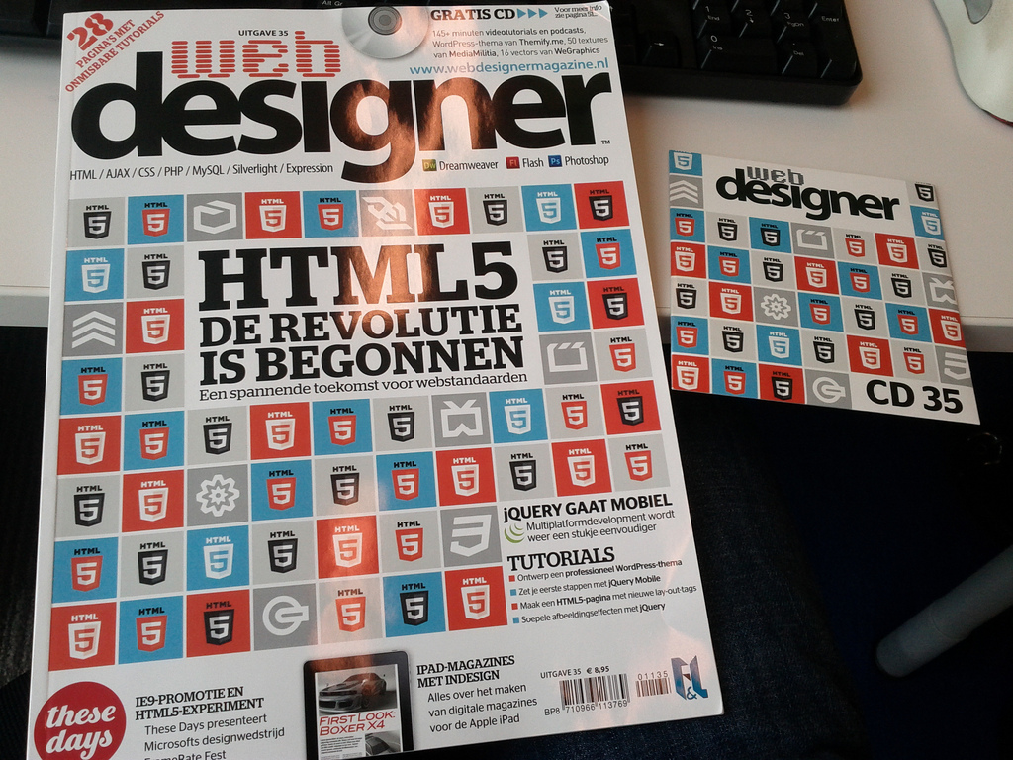
RDF Data and Web Pages?
(RDFa, microdata, microformats,
GRDDL)
Photo credit “shetladd”, Flickr

Slide 98
RDF with HTML
Obviously, a huge source of information
By adding some “meta” information, the same source can be reused for, e.g., data integration, better mashups, etc.
  typical example: your personal information, like address, should be readable for humans and processable by machines
Some solutions have emerged:
  use microformats and convert the content into RDF
  add extra statements in microdata, that can be converted to RDF
  add RDF statements directly into XHTML via RDFa

Slide 99
Microformats
Not a Semantic Web specification per se
  there is a separate microformat community
Approach: re-use (X)HTML attributes and elements to add “meta” information
  typically @abbr, @class, @title, …
  different agreements for different applications
It is not a specification per se, rather a common methodology
  each vocabulary has its own, independent specification

Slide 100
Microformat example: hCalendar
Goal: “markup” calendaring information on your HTML page
  use a community agreement using, eg, :
    @class for event name
    abbr element for dates
    @title for date values
    etc.
Automatic procedures (ie, calendaring applications) may then get to the right data

Slide 101
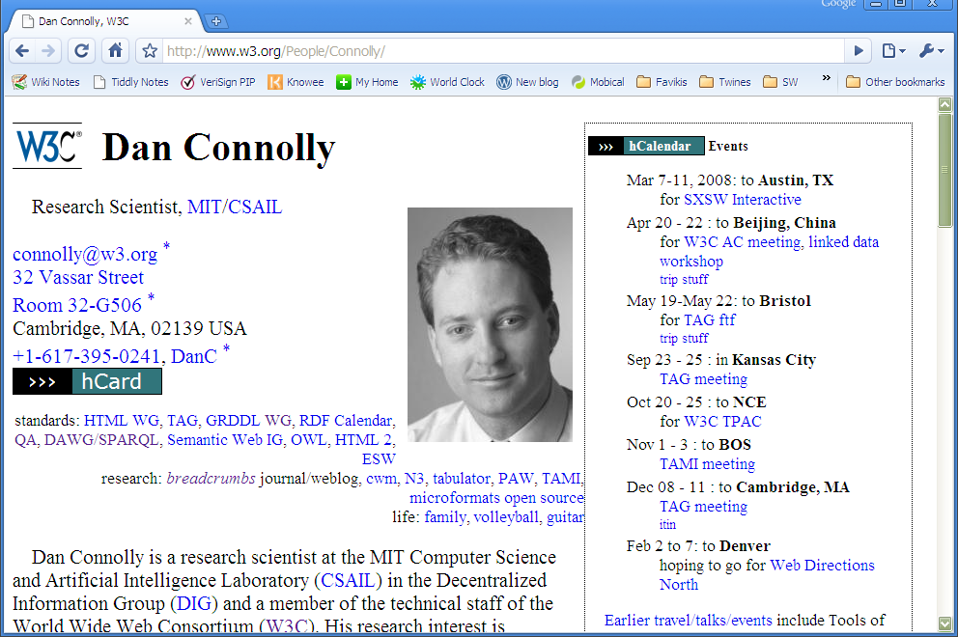
Microformat example: hCalendar

Slide 102
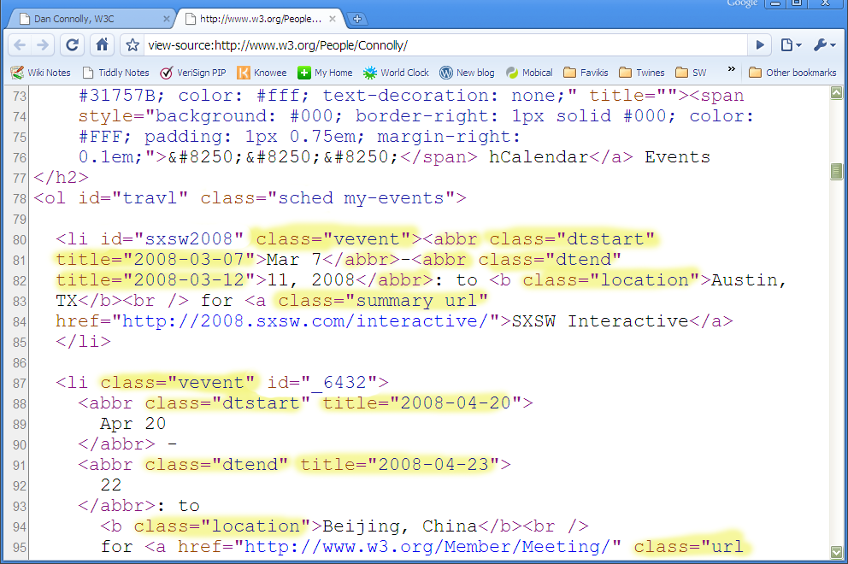
Behind the scenes…

Slide 103
Microformat extraction
To use it on the Semantic Web, microformat data should be converted to RDF
A simple transformation (eg, in XSLT) can be defined, yielding:
<http://www.w3.org/People/Connolly/#sxsw2008>
a hcal:Vevent;
hcal:organizer <http://www.w3.org/People/Connolly/#me>;
hcal:summary "SXSW Interactive";
hcal:dtstart "2008-03-07"^^xsd:date;
hcal:dtend "2008-03-12"^^xsd:date;
hcal:url <http://2008.sxsw.com/interactive/>;
hcal:location "Austin, TX" .

Slide 104
So far so good, but…
The XSLT transformation is hCalendar specific
  each microformat dialect needs its own
How does a general processor find the right transformation?
Enter GRDDL

Slide 105
GRDDL: find the right transformation
GRDDL defines
  a few extra attribute values to locate the right transformation
  a precise processing model on how the transformation should be applied to generate RDF
Note: we describe GRDDL in terms of XHTML (and microformats) but GRDDL can be used for any XML data

Slide 106
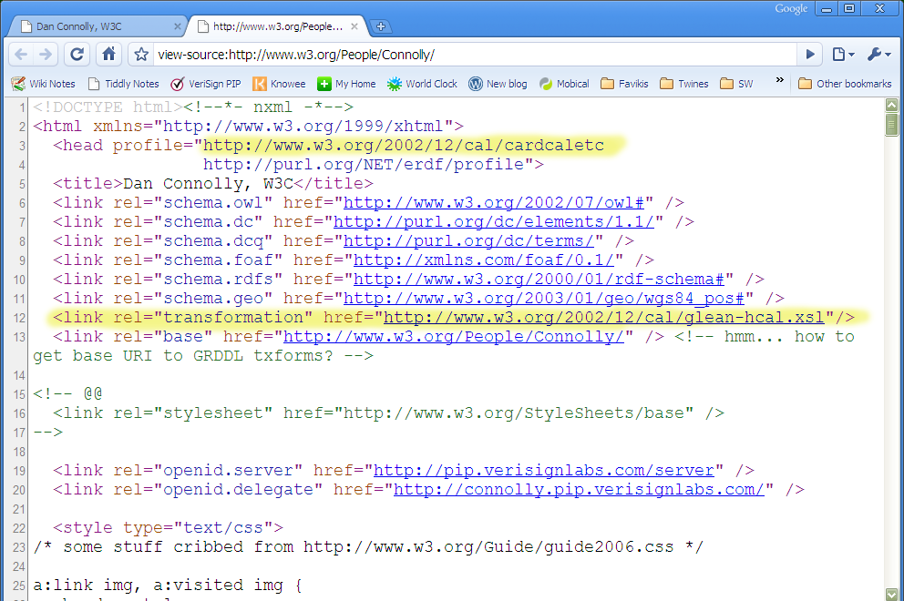
GRDDL: find the right transformation

Slide 107
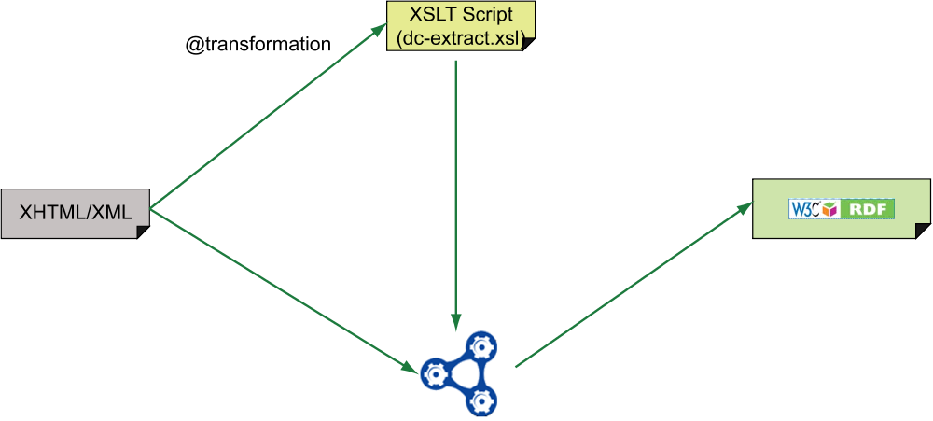
The GRDDL process: simple case

Slide 108
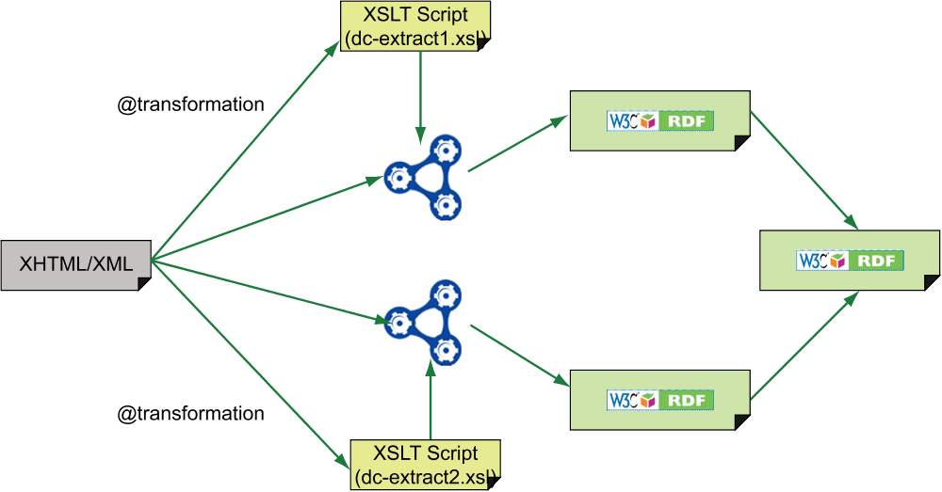
The GRDDL process: merging case

Slide 109
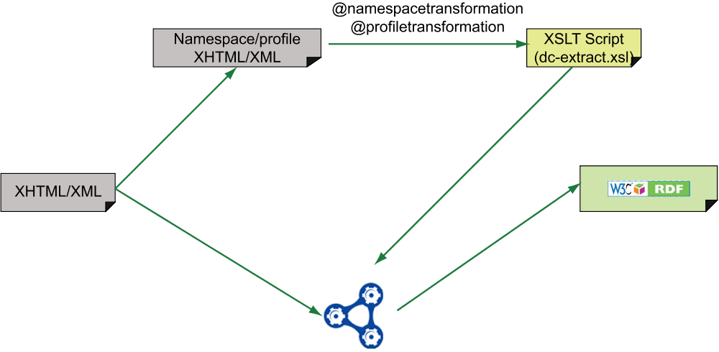
The GRDDL process: indirect case

Slide 110
Microformats & GRDDL: pros
Pros:
  simple to define/add new vocabularies
    there is a strong microformat community for this
  works with all current browsers, markup validators, etc
  fairly user friendly, easy to understand and use

Slide 111
Microformats & GRDDL: cons
Cons:
  does not scale well for complex vocabularies
    remember: needs a transformation per vocabulary
  difficult to mix vocabularies within one page
    what if the usage of an attribute clashes among different vocabularies?
  the “target” RDF vocabulary is to be defined additionally to the specific microformat specification
  some of the attributes are meant for other usage
    eg, the abbr element, the @title attribute, …

Slide 112
A more general solution: microdata and RDFa
General idea: define a set of extra attributes to add “structured data” to an HTML page
This extra structured data can
  be used directly by a 3rd party (e.g., to improve the user interface)
  extracted, converted into RDF and integrate it with the rest of data out there
Two “syntaxes” emerged at W3C:
  RDFa (developed in general for XML languages and for HTML)
  microdata (part of the HTML5 family of specifications)

Slide 113
HTML+microdata or HTML+RDFa are becoming a major source of data on the Web!

Slide 114
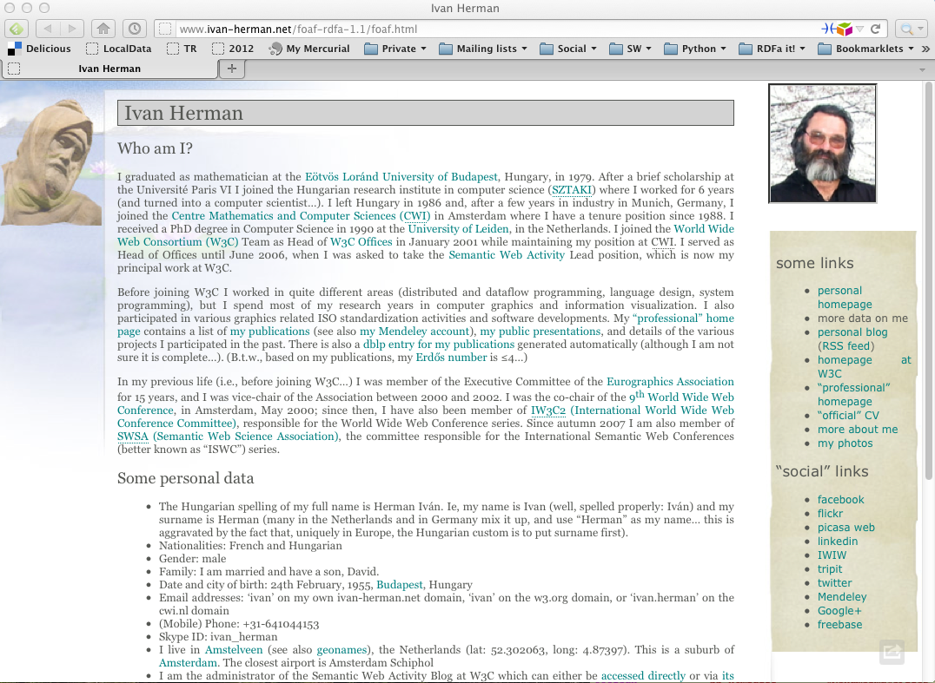

Slide 115
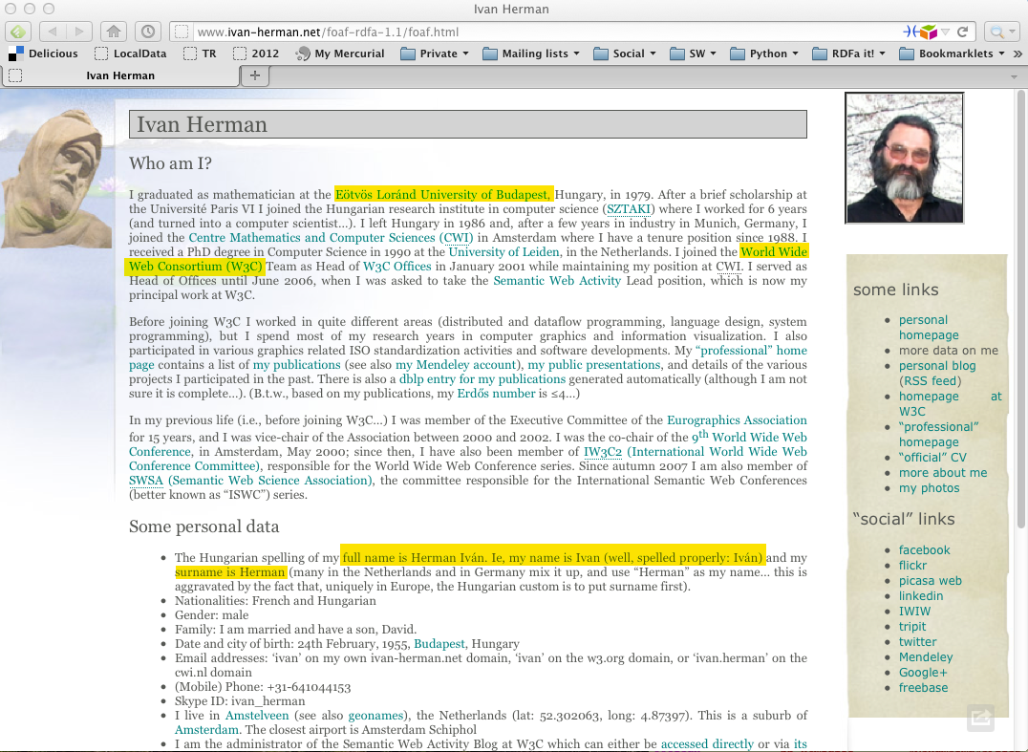

Slide 116
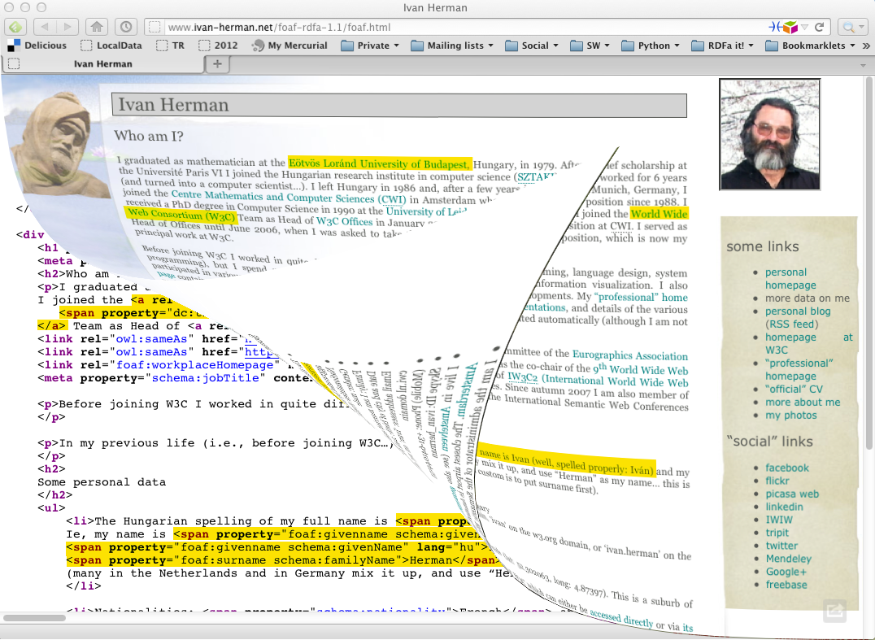

Slide 117
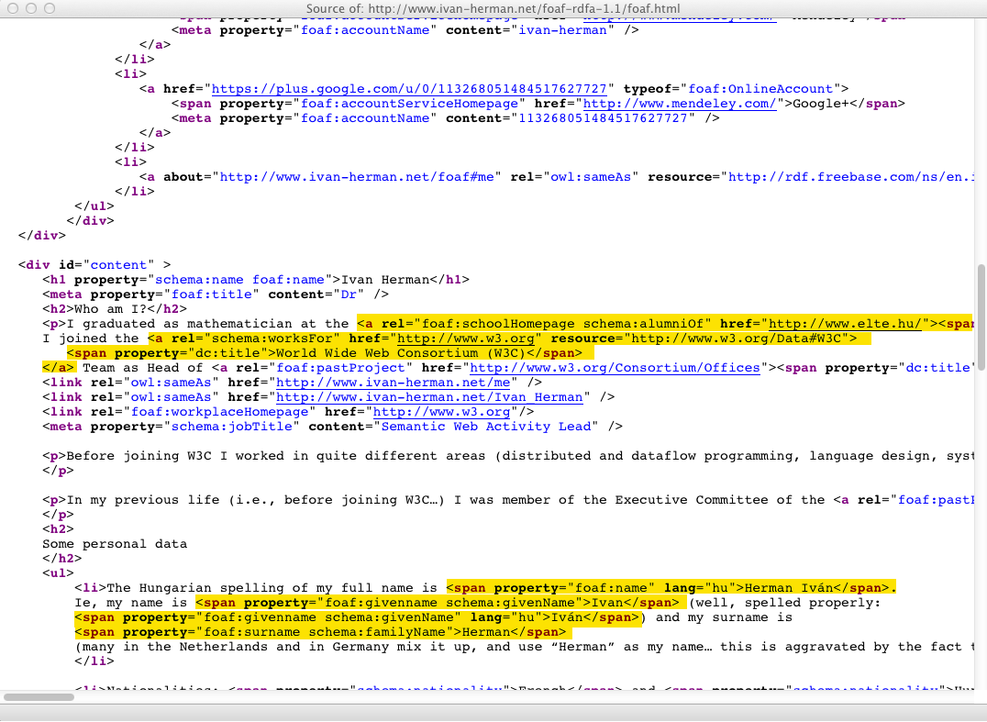

Slide 118
In a slightly more readable format…
<html>
....
<body prefix="schema: http://schema.org/
foaf: http://xmlns.com/foaf/0.1/"
<div about="http://www.ivan-herman.net/foaf#me" ... >
...
<p>I graduated as mathematician at the
<a rel="foaf:schoolHomepage schema:alumniOf"
href="http://www.elte.hu/">
<span property="dc:title">Eötvös Loránd University of
Budapest</span>
</a>, ...
...

Slide 119
In a slightly more readable format…
Triple
<html>
....
<body prefix="schema: http://schema.org/
foaf: http://xmlns.com/foaf/0.1/"
<div about="http://www.ivan-herman.net/foaf#me" ... >
...
<p>I graduated as mathematician at the
<a rel="foaf:schoolHomepage schema:alumniOf"
href="http://www.elte.hu/">
<span property="dc:title">Eötvös Loránd University of
Budapest</span>
</a>, ...
...
Triple

Slide 120
Yielding…
<http://www.ivan-herman.net/foaf#me>
schema:alumniOf <http://www.elte.hu> ;
foaf:schoolHomePage <http://www.elte.hu> ;
schema:worksFor <http://www.w3.org/W3C#data> ;
…
<http://www.elte.hu>
dc:title "Eötvös Loránd University of Budapest" .
…
<http://www.w3.org/W3C#data>
dc:title "World Wide Web Consortium (W3C)”
…

Slide 121
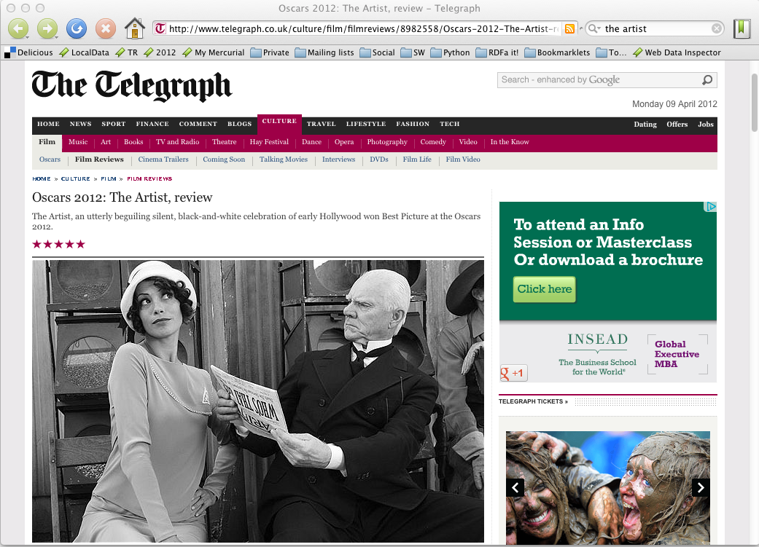

Slide 122
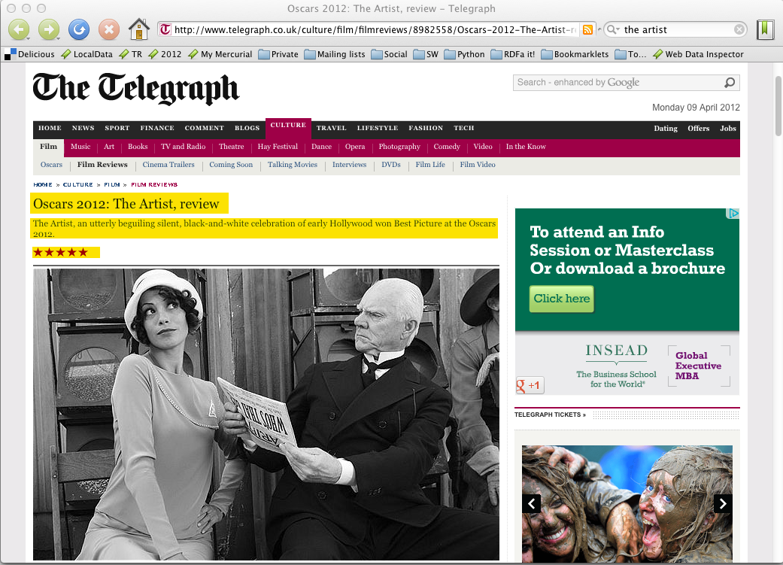

Slide 123
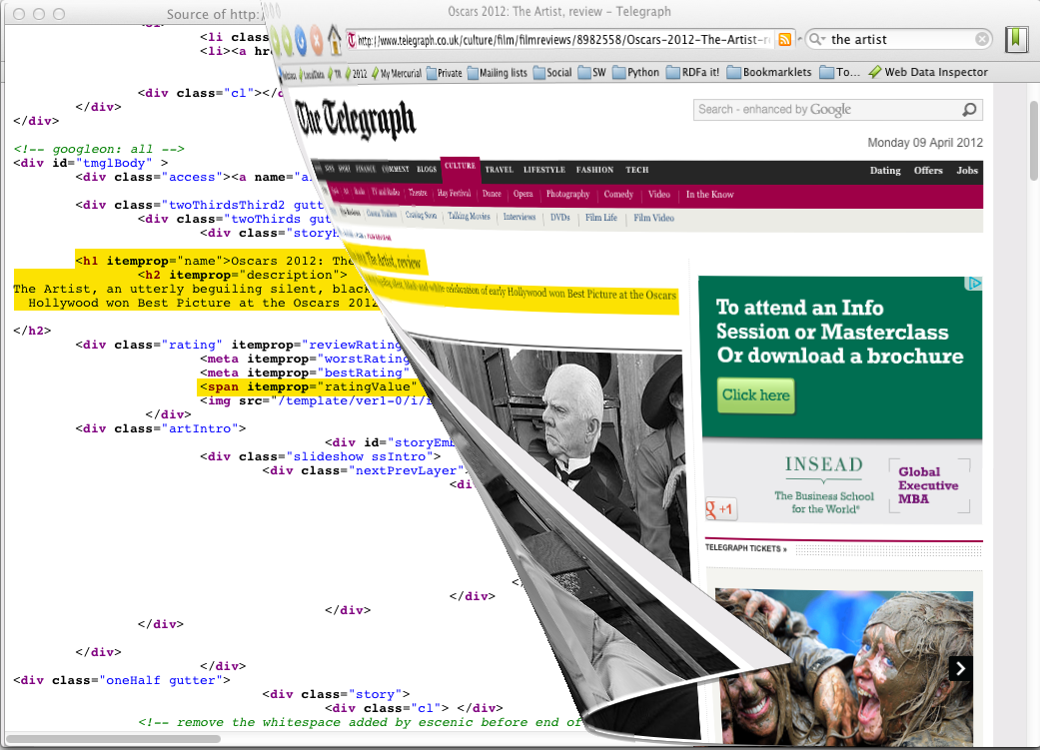

Slide 124
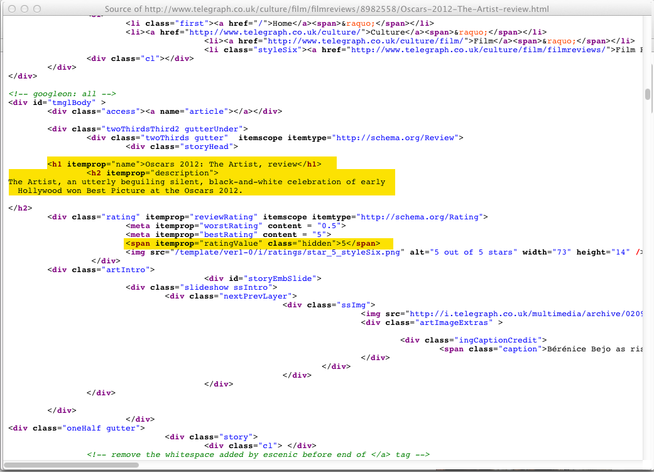

Slide 125
In a slightly more readable format…
<div itemscope itemtype="http://schema.org/Review">
...
<h1 itemprop="name">Oscars 2012: The Artist, review</h1>
<h2 itemprop="description">The Artist, an utterly beguiling…</h2>
...
<span itemprop="ratingValue" class="hidden">5</span>
...

Slide 126
Yielding…
[ rdf:type schema:Review ;
schema:name "Oscars 2012: The Artist, review" ;
schema:description "The Artist, an utterly beguiling…" ;
schema:ratingValue "5" ;
…
]

Slide 127
RDFa and microdata: similarities
Both have similar philosophies:
  the structured data is expressed via attributes only (no specialized elements)
  both define some special attributes
    e.g., itemscope for microdata, resource or about for RDFa
  both reuse some HTML core attributes (e.g., href)
  both reuse the textual content of the HTML source, if needed
RDF data can be extracted from both

Slide 128
RDFa and microdata: differences
Microdata has been optimized for simpler use cases:
  one vocabulary at a time
  tree shaped data
  no datatypes
RDFa provides a full serialization of RDF in XML or HTML
  the price is an extra complexity compared to microdata
RDFa 1.1 Lite is a simplified authoring profile of RDFa, very similar to microdata

Slide 129
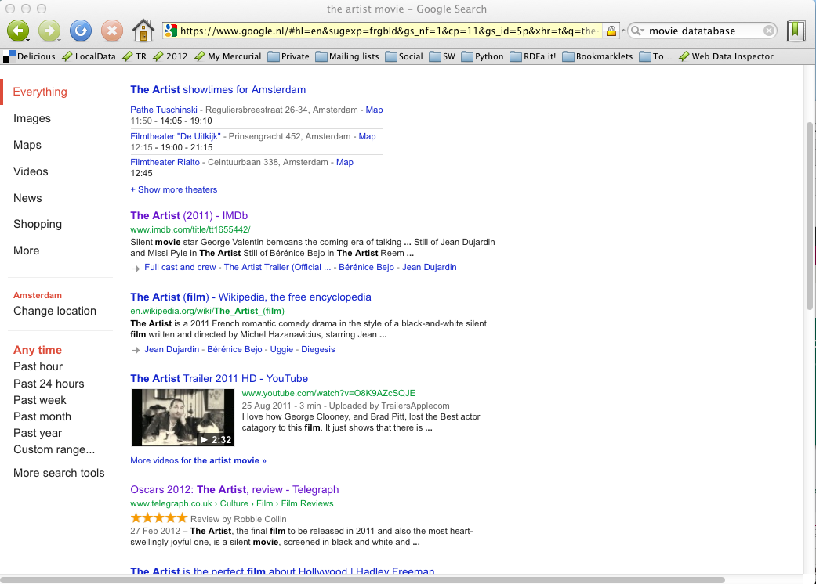
Typical usage of structured data

Slide 130
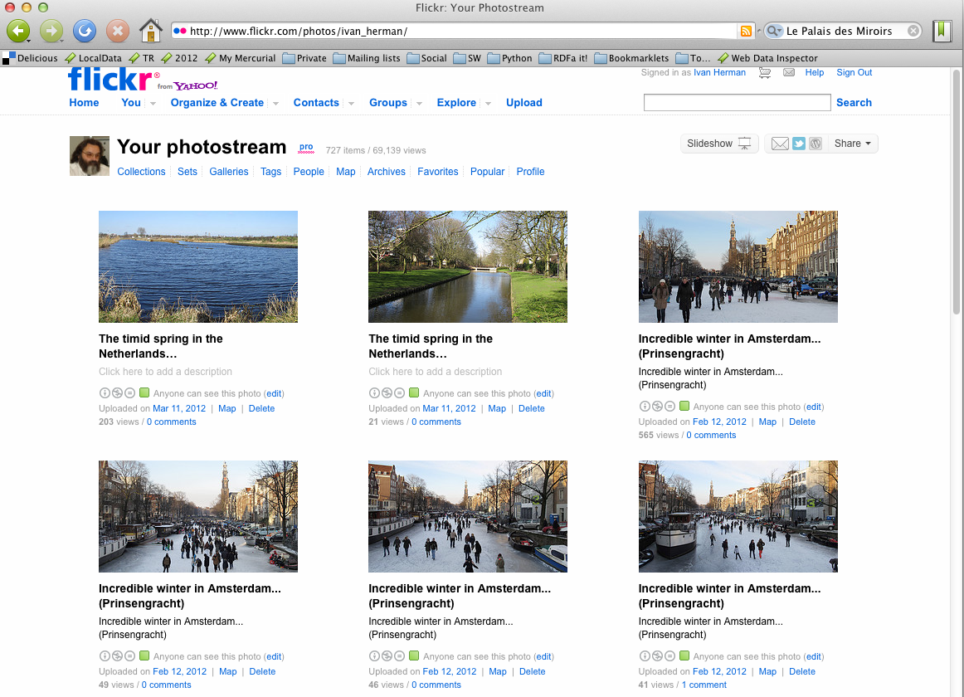
How to “assign” RDF data to resources?

Slide 131
How to “assign” RDF data to resources?
This is important when the RDF data is used as “metadata”
Some examples:
  copyright information for your photographs
  is a Web page usable on a mobile phone and how?
  bibliographical data for a publication
  annotation of the data resulting from a scientific experiment
  etc

Slide 132
If I know the URI of the resource (photograph, publication, etc), how do I find the relevant RDF data?

Slide 133
The data might be embedded
Some data formats allow the direct inclusion of (RDF) metadata:
  SVG (Scalable Vector Graphics)
    direct inclusion of RDF/XML
    via RDFa attributes
  HTML with RDFa
  JPG files using the comment area and, eg, Adobe’s XMP technology

Slide 134
Simple linkage
Some formats have special link statements. Eg, in (X)HTML:
<html>
<head>
<link rel="meta" href="meta.rdf"/>
...
Similar facilities might exist in other formats (eg, SMIL)

Slide 135
POWDER
POWDER provides for a more elaborate scenarios:
  define a set of resources by constraints on the URIs; eg
    URIs must begin with http://www.example.com/bla/
    the port number in the URI-s should be XYZW
  define “description resources” that bind those resources to additional information
  get such description resources, eg, via a link statements, via HTTP, via SPARQL, …
Use cases: licensing information, mobileOK (and other) trustmarks, finding accessible Web sites, content labeling (eg, child protection), …

Slide 136
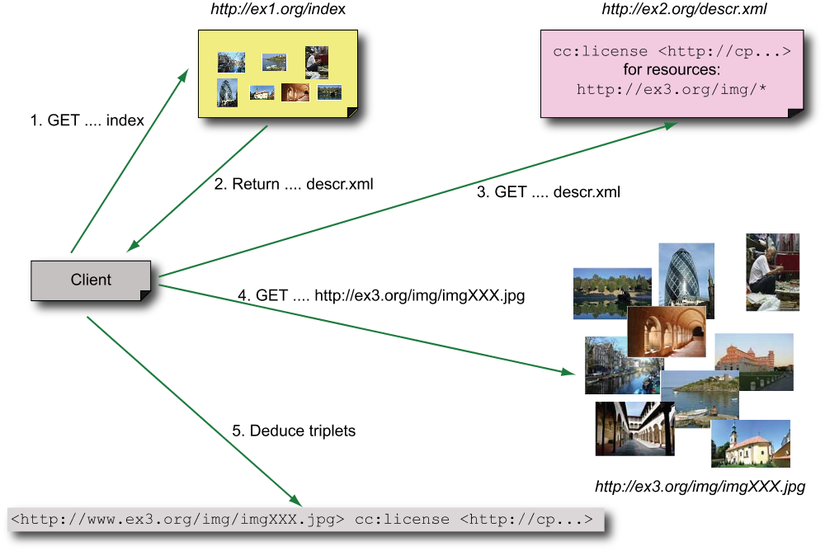
A POWDER scenario: copyright for photos

Slide 137
The gory details…
The “description resource” is an XML file:
<powder xmlns="http://www.w3.org/2007/05/powder#"
xmlns:cc="http://creativecommons.org/ns#">
<attribution>
<issuedby src="http://www.ivan-herman.net/me"/>
</attribution>
<dr>
<iriset>
<includehosts>www.ex2.org</includehost>
<includepathstartswith>/img/</includepathstartswith>
</iriset>
<descriptorset>
<cc:license rdf:resource="http://..."/>
</descriptorset>
</dr>

Slide 138
The gory details…
Powder processors may then return
  direct RDF triples, eg:
<http://www.ex2.org/img/imgXXX.jpg> cc:license <http://...>.
or can transform this XML file into an RDF (OWL) for more generic processors
  a canonical processing of the XML file is defined by the POWDER specification

Slide 139
POWDER Service
Online POWDER service can be set up:
  a Web service with
    submit a URI and a resource description file
    return the RDF statements for that URI
  such service should be set up, eg, at W3C
A GRDDL transform is also defined

Slide 140
But there is a hidden “hiccup”
RDF makes a strong separation between
  URI as an ID for a resource
  URI as a datatype (xsd:anyURI)
  there is no “bridge” between the two
POWDER includes a small extension to the formal semantics of RDF for two properties:
  wdrs:matchregex and wdrs:notmatchregex such that
    (R wdrs:matchregex Regex) holds iff the URI of R matches Regex

Slide 141
If you want the OWL version…
<> wdrs:issuedBy <http://www.ivan-herman.net/me> .
_:iriset_1 a owl:Class; owl:intersectionOf (
[ a owl:Restriction;
owl:onProperty wsdr:matchregex ;
owl:hasValue "..ugly regex for ex2.org"^^xsd:string ]
[ a owl:Restriction;
owl:onProperty wsdr:matchregex ;
owl:hasValue "..ugly regex for /img"^^xsd:string ]
).
_:desc_1 a owl:Restriction;
owl:onProperty cc:license;
owl:hasValue <http://...>.
_:iriset_1 rdfs:subClassOf _:desc_1 .

Slide 142
Consequences of the “hiccup”
In practice this means that only “POWDER aware” agents can fully handle the description files
  note that the extension is fairly easy to add, so it is not a big implementation issue…
Existence of the services to provide the triplets automatically relieve the pain…

Slide 143
Other POWDER features
There are a number of additional features:
  built in authentication: description resources must be attributed and this is open for authentication
  assignments may carry validity dates
  packaging several resource descriptions in one, possibly control their processing order
  using tags to identify resources instead of URI patterns

Slide 144
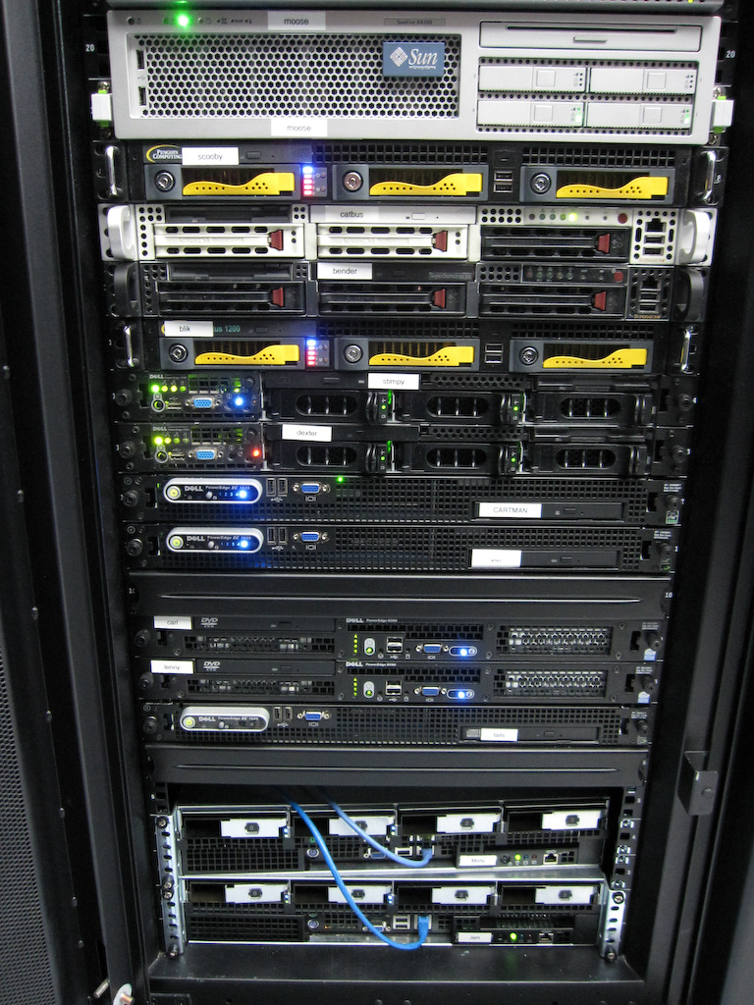
Access to Relational Databases
(Direct Mapping, R2RML)
Photo credit “mayhem”, Flickr

Slide 145
Relational Databases and RDF
Most of the data on the Web is, in fact, in RDB-s
Proven technology, huge systems, many vendors…
Data integration on the Web must provide access to RDB-s

Slide 146
RDF provides a common “view”
Common “view”
in
RDF
export
export
query
query
query
export

Slide 147
What is “export”?
“Export” does not necessarily mean physical conversion
  for very large databases a “duplication” would not be an option
  systems may provide SQL “bridges” to make queries on the fly
Result of export is a “logical” view of the RDB content

Slide 148
Simple export: Direct Mapping
A standard RDF “view” of RDB tables
Valid for all RDB-s, independently of the RDB schema
Fundamental approach:
  each row is turned into a series of triples with a common subject
  column names provide the predicate names
  cell contents are the objects as literals
  linked tables are expressed with URI subjects

Slide 149
What DM processor does
An DM processor has access to:
  an RDB schema
  a database governed by the schema
… and produces an RDF graph
RDB Schema
DM Processing
Tables

Slide 150
Back to the bookshop example
ISBN | Author | Title | Publisher | Year
0006511409X | id_xyz | The Glass Palace | id_qpr | 2000
ID | Name | Homepage
id_xyz | Ghosh, Amitav | http://www.amitavghosh.com
The Glass Palace
a:title
http://…isbn/000651409X
2000
a:year
a:author
a:name
a:homepage
Ghosh, Amitav
http://www.amitavghosh.com

Slide 151
Direct mapping of the bookshop tables
ISBN | Author | Title | Publisher | Year
0006511409X | id_xyz | The Glass Palace | id_qpr | 2000
ID | Name | Homepage
id_xyz | Ghosh, Amitav | http://www.amitavghosh.com

Slide 152
Direct mapping of the bookshop tables
ISBN | Author | Title | Publisher | Year
0006511409X | id_xyz | The Glass Palace | id_qpr | 2000
ID | Name | Homepage
id_xyz | Ghosh, Amitav | http://www.amitavghosh.com
“ISBN” and “ID” are keys
Book table refers to the author table

Slide 153
Direct mapping of the bookshop tables
ISBN | Author | Title | Publisher | Year
0006511409X | id_xyz | The Glass Palace | id_qpr | 2000
ID | Name | Homepage
id_xyz | Ghosh, Amitav | http://www.amitavghosh.com
0006511409X
<Book#ISBN>
<Book#Author>
id_xyz
The Glass Palace
<Book#Title>
<Book/ISBN-0006511409>
2000
<Book#Year>
<Book#ref-Author>

Slide 154
Direct mapping of the bookshop tables
ISBN | Author | Title | Publisher | Year
0006511409X | id_xyz | The Glass Palace | id_qpr | 2000
ID | Name | Homepage
id_xyz | Ghosh, Amitav | http://www.amitavghosh.com
0006511409X
<Book#ISBN>
<Book#Author>
id_xyz
The Glass Palace
<Book#Title>
<Book/ISBN-0006511409>
2000
<Book#Year>
<Book#ref-Author>
id_xyz
<Person/ID-id_xyz>
<Person#ID>
<Person#Name>
<Person#Homepage>
Ghosh, Amitav
http://www.amitavghosh.com

Slide 155
Result of the Direct Mapping
What do we have?
  we have an RDF “view” of the two tables
What do we miss?
  an RDF view that is close to our application; a more “natural” view of the book data

Slide 156
Direct graph must be transformed
0006511409X
<Book#ISBN>
<Book#Author>
id_xyz
The Glass Palace
<Book#Title>
<Book/ISBN-0006511409>
2000
<Book#Year>
<Book#ref-Author>
id_xyz
<Person/ID-id_xyz>
<Person#ID>
<Person#Name>
<Person#Homepage>
Ghosh, Amitav
http://www.amitavghosh.com
Property names should be mapped
URI-s should be minted
Literals should be replaced by URI-s
The Glass Palace
a:title
http://…isbn/000651409X
2000
a:year
a:author
a:name
a:homepage
Ghosh, Amitav
http://www.amitavghosh.com

Slide 157
Pros and cons of Direct Mapping
Pros:
  Direct Mapping is simple, does not require any other concepts
  know the Schema ⇒ know the RDF graph structure
  know the RDF graph structure ⇒ good idea of the Schema(!)
Cons:
  relies on other tools to get the “final” RDF graph

Slide 158
Enters R2RML
Separate vocabulary to control the mapping
Gets to the final RDF graph with one processing step
Fundamentals are similar:
  each row is turned into a series of triples with a common subject
But:
  cell contents may become a resource (not a literal)
  there is a control over the generated URI-s
Direct mapping is a “default” R2RML mapping

Slide 159
What R2RML processor does
An R2RML processor has access to:
  an RDB schema
  an R2RML instance
  a database governed by the schema
… and produces an RDF graph
RDB Schema
R2RML Processing
Tables
R2RML Instance

Slide 160
Back to the bookshop example
ISBN | Author | Title | Publisher | Year
0006511409X | id_xyz | The Glass Palace | id_qpr | 2000
ID | Name | Homepage
id_xyz | Ghosh, Amitav | http://www.amitavghosh.com
The Glass Palace
a:title
http://…isbn/000651409X
2000
a:year
a:author
a:name
a:homepage
Ghosh, Amitav
http://www.amitavghosh.com

Slide 161
Back to the bookshop example
ISBN | Author | Title | Publisher | Year
0006511409X | id_xyz | The Glass Palace | id_qpr | 2000
ID | Name | Homepage
id_xyz | Ghosh, Amitav | http://www.amitavghosh.com
The Glass Palace
a:title
http://…isbn/000651409X
2000
a:year
a:author
a:name
a:homepage
Ghosh, Amitav
http://www.amitavghosh.com

Slide 162
Back to the bookshop example
ISBN | Author | Title | Publisher | Year
0006511409X | id_xyz | The Glass Palace | id_qpr | 2000
ID | Name | Homepage
id_xyz | Ghosh, Amitav | http://www.amitavghosh.com
The Glass Palace
a:title
http://…isbn/000651409X
2000
a:year
a:author
a:name
a:homepage
Ghosh, Amitav
http://www.amitavghosh.com

Slide 163
Back to the bookshop example
ISBN | Author | Title | Publisher | Year
0006511409X | id_xyz | The Glass Palace | id_qpr | 2000
ID | Name | Homepage
id_xyz | Ghosh, Amitav | http://www.amitavghosh.com
The Glass Palace
a:title
http://…isbn/000651409X
2000
a:year
a:author
a:name
a:homepage
Ghosh, Amitav
http://www.amitavghosh.com

Slide 164
Step 1: transform “Person Table”
ISBN | Author | Title | Publisher | Year
0006511409X | id_xyz | The Glass Palace | id_qpr | 2000
ID | Name | Homepage
id_xyz | Ghosh, Amitav | http://www.amitavghosh.com
<Person>
rr:tableName "Person_Table" ;
rr:subjectMap [
rr:termtype rr:BlankNode ;
] ;
rr:predicateObjectMap [
rr:predicate a:name
rr:objectMap [
rr:column "Name"
]
] ;
rr:predicateObjectMap [
rr:predicate a:homepage ;
rr:objectMap [
rr:column "Homepage" ;
rr:termtype "IRI"
]
] ;
The Glass Palace
a:title
http://…isbn/000651409X
2000
a:year
a:author
a:name
a:homepage
Ghosh, Amitav
http://www.amitavghosh.com

Slide 165
Step 2: transform “Book Table”
ISBN | Author | Title | Publisher | Year
0006511409X | id_xyz | The Glass Palace | id_qpr | 2000
ID | Name | Homepage
id_xyz | Ghosh, Amitav | http://www.amitavghosh.com
<Book>
rr:tableName "Book_Table" ;
rr:subjectMap [
rr:template "http://...isbn/{ISBN}" ;
];
rr:predicateObjectMap [
rr:predicate a:title ;
rr:objectMap [
rr:column "Title"
]
] ;
rr:predicateObjectMap [
rr:predicate a:year ;
rr:objectMap [
rr:column "Year" ;
]
] ;
The Glass Palace
a:title
http://…isbn/000651409X
2000
a:year
a:author
a:name
a:homepage
Ghosh, Amitav
http://www.amitavghosh.com

Slide 166
Step 3: “bind” the two tables
ISBN | Author | Title | Publisher | Year
0006511409X | id_xyz | The Glass Palace | id_qpr | 2000
ID | Name | Homepage
id_xyz | Ghosh, Amitav | http://www.amitavghosh.com
<Book>
...
rr:refPredicateObjectMap [
rr:predicate a:author ;
rr:objectMap [
rr:parentTriplesMap <Person> ;
rr:joinCondition
rr:child "Author" ;
rr:parent "ID”
]
]
].
The Glass Palace
a:title
http://…isbn/000651409X
2000
a:year
a:author
a:name
a:homepage
Ghosh, Amitav
http://www.amitavghosh.com

Slide 167
Further R2RML features
There are some additional features
  assign a datatype to a literal object
  more complicated object assignments (e.g., for a specific column the object is a cell of another column)
<Book>
...
rr:predicateObjectMap [
rr:objectMap [
rr:column "Year" ;
rr:datatype xsd:year
]
...
] ;

Slide 168
Further R2RML features: logical table
Back to our example:
<Book>
rr:tableName "Book_Table"
rr:subjectMap [
rr:template "http://...isbn/{ISBN}";
];
…
ISBN | …
0006511409X | …
http://…isbn/000651409X

Slide 169
Further R2RML features: logical table
An alternative could have been to use SQL
  generate a “logical table”
  all other definitions are on that logical table
Would be an overkill for our example, but can be very powerful for complicated cases!
<Book>
rr:sqlQuery """Select
("http://…isbn/" || ISBN) AS id,
Author, Title, Publisher, Year
from Book_Table """ ;
…
ISBN | …
0006511409X | …
id | …
http://…isbn/0006511409X | …
<Book>
…
rr:subjectMap [
ff:column "id"
];
…
http://…isbn/000651409X

Slide 170
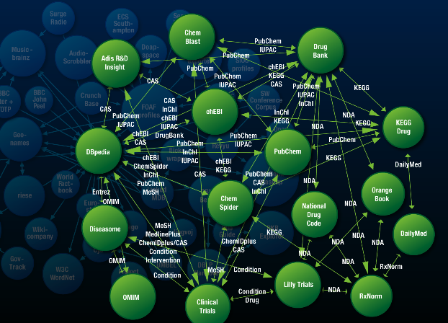
Linked Data

Slide 171
Linked Data “Project”
Goal: “expose” datasets on the Web
  remember the importance of data!
Set links among the data items from different datasets
  we want to avoid the silo effects
Notes:
The important point here is that (1) the data becomes available to the World via a unified format (ie, RDF), regardless on how it is stored inside and (2) the various datasets are interlinked together, ie, they are not independent islands. Dbpedia is probably the most important 'hub' in the project.

Slide 172
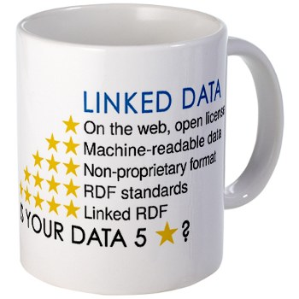
Is your data 5 Star?
Available on the web (whatever format), but with an open license
Available as machine-readable structured data (e.g., excel instead of an image scan)
As before, but using a non-proprietary format (e.g., CSV instead of excel)
All the above, plus use open standards (RDF & Co.) to identify things, so that people could point at your stuff
All the above, plus link your data to other people’s data to provide context

Slide 173


Example data source: DBpedia
DBpedia is a community effort to
  extract structured (“infobox”) information from Wikipedia
  provide a query endpoint to the dataset
  interlink the DBpedia dataset with other datasets on the Web

Slide 174
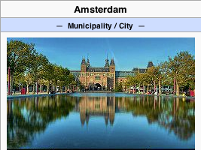
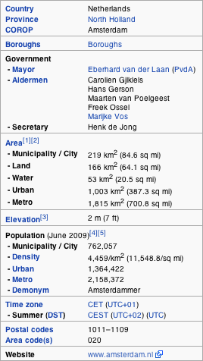
Extracting structured data from Wikipedia
@prefix dbpedia <http://dbpedia.org/resource/>.
@prefix dbterm <http://dbpedia.org/property/>.
dbpedia:Amsterdam
dbterm:officialName "Amsterdam" ;
dbterm:longd "4" ;
dbterm:longm "53" ;
dbterm:longs "32" ;
dbterm:website <http://www.amsterdam.nl> ;
dbterm:populationUrban "1364422" ;
dbterm:areaTotalKm "219" ;
...
dbpedia:ABN_AMRO
dbterm:location dbpedia:Amsterdam ;
...
Notes:
The right hand portion of the wiki side is what is referred to as 'infobox'. The left side is the dbpedia content as made available.

Slide 175
Automatic links among open datasets
<http://dbpedia.org/resource/Amsterdam>
owl:sameAs <http://rdf.freebase.com/ns/...> ;
owl:sameAs <http://sws.geonames.org/2759793> ;
...
<http://sws.geonames.org/2759793>
owl:sameAs <http://dbpedia.org/resource/Amsterdam>
wgs84_pos:lat "52.3666667" ;
wgs84_pos:long "4.8833333";
geo:inCountry <http://www.geonames.org/countries/#NL> ;
...
Processors can switch automatically from one to the other…
Notes:
This is the important point: this is why this is Linking open data. What the community does (and this is a community project) is to make agreements on how the different datasets can be linked and then the linkage is done automatically by the 'bridges' that map the public datasets into RDF. Eg, geonames is a public dataset by geonames.org and dbpedia is, well... wikipedia:-)

Slide 176
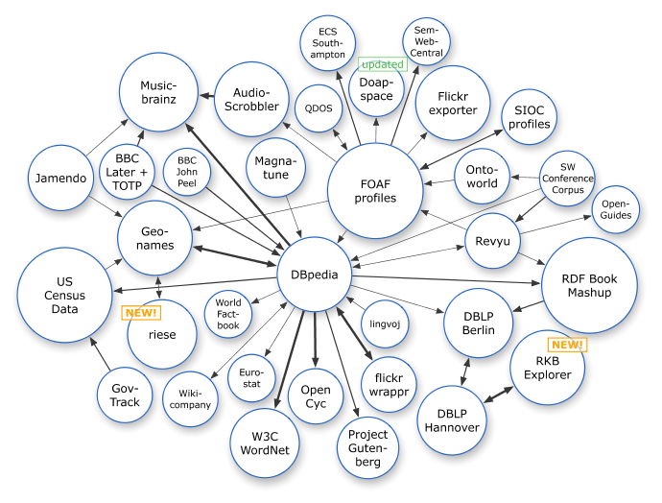
The LOD “cloud”, March 2008
Courtesy of Richard Cyganiak and Anja Jentzsch

Slide 177
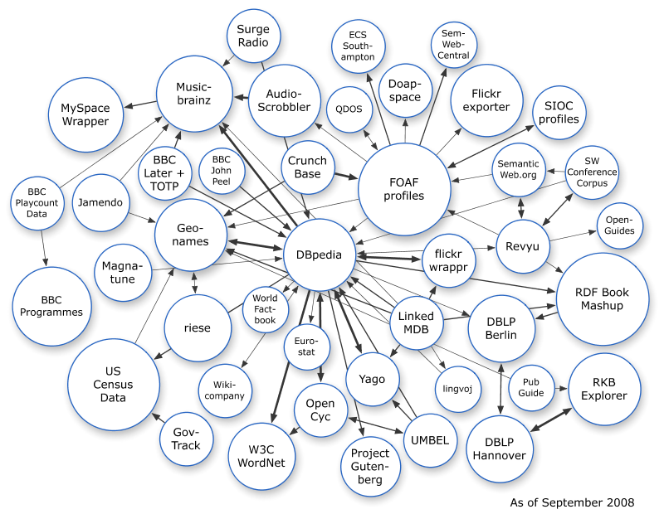
The LOD “cloud”, September 2008
Courtesy of Richard Cyganiak and Anja Jentzsch

Slide 178
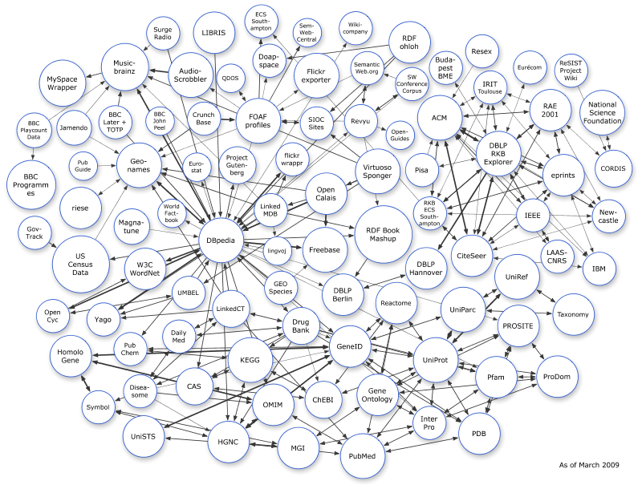
The LOD “cloud”, March 2009
Courtesy of Richard Cyganiak and Anja Jentzsch

Slide 179
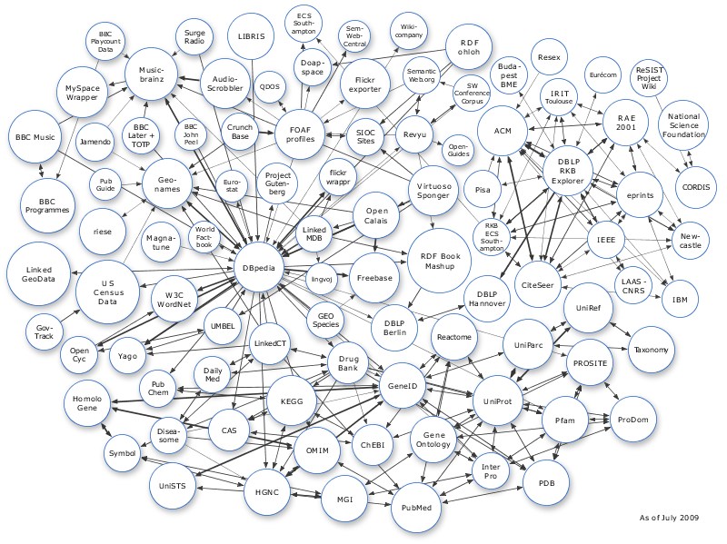
The LOD “cloud”, June 2009
Courtesy of Richard Cyganiak and Anja Jentzsch

Slide 180
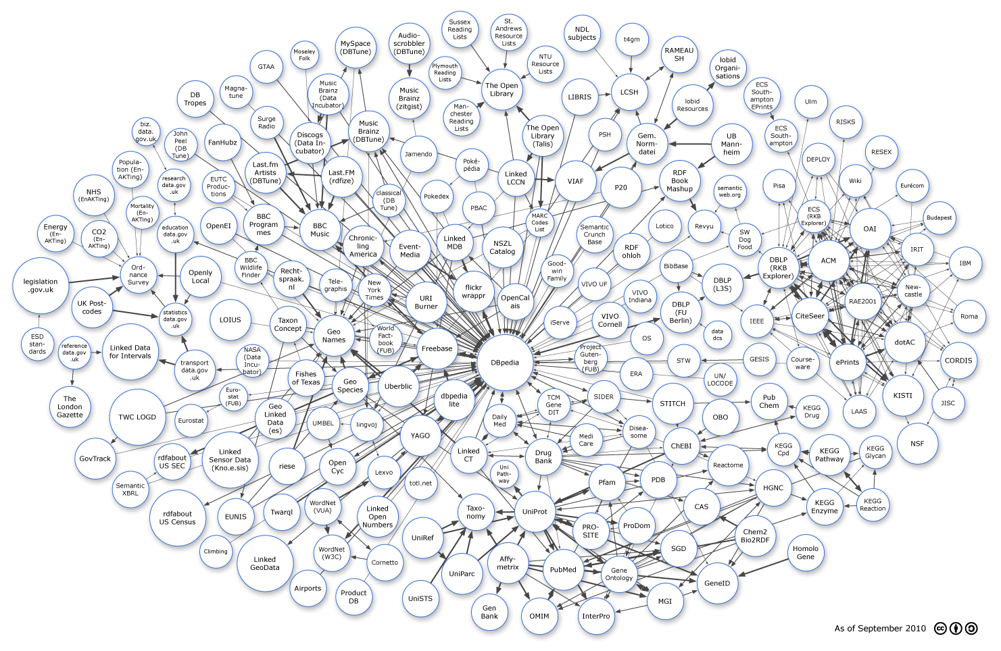
The LOD “cloud”, September 2010
Courtesy of Richard Cyganiak and Anja Jentzsch

Slide 181
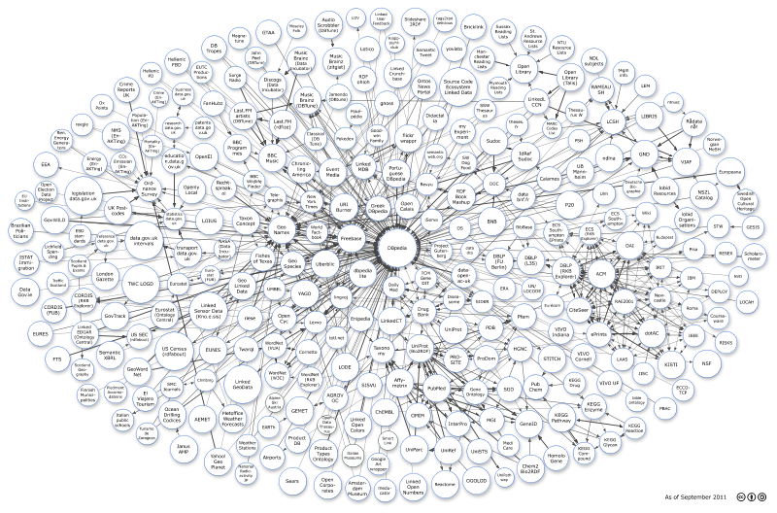
The LOD “cloud”, September 2011
Courtesy of Richard Cyganiak and Anja Jentzsch

Slide 182
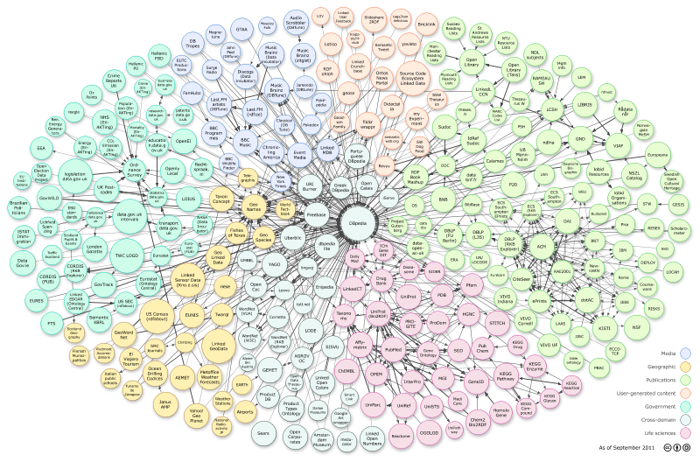
Application specific portions of the cloud
Eg, “bio” related datasets
  done, partially, by the “Linking Open Drug Data” task force of the HCLS IG at W3C
Courtesy of Richard Cyganiak and Anja Jentzsch

Slide 183
The importance of Linked Data
It provides a core set of data that Semantic Web applications can build on
  stable references for “things”,
    e.g., http://dbpedia.org/resource/Amsterdam
  many many relationships that applications may reuse
    e.g., the BBC application!
  a “nucleus” for a larger, semantically enabled Web!
For many, publishing data may be the first step into the world of Semantic Web

Slide 184
Some things to remember if you publish data
Publish your data first, care about sexy user interfaces later!
  the “raw data” can become useful on its own right and others may use it
  you can add your added value later by providing nice user access
If possible, publish your data in RDF but if you cannot, others may help you in conversions
  trust the community…
Add links to other data. “Just” publishing isn’t enough…

Slide 185
Read only vs. Read/Write
Currently, Linked Data is dominated by publishing data for read-only usage
  creating/updating the data is done “out of band”
The future to read and write Linked Data

Slide 186
Example: Simple Application Integration via Linked Data
Application #1
Application #2
HTTP GET, HEAD
HTTP PUT, DELETE
Linked Data
on Server #1
Linked Data
on Server #2

Slide 187
Example: Simple Application Integration via Linked Data
Public Library
Bookshop
HTTP GET, HEAD
HTTP PUT, DELETE
Catalogue
in Library of Congress
Catalogue
in the Centre Pompidou

Slide 188
Example: Simple Application Integration via Linked Data
Private Email Client
Corporate Email Client
HTTP GET, HEAD
HTTP PUT, DELETE
Private Address Data
Corporate Contact Data

Slide 189
Linked Data Platform
Define an “entry” level, HTTP/RESTful based infrastructure to publish, read, write, or modify linked data
  typical usage: data intensive application in a browser, application integration using shared data…
The infrastructure should be easy to implement and install
  provides an “entry point” for Linked Data applications!
The work has just started to flesh out the details…

Slide 190
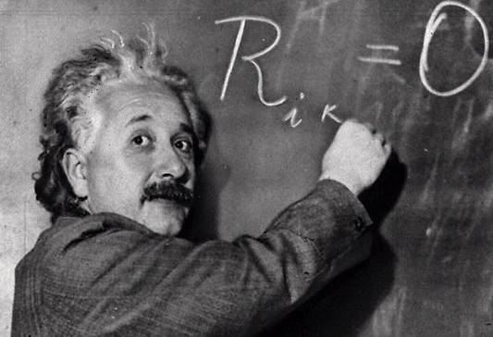
Provenance

Slide 191
The goal is simple…
We should be able to express all sorts of “meta” information on the data
  who played what role in creating the data (author, reviewer, etc.)
  view of the full revision chain of the data
  in case of data integration: which part comes from which original data and under what process
  what vocabularies/ontologies/rules were used to generate some portions of the data
  etc.

Slide 192
…the solution is more complicated
Requires a complete model describing the various constituents (actors, revisions, etc.)
The model should be usable with RDF
Has to find a balance between
  simple (“scruffy”) provenance: easily usable and editable
  complex (“complete”) provenance: allows for a detailed reporting of origins, versions, etc.
That is the role of the Provenance Working Group (started in 2011)

Slide 193
ex:aggregation
ex:chart
prov:used
prov:wasGeneratedBy
ex:illustrate
prov:wasGeneratedBy
prov:wasControlledBy
DRAFT!!!
prov:wasControlledBy
ex:aggregate
foaf:name
Derek
prov:used
prov:used
foaf:mbox
ex:regionList
ex:dataSet
mailto:derek@ex.com
Notes:
Blue: Prov Entity
Green: Yellowish Action
Red: Prov Agent

Slide 194
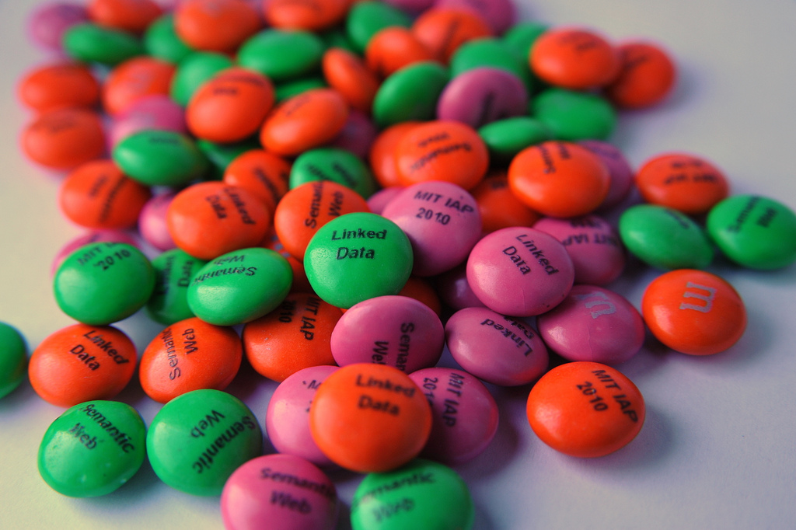
Query RDF:
(SPARQL)
Photo credit “reedster”, Flickr

Slide 195
RDF data access
The HTTP/RESTful approach is great to build up simple applications
But as data grows, complexity of relationships grows
  more sophisticated query possibilities are necessary!
How do I query the RDF data?
  e.g., how do I get to the DBpedia data?

Slide 196
Querying RDF graphs
Remember the Python+RDFLib idiom:
for (s,p,o) in graph.triples((subject,None,None)) :
do_something(p,o);

Slide 197
Querying RDF graphs
In practice, more complex queries into the RDF data are necessary
  something like: “give me the (a,b) pair of resources, for which there is an x such that (x parent a) and (b brother x) holds” (ie, return the uncles)
    these rules may become quite complex
The goal of SPARQL (Query Language for RDF)

Slide 198
Analyze the Python+RDFLib example
for (s,p,o) in graph.triples((subject,None,None)) :
do_something(p,o);
?p
?o
?p
?o
subject
?p
?o
?p
?o

Slide 199
General: graph patterns
The fundamental idea: use graph patterns
  the pattern contains unbound symbols
  by binding the symbols, subgraphs of the RDF graph are selected
  if there is such a selection, the query returns the bound resources

Slide 200
Our Python example in SPARQL
SELECT ?p ?o
WHERE {subject ?p ?o}
The triples in WHERE define the graph pattern, with ?p and ?o “unbound” symbols
The query returns all p,o pairs
?p
?o
?p
?o
subject
?p
?o
?p
?o

Slide 201
Simple SPARQL example
SELECT ?isbn ?price ?currency # note: not ?x!
WHERE {?isbn a:price ?x. ?x rdf:value ?price. ?x p:currency ?currency.}
a:name
Ghosh, Amitav
a:author
a:author
http://…isbn/000651409X
http://…isbn/2020386682
a:price
a:price
a:price
a:price
rdf:value
p:currency
rdf:value
p:currency
rdf:value
p:currency
rdf:value
p:currency
33
:£
50
:€
60
:€
78
:$

Slide 202
Simple SPARQL example
SELECT ?isbn ?price ?currency # note: not ?x!
WHERE {?isbn a:price ?x. ?x rdf:value ?price. ?x p:currency ?currency.}
Returns: [<…409X>,33,:£]
a:name
Ghosh, Amitav
a:author
a:author
http://…isbn/000651409X
http://…isbn/2020386682
a:price
a:price
a:price
a:price
rdf:value
p:currency
rdf:value
p:currency
rdf:value
p:currency
rdf:value
p:currency
33
:£
50
:€
60
:€
78
:$

Slide 203
Simple SPARQL example
SELECT ?isbn ?price ?currency # note: not ?x!
WHERE {?isbn a:price ?x. ?x rdf:value ?price. ?x p:currency ?currency.}
Returns: [<…409X>,33,:£], [<…409X>,50,:€]
a:name
Ghosh, Amitav
a:author
a:author
http://…isbn/000651409X
http://…isbn/2020386682
a:price
a:price
a:price
a:price
rdf:value
p:currency
rdf:value
p:currency
rdf:value
p:currency
rdf:value
p:currency
33
:£
50
:€
60
:€
78
:$

Slide 204
Simple SPARQL example
SELECT ?isbn ?price ?currency # note: not ?x!
WHERE {?isbn a:price ?x. ?x rdf:value ?price. ?x p:currency ?currency.}
Returns: [<…409X>,33,:£], [<…409X>,50,:€],
[<…6682>,60,:€]
a:name
Ghosh, Amitav
a:author
a:author
http://…isbn/000651409X
http://…isbn/2020386682
a:price
a:price
a:price
a:price
rdf:value
p:currency
rdf:value
p:currency
rdf:value
p:currency
rdf:value
p:currency
33
:£
50
:€
60
:€
78
:$

Slide 205
Simple SPARQL example
SELECT ?isbn ?price ?currency # note: not ?x!
WHERE {?isbn a:price ?x. ?x rdf:value ?price. ?x p:currency ?currency.}
Returns: [<…409X>,33,:£], [<…409X>,50,:€],
[<…6682>,60,:€], [<…6682>,78,:$]
a:name
Ghosh, Amitav
a:author
a:author
http://…isbn/000651409X
http://…isbn/2020386682
a:price
a:price
a:price
a:price
rdf:value
p:currency
rdf:value
p:currency
rdf:value
p:currency
rdf:value
p:currency
33
:£
50
:€
60
:€
78
:$

Slide 206
Pattern constraints
SELECT ?isbn ?price ?currency # note: not ?x!
WHERE { ?isbn a:price ?x. ?x rdf:value ?price. ?x p:currency ?currency.
FILTER(?currency == :€) }
Returns: [<…409X>,50,:€], [<…6682>,60,:€]
a:name
Ghosh, Amitav
a:author
a:author
http://…isbn/000651409X
http://…isbn/2020386682
a:price
a:price
a:price
a:price
rdf:value
p:currency
rdf:value
p:currency
rdf:value
p:currency
rdf:value
p:currency
33
:£
50
:€
60
:€
78
:$

Slide 207
Optional pattern
SELECT ?isbn ?price ?currency ?wiki
WHERE { ?isbn a:price ?x. ?x rdf:value ?price. ?x p:currency ?currency.
OPTIONAL ?wiki w:isbn ?isbn. }
http://en.wikipedia/…/The_Glass_Palace
a:name
Ghosh, Amitav
w:isbn
a:author
a:author
http://…isbn/000651409X
http://…isbn/2020386682
a:price
a:price
a:price
a:price
rdf:value
p:currency
rdf:value
p:currency
rdf:value
p:currency
rdf:value
p:currency
33
:£
50
:€
60
:€
78
:$

Slide 208
Optional pattern
SELECT ?isbn ?price ?currency ?wiki
WHERE { ?isbn a:price ?x. ?x rdf:value ?price. ?x p:currency ?currency.
OPTIONAL ?wiki w:isbn ?isbn. }
Returns: [[<..09X>,33,:£,<…Palace>], … , [<..6682>,78,:$, ]]
http://en.wikipedia/…/The_Glass_Palace
a:name
Ghosh, Amitav
w:isbn
a:author
a:author
http://…isbn/000651409X
http://…isbn/2020386682
a:price
a:price
a:price
a:price
rdf:value
p:currency
rdf:value
p:currency
rdf:value
p:currency
rdf:value
p:currency
33
:£
50
:€
60
:€
78
:$

Slide 209
Construct a new graph
CONSTRUCT { ?isbn b:price ?price.
?isbn a:author ?y. ?y a:name ?name . }
WHERE { ?isbn a:price ?x. ?x rdf:value ?price. ?x p:currency ?currency.
?isbn a:author ?y. ?y a:name ?name .
FILTER(?currency == :€) }
a:name
Ghosh, Amitav
a:author
a:author
http://…isbn/000651409X
http://…isbn/2020386682
a:price
a:price
a:price
a:price
rdf:value
p:currency
rdf:value
p:currency
rdf:value
p:currency
rdf:value
p:currency
33
:£
50
:€
60
:€
78
:$

Slide 210
Construct a new graph
CONSTRUCT { ?isbn b:price ?price.
?isbn a:author ?y. ?y a:name ?name . }
WHERE { ?isbn a:price ?x. ?x rdf:value ?price. ?x p:currency ?currency.
?isbn a:author ?y. ?y a:name ?name .
FILTER(?currency == :€) }
a:name
Ghosh, Amitav
a:author
a:author
http://…isbn/000651409X
http://…isbn/2020386682
b:price
b:price
50
78

Slide 211
Other SPARQL features
Limit the number of returned results; remove duplicates, sort them, …
Specify several data sources (via URI-s) within the query
Construct a graph combining a separate pattern and the query results
Use datatypes and/or language tags when matching a pattern
Aggregation of the results (min, max, average, etc.)
Path expressions (a bit like regular expressions)

Slide 212
SPARQL usage in practice
SPARQL is usually used over the network
  http request is sent to a SPARQL endpoint
  result is the result of the SELECT, the CONSTRUCT,…
Separate documents define the protocol and the result format
    SPARQL Protocol for RDF with HTTP and SOAP bindings
    SPARQL results in XML or JSON formats
Big datasets usually offer “SPARQL endpoints” using this protocol

Slide 213
Remote query/reply example
GET /qps?&query=SELECT+:…+WHERE:+… HTTP/1.1
User-Agent: my-sparql-client/0.0
Host: my.example
HTTP/1.1 200 OK
Server: my-sparql-server/0.0
Content-Type: application/sparql-results+xml
<?xml version="1.0" encoding="UTF-8"?>
<sparql xmlns="http://www.w3.org/2005/sparql-results#>
<head>
<variable name="a"/>
...
</head>
<results>
<result ordered="false" distinct="false">
<binding name="a"><uri>http:…</uri></binding>
...
</result>
<result> ... </result>
</results>
</sparql>

Slide 214
SPARQL 1.1 Update
SPARQL CONSTRUCT returns a new, modified graph
  the original data remains unchanged!
SPARQL 1.1 Update modifies the original dataset!

Slide 215
Update: insert
INSERT {?isbn rdf:type frbr:Work}
WHERE {?isbn a:price ?x. ?x rdf:value ?price. ?x p:currency ?currency.}
a:name
Ghosh, Amitav
a:author
a:author
http://…isbn/000651409X
http://…isbn/2020386682
a:price
a:price
a:price
a:price
rdf:value
p:currency
rdf:value
p:currency
rdf:value
p:currency
rdf:value
p:currency
33
:£
50
:€
60
:€
78
:$

Slide 216
Update: insert
INSERT {?isbn rdf:type frbr:Work}
WHERE {?isbn a:price ?x. ?x rdf:value ?price. ?x p:currency ?currency.}
frbr:Work
rdf:type
rdf:type
a:name
Ghosh, Amitav
a:author
a:author
http://…isbn/000651409X
http://…isbn/2020386682
a:price
a:price
a:price
a:price
rdf:value
p:currency
rdf:value
p:currency
rdf:value
p:currency
rdf:value
p:currency
33
:£
50
:€
60
:€
78
:$

Slide 217
Update: delete
DELETE {?x p:currency ?currency}
WHERE {?isbn a:price ?x. ?x rdf:value ?price. ?x p:currency ?currency.}
a:name
Ghosh, Amitav
a:author
a:author
http://…isbn/000651409X
http://…isbn/2020386682
a:price
a:price
a:price
a:price
rdf:value
p:currency
rdf:value
p:currency
rdf:value
p:currency
rdf:value
p:currency
33
:£
50
:€
60
:€
78
:$

Slide 218
Update: delete
DELETE {?x p:currency ?currency}
WHERE {?isbn a:price ?x. ?x rdf:value ?price. ?x p:currency ?currency.}
a:name
Ghosh, Amitav
a:author
a:author
http://…isbn/000651409X
http://…isbn/2020386682
a:price
a:price
a:price
a:price
rdf:value
rdf:value
rdf:value
rdf:value
33
50
60
78

Slide 219
SPARQL as a unifying point
Application
SPARQL Endpoint
SPARQL Endpoint
SPARQL Construct
SPARQL Construct
Triple store
SPARQL Processor
Database
RDFa
NLP Techniques
GRDDL, RDFa
SQL⬄RDF
RDF Graph
Relational
Database
HTML
Unstructured Text
XML/XHTML

Slide 220
SPARQL 1.1 as a unifying point
Application
SPARQL Endpoint
SPARQL Endpoint
SPARQL Construct
SPARQL Construct
Triple store
SPARQL Update
SPARQL Processor
SPARQL Update
Database
RDFa
NLP Techniques
GRDDL, RDFa
SQL⬄RDF
RDF Graph
Relational
Database
HTML
Unstructured Text
XML/XHTML

Slide 221
Remember the Direct Mapping issue?
0006511409X
<Book#ISBN>
<Book#Author>
id_xyz
The Glass Palace
<Book#Title>
<Book/ISBN-0006511409>
2000
<Book#Year>
<Book#ref-Author>
id_xyz
<Person/ID-id_xyz>
<Person#ID>
<Person#Name>
<Person#Homepage>
CONSTRUCT {
?id a:title ?title ;
a:year ?year ;
a:author _:x .
_:x a:name ?name ;
a:homepage ?hp .
}
WHERE {
?book
<Book#ISBN> ?isbn ;
<Book#Title> ?title ;
<Book#Year> ?year ;
<Book#ref-Author> ?author .
?author
<Person#Name> ?name ;
<Person#Homepage> ?homepage .
BIND (IRI(fn:concat("http://...",?isbn)) AS ?id)
BIND (IRI(?homepage) AS ?hp)
}
Ghosh, Amitav
http://www.amitavghosh.com
The Glass Palace
a:title
http://…isbn/000651409X
2000
a:year
a:author
a:name
a:homepage
Ghosh, Amitav
http://www.amitavghosh.com

Slide 222

Vocabularies
Photo credit “Indy Reading Coalition”, Wordpress.com

Slide 223
Vocabularies
Data integration needs agreements on
  terms
    “translator”, “author”
  categories used
    “Person”, “literature”
  relationships among those
    “an author is also a Person…”, “historical fiction is a narrower term than fiction”
    ie, new relationships can be deduced

Slide 224
Vocabularies
There is a need for “languages” to define such vocabularies
  to define those vocabularies
  to assign clear “semantics” on how new relationships can be deduced

Slide 225
But what about RDFS?
Indeed RDFS is such framework:
  there is typing, subtyping
  properties can be put in a hierarchy
  datatypes can be defined
RDFS is enough for many vocabularies
  we have seen some of those…
But not for all!

Slide 226
Three technologies have emerged
To re-use thesauri, glossaries, etc: SKOS
To define more complex vocabularies with a strong logical underpinning: OWL
Generic framework to define rules on terms and data: RIF

Slide 227

Thesauri, glossaries
(SKOS)
Photo credit “scarletgreen”, Flickr

Slide 228
SKOS
Represent and share classifications, glossaries, thesauri, etc
  for example:
    Dewey Decimal Classification, Art and Architecture Thesaurus, ACM classification of keywords and terms…
    classification/formalization of Web 2.0 type tags
Define classes and properties to add those structures to an RDF universe
  allow for a quick port of this traditional data, combine it with other data

Slide 229
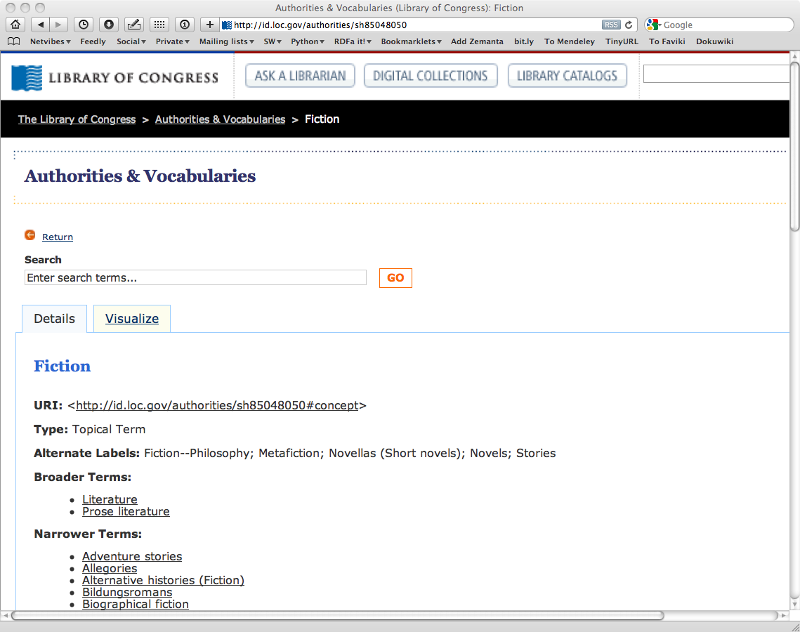
Example: the term “Fiction”, as defined by the Library of Congress

Slide 230
Example: the term “Fiction”, as defined by the Library of Congress

Slide 231
Thesauri have identical structures…
The structure of the LOC page is fairly typical
  label, alternate label, narrower, broader, …
  there is even an ISO standard for these
SKOS provides a basic structure to create an RDF representation of these

Slide 232
LOC’s “Fiction” in SKOS/RDF
Literature
skos:Concept
Fiction
skos:prefLabel
rdf:type
skos:prefLabel
skos:broader
http://id.loc.gov/…#concept
skos:altLabel
skos:narrower
Metafiction
skos:altLabel
skos:narrower
skos:prefLabel
Novels
Allegories
Adventure stories
skos:prefLabel

Slide 233
Usage of the LOC graph
Fiction
skos:Concept
Historical Fiction
skos:prefLabel
skos:prefLabel
rdf:type
skos:broader
dc:subject
dc:title
http:.//…/isbn/…
The Glass Palace

Slide 234
Same serialized
<http://…/isbn/000651409X>
dc:title "The Glass Palace"@en;
dc:subject <http://id.loc.gov/authorities/sh85061165#concept>;
...
<http://id.loc.gov/authorities/sh85061165#concept>
a skos:Concept;
skos:prefLabel "Historical Fiction"@en;
skos:broader <http://id.loc.gov/authorities/sh85048050#concept>;
...
<http://id.loc.gov/authorities/sh85048050#concept>
a skos:Concept;
skos:prefLabel "Fiction"@en;
skos:narrower <http://id.loc.gov/authorities/sh85061165#concept>;
...

Slide 235
SKOS terms overview
Classes and Properties:
  Basic description (Concept, ConceptScheme,…)
  Labeling (prefLabel, altLabel,…)
  Documentation (definition, historyNote,…)
  Semantic relations (broader, narrower, related,…)
  Collections (Collection, OrderedCollection,…)
  Concept mappings (broadMatch, narrowMatch,…)

Slide 236
Importance of SKOS
SKOS provides a simple bridge between the “print world” and the (Semantic) Web
Thesauri, glossaries, etc, from the library community can be made available
  LOC is a good example
SKOS can also be used to organize, eg, tags, annotate other vocabularies, …

Slide 237
Importance of SKOS
Anybody in the World can refer to common concepts
  they mean the same for everybody
Applications may exploit the relationships among concepts
  eg, SPARQL queries may be issued on the library data+LOC

Slide 238
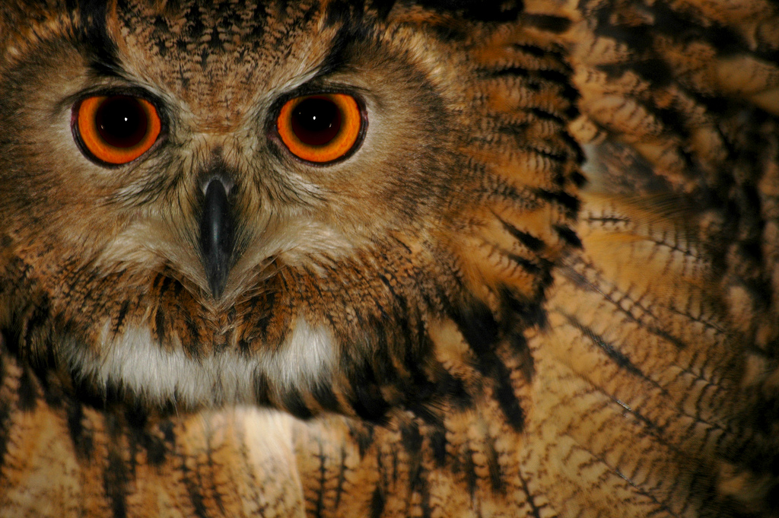
Ontologies
(OWL)
Photo credit “Rickydavid”, Flickr

Slide 239
SKOS is not enough…
SKOS may be used to provide simple vocabularies
But it is not a complete solution
  it concentrates on the concepts only
  no characterization of properties in general
  simple from a logical perspective
    i.e., only a few inferences are possible

Slide 240
Application may want more…
Complex applications may want more possibilities:
  characterization of properties
  identification of objects with different URI-s
  disjointness or equivalence of classes
  construct classes, not only name them
  more complex classification schemes
  can a program reason about some terms? E.g.:
    “if «Person» resources «A» and «B» have the same «foaf:email» property, then «A» and «B» are identical”
  etc.

Slide 241
Ontologies (cont.)
The term ontologies is used in this respect:
“defines the concepts and relationships used to describe
and represent an area of knowledge”
The term ontologies is used in this respect:
  Ie, there is a need for Web Ontology Languages
  RDFS can be considered as a simple ontology language
Languages should be a compromise between
  rich semantics for meaningful applications
  feasibility, implementability

Slide 242
Web Ontology Language = OWL
OWL is an extra layer, a bit like RDF Schemas
  own namespace, own terms
  it relies on RDF Schemas
It is a separate recommendation
  actually… there is a 2004 version of OWL (“OWL 1”)
  and there is an update (“OWL 2”) published in 2009
  this tutorial presupposes OWL 2

Slide 243
OWL is complex…
OWL is a large set of additional terms
We will not cover the whole thing here…

Slide 244
Term equivalences
For classes:
  owl:equivalentClass: two classes have the same individuals
  owl:disjointWith: no individuals in common
For properties:
  owl:equivalentProperty
    remember the a:author vs. f:auteur?
  owl:propertyDisjointWith

Slide 245
Term equivalences
For individuals:
  owl:sameAs: two URIs refer to the same concept (“individual”)
  owl:differentFrom: negation of owl:sameAs

Slide 246
Other example: connecting to French
a:author
owl:equivalentProperty
f:auteur
a:Novel
owl:equivalentClass
f:Roman

Slide 247
Typical usage of owl:sameAs
Linking our example of Amsterdam from one data set (DBpedia) to the other (Geonames):
<http://dbpedia.org/resource/Amsterdam>
owl:sameAs <http://sws.geonames.org/2759793>;
This is the main mechanism of “Linking” in the Linked Open Data project

Slide 248
Property characterization
In OWL, one can characterize the behavior of properties (symmetric, transitive, functional, inverse functional, reflexive, irreflexive, …)
OWL also separates data and object properties
  “datatype property” means that its range are typed literals

Slide 249
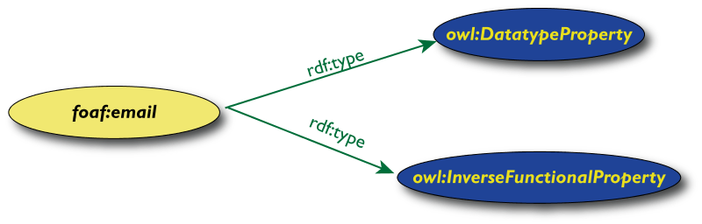
Characterization example
“foaf:email” may be defined as “inverse functional”
  i.e., two different subjects cannot have identical objects

Slide 250
What this means is…
If the following holds in our triples:
:email rdf:type owl:InverseFunctionalProperty.

Slide 251
What this means is…
If the following holds in our triples:
:email rdf:type owl:InverseFunctionalProperty.
<A> :email "mailto:a@b.c".
<B> :email "mailto:a@b.c".

Slide 252
What this means is…
If the following holds in our triples:
:email rdf:type owl:InverseFunctionalProperty.
<A> :email "mailto:a@b.c".
<B> :email "mailto:a@b.c".
then, processed through OWL, the following holds, too:
<A> owl:sameAs <B>.

Slide 253
Inverse properties
There may be an inverse relationship among properties, eg:
<somebook> ex:author <somebody>.
ex:author owl:inverseOf ex:authorOf.
yields, in OWL:
<somebody> ex:authorOf <somebook>.

Slide 254
Property chains
Properties, when applied one after the other, may be subsumed by yet another one:
  “if a person «P» was born in city «A» and «A» is in country «B» then «P» was born in country «B»”
  more formally:
ex:born_in_country owl:propertyChainAxiom
(ex:born_in_city ex:city_in_country).
More than two constituents can be used
There are some restrictions to avoid “circular” specifications

Slide 255
Keys
Inverse functional properties are important for identification of individuals
  think of the email examples
But… identification based on one property may not be enough

Slide 256
Keys
“if two persons have the same emails and the same
homepages then they are identical”
Identification is based on the identical values of two properties
The rule applies to persons only

Slide 257
Previous rule in OWL
:Person rdf:type owl:Class;
owl:hasKey (:email :homepage) .

Slide 258
What it means is…
If:
<A> rdf:type :Person ;
:email "mailto:a@b.c";
:homepage "http://www.ex.org".
<B> rdf:type :Person ;
:email "mailto:a@b.c";
:homepage "http://www.ex.org".
then, processed through OWL, the following holds, too:
<A> owl:sameAs <B>.

Slide 259
Classes in OWL
In RDFS, you can subclass existing classes… that’s all
In OWL, you can construct classes from existing ones:
  enumerate its content
  through intersection, union, complement
  etc

Slide 260
Classes in OWL (cont)
OWL makes a stronger conceptual distinction between classes and individuals
  there is a separate term for owl:Class, to make the difference
  individuals are separated into a special class called owl:Thing
Eg, a precise classification would be:
ex:Person rdf:type owl:Class.
<uri-for-Amitav-Ghosh>
rdf:type owl:Thing;
rdf:type owl:Person .

Slide 261

OWL classes can be “enumerated”
The OWL solution, where possible content is explicitly listed:

Slide 262
Same serialized
<owl:Class rdf:ID="Currency">
<owl:oneOf rdf:parseType="Collection">
<owl:Thing rdf:ID="£"/>
<owl:Thing rdf:ID="€"/>
<owl:Thing rdf:ID="$"/>
…
</owl:oneOf>
</owl:Class>
:£ rdf:type owl:Thing.
:€ rdf:type owl:Thing.
:$ rdf:type owl:Thing.
:Currency
rdf:type owl:Class;
owl:oneOf (:€ :£ :$).

Slide 263

Union of classes
Essentially, like a set-theoretical union:

Slide 264
Same serialized
<owl:Class rdf:ID="Literature">
<owl:unionOf rdf:parseType="Collection">
<owl:Class rdf:about="#Novel"/>
<owl:Class rdf:about="#Short_Story"/>
<owl:Class rdf:about="#Poetry"/>
…
</owl:unionOf>
</owl:Class>
Other possibilities: complementOf, intersectionOf, …
:Novel rdf:type owl:Class.
:Short_Story rdf:type owl:Class.
:Poetry rdf:type owl:Class.
:Literature rdf:type owl:Class;
owl:unionOf (:Novel :Short_Story :Poetry).

Slide 265
For example…
If:
:Novel rdf:type owl:Class.
:Short_Story rdf:type owl:Class.
:Poetry rdf:type owl:Class.
:Literature rdf:type owl:Class;
owl:unionOf (:Novel :Short_Story :Poetry).
<myWork> rdf:type :Novel .
then the following holds, too:
<myWork> rdf:type :Literature .

Slide 266
It can be a bit more complicated…
If:
:Novel rdf:type owl:Class.
:Short_Story rdf:type owl:Class.
:Poetry rdf:type owl:Class.
:Literature rdf:type owlClass;
owl:unionOf (:Novel :Short_Story :Poetry).
fr:Roman owl:equivalentClass :Novel .
<myWork> rdf:type fr:Roman .
then, through the combination of different terms, the following still holds:
<myWork> rdf:type :Literature .

Slide 267
What we have so far…
The OWL features listed so far are already fairly powerful
E.g., various databases can be linked via owl:sameAs, functional or inverse functional properties, etc.
Many inferred relationship can be found using a traditional rule engine

Slide 268
However… that may not be enough
Very large vocabularies might require even more complex features
  typical usage example: definition of all concepts in a health care environment
  some major issues
    the way classes (i.e., “concepts”) are defined
    handling of datatypes
OWL includes those extra features but… the inference engines become (much) more complex ☹

Slide 269
Property value restrictions
Classes are created by restricting the property values on a (super)class
For example: how would I characterize a “listed price”?
  it is a price (which may be a general term), but one that is given in one of the “allowed” currencies (€, £, or $)
  more formally:
    the value of “p:currency”, when applied to a resource on listed price, must take one of those values…
    …thereby defining the class of “listed price”

Slide 270
Restrictions formally
Defines a class of type owl:Restriction with a
  reference to the property that is constrained
  definition of the constraint itself
One can, e.g., subclass from this node when defining a particular class
:Listed_Price rdfs:subClassOf [
rdf:type owl:Restriction;
owl:onProperty p:currency;
owl:allValuesFrom :Currency.
].

Slide 271
Possible usage…
If:
:Listed_Price rdfs:subClassOf [
rdf:type owl:Restriction;
owl:onProperty p:currency;
owl:allValuesFrom :Currency.
].
:Price rdf:type :Listed_Price .
:Price p:currency <someCurrency> .
then the following holds:
<someCurrency> rdf:type :Currency .

Slide 272
Other restrictions
owl:allValuesFrom could be replaced by:
  owl:someValuesFrom
    e.g., I could have said: there should be a price given in at least one of those currencies
  owl:hasValue, when restricted to one specific value
  owl:hasSelf, for local reflexivity

Slide 273
Similar concept: cardinality restriction
In a property restriction, the goal was to restrict the possible values of a property
In a cardinality restriction, the number of relations with that property is restricted
  “a book being on offer” could be characterized as having at least one price property (i.e., the price of the book has been established)

Slide 274
Cardinality restriction
:Book_on_sale rdfs:subClassOf [
rdf:type owl:Restriction;
owl:onProperty p:price;
owl:minCardinality "1"^^xsd:integer.
].
could also be “owl:cardinality” or “owl:maxCardinality”

Slide 275
Qualified Cardinality Restriction
Combining cardinality and the “all value” restriction
  “there should be exactly two listed price tags with currency value”
:Listed_Price rdf:type owl:Class;
rdfs:subClassOf [
rdf:type owl:Restriction;
owl:onProperty p:currency;
owl:onClass :Currency;
owl:qualifiedCardinality "2"^^xsd:integer.
].

Slide 276
Datatypes in OWL
RDF Literals can have a datatypes, OWL adopts those
But more complex vocabularies require datatypes “restrictions”; eg, numeric intervals
  “I am interested in a price range between €5 and €15”

Slide 277
Datatype restrictions
For each datatype, there are possible restriction “facets”: min and max for numeric types, length for strings, etc
These facets can be used to define new datatypes

Slide 278
Definition of a numeric interval
:AllowedPrice rdf:type rdfs:Datatype;
owl:onDatatype xsd:float;
owl:withRestriction (
[ xsd:minInclusive 5.0 ]
[ xsd:maxExclusive 15.0 ]
) .
The possible facets depend on the datatype: xsd:pattern, xsd:length, xsd:maxLength, …

Slide 279
Typical usage of datatype restrictions
:Affordable_book rdf:type owl:Class;
rdfs:subClassOf [
rdf:type owl:Restriction;
owl:onProperty p:price_value;
owl:allValuesFrom [
rdf:type rdfs:Datatype;
owl:onDatatype xsd:float;
owl:withRestriction (
[ xsd:minInclusive 5.0 ]
[ xsd:maxExclusive 15.0 ]
)
]
].
i.e.: an affordable book’s price is between 5.0 and 15.0

Slide 280
But: OWL is hard!
The combination of class constructions with various restrictions is extremely powerful
What we have so far follows the same logic as before
  extend the basic RDF and RDFS possibilities with new features
  define their semantics, ie, what they “mean” in terms of relationships
  expect to infer new relationships based on those
However… a full inference procedure is hard ☹
  not implementable with simple rule engines, for example

Slide 281
OWL “species” or profiles
OWL species comes to the fore:
  restricting which terms can be used and under what circumstances (restrictions)
  if one abides to those restrictions, then simpler inference engines can be used
They reflect compromises: expressiveness vs. implementability

Slide 282
OWL Species
OWL Full
OWL DL
OWL EL
OWL RL
OWL QL

Slide 283
OWL Full
No constraints on any of the constructs
  owl:Class is equivalent to rdfs:Class
  owl:Thing is equivalent to rdfs:Resource
  this means that:
    Class can also be an individual, a URI can denote a property as well as a Class
      e.g., it is possible to talk about class of classes, apply properties on them
    etc.
Extension of RDFS in all respects
But: an OWL Full ontology may be, eg, inconsistent!

Slide 284
Example for a possible OWL Full problem
Here is a syntactically valid but inconsistent ontology:
:A rdf:type owl:Class;
owl:equivalentClass [
rdf:type owl:Restriction;
owl:onProperty rdf:type;
owl:allValuesFrom :B.
].
:B rdf:type owl:Class;
owl:complementOf :A.
:C rdf:type :A .
if c is of type A then it must be in B, but then it is in the complement of A, ie, it is not of type A…

Slide 285
OWL Full usage
Nevertheless OWL Full is important
  it gives a generic framework to express many things
Some application just need to express and interchange terms (with possible scruffiness)
Applications may control what terms are used and how
  in fact, they may define their own sub-language via, eg, a vocabulary (eg, SKOS!)
  thereby ensuring a manageable inference procedure

Slide 286
OWL DL
A number of restrictions are defined
  RDFS and OWL terms are reserved
    no statements on RDFS and OWL resources
  user’s object properties must be among individuals only
  no characterization of datatype properties
  the same symbol, when used for an individual and a class does not mean full identity
  …
But: well known inference algorithms exist!

Slide 287
Examples for restrictions
Given the statement:
<q> rdf:type <A>. # A is a class, q is an individual
the followings are not “legal” OWL DL:
<A> ex:something <B>. # properties are for individuals only
<q> ex:something <s>. # same property cannot be used as object…
<p> ex:something "54". # … and datatype property

Slide 288
Example for restriction on conceptual identity
Same symbol may be used both for a class and an instance
But not all “natural” inferences can be drawn
  eg, although the following is ok:
q rdf:type A. # A is a class, q is an individual
A owl:sameAs B. # A and B are equals as individuals
when using OWL DL, this does not yield
q rdf:type B.

Slide 289
“DL” stands for “Description Logic”
An area in knowledge representation
  a special type of “structured” First Order Logic (logic with safety guards…)
  formalism based on “concepts” (i.e., classes), “roles” (i.e., properties), and “individuals”

Slide 290
OWL DL and Description Logic
OWL DL can be interpreted as a variant of Description Logic
  for connoisseurs: OWL (2) DL ≈ SROIQ (D)
Hence the results of this particular area of logic are directly applicable

Slide 291
Description Logic Formalism
Traditional DL has its own terminology:
  named objects or concepts ⇔ definition of classes, relationships among classes
  roles ⇔ properties
  (terminological) axioms ⇔ subclass and subproperty relationships
  facts or assertions ⇔ statements on individuals (owl:Thing-s)

Slide 292
Description Logic Formalism
There is also a compact mathematical notation for axioms, assertions, etc:
  Literature ≣ Novel ⊔ Short_Story ⊔ Poetry
  Listed_Price ⊑ ∀currency.Currencies
You may see these in papers, books…

Slide 293
OWL DL usage
Abiding to the restrictions means that very large ontologies can be developed that require precise procedures
  eg, in the medical domain, biological research, energy industry, financial services (eg, XBRL), etc
  the number of classes and properties described this way can go up to the many thousands
OWL DL has become a language of choice to define and manage formal ontologies in general
  even if their usage is not necessarily on the Web

Slide 294
OWL also defines “profiles”
Further restrictions on how terms can be used and what inferences can be expected

Slide 295
OWL profiles: EL
Goal: classification and instance queries in polynomial time
Suitable for
  very large number of classes and/or properties
  not require complex expressions
    eg: SNOMED
Some excluded features (beyond those of DL)
  no cardinality restrictions, fewer property restrictions
  no inverse, reflexive, disjoint, symmetric, asymmetric, functional or inverse functional properties
  class disjunction
  …

Slide 296
OWL profiles: QL
Goal: conjunctive queries on top of relational databases (essentially: query rewriting to SQL)
Suitable for
  lightweight ontologies, but large data
Some excluded features (beyond those of DL)
  functional and inverse functional properties, sameAs, keys
  fewer property restrictions
  no cardinality restrictions
  transitive properties, property chains
  …

Slide 297
OWL profiles: RL
Goal: polynomial reasoning on top of rule engines
Suitable for
  relatively lightweight ontologies, but large data
Some excluded features
  fewer property restrictions
  fewer cardinality restrictions (at most 0/1)
  constraints on class expressions (union, intersections, etc) when used in subclass expressions
  no datatype restrictions
  …

Slide 298
Some more on OWL RL
Goal: to be implementable through rule engines
Usage follows a similar approach to RDFS:
  merge the ontology and the instance data into an RDF graph
  use the rule engine to add new triples (as long as it is possible)
This application model is very important for RDF based applications

Slide 299
What can be done in OWL RL?
Many features are available:
  identity of classes, instances, properties
  subproperties, subclasses, domains, ranges
  union and intersection of classes (though with some restrictions)
  property characterizations (functional, symmetric, etc)
  property chains
  keys
  some property restrictions (but not all inferences are possible)
All examples so far could be inferred with OWL RL!

Slide 300
What cannot be done in OWL RL?
There are restrictions on what can be a sub and superclass. Eg, the following is not manageable:
B rdf:type owl:Class;
owl:unionOf (P Q R).
A rdfs:subClassOf B .
Some features are not available or are restricted:
  not all datatypes are available
  no datatype restrictions
  no minimum or exact cardinality restrictions
  maximum cardinality only 0 or 1

Slide 301
What cannot be done in OWL RL?
Some “natural” conclusions cannot be drawn, eg:
A rdf:type owl:Class;
owl:intersectionOf (U V S).
does not yield:
A rdfs:subClassOf U .

Slide 302
Alternative syntaxes for OWL
OWL constructs in RDF can be fairly verbose
There are alternative syntaxes to express ontologies
  direct XML encoding of ontologies (OWL/XML)
  “functional” syntax
  “Manchester” syntax
The official exchange syntax is RDF (RDF/XML)
  all other syntaxes are optional for tools

Slide 303
Functional syntax example
:£ rdf:type owl:Thing.
:€ rdf:type owl:Thing.
:$ rdf:type owl:Thing.
my:Currency rdf:type owl:Class;
owl:oneOf (:€ :£ :$).
my:Listed_Price rdf:type owl:Class;
rdfs:subClassOf [
rdf:type owl:Restriction;
owl:onProperty p:currency;
owl:allValuesFrom my:Currency
].
is equal to:
Declaration(NamedIndividual(:£))
Declaration(NamedIndividual(:€))
Declaration(NamedIndividual(:$))
Declaration(Class(:Currency))
EquivalentClasses(:Currency one of(:€ :£ :$))
SubClassOf(my:Listed_Price AllValuesFrom(p:currency my:Currency))

Slide 304
Manchester syntax example
:£ rdf:type owl:Thing.
:€ rdf:type owl:Thing.
:$ rdf:type owl:Thing.
my:Currency rdf:type owl:Class;
owl:oneOf (:€ :£ :$).
my:Listed_Price rdf:type owl:Class;
rdfs:subClassOf [
rdf:type owl:Restriction;
owl:onProperty p:currency;
owl:allValuesFrom my:Currency
].
is equal to:
Individual: :€
Individual: :£
Individual: :$
Class: my:Currency EquivalentTo {:€ :£ :$}
Class: my:Listed_Price that p:currency only my:Currency

Slide 305
Ontology development
The hard work is to create the ontologies
  requires a good knowledge of the area to be described
  some communities have good expertise already (e.g., librarians)
  OWL is just a tool to formalize ontologies
  large scale ontologies are often developed in a community process

Slide 306
Ontology development (cont.)
Ontologies should be shared and reused
  can be via the simple namespace mechanisms…
  …or via explicit imports
Applications can also be developed with very small ontologies, though

Slide 307
Ontologies examples
eClassOwl: eBusiness ontology for products and services, 75,000 classes and 5,500 properties
National Cancer Institute’s ontology: about 58,000 classes
Open Biomedical Ontologies Foundry: a collection of ontologies, including the Gene Ontology to describe gene and gene product attributes in any organism or protein sequence and annotation terminology and data (UniProt)
BioPAX: for biological pathway data

Slide 308

Rules
(RIF)
Photo credit “Lili.chin”, Flickr

Slide 309
Why rules on the Semantic Web?
Some conditions may be complicated in ontologies (ie, OWL)
  e.g., Horn rules: (P1 & P2 & …) → C
In many cases applications just want 2-3 rules to complete integration
I.e., rules may be an alternative to (OWL based) ontologies

Slide 310
Rules
There is also a long history of rule languages and rule-based systems
  e.g., logic programming (Prolog), production rules
Lots of small and large rule systems (from mail filters to expert systems)
Hundreds of niche markets

Slide 311
Things you may want to express
An example from our bookshop integration:
  “I buy a novel with over 500 pages if it costs less than €20”
  something like (in an ad-hoc syntax):
{
?x rdf:type p:Novel;
p:page_number ?n;
p:price [
p:currency :€;
rdf:value ?z
].
?n > "500"^^xsd:integer.
?z < "20.0"^^xsd:double.
}
=>
{ <me> p:buys ?x }

Slide 312
Things you may want to express
p:Novel
rdf:type
p:page_number
?n
?n>500
?x
me
p:buys
?x
p:price
p:currency
:€
rdf:value
?z
?z<20

Slide 313
RIF (Rule Interchange Format)
The goals of the RIF work:
  define simple rule language(s) for the (Semantic) Web
  define interchange formats for rule based systems
RIF defines several “dialects” of languages

Slide 314
RIF Core
The simplest RIF “dialect”
A Core document is
  some directives like import, prefix settings for URI-s, etc
  a sequence of logical implications
RIF is not bound to RDF only
  eg, relationships may involve more than 2 entities

Slide 315
RIF Core example
Document(
Prefix(cpt http://example.com/concepts#)
Prefix(ppl http://example.com/people#)
Prefix(bks http://example.com/books#)
Group
(
Forall ?Buyer ?Item ?Seller (
cpt:buy(?Buyer ?Item ?Seller):- cpt:sell(?Seller ?Item ?Buyer)
)
cpt:sell(ppl:John bks:LeRif ppl:Mary)
)
)
This infers the following relationship:
cpt:buy(ppl:Mary bks:LeRif ppl:John)

Slide 316
Expressivity of RIF Core
Formally: definite Horn without function symbols, a.k.a. “Datalog”
  e.g., p(a,b,c) is fine, but p(f(a),b,c) is not
Includes some extra features
  built-in datatypes and predicates
  notion of “local names”, a bit like RDF’s blank nodes
  …

Slide 317
Expressivity of RIF Core
There are also “safeness measures”
  eg, variable in a consequent should be in the antecedent
    this secures a straightforward implementation strategy (“forward chaining”)
RIF Core is the simplest rule dialect
  but covers a large percentage of RDF related use cases…

Slide 318
RIF Syntaxes
RIF defines
  a “presentation syntax”
    a bit like the functional syntax for OWL
  a standard XML syntax to encode and exchange the rules
  there is a draft for expressing Core in RDF
    just like OWL is represented in RDF

Slide 319
What about RDF and RIF?
Typical scenario:
  the “data” of the application is available in RDF
  rules on that data is described using RIF
  the two sets are “bound” (eg, RIF “imports” the data)
    if RIF is encoded in RDF, the two sets may be in the same file
  a RIF processor produces new relationships

Slide 320
To make RIF/RDF work
Some technical issues should be settled:
  RDF facts/triples have to be representable in RIF
  various constructions (typing, datatypes, lists) should be aligned
  the formal semantics of the two worlds should be compatible
There is a separate document that brings these together

Slide 321
Expressing RDF triples in RIF
RIF has a “frame-based” syntax:
s[p->x q->z]
This is used to represent the RDF triples:
s p x .
s q z .
The rest is fairly obvious

Slide 322
RIF/RDF harmonization
RDF
RIF
s p o .
⬄
s[p->o]
s rdf:type A .
⬄
A # B
(A B C)
⬄
List(A B C)
datatypes
⬄
datatypes
_:a
(blank nodes)
_a
(local names)
⬄

Slide 323
Remember the what we wanted from Rules?
{
?x rdf:type p:Novel;
p:page_number ?n;
p:price [
p:currency :€;
rdf:value ?z
].
?n > "500"^^xsd:integer.
?z < "20.0"^^xsd:double.
}
=>
{ <me> p:buys ?x }

Slide 324
The same with RIF Presentation syntax
Document (
Prefix …
Group (
Forall ?x ?n ?z (
<me>[p:buys->?x] :-
And(
?x rdf:type p:Novel
?x[p:page_number->?n p:price->_abc]
_abc[p:currency->:€ rdf:value->?z]
External(pred:numeric-greater-than(?n "500"^^xsd:integer))
External(pred:numeric-less-than(?z "20.0"^^xsd:double))
)
)
)
)

Slide 325
Discovering new relationships…
Forall ?x ?n ?z (
<me>[p:buys->?x] :-
And(
?x # p:Novel
?x[p:page_number->?n p:price->_abc]
_abc[p:currency->:€ rdf:value->?z]
External( pred:numeric-greater-than(?n "500"^^xsd:integer) )
External( pred:numeric-less-than(?z "20.0"^^xsd:double) )
)
)

Slide 326
Discovering new relationships…
Forall ?x ?n ?z (
<me>[p:buys->?x] :-
And(
?x # p:Novel
?x[p:page_number->?n p:price->_abc]
_abc[p:currency->p:€ rdf:value->?z]
External( pred:numeric-greater-than(?n "500"^^xsd:integer) )
External( pred:numeric-less-than(?z "20.0"^^xsd:double) )
)
)
combined with:
<http://…/isbn/…> a p:Novel;
p:page_number "600"^^xsd:integer ;
p:price [ rdf:value "15.0"^^xsd:double ; p:currency :€ ] .

Slide 327
Discovering new relationships…
Forall ?x ?n ?z (
<me>[p:buys->?x] :-
And(
?x # p:Novel
?x[p:page_number->?n p:price->_abc]
_abc[p:currency->p:€ rdf:value->?z]
External( pred:numeric-greater-than(?n "500"^^xsd:integer) )
External( pred:numeric-less-than(?z "20.0"^^xsd:double) )
)
)
combined with:
<http://…/isbn/…> a p:Novel;
p:page_number "600"^^xsd:integer ;
p:price [ rdf:value "15.0"^^xsd:double ; p:currency :€ ] .
yields:
<me> p:buys <http://…/isbn/…> .

Slide 328
A word on the syntax
The RIF Presentation syntax is… only syntax
It can express more than what RDF needs
Hopefully, a syntax will emerge with
  close to one of the RDF syntaxes with a better integration of rules
  can be mapped on Core implementations

Slide 329
RIF vs. OWL?
OWL concentrates on “taxonomic reasoning”
  i.e., if you have large knowledge bases, ontologies, use OWL
Rules concentrate on reasoning problems within the data
  i.e., if your knowledge base is simple but lots of data, use rules
But these are thumb rules only…

Slide 330
At the end of the day…
Using rules vs. ontologies may largely depend on
  available tools
  personal technical experience and expertise
  taste…

Slide 331
What about OWL RL?
OWL RL stands for “Rule Language”…
OWL RL is in the intersection of RIF Core and OWL
  inferences in OWL RL can be expressed with rules
    the rules are precisely described in the OWL specification
  there are OWL RL implementations that are based on RIF

Slide 332
Why other RIF dialects?
Applications may want to exchange their rules:
  negotiate eBusiness contracts across platforms: supply vendor-neutral representation of your business rules so that others may find you
  describe privacy requirements and policies, and let clients “merge” those (e.g., when paying with a credit card)

Slide 333
In an ideal world
Rule system #1
Rule system #8
Rule system #2
Universal RULE exchange format and language
Rule system #7
Rule system #3
Rule system #6
Rule system #4
Rule system #5

Slide 334
In the real World…
Rule based systems can be very different
  different rule semantics (based on various type of model theories, on proof systems, etc)
  production rule systems, with procedural references, state transitions, etc
Such universal exchange format is not feasible
The idea is to define “cores” for a family of languages with “variants”

Slide 335
A partial interchange…
Rule system #1
Rule system #4
“Core”
Rule system #2
Rule system #3

Slide 336
RIF “dialects”…
Dialect #1
“Core”
Dialect #3
Dialect #2
Dialect #3
Possible dialects: F-logic, fuzzy logic, …

Slide 337
The role of dialects
Dialect #1
“Core”
Dialect #3
Dialect #2
Dialect #3

Slide 338
The role of dialects
Rule system #1
Rule system #2
Rule system #9
Dialect #1
Rule system #3
Rule system #8
“Core”
Dialect #3
Dialect #2
Dialect #3
Rule system #10
Rule system #4
Rule system #5
Rule system #7
Rule system #6

Slide 339
The role of dialects
Rule system #1
Rule system #2
Rule system #9
Dialect #1
Rule system #3
Rule system #8
“Core”
Dialect #3
Dialect #2
Dialect #3
Rule system #10
Rule system #4
Rule system #5
Rule system #7
Rule system #6

Slide 340
The role of dialects
Rule system #1
Rule system #2
Rule system #9
Dialect #1
Rule system #3
Rule system #8
“Core”
Dialect #3
Dialect #2
Dialect #3
Rule system #10
Rule system #4
Rule system #5
Rule system #7
Rule system #6

Slide 341
The role of dialects
Rule system #1
Rule system #2
Rule system #9
Dialect #1
Rule system #3
Rule system #8
“Core”
Dialect #3
Dialect #2
Dialect #3
Rule system #10
Rule system #4
Rule system #5
Rule system #7
Rule system #6

Slide 342
However…
Even this model does not completely work
The gap between production rules and “traditional” logic systems is too large
A hierarchy of cores is necessary:
  a Basic Logic Dialect and Production Rule Dialect as “cores” for families of languages
  the common RIF Core binding these two

Slide 343
Schematically…
The “BLD (Basic Logic Dialect)” is of the form:
  “if condition true then this is true”
  conditions may include functions, hierarchies
The “PLD (Production Logic Dialect)” is of the form:
  “if condition is true then do something”
The “Core”: shared subset of major language

Slide 344
Hierarchy of cores
Rule system #1
Rule system #2
RIF Core
RIF BLD
Rule system #9
Rule system #3
RIF PLD
Rule system #8
Rule system #4
Rule system #10
Rule system #5
Rule system #7
Rule system #6

Slide 345

A rough division of features...
Courtesy of Sandro Hawke, W3C

Slide 346
Remember this?
0006511409X
<Book#ISBN>
The Glass Palace
<Book#Title>
<Book/ISBN=0006511409>
2000
<Book#Year>
<Book#Author>
id_xyz
<Person/ID=id_xyz>
<Person#ID>
<Person#Name>
<Person#Homepage>
CONSTRUCT {
?id a:title ?title ;
a:year ?year ;
a:author _:x .
_:x a:name ?name ;
a:homepage ?hp .
}
WHERE {
?book
<Book#ISBN> ?isbn ;
<Book#Title> ?title ;
<Book#Year> ?year ;
<Book#Author> ?author .
?author
<Person#Name> ?name ;
<Person#Homepage> ?homepage .
BIND (IRI(fn:concat("http://...",?isbn)) AS ?id)
BIND (IRI(?homepage) AS ?hp)
}
Ghosh, Amitav
http://www.amitavghosh.com
The Glass Palace
a:title
http://…isbn/000651409X
2000
a:year
a:author
a:name
a:homepage
Ghosh, Amitav
http://www.amitavghosh.com

Slide 347
Same with RIF Core
0006511409X
<Book#ISBN>
The Glass Palace
<Book#Title>
<Book/ISBN=0006511409>
2000
<Book#Year>
<Book#Author>
id_xyz
<Person/ID=id_xyz>
<Person#ID>
<Person#Name>
<Person#Homepage>
?id[a:year->?year a:title->?title
a:author->?author] :-
And(
?book[<Book#ISBN> -> ?isbn
<Book#Title> -> ?title
<Book#Year> -> ?year
<Book#Author> -> ?author]
External(pred:iri-string(?id
External(func:concat("http://..." ?isbn))))
)
)
?author[a:name->?name a:homepage->?hp] :-
And(
?author[<Person#Name> -> ?name
<Person#Homepage> -> ?homepage]
External(pred:iri-string(?hp ?homepage))
)
)
Ghosh, Amitav
http://www.amitavghosh.com
The Glass Palace
a:title
http://…isbn/000651409X
2000
a:year
a:author
a:name
a:homepage
Ghosh, Amitav
http://www.amitavghosh.com

Slide 348
Vocabularies and SPARQL
Question: how does SPARQL queries and vocabularies work together?
  RDFS, OWL, and RIF produce new relationships
  on what data do we query?
Answer: in current SPARQL, that is not defined ☹
But, in SPARQL 1.1 it is…☺

Slide 349
SPARQL 1.1 and RDFS/OWL/RIF
SPARQL Engine with entailment
RDF Data
RDFS/OWL/RIF data
entailment
SPARQL Pattern
RDF Data with extra triples
SPARQL Pattern
Query result
pattern matching

Slide 350
SPARQL 1.1 as a unifying point
Application
SPARQL Endpoint
SPARQL Endpoint
SPARQL Construct
SPARQL Construct
Triple store
SPARQL Update
SPARQL Processor
SPARQL Update
Database
Inferencing
RDFa
NLP Techniques
GRDDL, RDFa
SQL⬄RDF
RDF Graph
Relational
Database
Inferencing
HTML
Unstructured Text
XML/XHTML

Slide 351

What have we achieved?
(putting all together)

Slide 352
Remember the integration example?
Applications
Manipulate
Query
…
Map,
Expose,
…
Data represented in abstract format
Data in various formats

Slide 353
Same with what we learned
Applications
RESTful API
SPARQL,
Inferences
…
R2RML,
RDFa,
…
Data represented in RDF with extra knowledge (RDFS, SKOS, RIF, OWL,…)
Data in various formats

Slide 354
Remember the integration example?
Web of Data Applications
Stand Alone Applications
Browser Applications
Query and Update
Common “Graph” Format &
Common Vocabularies
Inferencing
“Bridges”
Data on the Web

Slide 355
The same with what we learned
Semantic Web Applications
Stand Alone Applications
Browser Applications
SPARQL, RESTful API-s
RDF Graph with vocabularies in RDFS, SKOS, OWL, RIF, …
Inferencing
RDFa, μData,
R2RML, DM …
Data on the Web

Slide 356

What else may be on the horizon?

Slide 357
Some items, issues, questions, …
Quality constraints on graphs
  “may I be sure that certain patterns are present in a graph?”
Quality control of the content of the graphs
  are links really what they should be?
User interfaces for exploring large datasets
Access control issues on a Web of Data

Slide 358
Some items, issues, questions, …
Ontology merging, alignment, term equivalences, versioning, development, …
Scaling:
  what does it mean to “reason” and “infer” on graphs with millions of triples?
  how can one systematically “explore” a huge Web of Data

Slide 359
Some items, issues, questions, …
Naming:
  the SW infrastructure relies on unique naming of “things” via URI-s
  lots of discussions are happening that touch upon general Web architecture, too
    HTTP URI-s or other URN-s?
    URI-s for “informational resources” and “non informational resources”
    how to ensure that URI-s used on the SW are dereferencable
    etc.

Slide 360
Some items, issues, questions, …
A different aspect of naming: what is the URI for a specific entity (regardless of the technical details)
  what is the unique URI for, e.g., Bach’s Well-Tempered Clavier?
    obviously important for music ontologies an data
  who has the authority or the means to define and maintain such URI-s?
  should we define characterizing properties for these and use owl:sameAs instead of a URI?
The traditional library community may be of a big help in this area

Slide 361
Some items, issues, questions, …
Uncertainty:
  Fuzzy logic
    look at alternatives of Description Logic based on fuzzy logic
    alternatively, extend RDF(S) with fuzzy notions
  Probabilistic statements
    have an OWL class membership with a specific probability
    combine reasoners with Bayesian networks
  A W3C Incubator Group has issued a report on the current status, possibilities, directions, etc.
  possible RIF dialect for fuzzy logic, for example?

Slide 362

Available documents, resources
Photo credit “Abizern”, Flickr

Slide 363
Available specifications:
Primers, Guides
The “RDF Primer” and the “OWL Guide” give a formal introduction to RDF(S) and OWL
SKOS has its separate “SKOS Primer”
GRDDL Primer and RDFa Primer have been published; RIF Primer is on its way
The W3C Semantic Web Activity Wiki has links to all the specifications

Slide 364
“Core” vocabularies
There are also a number “core vocabularies”
  Dublin Core: about information resources, digital libraries, with extensions for rights, permissions, digital right management
  FOAF: about people and their organizations
  DOAP: on the descriptions of software projects
  SIOC: Semantically-Interlinked Online Communities
  vCard in RDF
  …
One should never forget: ontologies/vocabularies must be shared and reused!

Slide 365
Some books
T. Heath and C. Bizer: Linked Data: Evolving the Web into a Global Data Space, 2011
M. Watson: Practical Semantic Web and Linked data Applications, 2010
P. Hitzler, R. Sebastian, and M. Krötzsch: Foundation of Semantic Web Technologies, 2009
G. Antoniu and F. van Harmelen: Semantic Web Primer, 2nd edition, 2008
D. Allemang and J. Hendler: Semantic Web for the Working Ontologist, 2008
…
See the separate Wiki page collecting book references

Slide 366
Further information
Planet RDF aggregates a number of SW blogs:
  http://planetrdf.com/
Semantic Web Interest Group
  a forum developers with a publicly archived mailing list, and a constant IRC presence on freenode.net#swig
  anybody can sign up on the list
    http://www.w3.org/2001/sw/interest/
Linked Data mailing list
  a forum concentrating on linked data with a public archive
  anybody can sign up on the list
    http://lists.w3.org/Archives/Public/public-lod/

Slide 367

Great community…
From a presentation given by David Norheim, Computas AS, ESTC2008 Conference, Vienna, Austria

Slide 368
Lots of Tools (not an exhaustive list!)
Some names:
  Jena, AllegroGraph, Mulgara, Sesame, flickurl, 4Store, Stardog, …
  TopBraid Suite, Virtuoso environment, Falcon, Drupal 7, Redland, Pellet, …
  Disco, Oracle 11g, RacerPro, IODT, Ontobroker, OWLIM, Talis Platform, …
  RDF Gateway, RDFLib, Open Anzo, DartGrid, Zitgist, Ontotext, Protégé, …
  Thetus publisher, SemanticWorks, SWI-Prolog, RDFStore…
  …
Categories:
  Triple Stores
  Inference engines
  Converters
  Search engines
  Middleware
  CMS
  Semantic Web browsers
  Development environments
  Semantic Wikis
  …
More on http://www.w3.org/2001/sw/wiki/Tools

Slide 369
Deployment, applications

Slide 370
See the separate slide set…

Slide 371

Conclusions

Slide 372
To remember…
Data on the Web is a major challenge
  technologies are needed to use them, to interact with them, to integrate them
Semantic Web technologies, Linked Data principles and practices, etc., should play a major role in publishing and using Data on the Web

Slide 373

Lot remain to be done…
Lots of issues to be solved
But… W3C needs experts!
  consider joining W3C, as well as the work done there!

Slide 374

Thank you for your attention
These slides are also available on the Web:
http://www.w3.org/People/Ivan/CorePresentations/SWTutorial/

