Slide 1
MultilingualWeb Standards and best practices for the Multilingual Web
An Overview of the Thematic Network funded by
the European Commission
11 June 2010

Slide 2
Overview
Organization
Thematic Network funded by the European Commission (ICT PSP Grant Agreement No. 250500, and as part of the Competitiveness and Innovation Framework Programme)
Participants
22 partners from 15 countries all over Europe
Overall Objective
Industry (providers or users of technology or services), Academia, Standardization Organizations
Examine how the multilingual Web can be improved through standards and best practices
Coordination: World Wide Web Consortium (W3C)/European Research Consortium for Informatics and Mathematics (ERCIM)
Dissemination/Outreach
4 public events
Web site (http://www.multilingualweb.eu)
Other items (unfunded, developed by the W3C based on input from partners) Educational material/curriculum Test results (see http://www.w3.org/International/tests/) Internationalization Checker (http:// qa-dev.w3.org/i18n-checker)
Duration: 24 months from 1 April 2010
Covering wide range of subject areas: language technology, localization, browser development, content creation, social media …

Slide 3
Goals
Increase visibility and use of existing best practices and standards.
Act as catalyst for future projects related to standardization, best practices and tools development.
Create network links across organizations, scientific disciplines & industry application areas.
Improve use of standards & best practices in the creation of pages using (X)HTML and CSS by content developers.
Improve support for multilingual features in Web user agents.

Slide 4
Partners
Institutul de Cercetari Pentru Intelegentia Articificiala (RACAI), Romania
Institut Josef Stefan, Slovenia
University of Applied Sciences (UAS) Potsdam, Germany
Consiglio Nazionale delle Ricerche, Italy
Aalto-Korkeakoulusaatio, Finland
Industry
Academia
Bioloom Group, Germany
Facebook, Ireland
Standardization Organizations/Other
European Commission, Directorate-General for Translation, Luxembourg
Lionbridge, Belgium
Microsoft Ireland
Opera Software, Norway
SAP, Germany
University of Oviedo (ILTO), Spain
Universidad Politécnica de Madrid (UPM), Spain
University of Economics, Prague, Czech Republic
Transware Ltd (WeLocalize), Ireland
XML-INTL, UK
LISA, Switzerland
Translation Automation User Society (TAUS), Netherlands
W3C/ERCIM, France (coordination)
Language Technology Centre, UK
Language Resource Centre (LRC), Ireland

Slide 5
Dissemination – Public Events
Launch event: The Multilingual Web –Where are we?
Workshop: Content Creation
Workshop: Translation Tools
Workshop: TBD
5-6 October 2010
Madrid, Spain
March 2011
Pisa, Italy
Limerick, Ireland
February 2012
Luxembourg
September 2011

Slide 6
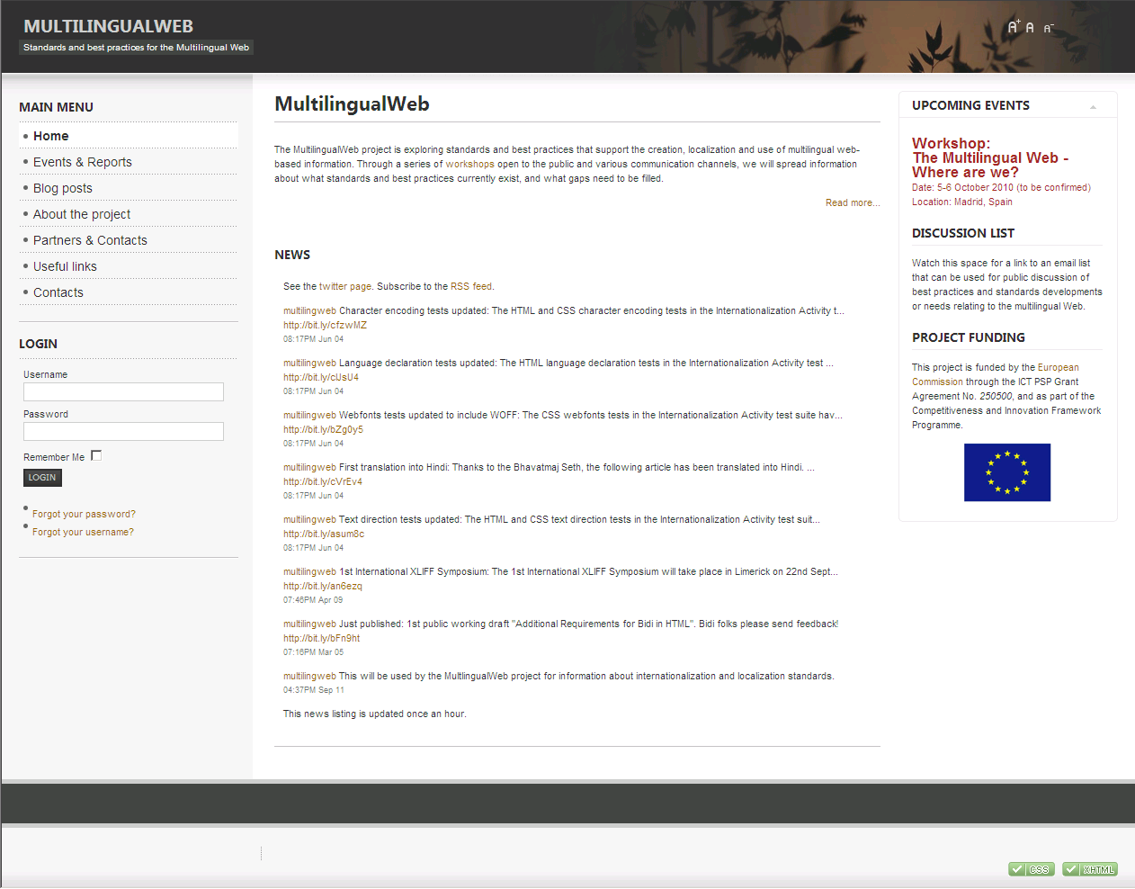
Dissemination – Other Outreach
Web Site
http://www.multilingualweb.eu/
Twitter
Facebook
Tools
http:// qa-dev.w3.org/i18n-checker
@multilingweb
TBA
…

