Slide 1
Multilingual Web-LT
Prague Face-to-Face

Slide 2
Motivations
Streamline linguistic review process
Reduce multiple review of similar content
Use provenance of segments to reinforce assessment
Harmonize user toolset
Reduce installation footprint and requirements
Transparently capture metadata for business intelligence
Build real-time workflow rules based on past translator performance
Build content profile from translation agent, MT confidence, domain, purpose, etc.
Use Linked Data to capture cross-silo process profile of content

Slide 3
Progress to date
Provenance
Language Quality
Parallel prototypes

Slide 4
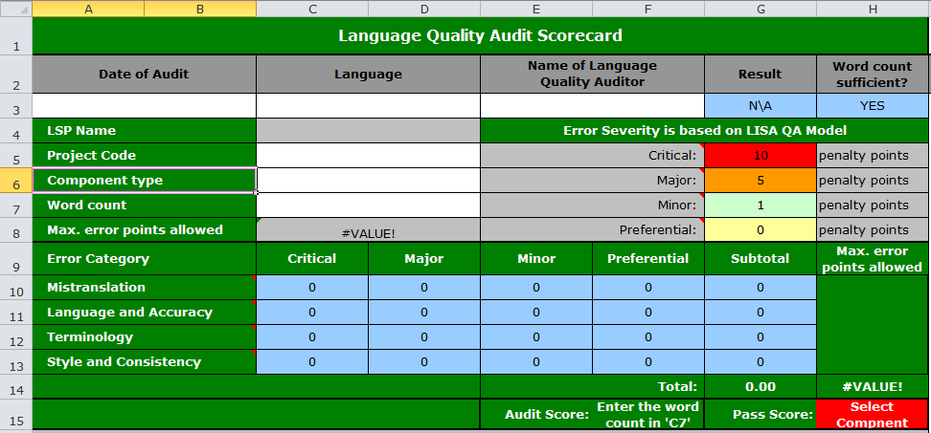
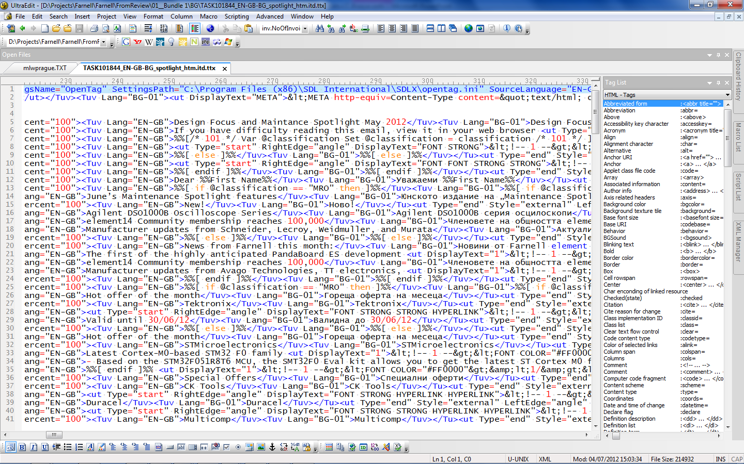
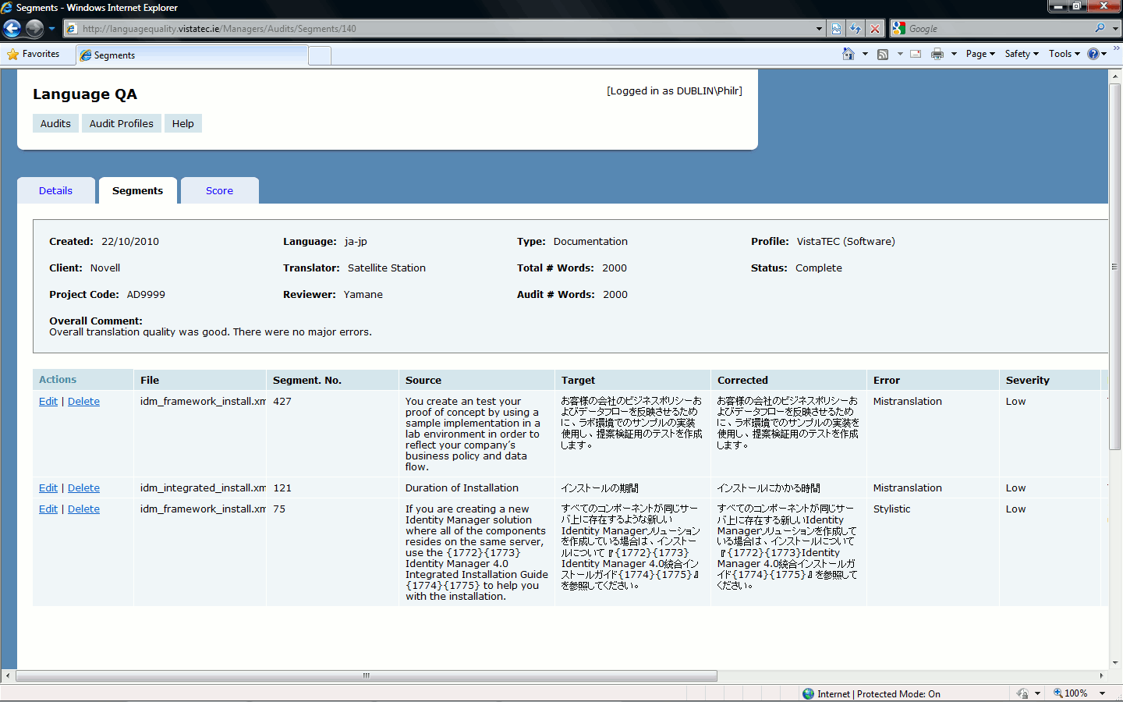
Current Workflow
Multiple applications
Double-handling
Invasive/explicit data capture
Translation (xliff, itd, sdlxliff)
Review (xliff, itd, sdlxliff + Excel)
Data harvest

Slide 5
SDL Trados output
Three files:
Pre Review - .ttx file
Post Review - .ttx file
Error log - .csv file

Slide 6
Pre and Post Review
.ttx Files
SDL’s XML envelope for storing translation data

Slide 7
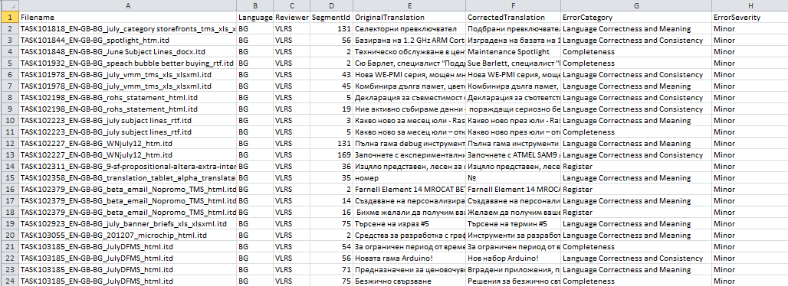
Error Log
.csv file
Holds the Quality Assurance information of the .ttx files

Slide 8
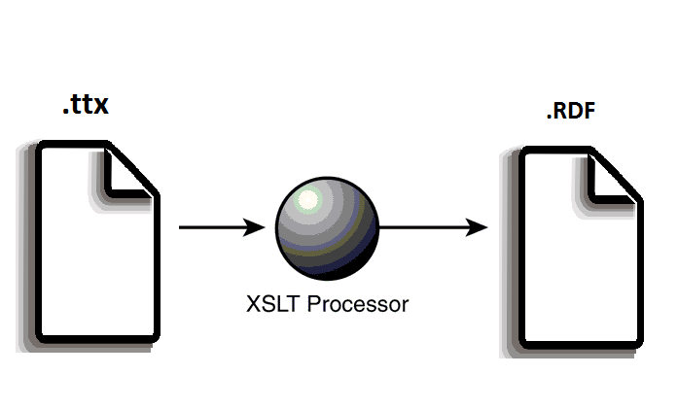
Converting to RDF (.ttx)
To convert the .ttx files to RDF we use a XSLT style sheet

Slide 9
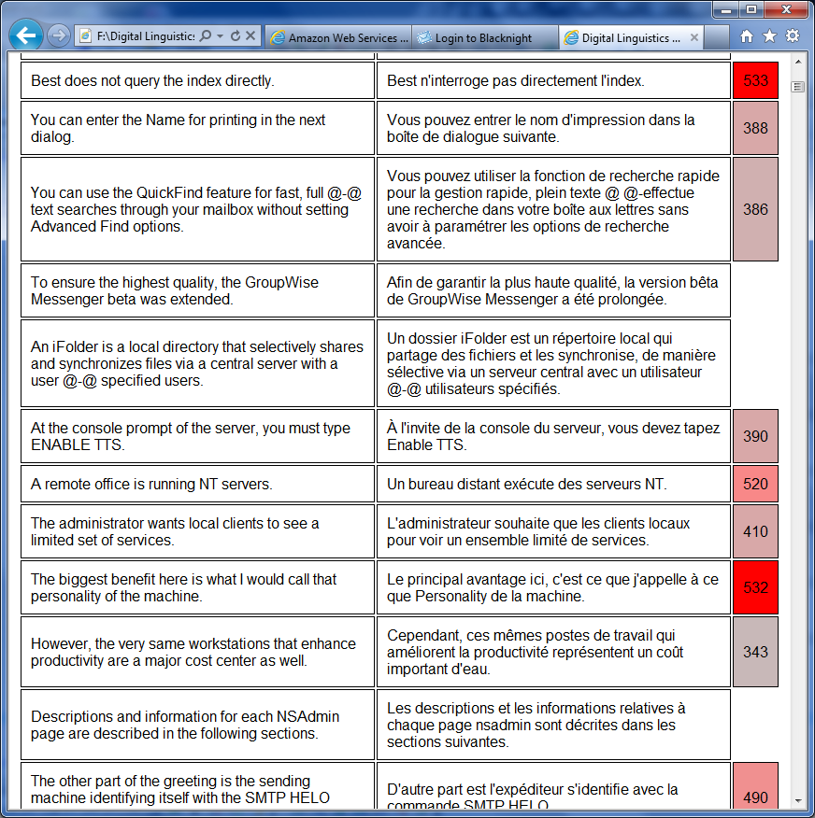
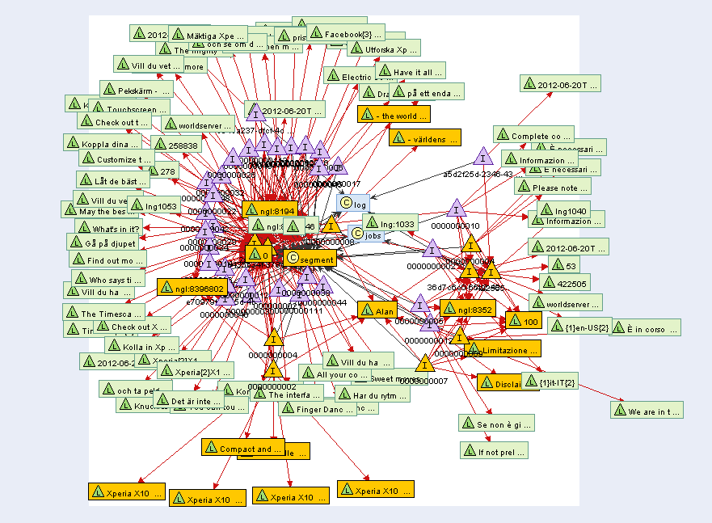
Improved Workflow
Translation (xliff)
Conformance check (xliff)
Review (xliff, html5)
Data harvest (provenance)
Single pervasive interface
Transparent data capture

Slide 10
Demo

