Slide 1









Linked Data as an enabler of cross-media and multilingual content analytics for enterprises across Europe
Gómez-Pérez (UPM)
asun@fi.upm.es
Project Coordinator
CSA
Budget: 1.482.000€
Starting date: 1. Nov. 2013
Duration: 2 Years
Notes:
1

Slide 2















The LIDER consortium
Universidad Politécnica de Madrid (UPM, Spain) [COORDINATOR]
Trinity College Dublin (Ireland)
DFKI (Germany)
National University of Ireland, Galway (Ireland)
Institut für Angewandte Informatik EV (INFAI, Germany)
University of Bielefeld (Germany)
Universita degli Studi di Roma La Sapienza (Italy)
GEIE ERCIM (France)

Slide 3
Evidence of industrial demand
Multilingual multimedia content annotation.
  Increase demand for NLP services that combine text processing with Multimedia meta-data and media processing components.
LOD generation from linguistic resources
  data is already being published by companies, but not linguistic resources as LLOD
LOD-based NLP services for Content Analytics
  CA related companies that actively use the English Dbpedia (OpenCalais, Zemanta, Ontos, Yahoo!, Nerd, etc.)
  multilingual LOD would be vital for reaching EU-wide and global markets

Slide 4
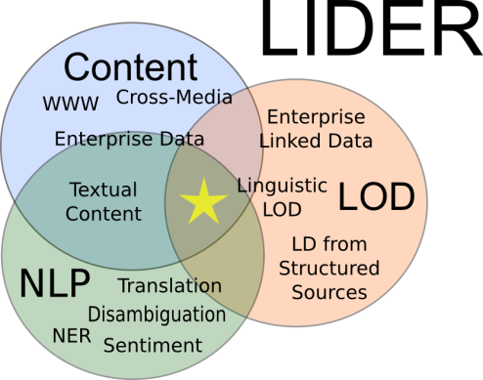
The use of LOD for NLP in Content Analytics
Which extensions to the LOD are needed to support a new generation of large-scale content analytics applications that will overcome language barriers.
  identification of key NLP tasks that require background knowledge
  Specification of a new generation of NLP services that are LOD-aware and can exploit LOD
    Licensed linguistic linked data (LLD or LLOD)

Slide 5


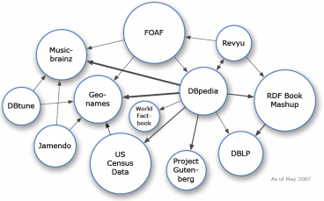
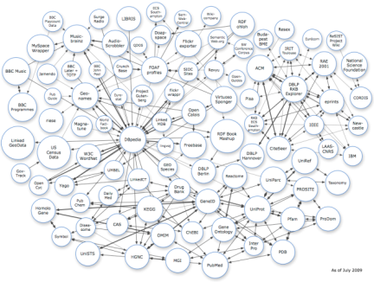


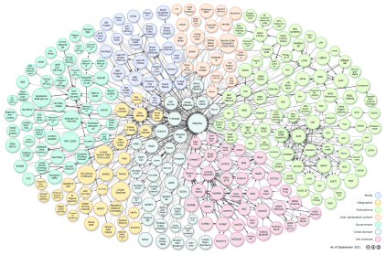

Linked Open Data and Language
LOD is increasingly multilingual
LOD interconnects resources in many languages
2007
2009
2012

Slide 6
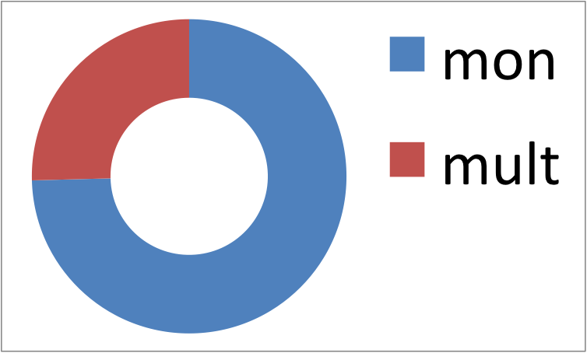
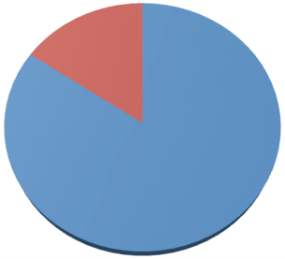
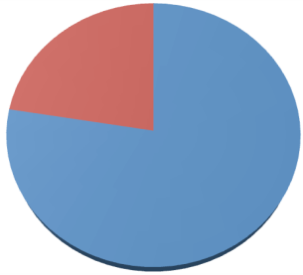
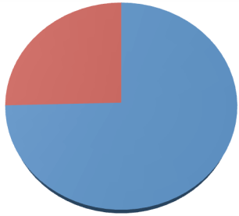
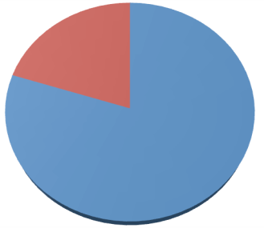
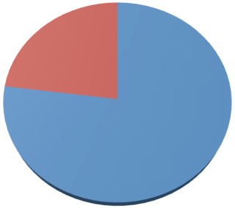
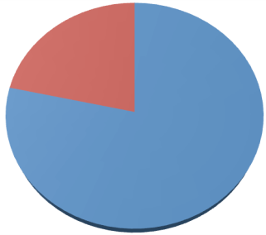
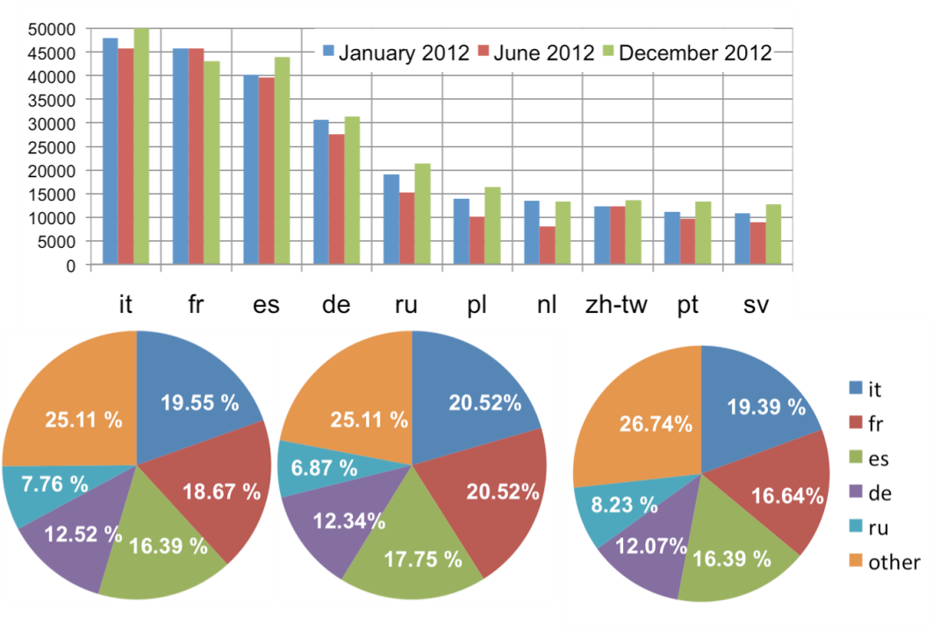

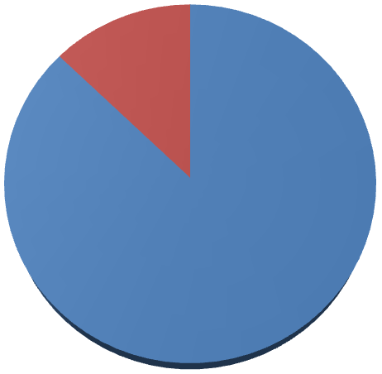
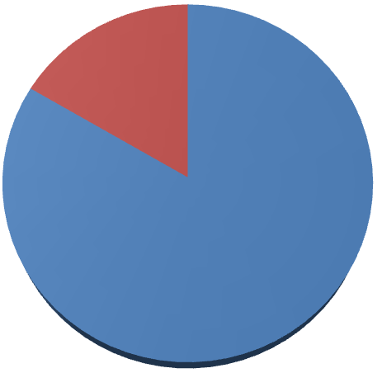
LOD is dominated by the English language
Monolingual
datasets
Multilingual
datasets
RDF literals without
language tag
RDF literals with
language tag
349
635
676
2,567,324
3,154,779
3,365,930
1,906
2,201
1,984
10,250,936
10,594,338
12,272,806
January 2012
June 2012
December 2012
January 2012
June 2012
December 2012
1. Number of Monolingual and multilingual datasets
2. Current usage of language tagging capabilities in RDF
RDF literals with
English tag
RDF literals with
other language tag
431,660
403,714
557,785
2,135,664
2,751,065
2,808,145
January 2012
June 2012
December 2012
3. English tags versus other languages' tags
4. Evolution of top-10 languages (non Eglish)

Slide 7






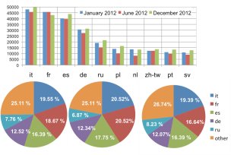
  LOD as large background knowledge for NLP
Content
Analytics
Producers
Consumers
Multimedia and
Multilingual Content
LOD-aware NLP services
Metadata Generation
Multilingual content medatada
LLOD (language resources as LD)
Linguistic LOD generation
...
Language Resources (Lexicon, corpora, ...) some of them are FOI other are private

Slide 8
Iterative approach
Industry use cases
Roadmap, guidelines, target architecture
Community building networking

Slide 9

Expected Contributions from the Community
Use case definition from industry will be input to the roadmap
Linguistic resources →LLOD
Validation of guidelines and reference architecture
Participation in surveys
Participation in events:
  Roadmapping WS, hackatons, etc.
public-lider-community@delicias.dia.fi.upm.es
Lider will help with travelling grants
to participants in Roadmapping WS

Slide 10
Linked Data as an enabler of cross-media and multilingual content analytics for enterprises across Europe
Gómez-Pérez (UPM)
asun@fi.upm.es
Project Coordinator
Notes:
10

Slide 11
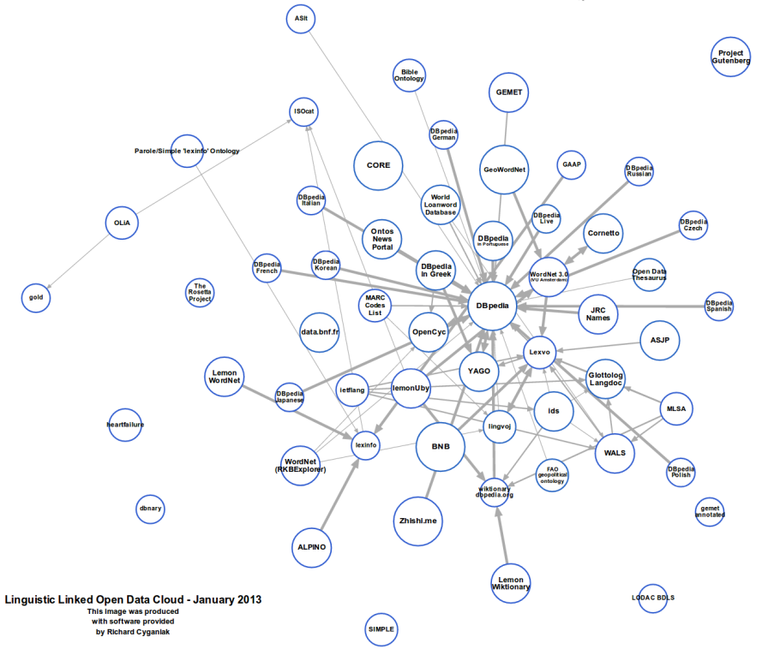
The use of (Linguistic) LOD for NLP
Linguistic LOD (LLOD)
  Subset of LOD
  Linguistic and Open resources in RDF interconnected with other Linguistic and Open resources
  Not too many linguistic resources as LOD
  Linguistic LD (LLD)
    Licensed linguistic linked data
  LOD, LLOD and LLD as a source of large background knowledge for NLP

Slide 12
Workplan and outcomes
1. Definition of business use cases
  Extract requirements needed to exploit LLD in content analytics processes
  Extract common and frequent NLP-based tasks that are needed for content analytics.
2. Definition of Guidelines and best practices for:
  Multimedia and multilingual content metadata generation and use
  LLD generation
  NLP services built on top of LLD
3. Reference Architecture and Roadmap for content analytics
  Reference architecture: reference model + architectural patterns
  Roadmap involving the academic community and industry
Business use cases: LLD in CA
Guidelines and best practices: LLD for CA
Linguistic LOD
LLD Reference Architecture
Roadmap: LLD for CA

Slide 13
Workplan and Outcomes
4. Community Building and Dissemination
  Industrial Board
  Open community Events tailored to the different audiences
    Roadmapping Workshops
    Surveys to localization industry and general Web companies
    Sessions at W3C Multilingual Web Workshop and European Data Forum
    Publication of best practices material via W3C community groups
    Hackathons
  Community portal
    Relying on http://www.multilingualweb.eu portal and the related social channels
  Dissemination activities

Slide 14
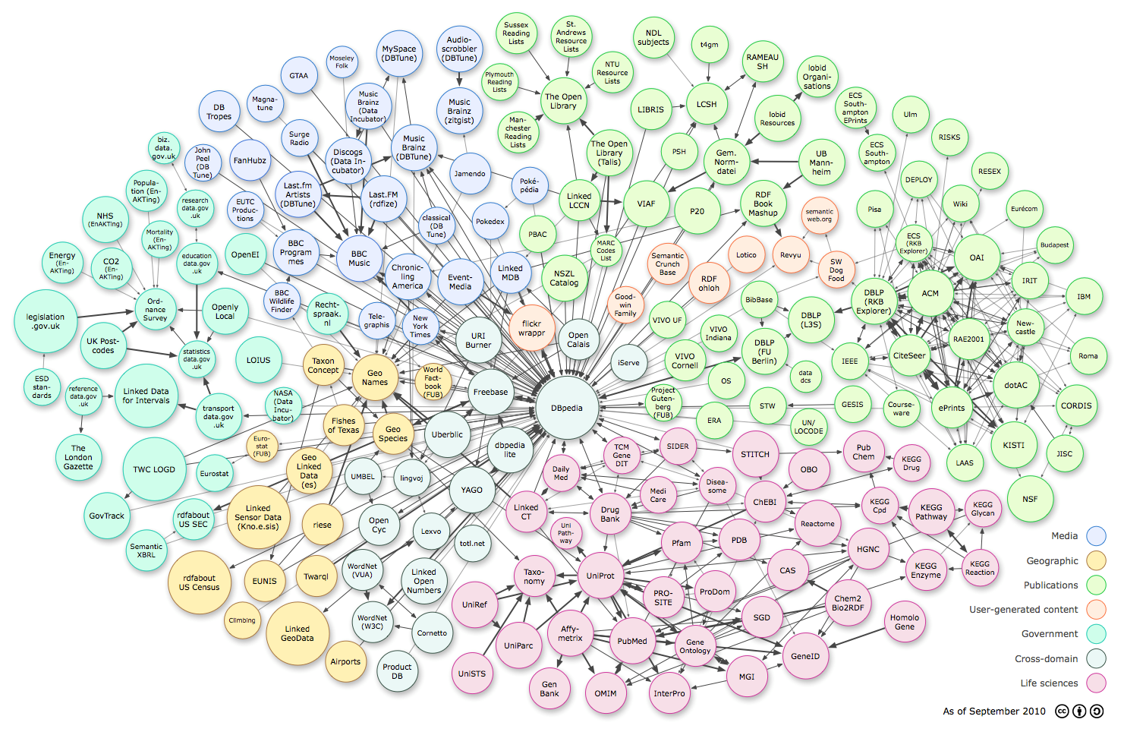
Lot of domain data in LOD…
Music
On-line activities
E-Gov
Publications
Cross-domains
Geographic
Life Sciences

