Slide 1

ITS Workbench
Two Problems,
One Open Standards Based Solution
Phil Ritchie, CTO, VistaTEC

Slide 2



Current Approach
Reviewer is often instructed on how much time to spend or amount of content to review.
This amounts to a random, human judgement on what to look at.
This amounts to a process which is statistically unlikely to discover errors.
Risk increases the larger the volume.

Slide 3
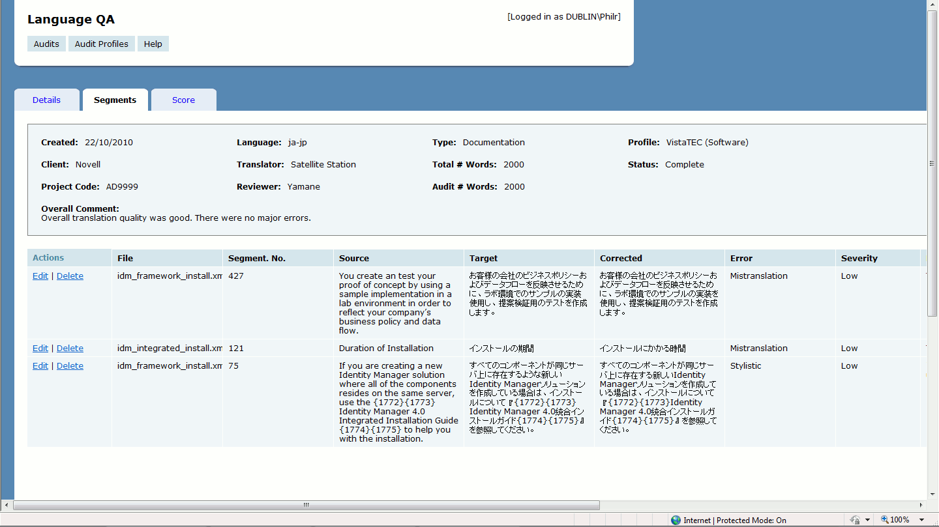
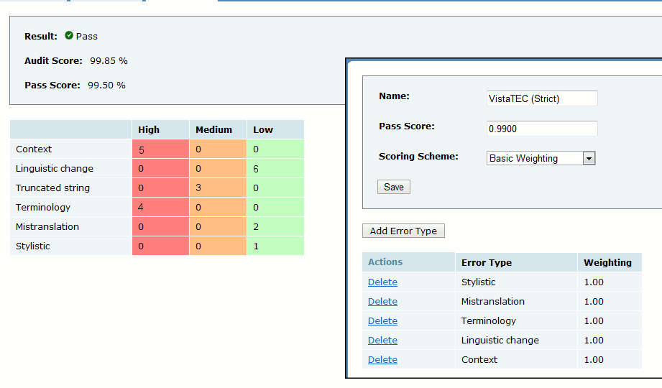
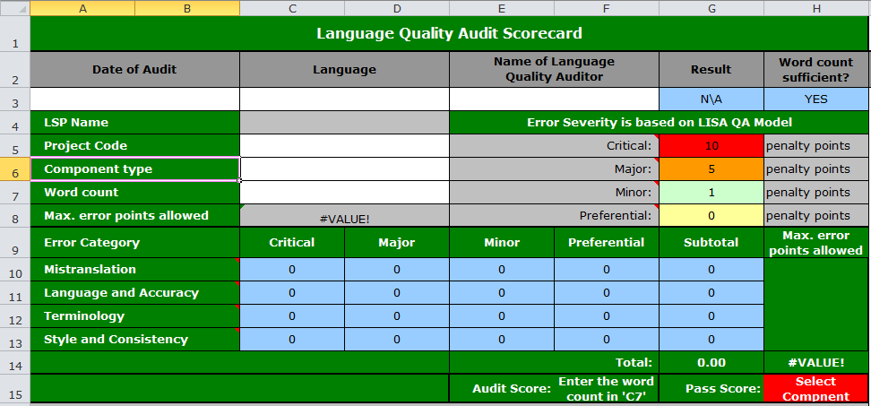
Current Practice

Slide 4
Desired Improvements
Directed effort
  Better use of humans
Faster reporting
  “Real-time” reporting and data gathering
Semantic business intelligence
  Discover relationships between source and translations and all interacting agents in-between

Slide 5
Scenario
Translation
Text Classification
Review
Automated QA Check
Agent provenance available
Checkmate, QA Distiller or similar
Review Sentinel
Human review using Reviewer’s Workbench
Conversion to RDF
Linked Data queries
“Non-conformance” scores added
Business Intelligence
Trends to inform future approach
Provenance (human and automated agents)
Localization Quality Issue
MT Confidence

Slide 6
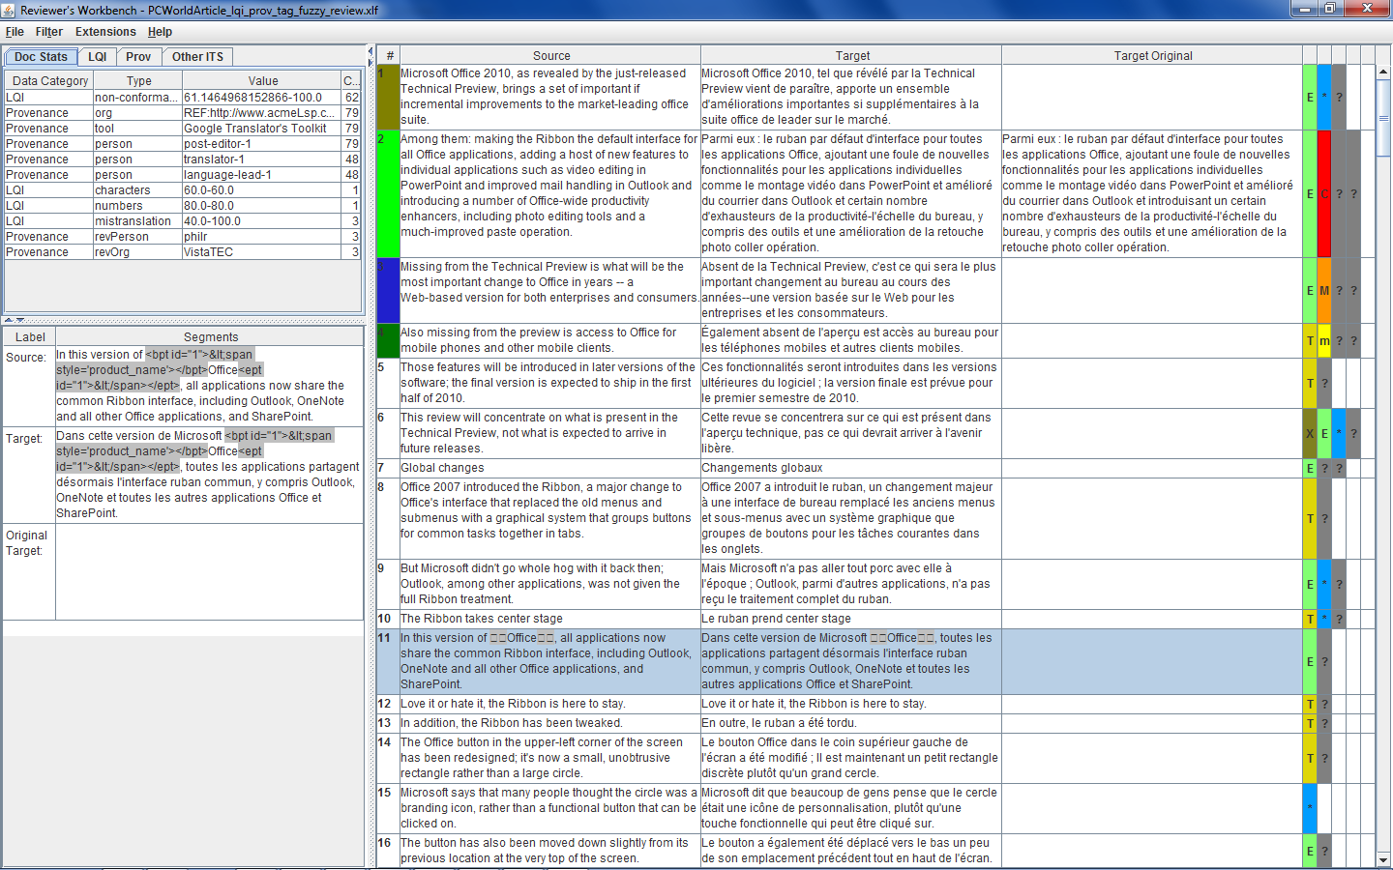
ITS Workbench

Slide 7
ITS Workbench
Summary of all metadata gives an overview of the number, type and severity of issues and this effort required for the job.

Slide 8
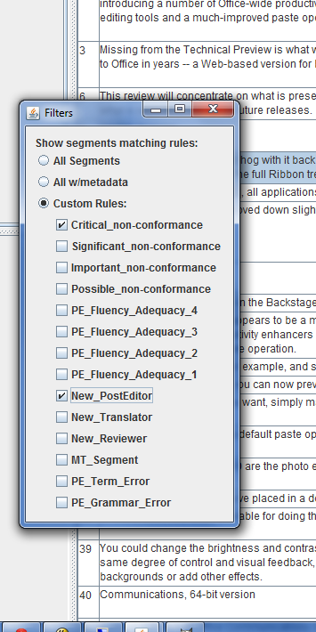
ITS Workbench
Individual categories can be user-defined rendered and used to filter content.
New metadata can be added using Ctrl+# hotkey combination

Slide 9
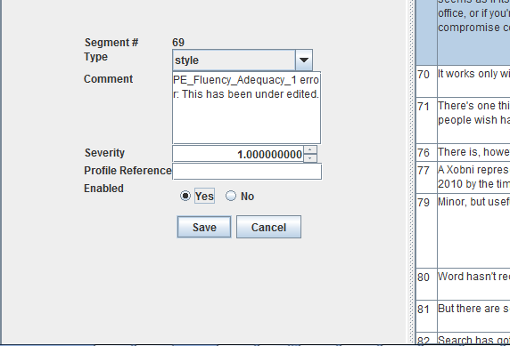
ITS Workbench
Additional Provenance captured during editing.

Slide 10
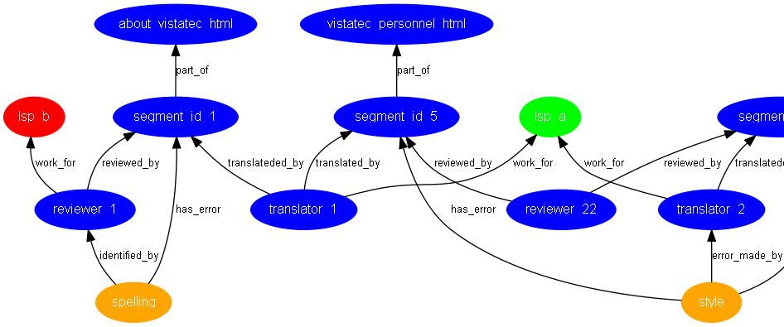
Linked Data

Slide 11
Business Benefits
Better context
Directed effort
Non-invasive data capture
Open standards (XLIFF + ITS)
Compatible with existing workflow tool-chains
5-20% time saving + data capture

Slide 12
Outreach To-date
Google HQ, Mountain View, CA
NetApp HQ, Santa Clara, CA
McAfee (Cork)
VistaTEC Webinar
MT Summit, Nice
Localization World, Santa Clara

Slide 13
Benefit To All
Board Level approval to contribute to Open Source
  Public announcement at Localization World Conference, Santa Clara, CA.
  Existing Okapi Framework Suite of localization related tools

Slide 14


Future
NIF
NLP Interchange Format
W3C PROV
Provenance Model
CNGL GLOBIC
MQM
Multidimensional Quality Metrics

Slide 15
Thank You
http://tinyurl.com/o24u92h

Slide 16
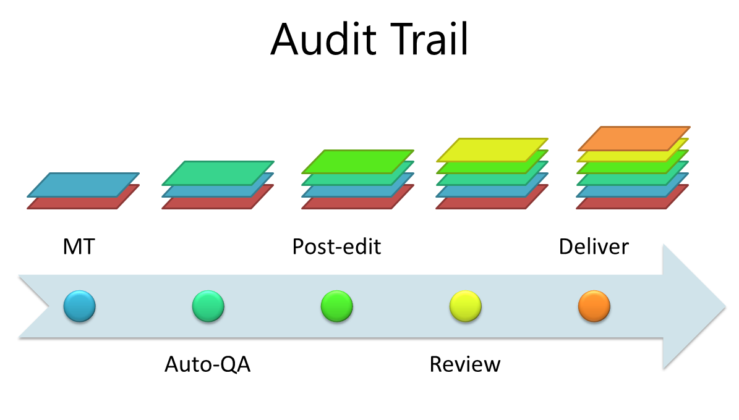
ITS Workbench
Capturing, rendering and editing of ITS 2.0 metadata in an XLIFF editor
See me at Localization World, Santa Clara!
Features
Benefits
XLIFF+ITS 2.0 files
MT Confidence
Provenance
Loc. Quality Issue
Match bands
Segment Filtering
Enhanced context
Directed effort
Fast data capture
Okapi compatible
Decision support
Review/Post-edit

