Slide 1
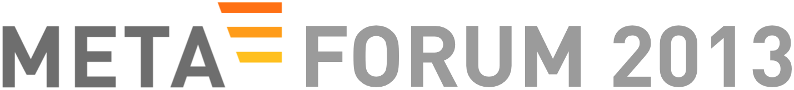


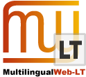


Session:
Technologies for the Multilingual Web
Notes:
This session will introduce you to technologies for the Multilingual Web. Many people are working in this area – so don’t be surprised to see many faces on the stage. The first presentation will be by Christian Lieske (SAP). He is a long term contributor to the MultilingualWeb community and will give a 5 minute introduction to the main multilingual technology covered in this session: Internationalization Tag set (ITS) 2.0

Slide 2
Introduction
“Technologies for the Multilingual Web”
&
ITS 2.0 – Bird’s Eye View
Felix Sasaki (DFKI, W3C), Christian Lieske (SAP AG)
2

Slide 3
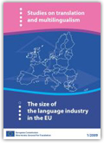
Multilingual Content
Imperative for society and business
Enable participation
Meet requirements
Maximize market share
Relevant
18 billion Euro are spend
3.6 billion Euro could be saved
Notes:
Study on the size of the language industry in the EU: http://bookshop.europa.eu/is-bin/INTERSHOP.enfinity/WFS/EU-Bookshop-Site/en_GB/-/EUR/ViewPublication-Start?PublicationKey=HC8009985

Slide 4
Multilingual Web
Most visible channel, and important set of base technologies
Technologies/standards such as HTML5 from e.g. World Wide Web consortium (W3C) are stewards
Need for large-scale multilingual content processing
European Commission invested in “MultilingualWeb-LT - Language Technology in the Web” to foster and enhance best practices/standards
Update of W3C Internationalization Tag Set as major MLW-LT deliverable
Practical reference implementations as cornerstone of viable success
MultilingualWeb initiative as community-building, and dissemination

Slide 5
Multilingual Content Processing
What?
Detect where a sentence ends
Spot linguistic mistakes
Get translation suggestions from a machine
…
Why?
Increase coverage, speed, consistency
…

Slide 6
Bird‘s Eye View - Multilingual Content with W3C ITS 2.0 (1/2)
Comprehensive
Supports internationalization, translation, localization and other aspects of the multilingual content production cycle
Standardized
Building on W3C ITS 1.0
Meta data
Data categories, values etc.
http://www.w3.org/TR/its20/

Slide 7
Bird‘s Eye View - Multilingual Content with W3C ITS 2.0 (2/2)
Metadata for the Multilingual Web - Usage Scenarios and Implementations
Machine Translation
… see also the “implementation basket” presentation in this session
Quality Checking
Conversion and validation
Coupling of systems
Content enrichment
Meta data visualization
Content/meta data editing
http://www.w3.org/TR/mlw-metadata-us-impl/

Slide 8
Opportunities to assist and use
ITS Interest Group
http://lists.w3.org/Archives/Public/public-i18n-its-ig (public list, free to subscribe)
http://www.w3.org/International/its/ig/
MultilingualWeb initiative
http://www.multilingualweb.eu/
ITS 2.0 Introduction
http://tinyurl.com/its20-intro

