Slide 1
W3C Internationalization Tag Set 2.0 Usage Scenarios and Implementations
Felix Sasaki (W3C, DFKI), Christian Lieske (SAP AG)

Slide 2
Authors
Prof. Dr. Felix Sasaki DFKI/FH Potsdam/W3C | Christian Lieske Globalization Services SAP AG
Appointed to Prof. in 2009; since 2010 senior researcher at DFKI (LT-Lab) Working in German-Austrian W3C-Office Before, staff of the World Wide Web Consortium (W3C) in Japan Main field of interest: combined application of W3C technologies for representation and processing of multilingual information Studied Japanese, Linguistics and Web technologies at various Universities in Germany and Japan | Knowledge Architect Content engineering and process automation (including evaluation, prototyping and piloting) Main field of interest: Internationalization, translation approaches and natural language processing Contributor to standardization at World Wide Web consortium (W3C), OASIS, Unicode Consortium and elsewhere Degree in Computer Science with focus on Natural Language Processing and Artificial Intelligence

Slide 3
Overview
Motivation for ITS (1.0 and 2.0)
Basic principles
Why ITS 2.0?
Selected data categories
Implementations and usage scenarios
Outlook and pointers for more information

Slide 4
Multilingual content production
Seen from the moon
Seen from an airplane
Seen from a desktop
Internationalize
Create
Specify directionality
Localize
Internationalize
Mark-up terminology
Translate
Translate/Localize
Add links about entities
Publish
Extract / filter content
Harvest
Segment
Analyze
Run through MT
Generate translation kit
Assess (linguistic) quality
Run post-production

Slide 5
Example problem with machine translation
Input from www.postbank.de
„Ob Postbank direkt, Online-Banking, Online-Brokerage oder myBHW. Die häufigsten Fragen zu unseren Transaktionssystemen finden Sie an dieser Stelle.“
Output via Google translate
“Whether Postbank direct, online banking, online brokerage or myBHW. Frequently asked questions about our transaction systems can be found at this location.”

Slide 6
Example problem with machine translation
Input from www.postbank.de
„Ob Postbank direkt, Online-Banking, Online-Brokerage oder myBHW. Die häufigsten Fragen zu unseren Transaktionssystemen finden Sie an dieser Stelle.“
Output via Google translate
“Whether Postbank direct, online banking, online brokerage or myBHW. Frequently asked questions about our transaction systems can be found at this location.”
Fixed terminology
should not have
been translated.
But – the MT tool had no chance to “know” that

Slide 7
ITS 2.0 – The help
Comprehensive
Supports internationalization, translation, localization and other aspects of the multilingual content production cycle
Standardized
Building on W3C ITS 1.0 (W3C Recommendation)
Meta data
data categories, values etc.

Slide 8
Why is this important?
Large quantities of multilingual data to be produced with tight quality, cost, delivery constraints
Content needs to be touched by various technologies

Slide 9
Overview
Motivation for ITS (1.0 and 2.0)
Basic principles
Why ITS 2.0?
Selected data categories
Implementations and usage scenarios
Outlook and pointers for more information

Slide 10
ITS 2.0 Basic principles
Say important things
“Do not translate”
About specific content
“All or selected data elements”
In a standard way
With agreed upon syntax and values

Slide 11
1. Say important things: ITS 2.0 “data categories”
Translate
Localization Note
Terminology
Directionality
Language Information
Elements Within Text
Domain
Text Analysis
Locale Filter
Provenance
External Resource
Target Pointer
Id Value
Preserve Space
Localization Quality Issue
Localization Quality Rating
MT Confidence
Allowed Characters
Storage Size

Slide 12
2. About specific content: Content selection approaches
ITS selection can be compared to CSS
global = “style” element
local = “style” attribute
Selection global
Selection local
XPath (or CSS) to select markup nodes
ITS local attributes
<rsrc ...>
<its:rules xmlns:its="http://www.w3.org/2005/11/its" version="2.0">
<its:translateRule selector="//data" translate="no"/>
</its:rules>
<data type="text" its:translate="yes">Cancel</data>
<data type="position">60,40</data> ... </rsrc>

Slide 13
3. In a standard way (1/2)
Pre-defined (if appl.) meta data values
“Translate”: “yes” or “no”
Specific defaults (if appl.)
Elements: translate “yes”, attributes: translate “no”
Specific HTML5 behaviour
E.g. “alt” attribute default “yes”
Notes:
Make demo with Okapi: local and global stuff. Use its2-in-the-browser-simple.html

Slide 14
3. In a standard way (2/2)
Independent /orthogonal
Dublin Core, xml
Strict conformance clauses
Supported ITS 2.0 data categories
Supported selection mechanism (local / global) and type of content (HTML / XML)
Powerful (e.g. easy combination)
Test suite to guide implementers and users https://github.com/w3c/its-2.0-testsuite
Example: locQualityIssueComment in addition to storageSize

Slide 15
Overview
Motivation for ITS (1.0 and 2.0)
Basic principles of ITS
Why ITS 2.0?
Selected data categories
Implementations and usage scenarios
Outlook and pointers for more information

Slide 16
Why ITS 2.0 (1/2)
ITS 1.0 = simplified view of multilingual content production
Too limited for comprehensive automated content processing/usage scenarios (see http://www.w3.org/TR/mlw-metadata-us-impl/ for various ITS 2.0 usage scenario descriptions)
Example limitation: too few data categories

Slide 17
Why ITS 2.0 (2/2)
Coverage for additional types of content: HTML5
Easy bridge to main Web formats
Accommodate relevant HTML5 markup (e.g. HTML5 “translate” attribute behaviour)
Easy mapping/conversion to other formats
XML Localization Interchange File Format (XLIFF) = bridge to localization workflows; status: informal mapping, under discussion, for XLIFF 1.2 mostly stable.
Natural Language Processing Interchange Format (NIF) = bridge to the Semantic Web and Natural Language Processing; status: informal mapping
Introduced traceability
Which tool produced what?
ITS RDF Ontology
To make ITS a first-class citizen of the Semantic Web (see http://www.w3.org/2005/11/its/rdf-content/its-rdf.rdf)
Some parts of ITS 1.0 needed to go (at least temporarily)
Ruby, dir

Slide 18
Demo: ITS2 in the browser
See
http://www.w3.org/International/its/ig/demos/its2-in-the-browser.html
Making ITS2 data categories explicit
Uses open source JQuery library which supports all ITS2 data categories

Slide 19
ITS 2.0 in HTML5 (1/3)
Difference in syntax for local markup
<myXMLVocabulary ...>
<span its:term="yes"
its:termInfoRef="http://example.com/terms/t1"> ...
</myXMLVocabulary>
<!DOCTYPE html> ...
<span its-term="yes"
its-term-info-ref="http://example.com/terms/t1"> ...
</html>
Notes:
Explain via http://www.w3.org/International/its/ig/demos/its2-in-the-browser.html its-term

Slide 20
ITS 2.0 in HTML5 (2/3)
Link to global rules via HTML “link” element
<!DOCTYPE html> ...
<link href=EX-translateRule-html5-1.xml rel=its-rules> ... </html>
Notes:
Show via http://www.w3.org/International/its/ig/demos/its2-in-the-browser.html link

Slide 21
ITS 2.0 in HTML5 (3/3)
Accommodation of existing HTML5 markup
<!DOCTYPE html><html lang="en" ...
<p id="p1" translate="no">This is a <em>motherboard</em> and
image: </p>
<img src="http://example.com/myimg.png" alt="My image"/> ...
</html>
ITS 2.0 processors “understand” without ITS markup:
“p” is not translatable
“alt” attribute at “img” is translatable
Language is “en”
“id” attribute at “p” is an “ID Value” data category value
“em” is “within text” (part of another text flow)
Notes:
Go through http://www.w3.org/International/its/ig/demos/its2-in-the-browser.html

Slide 22
ITS 2.0 in XHTML
Consumption on the Web: use HTML5 its-* syntax
<html xmlns="http://www.w3.org/1999/xhtml">...
<p>Don't use
<span its-loc-note="Internationalization Tag Set">ITS</span> prefixed attributes inside the content, like its:locNote.</p>
</body>
</html>
Consumption in XML workflows: use XML its:* syntax and process as XML

Slide 23
ITS Mime Type
its+xml – registered at
http://www.iana.org/assignments/media-types/application/its+xml
Applicable for ITS 1.0 and ITS 2.0 content
One important means to foster ITS adoption on the web

Slide 24
What went away?
Where did “Ruby” go?
Data category dropped from ITS2
Current definition in HTML5 not yet stable
Update of ITS2 might add then stable Ruby again
“Directionality” defined in terms of HTML 4.01
Again awaiting stability in HTML5

Slide 25
Overview
Motivation for ITS (1.0 and 2.0)
Basic principles of ITS
Why ITS 2.0?
Selected data categories
Implementations and usage scenarios
Outlook and pointers for more information

Slide 26
Text analysis
Annotate named entities or other „conceptual items“
- identify items that need special translation rules - assist in disambiguation of homonyms (e.g. the string “Armstrong” – dozens of meanings in Wikipedia)
<!DOCTYPE html> ...
<span
its-ta-confidence="0.7"
its-ta-class-ref="http://nerd.eurecom.fr/ontology#Movie"
its-ta-ident-ref=
"http://dbpedia.org/page/My_Neighbor_Totoro">
となりのトトロ</span>...</html>

Slide 27
Domain
Identify the topic or subject field of content
Example usage: choose the MT engine that fits to the domain
...<its:domainRule
selector="/h:html/h:body"
domainPointer=
"/h:html/h:head/h:meta[@name='dcterms.subject']/@content"
domainMapping=
"automotive auto, medical medicine, 'criminal law' law, 'property law' law"/>...

Slide 28
MT Confidence
Score from machine translation engine
Example for ITS2 capability: Tool traceability
<!DOCTYPE html> ...
<body its-annotators-ref="mt-confidence|file://tools.xml#T1">
<p>
<span its-mt-confidence=0.8982>Dublin is the capital of
Ireland.</span></p>
</body></html>

Slide 29
Locale Filter
Content relevant only for a specific locale
<!DOCTYPE html> ...
<div its-locale-filter-list="*-ca">
<p>Text for Canadian locales.</p>
</div>
<div its-locale-filter-list="*-ca" its-locale-filter-type="exclude">
<p>Text for non-Canadian locales.</p> </div> ...

Slide 30
Localization Quality Issue
For quality assessment
<!DOCTYPE html> ... <span
its-loc-quality-issue-comment="should be 'quality'"
its-loc-quality-issue-profile-ref=http://example.org/qaMovel/v1
its-loc-quality-issue-severity=50
its-loc-quality-issue-type=misspelling>qulaity</span> ...

Slide 31
Overview
Motivation for ITS (1.0 and 2.0)
Basic principles of ITS
Why ITS 2.0?
Selected data categories
Implementations and usage scenarios
Outlook and pointers for more information

Slide 32
Tooling for:
Content creation
Content enrichment
Workflows transporting ITS 2.0 between formats
Source formats (e.g. DocBook > HTML)
XLIFF roundtripping
A detailed example: ITS 2.0 processed via the OKAPI framework

Slide 33
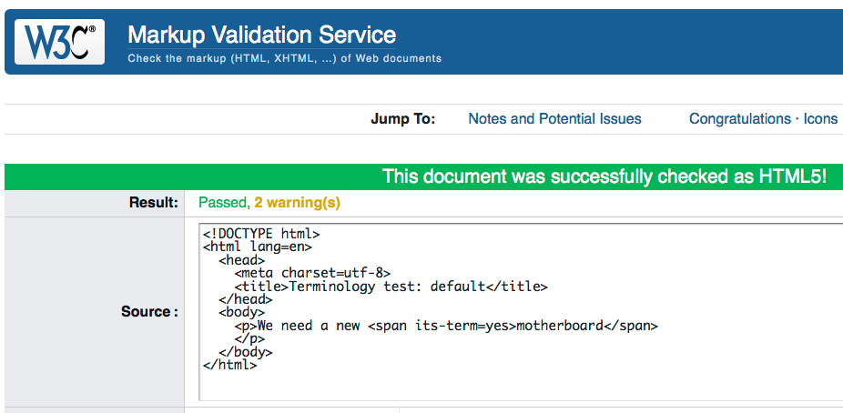
Helping creators: validation of HTML5
Notes:
Run http://www.w3.org/International/its/ig/demos/its2-in-the-browser.html in W3C validator

Slide 34
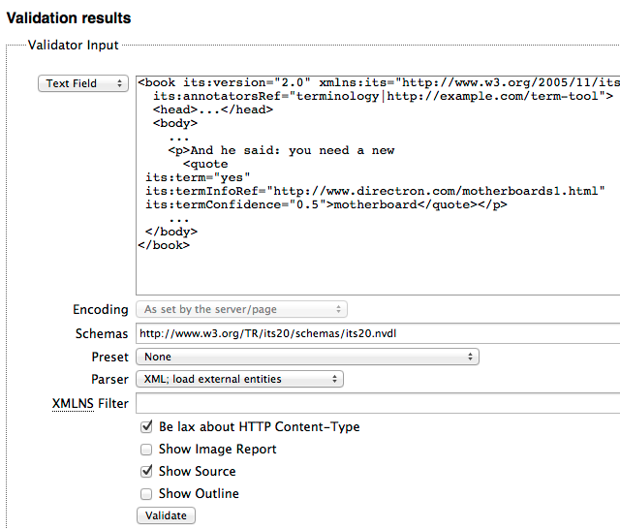
... and XML
Tool: validator.nu
Basis for HTML5 and XML validation
See
http://tinyurl.com/its2-xml-validation
HTML5 ITS Tools
https://github.com/kosek/html5-its-tools
ITS 2.0 validation of file sets
Syntax conversion: HTML5 <> XML
Notes:
Run validator for XML. Explain output.
Run version of HTML5 ITS tools using http://www.w3.org/2005/08/online_xslt/ , http://services.w3.org/tidy/tidy ,
https://raw.github.com/kosek/html5-its-tools/master/xsl/html2xhtml.xsl
http://www.w3.org/International/its/ig/demos/its2-in-the-browser.html

Slide 35
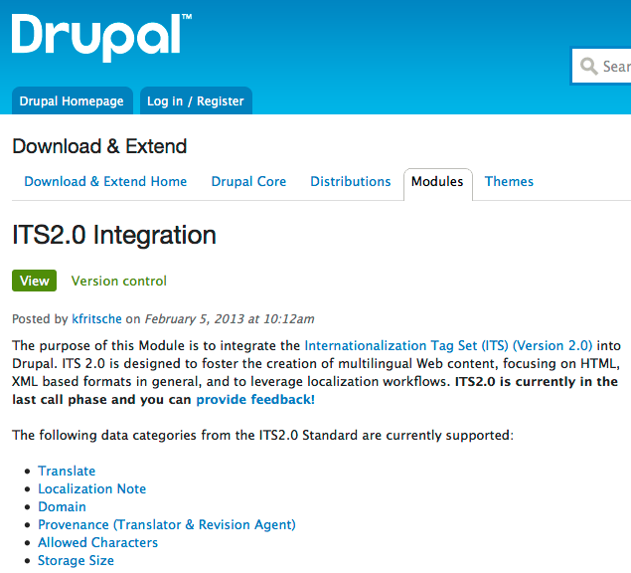
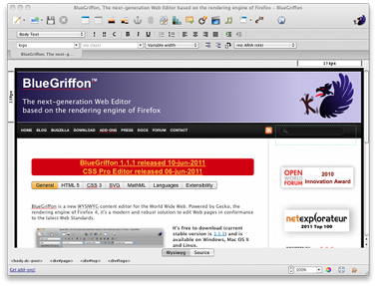
Helping creators: (plugins for) editing support
BlueGriffon
web editor
General JavaScript ITS2 parser
http://plugins.jquery.com/its-parser/
Notes:
Run Drupal video

Slide 36
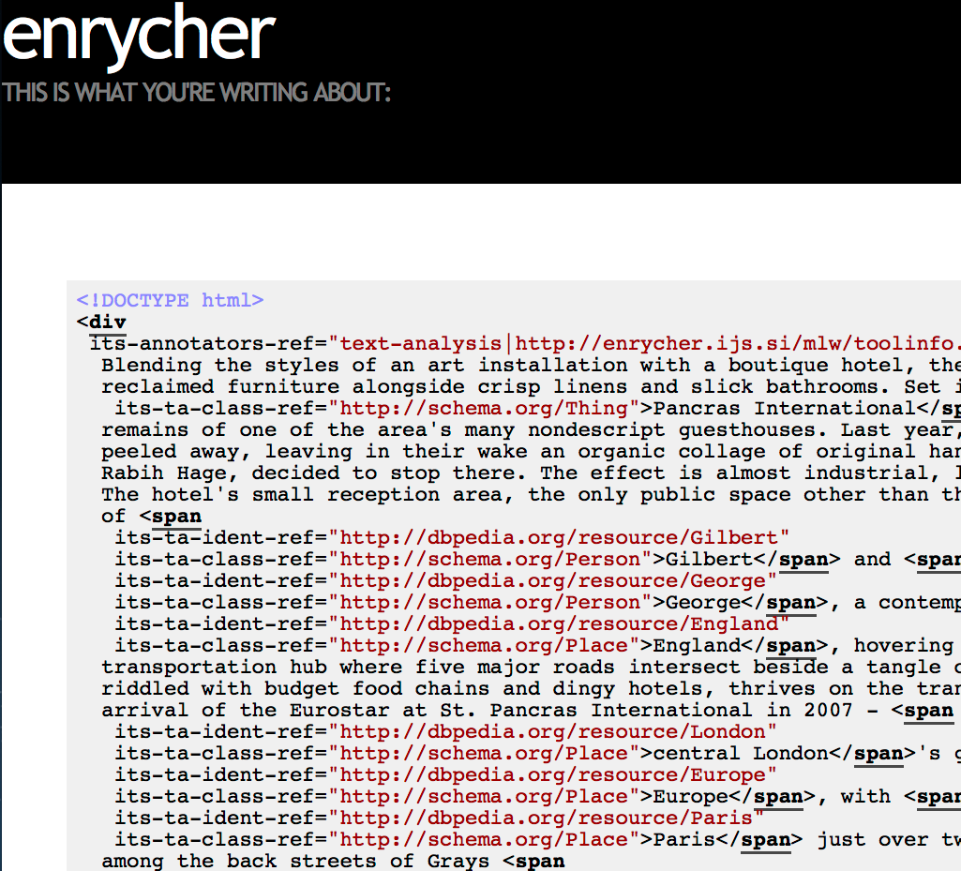
Adding more value to content: Named Entity Recognition and Disambiguation
See
http://enrycher.ijs.si/mlw/
Notes:
Run with small sample text: Welcome to Wiesbaden!

Slide 37
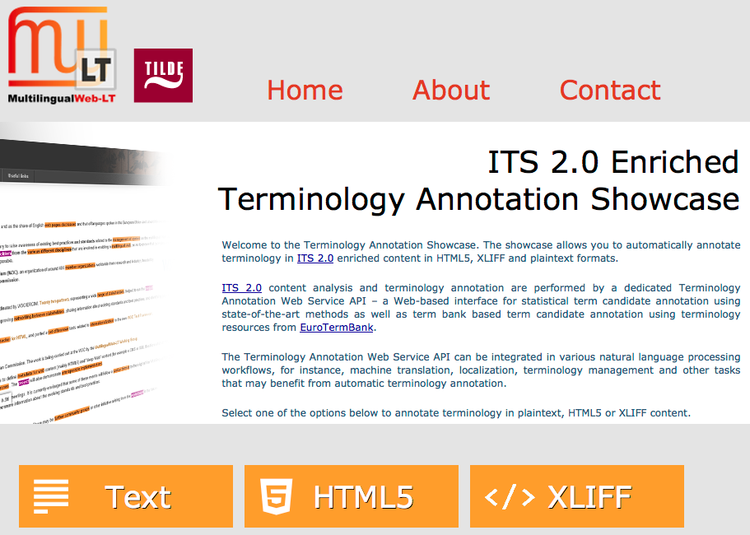
Adding more value to content: Generation of terminology markup
See
http://taws.tilde.com/
Notes:
Run with http://www.w3.org/TR/its20/

Slide 38
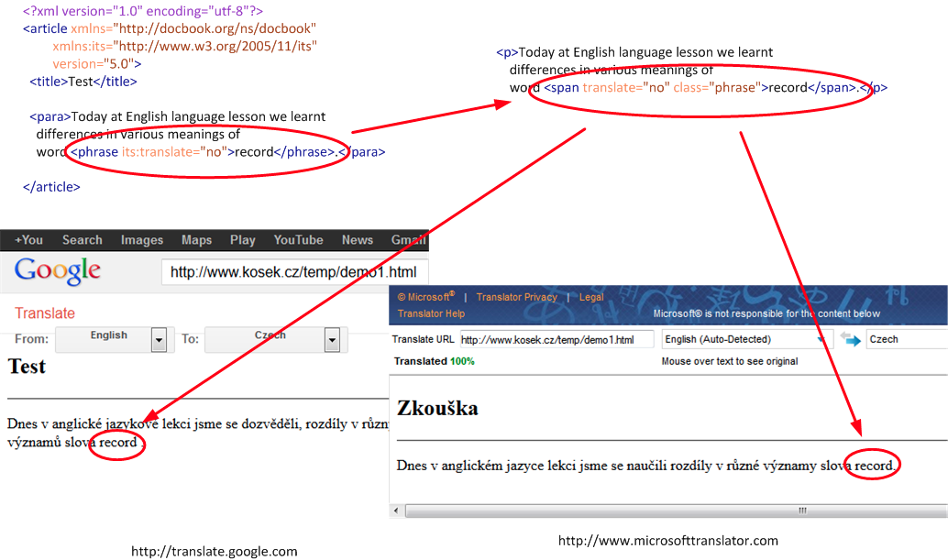
Format conversion and more: DocBook - > HTML - > online MT
See http://xmlguru.cz/2013/05/docbook-and-its2
Notes:
tbd

Slide 39
Service Oriented Localisation Architecture Solution (SOLAS)
See
http://mlwlt.moravia.com/mlwlt-web-test/Presentation.aspx
XLIFF in, (MT-translated) XLIFF out
ITS 2.0 mapped into XLIFF
Consumes data categories: Translate, Domain and Text Analysis
Generates metadata for data categories: Provenance and MT Confidence

Slide 40
A detailed example: ITS2 processing with OKAPI framework
See http://okapi.opentag.com/
Components and applications for localization and translation
ITS1 and ITS2 (ongoing) implemented in many usage scenarios
Scenarios and examples provided by Yves Savourel (ENLASO); run with Rainbow & CheckMate tools
Notes:
Open Okapi and run ITSDemo-Preparation.rnb

Slide 41
ITS2-aware XLIFF generation
<td class="totrans">
The Lost Temples of the Khmer</td>
<its:translateRule selector="//h:*[@class='totrans']"
translate="yes"/>
<its:storageSizeRule selector="//h:td[@class='totrans']"
storageSize="30"/>
<trans-unit ... <source xml:lang="en-us" its:storageSize="30">
The Lost Temples of the Khmer</source>

Slide 42
ITS2 “domain” mapping: choosing the ‘travel’ MT engine
<meta content="vacation packages" ... <td ...>
The Lost Temples of the Khmer</td>
<its:domainRule ...
domainPointer=
"/h:html/h:head/h:meta[@name='dcterms.subject']/@content"
domainMapping="'vacation packages' travel"/>
<trans-unit itsxlf:domains="travel"....
<target xml:lang="fr-fr">Les temples perdus des Khmers</target>

Slide 43
Segmentation, MT and quality checks
<td class="totrans">
Canyon X and the Land of the Navajo</td>
<its:domainRule .../>
<its:translateRule .../>
<its:storageSizeRule ... storageSize="30"/>
<target ... its:storageSize="30" its:locQualityIssueComment="Number of bytes in the target (using UTF-8) is: 32. Number allowed: 30." ... <mrk...>Canyon X et la terre des Navajos</mrk>...

Slide 44
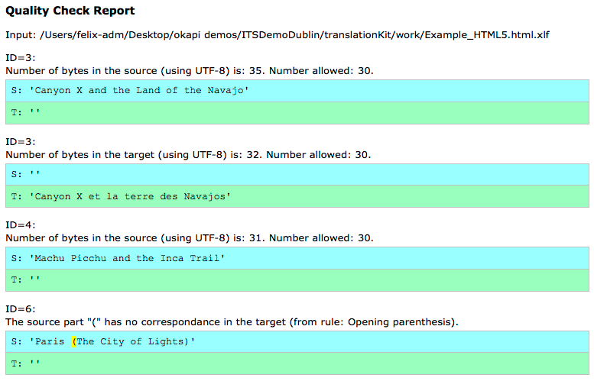
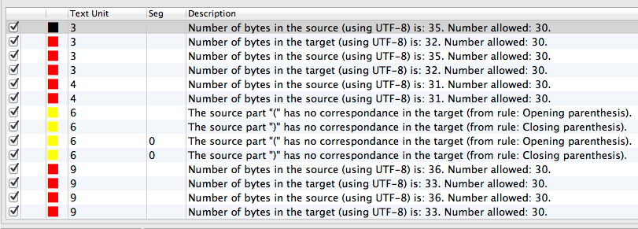
Quality check details
Rainbow
HTML output
CheckMate
tool report

Slide 45
Okapi Ocelot Editor
See http://open.vistatec.com/ocelot/
Open Source Java based XLIFF+ITS 2.0 Editor
Supports Localization Quality Issue, Provenance and MT Confidence
Also general XLIFF 1.2 editor

Slide 46
Showcases with “real clients” ...
ITS2-aware online MT
Using “Translate”, “Domain”, “Language information” to drive rule based MT system
Localization chain integration
Coupling Drupal Content Management System with Localization Service Provider/Translation Agency workflow
Demonstrating workflow benefits achieved via ITS2 data categories

Slide 47
... and more
ITS2 data categories for the human review process
Harvest metadata during the review
Facilitate audit during the review, e.g. via Ocelot tool
Conversion of ITS2 documents (XML, HTML) into RDF – NIF format
Informative feature
Prototypes to generate e.g. “text analysis” information in RDF out of Wikipedia pages

Slide 48
Overview
Motivation for ITS (1.0 and 2.0)
Basic principles of ITS
Why ITS 2.0?
Selected data categories
Implementations and usage scenarios
Outlook and pointers for more information

Slide 49
What is missing?
XLIFF mapping to be finalized
Representation of ITS2 markup in XLIFF not finished
XLIFF 1.2 to be stabilized first; XLIFF 2.0 later
ITS and RDF – to be continued
NIF conversion based on ITS RDF ontology
Not stabilized & not yet “real life” deployment

Slide 50
What will come next?
For some time no new ITS version - but: more
Usage scenarios
http://www.w3.org/International/its/wiki/Use_cases_-_high_level_summary
Implementations
http://www.w3.org/International/its/wiki/ITS_Implementations
User & implementers feedback at public-i18n-its-ig@w3.org
Join us in the ITS Interest Group!
For Multilingual Linked Open Data: Join BPMLOD group http://www.w3.org/community/bpmlod/

Slide 51
Proceedings text
Introduction and Overview
The Internationalization Tag Set (ITS) 2.0 is an upcoming standard developed by W3C (ITS 2.0 standardization is expected to be finished end of 2013). It is based on ITS 1.0: a set of metadata items ("data categories") to easily create content – mainly XML – which is internationalized and can be localized effectively. ITS 2.0 enhances and extends ITS 1.0 in various ways: easier use in important formats (e.g. HTML5), additional data categories, and support for more usage scenarios.
This document starts by answering the questions “What is ITS 2.0?” and “Why ITS 2.0?”. Afterwards rough outlines of usage scenarios and some already existing implementations are presented. These - partially large scale - implementations exemplify how ITS 2.0 enables and facilitates automated processing of human language/natural language processing especially into core Web technologies. The document closes with a view towards the future and references to additional information.
What is ITS 2.0?
ITS 2.0 addresses some of the challenges and opportunities related to internationalization, translation, localization, and automated processing of human language (e.g. Machine Translation). There are two ways to describe ITS 2.0 in a nutshell:
ITS defines a comprehensive set of standardized meta data
ITS allows you to say important things (e.g. “Do not translate”), about specific content (e.g. “All or selected data elements”), in a standard way (i.e. with agreed upon syntax and values).
The ITS meta data/ data categories help in all parts of the multilingual content production cycle.
Sample data categories are:
“Translate”: captures whether a piece of content shall be translated or not.
“Elements Within Text”: captures whether a piece of content is a standalone segment (e.g. emphasized content in a paragraph)
“Text Analysis”: annotates content with lexical or conceptual information (e.g. for the purpose of disambiguation)
“Localization Quality Issue”: describes the nature and severity of an error detected during a language-oriented quality assurance (QA) process.

Slide 52
Proceedings text
ITS 2.0, like its predecessor ITS 1.0, does not require that all of its 19 data categories are used in a given scenario. They are defined independently of each other, and thus can also be used independently.
All ITS data categories use the same basic approaches for “attaching” to a certain piece of content (e.g. one or more “span” elements in HTML):
“local approach”: add ITS 2.0 attributes “in-place” to content (e.g. <span translate="no">...</span>
“global approach”: use XPath or CSS (the latter only for HTML content) to attach ITS information (e.g. all “span” elements)
This follows the pattern of cascading stylesheets (CSS) and is hence easy to understand both for tool implementers and users.
Why ITS 2.0?
There are various reasons to go beyond ITS 2.0.
More and more content is created in a format that was not addressed by ITS 1.0: HTML5. Hence, ITS 2.0 covers HTML5, other flavors of HTML and XML. For all formats, the same basic concepts are used.
Multilingual content creation today is based more and more on automatized, natural language processing approaches, like automatic annotation/text analysis or machine translation. Thus, ITS 2.0 provides data categories that reflect this development (e.g. via the data category “Text Analysis”).
Mapping of ITS information into other formats turned out to be of high importance for integrating ITS into the content workflows (e.g. coupling computer-assisted translation with in-country review). ITS 2.0 provides two (non-normative) mappings:
Within the ITS 2.0 specification, a conversion to the Resource Description Format (RDF) - a Semantic Web format -has been defined. It relies on the RDF vocabulary NLP Interchange Format (NIF).
As part of the ITS Interest Group activities, a mapping of ITS 2.0 data categories to XLIFF 1.2 has been created. This will foster the adoption of ITS 2.0 in XLIFF-based localization tools.
Usage Scenarios and Implementation for ITS 2.0
A specific aspect of ITS 2.0 was that implementation development and underlying usage scenarios drove it. With funding from the European Commission, 13 organizations contributed to the standardization process and to testing implementation interoperability with a dedicated test suite (see https://github.com/w3c/its-2.0-testsuite/). They provided tooling in several areas:

Slide 53
Proceedings text
Supporting content creators Authoring support and visualization of data categories for e.g. the Drupal Content Management System, for Javascript-based implementations (jquery plugin), or for LibreOffice
Supporting content creators and tool makers to “do the right thing” Validators help to check proper usage of ITS 2.0 in XML or HTML. The latter can be done via the W3C HTML markup validator: it supports ITS 2.0 natively, see this example validation http://tinyurl.com/its2-html5-validation
Content enrichment Online tools allow to automatically creating ITS 2.0 “Terminology” or “Text Analysis” information.
Workflows transporting information between formats
In various tools, ITS 2.0 information can control the generation of other formats.
HTML > XLIFF > HTML workflow with HTML as the content’s source and target format. ITS 2.0 guides e.g. the segmentation for the XLIFF generation and transports selected data categories into the XLIFF structure.
A workflow leading to NIF.
Generation of ITS 2.0 information from various source formats, e.g. in a workflow DocBook > HTML.
Human or automated translation
Several machine translation services have been made “ITS 2.0”-aware.
Quality check and post editing
For review after a human or machine translation tools have been created. They visualize ITS 2.0 “Localization Quality Issue” or provide a localization quality dashboard.
The tutorial related to this document will provide detailed examples, among others based on the OKAPI localization framework; see
http://www.opentag.com/okapi/wiki/index.php?title=ITS_Components for further information.

Slide 54
Proceedings text
View towards the future and references to additional information
Of interest are especially
the ITS 2.0 specification itself http://www.w3.org/TR/its20/
the document summarizing the usage scenarios and implementations http://www.w3.org/TR/mlw-metadata-us-impl/ (still in a draft stage and will be developed within the ITS Interest Group)
The Interest Group http://www.w3.org/International/its/ig/ serves as a forum to discuss use cases and implementations, give feedback and think about the future of ITS. Everybody is free to join – see http://lists.w3.org/Archives/Public/public-i18n-its-ig
The work on ITS 2.0 has received funding by the European Commission (project name LT-Web) through the Seventh Framework Programme (FP7) in the area of Language Technologies. Grant Agreement No. 287815.
For questions: felix.sasaki@dfki.de; christian.lieske@sap.com

Slide 55
Disclaimer
All product and service names mentioned and associated logos displayed are the trademarks of their respective companies. Data contained in this document serves informational purposes only. National product specifications may vary.
This document may contain only intended strategies, developments, and is not intended to be binding upon the authors or their employers to any particular course of business, product strategy, and/or development. The authors or their employers assume no responsibility for errors or omissions in this document. The authors or their employers do not warrant the accuracy or completeness of the information, text, graphics, links, or other items contained within this material. This document is provided without a warranty of any kind, either express or implied, including but not limited to the implied warranties of merchantability, fitness for a particular purpose, or non-infringement.
The authors or their employers shall have no liability for damages of any kind including without limitation direct, special, indirect, or consequential damages that may result from the use of these materials. This limitation shall not apply in cases of intent or gross negligence.
The authors have no control over the information that you may access through the use of hot links contained in these materials and does not endorse your use of third-party Web pages nor provide any warranty whatsoever relating to third-party Web pages.

Slide 56
W3C Internationalization Tag Set 2.0 Usage Scenarios and Implementations
Felix Sasaki (W3C, DFKI), Christian Lieske (SAP AG)

