Slide 1
SPC-3DS UIs – Logo - Recurring & installment – Non-payment authentication
March 23, 2023
3DSWG
Notes:
Europe front cover option

Slide 2
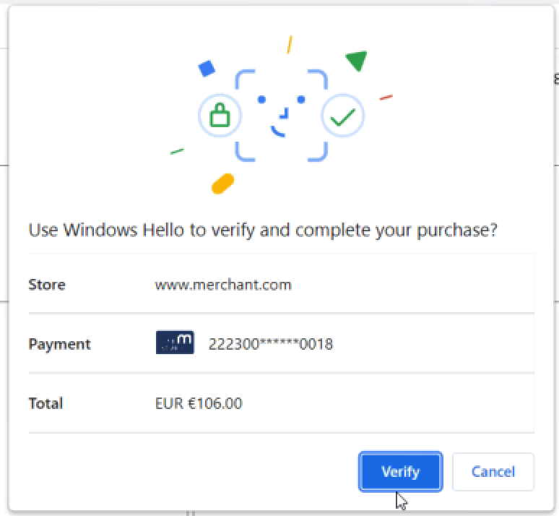


SPC UI Enhancements
“Enhanced” 3DS UI
Current SPC UI
spcTransData.issuerImageSpc #197
spcTransData.psImageSpc. #197
ACS information to CH. # 185
(Optional)
Merchant ABC will charge you $106.00 every 30 days from 2022/03/16 until 2023/03/16.
merchant name
Merchant name by ACS (= payeeName)
Card Art size and resolution. #184
SPC for non-payment. #186

Slide 3
Recurring transaction 1a/4
Fixed amount and fixed frequency: example subscription newspaper, cloud service
Merchant ABC will charge you $5.00 every 7 days from 2022/03/16 to 2023/03/16
5

Slide 4
Recurring transaction 1B/4
Fixed amount and fixed frequency: example subscription newspaper, cloud service
+ 1 free month. → Total = 0
Merchant ABC will charge you $5.00 every month from 2022/03/16 to 2023/03/16 with first month free
0

Slide 5
Recurring transaction 1C/4
Fixed amount and fixed frequency: example subscription newspaper, cloud service
In addition to a $100 purchase
Merchant ABC will charge you $5.00 every 7 days from 2022/03/16 to 2023/03/16 for your subscription in addition to your $100 purchase
105

Slide 6
Recurring transaction 2/4
Fixed amount and variable frequency : example prepaid train travel card with automatic top up.
From 2022/03/16,
Merchant ABC will charge you $25.00 when your credit is low
25

Slide 7
Recurring transaction 3/4
Variable amount, fixed frequency: example utility bills
From 2022/03/16 every 30 days,
Merchant ABC will charge you based on your consumption

Slide 8
Recurring transaction 4/4
Variable amount, variable frequency: example pay per use travel journey
From 2022/03/16
Merchant ABC will charge you based on your travels Today $13.40
13.40

Slide 9
Installment transaction
You agree to pay to Merchant ABC $90.00 in 3 monthly payments of $30.
30

Slide 10
Data dictionary - Initial ideas
ACS inputs SPC pre-defined text
Merchant –Name = “merchantABC”
will charge you
Amount – amount + Currency = “$5”
every
Recurring (optional) = ”month”
for
Purchase reason = ”your subscription”
from
Start date = ”March 28, 2023”
to
end date (optional) = ”March 28, 2024”
in addition to your xxx purchase
Purchase other – amount + Currency (optional) = “$100”
with
Exception (optional) = “one month free”

Slide 11
Non-Payment transaction
Ideally there should not be any amount or total line
However, it may be OK – re-assurance to the cardholder that he is not being charged
Use cases:
Add
Update
Confirm
Delete
You need to authenticate to add your card to the merchant XYZ wallet
0

