Slide 1
Privacy & Payments Discussion
May 2022. Questions? <ij@w3.org>

Slide 2
Background
WPWG requested privacy review of SPC in August 2021 (at FPWD)
Resulting PING issues
PING/WPWG discussion of issues in Oct 2021
Starting to think about advancing to CR; good opportunity to see what has evolved.

Slide 3
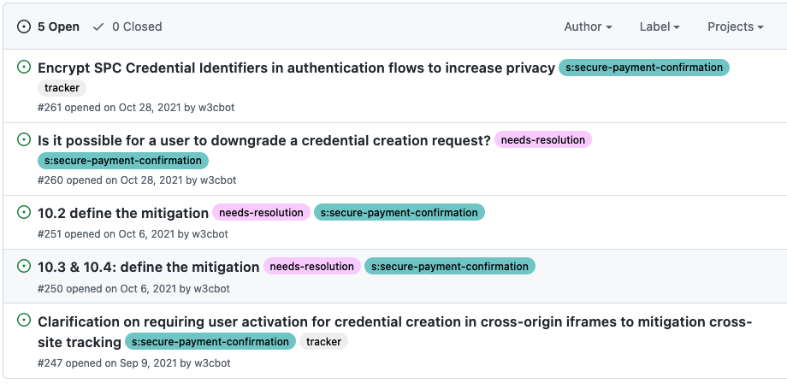
From the PING GitHub repo

Slide 4
On user activation for credential creation in cross-origin iframes to mitigate cross-site tracking
PING 247 (SPC 128)
WebAuth Level 2 and SPC support cross-origin authentication.
SPC supports cross-origin registration.
Mitigations to silent cross-origin leaking:
Permissions policy
Transaction dialog + Web Authentication dialog
User activation required by SPC (pending; supported by person who raised issue)
Plan: Close issue after user activation pull request merged.

Slide 5
Encrypt SPC Credential Identifiers in authentication flows to increase privacy
PING 261 (SPC 77)
Scenario: User registers one SPC credential for two payment instruments; merchant sees same credential ID for both.
Ineffective to obfuscate credential IDs as API inputs (e.g., by salting) because assertion credential data includes unencrypted IDs.
Proposed: Provide guidance to RPs to allow users to register a per-instrument SPC credential.

Slide 6
Allow user to downgrade a credential creation request?
PING 260 (SPC 154)
Scenario: Not-payment site attempts to create SPC-capable credentials to get around storage partitioning.
At authenticator level, there is support for a proposal for a “cross-origin bit”; we are bringing to FIDO.
At WebAuthn level, we plan to discuss (at this meeting) what is needed.
Proposed: No change to SPC. Leave issue open as we pursue topic of user consent with WebAuthn and FIDO/CTAP community.

Slide 7
Define Mitigation
PING 251 (SPC 142)
SPC 11.2 (Probing for credential ids) raises awareness about not leaking info.
New normative algorithm text (4.1.4, step 9) since FPWD:
The user agent must maintain authentication ceremony privacy and not leak this lack of matching credentials to the caller, by:
Not allowing the caller to perform a timing attack on this outcome versus the user declining to authenticate on the transaction confirmation UX, e.g., by presenting an alternative interstitial that the user must interact with.
Rejecting the show() promise with a "NotAllowedError" DOMException.
Proposed: Close issue.

Slide 8
Define Mitigation (credential id obfuscation)
PING 250 (SPC 143)
SPC 11.3 and SPC 11.4 are privacy considerations around tracking.
This issue appears to be a duplicate of issue 77.
Proposed: Close issue in favor of 77.

