Slide 1
EMVCo discussion of SPC use cases / demo Example of SPC-3DS UIs for Recurring, Installment and non-payment authentication
September 12, 2022
TPAC

Slide 2
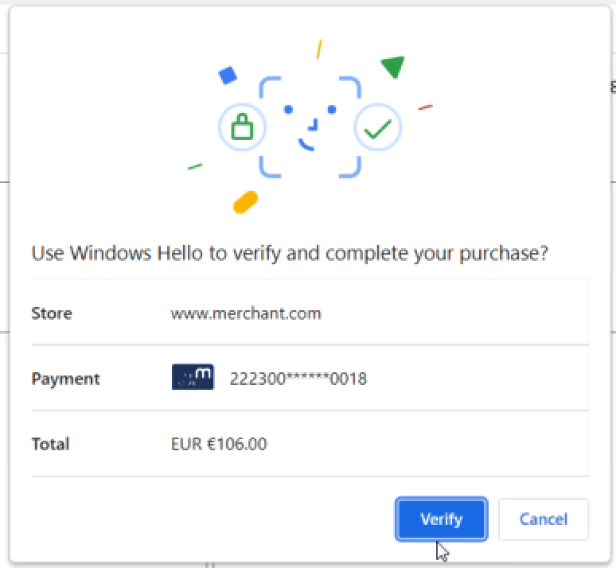
SPC UI Recommendations
Enhanced 3DS UI
Current SPC UI
spcTransData.issuerImageSpc
spcTransData.psImageSpc
ACS information to CH
Merchant ABC will charge you $106.00 every 30 days from 2022/03/16 until 2023/03/16.
merchant name
Merchant name by ACS
Card Art size and resolution
SPC for non-payment

Slide 3
Recurring transaction 1/4
Providing consumer transparency during the authentication of recurring transactions has become an important goal e.g. European Commission
Fixed amount and fixed frequency: example subscription newspaper, cloud service
Merchant ABC will charge you $5.00 every 7 days from 2022/03/16 to 2023/03/16

Slide 4
Recurring transaction 2/4
Fixed amount and variable frequency : example prepaid train travel card with automatic top up.
From 2022/03/16,
Merchant ABC will charge you $25.00 when your credit is low

Slide 5
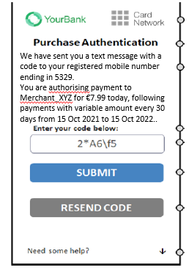
Recurring transaction 3/4
Variable amount, fixed frequency: example utility bills
From 2022/03/16 every 30 days,
Merchant ABC will charge you based on your consumption

Slide 6
Recurring transaction 4/4
Variable amount, variable frequency: example pay per use travel journey
From 2022/03/16
Merchant ABC will charge you based on your travels Today $13.40

Slide 7
Instalment transaction
You agree to pay to Merchant ABC $90.00 in 3 monthly payments of $30.

Slide 8
Non-Payment transactions
You need to authenticate to add your card to the merchant XYZ wallet

Slide 9
Branding
UI considerations:
Issuer and program logos should be displayed to be consistent with subsequent 3DS authentication screens and to convey trust
Logos convey that issuer authentication will take place and eliminates confusion that could occur if SPC is used in other contexts
UI studies found that consumers obtain comfort knowing issuer is involved
If 3DS branding standard is not followed, consumer would not have a consistent experience across merchant
spcTransData.issuerImageSpc
spcTransData.psImageSpc

Slide 10
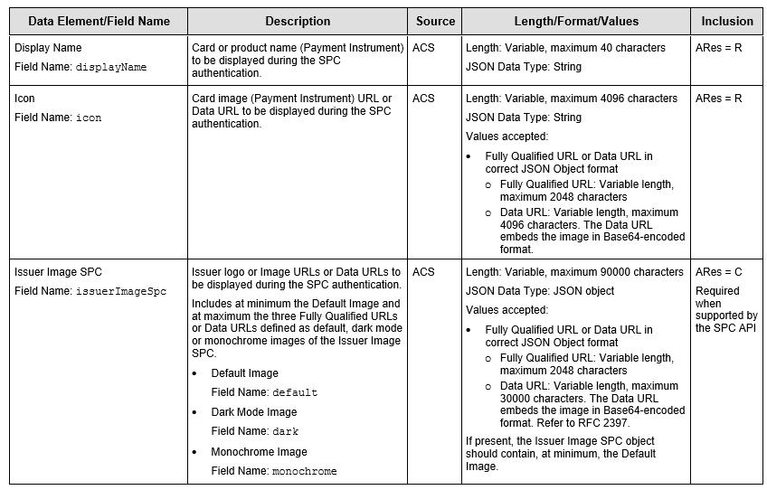
Related elements defined in SPC Transaction Data

Slide 11
SPC Demo

Slide 12
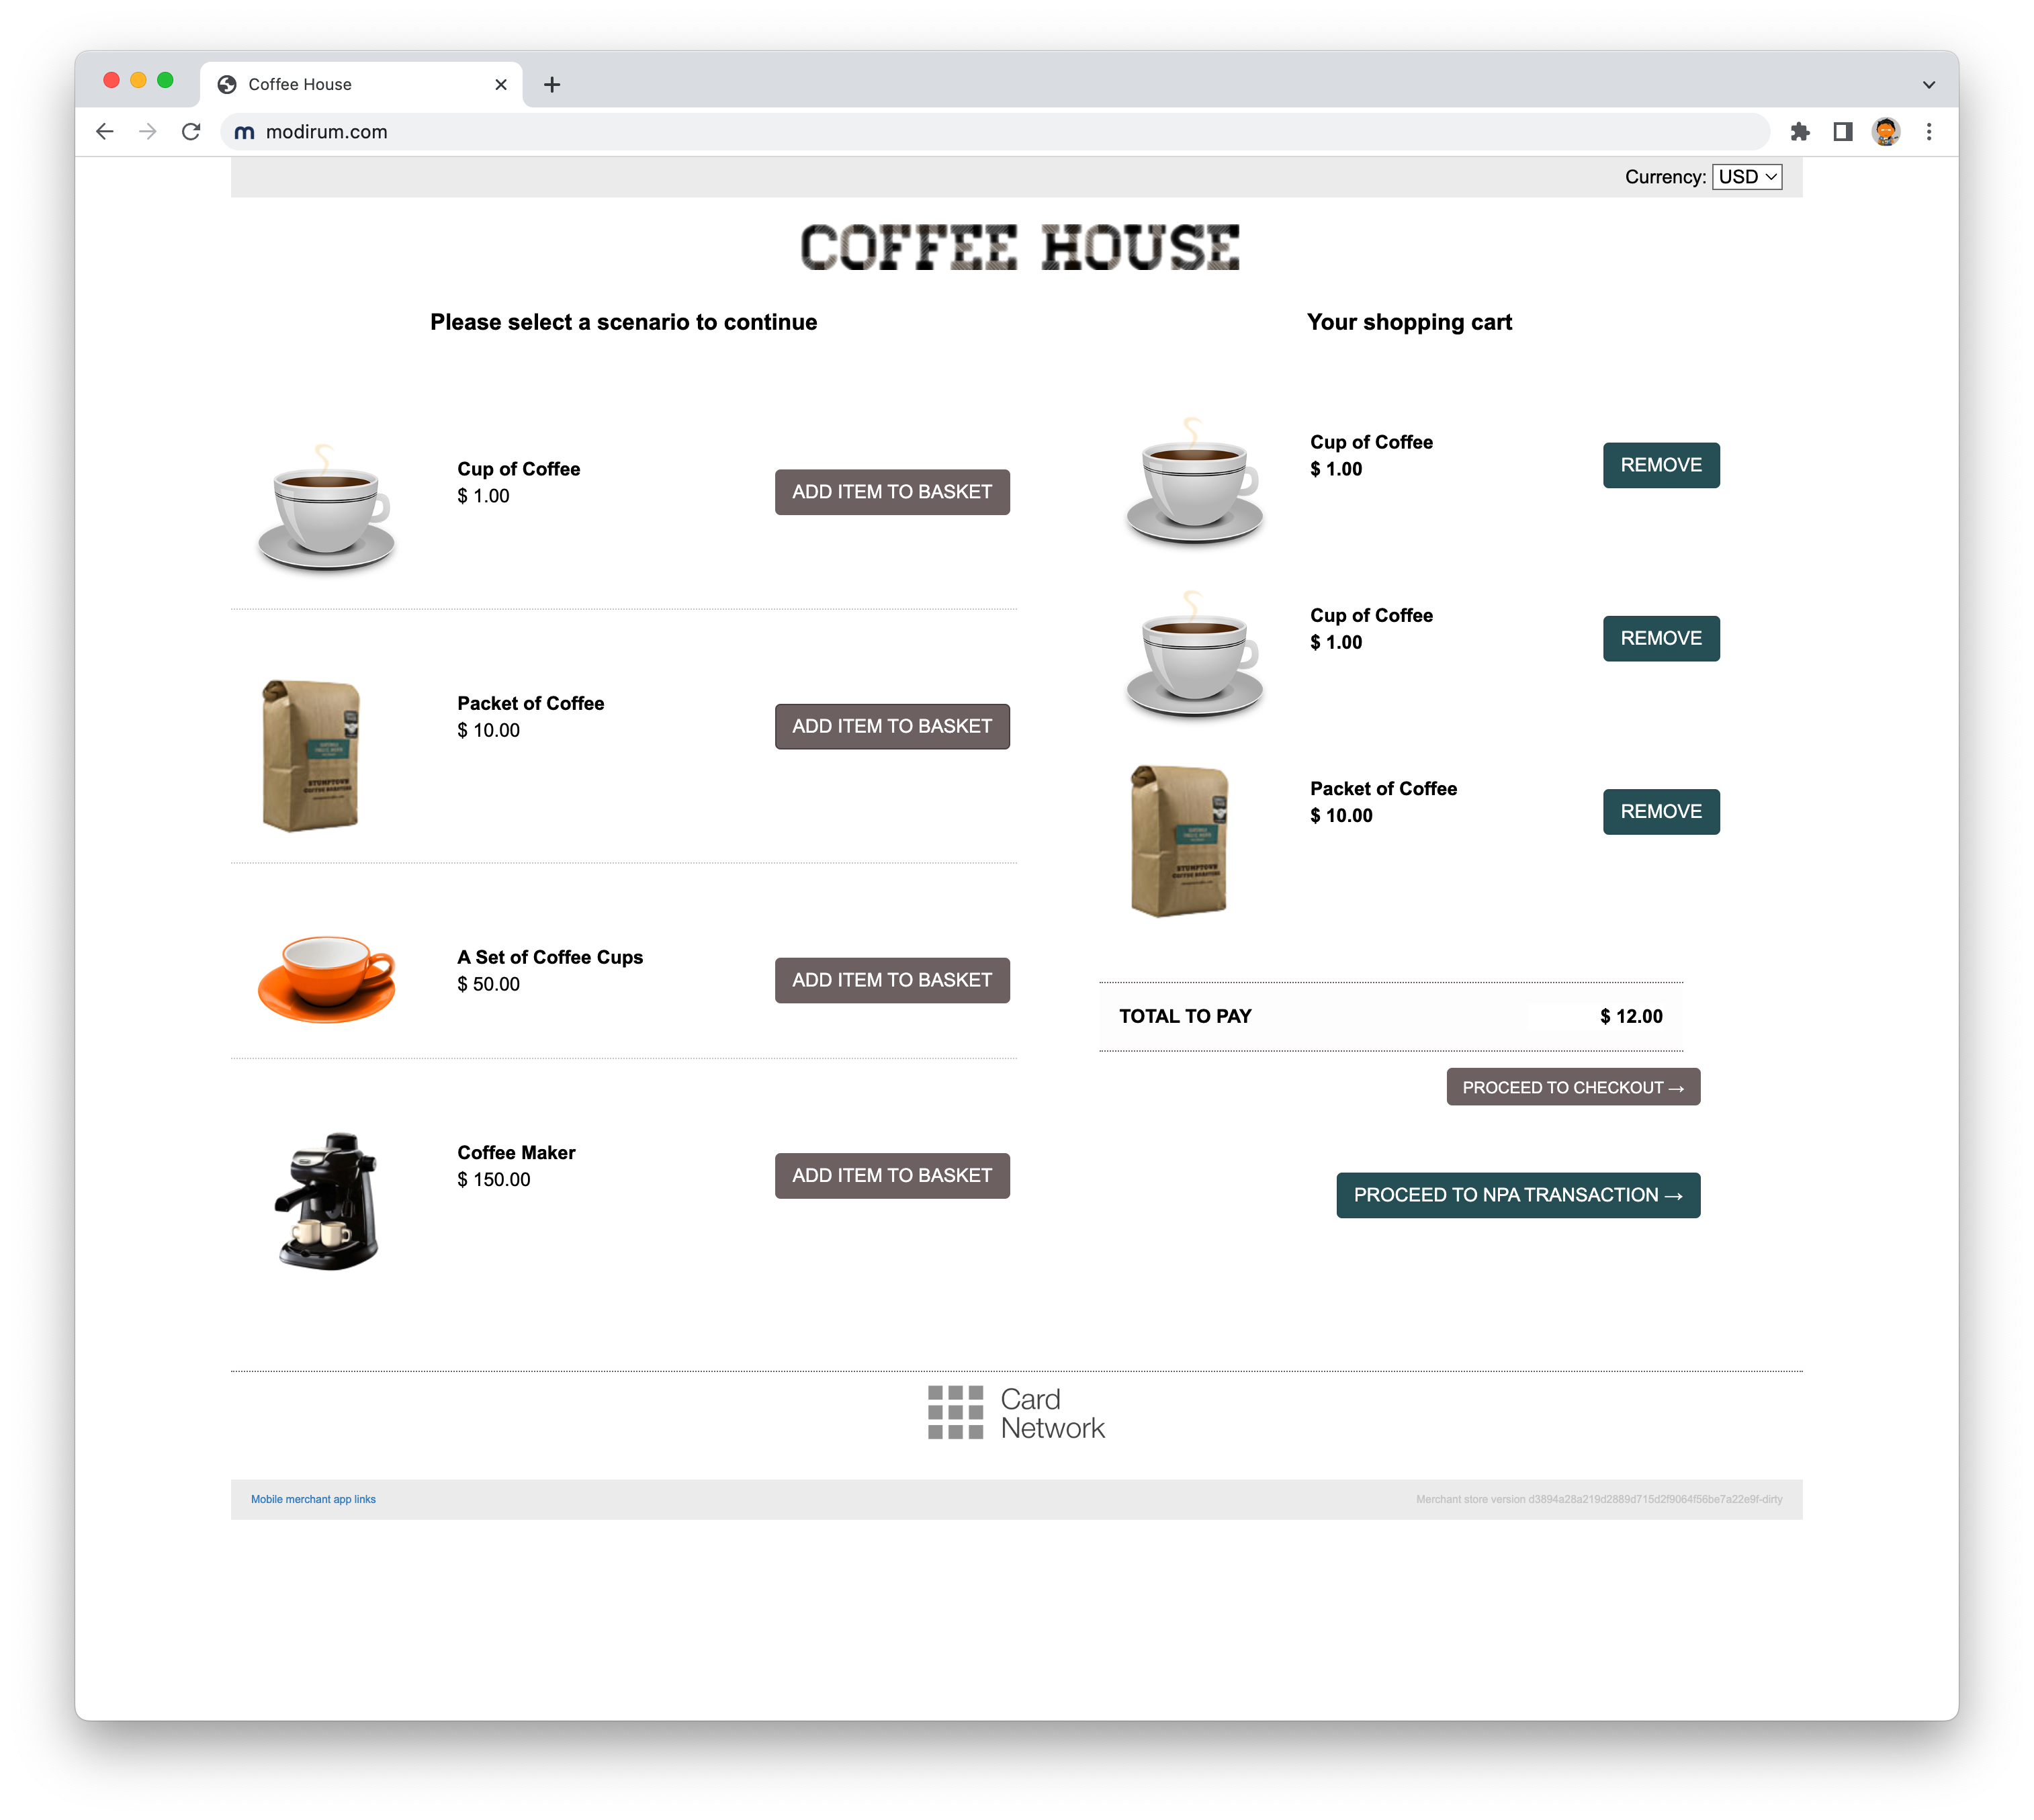
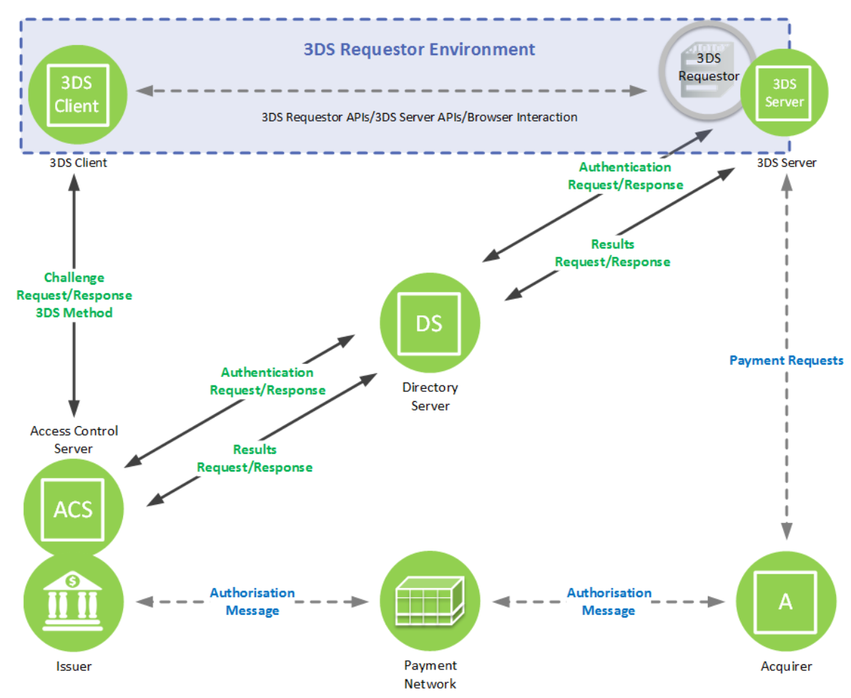

Slide 13
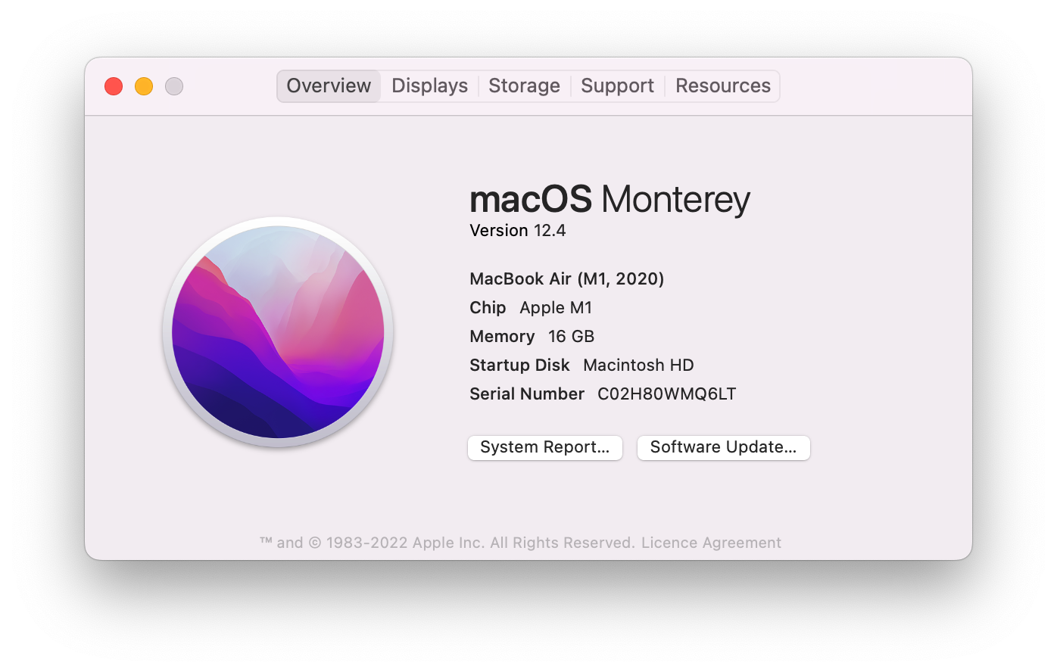
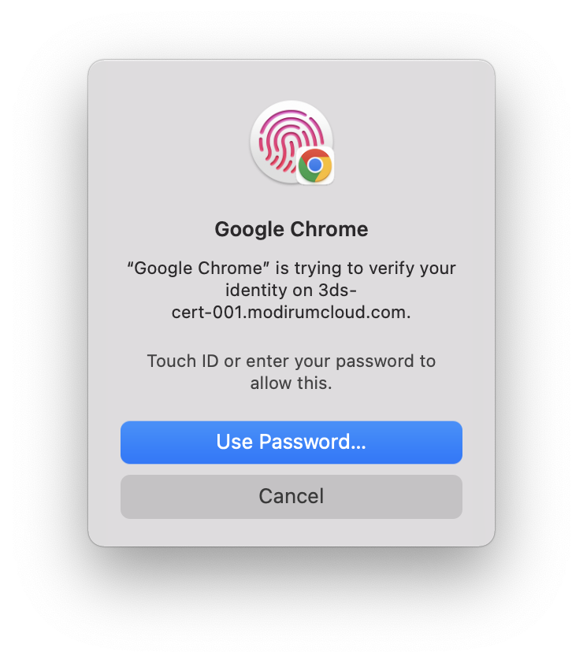

Slide 14
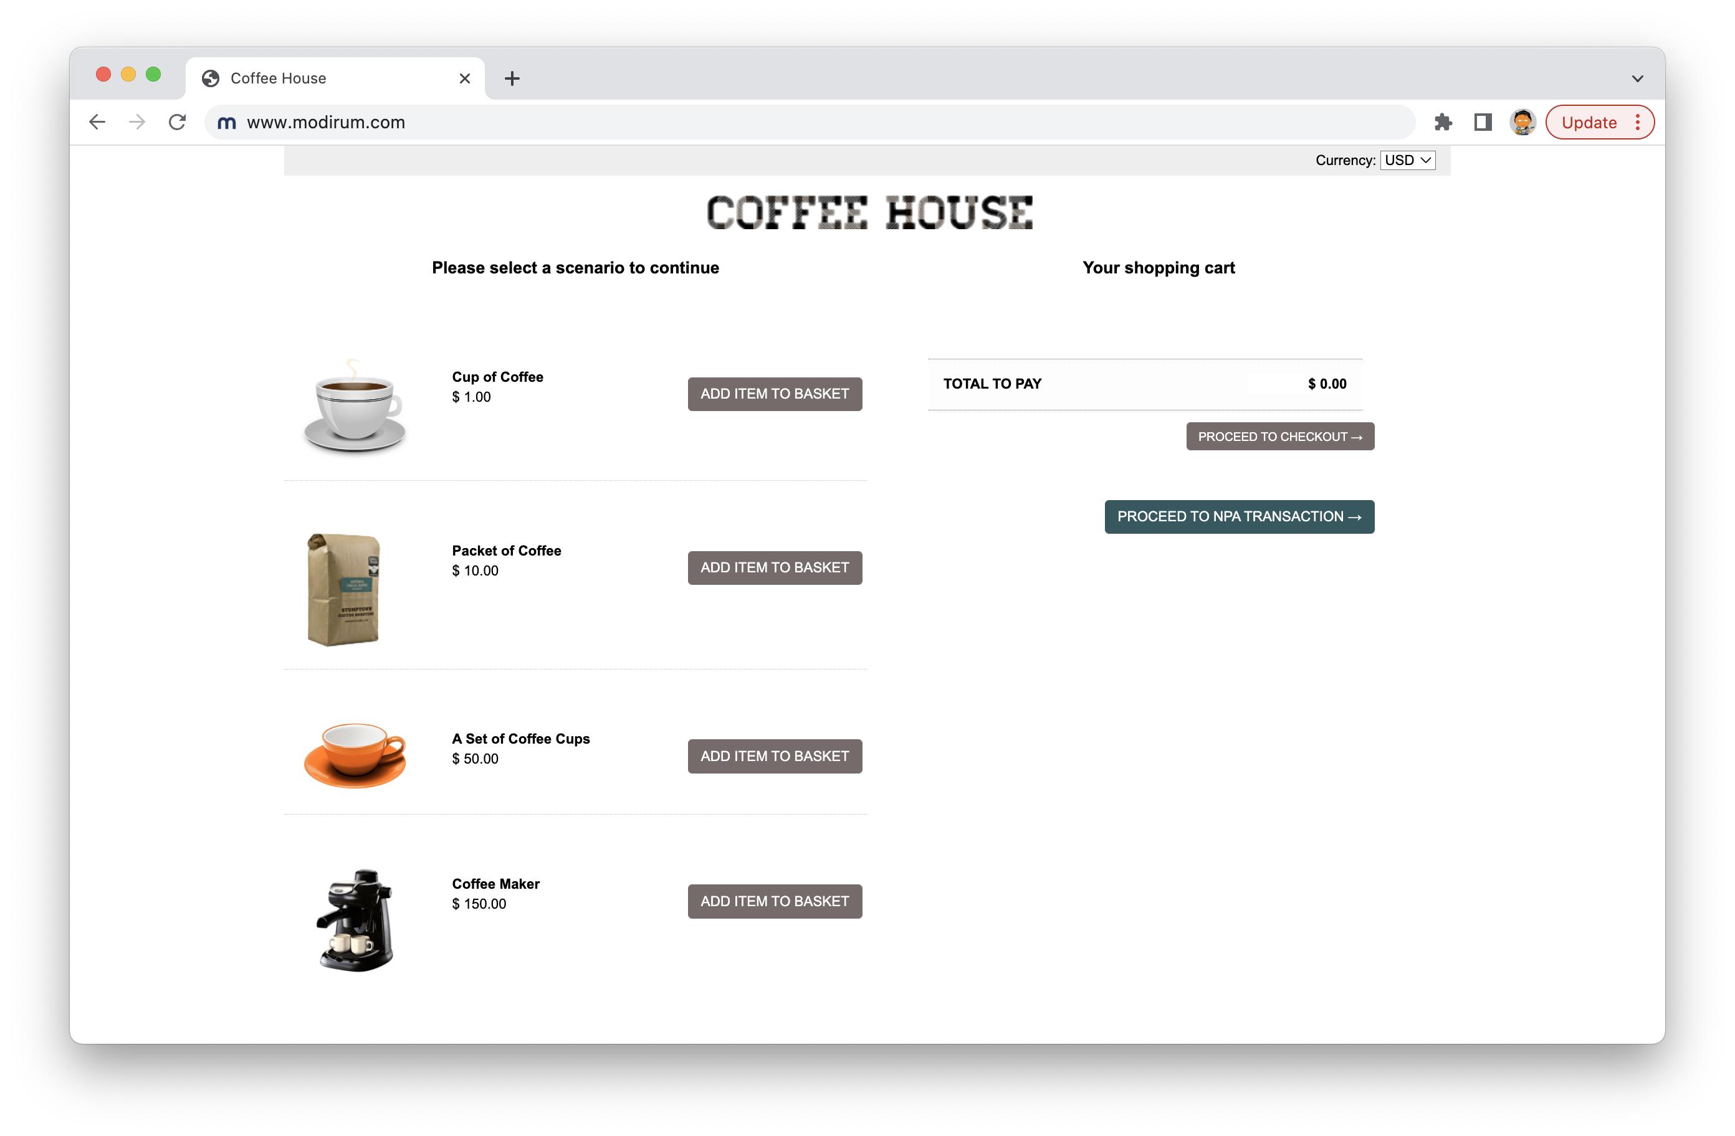

Slide 15
