Slide 1
Vehicle Access Control Policy Framework for Secure and Privacy-Preserving Vehicle to Everything (V2X) Communication
Supervisors : Harald Kosch
Lionel Brunie
Co-supervisor: Armin Gerl
Ph.D. Candidate: Ashish Ashutosh

Slide 2
What is Interesting?
Vehicles have a complex network of sensors.
Vehicles are already interacting with their environment with the help of sensors.
Data generated by smart vehicles can be used to provide services – E.g. fleet management, forward collision warning, etc.
Smart vehicles communicate and exchange data :
V2V(Vehicle to Vehicle)
V2I(Vehicle to Infrastructure)
V2C(Vehicle to Cloud)
V2X(Vehicle to Everything)
V2P(Vehicle to Pedestrian)
FTC Staff Issues Comments Discussing Key Security and Privacy Issues Surrounding Connected and Automated Vehicles
Notes:
1. Vehicle to Infrastructure: info about infrastructure of the car is collected and given to the driver. Information is usually about Safety, Mobility or env. related conditions.
2. Vehicle to Vehicle: info about speed, position of surrounding vehicles (through wireless exchange information) to avoid accidents, ease traffic congestion and
have a positive impact on environment.
3. Vehicle to Cloud: exchange info of vehicle with a CLOUD system. This allows the vehicle to use information from energy, transportation, smart homes and makes use of IoT
4. Vehicle to Pedestrian: sense info about its env. and communicates with other vehicles, infrastructure and personal mobile devices. It is intended to
improve safety and mobility on the road.
5. Vehicle to Everything: interconnection of vehicles to all types of vehicles and infrastructure systems. Ex. Cars, Highways, Ships, Trains, etc.

Slide 3
What are the Problems?
The data generated in vehicles is shared around and one has to deal with complex and mandatory security (access) and privacy issues.
Issues with vehicle generated data :
Protection of collected Personal Sensitive Data (in compliance with GDPR)
Example of sensitive data: location, drivers daily route, applications used by the driver, etc.
Interoperability problem (for V2X communication)
Different standards/proprietary models used by different companies to describe and access data.
Variety of sensors inside a vehicle
For access control and privacy, the designed model must be adaptive in order to accomodate the different types of sensor data collected.
Remote access to sensor data has to be restricted.
Because of limited resources in vehicles and to protect the privacy of the user.

Slide 4
Aim of this Research
Formalising data access control policies in order to enable privacy preserving and secure analytics.
Design an overarching access control framework for V2X and In-vehicle access control that ensures security and privacy while efficiently managing the vehicles limited resources.
Cooperation with W3C Automotive Working Group
Target use-cases and requirements will be taken from the Automotive Domain

Slide 5
State-of-the-Art
Several Domain-Specific Languages for access control can be found. E.g. XACML especially because it allows Deontic Logic (Obligation, Prohibition and Permission).
Layered Privacy Language(LPL) allows modelling legal policies (based on GDPR) in a human-readable and machine readable format.
Enforces it using access control mechanisms, data transformations for de-identifying user data.
Based on the concept of Purpose-Based Access Control (PBAC)
Designed in a generic way such that it can be applied in the context of Fog Computing and analysis of vehicle data.

Slide 6
An approach to solving the problem
Extensive research to gather requirements and also to understand the stakeholders involved in the V2X environment.
To look into DSLs that are based on access control and privacy.
Requirement analysis in cooperation with W3C Automotive Working Group members (to identify additional use-cases)
Architecture design is essential
To define the position of the Policy Deicision Point(PDP), Policy Enforcement Point(PEP), PRP(Policy Retrieval Point), Policy Information Point(PIP) correctly.
Evaluation of the access control framework and vehicle access control policy will be done by using a V2X Simulation (based on the identified V2X scenarios)
V2X simulation based on real data (E.g. Ford Autonomous Vehicle Dataset)

Slide 7
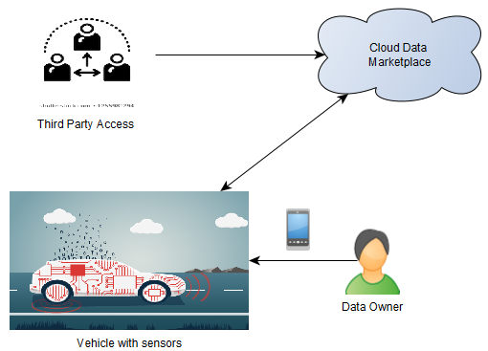
Use- Cases
Vehicle owner to a 3rd party: temporary access to a 3rd party (a garage, a delivery guy, etc)
Vehicle to Cloud Marketplace: permissions to use data for analytics purposes
In-Vehicle Access Control: emergency situations where the data must be accessed without delay.

Slide 8
Discussion and Feedback
What are the other possible target use-cases for this research problem?
Real data from WG?
Tech used in cars?
Autograde Linux or other flavours of Linux?
C++ for ECU (Electronic Control Unit)

