Slide 1
QR Code Payment in Japan
JCB Co., Ltd.
September 2019

Slide 2
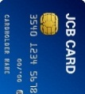
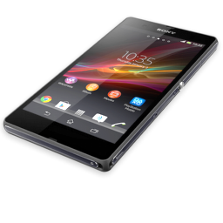

Agenda
About JCB
JCB Mobile Payment Solution Overview
QR Code Payment in Japan
SmartCode

Slide 3
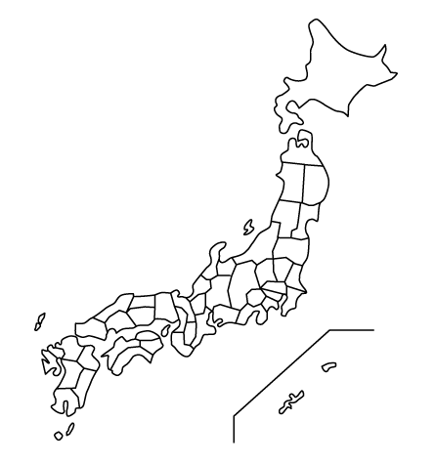


1. About JCB
Brand, Issuer, Acquirer, Processor
in global markets,
as Payment Brand
in Japan,
Brand, Issuer, Acquirer,
and Processor

Slide 4
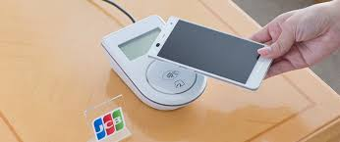
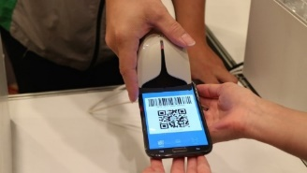





2. JCB Mobile Payment Solution Overview
As an Int’l Payment Scheme, JCB offers the global compliance standard mobile payment solution.
In Japan, JCB offers solutions to adopt to unique market environment by utilizing our existing assets.
Mobile Payment Solution
NFC
QR/Barcode
GLOBAL
GLOBAL
JAPAN
JAPAN
JCB CONTACTLESS
（Type A/B）
QUICPay
（Type F）
Smart Code
JCB QR Code Payment
Compliant with Global Standard Type A/B
Compliant with Type F – unique to Japanese market
Adapt to market environment
Support CPM
Compliant with EMV standard
Start with MPM

Slide 5







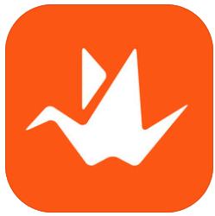

3. QR Code Payment in Japan
Market Background information in Japan
Because of Alipay & WeChatPay, QR code/bar code payment has been attracted much attention in the Japanese market.
Companies from different industries and start-ups have newly joined in the payment market with this technology.
In this trend, various different specifications has shown up in the market and merchants have troubles to deal with them.
*Alipay is accepted in PayPay’s Merchants.
*WeChat Pay is accepted in LinePay’s Merchants.

Slide 6
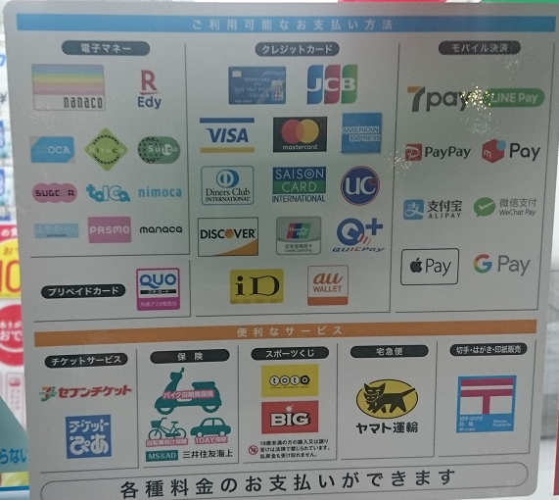
3. QR Code Payment in Japan
[Reference] Payment Acceptance @ Convenience Store
(e-Money /Contactless)
(Credit Card /Contactless)
(Mobile Payment)

Slide 7


3. QR Code Payment in Japan （Cont.）
Action for improving Interoperability between every QR Payment
In 2018, Japanese government (METI) has released “Cashless Vision” (40% by 2025) in April and organized the industry-academia-government collaboration “Payments Japan Association (PJ)” in July.
In 2019, PJ has released “JPQR” - the Guideline for Unified Technical Specification of Code Payment (CPM & MPM) in March.
Major Issuers (Code Payment companies) switch from their original specification codes to JPQR on 1st of August, 2019.

Slide 8
3. QR Code Payment in Japan
[Reference] Faster payment network does not exist in Japan
In some countries in Asia, QR Payment is operated through a nation-wide
Faster Payment System.
Ex: Prompt Pay (Thailand), BharatQR (India)…
In Japan, Faster Payment System type of “light” and “cheap” retail interbank network does not exist.
(Yes, Japanese Zengin does act as 24/7 retail interbank network.
But, Zengin is very “heavy” and “costly”. It isn’t able to act as a retail ACH).
As a result, all of Japanese QR Payments act as
“Bank account connected On-Us (like Alipay)”
or
“Initiator or Handler of traditional payment service (including Credit Card)”.

Slide 9
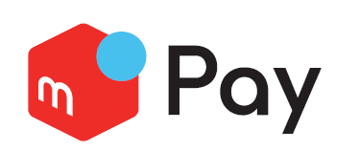
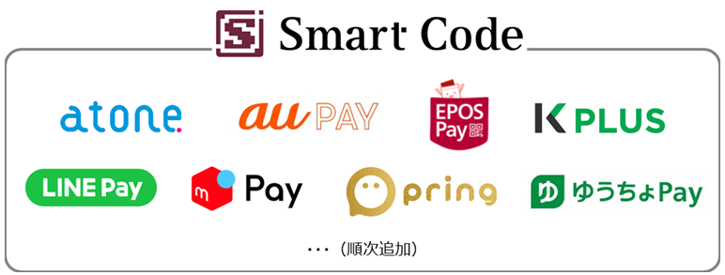
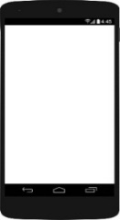
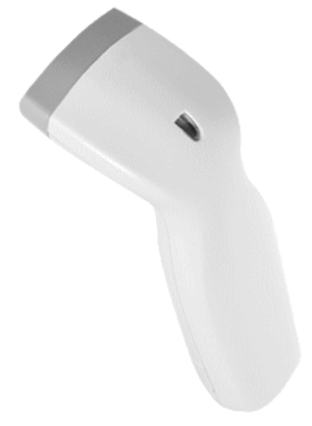
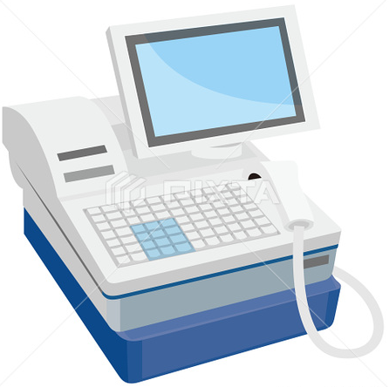





4. Smart Code
Overview of Smart Code
JCB has established an open platform called “Smart Code” for QR Code and Bar Code issuers in the Japanese market with its subsidiary companies.
JCB will acquire and open its merchant network to participating issuers.
Next 5 years, over 600 thousand merchants to be recruited (plan).
Acquirer
Gateway
Pay
Pay
Issuers’ logo will be displayed at point-of-sales of merchants
Issuers

Slide 10
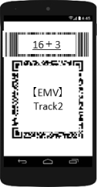
4. Smart Code
Specification of Smart Code
In order to utilize the current infrastructure at merchants in Japan, we decided to make QR Code and Barcode specification.
Display Requirement of Smart Phone
 | Display | Data format
A | Barcode | 19 digit (16＋3(Security Data) ^{※1}
B | QR Code (Magstripe) | EMV format：Magstripe Track2 equivalent^{※2}
C | QR Code (IC)（out of scope） | EMV format：IC equivalent^{※3}
Track 2 equivalent data in QR Code
Follow current Track 2 equivalent data layout※ and set 3 digit variable value in the CAV area (30-32)
※This layout is tag 57 of track 2 equivalent data described in the EMV QR Code Specification and it is different from the data in magstripe.
16 digit variable value
3 digit variable value

Slide 11
















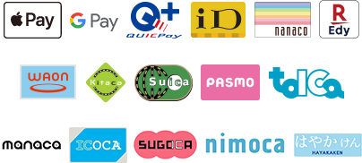





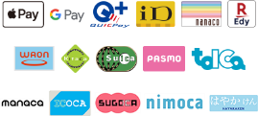
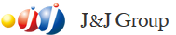


Appendix:JCB’s Acquiring Business in Japan
  The single JCB Acquirer in Japan and a largest merchant network
  Acquiring other int’l payment brands and e-money in Japan
  “QUICPay” acceptance network (Felica based contactless)
  Subsidiary & JV Companies
    Japan Card Network: Authorization & Settlement Switching Center
    JMS - JV among
    J&J Business Development – JV with JTB and provides "J-Tax Free" Solution
Large retailers’ e-money
Railways companies’ Felica based e-money
=
&
&

Slide 12
Thank You

