Slide 1
Open Banking Update
W3C, 22 Oct 2018
Chris Michael
chris.michael@openbanking.org.uk

Slide 2
Covering regulatory requirements AND market needs
Introduction
RTS (SCA and secure communications)
Account Info + Transactions
Payment Initiation (Same Day Payments)
Personal and Business Current Accounts
£GBP
Recurring & Future Dated Payments
All payment enabled accounts
(inc cards, savings, loans)
All currencies & FX
Confirmation of Funds (CBPII)
Mandated common and open standard
for CMA9
Open Data
Directory
Roadmap includes: Variable Recurring Payments, SCA Exemptions, Status, Refunds, Confirmation of Payee
CMA Order
PSD2 scope
Extended scope

Slide 3
Version 3 Technical Specifications
Introduction
Open Data APIs
Read / Write APIs
Security Profile
ATM info
Branch info
Product info
Personal Current Accounts
Business Current Accounts
SME Lending
SME Credit Cards
Account & Transaction Info (‘read’)
Payment Initiation (‘write’)
CBPII (‘funds check’)
Event (‘notifications’)
New in Version 3, launched Sept 2018:
Covers Redirect and Decoupled Flows
All payment accounts (incl. credit cards, wallets, pre-paid)
Domestic and international payments
Multi-currency
Single Immediate, Scheduled, File Payments
Confirmation of Funds
FAPI Profile (redirect)
CIBA Profile (decoupled)
Dynamic Client Management (onboarding)
Based on OAuth2 and OIDC
MTLS
JWS

Slide 4
OBIE is more than a standards body
Introduction
Open Banking has been live in the UK since Jan 2018. We’ve encountered a number of issues and developed innovative solutions so you don’t have to…
ASPSPs and TPPs struggling to understand standards
Documentation + Ref Apps + Support Services
Variable/poor ASPSP authentication experience
Customer Experience Guidelines + Checklist
Participants not implementing standards correctly
Conformance + Certification
Variable/poor API performance (speed and reliability)
MI + Monitoring
APIs lacking functionality
OB Roadmap (e.g. v4 to include VRPs)

Slide 5
Technical Specifications v User Experience
Customer Experience Guidelines
Technical Specifications
User Experience
No shared credentials
Same AuthN Factors/Methods
No more steps/friction

Slide 6
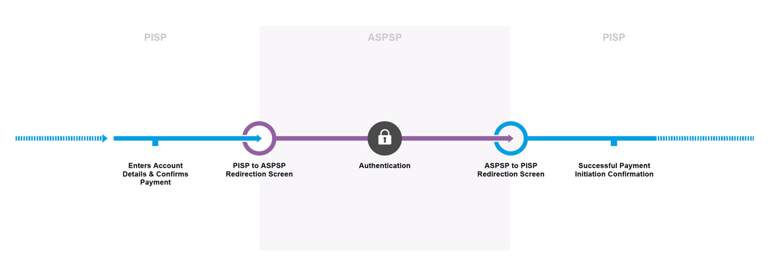
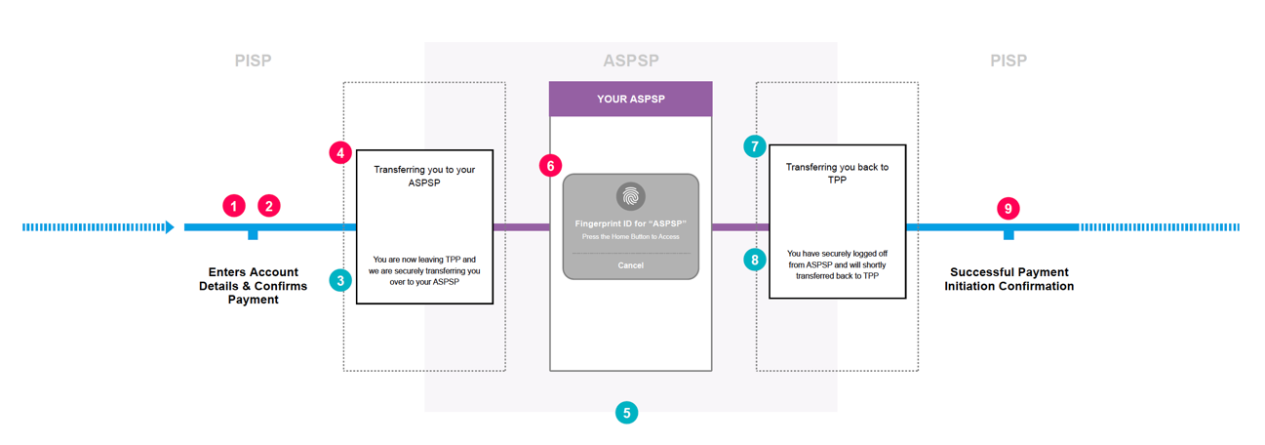
Redirect Model: Simple App-to-App Flow
Customer Experience Guidelines

Slide 7
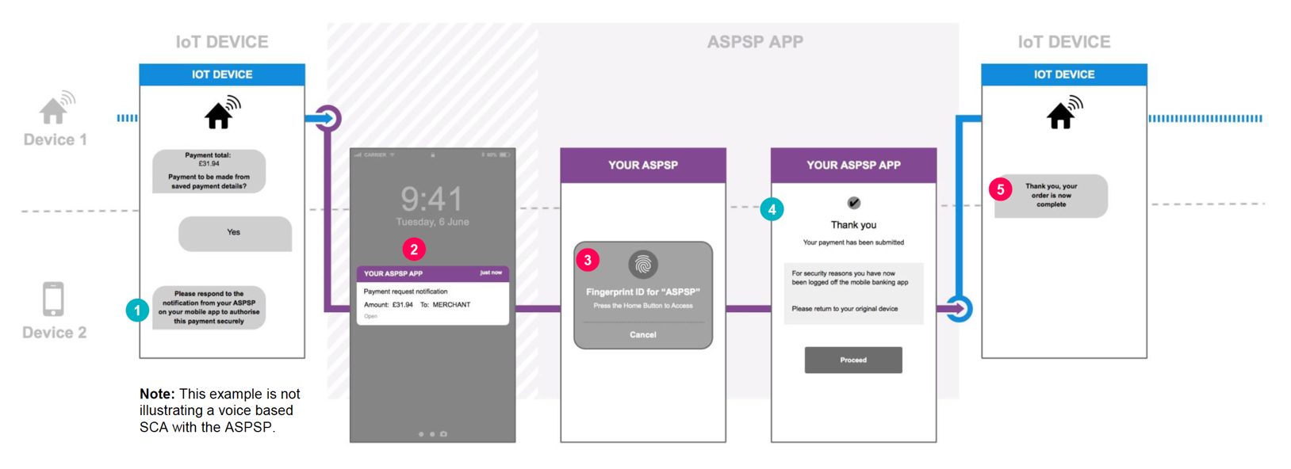
Decoupled Model D: PSU with a TPP account
Customer Experience Guidelines

Slide 8
Overview of Standards and Conformance Tools
Conformance and Certification
Enabling regulatory requirements (PSD2/RTS) to be met, in order to achieve an exemption from contingency mechanism, while supporting the commercialisation of rich, innovative customer propositions by ASPSPs
API Standards and Standard Implementation Requirements
+
SIR Conformance Tools
=
A modular approach to check ASPSP implementation and ensure SIRs are met
Compliance
Meet mandatory regulatory (PSD2) requirements
Commercial
Enabling additional functionality (optional)
Compliance
Scope: PSD2/RTS
Commercial
Scope: Market enabling
Selected to suit ASPSP requirements, covering both regulatory compliance and optional commercial implementations.
Technical Standards
Technical Standards
OBIE Conformance Suite
OBIE Conformance Suite
(a) Compliance with PSD2 for Account Information, Payment Initiation and Confirmation of Funds
(b) Extensible optional commercial standards
Security: OIDF
Security: OIDF
Open ID Foundation. In line with globally supported standards (FAPI)
Customer Experience
Customer Experience
CEG Checklist
CEG Checklist
Covering both redirect and decoupled authentication methods, with examples for all PSD2 use cases.
(a) CEG Checklist enables a check that all journeys are PSD2 compliant
(b) Customer experience for optional commercial standards
Operational Guidelines
Operational Guidelines
OG Checklist
OG Checklist
Aligned to EBA Guidelines and provide clear guidance to ASPSPs about required Service Levels.
Additionally support ASPSPs to meet their obligations regarding MI Reporting, Design and Testing with TPPs and Issue Resolution

Slide 9
End-to-end process for OBIE Certification of ASPSPs
Conformance and Certification
Iterative process to address any issues identified by OBIE
ASPSP pre-application, having made initial internal assessment
ASPSP applies for some / all Certificates for each brand
Participant submits SIR Checklists and supporting evidence
OBIE validation process
OBIE issue OB [Standard] Certificate
Certification overview
OBIE Certification is ultimately concerned with ensuring participants, and in particular ASPSPs, implement the Open Banking Standards correctly
Modular Certificates are granted for Conformance to each aspect of the SIRs
Yearly process
Certificates can be revoked if organisation loses licence or other major issue is judged by NCA as requiring revocation
ASPSP disputes OBIE decision
Participant¹ raises complaint and queries Certificate issuance
ASPSP Appeal Process – Independent panel
Dispute Resolution Process – Independent panel
1. Could be TPP or another ASPSP

Slide 10
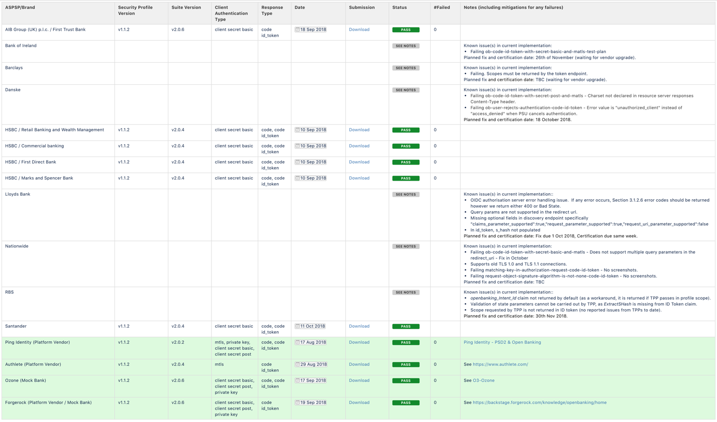
Certifications for v2 (as of 12 Oct 2018)
Conformance and Certification

