Slide 1
EU Payments Update
David Ballaschk, Deutsche Bundesbank
Digitalisation in Payments
TPAC 2018
Lyon, 25 October 2018

Slide 2
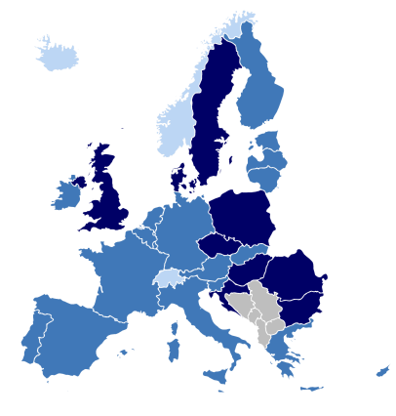
The European Payments Landscape
Eurosystem
Countries: 19
Population: 339.3 mln
Banks: 5,305
Payments per year: 68.1 bln
EU-28
Countries: 28
Population: 508.2 mln
Banks: 6,898
Payments per year: 103.2 bln
SEPA
Countries: 34
Population: approx. 520 mln
Source: ECB (2016), European Commission (2015)
David Ballaschk, Deutsche Bundesbank

Slide 3
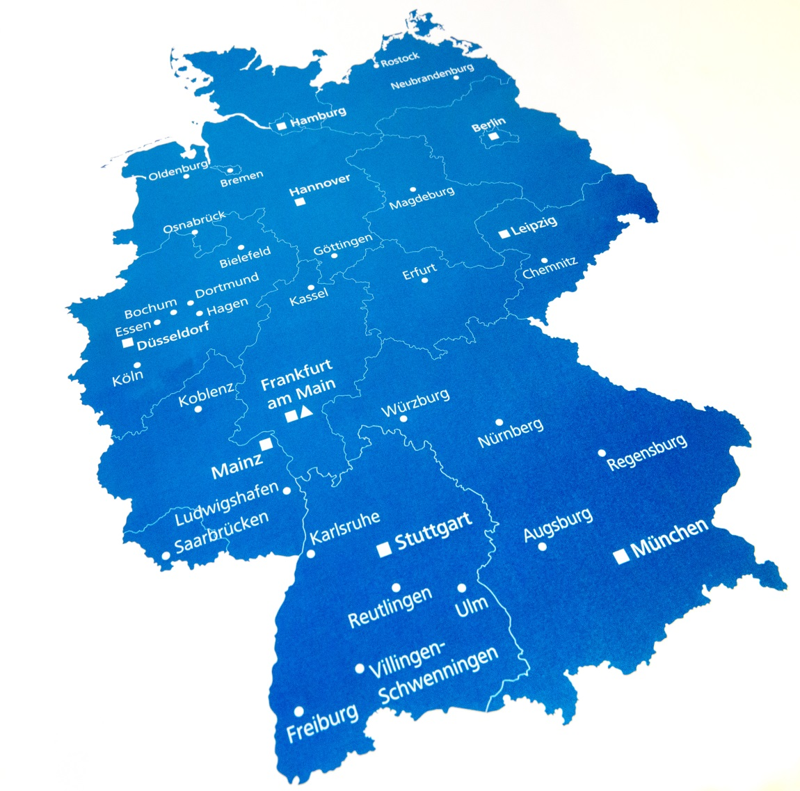
The German Payments Landscape
Population: 82.5 mn.
Strong use of cash at the POS (74,3 % [volume], 47,6 % [value])
Medium use of cards
However, big market in terms of credit transfers + direct debits
Integral part of SEPA
David Ballaschk, Deutsche Bundesbank

Slide 4
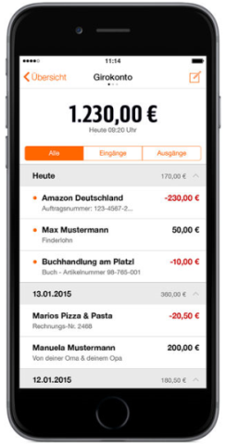
Payment Services Directive – PSD2 Main points
Interface for third party services
Current account
Strong customer authentification
Access to account for approved:
Account information services
Payment initiation services
Issuers of payment instruments (e.g. payment cards)
Higher security requirements for payment initiation, esp. for online payments (2-factor-authentification); use of at least two elements:
Something only known to the user (e.g. password)
Something solely in possession of the user (e.g. token)
Something belonging directly to the user (e.g. fingerprint)
Status quo
Transposition in national law was due in January 2018
Additions to PSD2 published as Regulatory Technical Standards (RTS) by the European Banking Authority (EBA) → to be implemented latest September 2019
David Ballaschk, Deutsche Bundesbank

Slide 5


Payment Services Directive – PSD2 Access to Accounts for TPPs
Payment Initiation Service Provider (PISP)
Account Information Service Provider (AISP)
Issuers of card-based payment instruments
Access for licensed third parties and for CRR- and E-money-institutions
For whom?
3 Options
Modified Customer Interface (Art. 30 and 31 RTS on SCA &CSC)
Dedicated Interface with fall back option (Art. 30, 32 and 33 Abs. 1 - 5 RTS on SCA & CSC)
Dedicated Interface with exemption to the fall back option granted by the NCA (Art. 30, 32 and 33 Abs. 1 - 3, 6 – 7 RTS on SCA & CSC) → NCAs grant permission for each PSP individually
TPP is obliged to identify itself regardless of the option chosen by the ASPSP
How?
Notes:
Zur Ausnahme vom Fallback
EBA erarbeitet im Moment Leitlinien zu den Bedingungen, die zu erfüllen sind, damit eine NCA eine Ausnahme von der Implementierung eines Fallback-Mechanismus‘ genehmigen kann (Konsultation war bis 13.08.2018)
Befreiung erfolgt auf der Ebene des einzelnen ZDL (nicht direkt auf der Ebene der API-Initiativen), da die Standardisierungsinitiativen quasi einen Werkzeugkasten definieren, aus dem heraus die einzelnen Institute ihre konkrete Implementierung zusammenstellen können. Beispiel: Berlin Group ermöglicht drei verschiedene Methoden des Kontozugangs:
(1) embedded (= Drittanbieter nimmt die Credentials vom Kunden auf und leitet sie an den Kontoführer weiter)
(2) decoupled (= die Authentifizierung des Kunden erfolgt losgelöst vom Online-Banking z.B. in einer separaten mobilen App)
(3) redirect (= der Kunde wird vom ecommerce direkt auf seine Online-Banking Seite weitergeleitet, wo er sich beim Kontoführer selbst authentifiziert)
Hinweis: Es kann sein, dass die Bankvertreter Gründe dafür vorbringen, dass nur Redirect implementiert werden soll. Unsere Position dazu: Das ist grundsätzlich möglich, dann ist aber darauf zu achten, dass Redirecting keine Behinderung für Drittanbieter beinhaltet, da sonst (a) keine Ausnahme vom Fallback gewährt werden kann und (b) darin möglicherweise eine Wettbewerbsbehinderung gesehen werden könnte (→ ggf. Verweis auf das Kartellamt). Unsere Empfehlung: Kontoführer sollten neben Redirect noch eine zweite Zugangsmethode implementieren (das schlägt auch der BdB vor). Am sichersten wäre Embedded.
BaFin plant vereinfachte Verfahren für Verbünde und Gruppen und wird hierzu und zu einer grundsätzlichen Vereinfachung des Verfahrens (der Gewährung von Ausnahmen vom Fallback) noch weitere Informationen bereitstellen
The RTS do not provide technical standards or a rulebook. Therefore, questions regarding the design of the APIs or the identification of licensed providers of the new services remain open, e.g. national registries and certification processes.
Market initiatives developing APIs are Berlin Group NextGenPSD2, Open Banking UK, Stet, Polish Bank Association, Czech Banking Association and Slovak Banking Association.
Working Group on payment initiation services of the ERPB
Task: Develope common technical, operational and business requirements in order to prevent the development of a fragemented market for APIs in Europe
Final report to be delivered in June 2018
Expected outcome: The working group will not solve the outstanding questions
API Evaluation Group
Market stakeholder group which is developing „qualitative“ criteria for the evaluation of APIs and to assess wether there is room for improvement of the solutions
These criteria shall help NCA evaluting if ASPSPs can be exempted from providng fall-back solutions, but: final decision is up to the NCA

Slide 6
Payment Services Directive – PSD2 Timeline for the API
Publication of API-dokumentation and provision of a test environment
TPPs access via a dedicated interface*
Beginning of market tests with „real“ transactions
until 14. March 2019
until 14 Sept. 2019
until 13. June 2019
* Requirement: Exemption from the fall back option
Okt./Nov. 2018

Slide 7
Payment Services Directive – PSD2 Information given to TPPs
All Information given to the payment service user regarding initiation and execution of the payment (differs between batch and real-time payment)
Additionally: Confirmation of availability of required amount (yes / no)
Alternatively: additional account data
PISP
Information about specified, online accessible payment accounts and associated payments
No information about other accounts or securities deposits
No information about personal data of the payment service user
AISP
Confirmation of availability of required amount (yes / no)
Card Issuer
Notes:
Zu Kontoinformationen
Die PSD2 bezieht sich nur auf Zahlungskonten. D.h. Informationsanfragen zu anderen Konten (z.B. Kreditkonten) oder Wertpapierdepots können vom Kontoführer zurückgewiesen werden.
Grundsätzlich entscheidet der Kunde, auf welche Konten er den Drittdienstleister zugreifen lassen möchte. D.h. ohne vorherige Einwilligung des Kunden ist kein Zugriff möglich. Die Einwilligung kann auch dem Dritten gegenüber abgegeben und von diesem dem Kontoführer übermittelt werden.
Zugriff ist nur auf online zugängliche Konten möglich und nur dann, wenn der Kunde für sein Konto eine Nutzung im Online-Banking vereinbart hat. Bei den sog. Drittkartenissuern genügt es, wenn das Konto online erreicht werden kann, also Online-Banking fähig ist, einer Online-Banking Vereinbarung bedarf es in diesem Fall nicht.

Slide 8
Payment Services Directive – PSD2 Other developments
EBA plans to issue the final guidelines on the exemptions to the fall back options by Q4 2018
Main concerns at the moment include:
Design and testing of infrastructure of interface to the satisfaction of the TPPs
Calculation of downtime
Involvement of TPPs in the exemption process
Clarity on timelines
Source: EPC
David Ballaschk, Deutsche Bundesbank

Slide 9
Instant Payments in Euro European Approach
Initiation of a discussion on Instant Payments with an advance of the European Retail Payments Board (ERPB) in December 2014
Definition of Instant Payments:
Electronic retail payment solution available 24/7/365
Immediate or close-to-immediate interbank clearing and crediting of the payees account
Conformation to the payer (within seconds of the payment initiation)
Irrespective of underlying payment instrument used, clearing arrangements and settlement
Goal: At least one Instant Payment solution (pan-European or mutually interoperable) to be available to all payment service providers in Europe
The objective of the ERPB is to contribute to and to facilitate the further development of an integrated, innovative and competitive market for euro retail payments in the EU with an involvement from the supply side as well as the demand side of the market and chaired by the ECB.
Source: EPC
David Ballaschk, Deutsche Bundesbank

Slide 10
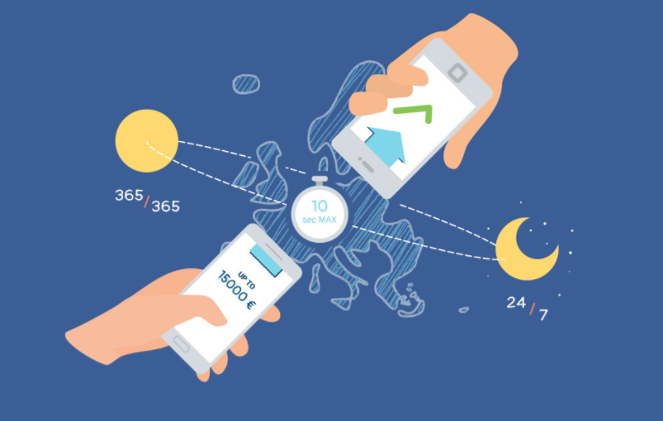
Instant Payments in Euro SCTinst-Scheme
Source: EPC
David Ballaschk, Deutsche Bundesbank
Notes:
Real-time as a consumer expectation
Instant Payments in Euro as facilitator for innovation
Scheme is available since 2016
First implementations from November 2017
26% of all payment service providers from 16 countries offer instant payments
Various new business models are possible
26% of European PSPs have adhered to the scheme

Slide 11
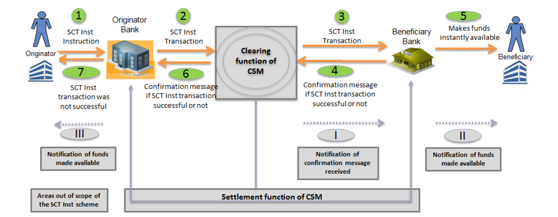
Instant Payments in Euro SCTinst-Scheme
Source: EPC
David Ballaschk, Deutsche Bundesbank

Slide 12

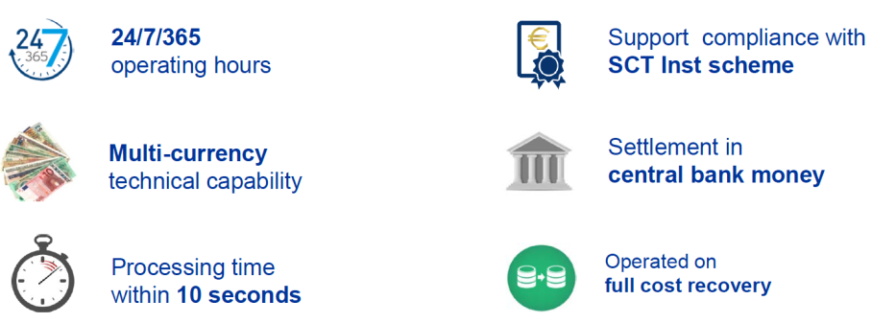
Instant Payments in Euro TIPS as a Eurosystem contribution
Liquidity on TIPS accounts is included in the minimum reserve calculation
TIPS-Costs:
No fixed fees
No joining fees
0,002 EUR per transaction
Source: EPC
David Ballaschk, Deutsche Bundesbank

Slide 13
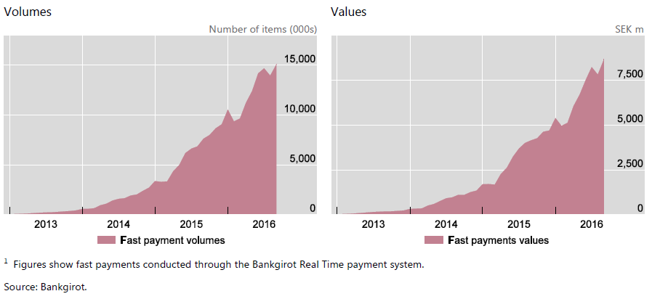
Outlook Instant Payments in Sweden
7,5 Bn. SKK =728,5 Mio. EUR
15 Mio. Tx/month equal roughly 3% of monthly cashless payment volume
David Ballaschk, Deutsche Bundesbank

Slide 14
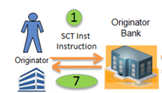



Outlook – What can W3C do?
Although the background infrastructure is standardised, there‘s still room for standardisation on the front end:
Notification for the customer in E-Commerce could be shown in the browser
Use of Banking APIs could be possible
Room for cooperation with banks for browser integrated solutions without the involvement of TPPs
Source: EPC
David Ballaschk, Deutsche Bundesbank

