Slide 1

Creating Secure Consumer Experience through W3C PR API
Overview, Benefits, Recommendation
Mastercard Digital Payments and Labs

Slide 2
Agenda
Security in W3C
Advancing Network Tokenization Spec
3DS 2.0 – Benefits and Scale
Q&A

Slide 3
Making W3C Payments Ecosystem Secure

Slide 4
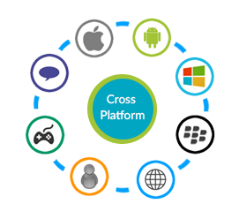


W3C PR API : Driving simplified and secure consumer experience at scale
Ubiquitous
Simplified and contextual user experience
Security with Scale

Slide 5
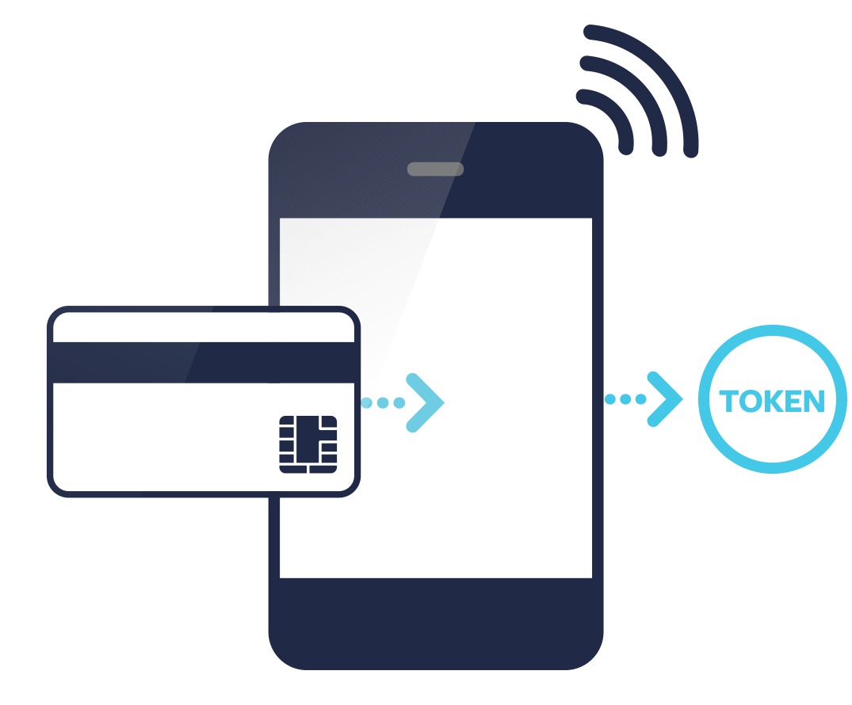
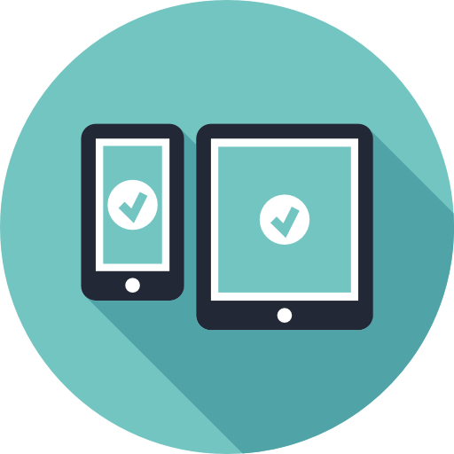


How to make W3C Ecosystem Secure
EMVCo Token Standards
Security at Scale
Cross Platform
Faster Checkout
Simplified UX
3DS 2.0

Slide 6
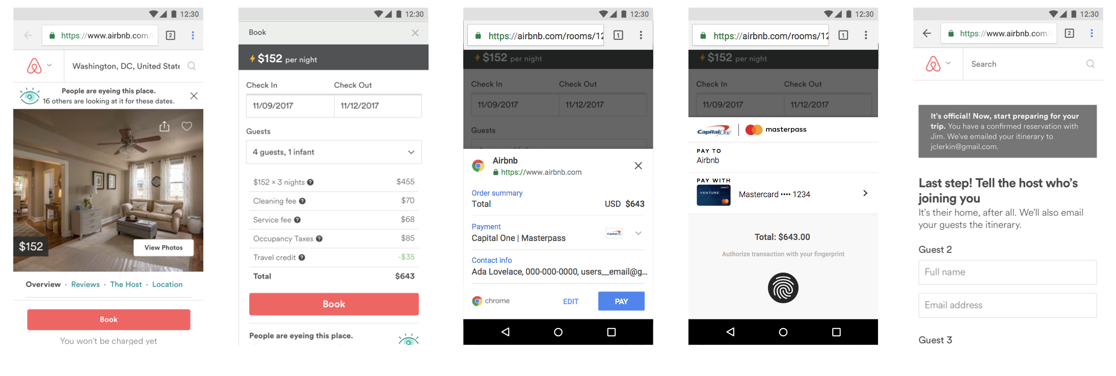
Prototype to showcase Secure W3C transaction using Network Token Spec
W3C Payments Working Group - Network Token Spec

Slide 7
Network Token Spec

Slide 8



Gaps with Basic Card Standard Method
Not Secure
Bad UX – CVV Entry
Lower Approval Rate

Slide 9
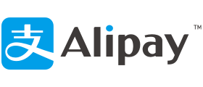

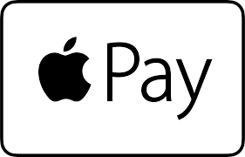

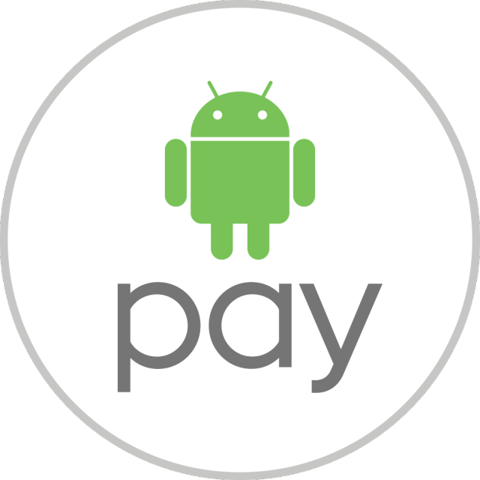
Gaps with Custom Payment Methods
Scalability Challenge
Custom Integration

Slide 10
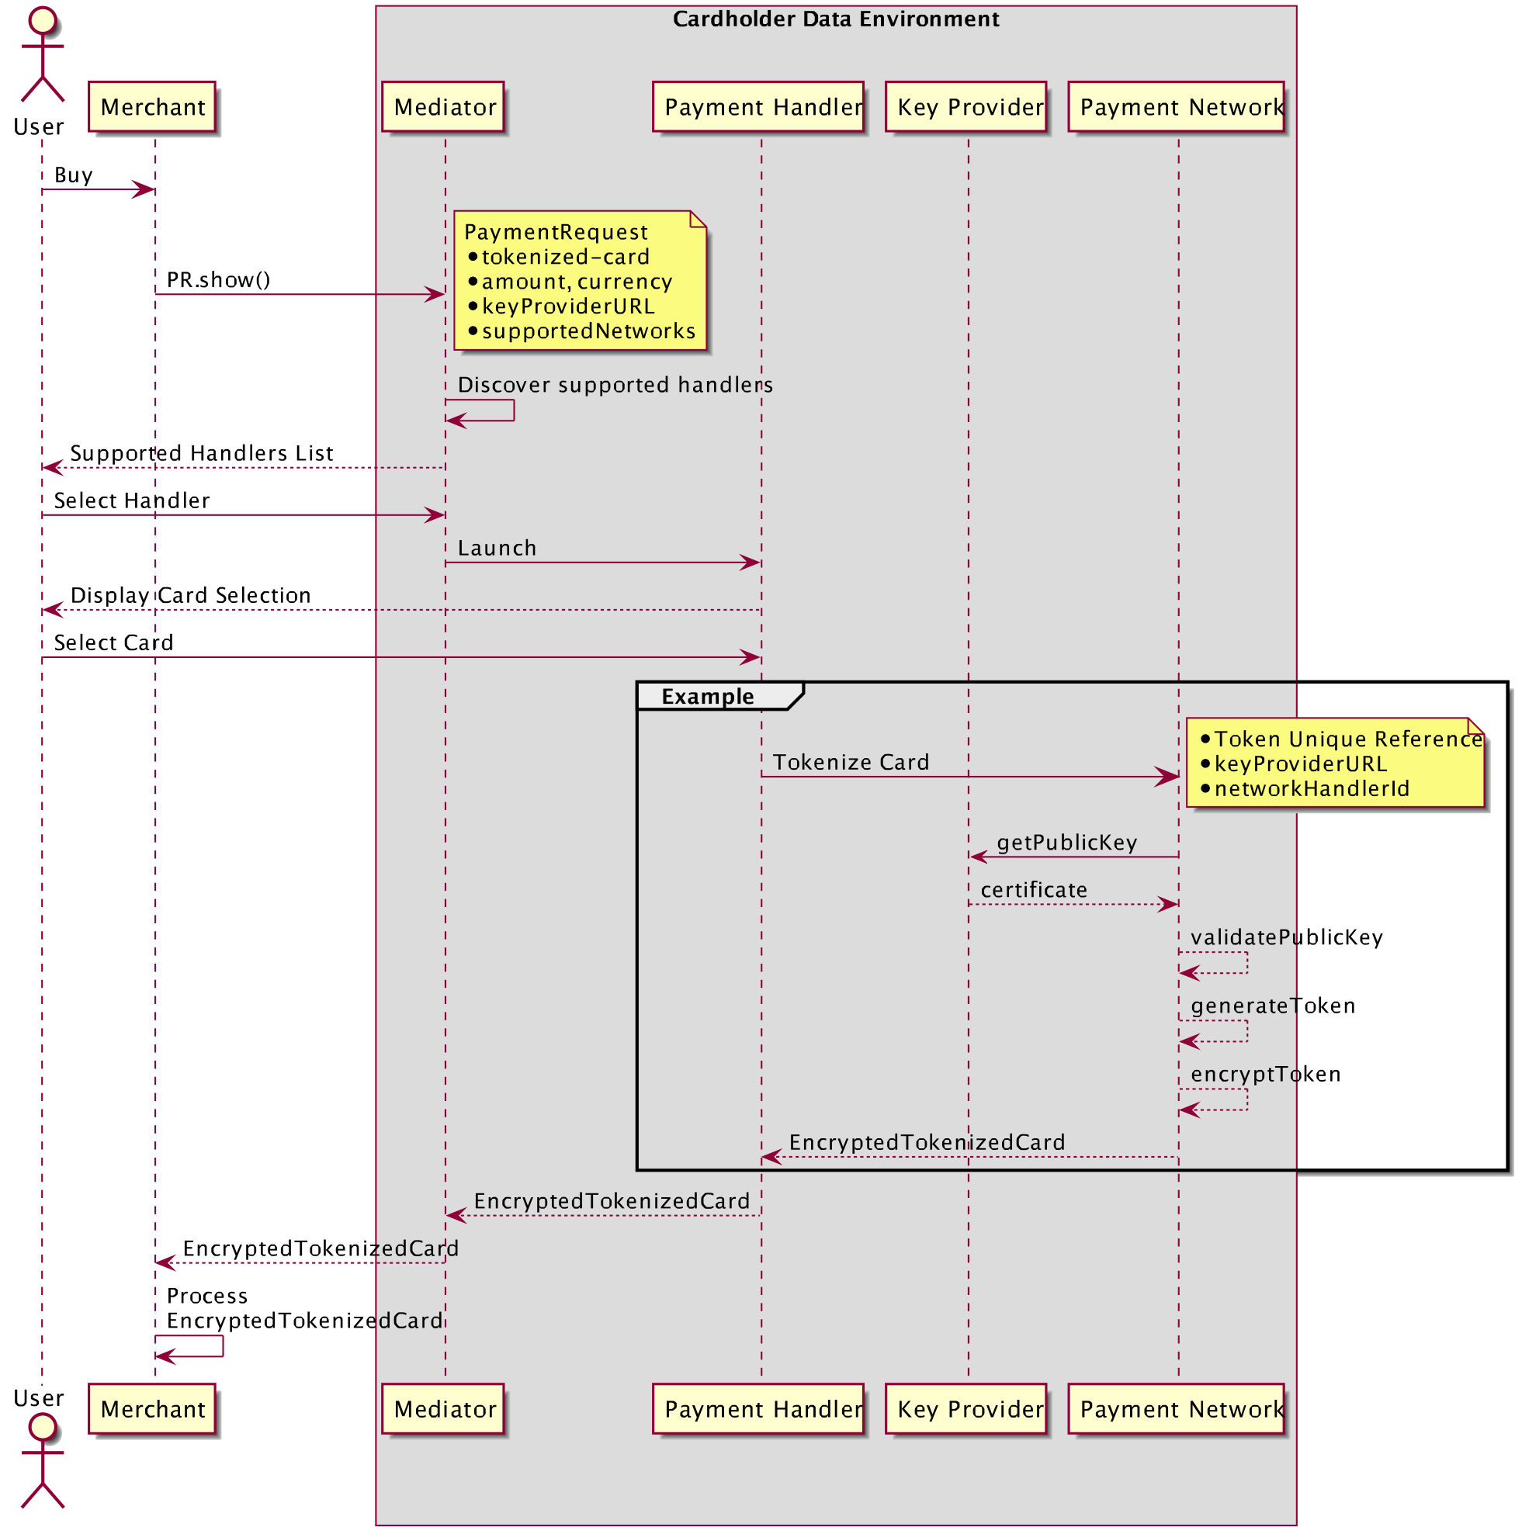
W3C Network Tokens Custom Payment Method – Security with Scalability
Security with Scale
https://github.com/w3c/webpayments-methods-tokenization/wiki/Tokenized-Card
Scalable across multiple merchants without custom development.
Security using verifiable Public Key
Low merchant adoption challenge
Cross platform – Native and Web Payment App
Next Steps – Road to Consensus Candidate

