Slide 1
EMV 3DS
Seizing the opportunity to enhance security and deliver a great consumer experience

Slide 2
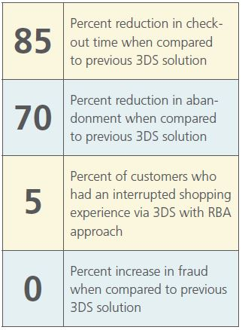


Authentication is a key enabler of digital payments
Digital payments have lower approvals and higher fraud rates
Authentication can help close the gap
New authentication technology reduces the friction
Example: Risk-Based Authentication
Physical
Increase approvals
Approval rate
Fraud
96%
1x
+10%
Increase in approvals
when transactions are
fully authenticated
Digital
Reduce fraud
Approval rate
Fraud
<8BPS
Lower digital fraud when dynamic authentication is used
83%
3x
41
Fraud and approval rate data is global and based on Mastercard transaction data
RBA example based on RSA case study with large UK issuer

Slide 3
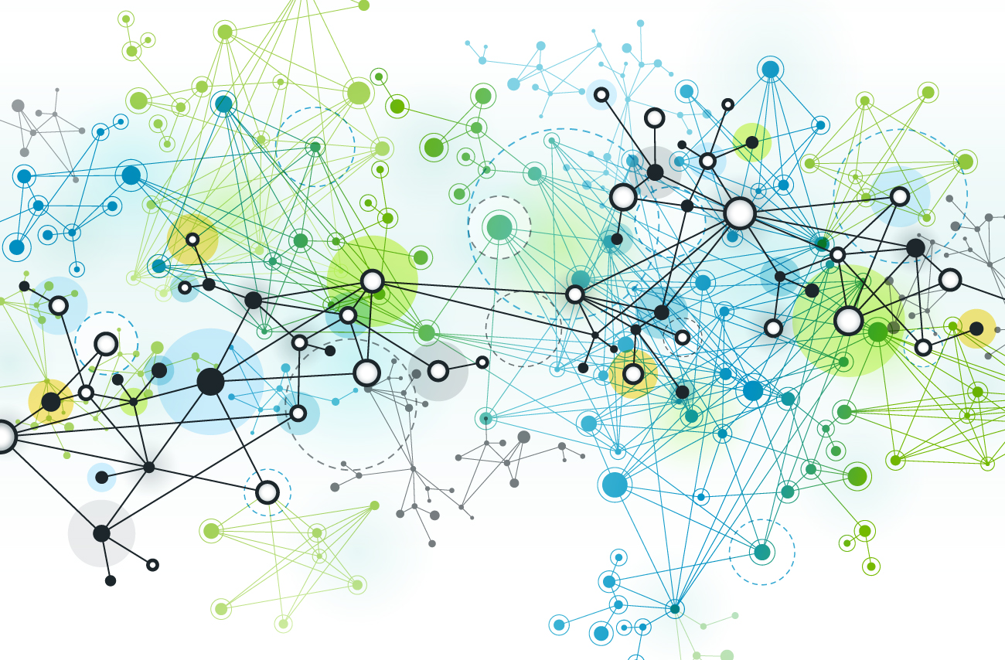
eCommerce with 3DS
Authorization Network infrastructure
  Millions of merchants / thousands of banks
  Five to ten “players” on very transaction
  Virtual private network
  Very fast – 130 milliseconds
  Manages and verifies data
  Layers of fraud and security tools
  Feeds into Clearing and Settlement network
Network rules work to encourage information sharing and reduce fraud
Network message ISO8583
  0100 / 0200 messages are where the yes / no decision is made
  Card present -physical location / physical card
  Upgraded to manage tokens / EMV chip cryptograms
  Upgraded to work in sync with 3DS
    CRYPTOGRAM
    DEVICE
    CONSUMER
    LOCATION
    ENVIRONMENTAL
The ecosystem needs more data

Slide 4
Security standards in the payment industry are evolving…
Physical
Digital
10x more data = better authorization decisions
Enhanced support for frictionless authentication (Risk-Based)
Seamless consumer experience – integrated into checkout flow
Support for mobile in-app & connected devices
Security Standard
    EMV
    Tokenization
    3-D Secure 2.0
Securing the payment credentials
Authenticating the cardholder
All managed by EMVCo and open for industry participation

Slide 5
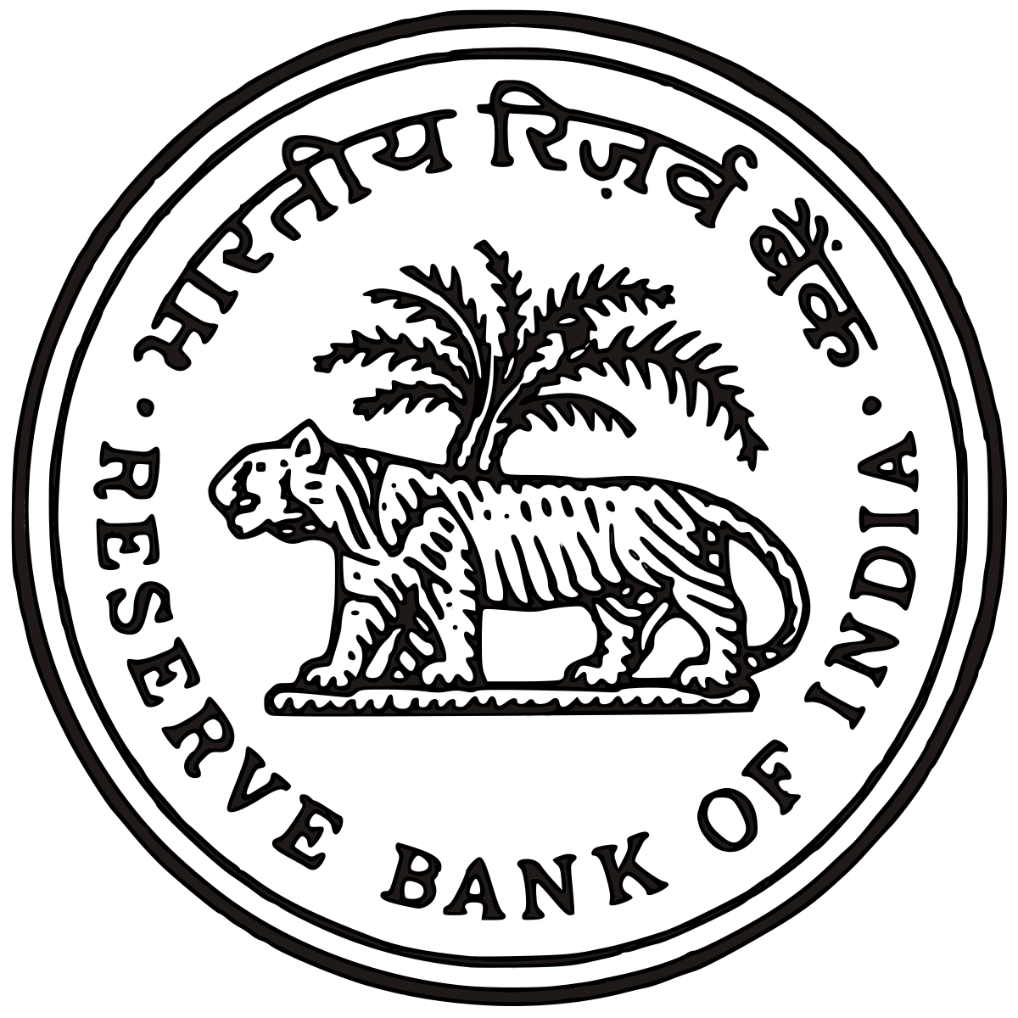
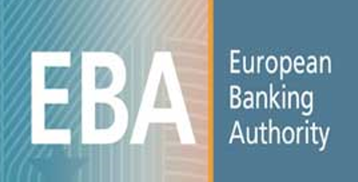
Regulators continue to introduce new authentication requirements to protect the consumer
Impacted Markets
Examples
India
Europe & PSD2
Austria
Belarus
Belgium
Bulgaria
Croatia
Cyprus
Czech Republic
Denmark
Estonia
Finland
France
Germany
Greece
Hong Kong
Hungary
Iceland
Ireland
India
Israel
Italy
Japan
Latvia
Lithuania
Malta
Mexico
Netherlands
Nigeria
Norway
Philippines
Poland
Portugal
Romania
Singapore
South Africa
Spain
Sweden
Taiwan
Thailand
United Kingdom
Two-factor authentication required on all online transactions
In late 2016 RBI relaxed two-factor authentication requirement allowing Risk-Based Authentication on transactions under 2,000 Rupees
RBI evaluating use of risk-based authentication on payment network to enhance consumer experience
Strong consumer authentication required on digital transactions
Risk-Based Assessment expected to be a core requirement of the regulation on day 1
Risk-Based Authentication permitted on transactions – based on fraud level and amount
Consumers permitted “white list” merchants that they know and trust
For illustrative purposes; highlights examples of current and pending regulation

Slide 6



Overview of EMV 3-D Secure (3DS)
The additional security layer reduces fraudulent use of online credit and debit transactions by…
… preventing unauthorised use of cards online
… and protecting merchants from exposure to fraud-related chargebacks and increasing approval
3-D (Three Domain) Secure is a messaging protocol which enables consumers to directly authenticate with the card issuer when shopping online
Three domains consist of:
Merchant / Acquirer Domain
Merchant Integrator (MI)
Interoperability Domain
(Payment Networks)
Directory Server (DS)
Issuer domain
Access Control Server
(ACS)

Slide 7

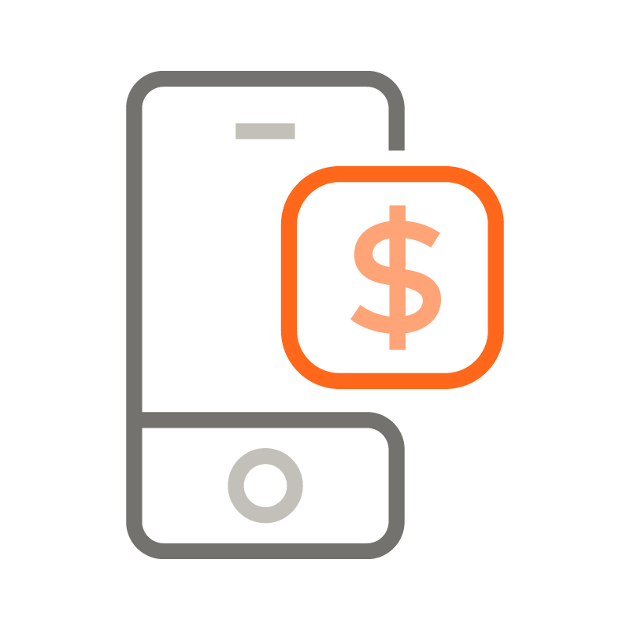

EMV 3DS is a multi-purpose protocol…
EMV 3DS is designed to support many authentication use cases
  Payment Authentication
  Non-Payment Authentication (Identification and Verification)
  Requestor Initiated Account Verification
  Other future use cases
EMV 3DS messaging and data structure accommodates for authentication when transacting from any connected device
  Smartphones
  Browsers
  Any other connected device (via future device data specifications)
Allows optional account data sharing to occur across all channels from merchants to card issuers, better facilitating frictionless flows
  Merchant account confidence (or lack thereof)
  Recent activity relevant to the merchant account
  Transaction specific data as fraud indicators (shipping info, authentication method used for current transactions, number of non-fraud transactions, etc.)

Slide 8
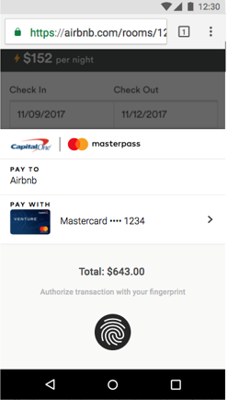
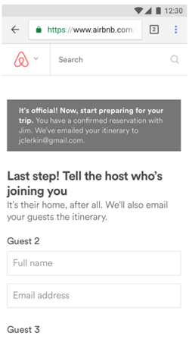

Primary Use Cases for W3C APIs and EMV 3DS
PAYMENT METHODS | PAYMENT APPS | 3DS CHANNELS | 3DS USE CASES
Basic Card (existing) | Card on Browser | Browser | Payment Authentication Non-Payment / ID&V
Custom (existing) | Native Apps Web Based Apps | Browser and App | Payment Authentication Non-Payment / ID&V
Network Tokens (under development) | Native Apps Web Based Apps | Browsers and App | Payment Authentication Non-Payment / ID&V

Slide 9
Opportunities for W3C
Integration of EMV 3DS functionality into W3C APIs to maximize benefits to the payments ecosystem
Streamline ecosystem usage of EMV 3-D Secure within W3C payment APIs
Drive scale to the market through a holistic approach leveraging EMV 3DS and network tokenization with W3C APIs

