Slide 1
Automotive Web Payments Task Force | TPAC’17
Chair: Rodrigo Meirelles (WEX)
W3C Staff: Ian Jacobs(W3C/MIT)
W3C Staff: Ted Guild (W3C/MIT)
November 9th, 2017

Slide 2
TOPICS
 | 1 |Introduction and Summary 2 |Charter 3 |Big Picture BG Auto BG WEB Payments Task Force Mission 4 |Use Cases (Overview) Actors, Entities, Explainers, User Flows, Data Models 5 | Moving Forward / Next Steps 6 | Proposed Milestones TF Report
 | Session Time | 09:15 - 10:30

Slide 3
Introduction
Commerce Networks
Technology and Solution Providers
Government
Agencies
Financial Institutions
Merchants
Entertainment and Media companies
Payment Networks
Automotive
Web Payments
Task Force
Connectivity Network Providers
Charging Network Providers
Platform Providers
Auto Manufacturers (OEM)
Among many others…

Slide 4
Task Force Summary
URL https://github.com/w3c/automotive-pay/wiki
MISSION The mission of the Automotive Web Payments Task Force is to support streamlined and secure Web payments from connected vehicles.
PARTICIPATION Participants from the Automotive and Web Platform Business Group and the Web Commerce Interest Group are invited to participate. | MEETINGS The task force meets Thursdays from 9:00-9:45am ET irc.w3.org #autopay
PUBLISHING POLICY GitHub repository or w3.org for publishing materials as part of the group's work. | RESOURCES Template for explainer Use case considerations

Slide 5
W3C Automotive Web Payments Task Force | Charter
LEADERSHIP Rodrigo Meirelles, WEX Ted Guild, W3C Ian Jacobs, W3C
2. SCOPE 2.1 ACTIVITIES Build shared understanding: To start, the task force will build a shared understanding of the connected vehicle ecosystem. Describe use cases: The task force will describe use cases for automotive Web payments. Do a gap analysis: The task force will study existing and emerging Web standards that might bear on the use cases, then identify and prioritize gaps in Web technology to address the use cases.
2.1.1 OUT OF SCOPE Incubation of technical work: The Task Force is not chartered to develop specifications. Therefore, any specification work should happen within a different type of W3C group.
2.2 TOPICS Pay at the pump / charging station Tolls & Road usage Parking Retail Point of Sale (POS) (such as "drive-thru") Driver Safety (During a Commerce Transaction) Automated payments (e.g., delegation of authority to the vehicle to make payments) Shared Vehicles Connectivity | 3. DELIVERABLES Prioritized automotive payments use cases Web technology gap analysis to satisfy the use cases Plan for incubation

Slide 6
W3C Automotive Web Payments Task Force | Charter
TIMELINE By end of August: Prioritization of topics and initial use case descriptions By end of September: Detailed prioritized use case descriptions By end of October: Initial gap analysis TPAC 2017 face-to-face discussion of results By early December: Plan for incubation
PARTICIPATION Participants from the Automotive and Web Platform Business Group and the Web Commerce Interest Group are invited to join this task force. Participation from different parts of the ecosystem will be important to ensuring the quality and relevance of the deliverables. This includes participation from: Auto manufacturers Tier One providers Fuel and service companies Merchants and merchant associations Digital wallet / payment app developers Fleet management companies Web technology specialists Payment solution providers (e.g., POS vendors, shopping cart providers) Standards bodies involved in vehicle payments (e.g., IFSF, Conexxus)

Slide 7
The Big Picture
Automotive
Web Payments
Task Force
Web Payments
WG / BG
Automotive
WG / BG
Payment Request API
Vehicle Information API
Vehicle Signals API
Industry Knowledge
Prioritized automotive payments use cases
Web technology gap analysis to satisfy the use cases
Plan for incubation

Slide 8
Use Cases | Overview
INITIAL CANDIDATE USE CASES
Pay at the pump / charging station
Retail Point of Sale (POS) (such as "drive-thru")
Parking
Tolls & Road usage
Driver Safety (During a Commerce Transaction)
Automated payments (e.g., delegation of authority to the vehicle to make payments)
Shared Vehicles
Connectivity
PROPOSED PRIORITIES
Note:
Some but not all vehicles will include browser runtimes.
Task force may explore both in-browser and out-of-browser approaches (such as described in the ViWi protocol)

Slide 9
Use Case: Pay at the PUMP
PROBLEM STATEMENT According to a 2016 NACS report the primary reasons (by far) that people choose to purchase fuel from a service station are price and location. Loyalty programs are also important to some consumers. While key factors that affect fuel price (such as production costs and taxes) are beyond the scope of W3C's activities, mobile digital devices offer opportunities to lower other costs by fostering payment method innovation and reducing fraud. Digital devices can also make it possible for vendors to offer enhanced loyalty programs. However, it is not common today to initiate payments at a fuel pump (gas or electricity) from a digital device (phone or the vehicle itself). One reason is the challenge of establishing secure communication between the station and the user's devices. Fraud is a problem at service stations; the expense of installing chip readers has slowed the deployment of more secure card payments. Furthermore, friction in the user experience (e.g., being required to download and install an app, or set up an account in advance, or enter payment information manually) may lead customers to fall back to non-digital payments. Note: Check for Regulatory Issues. E.g., user interaction only possible when car is not in motion.
OPPORTUNITY Leverage the ubiquitous Web platform (including Payment Request API) to lower the cost of distributing software to collect payment at fuel stations, and streamlining secure payment for customers. The ability to provide faster service and reduce forecourt congestion. Basically it eliminates the queue in the shop/kiosk by proving a “Till” in every vehicle/customers pocket. Pay at pump by mobile phone increases throughput by as much as 12% in recent studies (more on highly congested sites with high number of MP users). This is conservative because only a fraction of people uses the MP application currently. So a massive benefit for the motorist is faster service and the Retailer gets higher throughput. Opportunity to simplify forecourt through elimination of OPTs

Slide 10
Use Case: Pay at the PUMP
CHALLENGE Identify secure and low-cost ways to automatically bring up the proper Web page in the user's browser. Potential communications channels include cellular networks, local wifi networks, bluetooth, NFC, and QR codes. Depending on the market, specific approaches may be favored. Manual URL entry, bookmarking, and search engines are available but not optimal.
ASSUMPTIONS No previous relationship between customer and station owner is required (though, of course, one might exist). No previous relationship between merchant and app provider is required (though, of course, one might exist). No native mobile app is required. However, if the browser supports third party payment apps in the Payment Request API implementation, then native mobile apps may be used to make payments.
Requirements / Prerequisites The user has internet connectivity. ◦While it is also valuable to explore use cases where the user does not have connectivity, the focus of this document is where users do have connectivity. The user has a browser (on phone, car, or other mobile device) that supports Payment Request API. The station owner (or their service provider) provides a Web site where the user chooses services (e.g., by selecting a type of fuel from a particular pump, choosing to get a car wash, etc.) and makes a payment. The Web site can be hosted anywhere. Once the user has selected services and paid (via Payment Request API), the station owner can (remotely) active a pump or other service. The device may be unattended.
Not addressed by this use case Receipts; this use case assumes those are managed as they are today. Payments in advance; this probably could be addressed with a different flow description but similar communications approaches. Loyalty programs; this use case assumes that the user does not have to have an account to purchase fuel. However, the flow would be very similar if the user does have an account an logs in prior to the purchase. Payment for convenience store items at the same time as fuel purchase; that too might be addressable and might offer additional security (e.g., secured and monitored hardware).

Slide 11
Use Case: Pay at the PUMP
Fraud Mitigation The user device initiation scenario (based on user location) avoids local device integrity issues. In either flow, geolocation in conjunction with service databases (e.g., "there is no service station with that origin in your neighborhood") can be used in risk assessment. Cross-checking local device information with service databases might take place at different times (e.g., the mobile device only displays broadcast URLs that are known in a database, or the browser or third party payment app validate once displayed, or both). Browsers may contribute to fraud mitigation through verification of URLs. If the browser is aware that this is a payment in a physical location, it may invoke additional relevant security measures. The browser might be aware through OS features or by asking the user. It may not be useful to add a parameter to Payment Request API for this purpose due to unreliability in case of fraud. Strong authentication should help reduce fraud and also help with conformance to regulatory requirements (e.g., related to customer age). OEMs may have partnerships with some merchants, and can increase security through a merchant onboarding process. In this case, OEMs will also want to account for situations where users wish to get fuel from merchants that are not yet OEM partners.
Potentially related use cases Parking Drive-through restaurants

Slide 12
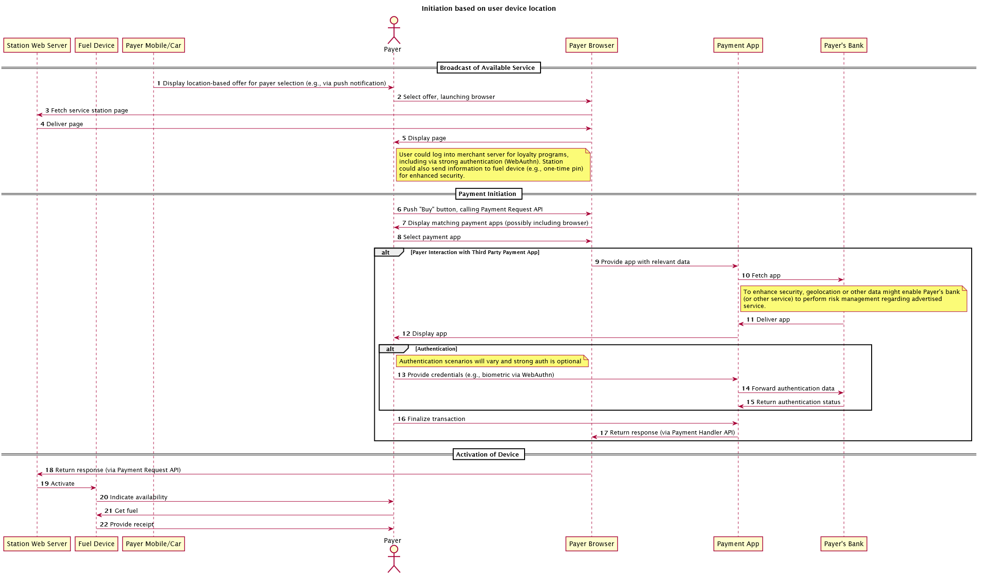
Use Case: Pay at the PUMP
Initiation based on local device data.

Slide 13
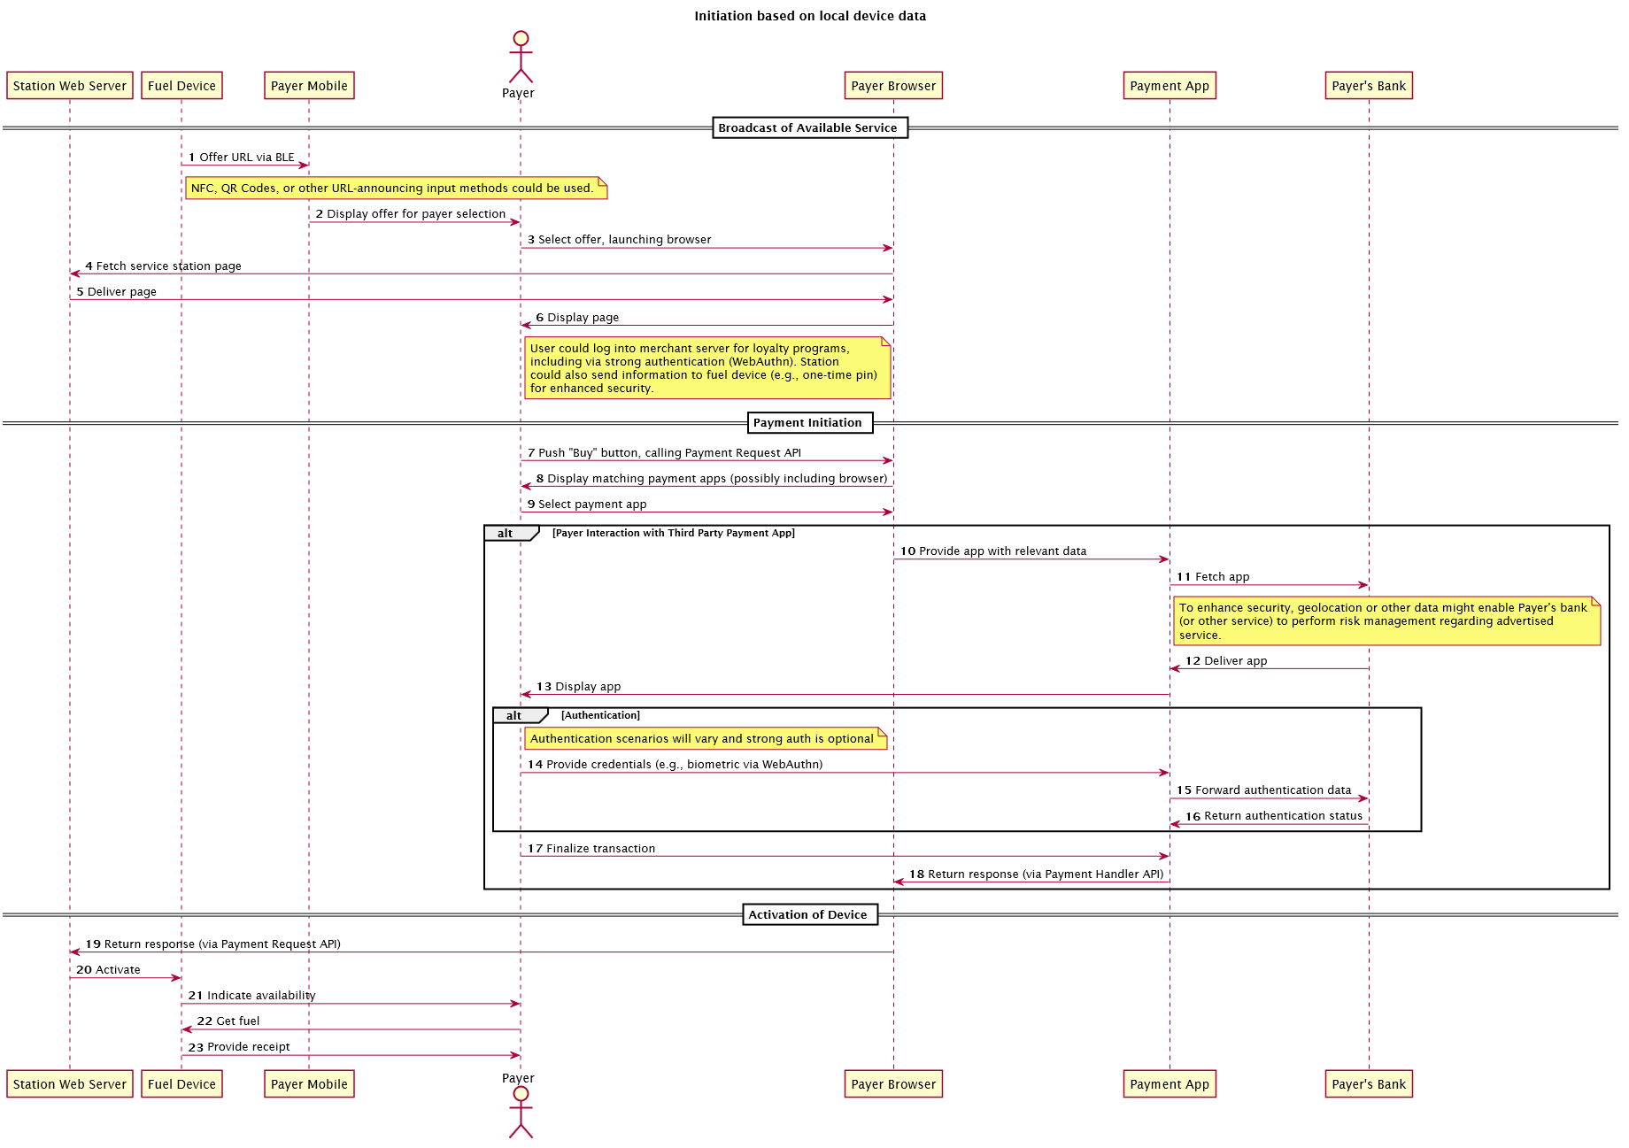
Use Case: Pay at the PUMP
Initiation based on user device location.

Slide 14
Use Case: Pay at the PUMP
URL: https://github.com/w3c/automotive-pay/wiki/PayAtPumpExplainer
Actors, Entities, Explainers, User Flows, Data Models

Slide 15
MOVING FORWARD
PARTICIPATION
  Develop Richer communications and reach out to new players to participate in the Task Force
  Communicate the Proposal and Targets to the broader community.
TIMELINE / MILESTONES
  Focus on the 3 identified Use Cases.
  PROPOSAL: Move December Milestone to February due to poor communication of the task force and participation in the group
INDUSTRY KNOWLEDGE
  Develop Thought Leadership session to develop the knowledge in WEB PAY and AUTO groups.

Slide 16
PROPOSED MILESTONES
TIMELINE (REVIEWED and PROPOSED)
  TPAC 2017: Prioritization of topics and initial use case descriptions
  TPAC 2017 face-to-face discussion of early results
  December/17: Develop detailed descriptions of the selected/prioritized use cases.
  January/18: Initial gap analysis
  February/18: Plan for incubation

Slide 17
THANKS.

