Slide 1

Does Television Viewership Predict Presidential Election Outcomes?
Arash Barfar & Balaji Padmanabhan
Information Systems & Decision Sciences (ISDS) Department
Muma College of Business
University of South Florida
bp@usf.edu and abarfar@usf.edu

Slide 2
Motivation
It’s November 5, 2012. The world is awaiting news on the next US President. Who will it be?
A what-if question. What if, we had data on who watched what shows on TV in the preceding weeks, October 1 through November 5.
  Can we predict the outcome?
Pulled together data, thanks to Nielsen on:
  547 television programs, 165 populated counties, 49 states

Slide 3
Methodology
Two simple variables per show. Minutes Per Voter & Percentage of Fans
Data (49 rows, or 165 rows, depending on state/county)
Took over a year to fully analyze, from the raw data tables, understanding the schema, resolving numerous complicated data challenges, working with ETL and advanced SQL operations, validating and cross-checking the findings, integrating third party data into the analysis.
The data was transformed from a finely granular data model with nearly a half billion minutes of watching 138,000 telecasts that were registered as approximately 20 million of <Person_ID, Telecast_ID, Minutes, …> tuples
Arash Barfar and Balaji Padmanabhan

Slide 4
Synopsis of Findings
Able to rank 547 programs based on their “signal strength” in predicting outcomes.
  Top two in particular were exactly the ones pointed out recently in a Facebook Data Science report.
Based on a single show alone achieved 82% accuracy at the state level and 75% accuracy at the county level.
The night before the elections the strongest state model would have predicted 8 out of 10 “swing states” accurately.

Slide 5
Predicting State Outcomes:
The Daily Show Tree

Slide 6
Predicting State Outcomes:
Evaluation on the Swing States

Slide 7
Predicting County Level Outcomes:
The Duck Dynasty Model

Slide 8
Methodology: Challenges & Solutions
Few rows and thousands of columns
  Simpler models
False discovery from testing hundreds of models
  Randomization to compute false discovery rates
Election (in)frequency and the life of TV shows
  Making a model useful in real time

Slide 9
Randomization Tests

Slide 10

Analysis at the DMA Level
(tree built on “safe” DMAs)

Slide 11
Testing on the “close” DMAs
Close | DMA | DMA | DMA Main | Duck Dynasty |  | Fox & Friends
DMA | Result | State(s)* | State Result** | MPV | DMA Pred. | POF | DMA Pred.
Columbus, oh | D | OH | D | 22.62 | R | 4.92% | D
Fresno-Visalia | R | CA | D | 5.83 | D | 3.70% | D
Kansas city | R | MO (63%) KS (37%) | R | 22.15 | R | 6.90% | R
Milwaukee | D | WI | D | 10.37 | D | 5.08% | D
Orlando-Daytona Beach-Melbourne | R | FL | D | 12.55 | D | 9.26% | R
Pittsburgh | R | PA (96%) WV (3%) MD (1%) | D | 17.38 | R | 6.41% | R
St. Louis | D | MO (73%) IL (27%) | R | 14.42 | D | 4.09% | D
Tampa-St. Petersburg (Sarasota) | R | FL | D | 9.85 | D | 6.21% | R
Wilkes Barre-Scranton | R | PA | D | 14.23 | D | 7.41% | R

Slide 12
Optimizing Advertising in Campaigns (literally)
One interesting note is that television advertising in the 2012 presidential election was approximately $1.9 billion
Significant potential to optimize ad spend, with newer multi-platform digital media offering novel opportunities as well as challenges.

Slide 13
Three Specific Challenges
Cross Platform Data Integration.
Geo-targeting within DMAs and Political Boundaries
Personalized and Context Sensitive Advertising

Slide 14
Cross Platform Data Integration
Media consumption is fragmented across multiple devices
  Need to track usage across multiple devices to the same user.
Independent and heuristic solutions exist, however:
Privacy concerns arise.
  necessitates a need for a privacy-sensitive cross platform tracking technology. While the two concerns (cross platform and privacy) may appear
Transparency, user-control, and the design of incentives might be aspects to consider as the industry matures in this area.

Slide 15
Geo-targeting within DMAs and Political Boundaries
The unit of analysis in presidential elections are geographical regions such as counties and states. Yet, many television programs are targeted at the DMA levels.
Raises geo-targeting needs
  Location identification needs to be precise at the state, county and DMA level for instance, but focuses on the location of the home state where the device primarily resides.
  Being able to have a geo-history for devices might be a possible approach but is one that needs user opt-in in order to be privacy sensitive.
Reiterates need for any technology that provides potential solutions using a framework that is user-centric in terms of incentives and privacy.

Slide 16
Personalized and Context Sensitive Advertising
There are likely programs with some noisy ability to forecast presidential election outcomes.
  Could be correlation (latent factor impact) or influence
Both cases are interesting for campaigns to use in a personalized and context sensitive manner.
Displaying advertisements to a mobile device in a house that is watching a television show might be a part of the strategy. This would mean having the technical ability to target devices “close” to each other but where there is some constraints between what is being watched in both devices at the same time.
  While the advertisement might also be integrated into the actual show the cost of doing so might be different than if done in a personalized manner to a few specified devices. Being able to do so in a transparent and privacy-sensitive manner is critical.

Slide 17
Concluding Thoughts
Digital marketing has made tremendous strides over the past few years, supported in large part by standards-based technologies as well as proprietary algorithms from leading companies in the industry.
Many of the innovations are spurred by applications which have needs. One such application area is political advertising.
  If these dollars were more effectively targeted it would potentially help the campaigns spend their limited resources in a judicious manner.
Building on our recent work that shows the ability to forecast election outcomes from television watch data, here we present a few important implications and challenges for marketing technology.
Solutions to the challenges highlighted here might be through new standards, proprietary technologies or as often the case a combination of the two.

Slide 18
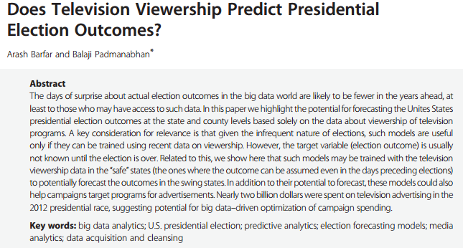


Slide 19
Arash Barfar & Balaji Padmanabhan
Information Systems & Decision Sciences (ISDS) Department
Muma College of Business
University of South Florida
bp@usf.edu and abarfar@usf.edu

