Slide 1
Using Purchase Data to Inform Digital Advertising
W3C Workshop on Digital Marketing
September 2015
Satya Satyamoorthy
Director of Software Development
Nielsen Catalina Solutions
satya.satyamoorthy@ncsolutions.com

Slide 2
Agenda
Demographic Inefficiencies
The Buyergraphic Solution
How Digital Marketing is Changing
Mobile Attribution

Slide 3
Demographics-based marketing misses sales opportunity!

Slide 4
Demographics-Based Audience Delivery Misses Buyers
Looking at more than 10 leading CPG brands that account for more than $415 MM on measured TV in 2011, we found that:
Demo-based media plans over-deliver to low-value consumers
  The average brand in the study delivered 64 percent of television media exposures to households accounting for 2 percent of sales among the heavy buyers
Demo-based media plans under-deliver to brands’ best consumers
  A mere 36% of exposures reached the households that accounted for 98% of brand sales among the heavy buyers
Common demo targets miss a majority of sales volume

Slide 5
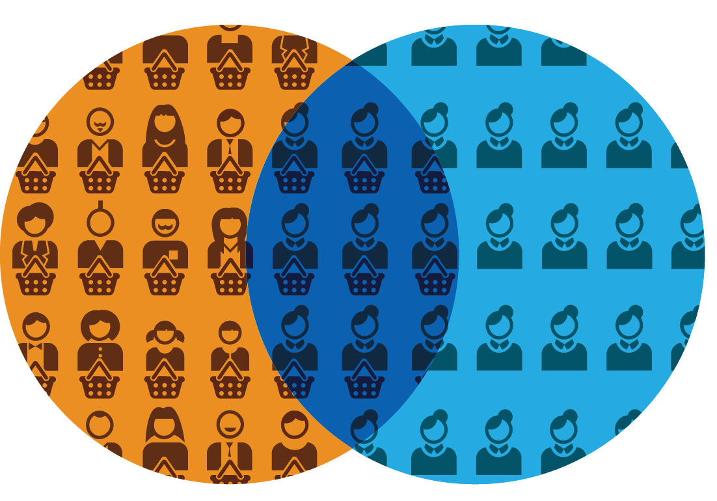

What is the Disconnect?
47%
of the brand’s volume reached by demographic target.
53%
of the brand’s volume is outside the demographic target.
Brand Volume
Demo Target
Source: Deconstructing Demographics, Catalina (2012); data and analytics from Nielsen Catalina Solutions
Case Study of 10 CPG brands that spent $415 million on national TV in 2011.

Slide 6
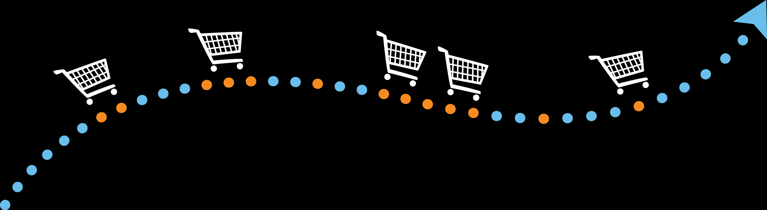
So what’s the solution?

Slide 7
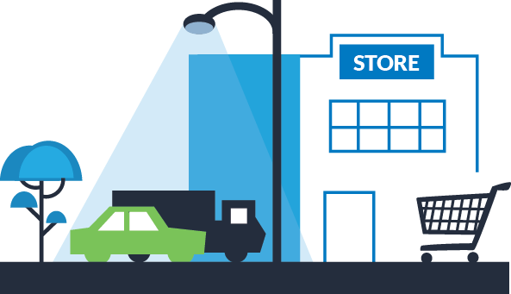
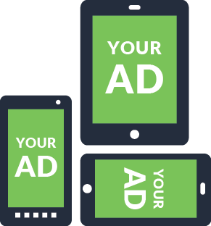

Linking What Consumers Watch and Buy
1.5 MM UPCs; 120,000 brands in over 350 categories
70MM+ households...
Notes:
Linking What Consumers Watch and Buy in a single source makes advertising accountable to sales

Slide 8



NCS single source links what consumers watch with what they buy
Digital
Watch Data
Nielsen Media Data
Nielsen Cookie Pool
100MM HH
Buy Data
Catalina Frequent Shopper Card Data,
Nielsen Homescan All-Outlet Data
70MM+ HH
~1.4 MM Single
Source
TV HHDs
~1.4 MM Single
Source
TV HHDs
41 million
Single Source Digital HH
For Precision Marketing
15 million
Single SourceDigital HH
For Sales Lift Measurement
ANONYMOUS SINGLE SOURCE HHs

Slide 9






Buyergraphic Approach Improves Media Buying
PURCHASE BEHAVIOR
MEDIA TARGET
MEDIA METRIC
SUCCESS METRIC
Claimed / Syndicated
“Proxy” or best fit:
Women 25-54
Women 25-54 (GRPs)
Note: ~half of brand volume typically outside the demo
Improvements vs. last year
DEMOGRAPHIC
APPROACH
+
/
-
BRAND
VOLUME
DEMO
VOLUME
vs. last year
Actual
Actual Category or Brand Buyers
Increase Buyer Rating Points (BRPS)
Up to 15% Increase in TV driven sales
BUYERGRAPHIC
APPROACH

Slide 10







Buyergraphic Approach = Effective Campaign
Average
CPG ROAS
$3.32
BABY $4.71
OTC $3.14
PET $4.15
BEVERAGE
$3.41
MERCH
$3.60
HBA $3.12
FOOD $3.20
Source: Nielsen Catalina Solutions Norms Database,
Digital studies through 2014

Slide 11












Buyergraphic Activation Across All Media/X-Media
TV
ONLINE
DISPLAY
ONLINE
VIDEO
BUYER-BASED
TARGETING
MOBILE
CRM
PROGRAMS
SALES LIFT
MEASUREMENT
GAMING
PRINT
RADIO
Define Once, Activate Everywhere™
Notes:
This ROI-Centric Media Approach is enabled by:
Single source data that integrates purchaser information. Ours happens to be shopper data, but other first and second party data, like credit card information can be used in this model.
The two major solutions that are the foundation of this approach is “targeting” and “ROI Measurement.”
When combined, this drives sales and increases ROAS for all media

Slide 12
Digital marketing
is changing, again.

Slide 13
8.7 Billion Impressions!
Notes:
Available impressions are rising, hitting an all-time single-day high of 8.7 billion impressions on January 29 of 2015.
Video advertising has increased 5x in the past 12 months, and video is now the majority of mobile traffic. 9x more publisher revenues than banner

Slide 14
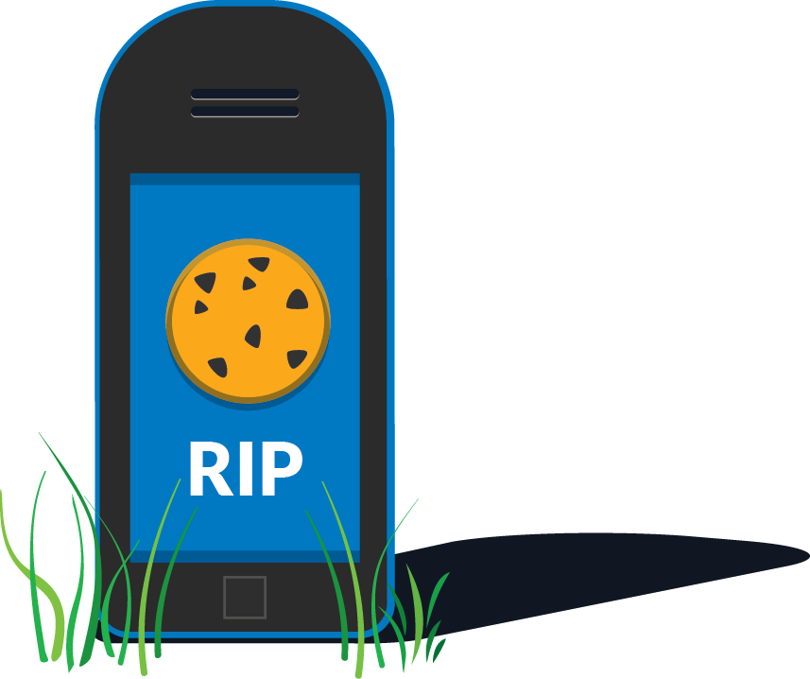
A moment of silence for our friend, the digital cookie.

Slide 15

We Are Entering The Post-Cookie World
People are shifting from desktop to mobile
86% of mobile time is spent in apps, NOT the browser
Share of media time spent per day by US adults (%)
14% Browser 86% APPS
20.7
23.3
19.2
18.0
19.2
13.4
Gaming 32%
Others 2%
Google Browsers 5%
Apple Safari 7%
Facebook 17%
Desktop/laptop
Mobile
Others 3%
News 3%
Twitter 1.5%
Productivity 4%
Social Messaging
9.5% (other)
Utilities 8%
2012
2013
2014
Entertainment 4% (other)
YouTube 4%
Source: eMarketer
Source: Flurry Analytics, ComScore, NetMarketShare

Slide 16
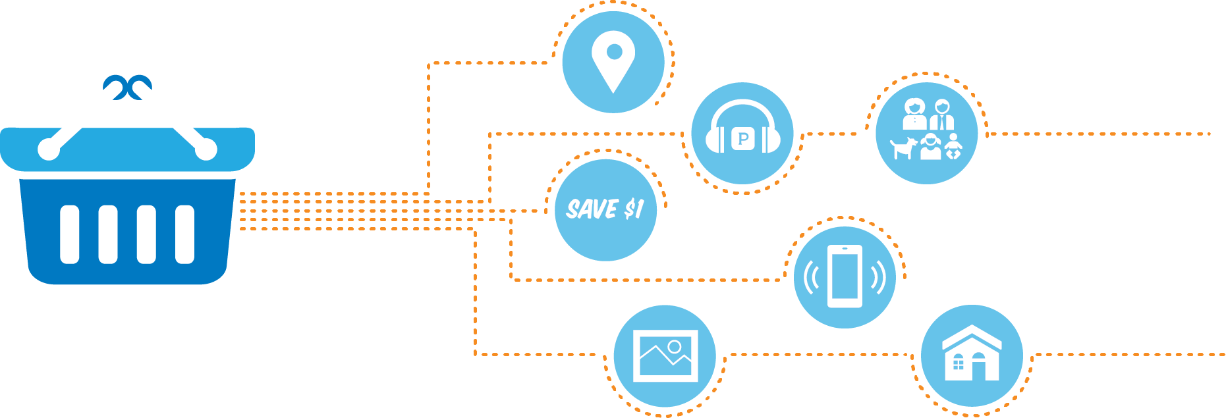
What Gets the Credit?
More importantly, what’s the metric?

Slide 17

What does Mobile Mean for Attribution?
Ad targeting in mobile is challenged by Advertisers and Agencies
Without cookies, anonymous users are identified only by mobile advertising IDs (MAIDs)
Devices are changed on average every 18 months, making MAID an inconsistent identifier
Most consumer data is siloed within apps
Cookie-based desktop data is still unplugged for mobile

Slide 18
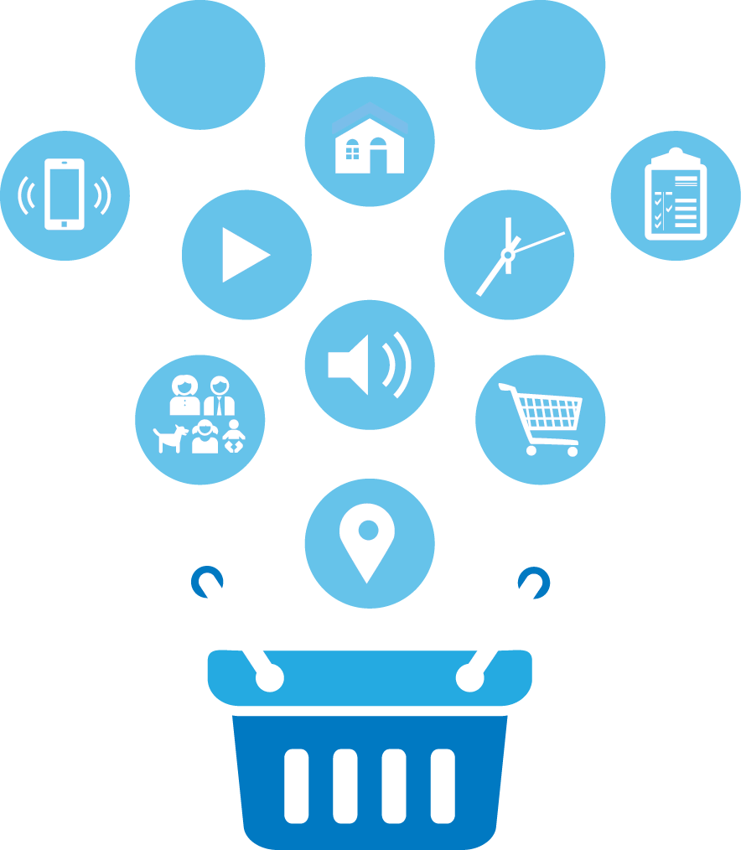
Delivering on Mobile
Attribution now applies to time, location, audience, device, app, etc… but could also be a consideration in closed networks for consumer (listener) behavior
POV Shift: Attribution is not just about publisher but every element of delivery

Slide 19
Summary:
Buyergraphics based Ad delivery increases the efficacy of marketing and Return on Ad Spend (ROAS)
For mobile -- an alternative approach based on time, location, user, device, app and off-line behavior such as purchase behavior is needed to track consumer behavior across multi touch devices

Slide 20
Thank You!
satya.satyamoorthy@ncsolutions.com
www.ncsolutions.com

