Slide 1
Building Social Software
on the W3C
Linked Data Platform (LDP)
Sandro Hawke, W3C/MIT
sandro@w3.org twitter: sandhawke
SemTechBiz San Jose
20 Aug 2014
Slides at http://www.w3.org/2014/Talks/0820-sandro

Slide 2
Research at W3C/MIT
W3C is where web standards are made (HTML, CSS, … RDF, OWL, SPARQL, …)
Paid staff, supported by Membership Fees
I served RDF 1 + 1.1, OWL 1 + 2, SPARQL 1.1, RIF, PROV, GLD (dcat, etc), ...
Also sometimes Research Grants (me today):
John S. and James L. Knight Foundation, Qatar Computing Research Institute (QCRI), National Science Foundation (NSF), John D. and Catherine T. MacArthur Foundation (via NYU GovLab)

Slide 3
Social Software
Value comes from other users
ebay, uber, airbnb, yelp, foursquare, kickstarter, evite, meetup, doodle, eHarmony, okcupid, digg, reddit, facebook, linkedin, twitter, tumblr, instagram, pinterest, flickr, wikipedia, StackOverflow, words with friends, github, irc, email, ...
No other users = Ghost Town (minimal value)
When everyone uses it: incredibly compelling

Slide 4
Why build on LDP?
Very straightforward, standard open data
However LDP 1.0 is not enough
We’re building on LDP 1.0 with extensions
Hopefully next version of LDP will include them

Slide 5
Crosscloud
Envisioned as system to end social lock-in
No more Ghost Town; Similar apps share users
Make it easy for users to move between vendors
Make it easy to develop/deploy social software
Research and Development at W3C/MIT

Slide 6
Why is this important?
For Users:
Shop around for better privacy
Shop around for better security
Be able to reach everyone online, not just folks who choose the same vendors
Option to self-pay instead of endure ads
Use the same tools with different communities (home vs employer to-do list)
Better quality, more innovation in software

Slide 7
Why is this important?
For Application Developers:
Avoid the Ghost Town
Immediate Value: People can use your product with their existing data and social connections
No need for backend operations staff
… assuming there’s a market for generic LDP+ data service providers
Have your users be your customers
Instead of packaging them as a product for advertisers

Slide 8
So How Does it Work?
We separate the data from the software and let the user control the data.
It’s like a DBMS that the user controls.
All their software works with that same data

Slide 11
Cimba
flagship/demo app, available at cimba.co
aiming for Twitter circa 2009
each user has their own LDP webspace
Client-Integrated Micro-Blogging Application
- like blogs, but with webapp UI
- chosen to be straightforward

Slide 12
Beyond Cimba
Apps we’re most excited about right now:
Personal Health Tracking (exercise)
Issue Tracking (bug reports)
Expert Network (who knows what)
FriendCam (sharing camera output)
MeetingCard (shared schedule/agenda)
AnythingMarket (buy/sell)

Slide 13
How Cimba Works
To publish a note (to “tweet”), the app does an HTTP POST to the channel (an ldp:BasicContainer)
To see notes in a channel, the app does an HTTP GET on the channel, then follows the links to each posting.
Homescreen is result of doing this on all channels you’re subscribed to

Slide 14
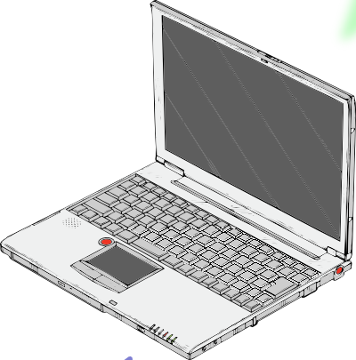
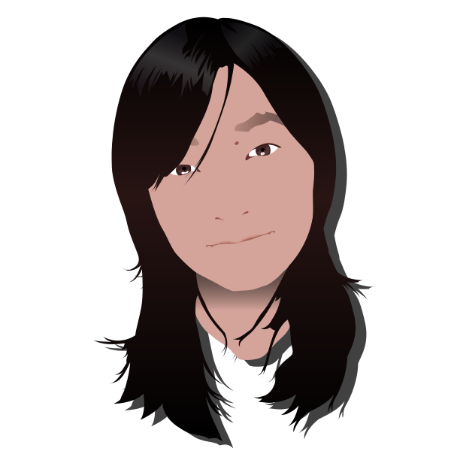
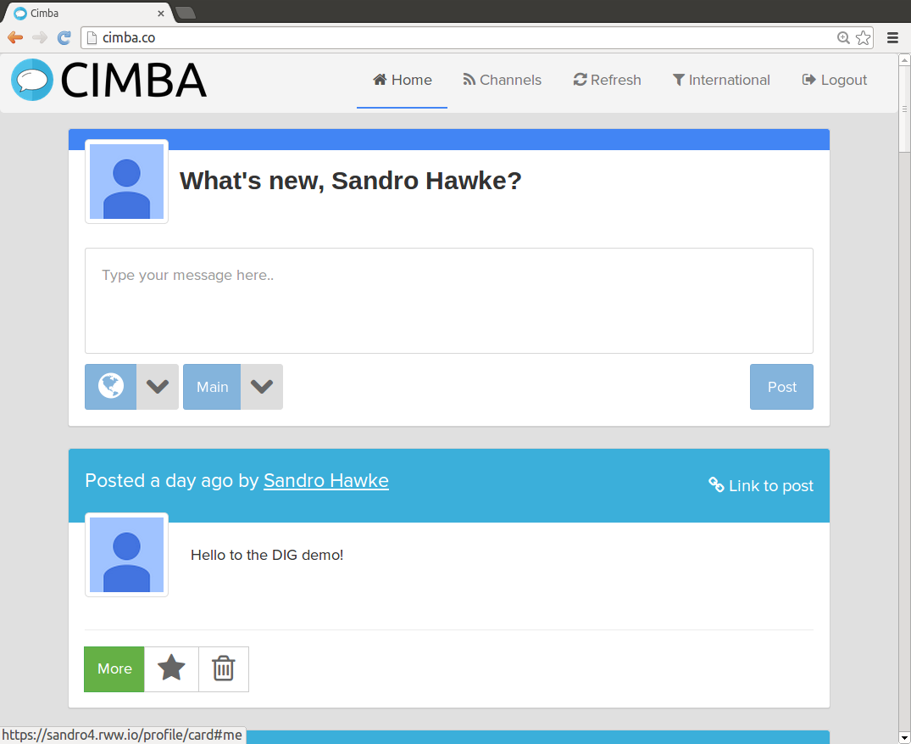
html+css+js
from cimba.co
(or elsewhere)

Slide 15
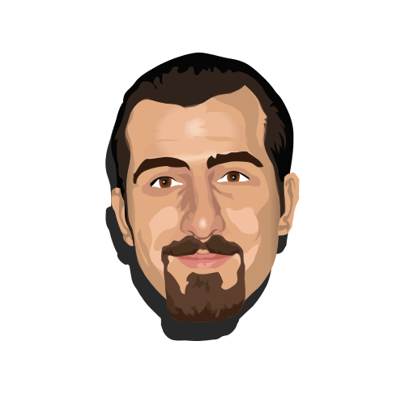
html+css+js
from cimba.co
(or elsewhere)

Slide 16
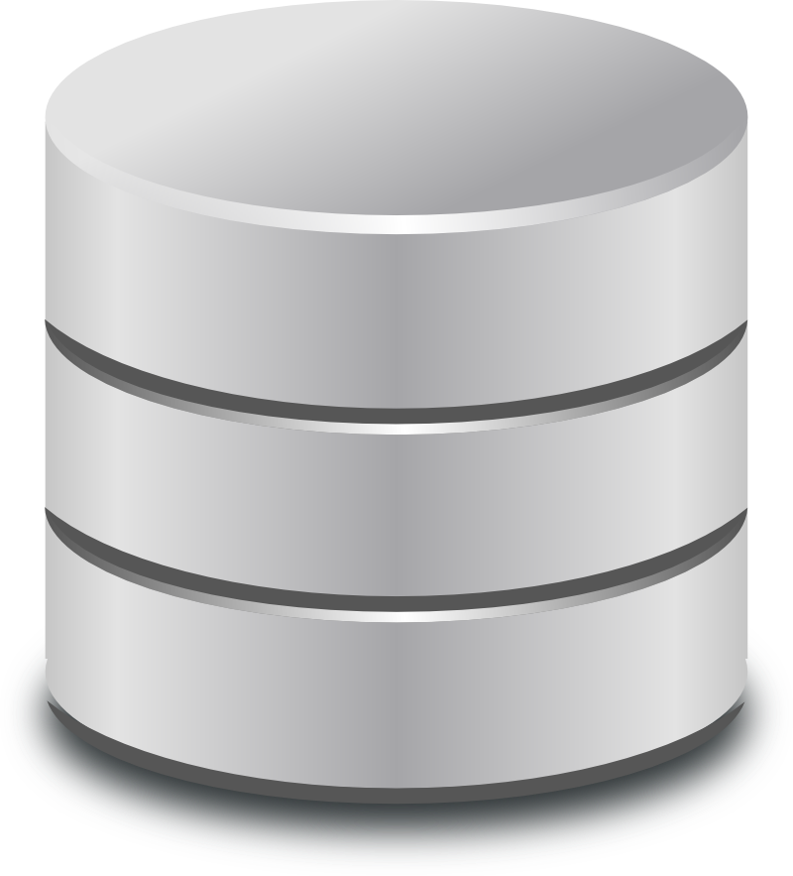
html+css+js
from cimba.co
(or elsewhere)
RDF writes (POST,
PUT, PATCH)
RDF writes (POST, PUT, PATCH)
Alice’s Pod
LDP Space
(with extensions)
Bob’s Pod
(LDP Space
with extensions)

Slide 17
html+css+js
from cimba.co
(or elsewhere)
RDF writes (POST,
PUT, PATCH)
RDF writes (POST, PUT, PATCH)
RDF reads
(GET, HEAD, link-following SPARQL)
Alice’s Pod
LDP Space
(with extensions)
Bob’s Pod
(LDP Space
with extensions)

Slide 18
html+css+js
from cimba.co
(or elsewhere)
RDF writes (POST,
PUT, PATCH)
RDF writes (POST, PUT, PATCH)
RDF reads
(GET, HEAD, link-following SPARQL)
Alice’s Pod
LDP Space
(with extensions)
Bob’s Pod
(LDP Space
with extensions)

Slide 19
html+css+js
from cimba.co
(or elsewhere)
RDF writes (POST,
PUT, PATCH)
RDF writes (POST, PUT, PATCH)
RDF reads
(GET, HEAD, link-following SPARQL)
Alice’s Pod
LDP Space
(with extensions)
Notifications (webmention, etc)
Bob’s Pod
(LDP Space
with extensions)

Slide 20
html+css+js
from cimba.co
(or elsewhere)
RDF writes (POST,
PUT, PATCH)
RDF writes (POST, PUT, PATCH)
RDF reads
(GET, HEAD, link-following SPARQL)
Alice’s Pod
LDP Space
(with extensions)
Notifications (webmention, etc)
Bob’s Pod
(LDP Space
with extensions)

Slide 21
Contents of POST
POST /shared/mb/ch1
Host: alice.com
Content-Type: text/turtle
...
<> a sioc:Post;
sioc:content “Hello World!”;
dct:created “2014-08-05T16:02”^^xs:...;
mblog:owner <http://alice.com/profile#>
HTTP/1.1 201 Created
Location: http://alice.com/shared/mb/ch1/5

Slide 22
Channel GET
GET /shared/mb/ch1/
Host: alice.com
Accept: text/turtle
...
<> a ldp:BasicContainer; dct:title "Alice’s Thoughts”; ldp:contains <1>, <2>, <3>, <5>.

Slide 23
GET of one Post (“tweet”)
GET /shared/mb/ch1/5
Host: alice.com
Accept: text/turtle
<> a sioc:Post;
sioc:content “Hello World!”;
dct:created “2014-08-05T16:02”^^xs:...;
mblog:owner <http://alice.com/profile#>

Slide 24
Identifying Users
Linked Data:
IRI for the user
Dereference gives us the info we want
GET http://alice.com/profile#me
…
<#me> foaf:name “Alice I. Wonderland”;
foaf:image </image.jpg>;
...

Slide 25
Finding a User’s Channels
Deref their WebID to get their profile
Look in profile for space:storage link
Look in there for an mblog:ChannelSpace
Look in there for a channel

Slide 26
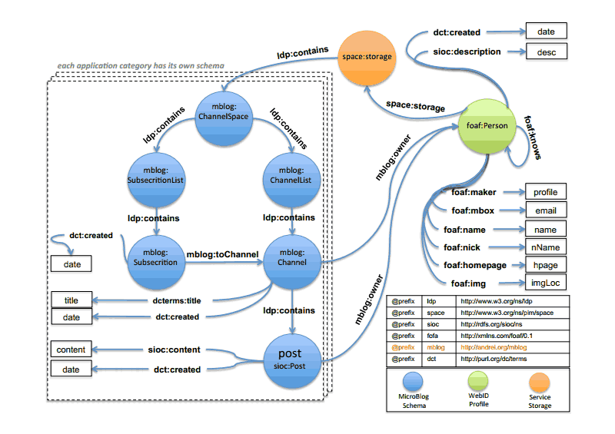
Image by Essam Mansour

Slide 27
Authentication
Currently using WebID-TLS
Self-signed client certificates
Public key is in user’s profile (dereference WebID)
Probably very secure, but client certs have problematic UI

Slide 28
Cimba 1.0 Demo
Video at https://www.youtube.com/watch?v=z0_XaJ97rF0
Run it at http://cimba.co/versions/1.0/
Code on github (linkeddata/cimba)

Slide 29
Link-Following SPARQL (in progress)
Avoid all the Client-Cert pop-ups by having the pod aggregate the data
Can cache between runs, making startup much faster
proxy authentication (pod has own identity)

Slide 30
Search (in progress)
Need to find People, Channels, Postings from anywhere in the world.
Requires a global index (aka Search Engine)
Cimba plans to use many at once
Currently just using webizen.org, for People
Each one can be centralized, or DHT-style
Pods can search outward in the social network

Slide 31
Notify (in progress)
How can you tell the user about:
a New Subscriber
a Reply
a Mention
Backlinks (via ldp-exposed webmention)
When you publish <s> <p> <o>...
You notify s, p, and o
SiteWatch instead of polling

Slide 32
Same Approach works for other Social Software
Example: Alice and Bob are playing chess:
Alice POSTs each of her moves to an ldp:BasicContainer on her site
Bob does the same.
Each move links to both sides
Anyone (with access) can see all the moves
Alice, Bob, etc, can see the game
They probably make a copy of each others moves, for speed and to detect cheating

Slide 33
Such as
Personal Health Tracking
POST descriptions of what you’ve done
Query them, and related data, eg other people
Issue Tracking
POST new issues, comments
PATCH to update status
Query to see issues, comments, status
Expert Network
PATCH to update self-description
Query to find appropriate matches

Slide 34
Con’t
FriendCam
POST photos, videos
POST access-control rules, comments, metadata
Query to see what’s new & interesting
GET photos, videos (if given access)
MeetingCard
POST meeting proposal
POST availability
POST decisions
Query for status of your meetings
AnythingMarket

Slide 35
Essentials
When something happens:
POST new things
PATCH to update existing things
The state of the world?
low-level: GET
high-level: Link-Following Query
Everything has dereferenceable identifier (URL)
Access control always available
Backlinks/Notification

Slide 36
Next Steps
LDP
Try implementing http://www.w3.org/TR/ldp
Join public-ldp@w3.org
Consider joining next round of LDP WG
Social Web WG http://www.w3.org/Social/WG
Just starting, great time to join (Tues 10am PT)
Try http://cimba.co or on github
Join crosscloud-announce@csail.mit.edu
Follow crosscloudorg on twitter
Write to me (sandro@w3.org)

