Slide 1
Avoiding Social Lock-In with Crosscloud
Sandro Hawke, W3C / MIT, sandro@hawke.org
W3C Tech Talk
5 Jun 2014
http://www.w3.org/2014/Talks/0605-sandro

Slide 2
Overview
The Problem
Social Lock-In
The Solution
Crosscloud = Blogs + RDF + Auth + ...
The Plan
Research
Community
Standards
Business

Slide 3
Product Lock-In
Once you start using a product, there can be a high cost to switch. This is old news.
Most common: Data Format Lock-In
.doc files (“proprietary formats”)
ever switch accounting systems?
Mitigated by standards, non-binary formats

Slide 4
Social (Multi-User) Software
You’re interacting with people via computer
chat
auction
meeting scheduling
dating
video sharing
… many more
The value is largely in other people using it.

Slide 5
Social Lock-In
If you switch, you find yourself in a ghost town, unless you can get your primary contacts to move at the same time.
Re diaspora (facebook competitor): “It’s cool, but the sad fact is most people will still go to Facebook simply because that's where all their friends are." -- Newsweek
It’s not insurmountable (cf snapchat, g+) but it is very strong.

Slide 6
Examples
Imagine these without other users:
eBay, airbnb, yelp, foursquare, kickstarter, evite, meetup, doodle, eHarmony, okcupid, digg, reddit, facebook, linkedin, twitter, tumblr, instagram, pinterest, flickr, wikipedia, StackOverflow, Words with Friends, Github, ...
Very high barrier to entry for competition

Slide 7
Results?
Other developers (innovation) are locked out.
Little “serious” (enterprise) use.
Exclusion. Not everyone’s on every system.
No real options for privacy.
The systems change when they want.

Slide 8
So what is Crosscloud?
A system (under construction) that doesn’t have these problems.
You can switch apps, still working with the same people and data
Healthy competition:
vi/emacs
firefox/chrome
elm/pine/thunderbird

Slide 9
Great for Free/Open Source Software
As a coder, even if github’s software were 100% free, I couldn’t effectively fork it (social lockin, all the other users)
With Crosscloud I could.
Don’t like the latest change? Just keep running the older version of the code.
Share your own changes with the world

Slide 10
Of course it’s Decentralized
We’re building it, but once it’s out there, no one will be able to control it.
Like the Web
Like email
People can join & participate without asking anyone’s permission or paying anyone (beyond various service providers, which could be ad-subsidized).
Good for weekend hackers and for enterprise

Slide 11
Problem Summary
Social Lock-in comes naturally with Social Software (where the value is the people)
It locks out innovation, business applications, government applications
It forces people to accept random site changes, privacy invasion, ads, questionable security
We imagine Crosscloud as a platform without Lock-in.

Slide 12
So how could this possibly work?
It’s about the data.

Slide 13
Meeting Scheduling Today

Slide 14
Meeting Scheduling with Crosscloud

Slide 15
The Solution:
Blogs + RDF + Auth + ...
Blog =
everyone has “their own” website
link notification enables conversation
RDF =
general data format
anyone can extend to any problem domain
Auth =
refer to people
access control

Slide 16
Blog instead of Twitter
blogging vs microblogging? it’s mostly UI.
tweeting = posting to your own microblog
following = your reader-software gathers it for you
Just post/store data, let WebApp render it

Slide 17
Cimba
Implemented by Andrei (deiu) Sambra in Q1
Provides basic microblogging features
Data stored as RDF (Turtle) files with LDP
Authentication done with WebID-TLS (for now)

Slide 18
Cimba Demo
Watch at: https://www.youtube.com/watch?v=z0_XaJ97rF0
Try it at: http://cimba.co

Slide 19
Play Chess via Blogs
1. Alice posts she’s playing a game with Bob
2. Bob posts he’s playing that game
3. Alice posts her move
4. (optionally) Bob posts a copy of that move
5. Bob posts his move … etc
A client can render this like any chess app
URLs linking all over the place
Polling is slow; notification is good

Slide 20
Auction a textbook via Blogs
1. Alice posts her Chem textbook for auction
2. Alice notifies many auction index services
3. Bob finds it, posts a bid
4. Alice links to his bid as the new high bid
…
n. Alice closes the auction
Again: UI can make this look like eBay, etc
Note that eBay is more than software
ISSUE: does Bob POST to his own blog and notify Alice, or does he POST to Alice’s server?)

Slide 21
Machine Readable Blogs
These “POSTS” are RDF triples, not HTML
They are created and viewed through WebApps (or desktop or mobile apps)
They link to each other heavily, using Linked Data principles, much like Blog posts do.

Slide 22
Photo Sharing
1. Alice posts photos to her site
2. She tags, stars, groups, etc the photos
3. She sets ACLs on them
4. They get registered with index servers
5. Bob sees her photos in response to a search
6. He filters, tags, stars, etc some of them.
They each see them in the UI they want, that they are using at the time.
They have a default “skin” WebApp that makes them look nice to folks just following a link

Slide 23
Technologies in Cimba Today
Usual WebApp stuff
LDP (read and POST RDF (turtle) documents)
Vocabs: mostly sioc, some foaf
WebID (IRI for a person)
WebID-TLS (for now)

Slide 24
Technologies Cimba Still Needs
Who is following who? (backlinks)
TrackBack, WebMention
In SocWeb charter (currently in AC review)
Change Notification (avoid polling)
revisit PubSubHubbub?
Query Service (follow many at once)
Link-Following SPARQL

Slide 25
Still needs...
Better UX than WebID-TLS
Maybe a p2p CDN

Slide 26
Technology Summary
blogs
people have their own sites
their apps can post/edit their content
backlinks
change notification
+ semweb stack
linked data platform (read/write RDF FS)
link following sparql
vocabulary conversion (owl?, rif?)
indexing
+ identity = Crosscloud protocols

Slide 27
Is this just going to happen on its own?
Probably not.

Slide 28
The Plan
Build an ecosystem
users + apps + data servers, standards
Start small
cimba, rww.io,
Viral growth
(easy, right?)

Slide 29
Perspective
1987 - Started to worry about this problem
1991 - My first startup in this space
2000 - EricP told me TimBL was on same track
2009 - RIF done, revisiting Social Lock-In
2010 - spare time=hacking on MVP
2012 - spare time=applying for grants
2013 - grants begin to arrive, WGs wrap up
2014 - assembling team

Slide 30
Grants
Very grateful to:
John S. and James L. Knight Foundation
QCRI
National Science Foundation
John D. and Catherine T. MacArthur Foundation

Slide 31
Research
Several Interesting Comp Sci Questions
- rdf patch
- link-following sparql
- efficient notifications
- scaling to many consumers (cf Akamai)
- scaling to many producers (cf Google)
- practical vocab conversion (RIF?)

Slide 32
Community
App Developers
Start with MIT Students (UROP)
Need to build a nice toolkit, docs, etc
Data Service Providers
Partners? OwnCloud?
Show it’s a viable business
IndieWeb? FedSocWeb? tent.io?

Slide 33
Standards
Linked Data Platform (LDP)
Going to CR now
Crosscloud needs several other bits
Hopefully re-charter in 6-12 mos
… but they’re not about social lock-in
SocWeb WG
Hopefully launching in July
… to soon to see their focus

Slide 34
Business
Ultimately, we need commercial participation
In app development
but it won't be the folks that want to mine your data
it’ll be the folks that want to provide value to users
In cloud data hosting
intense market out there; this might catch on
In data interoperability
apps written to be compatible with existing apps
apps written separately, integrated by another
Branded and sold for end users
Participating in standards

Slide 35
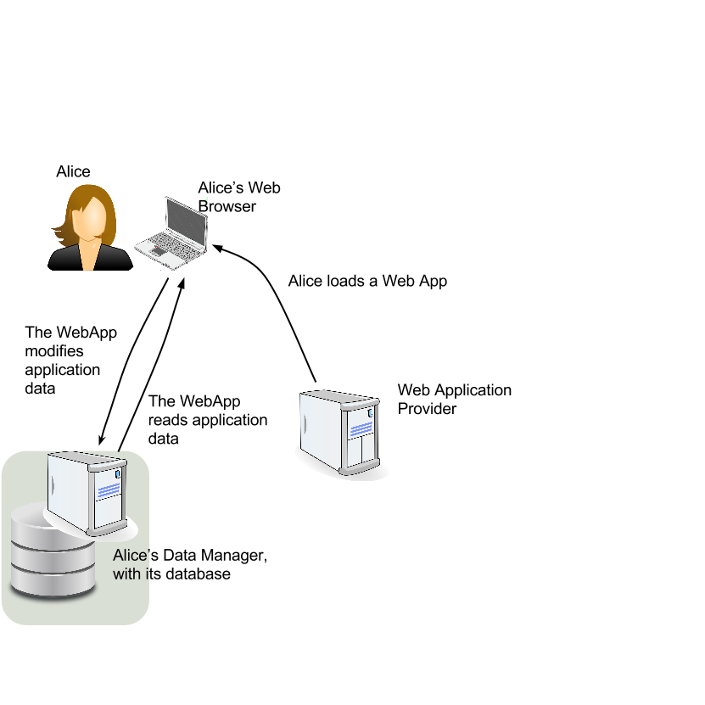
Customer Development
Multisided market, multiple customer bases:
1. End Users
2. Application
Developers
3. Data Service
Providers

Slide 36
End Users
Possible benefits:
Sense of control, actual control
Sense of privacy, actual privacy
No ads (if you pay)
Integrated interface to multiple systems
Ability to include everyone
Custom support for your group/enterprise
Issues:
Need apps
Need data service providers
Need other users

Slide 37
Application Developers
Possible benefits:
Doing right by the users
Easier critical mass of users
No need for backend operations
scaling, security, expertise, 24hr staff
Ecosystem of collaboration
Issues:
Need to hide RDF?
WebApps only for now?
Platform is still evolving rapidly

Slide 38
Data Service Providers
Possible benefits:
Money
Different market from file storage
Not much harder
Supporting your enterprise / people
Issues:
Will be highly competitive market
Platform is still evolving rapidly

Slide 39
Short Term
Focus on cimba MVP
microblogging plus
access control groups
and revise as needed
… While documenting protocols, feeding them into LDP and SocWeb WGs
… And doing necessary Comp Sci

Slide 40
Summary
Social lock-in hobbles social software
Crosscloud will solve social lock-in by
putting data under user control
in a standard format (RDF)
with lots of links
notification
indexes
vocab mapping shims
Protocol/standards work needed
Comp Sci research needed
App developers needed

Slide 41
Next Steps
Look at the app area lists and email me your favorites (and edits) https://github.com/sandhawke/crosscloud/blob/master/apps.md
Join the announcements mailing list: crosscloud-announce@csail.mit.edu subscribe
Let us know how your technologies/groups might fit in or use this
Suggest more funding sources
Suggest people to hire (especially postdoc, MIT UROP)

