Slide 1
The Seismic Shift in Digital Publishing
…and How You Can Shape
the Future
Jeff Jaffe, W3C CEO

Slide 2
20 Years Ago The Web Changed Publishing

Slide 3
Early Impact
Global distribution of linked documents
Low barrier to entry for sites
Non-linear reading habits
Creation of bite-sized content

Slide 4
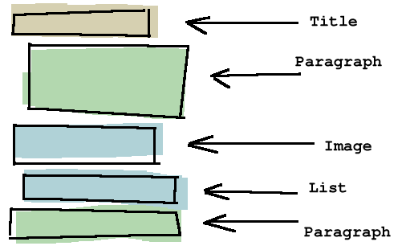
No Substitute for Print
Low-resolution screens
Impoverished layout, style
Static, read-only
Low bandwidth
Observation: The early Web was useful for publishing, but its relevance to the industry was not sufficient for publishers to participate in core standards development.
Image: outer-court.com

Slide 5
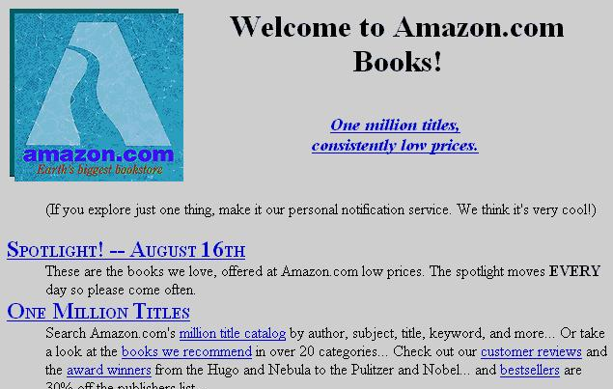
Good Enough for Innovation
Businesses flocked to the Web to push content
Revenue models appeared (e.g., pop-up ads, search engine ads)
Tools lowered cost of publishing by more people (blogs, wikis)

Slide 6
So the Web Grew

Slide 7
Recent Tectonic Shifts Have Accelerated Movement
Geography no longer a barrier
Internet everywhere
Social
Cloud
Generational divide
in consuming info
Broadband
Mobility
Image: room6halcombeschool.blogspot.com

Slide 8
Significant Impact on Publishing
25% of Americans own a tablet
“After 79 years in print, Newsweek goes digital only”
Google Ad Revenue Now More Than U.S. Print Publications Combined
E-Books See Triple Digit Growth As Paper Book Sales Dive
Pew: Survey Finds Rising Reliance on Libraries as a Gateway to the Web

Slide 9
Web Trends Will Further Alter Landscape
Web will improve
Screens, typography, and layout will grow in power
Web will add value
Links will raise asset value exponentially
Rich media will enhance ebooks, news, education
Data will power journalism; curation
Web will spur business model innovation
Many eBooks will become (mobile) apps, including ads
Photo: Andy Goldsworthy

Slide 10
Consumer Behavior Paradigm Shifts
Rich content anywhere, anytime, across multiple devices
Pew: “[Mobile phone] users under age 50 are almost three times as likely as their older counterparts to get news on the go…”
Forbes: “Google Research: No Mobile Site = Lost Customers”
Human activities (work, play, family) overlap
Social, customized
Pew: “News is becoming a shared social experience as people exchange links and recommendations as a form of cultural currency in their social networks.”
Nielsen: “33% of people 18-24 use social media in the bathroom”
Time-slicing
William Schrader in Pew survey: “The youth of 2020 will enjoy cognitive ability far beyond our estimates today … [but also] by their ability to share immediately any information with colleagues/friends and/or family, selectively and rapidly.”

Slide 11
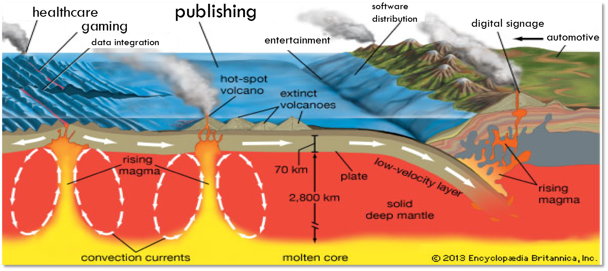
This is Happening Across Industries

Slide 12
TV/Entertainment Industry Stories
Rich content anywhere, anytime, across multiple devices
“This year, we’re looking forward to turning iPlayer into an entertainment destination…for the BBC’s iPlayer, 25% of access is mobile (BBC)
“Zynga signed a deal with Synacor … [the] move puts Zynga games seamlessly on all screens for more stickiness potential.” (Ecommerce Times)
YouTube, Hulu, Google TV, Vimeo, …
Social, customized
“[Smart] TV platforms offer global distribution opportunities, … high-end, attractive niche content, which cannot easily find distribution via traditional broadcasting.” (TelecomsTech)
Time-slicing
Study: “Majority of US consumers watch TV and surf Web simultaneously”

Slide 13
But Publishing Unlike Other Industries…
Automotive, government, health care, etc. serve their own intrinsic purposes
Web has an impact on delivery of those services, but is secondary
Web is more “intimately” tied to the intrinsic purpose of publishing

Slide 14
…and thus a Bigger Stake in the Future
Parts of the industry have leveraged the Web for 20 years and are early adopters.
Others are just beginning the journey
eBooks are picking up the technology today
Tomorrow they will be fully part of the Web
Although the industry as a whole is not there yet, in time…

Slide 15
Publishing = Web
Photo: Electro-L Images

Slide 16
Building on the Open Web Platform
Web pages are more beautiful, interactive and intelligent
HTML5 provides cross-browser interoperability and all major browser vendors plan to support it; now complete and stable
Video is a first-class citizen
Simplifies data integration
Runs on many devices
Has tools for social networking (privacy, security, identity)
Is the most interoperable platform in the industry
Unedited photo: WiseGeek

Slide 17
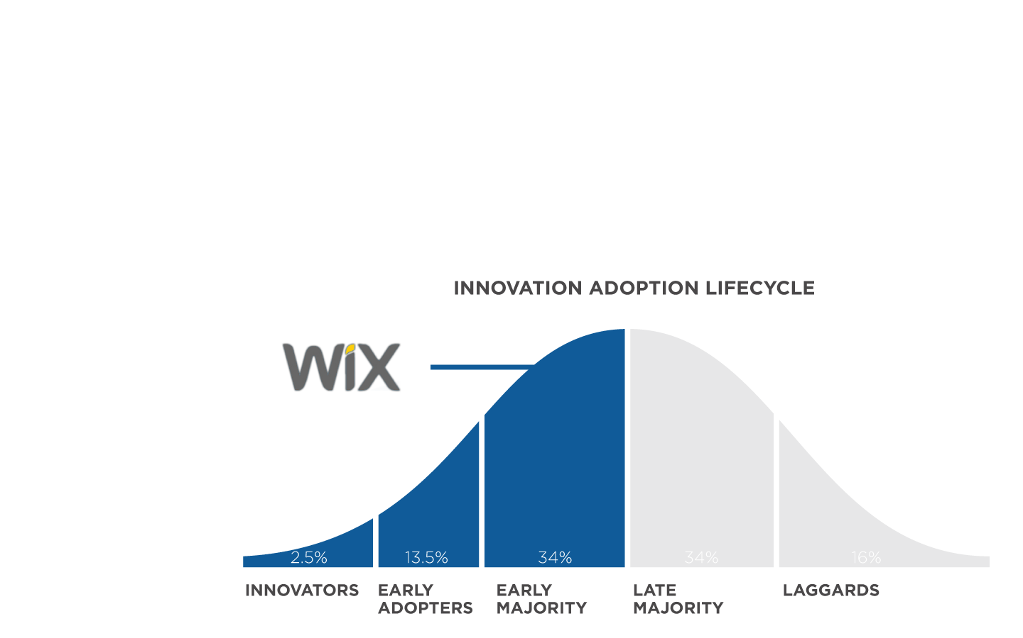
Broadly Embraced
Analysts
New Apps
Tools
Acquisitions
Browsers
Photo: BBC

Slide 18
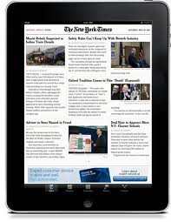
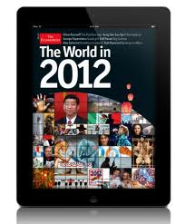
A Few Examples

Slide 19
How Do We Bring Publishing and Web Industry Closer?
Time and collaboration
W3C eBooks Workshop this week
Participation by W3C in publishing events
Participation by publishing industry in W3C groups
Participation by W3C in publishing industry groups

Slide 20
TV Industry Shows How
Three W3C Workshops to gather stakeholders, listen to requirements
Interest Group developed requirements in task forces (e.g., Home Network)
Priority requirements moved to Working Groups for inclusion in core standards such as HTML5
DOM Events
Multitrack
Streaming media
Encrypted media

Slide 21
Core Themes for Convergence
Match current publishing practices
Leverage value-add of the Web
Support diverse business and distribution models
Satisfy diverse consumer behaviors
Image: sciencedaily.com

Slide 22
Match Current Publishing Practices
Screens, typography, high quality fonts, colors
Advanced layout
adaptive layout for diverse devices
multi-column
pagination
media integration
formatting of the world’s scripts
Readability of long texts
Photo: behance.net

Slide 23
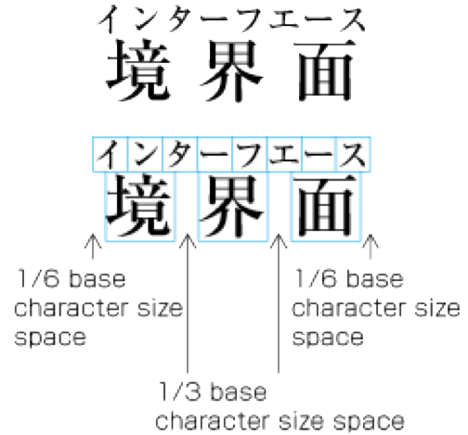
Leverage Value-Add of the Web
Links raise asset value, foster sharing, bookmarks
Rich media for ebooks, news, education
Data integration for journalism, book ids, catalogs, specialized search, discovery, curation, annotations
Cross-device support at lower cost
Accessibility, internationalization
Customization, specialized content for niche audiences

Slide 24
Support Diverse Business and Distribution Models
Revenue generation
Subscription
Ad insertion in eBook apps
Social sharing
Product placement
Web Payments
Content protection
One device
One user
None

Slide 25
Satisfy Diverse Consumer Behaviors
Rich content anywhere, anytime, across multiple devices
news on the go
content portability (across devices)
mobile ads, payments
Social, customized
niche audiences
sharing to drive marketing, revenues
reviews
Time-slicing
integrate reading experience with Web (dictionaries, references, etc.) and other activities
Photo: extremetech.com

Slide 26
Keep the Conversation Going Let’s Build a Web for Publishing

