Slide 1
The Future of the Open Web Platform
and its
Impact on the World of Publishing
Jeff Jaffe, W3C CEO

Slide 2
20 years ago the Web created new experiences for publishing
Reading
Hyperlinks / non-linear reading
But low-resolution screens at the time
Authoring
Small chunks of text
Publishing
Global distribution
Anyone could publish / low barriers
New advertising opportunities (search engines, pop-ups)
But impoverished style, layout of early Web no match for print

Slide 3
Trends of past decade have further transformed reading, publishing
Internet everywhere
Mobility
Social
Customization
Cloud
Broadband
Time-slicing
Multi-function devices
Generational divide

Slide 4
Paradigm shifts in consumer behavior
Pew: “[Mobile phone] users under age 50 are almost three times as likely as their older counterparts to get news on the go…”
Pew: “News is becoming a shared social experience as people exchange links and recommendations as a form of cultural currency in their social networks.”
Pew: “In the past year, the number of those who read e-books increased from 16% of all Americans ages 16 and older to 23%. At the same time, the number of those who read printed books in the previous 12 months fell from 72% of the population ages 16 and older to 67%.”
Pew: “[The] number of owners of either a tablet computer or e-book reading device such as a Kindle or Nook grew from 18% in late 2011 to 33% in late 2012.”

Slide 5
Many industries feeling the impact
Mobile
Television
Automotive
Health Care
Gaming
Government
Digital signage

Slide 6
But publishing in particular
20% of all US Newspapers are digital
“After 79 years in print, Newsweek goes digital only”
Google Ad Revenue Now More Than U.S. Print Publications Combined
E-Books See Triple Digit Growth As Paper Book Sales Dive
Pew: Survey Finds Rising Reliance on Libraries as a Gateway to the Web

Slide 7
That is because Publishing = Web
Web is “intimately” tied to intrinsic purpose of publishing
Web impact on automotive, government, health care, etc. is secondary to their intrinsic purposes.
Publishing industry has leveraged Web for 20 years
Parts of industry have been early adopters
Ebooks picking up the technology today (e.g., via EPUB)
Tomorrow they will be fully part of the Web

Slide 8
Web has become an Open Web Platform
Web pages are more beautiful, interactive and intelligent
HTML5 provides cross-browser interoperability and all major browser vendors plan to support it; now complete and stable
Video is a first-class citizen
Simplifies data integration
Runs on many devices
Has tools for social networking (privacy, security, identity)
Is the most interoperable platform in the industry

Slide 9
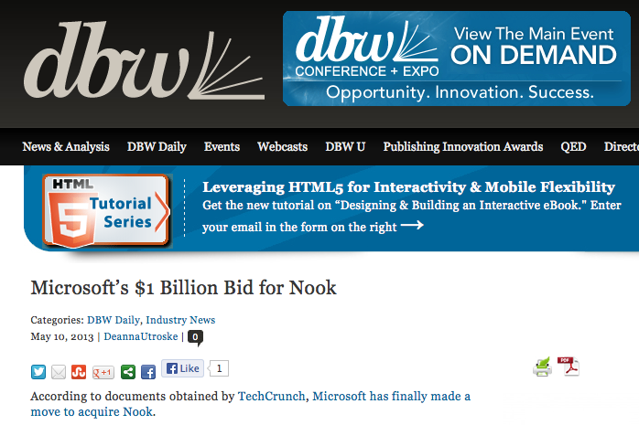
Convergence is ongoing

Slide 10
What are new experiences for publishing?
Photo outsideonline.com

Slide 11
Newspapers with audio, video, animations
Screencast from nytimes.com
Notes:
This NYT article drew a lot of attention for integration of multimedia into news.
The presentation has embedded video (for interviews) as well as some interesting
Design effects, bringing objects into view as you scroll.
Multimedia through use of HTML5 video, photos, audio clips
CSS filter applied during user interaction (the video becomes more opaque as you scroll)
- CSS used (similarly) to make things appear as user scrolls (e.g., “I couldn’t breathe” video appears)
Not shown in presentation but part of web site:
Advertising is used in the middle of the text (clickable)
Presentation links to additional slide shows (thus, web used to provide supporting materials)
Animations used to highlight ski trails as user scrolls down the page (on “Descent begins”)
Other things that could have been done:
Link from maps in the article to other maps on the web

Slide 12
Catalogs and magazines with beautiful, interactive layouts and typography
Screencast of moma.org
Notes:
This site shows off high-quality layout, including the use of downloadable fonts.
In addition, the catalog is social, allowing readers to share information in their social networks.
One can easily imagine a similar catalog making it easy for readers to purchase items through their favorite online payment networks.
It is this sort of integration with other services people want to use on the Web that is so valuable.
Jeff notes:
Updateable in place
Nice style using CSS
User can browse the catalog via linking (at which point I started the video)
CSS transforms allows me to rotate
CSS Animations allows me to jump around
Downloadable fonts
In principle I could have accessed the Web for more info.

Slide 13
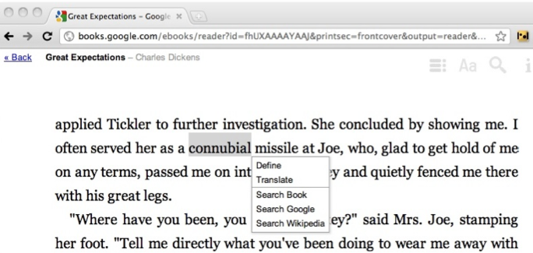
Books with third-party service integration
Screen shot from techwhack.co about Google ebooks
Notes:
One of the great strengths of the web is that people have access to the many other connected services they use all the time. When publishing moves to the web, it will be possible to integrate third-party services easily for translations, dictionaries, searches, and so on.

Slide 14
All of those will become more social
Screen shot from latimes.com
Notes:
Web users (and young web users in particular) increasingly want to share their online experiences with friends,
Including reading. Not only does this provide new promotion opportunities, but people are exploring monetization of
reviews and sharing as well.

Slide 15
Inspire new authoring forms (e.g., cell novels)
Screen shot from cbc.ca
Notes:
Just as the Web spawned new ways to publish in the form of blogs, facebook, twitter, and so in, the Open Web Platform has led innovators to explore new authoring ideas such as “cell phone novels”, which began in Japan but has spread elsewhere. This is just an illustration of how mobility, interoperability, and a common publishing platform continue to create new publishing opportunities.

Slide 16
And run on any device
Screen shot from bradfrostweb.com
Notes:
One of the strongest selling points for the Open Web Platform is its ability to run on many devices.
(Facebook reports that their Web app allows them to reach 7000 devices, and traffic to their Web app exceeds the combined traffic of their iOs and Android apps).
In addition, the Web can allow you to link devices in new ways, which the television industry is keen on: multi-screen scenarios. This has potential in the automotive industry as well.
People time-slice and use multiple devices at once. They shop on one device while watching television. We may see readers wanting to make use of multiple screens in similar ways.

Slide 17
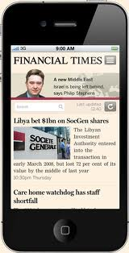
Publishers see cross-platform benefits
Financial Times Web application
“Financial Times: 'There is no drawback to working in HTML5’”
“[S]ince the Financial Times launched its HTML5 web app in June 2011, mobile devices … [account] for a third of the FT.com website's traffic and 15% of digital subscriptions.”
George Lossius Top 5 Trade Publishing Trends for 2013
“Technological competition will, over time, result in a diminished market share for the “closed” technology products that dominate the landscape today. A clear side-effect of this will be a move from device-based apps to web-based apps that buffer content and tools, but at the same time function cross-platform. This transition offers publishers a much stronger opportunity to invest in end-user satisfaction and successfully invest once to monetize content for numerous platforms.”

Slide 18
And business opportunity
New York Times, 19 January 2013:
“In 2012, something remarkable happened at The Times. It was the year that circulation revenue — money made from people buying the paper or access to its digital edition — surpassed advertising revenue.”
Various advertising approaches
E.g., March 2013: Launch of ADAP, eBook Advertising for Authors

Slide 19
What do publishers need from the Web?
Match current publishing practices
Leverage value-add of the Web
Support diverse business and distribution models
Satisfy diverse consumer behaviors
Screen shot: premiumfreebies.eu

Slide 20
Match Current Publishing Practices
Screens, typography, high quality fonts, colors
Advanced layout
adaptive layout for diverse devices
multi-column
pagination
media integration
formatting of the world’s scripts
Readability of long texts
Photo: behance.net

Slide 21
Leverage Value-Add of the Web
Links raise asset value, foster sharing, bookmarks
Rich media for ebooks, news, education
Data integration for journalism, book ids, catalogs, specialized search, discovery, curation, annotations
Cross-device support at lower cost
Accessibility, internationalization
Customization, specialized content for niche audiences

Slide 22
Support Diverse Business and Distribution Models
Revenue generation
Subscription
Ad insertion in eBook apps
Social sharing
Product placement
Web Payments
Content protection
One device
One user
None (e.g., “Tor Books UK Says Ditching DRM Showed No Increase In Piracy”)

Slide 23
Satisfy Diverse Consumer Behaviors
Rich content anywhere, anytime, across multiple devices
news on the go
content portability (across devices)
mobile ads, payments
Social, customized
niche audiences
sharing to drive marketing, revenues
reviews
discovery
Time-slicing
integrate reading experience with Web (dictionaries, references, etc.) and other activities
Photo: extremetech.com

Slide 24
How Can W3C Bring Publishing and Web Industry Closer?
W3C speaking at publishing events
Industry joining W3C groups
W3C working with industry groups
How else can we collaborate?
IDPF
BISG
BEA
IBPA
JEPA

Slide 25
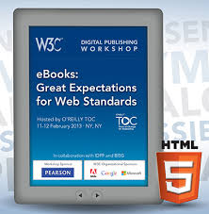
Recent Collaboration
W3C Workshop on eBooks and the Open Web Platform
February 2013 in New York (report)
Co-organized by BISG, IDPF, W3C
Tools of Change Conference, Hosted by O'Reilly
Joint meeting - CSS Working Group and Publishers
A List Apart column by Ivan Herman
Digital Publishing and the Web
New W3C Members: Pearson, Bloomberg
Pearson launched the Open Linked Education Community Group

Slide 26
Get Involved!
New! W3C Digital Publishing Activity
Co-Chairs Markus Gylling (IDPF & DAISY CTO), Madi Solomon (Pearson PLC)
The mission of the Digital Publishing Interest Group, part of the Digital Publishing Activity, is to provide a forum for experts in the digital publishing ecosystem of electronic journals, magazines, news, or book publishing (authors, creators, publishers, news organizations, booksellers, accessibility and internationalization specialists, etc.) for technical discussions, gathering use cases and to better align existing formats and technologies (e.g., EPUB) with the broader Open Web Platform.
W3C Workshops
Richer Internationalization for eBooks, 4 June in Tokyo, Japan
Publishing and the Open Web Platform, 16-17 September in Paris, France

Slide 27
Let’s Build an Open Web Platform for Publishing

