Slide 1
What the Web Brings to the Cloud
Jeff Jaffe, W3C CEO
Cloud World Forum, June 2013

Slide 2
Web and Cloud go hand in hand
Open Web Platform impacts cloud requirements
Significant parts of the cloud (e.g. PaaS, SaaS) live on the Web
The platform for consumers
Business platform for industry
Interleave consumer and professional computing
Lessons from Web standardization
Royalty-free standards and cohesive architectures are the keys to interoperability and a thriving ecosystem
The cloud can expand more rapidly than its current pace

Slide 3
Characteristics of the Open Web Platform
Web pages are more beautiful, interactive and intelligent
HTML5 provides cross-browser interoperability and all browser vendors are supporting it; now complete and stable
Video, rich multimedia, are first-class citizens
Unprecedented device support: e-books, set-top box, automotive
Web of Apps: full application development environment
Social networking
Is the most interoperable platform in the industry

Slide 4
Growing technology stack
Core | Hypertext Markup Language (HTML)
Video/Audio | HTML, Web Audio
Styles | Cascading Style Sheets (CSS)
Fonts | Web Open Font Format (WOFF)
Protocols | Hypertext Transfer Protocol (HTTP), WebRTC
Dynamic | Javascript (ES), Web Application Programming Interfaces (WebAPIs)
Graphics | Scalable Vector Graphics (SVG), 2D Canvas API
Real Time | WebRTC
Device access | WebAPIs: Geolocation, Multi-touch, etc.
Performance | WebAPIs: Navigation timing, Page visibility, Timing control

Slide 5
Early Majority has Embraced OWP
Gartner: ”[More] than 50 percent of mobile apps deployed by 2016 will be hybrid.”
ABI Research: “2.1 Billion HTML5 Browsers on Mobile Devices by 2016”
Kendo UI: “90 percent of more than 5,000 app developers and IT decision makers saying they will develop apps using HTML5 in 2013, and only 15 percent preferring a native-only approach.”

Slide 6
Rich ecosystem surrounds the standards
Implementer support
Tests for interop
Performance tools
Developer community
Libraries, frameworks
Documentation
Tools
Education and training

Slide 7
The result is transformations: Publishing
20% of all US Newspapers are digital
“After 79 years in print, Newsweek goes digital only”
Google Ad Revenue Now More Than U.S. Print Publications Combined
E-Books See Triple Digit Growth As Paper Book Sales Dive
Pew: Survey Finds Rising Reliance on Libraries as a Gateway to the Web

Slide 8
What are we doing with publishers?
Match current publishing practices
Pagination, rich-styling
Leverage value-add of the Web
Linkability, etc.
Support diverse business and distribution models
Satisfy diverse consumer behaviors
Social, device independent, interleave
Screen shot: premiumfreebies.eu

Slide 9
Open Web Platform Demo
Screencast of moma.org
Notes:
This site shows off high-quality layout, including the use of downloadable fonts.
In addition, the catalog is social, allowing readers to share information in their social networks.
One can easily imagine a similar catalog making it easy for readers to purchase items through their favorite online payment networks.
It is this sort of integration with other services people want to use on the Web that is so valuable.
Jeff notes:
Updateable in place
Nice style using CSS
User can browse the catalog via linking (at which point I started the video)
CSS transforms allows me to rotate
CSS Animations allows me to jump around
Downloadable fonts
In principle I could have accessed the Web for more info.

Slide 10
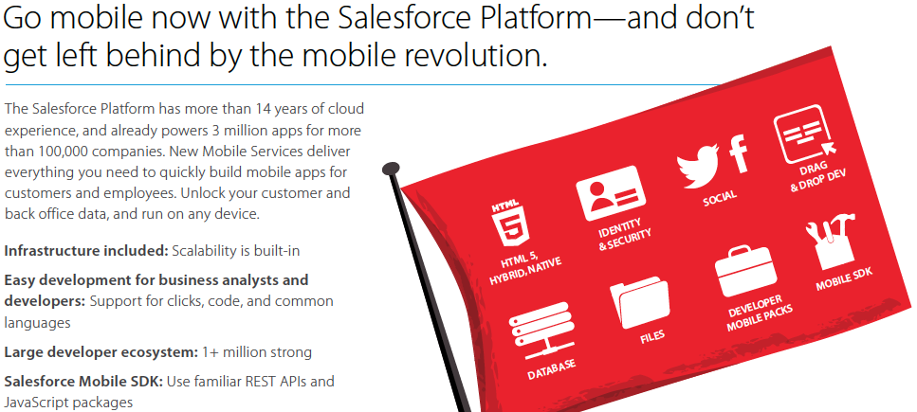
OWP gives mobile device independence
Source: Salesforce.com

Slide 11
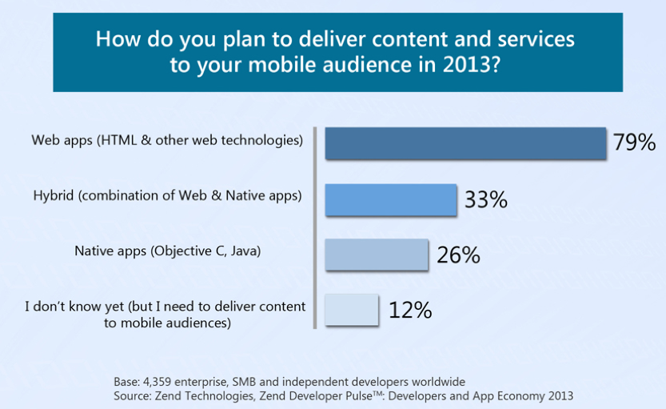
HTML5 momentum for mobile
Source: Zend Developer Pulse, Q2 2013

Slide 12
Entertainment broadens the platform
Web and TV Interest Group
Streaming media
Captions
Content protection
Testing for consumer electronics
Recording and downloading
Stereoscopic 3D
Terminal capabilities
“Globally, consumer Internet video traffic will be 69 percent of all consumer Internet traffic in 2017, up from 57 percent in 2012.”
“In 2017, the gigabyte equivalent of all movies ever made will cross global IP networks every 3 minutes. Global IP networks will deliver 13.8 petabytes every 5 minutes in 2017.”
Source of quotations: Cisco

Slide 13
Automotive, publishing broaden the platform
Automotive Business Group
Safety
New UI paradigms
Vehicle APIs
Digital publishing Interest Group
ePub based on Web standards
Pagination
High-end typography

Slide 14
Greater expectations
Robustness and stability
Developing large-scale testing program, e.g. for consumer electronics
Performance
User expectations higher due to native apps
Interoperability
Phones, tablets, televisions, automobiles, ebooks, …
Capability
APIs for access to device capabilities, distribution, monetization, etc.

Slide 15
Implications for Cloud
The Web is an underlying platform for much of the Cloud
Cloud supports computing
Personal computing is the Web
Cloud is impacted by what the Web is; namely
Apps
Video
Books
Entertainment
Automotive Infotainment
And industry computing is also the Web…

Slide 16
Web and Cloud go hand in hand
Open Web Platform impacts cloud requirements
Significant parts of the cloud (e.g. PaaS, SaaS) live on the Web
The platform for consumers
Business platform for industry
Interleave consumer and professional behavior
Lessons from Web standardization
Royalty-free standards and cohesive architectures are the keys to interoperability and a thriving ecosystem
The cloud can expand more rapidly than its current pace

Slide 17
Key to success of Web community: Build on open standards
Due process, cooperation, broad consensus, transparency
Multi-stakeholder participation
Address use cases for diverse use cases
For social issues such as privacy you need all players
Web is global; need international participation
Longevity
Ensure humanity’s knowledge remains available long into the future
Specifications are freely available

Slide 18
Web and Cloud both large economic forces
Web/Internet
McKinsey 2011: Almost $8 trillion exchange hands annually in e-commerce
… and the Web is much more than e-commerce
Cloud
Gartner: “The public cloud services market is forecast to grow 19.6 percent in 2012 to total $109 billion worldwide.”
Forrester: “The SaaS software market will increase 25 percent in 2013 to $59 billion, a 25 percent increase. In 2014, the market is expected to total $75 billion.”
McKinsey 2013: “We estimate the total potential economic impact for cloud technology across sized applications could be $1.7 trillion to $6.2 trillion in 2025…”

Slide 19
Let’s look at that again
8 Trillion v
100 Billion

Slide 20
How did the Web reach that number?
We built on open standards
Universal architecture
Designed for all devices
Designed for all people
Implementable Royalty-Free
With a strong open source community

Slide 21
Universal architecture
World Wide Web is a global information space (URIs)
Design is universal, including provisions for access control
Universality makes sharing easy (when sharing is desired)
Don’t satisfy social requirements by introducing interop barriers
Global linkability gives powerful network effects
Silos lower value
Global interoperability increases value to all

Slide 22
Designed for all devices
Image: Brad Frost

Slide 23
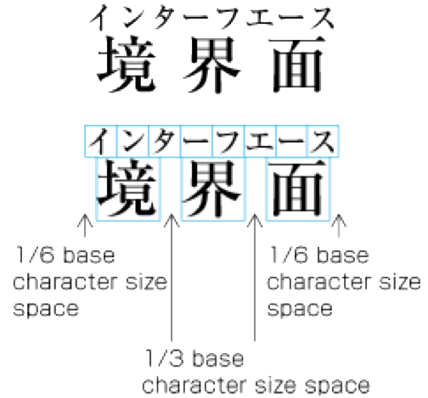
Designed for all people
Accessibility
Multilingual

Slide 24
Diverse classes of Web software
Browsers
Authoring tools
Servers
(HTML) mail clients
Converters
Word processor save as, …
Search engines
Mobile operating systems
Tizen, FirefoxOS, …
Assistive technologies
Important for accessibility
Future software we don’t know about!

Slide 25
Implementable Royalty-Free
Royalty-Free Web from the start
From CERN’s original declaration
W3C’s RF Patent Policy
Royalty-Free standard platform levels playing field
Infrastructure that the entire planet will use cannot be proprietary
Level playing field fosters innovation
Supports all software models (closed, open source)

Slide 26
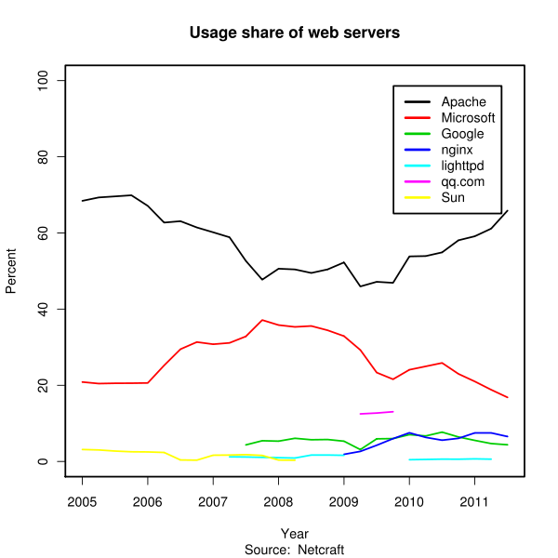
Strong open source community
Apache leading Web server
Webkit used in numerous browsers
Many others

Slide 27
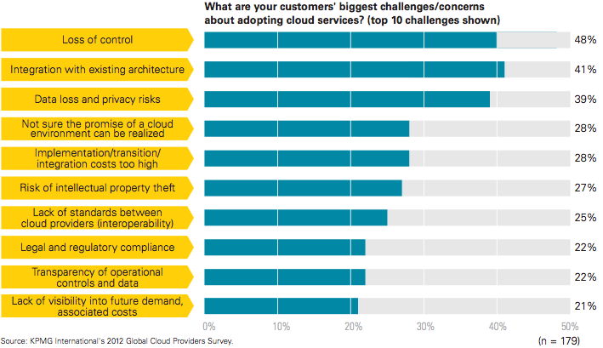
Factors holding back cloud adoption
“lack of standards between cloud providers (interoperability)”
Source: “Breaking through the cloud adoption barriers,” KPMG, February 2013

Slide 28
What are we hearing about Cloud standards?
Not the right time
Market too young
People haven’t agreed what to standardize
Moving too fast
Not the right place
Too many cloud standards organizations
Not necessary
Open source projects are replacing standards

Slide 29
Cohesive focus on Web standards in 5 years
1989: Web invented
1991: Web software available via FTP
1994: HTML standardization starts at IETF in September (through 1995)
1994: W3C launched
1996: CSS 1 Recommendation
1996: Portable Network Graphics (PNG) Recommendation
1997: HTML 3.2 Recommendation

Slide 30
Market too young for standardization?
1950s: Underlying concepts for cloud formulated
1960s-1990s: Time-sharing of resources
1990s: Web provides abstraction layer above hardware; VPN, ASPs
2006: Amazon Web Service
2008: Eucalyptus open source platform for private clouds
Source: Wikipedia

Slide 31
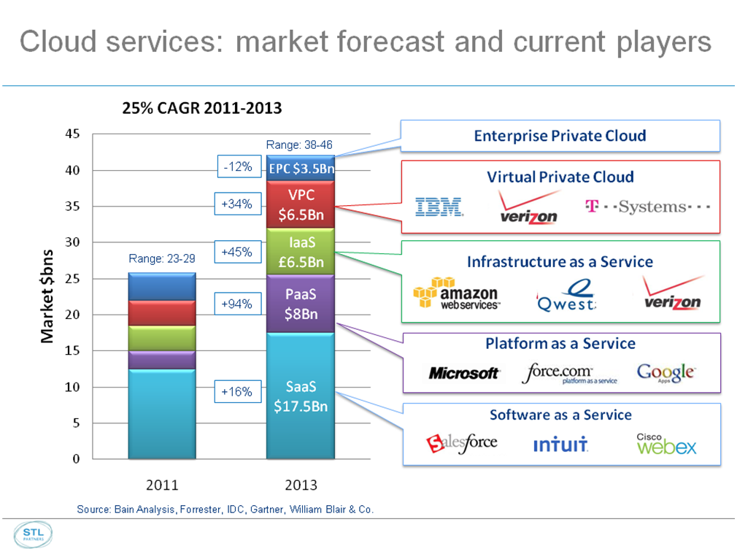
People haven’t agreed what to standardize
Source: Telco 2.0 Research

Slide 32
The consequence: silos are getting deeper
IT innovation truly is continuous
But that does not conflict with standardization
A stable base is required to facilitate the next level of innovation
Solution
Welcome innovation
Stabilize technology at the right time
Agile process to build consensus, get implementation experience

Slide 33
Standardize a fast-moving market by also welcoming innovation
W3C Approach
Working Groups
Workshops (targeting industry requirements)
Member Submissions (candidate technology)
Community Groups (free, open to all)
Business Groups (target industry requirements)
Collaboration with other organizations

Slide 34
Community/Business Group Growth
 | June 2011 | June 2012 | June 2013
Number of Groups | 0 | 82 | 128
Number of Participants | 0 | >1280 | >2850
Several CG specs now on Standards Track

Slide 35
What are we hearing about Cloud standards?
Not the right time
Market too young
People haven’t agreed what to standardize
Moving too fast
Not the right place
Too many cloud standards organizations
Not necessary
Open source projects are replacing standards

Slide 36
Not the right place: too many stds orgs
DMTF
ETSI
GICTF
ISO
ITU
NIST
OGF
OMG
OCC
OASIS
SNIA
CSA
TOC
ARTS
TM Forum
More at cloud-standards.org
Cloud community needs to fix this

Slide 37
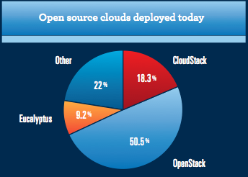
Not necessary: open source replaces stds
Source: “The State of the Open Source Cloud 2012”, Zenoss, October 2012

Slide 38
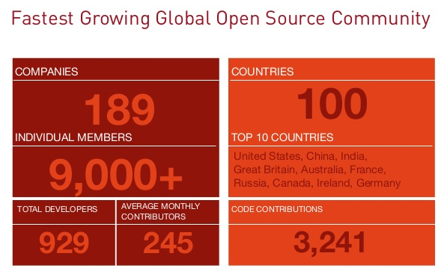
Open Stack thriving
Source: State of the Stack, Randy Bias, April 2013

Slide 39
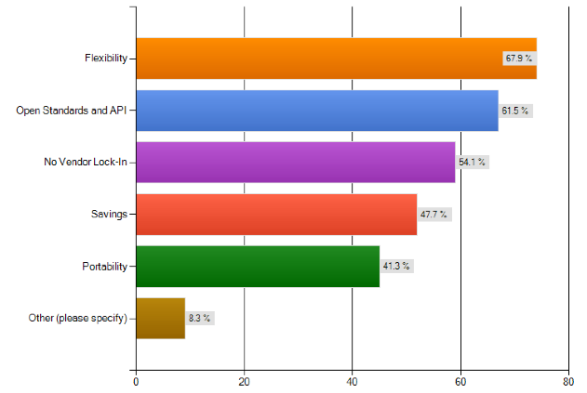
Market still seeking open standards
What drove you to make the decision to migrate to an open source cloud?
Source: “The State of the Open Source Cloud 2012”, Zenoss, October 2012

Slide 40
Does open source substitute for standards?
Gartner: “Don't assume that "open source" equates to open standards, broad interoperability and freedom from commercial interests. In reality, OpenStack is dominated by vendor interests, where they want customers to adopt their own offerings, potentially to include proprietary lock-in. “

Slide 41
Popular open source can still fragment
Source: State of the Stack, Randy Bias, April 2013

Slide 42
Why might Open Source fragment?
Vendors make different choices for different business goals
Design choices based on devices supported
Open source reduces barriers to entry
Which brings in more players and diversity
Which perversely creates more choices and fragmentation
Unless there is also a standard

Slide 43
What standards give you that OSS does not
Consensus agreements
Horizontal review (security, privacy, device independence, accessibility, internationalization)
Clear patent licensing commitments
Longevity
Government recognition
A rich ecosystem with interoperability testing, validation, documentation, training

Slide 44
Web and Cloud go hand in hand
Open Web Platform drives cloud requirements
Significant parts of the cloud (e.g. PaaS, SaaS) live on the Web
The platform for consumers
Business platform for industry
Interleave consumer and professional behavior
Lessons from Web standardization
Royalty-free standards and cohesive architectures are the keys to interoperability and a thriving ecosystem
The cloud can expand more rapidly than its current pace

Slide 45
Call to action: help the Cloud further thrive
Consensus agreement on cohesive architecture(s)
Royalty-Free open standards driven by small number of bodies

Slide 46
What this will enable
Sharing
Data portability (when desired)
Integration with existing services
Metrics
Easier to determine compliance
Innovation around analytics
Path for innovation
Trust
Transparency
Competition for trust
Lower costs
More competition
Interoperability through freely available published standards
Growth for the Cloud industry

Slide 47
Distinction by service, not silo
Price
Quality of service
Additional capabilities
Open standards compliance

Slide 48
The time has come
Royalty-Free Standards
For
Cohesive Cloud Architecture

