Slide 1
Standardizing for Open Data
Ivan Herman, W3C
Open Data Week
Marseille, France, June 26 2013
Slides at: http://www.w3.org/2013/Talks/0626-Marseille-IH/

Slide 2
Data is everywhere on the Web!
Public, private, behind enterprise firewalls
Ranges from informal to highly curated
Ranges from machine readable to human readable
HTML tables, twitter feeds, local vocabularies, spreadsheets, …
Expressed in diverse models
tree, graph, table, …
Serialized in many ways
XML, CSV, RDF, PDF, HTML Tables, microdata,…

Slide 3
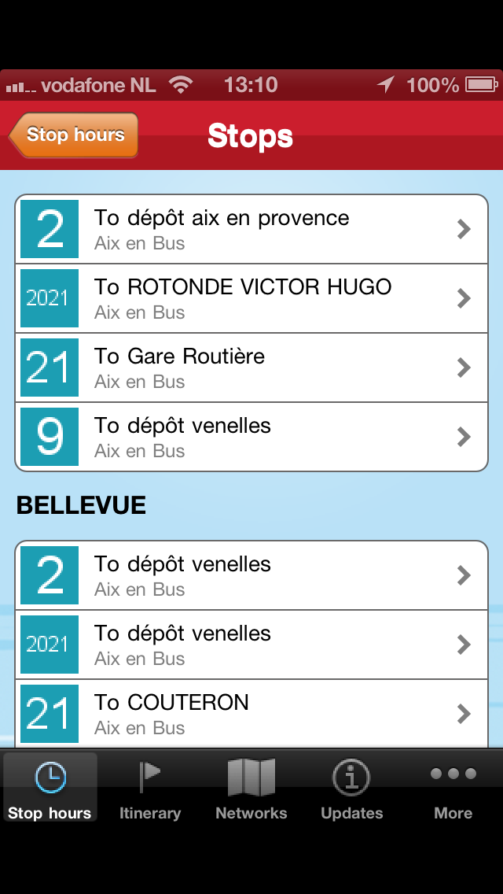
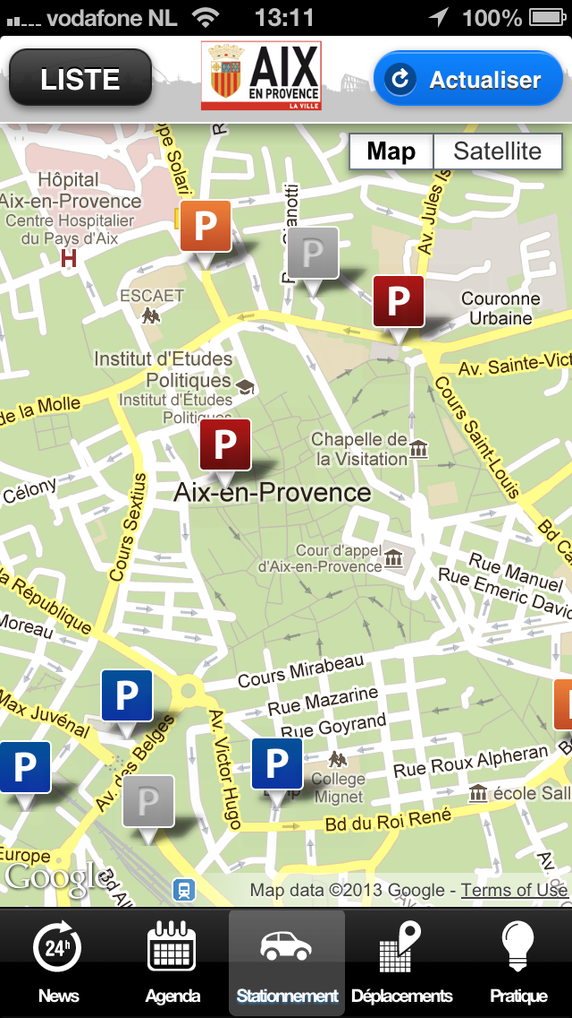
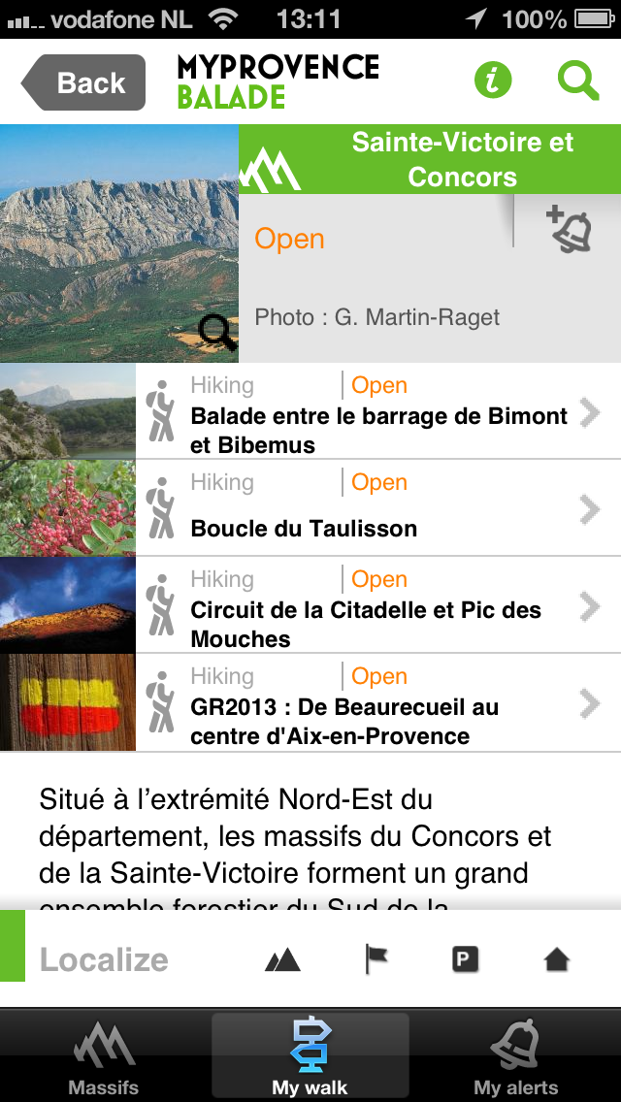
Notes:
Applications relying on various types of data published by the municipality of Aix

Slide 4
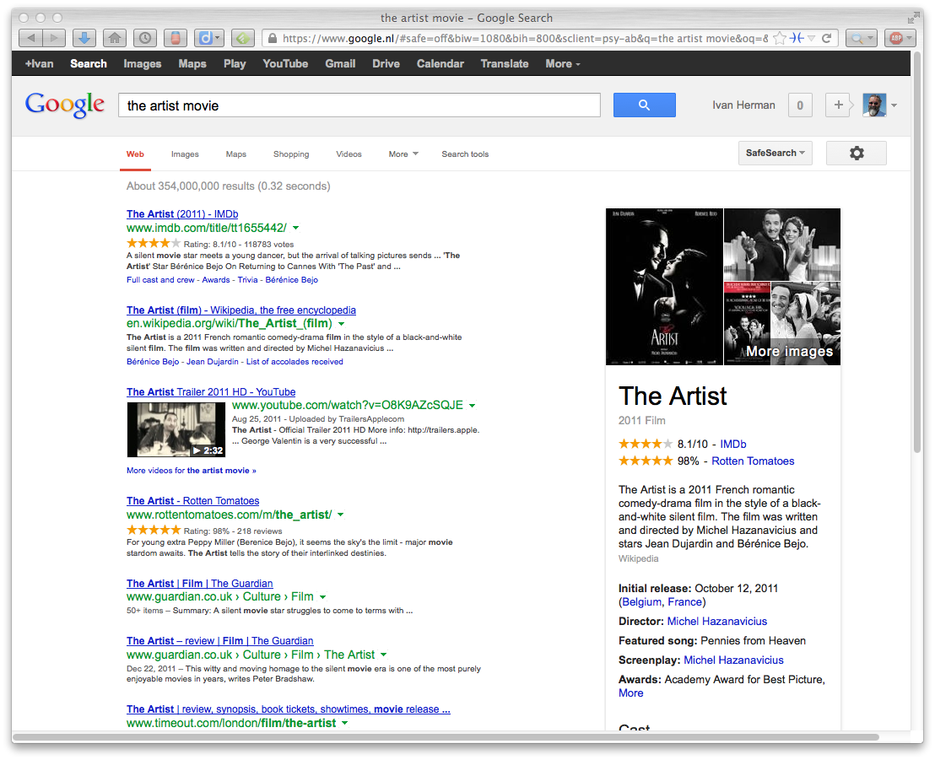
Notes:
Typical Google search results reusing schema.org related data

Slide 5
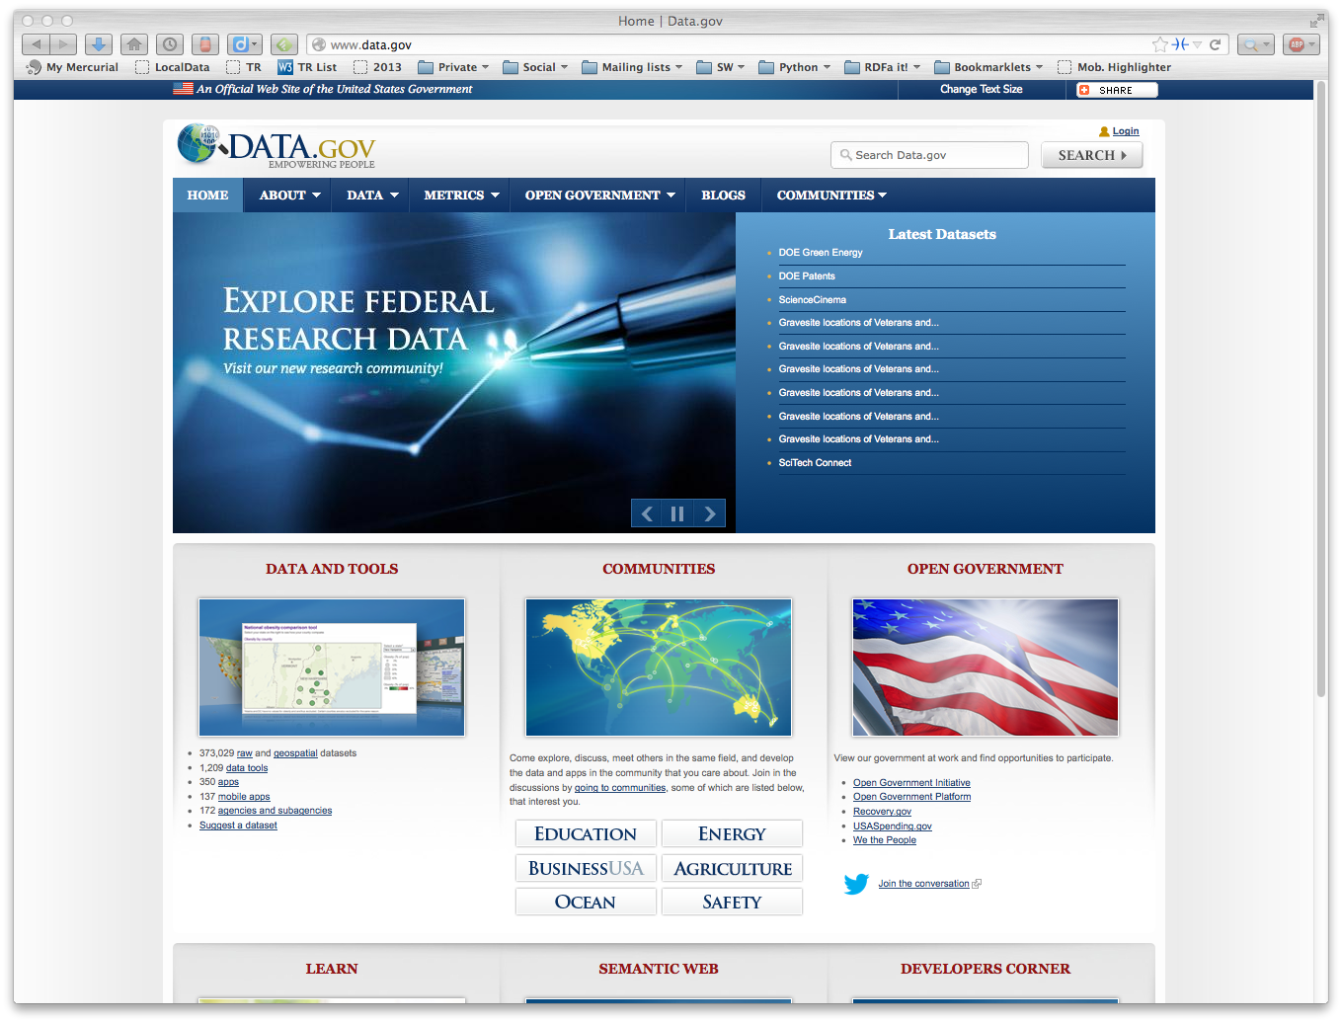

Slide 6
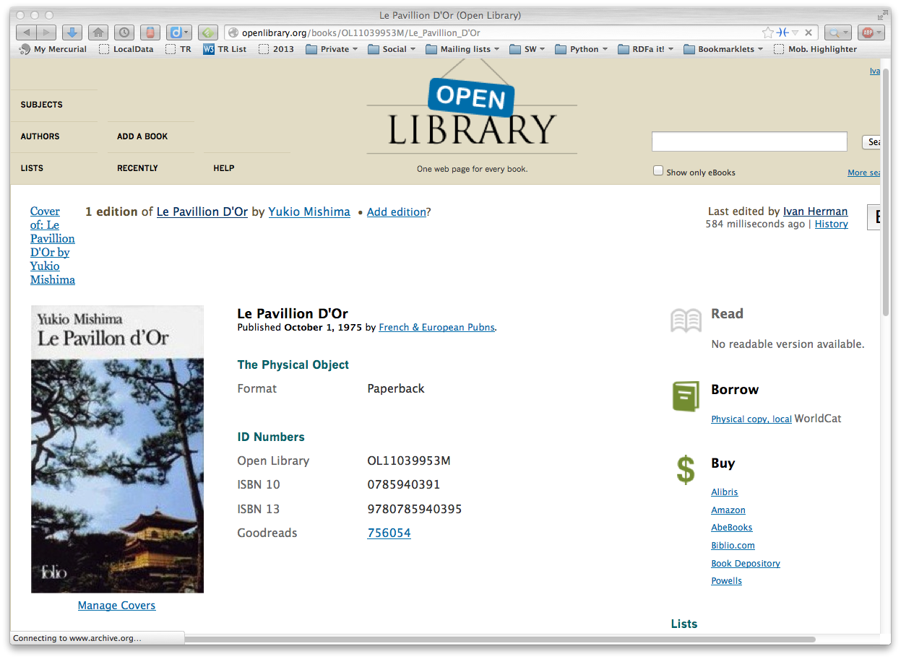

Slide 7
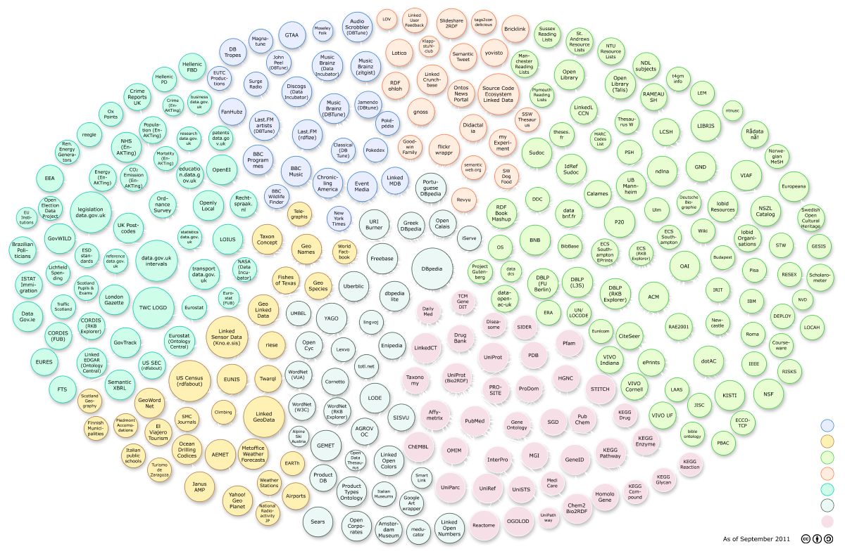

Slide 8
W3C’s standardization focus was, traditionally, on Web scale integration of data
Some basic principles:
use of URIs everywhere (to uniquely identify things)
relate resources among one another (to connect things on the Web)
discover new relationships through inferences
This is what the Semantic Web technologies are all about

Slide 9
We have a number of standards
SPARQL: querying data
SPARQL 1.1
RDF 1.1
JSON-LD
Turtle
RDFa
RDF/XML
URI
RDF: data model, links, basic assertions;
different serializations
A fairly stable set of technologies by now!

Slide 10
We have a number of standards
RDB2RDF: databases to RDF
OWL 2
SPARQL: querying data
SPARQL 1.1
RDFS 1.1
OWL: complex vocabularies, ontologies
RDB2RDF
RDF 1.1
RDFS: simple vocabularies
JSON-LD
Turtle
RDFa
RDF/XML
URI
RDF: data model, links, basic assertions;
different serializations
A fairly stable set of technologies by now!

Slide 11
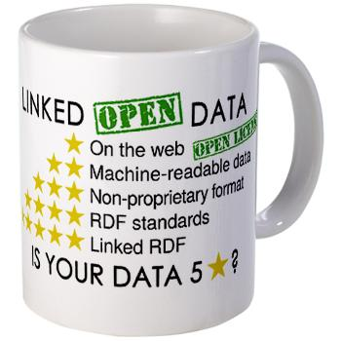
We have Linked Data principles

Slide 12
Integration is done in different ways
Very roughly:
data is accessed directly as RDF and turned into something useful
relies on data being “preprocessed” and published as RDF
data is collected from different sources, integrated internally
using, say, a triple store

Slide 13
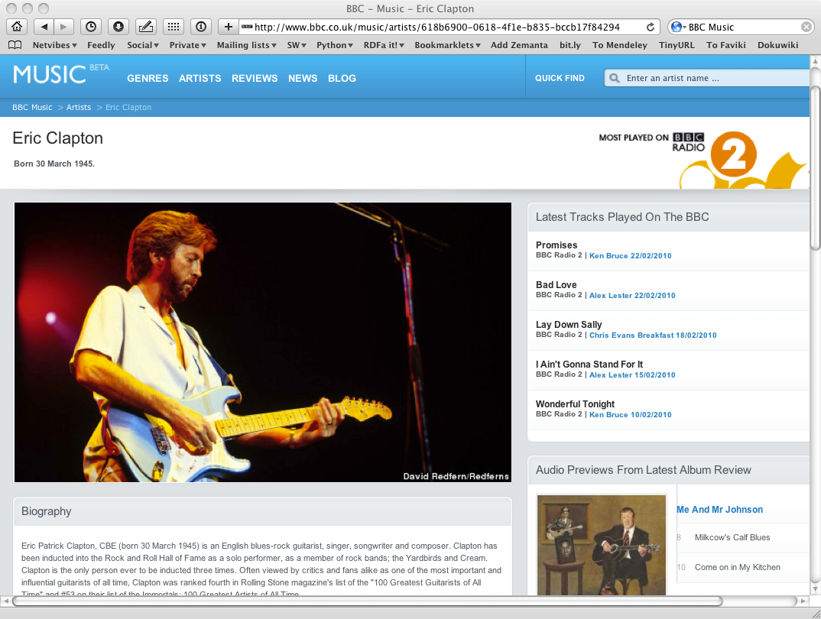
Notes:
Content generated by extracting and integrating data from the Linked Open Data cloud.

Slide 14
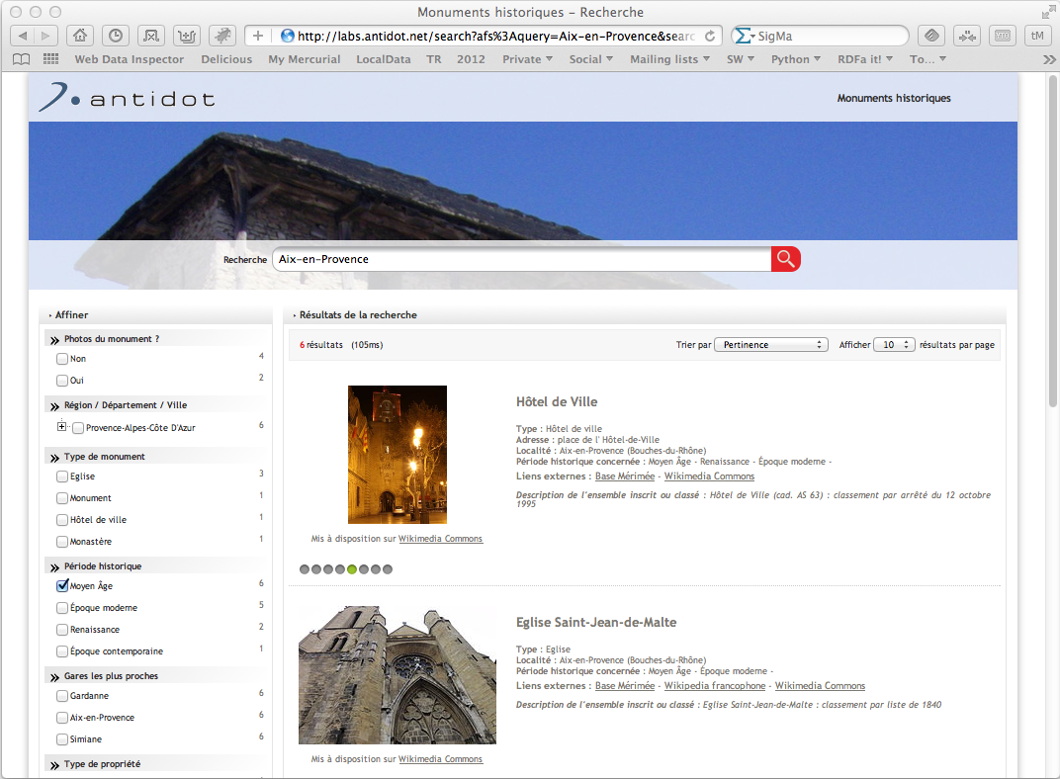
Notes:
Integrated datasets: dbpedia, open street maps, INSEE geographical information, official french list of historical monuments; not all made available in RDF, but integrated in RDF with the available conversion tools; results are merged in an RDF database (over 4.5 million triples) and a company tools is created for the user interface. Done in a few days using available tools

Slide 15
However…
There is a price to pay: a relatively heavy ecosystem
many developers shy away from using RDF and related tools
Not all applications need this!
data may be used directly, no need for integration concerns
the emphasis may be on easy production and manipulation of data with simple tools

Slide 16
Typical situation on the Web
Data published in CSV, JSON, XML
An application uses only 1-2 datasets, integration done by direct programming is straightforward
e.g., in a Web Application
Data is often very large, direct manipulation is more efficient

Slide 17
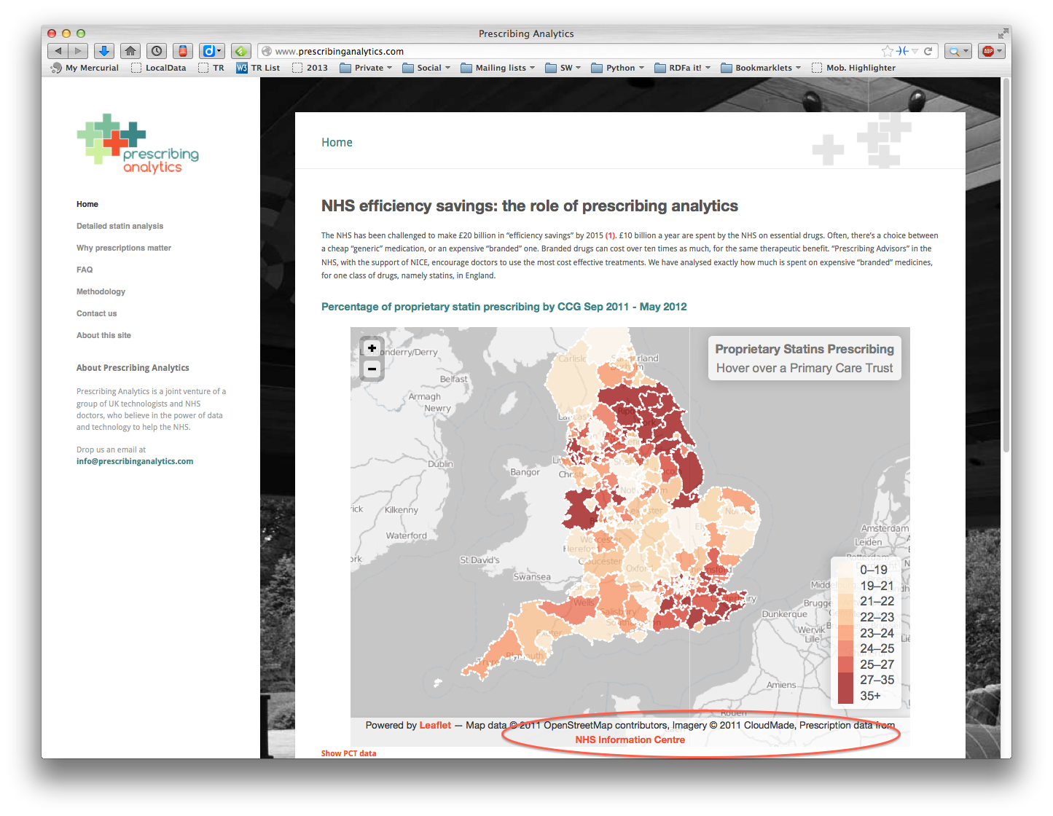
Non-RDF Data
In some setting that data can be converted into RDF
But, in many cases, it is not done
e.g., CSV data is way too big
RDF tooling may not be adequate for the task at hand
integration is not a major issue

Slide 18
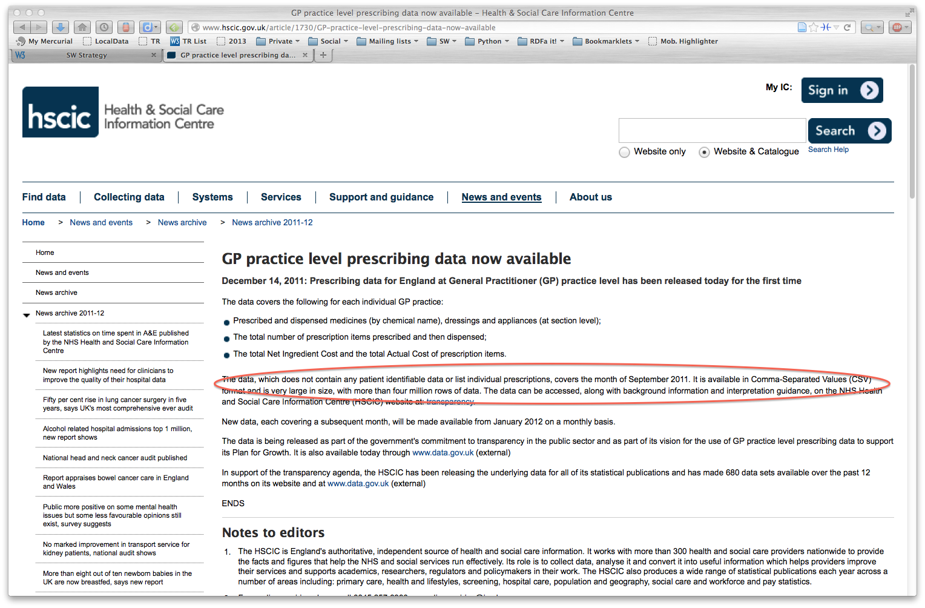

Slide 19
What that application does…
Gets the data published by NHS
Processes the data (e.g., through Hadoop)
Integrates the result of the analysis with geographical data
Ie: the raw data is used without integration

Slide 20
The reality of data on the Web…
It is still a fairly messy space out there ☹
many different formats are used
data is difficult to find
published data are messy, erroneous,
tools are complex, unfinished…

Slide 21
How do developers perceive this?
‘When transportation agencies consider data integration, one pervasive notion is that the analysis of existing information needs and infrastructure, much less the organization of data into viable channels for integration, requires a monumental initial commitment of resources and staff. Resource-scarce agencies identify this perceived major upfront overhaul as "unachievable" and "disruptive.”’
-- Data Integration Primer: Challenges to Data Integration, US Dept. of Transportation

Slide 22
One may look at the problem through different goggles
Two alternatives come to the fore:
provide tools, environments, etc., to help outsiders to publish Linked Data (in RDF) easily
a typical example is the Datalift project
forget about RDF, Linked Data, etc, and concentrate on the raw data instead

Slide 24
But religions and cultures can coexist… ☺

Slide 25
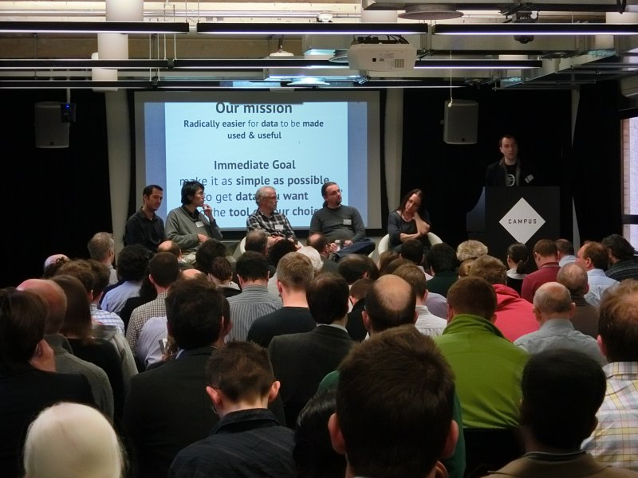
Open Data on the Web Workshop
Had a successful workshop in London, in April:
around 100 participants
coming from different horizons: publishers and users of Linked Data, CSV, PDF, …

Slide 26
We also talked to our “stakeholders”
Member organizations and companies
Open Data Institute, Open Knowledge Foundation, Schema.org
…

Slide 27
Some takeaway
The Semantic Web community needs stability of the technology
do not add yet another technology block ☺
existing technologies should be maintained

Slide 28
Some takeaway
Look at the more general space, too
importance of metadata
deal with non-RDF data formats
best practices are necessary to raise the quality of published data

Slide 29
We need to meet app developers where they are!

Slide 30
Metadata is of a major importance
Metadata describes the characteristics of the dataset
structure, datatypes used
access rights, licenses
provenance, authorship
etc.
Vocabularies are also key for Linked Data

Slide 31
Vocabulary Management Action
Standard vocabularies are necessary to describe data
there are already some initiatives: W3C’s data cube, data catalog, PROV, schema.org, DCMI, …
At the moment, it is a fairly chaotic world…
many, possibly overlapping vocabularies
difficult to locate the one that is needed
vocabularies may not be properly managed, maintained, versioned, provided persistence…

Slide 32
W3C’s plan:
Provide a space whereby
communities can develop
host vocabularies at W3C if requested
annotate vocabularies with a proper set of metadata terms
establish a vocabulary directory
The exact structure is still being discussed:
http://www.w3.org/2013/04/vocabs/

Slide 33
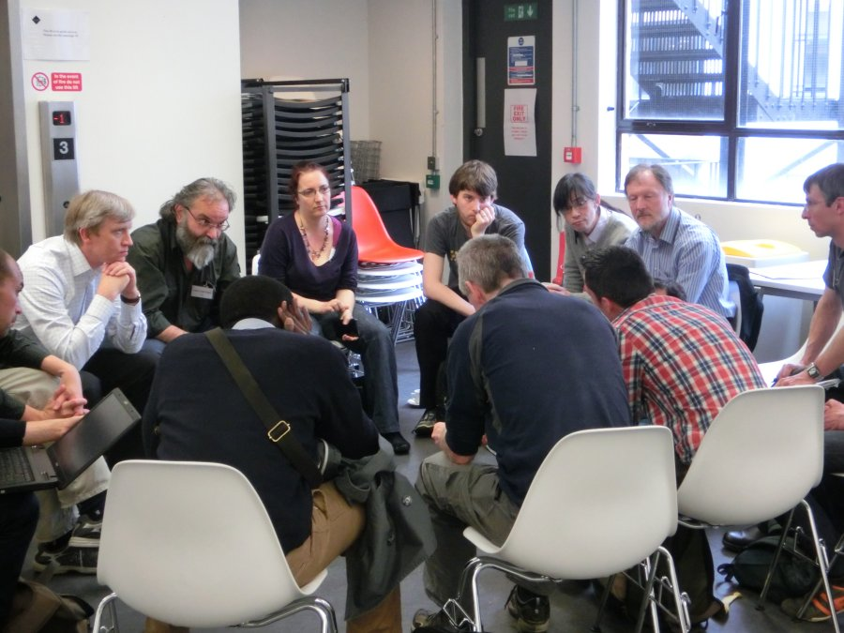

Slide 34
CSV on the Web
Planned work areas:
metadata vocabulary to describe CSV data
structure, reference to access rights, annotations, etc.
methods to find the metadata
part of an HTTP header, special rows and columns, packaging formats…
mapping content to RDF, JSON, XML
Possibly at a later phase:
API standards to access CSV data

Slide 35
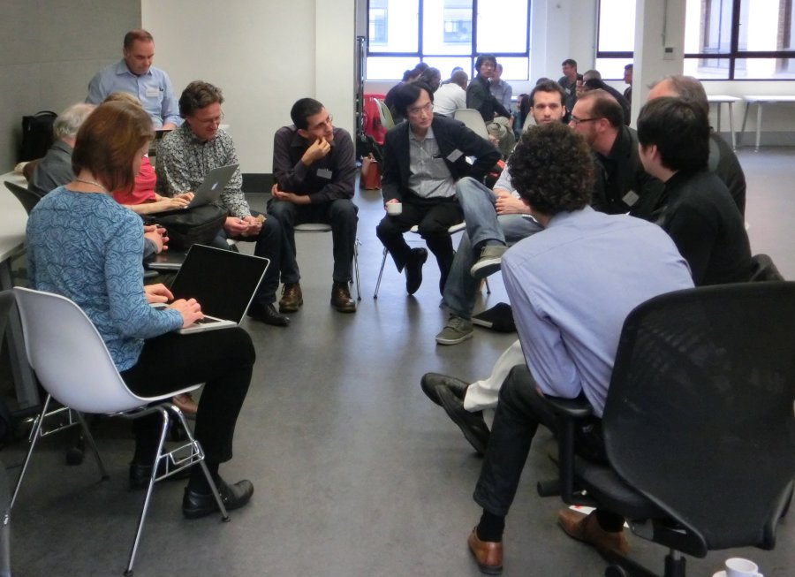

Slide 36
Open Data Best Practices
Document best practices for data publishers
management of persistence, versioning, URI design
use of core vocabularies (provenance, access control, ownership, annotations,…)
business models
Specialized Metadata vocabularies
quality description (quality of the data, update frequencies, correction policies, etc.)
description of data access API-s
…

Slide 37
Summary
Data on the Web has many different facets
We have concentrated on the integration aspects in the past years
We have to take a more general view, look at other types of data published on the Web

Slide 38
In future…
We should look at other formats, not only CSV
MARC, GIS, ABIF,…
Better outreach to data publishing communities and organizations
WF, RDA, ODI, OKFN, …
Notes:
ABIF: Applied Biosystems Genetic Analysis Data File
GIS: Geographical information system
MARC: Bibliography format for libraries

Slide 39
Enjoy the event!

