Slide 1
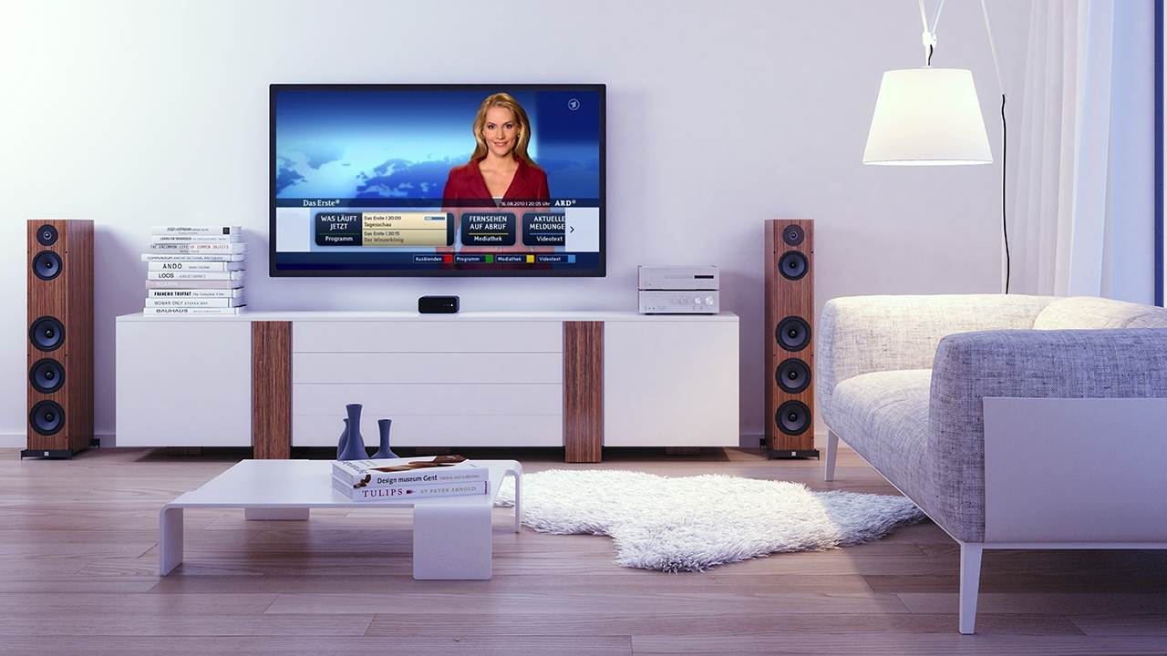
Web & TV Workshop – Next Steps
Giuseppe Pascale, Opera Software
Notes:
1

Slide 2
Wrap-up and next steps
GGIE presentation (Glenn, NBCU)
Go through the list of identified gaps and
Check that they are correctly defined
Is the W3C the right place for a follow-up?
(if yes) is the IG the right place to have a follow-up?
Assess interest in working on it in W3C

Slide 3
Gaps/Issues identified
Synchronization of Video and (meta) data, video & video
Partial coverage from existing specs: Media Fragments, HTML5 multitrack API, HTML5 MediaController
Missing:
Stream events, esposure of multiple timelines
Open question
Is this something for W3C to handle? Or is it an integration issue? Are there gaps in the existing specs (e.g. HTML5)?
Discussion
Not clear if W3C is the right place
There may be some gaps, but not clear yet
There are some existing bugs in Bugzilla
Need to break down the use cases in order to find gaps
Conclusion
Interested parties need to raise bugs against relevant specs
Send Bug report to IG list and ask for support
Use the IG list as a way to share issues and ask for support

Slide 4
Gaps/Issues identified
Testing devicing based on web technologies
People agree that testing is important
Would be ideal to have a common solution for all HTML based products
Outstanding Issues
More information on the existing material and tools.
Make sure that tools are suitable for the TV industry
More test cases
Different definitions of testing in different fora
Operational issues around test development, approval and maintainence (in W3C)
What can we do?
Revive the testing TF to look at the existing tools and material, and see if they are suitable for the TV industry (and if not, work to address the missing features)
Test The Web Forward event for TV
Discussion
Next Steps
IG to facilitate a conversation among interested parties

Slide 5
Gaps/Issues identified
Rendering and control of linear video using <video> («Tuner API»)
Outstanding issues:
no common API to render linear content via the video element
HTML5 API may not be currently covering all the requirements needed to render linear content, e.g.
Access to list of services
Parental access control
…
Next steps
Create a CG to draft a technical solution to be later moved to a WG?
Follow-up in the IG.

Slide 6
Gaps/Issues identified
Misc gaps around delivery & rendering of IP video, mostly integration issues for TV devices
see HbbTV/Jon P. bugs
Can the IG help SDOs driving their issues and requirements to the HTML WG? (Yes)
How? Should the bug be sent to the IG list? Should the SDOs monitor the mailing list and try to contribute to the discussion if they are facing the same issues?
Discussion
Would it help for the IG to have phone conferences where bugs are discussed?
Maybe we should use the IG to keep track of TV related bugs, and their status
Next steps
Follow-up this in the IG and define a way to handle its

Slide 7
Gaps/Issues identified
Discovery and communication between two UAs or a UA and another device/service :
Ongoing related work:
Second Screen CG (web screens)
Sysapps WG
Network Service Discovery (in DAP WG)
Is there anything more that the IG can do at this point?
Next Steps
Continue the discussion in existing groups

Slide 8
Gaps/Issues identified
Performance measurement (benchmarks) for web technologies/animations.
Difficult to guarantee a good experience on low end devices
Should there be a reference benchmark?
Topic raised in Web Performance WG, but not prioritized. Can/should the IG help with that?
Discussion
This can easily became an issue, W3C could define the benchmarks (and related APIs)
Some devices already suffer from this, some time even if the technology is supported, bad performances make it unusable
Risk is that people optimize for tests and real world apps still suffer from performance issues.
Is doing nothing worst than doing something that is not perfect?
Next steps
time to raise the issue again with the web performance working group?
try to discuss it also with the gaming community
IG to collect requirements from interested parties to be passed on to the approriate groups

Slide 9
Gaps/Issues identified
(Other) accessibility features
Should the IG be working on collecting use cases and requirements for accessibility features other then captioning and subtitles?
Discussion
We probably should try to work on this
There is an accessibility group, not sure if it’s working on topics of interest of the TV communit (e.g. CVAA regulation)
Web Accessibility group is interested in engaging with the IG
Next steps
Discuss this in the IG

Slide 10
Gaps/Issues identified
Pluggable CDM for EME
Discussion
Is this something for the IG or better raised directly with Media TF of the HTML WG (working on EME)?
Is the W3C the right place to discuss it?
Next Steps
IG participants to raise the issue within the Media TF of the HTML WG

Slide 12
Thanks
Giuseppe Pascale, Opera Software
Notes:
12

