Slide 1
Linking Web Content Seamlessly with Broadcast Television
Issues and Lessons Learned
Position Paper to the 4th W3C Web and TV Workshop
Jan Thomsen¹, Lyndon Nixon², Raphael Troncy³
¹ Condat AG, ²MODUL University, ³EURECOM
March 2014, 12-13, IRT Munich

Slide 2
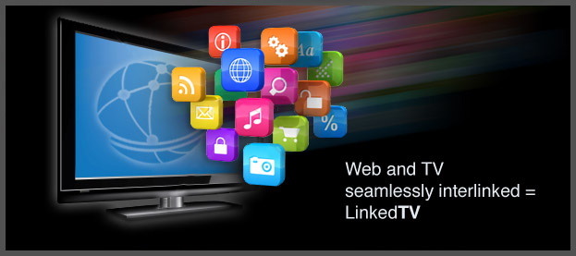
The LinkedTV Project
EU FP7 funded project, Duration 2011/10 – 2015/03
Objective: Seamless integration of Web & TV
Consortium:
Fraunhofer (DE), U MODUL (AT), EURECOM (FR), CERTH (GR), UEP (CZ), CWI (NL), S&V (NL), Noterik (NL), rbb (DE), Condat (DE), U Mons (BE), U St. Gallen (CH)
http://www.linkedtv.eu, @linkedtv

Slide 3
Seamless integration of Web & TV?
„... a true TV ecosystem must functionally integrate the apps with the television programming service and content being offered to the consumer.“
TVs can't be smart. Stop trying to make it happen. - WIRED Opinion, Gary Myer, Oct 2013
Notes:
3

Slide 4
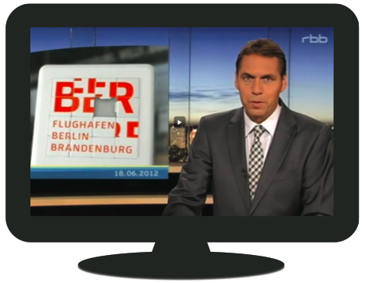
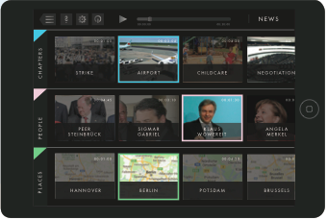
Seamless integration of Web & TV?
Linked Television is the seamless
interweaving of TV and Web content
into a single, integrated
experience.
e.g, … watching the news and getting background information on the stories at your fingertips ...
Notes:
4

Slide 5
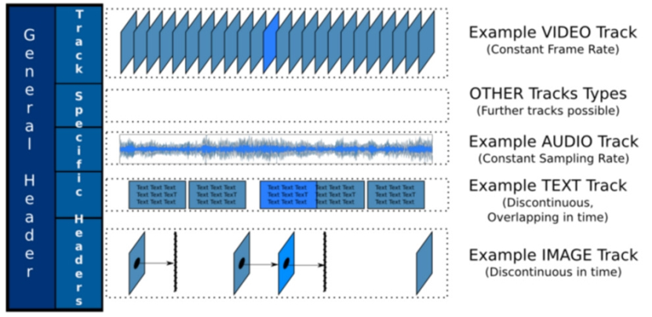
What is our approach?
Fragmenting and Annotating multimedia content
ASR, Shot/Scene Segmentation, Concept Detection, Object Recognition, Face Recognition, OCR, Entity Recognition, Metadata (e.g. TV-Anytime)
➔ multi-level indexing of media resources
➔ thousands of fragments for each media resource
Generating Media Fragment URIs (identifiers) for each fragment of interest
Analysis results seen as annotations according to the W3C Open Annotation Model
Enrichment seen as interlinked annotations too
Representation in RDF

Slide 6
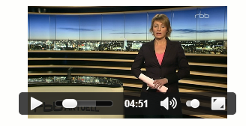
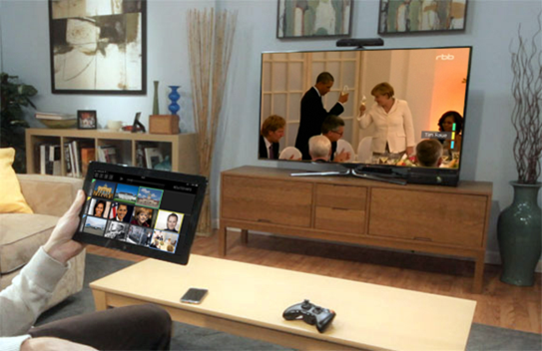
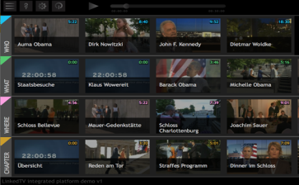
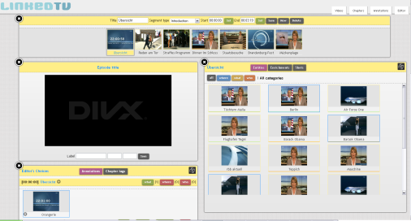
The LinkedTV Workflow
Annotation
seed content
Media Fragments
Multiscreen Viewing
Personalisation
Curation
Enrichment
Related Content

Slide 7
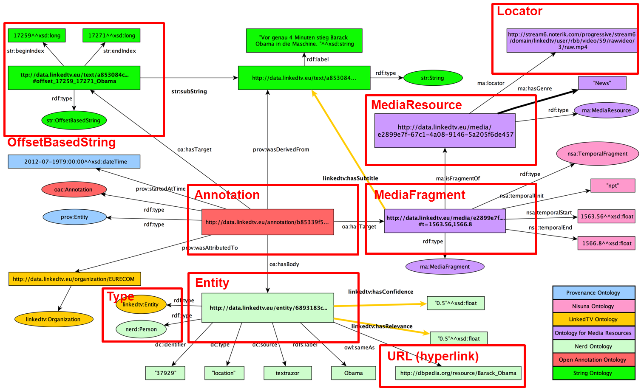
The LinkedTV Standard Data Model: Media Fragment URI + Open Annotation

Slide 8
LinkedTV and Broadcast TV: Key Facts and Lessons Learned
The LinkedTV workflow works on Web-based video, not on broadcast TV content yet (albeit it is true TV content)
In-depth, real-time multimedia analysis and annotation is VERY costly, options (besides trying to scale until possible)
Integrate into the production process
Apply to after-transmissions of web video versions
Use only less time-consuming analysis techniques
HTML5 Web ecosystem technology used
HTML Web Stack and technology currently more open and complete
HbbTV 1.5 variant for demonstration purposes in development
Need for HbbTV 2.0+

Slide 9
LinkedTV and Broadcast TV: Key Facts and Lessons Learned, cont‘d
Standards used as much as possible and available at time of conception/development, but some proprietary solutions necessary
Video served from own streaming server, not broadcast yet
MF URI compatible streaming server required
Need for dereferencable HTTP URI
Server-side multiscreen synchronisation with own LinkedTV Toolkit
Own REST API for accessing Media Fragments and Annotations
e.g. GET data.linkedtv.eu/{uuid}#t=20.00,24.00/annotation

Slide 10
Gaps in Broadcast TV integration (overview)
Support of Media Fragments URI specification
Locator schemes and attached annotations
Extension of TV metadata standards
E.g. extend EBU standard, see e.g. BBC Programme Ontology¹
Integration into Broadcast publishing workflows
¹http://www.bbc.co.uk/ontologies/programmes/2009-09-07.shtm

Slide 11
Support of Media Fragments URI
MF URI Specification 1.0¹ identifies 4 dimensions:
time, region, track, id
time is the most important one (start and end position)
relative to the beginning of a video
Support of clock element for synchronisation
Support of MF URI standard in future HbbTV standards
Support of MF URI in CRID URIs
¹http://www.w3.org/TR/media-frags/

Slide 12
Program locators and attached annotations
In LinkedTV, URIs are created to identify programs which can link to different broadcasts (live, replay, on demand) and locators
Annotations of programs are shared accross all possible deliveries of broadcasts
Each instance can be attached to different locators (except CRIDs)
Locators often expose communication schemes while unique identifiers by content owners are often not publicly available
BBC demonstrated an alternative approach with its Programme Ontology and Linked Data URIs¹
¹http://www.bbc.co.uk/ontologies/programmes/2009-09-07.shtm

Slide 13
Open Annotations
The usage of annotations of Media Fragment allows very rich, fine grained and personalizable relation of web content in single screen and multiscreen environments
LinkedTV sees this as the main way for real TV and Web convergence
Goes far beyond what is currently available for TV applications (mainly EPG data)
Not many efforts yet adopted by the broadcast industry

Slide 14
Broadcast publishing workflow integration
In-depth real-time analysis and annotation are costly
Analysis, annotation and curation has to be integrated into broadcoast production and publishing workflow for real benefit
Service levels for different use cases concerning tracks audio, subtitles, existing metadata, visual objects, face recognition

Slide 15
Proposals for standardization activities
Support for the Media Fragment URI 1.0 specification in TV media players, STBs
Consistent implementation of spatial and temporal markers for Broadcast TV
Agreement on identification of TV content
Description and addressing scheme for rich TV annotations, e.g. via WebVTT/TTML Timed Annotation Track

Slide 16
Proposals for standardization activities (cont‘d)
Introducing Media Fragments Annotations into production and metadata exchange standards
Standard way to request and display Media Fragment Annotations in singlescreen and multiscreen environments
Adding annotations by 3rd parties
Adoption in future synchronization efforts like W3C Second Screen Presentation Community Group, Media API TF

Slide 17
Thank you for your attention!
Contacts:
lyndon.nixon@modul.at
jan.thomsen@condat.de
raphael.troncy@eurecom.fr

