Slide 1
Web-Distribution Formats
For Subtitles & Captions
Web & TV Workshop, 12/13.3.
Andreas Tai,
Institut für Rundfunktechnik

Slide 2
Formats

Slide 3
TTML &
WebVTT

Slide 4
TTML

Slide 5

2003

Slide 6
<p begin="00:00:00.000" end="00:00:02.000"
xmlns="http://www.w3.org/ns/ttml">
This is a subtitle<br/>
on two lines
</p>

Slide 7
Status
TTML 1.0, 2nd Edition
Next
TTML 2.0

Slide 8
Who?

Slide 9



DVB
HbbTV
SMPTE-TT
EBU-TT-D
CFF-TT

Slide 10

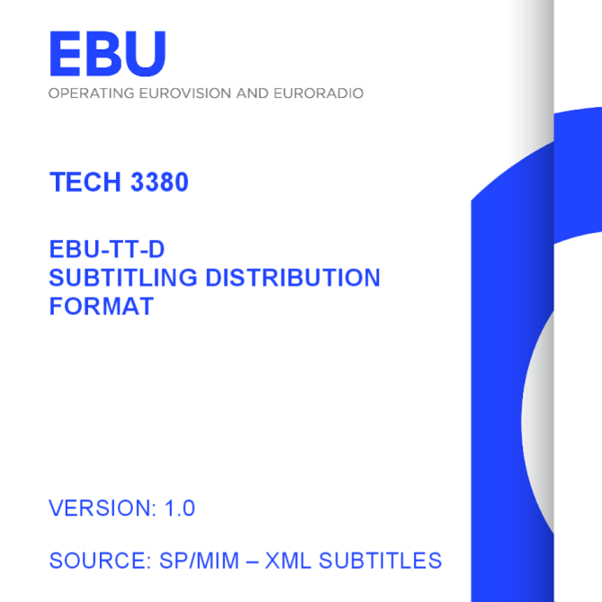


+

Slide 11
SMPTE-TT
TTML
CFF-TT
EBU-TT-D

Slide 12
WebVTT

Slide 13
2010

Slide 14
00:00:00.000 --> 00:00:02.000
This is a subtitle
on two lines

Slide 15


Web Media Text Tracks
Community Group

Slide 16
Status
Draft Community Specification
Next
W3C Rec Track

Slide 17
Who?

Slide 18





Slide 19
Why not TTML?

Slide 20
<?XML >

Slide 21
Perspective

Slide 22
TTWG
TTML WebVTT

Slide 24
Consensus Input
Timed Text Task Force of the Web & TV IG

Slide 25
3
Strategies
Mappings
One single Spec
Clients support TTML & WebVTT

Slide 26

Exception
+
TTML
(SDP-US)

Slide 27

Future HbbTV 2.0 Devices
+
TTML with Profile
EBU-TT-D

Slide 28
Other Web Browsers
WebVTT Only

Slide 29
Other Web Browsers
WebVTT Welcome
TTML Welcome

Slide 30
Thank you for your attention!
Andreas Tai
Production Systems Television
Institut für Rundfunktechnik
Floriansmühlstraße 60
80939 München
Tel. +49-(0)89-32399-0
Fax +49-(0)89-32399-351
E-Mail: tai@irt.de

