Slide 1
Digital Marketing Discussion
31 October, 2012

Slide 2

Digital Marketing Task Force Contributors, Resources
Carl Cargill, Adobe
John Carney, Cable Labs
David Ezell, National Association of Convenience Stores
Steve Holbrook, IBM
Ora Lassila, Nokia
Philippe Le Hegaret, W3C
Kepeng Li, Huawei
Karen Myers, W3C
Thomas Roessler, W3C
Mark Vickers, Greg Thomson, Walt Michel, Comcast
Rigo Wenning, W3C

Slide 3

Why Digital Marketing at W3C?
Leverage the benefits of the Open Web Platform for Marketers.
Share expertise with new communities
Identify gaps in the OWP for Marketers to increase adoption

Slide 4

Digital Marketing
“Digital Marketing is the use of digital sources based on electronic signal like Internet, digital display advertising and other digital media such as television, radio, and mobile phones in the promotion of brands and products to consumers.”
http://en.wikipedia.org/wiki/Digital_marketing

Slide 5
Digital Marketing Mix
Display Advertising | Search engine marketing | Internet Marketing | Social Media Marketing
Contextual advertising | Pay per click Cost per impression | Search engine optimization; customer experiences | Data formats, data collection and optimization
Behavioral targeting | Search analytics Web analytics | Email marketing | Relationship, lifestyle enhancements & customer experiences

Slide 6
Current W3C Work
Relevant for Marketers
Client Side + Devices | Server Side + Horizontal
Open Web Platform: HTML5, CSS, Fonts, Timed Text, Audio, Video, Captioning | Identity, Privacy, Do Not Track, Content Protection
Web Performance, Web App Security, Real Time Communications | Web of Data: Linked Data Platform, RDF, Ontologies
Mobile Web, Tablets, Web & TV, Digital Signage | Horizontal: Internationalization, Accessibility, Security

Slide 7

Immediate Opportunity for W3C to Lay Foundation
Better story telling to digital marketers about W3C relevance and current opportunities
Create “Digital Marketing” module for W3C slide presentations
Create “Digital Marketing” landing page with examples of current, relevant W3C WGs and IGs
Host W3C Workshop to focus and prioritize new areas for standardization

Slide 8
Potential Areas for Standardization 1
Display Advertising Use Cases | Current W3C Work | New Work Opportunity
Advertising Formats: 1. Display parameters 2. Standardized color 3. Display methodology | Do not currently do Minimally in SVG Color 1.2 Part 2 (working draft) http://www.w3.org/TR/2009/WD-SVGColor12-20091001/ Does not address video color management 3. Not doing work here | Yes Yes; color management is complex due to inconsistent image color profiles; need more members to participate Advertisers and Print Industry interested in improving color management on the Web

Slide 9
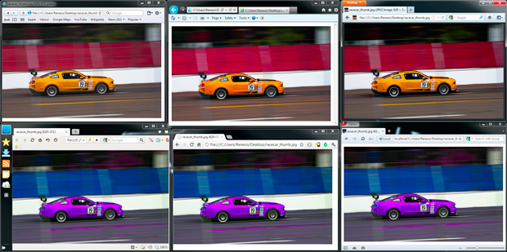
Inconsistent Color Management in Browsers
Top row, left to right: Safari 5, IE9, Firefox 12: Bottom row: Maxthon 3, Chrome 19, Opera 11
http://www.petapixel.com/2012/06/25/is-your-browser-color-managed/

Slide 10
Potential Areas for Standardization 2
Display Advertising Use Cases | Current W3C Work | New Work Opportunity
HTML5-based video-synchronized interactive advertising standard [ETV 2.0]: *Get current program identifier (EIDR?) *Get current time code of asset *Get type: live, buffer *Get type: DVR, VOD | Not currently being addressed. Need to refine use cases. Not doing video discovery DVR and VOD not supported [DVR could overlap with media storage] | Yes Broadcasters, brand advertisers, other video content providers interested; CableLabs doing work here Yes Yes

Slide 11
Potential Areas for Standardization 3
Display Advertising Use Cases | Current W3C Work | New Work
Ad caching by browser of JavaScript/Web App | [clarify how this differs from regular content caching] | Possibly
API between JS/Web App and browser to request/receive ads | [what is browser expected to do? Tie to a platform?] | Possibly
Embed ads in Web TV Web Display Tied to CSS | No [clarify] | Yes

Slide 12
Potential New Areas for Standardization 4
Measurements and Tracking Ads
Measurements recording, verification, accumulation (by Browser, or JS/Web App);
Analytics (e.g. Adwords, Adsense are proprietary); look at standardizing data formats
Multi-device signaling/communication metrics – e.g. where an HTML-5 app on a remote device is launched from an HTML app on a TV (or vice-versa). Is there a standard way to track? In this scenario, a linear commercial may call out to launch a deeper ad experience on a companion device where we want to track the end-to-end interaction.

Slide 13
Potential New Areas for Standardization 5
Customer Experience
Data Formats
Customer rating systems
Customer discovery of relevant products and services

Slide 14

Potential Scope of Workshop
Technical Focus:
Client Side: HTML5, enhancements to Open Web Platform such as video, mobile
Server Side: Web of Data; Improving Customer Experiences
Source: IAB

Slide 15
Proposal for Workshops
Direction A: Series of W3C Workshops to bring together diverse digital marketing and web communities and prioritize focused areas of interest.
First Workshop Scope: Display Advertising Focus (OWP)
Second Workshop Scope: Customer Experience (Data) Focus

Slide 16
Proposal for Workshops
Direction B: Single Workshop
Focus:
Day 1: Display Advertising (OWP) Focus
Day 2: Customer Experience (Data) Focus

Slide 17

Current Challenges
Digital Marketing Task Force needs to engage digital marketing practitioners to serve on program committee
Need to have clearer focus of the first areas we will address
Create crisp “elevator pitch” for both technical and business audiences that will increase interest and support for this area of work at W3C

Slide 18
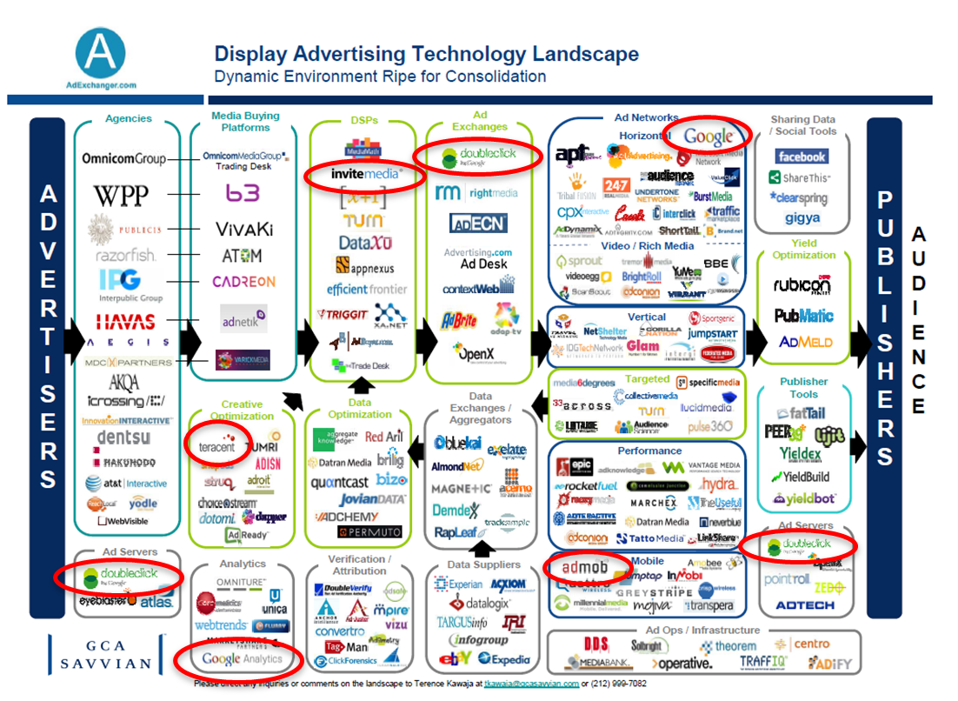

Slide 19
Start Conversations with Marketing Community
  Digital Marketing Agencies
  Marketing Associations
  Attend Digital Marketing Conferences
    Advertising Age, April 2012
    Mobile Marketing, October 2012
  Brand Marketers
  Publishers

Slide 20


Digital Marketing Agencies

Slide 21

Marketing Associations

Slide 22


Brand Marketers

Slide 23

Publishers, Media Owners

Slide 24
Where do we go from here
discussion?

