Slide 1
THE IMPACT OF WEB
PLATFORM GROWTH
Jeff Jaffe, CEO
31 October 2012

Slide 2
AGENDA
Platform progress
Strengthen the core and reach new markets
Work with developers

Slide 3
WHAT IS THE OPEN WEB PLATFORM?
The Open Web Platform is a full-fledged programming environment for rich, interactive, cross-platform applications.
IS THE CORNERSTONE
Notes:
What we talked about last year – indications that HTML5 and the Open Web Platform (OWP) is gaining traction and a REAL thing

Slide 4
IN OTHER WORDS, IT’S THE WEB WITH:
APIS: Geolocation, gyroscopes, near-field communications (NFC), cameras, address book, linked data, …
Rich media: Audio and video, vectorial images, graphics, animations, high-quality typography, …
Cross-device: screens of all sizes, touch, keyboards, voice, vibrations, beeps, …
Communications: client-server, real-time, peer-to-peer, sockets, …
Society: privacy, security, multilingual, accessibility
Notes:
What we talked about last year – indications that HTML5 and the Open Web Platform (OWP) is gaining traction and a REAL thing

Slide 5
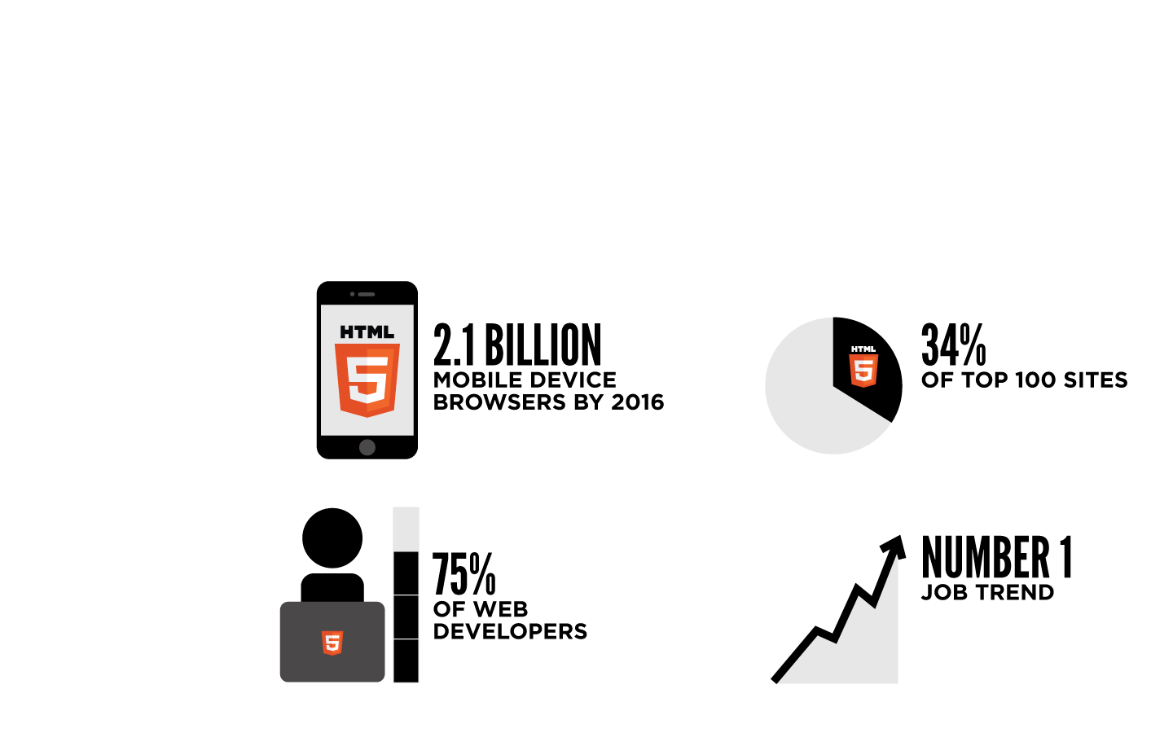
MAY 2012:
The Open Web Platform is here!
Notes:
What we talked about last year – indications that HTML5 and the Open Web Platform (OWP) is gaining traction and a REAL thing

Slide 6
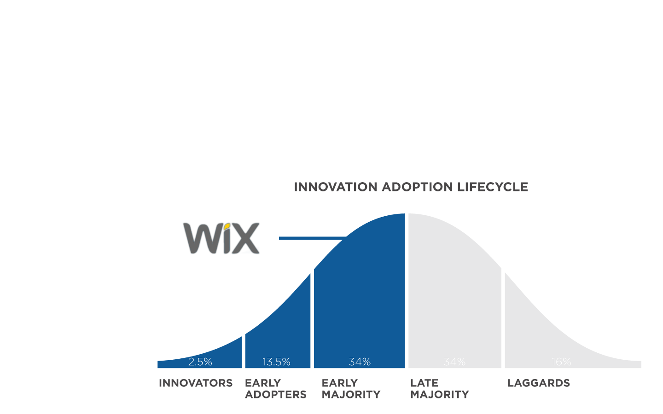
NOVEMBER 2012:
Where is the OWP today?
Analysts
New Apps
Developer Tools
Acquisitions
Browser Market
Notes:
Slides 4-12 show that not only is OWP real, it has reached an early majority and is ready to tip into all sorts of industries and opportunities beyond just the web
We should create a better way to show this graph and the annotations on it…

Slide 7
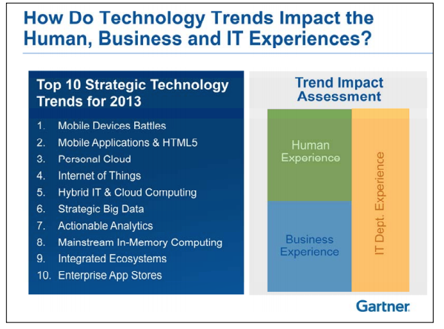
GARTNER
Tech Trends 2013 (from October)
Notes:
Slides 4-12 show that not only is OWP real, it has reached an early majority and is ready to tip into all sorts of industries and opportunities beyond just the web
We should create a better way to show this graph and the annotations on it…

Slide 8
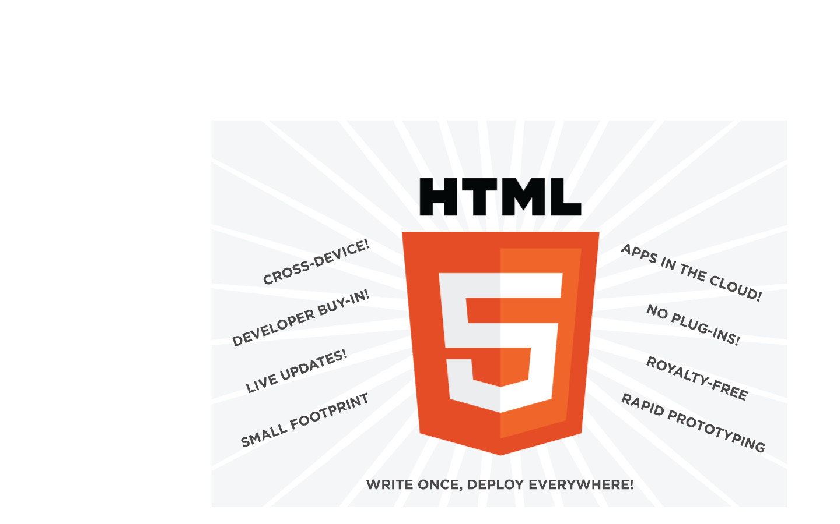
THE PROMISE IS UNIQUE
Notes:
Capability
Create apps in the cloud
Reduce need for plug-ins
Live updates
Reach users quickly (one click away)
Connect devices in ways not currently possible with native
Interoperability
Multi-device, multi-OS
Cross-site information sharing
Performance
Smaller size
Broad developer support
W3C Royalty-Free Patent Policy
Rapid prototyping
Single development platform

Slide 9
REALITY CHECK
Reuters: “Critics say that HTML 5's one-size-fits-all approach will mean average experience across the board at the expense of excellence on individual platforms.” – October 2012
Appcelerator/IDC: “Appcelerator and IDC surveyed 5,526 developers … disappointment with nearly every aspect of HTML5…” – Q3 2012
Mark Zuckerberg / Facebook: “…betting too much on HTML5 as opposed to native... because it just wasn't there. And it's not that HTML5 is bad. I'm actually, on long-term, really excited about it. [We] actually have more people on a daily basis using mobile Web Facebook than we have using our iOS or Android apps combined. So mobile Web is a big thing for us.”

Slide 10
WHAT DO EARLY MAJORITY SAY?
Close the gap with native
Improve Performance, capability, packaging, payment, discovery, system-level APIs
Achieve broad interoperability
Increase testing, libraries, modularization, developer outreach
Meet reqs of adjacent industries
Increase participation from industries most dramatically affected by new devices, connectivity, mobility, social

Slide 11
TO GO FROM THE EARLY MAJORITY TO THE FULL MAJORITY…
Notes:
Maybe a graphic to introduce and connect the entire 13-22 section would help.
It would convey the following sentiments:
"When you get to the early majority phase - everything shifts. It's relatively new for us - when was the last time that a deliverable as broad as the OWP reached the early majority phase. It means we need to tap into a much broader set of stakeholders and participants then we usually do in the vanilla 'standards creation' process. So we've been doing that; talking to everyone; learning the needs: strengthen the core and enable new markets. And we've been responding. Modular design (which leads to questions of what is HTML), workshops, Community Groups, participation, webplatform. In the next module of slides we'll discuss in detail.”
OWP is BIG – so big that it is transforming industries beyond tech…auto, telecom, publishing, healthcare, etc. – W3C is reaching out to new industries
OWP is familiar – developers know it, but W3C (and others) need to provide more support
All of the above impacts W3C and pushes evolution of the organization as described on slides 19-22

Slide 12
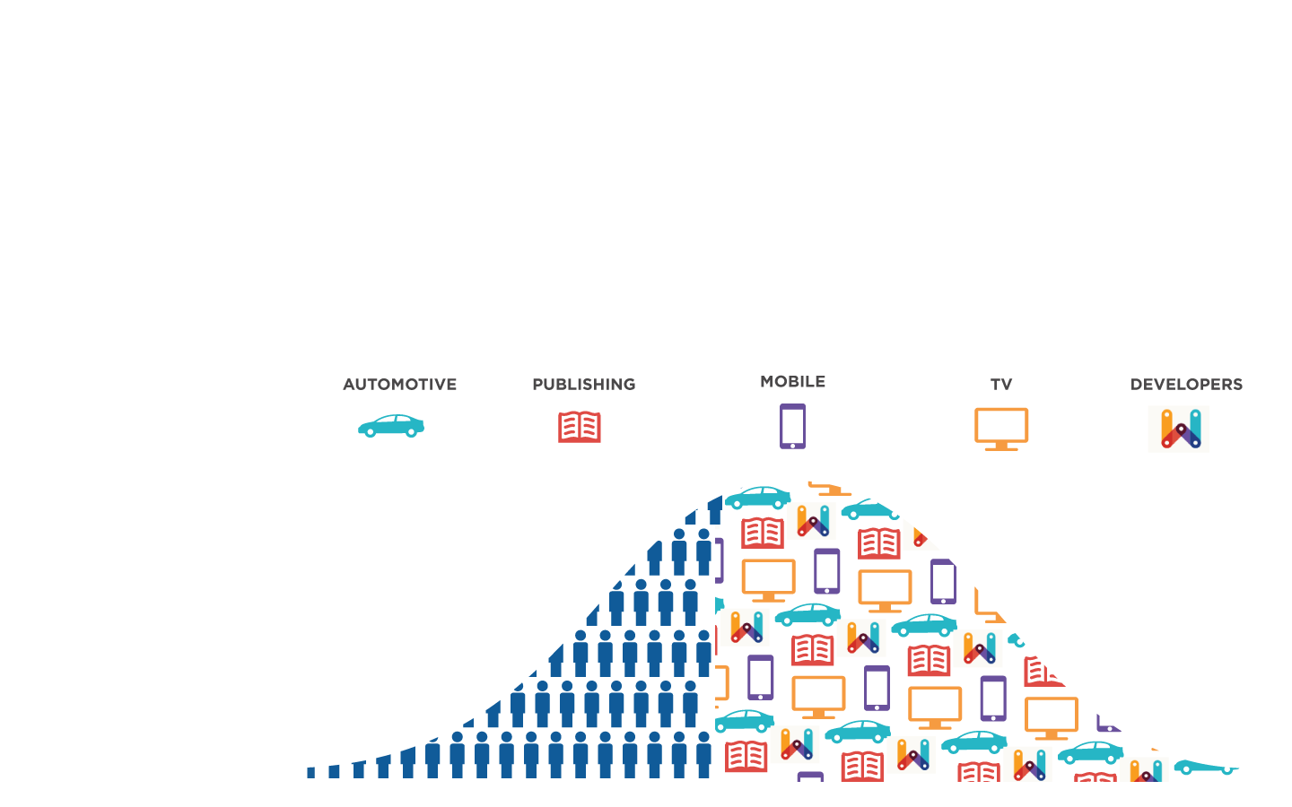
WE MUST STRENGTHEN THE CORE AND REACH NEW MARKETS
Notes:
Maybe a graphic to introduce and connect the entire 13-22 section would help.
It would convey the following sentiments:
"When you get to the early majority phase - everything shifts. It's relatively new for us - when was the last time that a deliverable as broad as the OWP reached the early majority phase. It means we need to tap into a much broader set of stakeholders and participants then we usually do in the vanilla 'standards creation' process. So we've been doing that; talking to everyone; learning the needs: strengthen the core and enable new markets. And we've been responding. Modular design (which leads to questions of what is HTML), workshops, Community Groups, participation, webplatform. In the next module of slides we'll discuss in detail.”
OWP is BIG – so big that it is transforming industries beyond tech…auto, telecom, publishing, healthcare, etc. – W3C is reaching out to new industries
OWP is familiar – developers know it, but W3C (and others) need to provide more support
All of the above impacts W3C and pushes evolution of the organization as described on slides 19-22

Slide 13
PURPOSE OF TPAC BREAKOUTS
General
Brainstorm with colleagues about anything Web/W3C
Specific
Address topics that cross WGs, IGs, BGs, CGs
My personal pitch
Define next work agenda for the Open Web Platform
Identify priorities for strengthening the core
Find ways to reach new markets
Identify areas for potential work
Notes:
Maybe a graphic to introduce and connect the entire 13-22 section would help.
It would convey the following sentiments:
"When you get to the early majority phase - everything shifts. It's relatively new for us - when was the last time that a deliverable as broad as the OWP reached the early majority phase. It means we need to tap into a much broader set of stakeholders and participants then we usually do in the vanilla 'standards creation' process. So we've been doing that; talking to everyone; learning the needs: strengthen the core and enable new markets. And we've been responding. Modular design (which leads to questions of what is HTML), workshops, Community Groups, participation, webplatform. In the next module of slides we'll discuss in detail.”
OWP is BIG – so big that it is transforming industries beyond tech…auto, telecom, publishing, healthcare, etc. – W3C is reaching out to new industries
OWP is familiar – developers know it, but W3C (and others) need to provide more support
All of the above impacts W3C and pushes evolution of the organization as described on slides 19-22

Slide 14
AGENDA
Platform progress
Strengthen the core and reach new markets
Work with developers

Slide 15
WHERE DO WE GET IDEAS FOR THE CORE?
Working, Business, Community Groups
Workshops
Members
Developers
Media and Analysts
Notes:
Maybe a graphic to introduce and connect the entire 13-22 section would help.
It would convey the following sentiments:
"When you get to the early majority phase - everything shifts. It's relatively new for us - when was the last time that a deliverable as broad as the OWP reached the early majority phase. It means we need to tap into a much broader set of stakeholders and participants then we usually do in the vanilla 'standards creation' process. So we've been doing that; talking to everyone; learning the needs: strengthen the core and enable new markets. And we've been responding. Modular design (which leads to questions of what is HTML), workshops, Community Groups, participation, webplatform. In the next module of slides we'll discuss in detail.”
OWP is BIG – so big that it is transforming industries beyond tech…auto, telecom, publishing, healthcare, etc. – W3C is reaching out to new industries
OWP is familiar – developers know it, but W3C (and others) need to provide more support
All of the above impacts W3C and pushes evolution of the organization as described on slides 19-22

Slide 16
KEYS TO THE CORE
Performance
“Performance is critical as user expectations rise for rich media, social” (Forrester Research, August 2012)
Should we develop performance profiles?
8 November Workshop hosted by Google
Capability
Interoperability
Notes:
Forrester Research: “Shifting Performance Strategies and Solutions for Mobile and Web Delivery”

Slide 17
PERFORMANCE
Tobie Langel to Coremob CG
Tooling
Memory usage
Frame rate
Scrolling
Hardware acceleration

Slide 18
PERFORMANCE
Paul Bakaus to Web Performance WG
Javascript engine performance
Memory info (“the biggest performance bottleneck”)
Scrolling, touch events
GPU, smooth animation
Unload images, refresh rate display
See this presentation: The state of HTML5 mobile game development

Slide 19
CAPABILITY
New API ideas include:
Content
Devices
Tuning
Needs Fix
Content protection
Payments
Proof of purchase
Alarm
Access to textures
Archive/Zip
User data (e.g., browser history)
Bluetooth
FM Radio
Memory
Momentum scrolling
GPU
GC
AppCache
Device orientation
But also CSS 3, SVG 2, WOFF 2, WebRTC,
Tracking Protection, Accessibility, and much more

Slide 20
CAPABILITY
From Web and TV Interest Group
Adaptive streaming
Premium content protection
Analyst during briefing: “#1 issue I hear is need for content protection”
Service discovery in home networks
Control and communication
What are next priorities?

Slide 21
CAPABILITY
From Web Signage Business Group
Device discovery
Real-time notification from server
in emergency scenarios
Location-based services
in train stations, airports

Slide 22
CAPABILITY
Upcoming Automotive Workshop
Putting safety first
Relation of car and smartphone
Markets for automotive applications
Infotainment
Location-based services

Slide 23
CAPABILITY
Upcoming Publishing Workshops
What is published (media, 3D, etc.)
Packaging (Web site, apps, etc.)
Business models (content protection, advertising)
Journalism and the social web
Rise of ebooks and tablets

Slide 24
INTEROPERABILITY
Test suite development is happening
HTML WG, CSS WG, Coremob CG, etc.
Community efforts such as “Test the Web Forward” are valuable
We need more
AB discussing interop planning as part of process
Impact of modularization
HTML WG plan extension specs
Impact on test suites?

Slide 25
WORKSHOPS FOR NEW MARKETS
Digital signage
Digital publishing
Two Workshops: February 2013, Q2 2013
Digital Marketing
Q2 2013 Workshop
Automotive
14-15 Nov Workshop hosted by Intel and sponsored by Webinos.
Privacy
26-27 Nov Workshop hosted by UC Berkeley and TRUST Science and technology center.
Television
Q2 or Q3 2013 Workshop
Notes:
Getting feedback that performance is a major concern as new industries adopt OWP – expanding platform means new verticals and new developers

Slide 26
FLOW OF IDEAS
CG
BG
HTML
Linked Data
Performance
CSS
SVG
WebApps
Testing
…
Extension
Requirements
Features
Issues
Module
Breakouts!
API
New Workshop
Upcoming Workshop

Slide 27
AGENDA
Platform progress
Strengthen the core and reach new markets
Work with developers

Slide 28
WEB PLATFORM DOCS
A comprehensive and authoritative source for Web developer documentation, convened by W3C
Supported by stewards
Founding stewards: Adobe, Apple, Facebook, Google, HP, Microsoft, Mozilla, Nokia, Opera
More organizations expected to join them
Entire community will build site

Slide 29
SUCCESSFUL ALPHA ANNOUNCED
Day of announcement:
86K visitors
720K page views
14 days later:
500 active users
12K registered users
3K edits

Slide 30
COMMUNITY GROUPS
> 100 groups
> 1900 individuals
168 Members participating
700 non-Member orgs

Slide 31
TRAINING AND TOOLS
W3Dec Campus (online)
W3Conf 2013 (coming soon)
Validator

Slide 32
SUMMARY
Take advantage of TPAC
Priorities for strengthening the core?
Breakout to solve a hard problem?
Stakeholders who should be at W3C?
THANK YOU FOR PARTICIPATING!

