Slide 1
and
The Open Web Platform
by Jeff Jaffe, W3C CEO

Slide 2
WORLD WIDE WEB
The
"Thirty years ago, we couldn't know that something called the Internet would lead to an economic revolution."
Barack Obama
FEBRUARY 2011

Slide 3
Actually, we had some ideas about that ...
Tim Berners-Lee
WEB INVENTOR AND W3C DIRECTOR

Slide 4
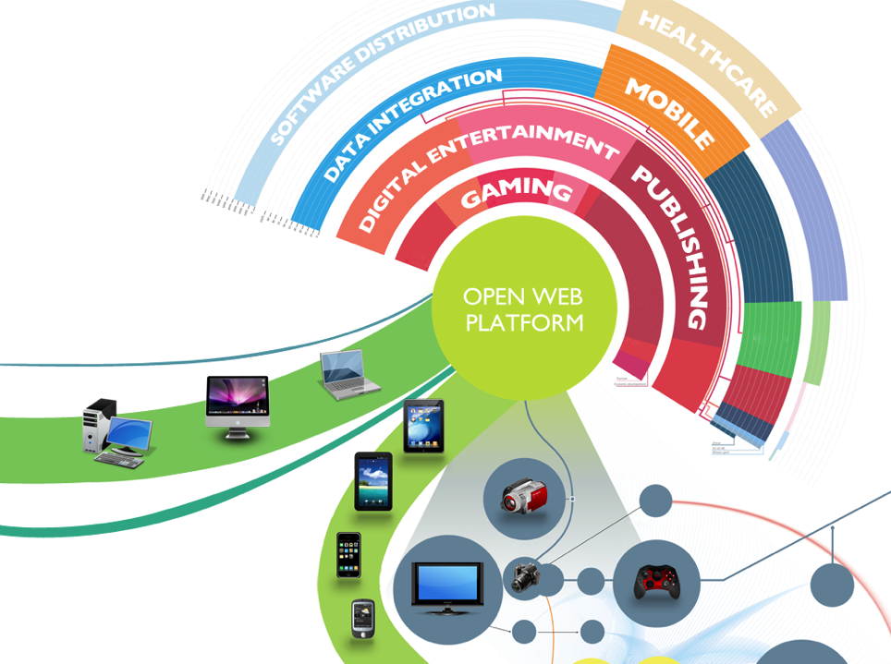
A NEW WAVE
of
TRANSFORMATIONS
Just as the Web has transformed everything…
…It will transform everything again

Slide 5
Agenda
Role of W3C
HTML5 and the Open Web Platform
Momentum
Industry Use of the Open Web Platform

Slide 6
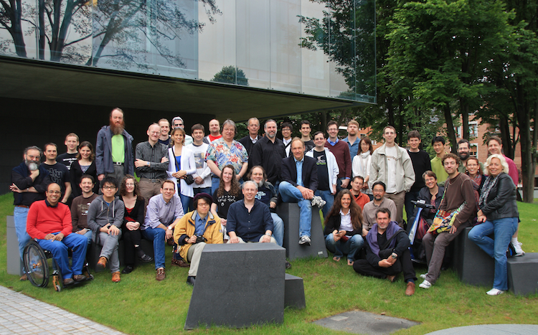
Role of W3C
World Wide Web Consortium
340 Members (75 Full)
Web ecosystem: users, developers, browsers, etc.
67 staff in US (MIT), France (ERCIM) and Japan (Keio)

Slide 7
W3C Open Web Platform Standards are Royalty-Free
Role of W3C
Standard platform creates level playing field
Level playing field allows innovation
Participation allows organizations to shape platform, ensure needs met, standardize best practices

Slide 8
Role of W3C
22 New Full Members in Past 22 Months
Baidu
China Unicom
Comcast
Cox Communications
Facebook
Gemalto
Huawei
KDDI
LG
Motorola Mobility
Mstar Semiconductor
NEC
Netflix
Nielsen
Qihoo 360
Rakuten
SanDisk
Sony
Telenor
Tencent
Zynga
Smart Communications

Slide 9
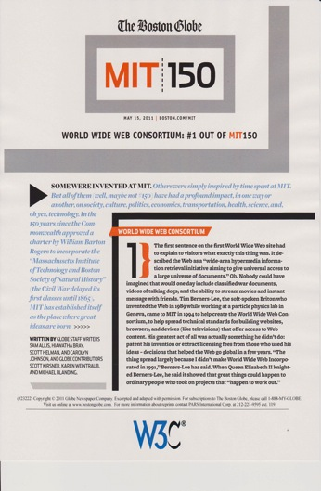
Role of W3C
W3C #1 out of MIT 150

Slide 10
Agenda
Role of W3C
HTML5 and the Open Web Platform
Momentum
Industry Use of the Open Web Platform

Slide 11
Web Trends Affecting Society
HTML5 and Open Web Platform
Web everywhere
Devices
85% – Percentage of handsets shipped globally in 2011 that included a web browser
Diversity of device types (eBooks, printers, tablets, televisions, automobiles)
Apps with rich interactions. People want:
Apps in addition to documents
Rich media (video, animations, digital photography, music)
Location-based services
Social

Slide 12
A Platform for Innovation, Consolidation, Cost Efficiencies
HTML5 and Open Web Platform
Web pages are more beautiful, interactive, intelligent
HTML5 provides cross-browser interoperability and all major browser vendors plan to support it
Video a first-class citizen
Simplified data integration

Slide 13
HTML5: Cornerstone of the Platform
HTML5 and Open Web Platform
"The Web is going through a once-in-a-decade technology transition to HTML5 and CSS3”
- Gartner
Reach multiple devices
Desktop, mobile, tablet, TV
Powerful and modular
Documents, multimedia, interactivity
Multi-application
eBooks, user interfaces, games
Standard scheduled 2014

Slide 14
Benefits of W3C Web Standards
HTML5 and Open Web Platform
Lower cost of cross-platform development
Rapid prototyping
Create apps in the cloud
Broad developer support
Customers one click away
Full control over content

Slide 15
Standard Technologies
HTML5 and Open Web Platform
Core | Hypertext Markup Language (HTML)
Video/Audio | HTML, WebRTC, Web Audio
Styles | Cascading Style Sheets (CSS)
Fonts | Web Open Font Format (WOFF)
Protocols | Hypertext Transfer Protocol (HTTP)
Dynamic | Javascript (ES), Web Application Programming Interfaces (WebAPIs)
Graphics | Scalable Vector Graphics (SVG), 2D Canvas API
Offline access | WebAPIs: Web Storage, IndexedDB, File API
Device access | WebAPIs: Geolocation, Orientation, Multi-touch, etc.
Performance | WebAPIs: Navigation timing, Page visibility, Timing control

Slide 16
Web Client 2012
HTML5 and Open Web Platform

Slide 17
A Platform for Social Requirements
HTML5 and Open Web Platform
Privacy
Tracking protection
Security
Security story changes with distributed apps and logic on the client
Identity
New crypto work starting
Accessibility
By people with range of disabilities
Multilingual
Support the world’s languages

Slide 18
Privacy Focus: Tracking Protection
HTML5 and Open Web Platform
Online privacy a mainstream concern
Open Web Platform depends on ability to achieve trusted transactions
Online tracking momentum
April 2011: Workshop reviewed various tracking protection approaches
September 2012: W3C Tracking Protection WG is multi-stakeholder, international, open
European Commissioner Neelie Kroes and FTC Chairman Jon Liebowitz address WG at Jan 2012 meeting
Feb 2012: White House expresses support for W3C Do Not Track (DNT) technology
W3C to define meaning of DNT

Slide 19
Agenda
Role of W3C
HTML5 and the Open Web Platform
Momentum
Industry Use of the Open Web Platform

Slide 20
Rapidly Growing Support Cross-Device, Cross-Platform
Momentum
Major browsers
IE9+, FF4+, Safari5+, Opera11+, Chrome10+, Blackberry Browser, Silk
Platforms
iOS, Android, ChromeOS, BlackberryOS, Symbian, Windows Mobile 8
Libraries
Webkit (Google, Apple, Nokia, etc.), Gecko (Mozilla), Trident (Microsoft), Presto (Opera)

Slide 21
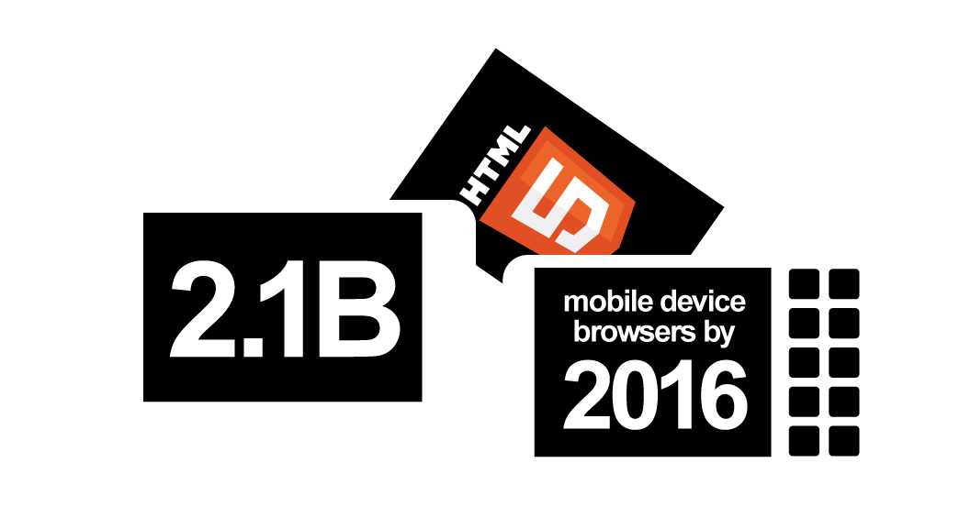
“2.1 billion HTML5 Browsers on Mobile Devices by 2016” - ABI Research
Momentum

Slide 22
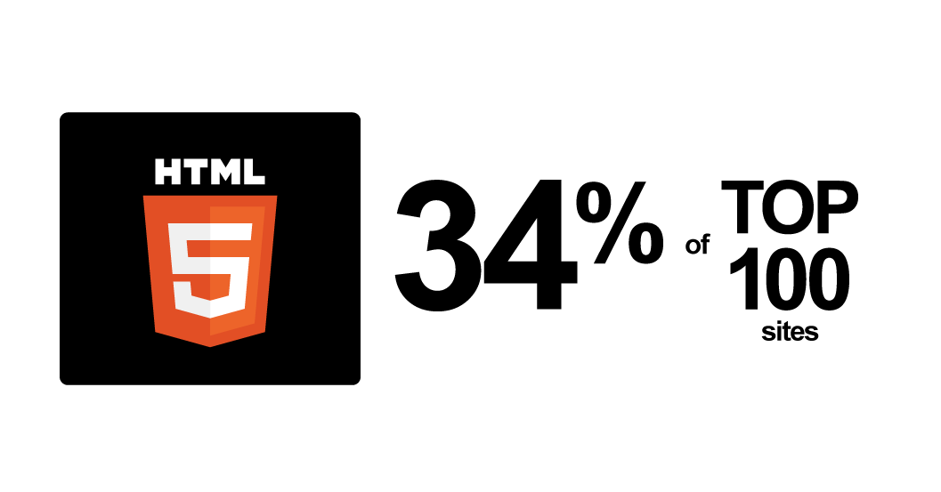
“34% of top 100 sites using HTML5” binvisions.com
Momentum

Slide 23
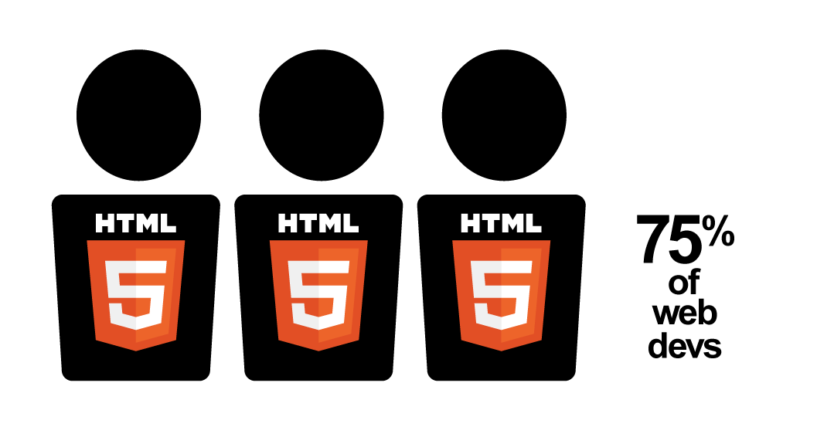
“75% of Developers Using or Plan to Use HTML5” – Evans Data
Momentum

Slide 24
“HTML5 is the #1 job trend” .netmagazine, indeed.com
Momentum

Slide 25
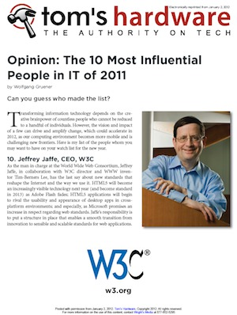
“Jeff Jaffe in top 10 Influencers in 2011” Tom’s Hardware
Momentum
Warren East, CEO, ARM
Steven Sinofsky, President, Windows Division, Microsoft
Steve Jobs
Mark Zuckerberg, CEO, Facebook
Sundar Pichai, Senior Vice President, Chrome, Google
Marc Pincus, CEO, Zynga
Jeff Bezos, CEO, Amazon.com
Burt Rutan, Founder, Scaled Composites
Virginia Rometty, CEO, IBM
Jeffrey Jaffe, CEO, W3C

Slide 26
Agenda
Role of W3C
HTML5 and the Open Web Platform
Momentum
Industry Use of the Open Web Platform

Slide 27
Industry Use of the Open Web Platform
MOBILE

Slide 28
Web is Mobile Platform of the Future
Industry Use of Open Web Platform
“58% Of Mobile Web Users Get Their Content Fix Through Browsers” – TechCrunch
“Mobile Web application platforms will generate almost $2.6 billion in service revenue by 2015” – Smith’s Point Analytics
Video and Audio
Voice, Videoconferencing, and real-time communications
Peer-to-peer
Location-based services
Social networking
Advertising
Games

Slide 29
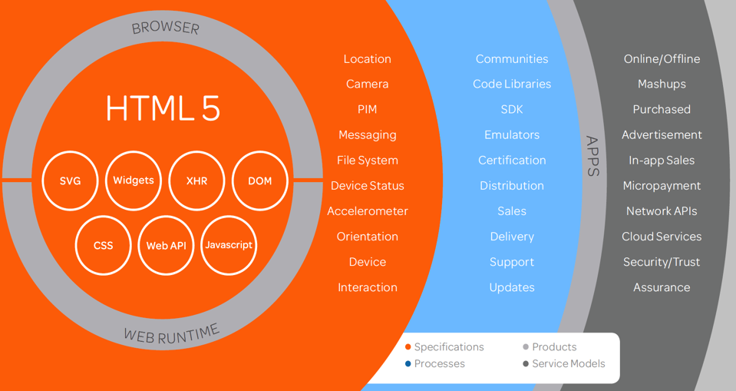
Industry Use of Open Web Platform
AT&T View
Used with permission
Used with permission
Used with permission
Used with permission
Used with permission

Slide 30
Industry Use of the Open Web Platform
Television

Slide 31
Industry Use of Open Web Platform
Web Transports and Enhances TV
Analog-to-digital conversion is nearly complete
User generated content commonplace on Internet
Convergence has started, but where will it lead?
User content and premium content
How much integration of Web content into programming?
Internet, wireless, or conventional distribution
Device: TV, laptop, handheld
Different stakeholders have different perspectives
Traditional broadcast
Telecoms
Content providers
New entrants (youtube, netflix, hulu, pandora, spotify, …)
Device manufacturers

Slide 32
Industry Use of Open Web Platform
Three Workshops Yielded Next Generation
TV Priorities
Multi-media, multi-device delivery and interaction
Dual screen scenarios
Adaptive streaming of content
Enhanced viewer experience
Home networking
E-commerce (social networking + retail)
Content protection
TV Profile of Web technology
Testing
Accessibility

Slide 33
Industry Use of Open Web Platform
Web and TV Interest Group Results
Home networking / device discovery / multi-screen
Joint work on “Web Intents” going on in two Working Groups
Adaptive streaming / content protection
Developing ideas for generic streaming support in browsers; fine-grain control
Developing content protection ideas
TV Web Profile
Group seeks to reduce fragmentation and eliminate the needs for extensions, by providing a common meta-profile that allows external organizations to align with W3C and with each other

Slide 34
Industry Use of the Open Web Platform
Social Networking

Slide 35
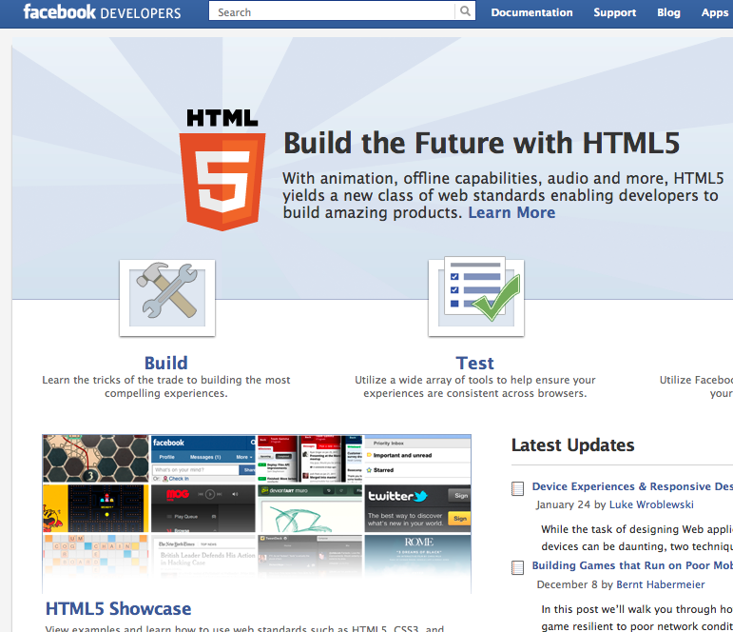
Facebook
Industry Use of Open Web Platform
CTO Bret Taylor in July 2011
“Over the long term, people in Silicon Valley really view HTML5 as the future platform …that’s where we’re putting a huge amount of our investment …”
Facebook mobile apps built with HTML5 (including native apps)
Facebook promotes HTML5 for mobile and social apps
Nearly 50% of 800 million users access Facebook through mobile.
Drawing
Video
History API
Geolocation
Web storage
Web sockets
CSS Transitions
App Cache

Slide 36
New: CG on Core Mobile Web Platform
Industry Use of Open Web Platform
CTO Bret Taylor at MWC 2012:
If you click on your "friends" apps you download the app automatically.
Strong integration with social will greatly expand apps on the Web
Need guarantee that these apps will work on broad range of devices
Facebook launches Core Mobile Web Platform Community Group
To accelerate the adoption of the Mobile Web as a compelling platform for the development of modern mobile web applications
CG Activities
Identify features developers can depend on
Test suites
Provide use cases, scenarios, and other input related to successful mobile development

Slide 37
Industry Use of the Open Web Platform
Gaming

Slide 38
Zynga
Industry Use of Open Web Platform
Zynga mission: social gaming for all
“The company … has 60 million daily active users, who play Zynga games for more than 2 billion minutes every day.”
Open Web Platform advantages
No plugins (mobile users don’t install)
Play quickly without install; one click away
Significant code reuse between desktop, mobile
User experience-driven live updates; bug fixes
Zynga leverages Facebook social network by using HTML5
Web sockets
Caching
CSS animations
CSS 2d transforms
Touch events
Orientation
HTML5 audio
Timing control

Slide 39
Industry Use of the Open Web Platform
Publishing

Slide 40
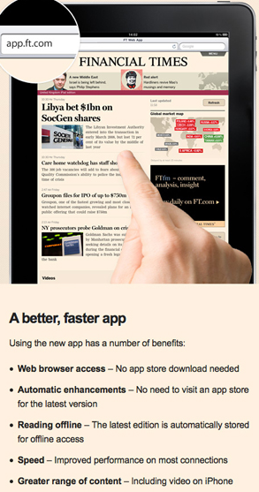
Financial Times
Industry Use of Open Web Platform
Financial Times launched popular iPad app
Quickly replicated 80-90% of user experience using Open Web Platform
Faster app launch times improve user experience; customers have switched to Web app
Web app approach more cost-effective, less confusion for users across devices
Audio, Video, Touch, CSS, SVG, Flex box, Web SQL,
History API, Local storage, App cache

Slide 41
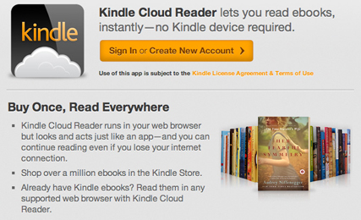
Amazon and eBooks
Industry Use of Open Web Platform
Amazon Silk browser supports HTML5, leverages cloud services
Ebook market leveraging HTML5+CSS
Ebooks starting to outsell printed books in some markets
Ebook standard (EPUB) based on W3C standards: HTML, CSS, SVG
Extensions also HTML+CSS (Amazon KF8 on Kindle Fire, Apple iBook)
Document formats are increasingly based on the Open Web Platform
SVG
Fonts
Backgrounds
Borders
Video
Audio
Fonts
Media Queries

Slide 42
Industry Use of the Open Web Platform
Advertising

Slide 43
AdTruth
Industry Use of Open Web Platform
AdTruth is device identification technology provider
January 2012: AdTruth joins W3C
to “drive the W3C's efforts to balance users' privacy preferences with their desire for a personalized Web experience.”
AdTruth Implements W3C’s emerging Do Not Track technology.
Seeks to comply to both US and EU standards and regulations
W3C has at least 10 new Members who have joined to support the DNT effort

Slide 44
Industry Use of the Open Web Platform
And more!

Slide 45
More Objects, More Information
Momentum
Retail
Product information, …
Airport logistics
Track suitcases, …
Automotive
Is car ready for trip?, …
General logistics
Track production parts
Medical care
State of medical instruments
Transportation
How to move to….

Slide 46
The
Open Web Platform is Transforming Industry
Value
Creation
Platform for
Innovation
Economic Revolution

