Slide 1

Semantic Web Activity @ W3C
Ivan Herman
W3C Workshop on Multilingual Web
Luxembourg, March 15, 2012

Slide 2
Before going into details…

Slide 3
What does the term “Semantic Web” mean to people?

Slide 4
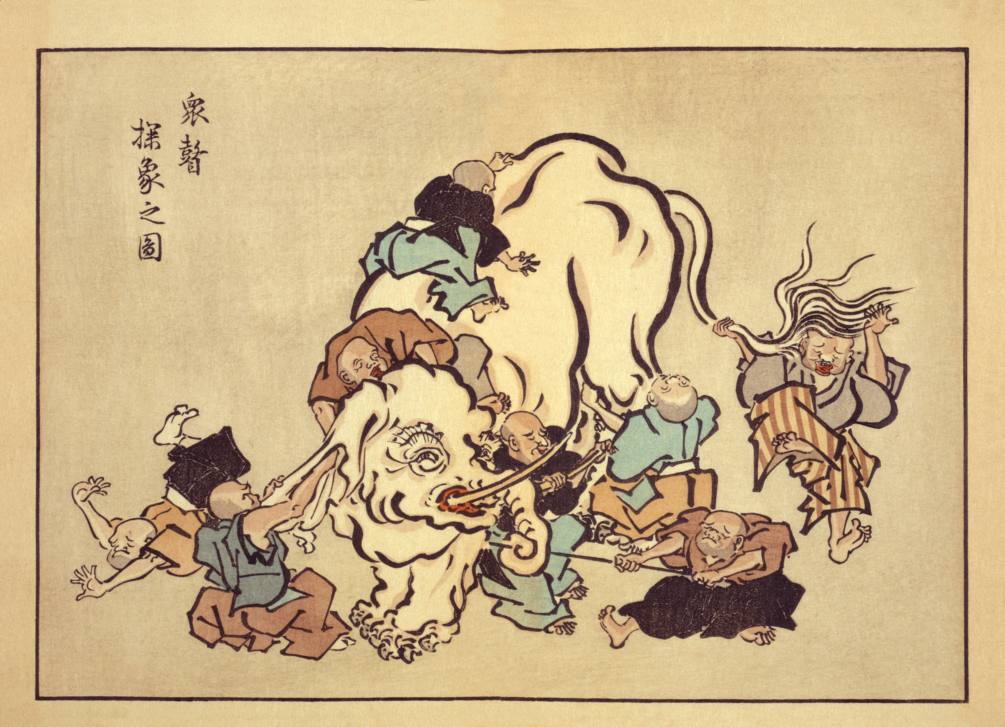

Slide 5
For some people, Semantic (Web) is…
An intelligent system manipulating and analyzing knowledge bases
  e.g., via big ontologies, vocabularies
A means to manage large amount of data
Improve search by adding structure to embedded data
A means to integrate many different pieces of data
And a mixture of all these…
Notes:
For the second bullet: in some cases graph based databases simply work better

Slide 6
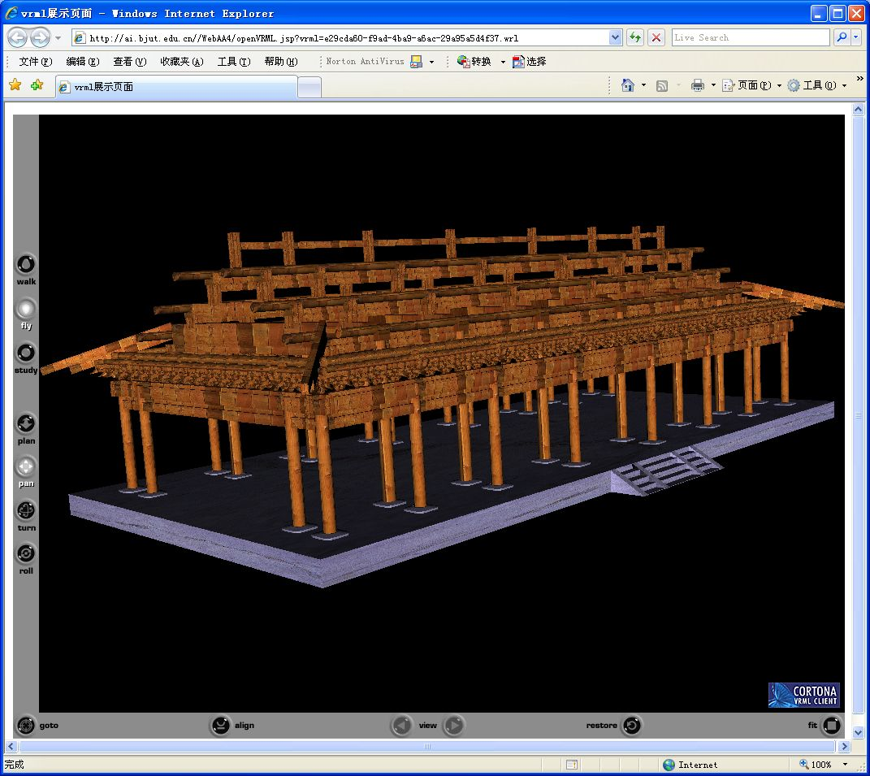
Example: OWL as a knowledge base
Xieshan wooden structure
Courtesy of Songmao Zhang, Academy of Mathematics and System Sciences, China
Notes:
All the knowledge about the wooden structures is encoded in OWL plus also SWRL rules, which then drives an external program to generate animation

Slide 7
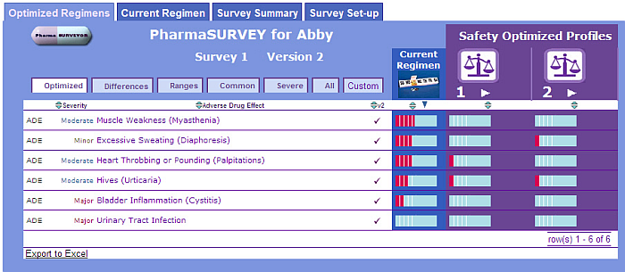
Example: making use of major ontologies
Help in finding the best drug regimen for a specific patient
Courtesy of Erick Von Schweber, PharmaSURVEYOR Inc., (SWEO Use Case)
Notes:
Tool to find the best drug usage adapted to an individual patient. The navigator tool combines various databases, ontologies to provide a better tool.
The flexibility of the interface is important: the structure of the underlying data (e.g., databases, regulation) change often, but by localizing the change on the database-to-RDF mapping, the rest of the system is protected against change; one of the main reasons why this approach was chosen

Slide 8
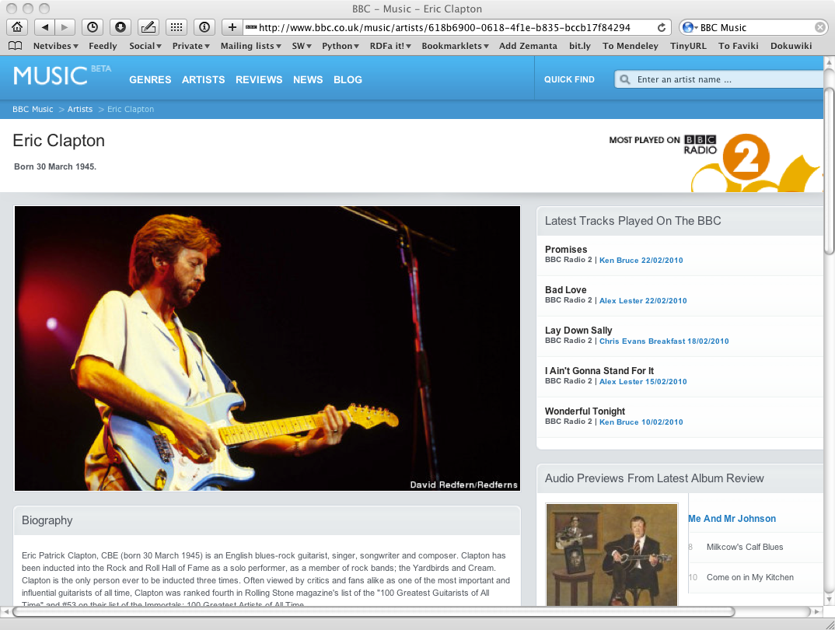
Example: making use of linked data
Courtesy of the BBC

Slide 9
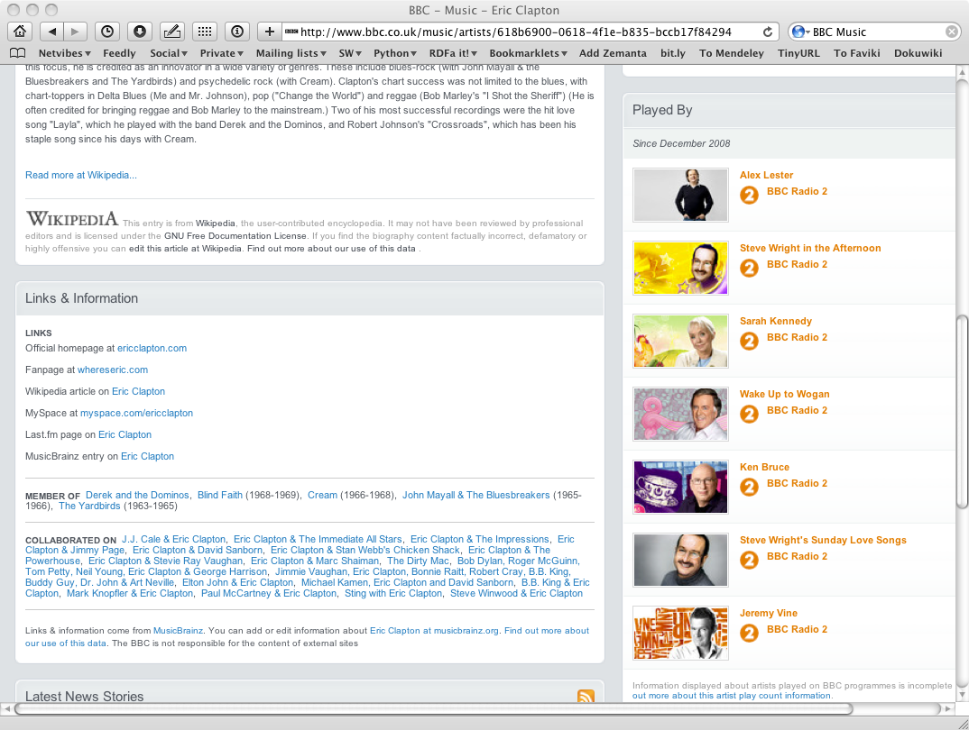
Example: making use of linked data
Courtesy of the BBC

Slide 10
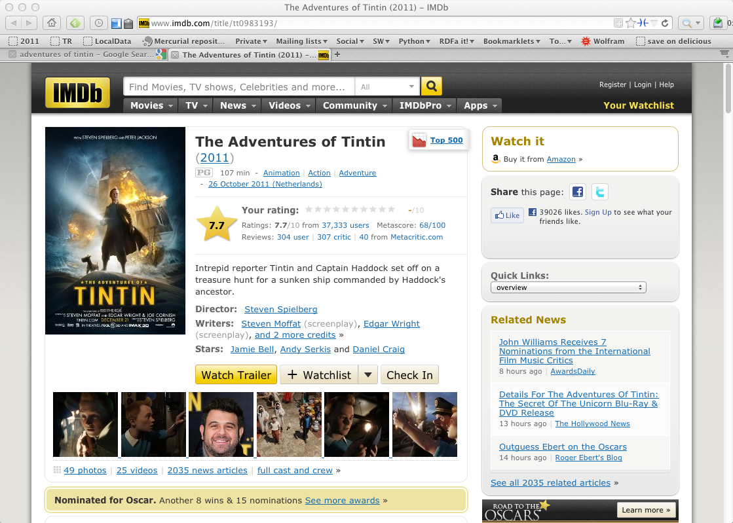
Example: making use of structured data and search engine facilities

Slide 11
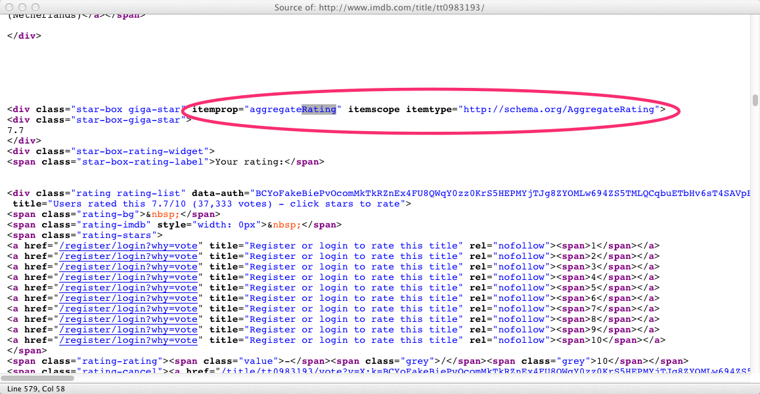
Example: making use of structured data and search engine facilities

Slide 12
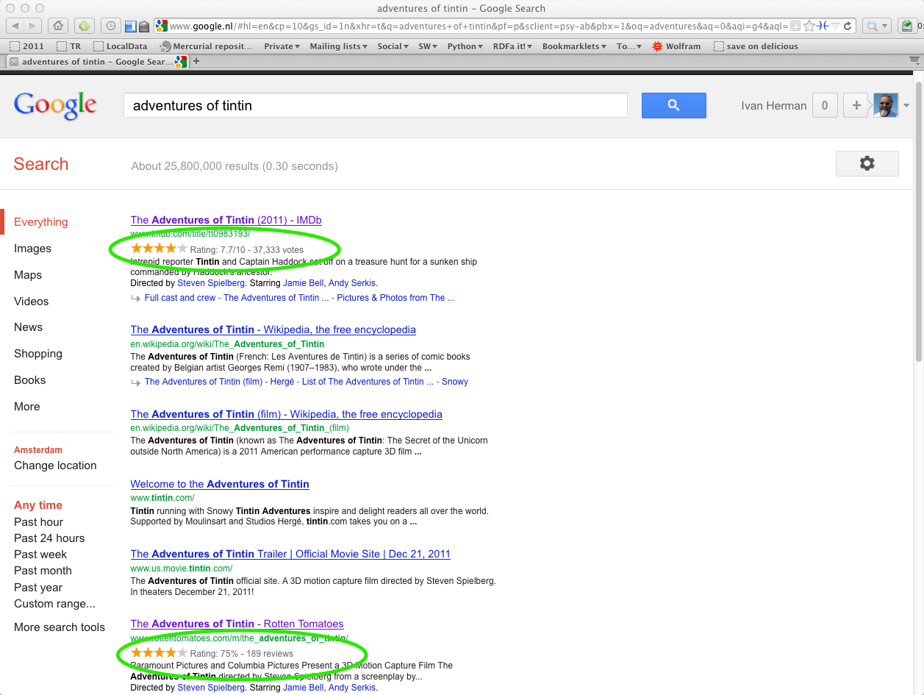
Example: making use of structured data and search engine facilities

Slide 13
And that is all right!

Slide 14
We have to acknowledge that the field has grown and has become multi-faceted
All different “views” have their success stories
There are also no clear and water-proof boundaries between the different views
The question is: where is the emphasis?

Slide 15
Data on the Web
There are more and more data on the Web
  government data, health related data, general knowledge, company information, flight information, restaurants,…
More and more applications rely on the availability of that data

Slide 16
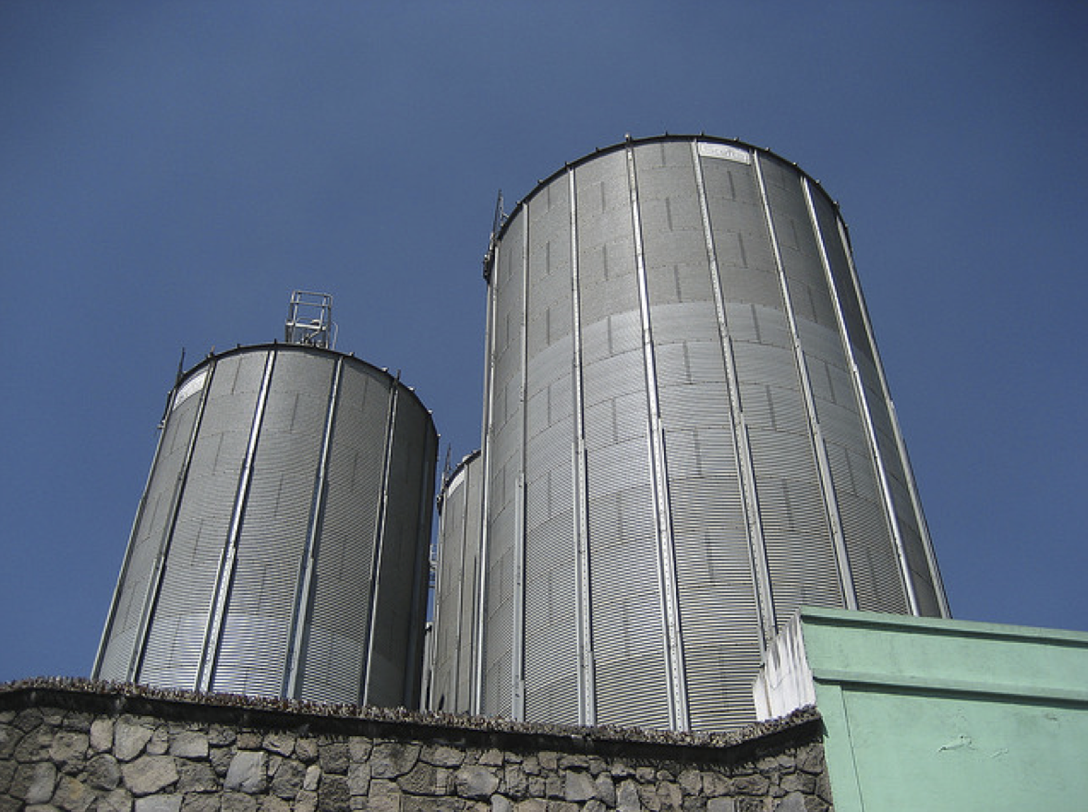
But: we do not want that!
Photo credit “nepatterson”, Flickr

Slide 17
Imagine…
A “Web” where
  documents are available for download on the Internet
  but there would be no hyperlinks among them

Slide 18
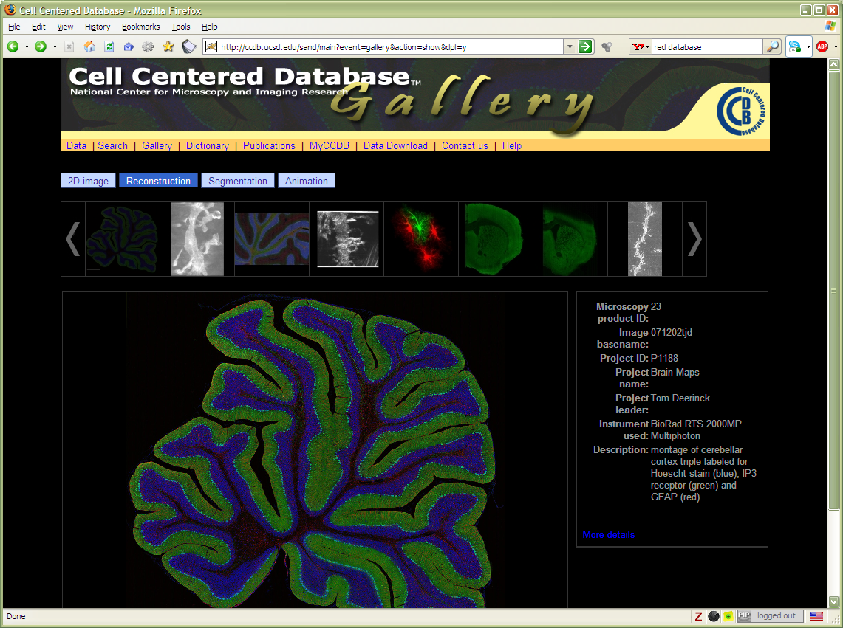
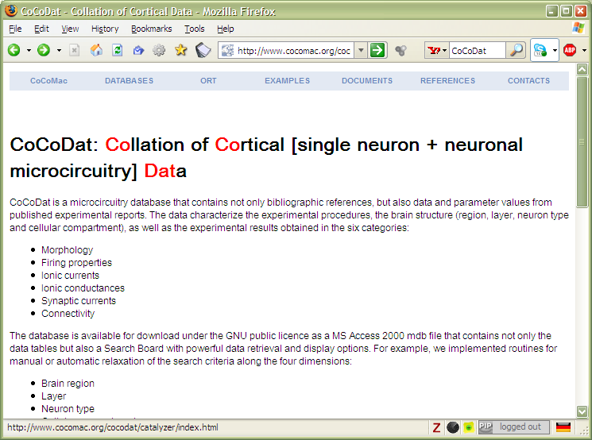
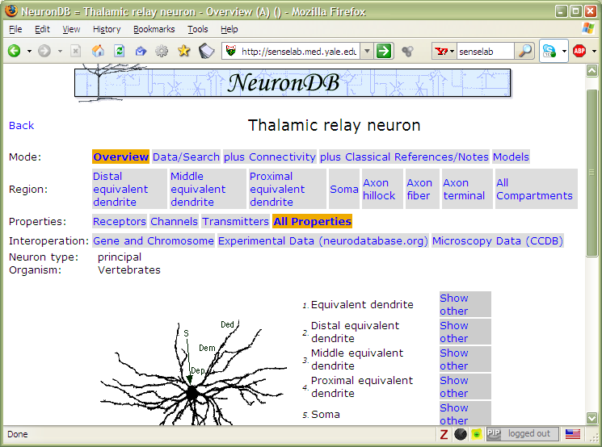

Slide 19
Data on the Web is not enough…
We need a proper infrastructure for a real Web of Data
  data is available on the Web
    accessible via standard Web technologies
  data are interlinked over the Web
    the terms used for linkage are well defined
I.e.: data can be integrated over the Web

Slide 20
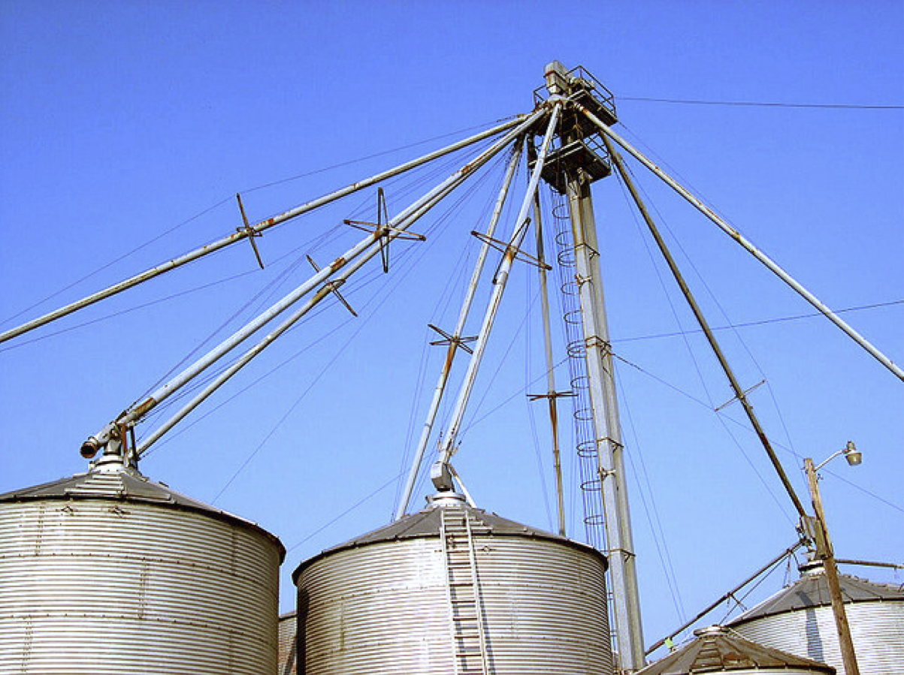
This is what we want!
Photo credit “kxlly”, Flickr

Slide 21
Semantic Web technologies should be at the service of such a Web of Data

Slide 22
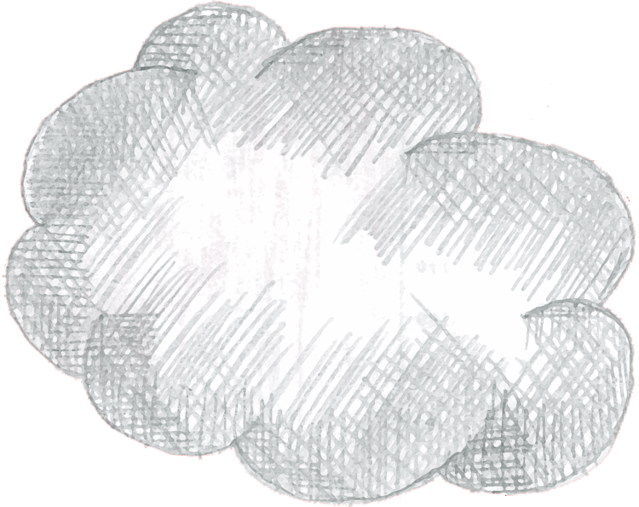
Web of Data Applications
Stand Alone Applications
Browser Applications
Query
Common Format &
Common Vocabularies
Inferencing
“Bridges”
Data on the Web

Slide 23
On a longer term…
Data should be easily manipulated from an application
Some sort of a “globally linked database”
But this is still further down the road…

Slide 24
Web of Data Applications
Stand Alone Applications
Browser Applications
Query and Update
Common Format &
Common Vocabularies
Inferencing
“Bridges”
Data on the Web

Slide 25
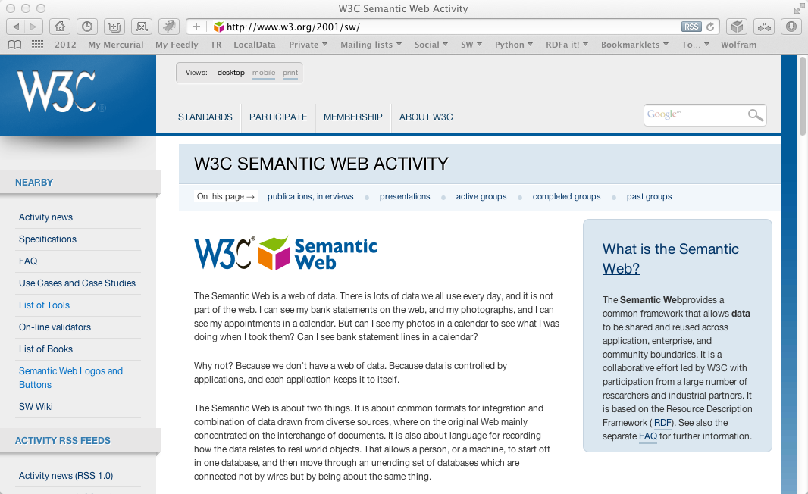
So… what is happening at W3C?

Slide 26
The (almost) past
Some technologies are in the process of finalization
  SPARQL 1.1 (SPARQL Protocol and RDF Query Language)
  RDB2RDF (Relational Databases to RDF)
  RDFa 1.1 (RDF in attributes)

Slide 27
The present
Some areas are subject of intensive work
  RDF update (Resource Description Framework)
  Provenance

Slide 28
The future
We are discussing new works, new areas, e.g.,
  Linked Data Platform
  Access Control issues
  Constraint checking on Semantic Web data
  …

Slide 29
Link to specialized communities
Various communities have different emphasis on which part of the Semantic Web they want to use
W3C has contacts with some of those
  health care and life sciences (a separate IG is up and running)
  libraries, publishing
  financials
  the oil, gas, and chemicals community

Slide 30
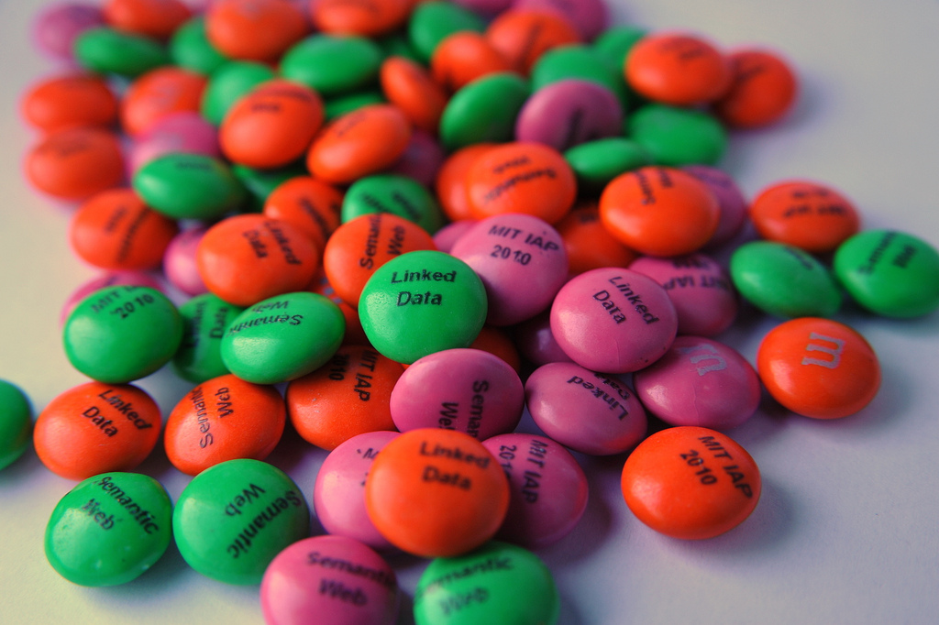
Query RDF: SPARQL 1.1
Photo credit “reedster”, Flickr

Slide 31
Reminder…
SPARQL is a query language on RDF data
SPARQL is defined in terms of a protocol, to send query and results over the Web
Is based on the idea of “graph pattern matching”:
  a graph pattern is described in the query, with real and unknown nodes (“variables”)
  if the pattern can match a portion of the graph, the unknown nodes are replaced by the “real” ones
  resulting information is returned
First version of SPARQL was published in 2008

Slide 32
SPARQL 1.1: adding missing features to SPARQL
Nested queries (i.e., SELECT within a WHERE clause)
Negation (MINUS, and a NOT EXIST filter)
Aggregate function on search results (SUM, MIN,…)
Property path expression (?x foaf:knows+ ?y)
SPARQL UPDATE facilities (INSERT, DELETE, CREATE)
Combination with entailment regimes

Slide 33
SPARQL 1.1 and RDFS/OWL/RIF
SPARQL Engine with entailment
RDF Data
RDFS/OWL/RIF data
entailment
SPARQL Pattern
RDF Data with extra triples
SPARQL Pattern
Query result
pattern matching

Slide 34
SPARQL as a unifying point
Application
SPARQL Endpoint
SPARQL Endpoint
SPARQL Construct
SPARQL Construct
Triple store
SPARQL Processor
Database
RDFa, Microdata
NLP Techniques
GRDDL, RDFa
SQL⬄RDF
RDF Graph
Relational
Database
HTML
Unstructured Text
XML/XHTML

Slide 35
SPARQL 1.1 as a unifying point
Application
SPARQL Endpoint
SPARQL Endpoint
SPARQL Construct
SPARQL Construct
Triple store
SPARQL Update
SPARQL Processor
SPARQL Update
Database
Inferencing
RDFa, Microdata
NLP Techniques
GRDDL, RDFa
SQL⬄RDF
RDF Graph
Relational
Database
Inferencing
HTML
Unstructured Text
XML/XHTML

Slide 36
SPARQL 1.1 Status
Technology has been finalized
Goes to “candidate recommendation” soon
Should be finished this summer

Slide 37
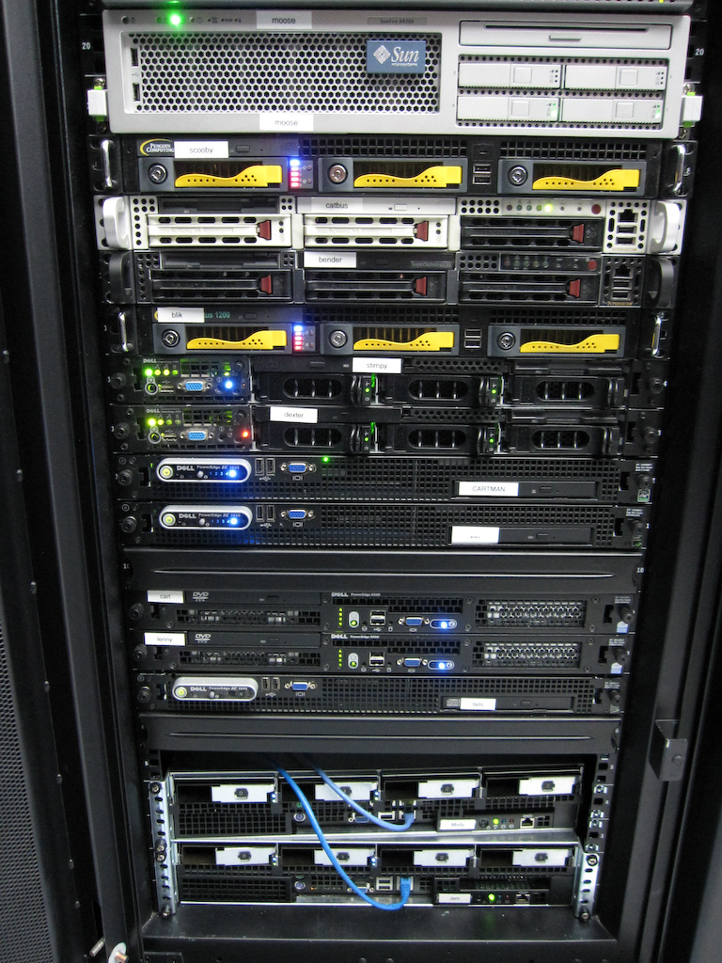
Access to Relational Databases
Photo credit “mayhem”, Flickr

Slide 38
Relational Databases and RDF
Most of the data on the Web is, in fact, in RDB-s
Proven technology, huge systems, many vendors…
Data integration on the Web must provide access to RDB-s
RDB2RDF provides means to “see” relational data as RDF

Slide 39
RDF provides a common “view”
Common “view”
in
RDF
export
export
query
query
query
export

Slide 40
What is “export”?
“Export” does not necessarily mean physical conversion
  for very large databases a “duplication” would not be an option
  systems may provide SPARQL⇔SQL “bridges” to make queries on the fly
Result of export is a “logical” view of the RDB content

Slide 41
Simple export: Direct Mapping
A canonical RDF “view” of RDB tables
Only needs the information in the RDB Schema

Slide 42
Fundamental approach
Each column name provides a predicate
ISBN | Author | Title | Publisher | Year
0006511409X | id_xyz | The Glass Palace | id_qpr | 2000
0007179871 | id_xyz | The Hungry Tide | id_qpr | 2004
Each row is a subject
Table references are URI objects
Cells are Literal objects
ID | Name | Homepage
id_xyz | Ghosh, Amitav | http://www.amitavghosh.com

Slide 43
Fundamental approach
ISBN | Author | Title | Publisher | Year
0006511409X | id_xyz | The Glass Palace | id_qpr | 2000
0007179871 | id_xyz | The Hungry Tide | id_qpr | 2004
0006511409X
<Book#ISBN>
<Book#Author>
id_xyz
The Glass Palace
<Book#Title>
<Book/ISBN-0006511409>
2000
<Book#Year>
<Book#ref-Author>
id_xyz
ID | Name | Homepage
id_xyz | Ghosh, Amitav | http://www.amitavghosh.com
<Person/ID-id_xyz>
<Person#ID>
<Person#Name>
<Person#Homepage>
Ghosh, Amitav
http://www.amitavghosh.com

Slide 44


Tables
RDB Schema
Direct Mapping
“Direct Graph”

Slide 45
Pros and cons of Direct Mapping
Pros:
  Direct Mapping is simple, does not require any other concepts
  know the Schema ⇒ know the RDF graph structure
  know the RDF graph structure ⇒ good idea of the Schema(!)
Cons:
  the resulting graph is not what the application really wants

Slide 46
Tables
RDB Schema
Direct Mapping
“Direct Graph”
Graph Processing
(Rules, SPARQL, …)
Final, Application Graph

Slide 47
Beyond Direct Mapping: R2RML
Separate vocabulary to control the details of the mapping, e.g.:
  finer control over the choice of the subject
  creation of URI references from cells
  predicates may be chosen from a vocabulary
  datatypes may be assigned
  etc.
Gets to the final RDF graph with one processing step

Slide 48
R2RML Instance
Tables
RDB Schema
R2RML
Mapping
Final, Application Graph

Slide 49
Relationships to the Direct Mapping
Fundamentals are similar:
  each row is turned into a series of triples with a common subject
Direct mapping is a “default” R2RML mapping

Slide 50
R2RML and Direct Mapping Status
Technology has been finalized
Both documents are in “Candidate Recommendation” phase
Should be finished this summer

Slide 51
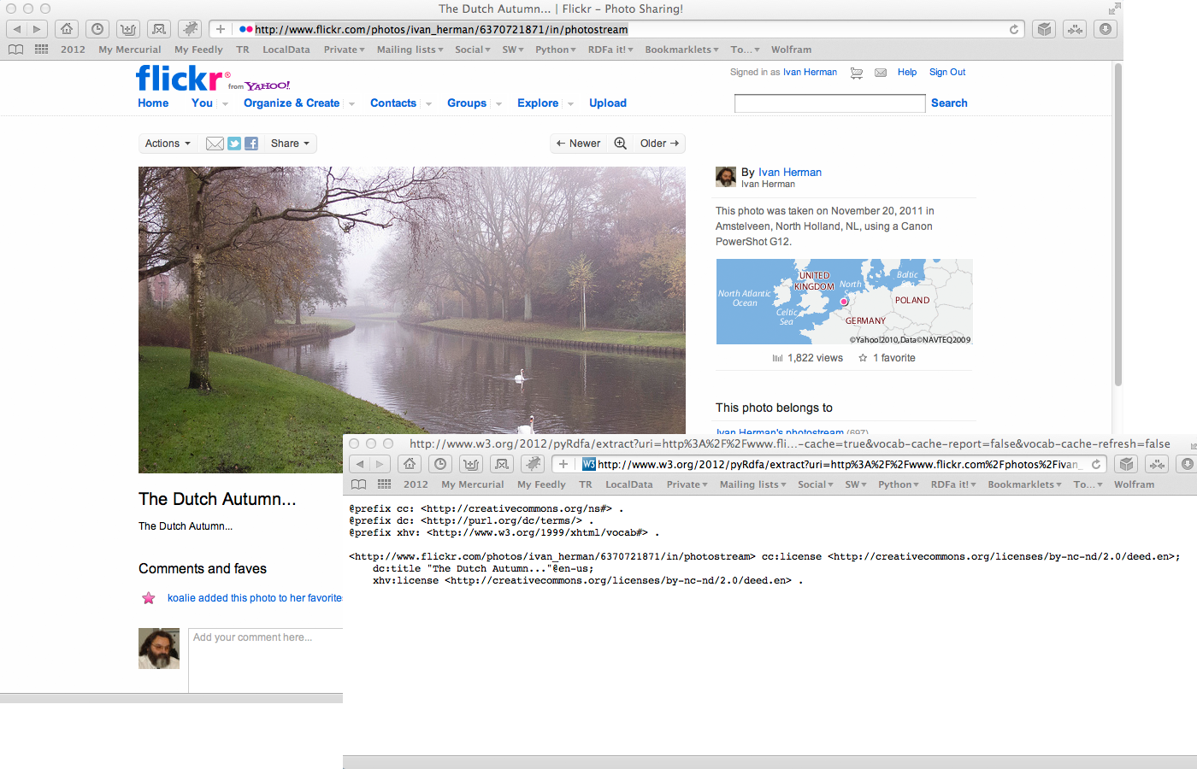
Structured data in HTML:
RDFa & microdata

Slide 52
HTML pages are a huge source of structured data
Not necessarily large amount of data per page, but lots of them…
Have become very valuable to search engines
  Google, Bing, Yahoo!, or Yandex (i.e., schema.org) all committed to use such data
Two syntaxes have emerged at W3C:
  microdata with HTML5
  RDFa with HTML5, XHTML, and with XML languages in general

Slide 53
Example: making use of structured data and search engine facilities

Slide 54
RDFa and microdata: similarities
Both have similar philosophies:
  the structured data is expressed via attributes only (no specialized elements)
  both define some special attributes
    e.g., itemscope for microdata, resource for RDFa
  both reuse some HTML core attributes (e.g., href)
  both reuse the textual content of the HTML source, if needed
RDF data can be extracted from both
  i.e., HTML+RDFa and HTML+microdata have become an additional source of Linked Data

Slide 55
RDFa and microdata: differences
Microdata has been optimized for simpler use cases, concentrating on
  one vocabulary at a time
  tree shaped data
  no datatypes
RDFa provides a full serialization of RDF in XML or HTML
  the price is an extra complexity compared to microdata
RDFa 1.1 Lite is a simplified authoring profile of RDFa, very similar to microdata

Slide 56
RDFa 1.1 and microdata status
For RDFa 1.1
  Technology has been finalized
  Is in “Candidate Recommendation”
  Should be finished this summer
For microdata
  Technology has been finalized
  Is part of HTML5, hence its advancement depends on other technologies

Slide 57
Relevant W3C notes
“HTML Data Guide”
  help publishers to choose what to use
  how to combine microdata and RDFa in one document
Microdata to RDF
  defines a mapping of an HTML5+Microdata document to RDF

Slide 58
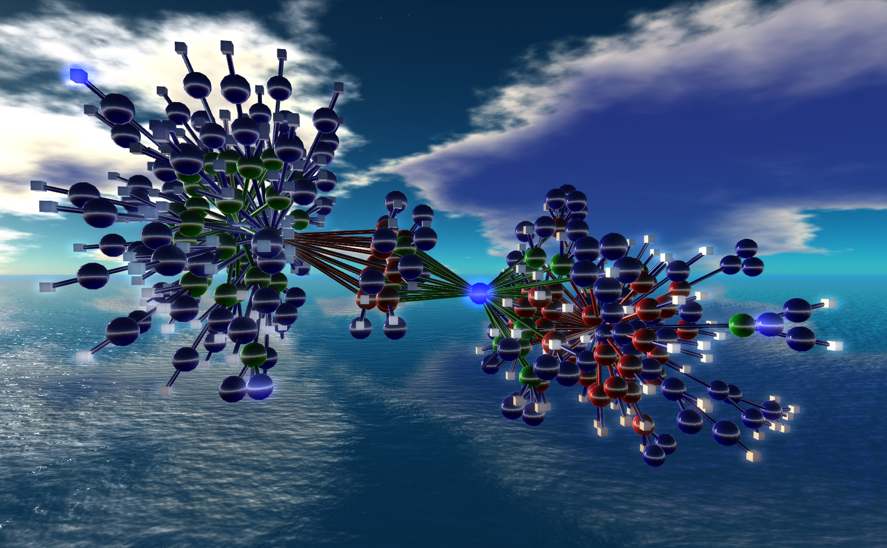
Cleaning up RDF
Nexus Simulation Credit Erich Bremmer

Slide 59
Reminder…
Resource Description Framework: a graph-based model for (Web) data and its relationships
  has a simple (subject,predicate,object) model
  makes use of URI-s for the naming of terms
    objects can also be Literals
  informally: defines named relationships (named links) among entities on the Web
  has different serialization formats
Latest version was published in 2004

Slide 60
RDF cleanup (a.k.a. RDF1.1)
Many issues have come up since 2004:
  deployment issues
  new functionalities are needed
  underlying technology may have moved on (e.g., datatypes)
The goal of the RDF Working Group is to refresh RDF
NOT a complete reshaping of the standard!

Slide 61
Some new features
Standardize Turtle as a serialization format
Clean up some aspects of datatyping, e.g.:
  plain vs. typed literals
  details and role of rdf:XMLLiteral
Proper definition for “named graphs”
  including concepts, semantics, syntax, …
    obviously important for linked data access
    but generates quite some discussions on the details
etc.

Slide 62
Editorial improvements
Cleanup the documents, make them more readable
  possibly rewrite all documents
  maybe a completely new primer
  new structure for the Semantics document

Slide 63
Status
Work has begun a bit less than a year ago
Turtle is almost finalized
Agreement on most of the literal cleanup
Lots of discussion currently on named graphs…

Slide 64
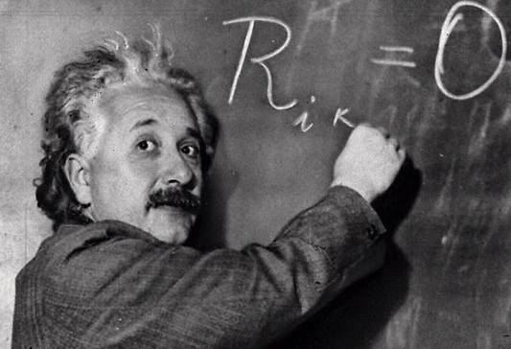
Provenance

Slide 65
The goal is simple…
We should be able to express all sorts of “meta” information on the data
  creator: who played what role in creating the data (author, reviewer, etc.)
  view of the full revision chain of the data
  in case of a integrated data: which part comes from which original data and under what process
  what vocabularies/ontologies/rules were used to generate some portions of the data
  etc.

Slide 66
…the solution is more complicated
Requires a complete model describing the various constituents (actors, revisions, etc.)
The model should be usable with RDF
Has to find a balance between
  simple (“scruffy”) provenance: easily usable and editable
  complex (“complete”) provenance: allows for a detailed reporting of origins, versions, etc.
That is the role of the Provenance Working Group (started in 2011)

Slide 67
ex:aggregation
ex:chart
prov:used
prov:wasGeneratedBy
ex:illustrate
prov:wasGeneratedBy
prov:wasControlledBy
DRAFT!!!
prov:wasControlledBy
ex:aggregate
foaf:name
Derek
prov:used
prov:used
foaf:mbox
ex:regionList
ex:dataSet
mailto:derek@ex.com
Notes:
Blue: Prov Entity
Green: Yellowish Action
Red: Prov Agent

Slide 68
Status
Drafts have been published
  abstract data model, OWL version
  primer
The current effort is on simplifying the first versions

Slide 69
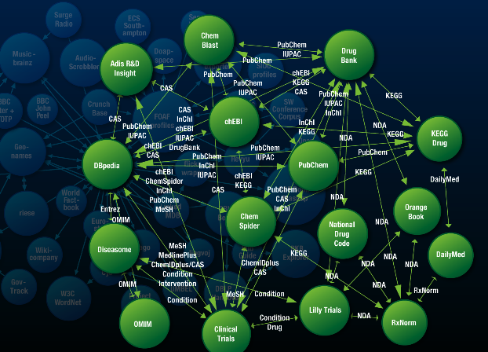
Linked Data Patterns

Slide 70
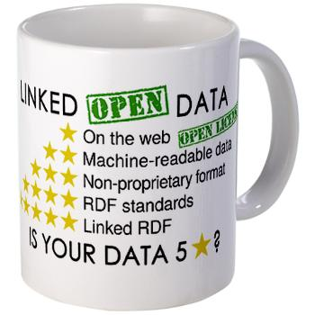
Linked Data: a seed for a Web of Data
“Linked Data” is also a set of principles:
  put things on the Web through URI-s
  use HTTP URI-s so that things could be dereferenced
  provide useful information (using standards) when a URI is dereferenced
  include links to other URI-s
RDF is an ideal vehicle to realize these principles

Slide 71
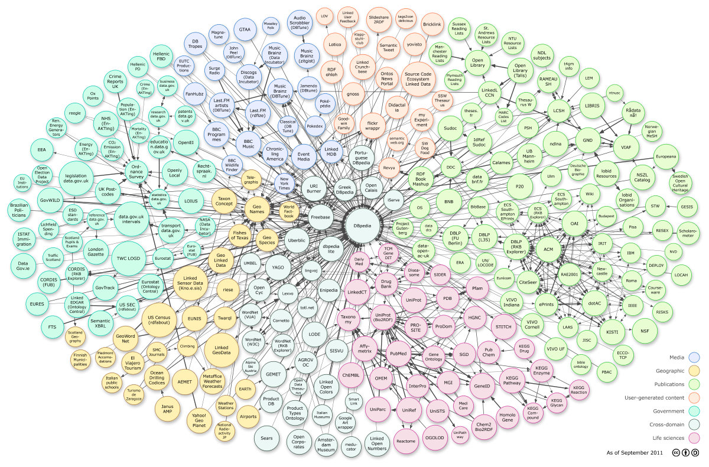
Courtesy of Richard Cyganiak and Anja Jentzsch
Notes:
295 datasets, cca. 31.6B triples

Slide 72
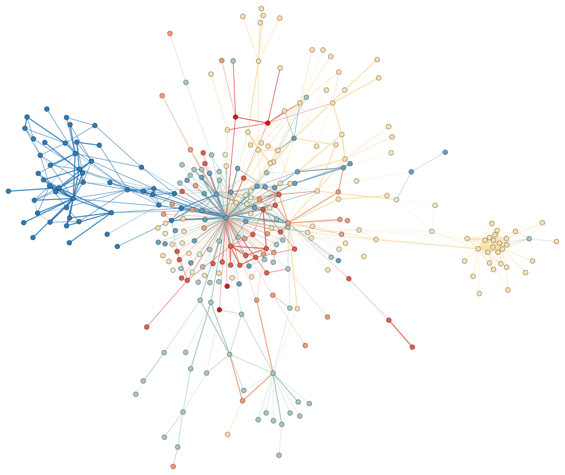
But: the number of links among datasets is still small
Courtesy of Frank van Harmelen, ISWC2011 keynote address

Slide 73
Linked Data offers major challenges for Semantic Web
Scale: we are talking about billions of triples, increasing every day
Highly distributed: data spread over the Web, connected via http links
Very heterogeneous data of different origins
Need not only to read but also to write the data (using the same concepts)
Setting a SPARQL endpoint everywhere may not be realistic

Slide 74
Read only vs. Read/Write
The current Linked Data work concentrates on publishing data for read-only usage
The future requires an easy way to read and write data
  SPARQL UPDATE is a step in this direction
  but requires an additional SPARQL processor

Slide 75
Planned: Linked Data Platform WG
General goal: to provide a “lower” level, HTTP based infrastructure to publish, read, write, or modify linked data
  typical usage: data intensive application in a browser, application integration using shared data…
The infrastructure should be “low-cost”, easy to implement and install

Slide 76
Planned: Linked Data Platform WG
Two major work areas:
  Define an HTTP protocol to
    access and update RDF data through standard HTTP terms
    define patch, paginated access
    define a RESTful API
  Linked Data Profiles: subsets of existing Semantic Web standards to be used for such HTTP based access
    use only a subset of datatypes
    use HTTP URI-s only
    etc.

Slide 77
Planned: Linked Data Platform WG
Two major work areas:
  Define an HTTP protocol to
    access and update RDF data through standard HTTP terms
    (possibly) define patch, paginated access
    define a RESTful API
  Linked Data Profiles: subsets of existing Semantic Web standards to be used for such HTTP based access
    use only a subset of datatypes
    use HTTP URI-s only
    etc.
Planned!!!

Slide 78

What else is on the horizon?

Slide 79
Further challenges raised by Linked Data
Knowledge structures vs. data is very different: very shallow, simple vocabularies for huge sets of data
  The role of reasoning is different (vocabularies, OWL DL, etc., may not be feasible)
Highly distributed SPARQL implementations are necessary
etc.

Slide 80
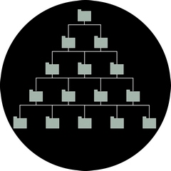
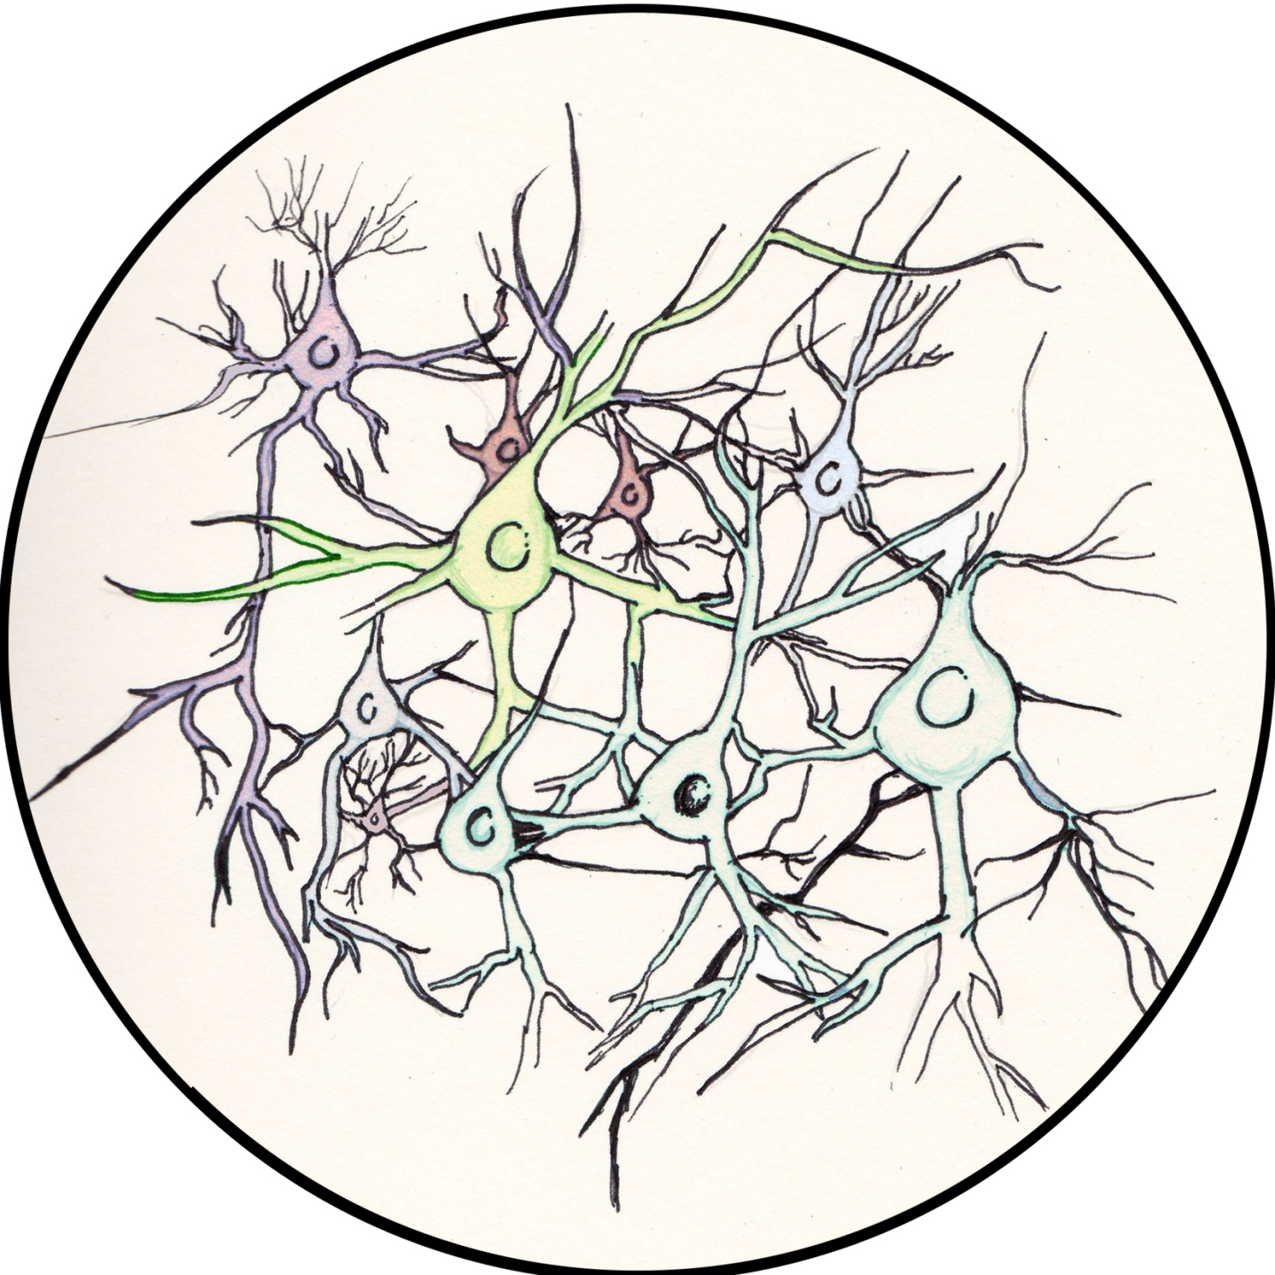
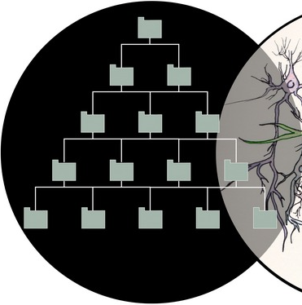
For example: data vs. vocabularies
Courtesy of Frank van Harmelen, ISWC2011 keynote address
Notes:
as an aside: the graph is now big enough to do statistics on it.

Slide 81
Other work areas in activity that are explored
Profiles for the publication of Linked Data, e.g.,
  further profiles of OWL
  URI patterns
  datatypes
  usage of Bnodes
  etc.
JSON serialization of RDF

Slide 82
Other work areas in activity that are explored
Standardized approaches for Access Control to data
Reconsider rule languages for (e.g., for Linked Data applications)
Constraint checking of Data
API-s for client-side Web Application Developers
…

Slide 83
To remember…
Data on the Web is a major challenge
  technologies are needed to use them, to interact with them, to integrate them
Semantic Web technologies (RDF(S), vocabularies, SPARQL, etc.) can play a major role in publishing and using Data on the Web

Slide 84
Semantic and Multilingual Web?
(leaving my domain of expertise ☺)
Relationships between Semantic Web and multilingualism is twofold:
  can SW help in achieving MLW?
  MLW challenges for SW?

Slide 85
SW helping MLW?
Semantic Web has powerful technologies to categorize knowledge (e.g., SKOS and other vocabulary standards)
  thesauri can be created with labels in different languages
  some level of knowledge extraction and analysis could be done on those
Via the Linked Data it is possible to interlink information different languages
  DBpedia integrates the various Wikipedia instances
It is possible to tag texts using the same terms (e.g., via stable URI-s)
etc.
These may help in “binding”, translating, etc., information in different languages

Slide 86
MLW challenges for SW?
SW technologies and practice has to consider the challenges of MLW
RDF has a very simple way of representing literals (copied from XML): single language tag. Is it enough?
Ontologies/vocabularies are typically monolingual, terms are mostly English…
Practice of vocabulary design very often forgets about MLW issues (first name, last name…)
IRI equivalence is a major headache in practice
etc.

Slide 87
I am looking forward to the discussions!

Slide 88

Thank you for your attention
These slides are also available on the Web:
http://www.w3.org/2012/Talks/0315-Luxembourg-IH/

