Slide 1

Introduction to Semantic Web Technologies
Ivan Herman, W3C
June 22nd, 2010

Slide 2
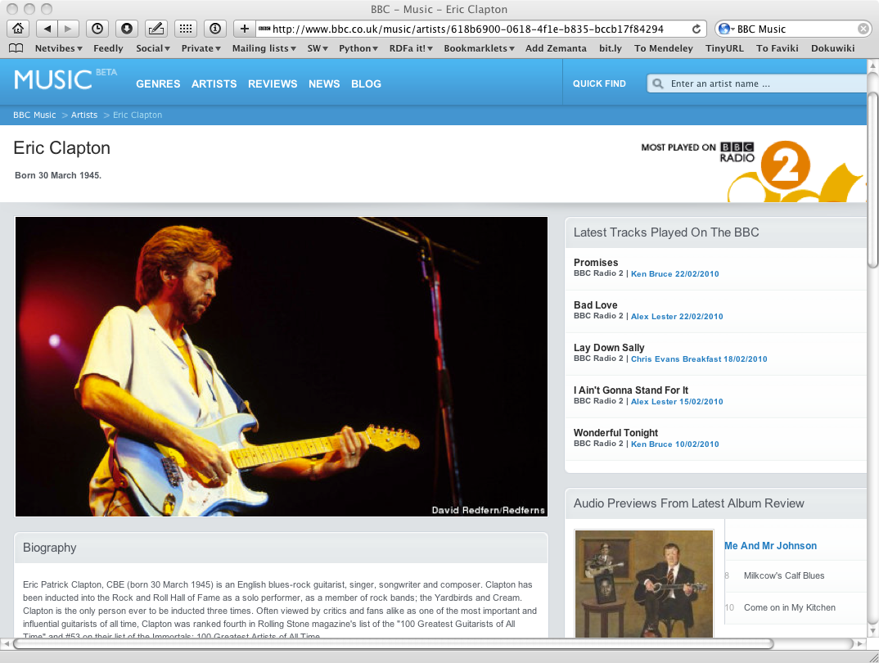
The Music site of the BBC

Slide 3
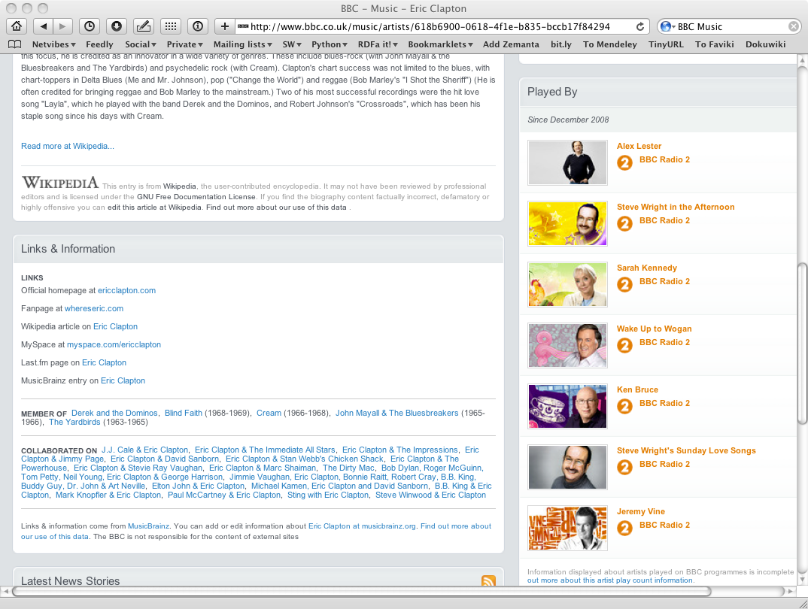
The Music site of the BBC

Slide 4
How to build such a site 1.
Site editors roam the Web for new facts
  may discover further links while roaming
They update the site manually
And the site gets soon out-of-date

Slide 5
How to build such a site 2.
Editors roam the Web for new data published on Web sites
“Scrape” the sites with a program to extract the information
  ie, write some code to incorporate the new data
Easily get out of date again…

Slide 6
How to build such a site 3.
Editors roam the Web for new data via API-s
Understand those…
  input, output arguments, datatypes used, etc
Write some code to incorporate the new data
Easily get out of date again…

Slide 7
The choice of the BBC
Use external, public datasets
  Wikipedia, MusicBrainz, …
They are available as data
  not API-s or hidden on a Web site
  data can be extracted using, eg, HTTP requests or standard queries

Slide 8
In short…
Use the Web of Data as a Content Management System
Use the community at large as content editors

Slide 9
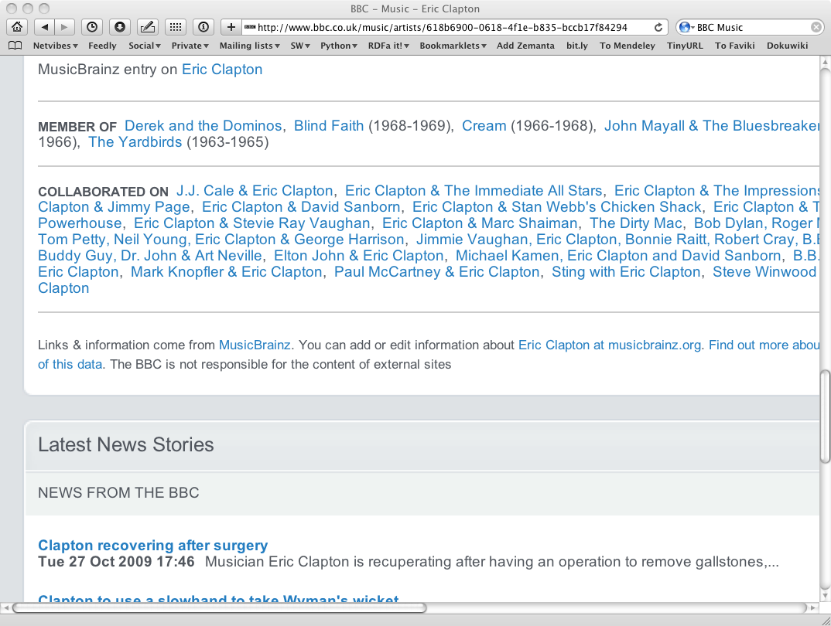
And this is no secret…

Slide 10
Data on the Web
There are more an more data on the Web
  government data, health related data, general knowledge, company information, flight information, restaurants,…
More and more applications rely on the availability of that data

Slide 11
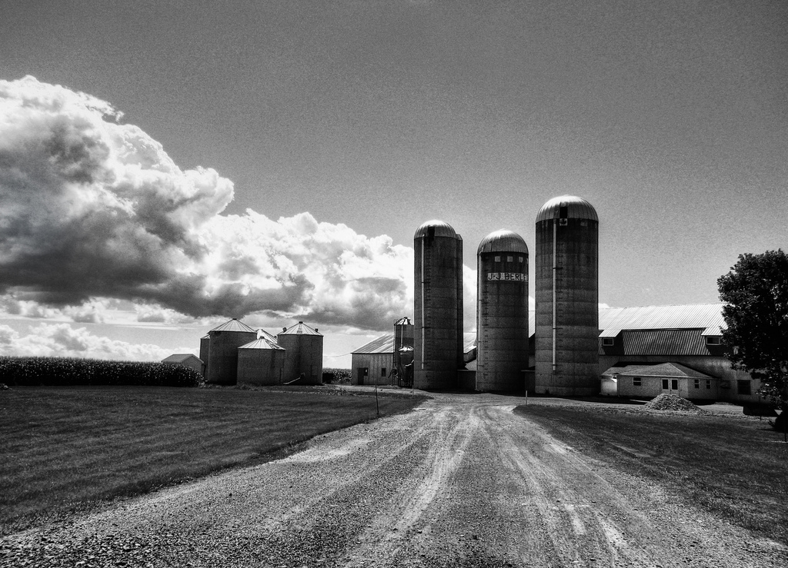
But… data are often in isolation, “silos”
Photo credit Alex (ajagendorf25), Flickr

Slide 12
Imagine…
A “Web” where
  documents are available for download on the Internet
  but there would be no hyperlinks among them

Slide 13
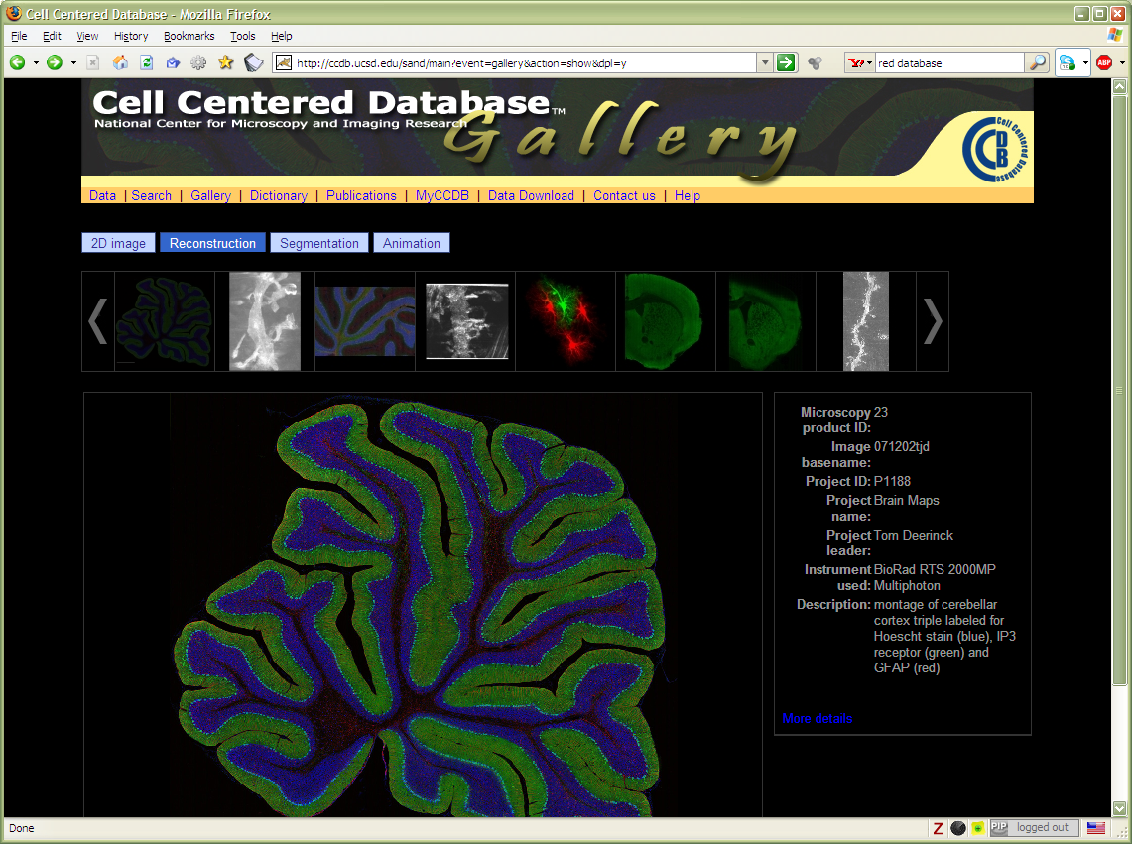
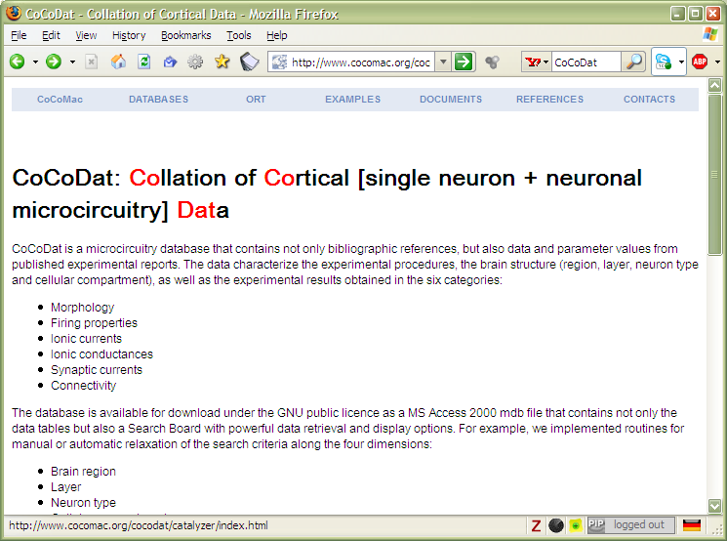
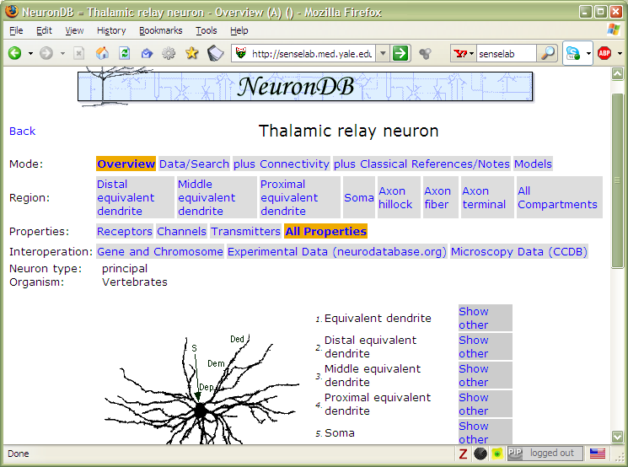
And the problem is real…

Slide 14
Data on the Web is not enough…
We need a proper infrastructure for a real Web of Data
  data is available on the Web
    accessible via standard Web technologies
  data are interlinked over the Web
  ie, data can be integrated over the Web
This is where Semantic Web technologies come in

Slide 15
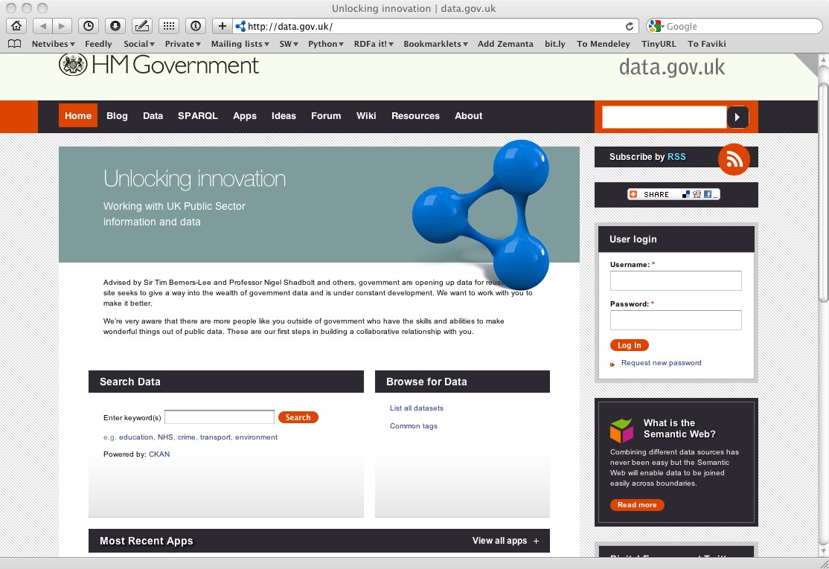
A Web of Data unleashes now applications

Slide 16
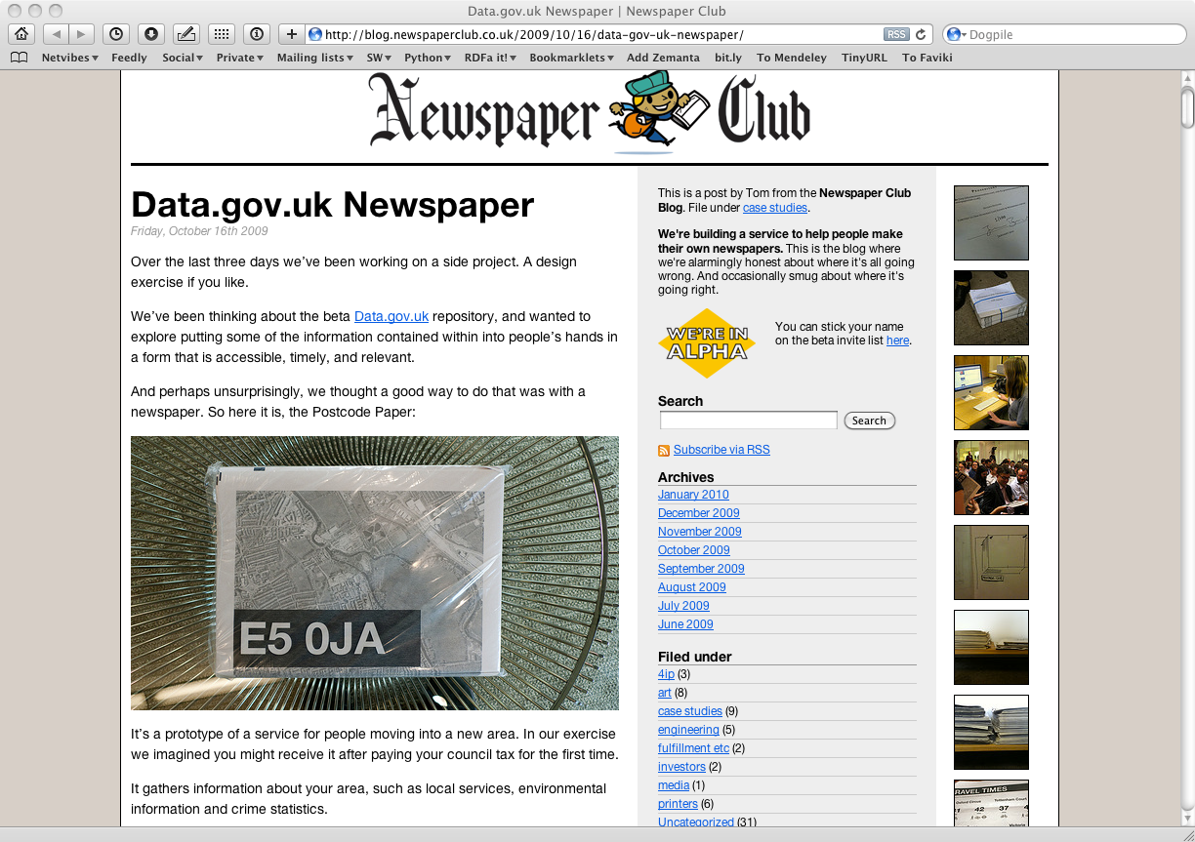
A nice usage of UK government data
Notes:
The point is: they combine data drawn from data.gov.uk to produce, traditional, printed paper to be distributed in the neighborhood providing practical information like doctors, pharmacies, etc, in an up-to-date fashion

Slide 17
In what follows…
We will use a simplistic example to introduce the main Semantic Web concepts

Slide 18
The rough structure of data integration
Map the various data onto an abstract data representation
  make the data independent of its internal representation…
Merge the resulting representations
Start making queries on the whole!
  queries not possible on the individual data sets

Slide 19

We start with a book...

Slide 20
A simplified bookstore data
(dataset “A”)
ID | Author | Title | Publisher | Year
ISBN 0-00-6511409-X | id_xyz | The Glass Palace | id_qpr | 2000
ID | Name | Homepage
id_xyz | Ghosh, Amitav | http://www.amitavghosh.com
ID | Publisher’s name | City
id_qpr | Harper Collins | London

Slide 21
1st: export your data as a set of relations
a:title
The Glass Palace
http://…isbn/000651409X
2000
a:year
a:publisher
London
a:city
a:author
Harper Collins
a:p_name
a:name
a:homepage
Ghosh, Amitav
http://www.amitavghosh.com

Slide 22
Some notes on the exporting the data
Relations form a graph
  the nodes refer to the “real” data or contain some literal
  how the graph is represented in machine is immaterial for now

Slide 23
Some notes on the exporting the data
Data export does not necessarily mean physical conversion of the data
  relations can be generated on-the-fly at query time
    via SQL “bridges”
    scraping HTML pages
    extracting data from Excel sheets
    etc.
One can export part of the data

Slide 24

Same book in French…

Slide 25
Another bookstore data
(dataset “F”)
 | A | B | C | D
1 | ID | Titre | Traducteur | Original
2 | ISBN 2020286682 | Le Palais des Miroirs | $A12$ | ISBN 0-00-6511409-X
3
4
5
6 | ID | Auteur
7 | ISBN 0-00-6511409-X | $A11$
8
9
10 | Nom
11 | Ghosh, Amitav
12 | Besse, Christianne

Slide 26
2nd: export your second set of data
http://…isbn/000651409X
Le palais des miroirs
f:original
f:titre
f:auteur
http://…isbn/2020386682
f:traducteur
f:nom
f:nom
Ghosh, Amitav
Besse, Christianne

Slide 27
3rd: start merging your data
The Glass Palace
a:title
http://…isbn/000651409X
2000
a:year
a:city
a:publisher
London
Harper Collins
a:p_name
a:author
a:name
http://…isbn/000651409X
a:homepage
f:original
Le palais des miroirs
Ghosh, Amitav
http://www.amitavghosh.com
f:titre
f:auteur
http://…isbn/2020386682
f:traducteur
f:nom
Ghosh, Amitav
f:nom
Besse, Christianne

Slide 28
3rd: start merging your data (cont)
The Glass Palace
a:title
http://…isbn/000651409X
2000
a:year
a:publisher
Same URI!
London
a:city
Harper Collins
a:p_name
a:author
a:name
http://…isbn/000651409X
a:homepage
f:original
Le palais des miroirs
Ghosh, Amitav
http://www.amitavghosh.com
f:titre
f:auteur
http://…isbn/2020386682
f:traducteur
f:nom
Ghosh, Amitav
f:nom
Besse, Christianne

Slide 29
3rd: start merging your data
The Glass Palace
a:title
http://…isbn/000651409X
2000
a:year
a:city
a:publisher
London
Harper Collins
a:p_name
a:author
f:original
a:name
f:auteur
a:homepage
Le palais des miroirs
Ghosh, Amitav
http://www.amitavghosh.com
f:titre
http://…isbn/2020386682
f:traducteur
f:nom
Ghosh, Amitav
f:nom
Besse, Christianne

Slide 30
Start making queries…
User of data “F” can now ask queries like:
  “give me the title of the original”
    well, … « donnes-moi le titre de l’original »
This information is not in the dataset “F”…
…but can be retrieved by merging with dataset “A”!

Slide 31
However, more can be achieved…
We “feel” that a:author and f:auteur should be the same
But an automatic merge doest not know that!
Let us add some extra information to the merged data:
  a:author same as f:auteur
  both identify a “Person”
  a term that a community may have already defined:
    a “Person” is uniquely identified by his/her name and, say, homepage
    it can be used as a “category” for certain type of resources

Slide 32
3rd revisited: use the extra knowledge
The Glass Palace
a:title
http://…isbn/000651409X
2000
a:year
f:original
Le palais des miroirs
a:publisher
f:titre
London
a:city
Harper Collins
a:p_name
a:author
http://…isbn/2020386682
f:auteur
r:type
f:traducteur
a:name
http://…foaf/Person
r:type
f:nom
a:homepage
f:nom
Besse, Christianne
Ghosh, Amitav
http://www.amitavghosh.com

Slide 33
Start making richer queries!
User of dataset “F” can now query:
  “donnes-moi la page d’accueil de l’auteur de l’original”
    well… “give me the home page of the original’s ‘auteur’”
The information is not in datasets “F” or “A”…
…but was made available by:
  merging datasets “A” and datasets “F”
  adding three simple extra statements as an extra “glue”

Slide 34
Combine with different datasets
Using, e.g., the “Person”, the dataset can be combined with other sources
For example, data in Wikipedia can be extracted using dedicated tools
  e.g., the “dbpedia” project can extract the “infobox” information from Wikipedia already…

Slide 35
Merge with Wikipedia data
The Glass Palace
a:title
http://…isbn/000651409X
2000
a:year
f:original
Le palais des miroirs
a:publisher
f:titre
London
a:city
Harper Collins
a:p_name
a:author
http://…isbn/2020386682
f:auteur
r:type
f:traducteur
a:name
http://…foaf/Person
r:type
f:nom
a:homepage
r:type
f:nom
Besse, Christianne
Ghosh, Amitav
http://www.amitavghosh.com
foaf:name
w:reference
http://dbpedia.org/../Amitav_Ghosh

Slide 36
Merge with Wikipedia data
The Glass Palace
a:title
http://…isbn/000651409X
2000
a:year
f:original
Le palais des miroirs
a:publisher
f:titre
London
a:city
Harper Collins
a:p_name
a:author
http://…isbn/2020386682
f:auteur
r:type
f:traducteur
a:name
http://…foaf/Person
r:type
f:nom
a:homepage
r:type
f:nom
w:isbn
Besse, Christianne
Ghosh, Amitav
http://www.amitavghosh.com
foaf:name
w:reference
http://dbpedia.org/../The_Glass_Palace
w:author_of
http://dbpedia.org/../Amitav_Ghosh
w:author_of
http://dbpedia.org/../The_Hungry_Tide
w:author_of
http://dbpedia.org/../The_Calcutta_Chromosome

Slide 37

Merge with Wikipedia data
The Glass Palace
a:title
http://…isbn/000651409X
2000
a:year
f:original
Le palais des miroirs
a:publisher
f:titre
London
a:city
Harper Collins
a:p_name
a:author
http://…isbn/2020386682
f:auteur
r:type
f:traducteur
a:name
http://…foaf/Person
r:type
f:nom
a:homepage
r:type
f:nom
w:isbn
Besse, Christianne
Ghosh, Amitav
http://www.amitavghosh.com
foaf:name
w:reference
http://dbpedia.org/../The_Glass_Palace
w:author_of
http://dbpedia.org/../Amitav_Ghosh
w:born_in
w:author_of
http://dbpedia.org/../Kolkata
http://dbpedia.org/../The_Hungry_Tide
w:long
w:lat
w:author_of
http://dbpedia.org/../The_Calcutta_Chromosome

Slide 38
Is that surprising?
It may look like it but, in fact, it should not be…
What happened via automatic means is done every day by Web users!
The difference: a bit of extra rigour so that machines could do this, too

Slide 39
It could become even more powerful
We could add extra knowledge to the merged datasets
  e.g., a full classification of various types of library data
  geographical information
  etc.
This is where ontologies, extra rules, etc, come in
  ontologies/rule sets can be relatively simple and small, or huge, or anything in between…
Even more powerful queries can be asked as a result

Slide 40

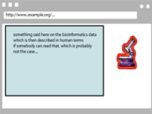


What did we do?
Applications
Manipulate
Query
…
Map,
Expose,
…
Data represented in abstract format
Data in various formats

Slide 41
So where is the Semantic Web?
The Semantic Web provides technologies to make such integration possible!
Hopefully you get a full picture at the end of the tutorial…

Slide 42
The Basis: RDF

Slide 43
RDF triples
Let us begin to formalize what we did!
  we “connected” the data…
  but a simple connection is not enough… data should be named somehow
  hence the RDF Triples: a labelled connection between two resources

Slide 44
RDF triples (cont.)
An RDF Triple (s,p,o) is such that:
  “s”, “p” are URI-s, ie, resources on the Web; “o” is a URI or a literal
    “s”, “p”, and “o” stand for “subject”, “property”, and “object”
  here is the complete triple:
(<http://…isbn…6682>, <http://…/original>, <http://…isbn…409X>)
RDF is a general model for such triples
  with machine readable formats like RDF/XML, Turtle, N3, RDFa, …

Slide 45
RDF triples (cont.)
Resources can use any URI
  http://www.example.org/file.html#home
  http://www.example.org/file2.xml#xpath(//q[@a=b])
  http://www.example.org/form?a=b&c=d
RDF triples form a directed, labeled graph (the best way to think about them!)

Slide 46
A simple RDF example (in RDF/XML)
http://…isbn/2020386682
f:titre
f:original
Le palais des miroirs
http://…isbn/000651409X
<rdf:Description rdf:about="http://…/isbn/2020386682">
<f:titre xml:lang="fr">Le palais des mirroirs</f:titre>
<f:original rdf:resource="http://…/isbn/000651409X"/>
</rdf:Description>
(Note: namespaces are used to simplify the URI-s)

Slide 47
A simple RDF example (in Turtle)
http://…isbn/2020386682
f:titre
f:original
Le palais des miroirs
http://…isbn/000651409X
<http://…/isbn/2020386682>
f:titre "Le palais des mirroirs"@fr ;
f:original <http://…/isbn/000651409X> .

Slide 48
A simple RDF example (in RDFa)
http://…isbn/2020386682
f:titre
f:original
Le palais des miroirs
http://…isbn/000651409X
<p about="http://…/isbn/2020386682">The book entitled
“<span property="f:title" lang="fr">Le palais des mirroirs</span>”
is the French translation of the
“<span rel="f:original" resource="http://…/isbn/000651409X">Glass
Palace</span>”</p> .

Slide 49
“Internal” nodes
Consider the following statement:
  “the publisher is a «thing» that has a name and an address”
Until now, nodes were identified with a URI. But…
…what is the URI of «thing»?
London
a:city
a:publisher
http://…isbn/000651409X
Harper Collins
a:p_name

Slide 50
One solution: create an extra URI
The resource will be “visible” on the Web
  care should be taken to define unique URI-s
<rdf:Description rdf:about="http://…/isbn/000651409X">
<a:publisher rdf:resource="urn:uuid:f60ffb40-307d-…"/>
</rdf:Description>
<rdf:Description rdf:about="urn:uuid:f60ffb40-307d-…">
<a:p_name>HarpersCollins</a:p_name>
<a:city>HarpersCollins</a:city>
</rdf:Description>

Slide 51
Internal identifier (“blank nodes”)
<rdf:Description rdf:about="http://…/isbn/000651409X">
<a:publisher rdf:nodeID="A234"/>
</rdf:Description>
<rdf:Description rdf:nodeID="A234">
<a:p_name>HarpersCollins</a:p_name>
<a:city>HarpersCollins</a:city>
</rdf:Description>
<http://…/isbn/2020386682> a:publisher _:A234.
_:A234 a:p_name "HarpersCollins".
Internal = these resources are not visible outside
London
a:city
a:publisher
http://…isbn/000651409X
Harper Collins
a:p_name

Slide 52
Blank nodes: the system can do it
Let the system create a “nodeID” internally (you do not really care about the name…)
<http://…/isbn/000651409X> a:publisher [
a:p_name "HarpersCollins";
…
].
London
a:city
a:publisher
http://…isbn/000651409X
Harper Collins
a:p_name

Slide 53
Blank nodes when merging
Blank nodes require attention when merging
  blanks nodes with identical nodeID-s in different graphs are different
  implementations must be careful…

Slide 54
RDF in programming practice
For example, using Java+Jena (HP’s Bristol Lab):
  a “Model” object is created
  the RDF file is parsed and results stored in the Model
  the Model offers methods to retrieve:
    triples
    (property,object) pairs for a specific subject
    (subject,property) pairs for specific object
    etc.
  the rest is conventional programming…
Similar tools exist in Python, PHP, etc.

Slide 55
Jena example
// create a model
Model model=new ModelMem();
Resource subject=model.createResource("URI_of_Subject")
// 'in' refers to the input file
model.read(new InputStreamReader(in));
StmtIterator iter=model.listStatements(subject,null,null);
while(iter.hasNext()) {
st = iter.next();
p = st.getProperty();
o = st.getObject();
do_something(p,o);
}

Slide 56
Merge in practice
Environments merge graphs automatically
  e.g., in Jena, the Model can load several files
  the load merges the new statements automatically
  merge takes care of blank node issues, too

Slide 57

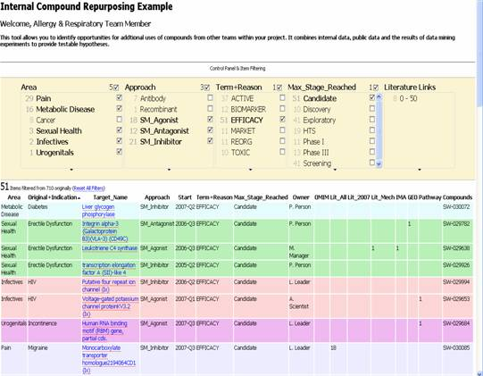
Another relatively simple application
Goal: reuse of older experimental data
Keep data in databases or XML, just export key “fact” as RDF
Use a faceted browser to visualize and interact with the result
Courtesy of Nigel Wilkinson, Lee Harland, Pfizer Ltd, Melliyal Annamalai, Oracle (SWEO Case Study)
Notes:
Various types of databases are accessed having an RDF transformation of (part of the data) on the fly. Some of the data may be simple tables, some are the result of continuous background processing analysing the literature (not directly related to the Semantic Web per se).
The integration of the data is done on the RDF level, and is viewed via an off-the-shelf (though experimental) faceted browser (Exhibit). Ie, the Semantic Web portion is very simple but allows for a very quick integration of the data on the screen.

Slide 58
One level higher up
(RDFS, Datatypes)

Slide 59
Need for RDF schemas
First step towards the “extra knowledge”:
  define the terms we can use
  what restrictions apply
  what extra relationships are there?
Officially: “RDF Vocabulary Description Language”
  the term “Schema” is retained for historical reasons…

Slide 60
Classes, resources, …
Think of well known traditional vocabularies:
  use the term “novel”
  “every novel is a fiction”
  “«The Glass Palace» is a novel”
  etc.
RDFS defines resources and classes:
  everything in RDF is a “resource”
  “classes” are also resources, but…
  …they are also a collection of possible resources (i.e., “individuals”)
    “fiction”, “novel”, …

Slide 61
Classes, resources, … (cont.)
Relationships are defined among resources:
  “typing”: an individual belongs to a specific class
    “«The Glass Palace» is a novel”
    to be more precise: “«http://.../000651409X» is a novel”
  “subclassing”: all instances of one are also the instances of the other (“every novel is a fiction”)
RDFS formalizes these notions in RDF

Slide 62
Classes, resources in RDF(S)
rdfs:Class
rdf:type
http://…isbn/000651409X
rdf:type
#Novel
RDFS defines the meaning of these terms
  (these are all special URI-s, we just use the namespace abbreviation)

Slide 63
Inferred properties
#Fiction
rdf:type
rdf:subClassOf
http://…isbn/000651409X
rdf:type
#Novel
(<http://…/isbn/000651409X> rdf:type #Fiction)
is not in the original RDF data…
…but can be inferred from the RDFS rules
RDFS environments return that triple, too

Slide 64
Inference: let us be formal…
The RDF Semantics document has a list of (33) entailment rules:
  “if such and such triples are in the graph, add this and this”
  do that recursively until the graph does not change
The relevant rule for our example:
If:
uuu rdfs:subClassOf xxx .
vvv rdf:type uuu .
Then add:
vvv rdf:type xxx .

Slide 65
Properties
Property is a special class (rdf:Property)
  properties are also resources identified by URI-s
There is also a possibility for a “sub-property”
  all resources bound by the “sub” are also bound by the other
Range and domain of properties can be specified
  i.e., what type of resources serve as object and subject

Slide 66
Example for property characterization
:title
rdf:type rdf:Property;
rdfs:domain :Fiction;
rdfs:range rdfs:Literal.

Slide 67
What does this mean?
Again, new relations can be deduced. Indeed, if
:title
rdf:type rdf:Property;
rdfs:domain :Fiction;
rdfs:range rdfs:Literal.
<http://…/isbn/000651409X> :title "The Glass Palace" .
then the system can infer that:
<http://…/isbn/000651409X> rdf:type :Fiction .

Slide 68
Literals
Literals may have a data type
  floats, integers, booleans, etc, defined in XML Schemas
  full XML fragments
(Natural) language can also be specified

Slide 69
Examples for datatypes
<http://…/isbn/000651409X>
:page_number "543"^^xsd:integer ;
:publ_date "2000"^^xsd:gYear ;
:price "6.99"^^xsd:float .

Slide 70
A bit of RDFS can take you far…
Remember the power of merge?
We could have used, in our example:
  f:auteur is a subproperty of a:author and vice versa
  (although we will see other ways to do that…)
Of course, in some cases, more complex knowledge is necessary (see later…)

Slide 71
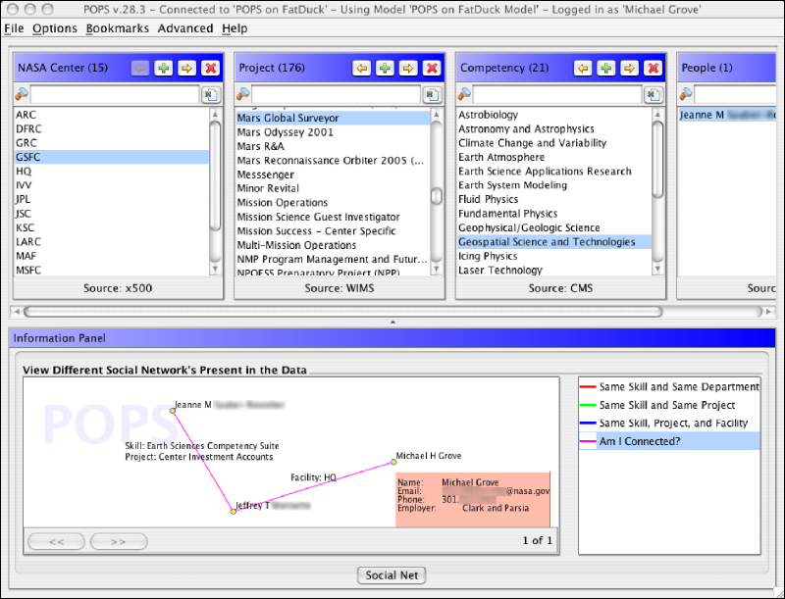
Find the right experts at NASA
Expertise locater for nearly 70,000 NASA civil servants,
  integrate 6 or 7 geographically distributed databases, …
Michael Grove, Clark & Parsia, LLC, and Andrew Schain, NASA, (SWEO Case Study)
Notes:
The use internal ontologies/vocabularies to describe the knowledge areas, and a combination of the RDF data and that ontology to search through the (integrated) databases for a specific knowledge expertise. The dump is from a faceted browser developed by the company to view result data.

Slide 72
How to get and create RDF Data?

Slide 73
Simple approach
Write RDF/XML, RDFa, or Turtle “manually”
In some cases that is necessary, but it really does not scale…

Slide 74
RDF with XHTML
Obviously, a huge source of information
By adding some “meta” information, the same source can be reused for, eg, data integration, better mashups, etc
  typical example: your personal information, like address, should be readable for humans and processable by machines

Slide 75
RDF with XML/(X)HTML (cont)
Two solutions have emerged:
  use microformats and convert the content into RDF
    XSLT is the favorite approach
  add RDF-like statements directly into XHTML via RDFa

Slide 76
Bridge to relational databases
Data on the Web are mostly stored in databases
“Bridges” are being defined:
  a layer between RDF and the relational data
    RDB tables are “mapped” to RDF graphs, possibly on the fly
    different mapping approaches are being used
  a number RDB systems offer this facility already (eg, Oracle, OpenLink, …)
W3C is working on a standard in this area

Slide 77
Linked Open Data

Slide 78
Linked Open Data Project
Goal: “expose” open datasets in RDF
Set RDF links among the data items from different datasets
Set up, if possible, query endpoints
Notes:
The important point here is that (1) the data becomes available to the World via a unified format (ie, RDF), regardless on how it is stored inside and (2) the various datasets are interlinked together, ie, they are not independent islands. Dbpedia is probably the most important 'hub' in the project.

Slide 79


Example data source: DBpedia
DBpedia is a community effort to
  extract structured (“infobox”) information from Wikipedia
  provide a query endpoint to the dataset
  interlink the DBpedia dataset with other datasets on the Web

Slide 80
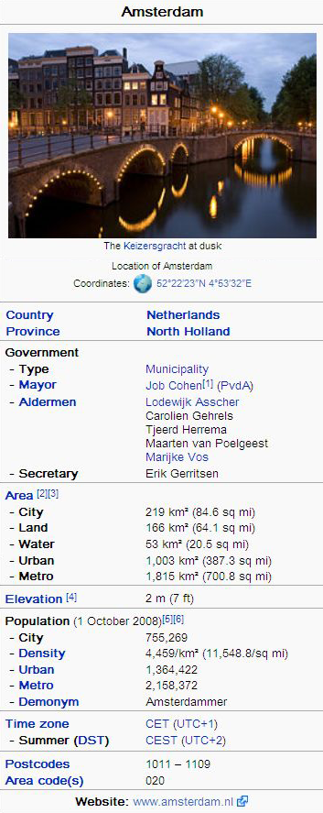
Extracting structured data from Wikipedia
@prefix dbpedia <http://dbpedia.org/resource/>.
@prefix dbterm <http://dbpedia.org/property/>.
dbpedia:Amsterdam
dbterm:officialName "Amsterdam" ;
dbterm:longd "4” ;
dbterm:longm "53" ;
dbterm:longs "32” ;
dbterm:leaderName dbpedia:Lodewijk_Asscher ;
...
dbterm:areaTotalKm "219" ;
...
dbpedia:ABN_AMRO
dbterm:location dbpedia:Amsterdam ;
...
Notes:
The right hand portion of the wiki side is what is referred to as 'infobox'. The left side is the dbpedia content as made available.

Slide 81
Automatic links among open datasets
<http://dbpedia.org/resource/Amsterdam>
owl:sameAs <http://rdf.freebase.com/ns/...> ;
owl:sameAs <http://sws.geonames.org/2759793> ;
...
<http://sws.geonames.org/2759793>
owl:sameAs <http://dbpedia.org/resource/Amsterdam>
wgs84_pos:lat "52.3666667" ;
wgs84_pos:long "4.8833333";
geo:inCountry <http://www.geonames.org/countries/#NL> ;
...
Processors can switch automatically from one to the other…
Notes:
This is the important point: this is why this is Linking open data. What the community does (and this is a community project) is to make agreements on how the different datasets can be linked and then the linkage is done automatically by the 'bridges' that map the public datasets into RDF. Eg, geonames is a public dataset by geonames.org and dbpedia is, well... wikipedia:-)

Slide 82
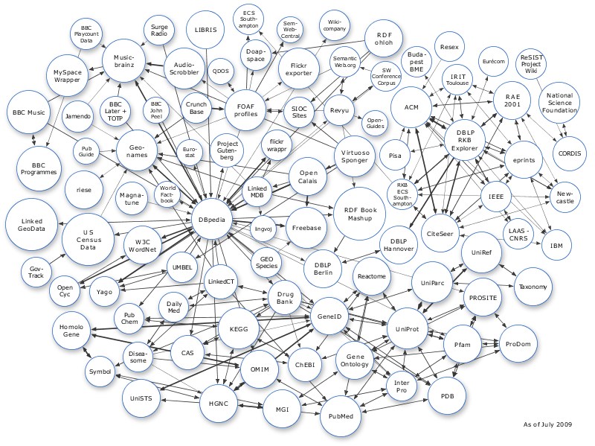
The LOD “cloud”, June 2009

Slide 83
Remember the BBC example?

Slide 84
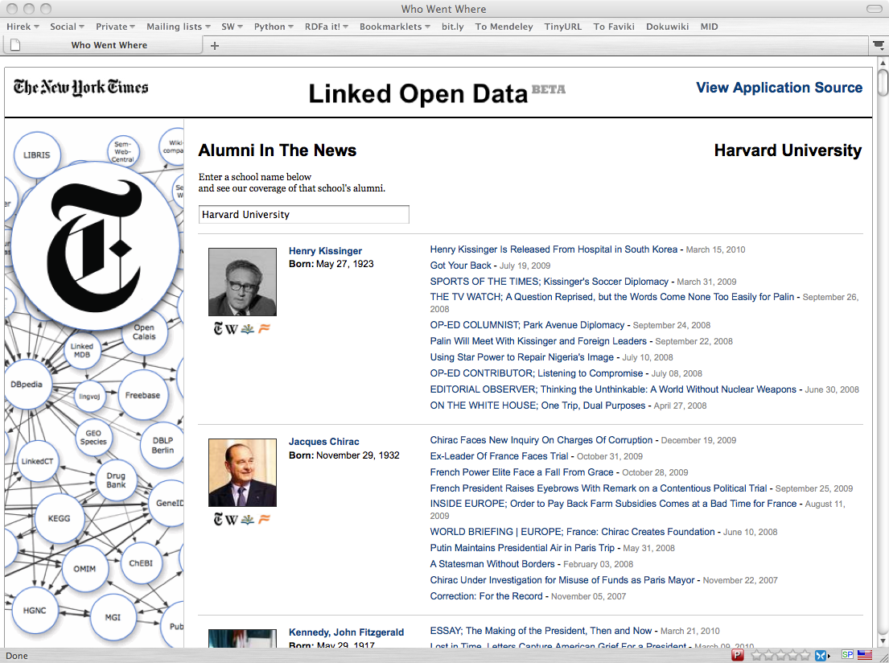
NYT articles on university alumni
Notes:
List of universities come from Dbpedia -> auto completion based on that list -> NYT identifiers are present in DBPedia, used to back index into the NYT archives; sameAs links to, say, freeBase is also provided

Slide 85
Query RDF Data
(SPARQL)

Slide 86
Querying RDF graphs
Remember the Jena idiom:
StmtIterator iter=model.listStatements(subject,null,null);
while(iter.hasNext()) {
st = iter.next();
p = st.getProperty(); o = st.getObject();
do_something(p,o);
In practice, more complex queries into the RDF data are necessary
  something like “give me (a,b) pairs for which there is an x such that (x parent a) and (b brother x) holds” (ie, return the uncles)
The goal of SPARQL (Query Language for RDF)

Slide 87
Analyze the Jena example
StmtIterator iter=model.listStatements(subject,null,null);
while(iter.hasNext()) {
st = iter.next();
p = st.getProperty(); o = st.getObject();
do_something(p,o);
?p
?o
?p
?o
subject
?p
?o
?p
?o

Slide 88
General: graph patterns
The fundamental idea: use graph patterns
  the pattern contains unbound symbols
  by binding the symbols, subgraphs of the RDF graph are selected
  if there is such a selection, the query returns bound resources

Slide 89
Our Jena example in SPARQL
SELECT ?p ?o
WHERE {subject ?p ?o}
The triples in WHERE define the graph pattern, with ?p and ?o “unbound” symbols
The query returns all p,o pairs
?p
?o
?p
?o
subject
?p
?o
?p
?o

Slide 90
Simple SPARQL example
SELECT ?isbn ?price ?currency # note: not ?x!
WHERE {?isbn a:price ?x. ?x rdf:value ?price. ?x p:currency ?currency.}
a:name
Ghosh, Amitav
a:author
a:author
http://…isbn/000651409X
http://…isbn/2020386682
a:price
a:price
a:price
a:price
rdf:value
p:currency
rdf:value
p:currency
rdf:value
p:currency
rdf:value
p:currency
33
:£
50
:€
60
:€
78
:$

Slide 91
Simple SPARQL example
SELECT ?isbn ?price ?currency # note: not ?x!
WHERE {?isbn a:price ?x. ?x rdf:value ?price. ?x p:currency ?currency.}
Returns: [<…409X>,33,:£]
a:name
Ghosh, Amitav
a:author
a:author
http://…isbn/000651409X
http://…isbn/2020386682
a:price
a:price
a:price
a:price
rdf:value
p:currency
rdf:value
p:currency
rdf:value
p:currency
rdf:value
p:currency
33
:£
50
:€
60
:€
78
:$

Slide 92
Simple SPARQL example
SELECT ?isbn ?price ?currency # note: not ?x!
WHERE {?isbn a:price ?x. ?x rdf:value ?price. ?x p:currency ?currency.}
Returns: [<…409X>,33,:£], [<…409X>,50,:€]
a:name
Ghosh, Amitav
a:author
a:author
http://…isbn/000651409X
http://…isbn/2020386682
a:price
a:price
a:price
a:price
rdf:value
p:currency
rdf:value
p:currency
rdf:value
p:currency
rdf:value
p:currency
33
:£
50
:€
60
:€
78
:$

Slide 93
Simple SPARQL example
SELECT ?isbn ?price ?currency # note: not ?x!
WHERE {?isbn a:price ?x. ?x rdf:value ?price. ?x p:currency ?currency.}
Returns: [<…409X>,33,:£], [<…409X>,50,:€],
[<…6682>,60,:€]
a:name
Ghosh, Amitav
a:author
a:author
http://…isbn/000651409X
http://…isbn/2020386682
a:price
a:price
a:price
a:price
rdf:value
p:currency
rdf:value
p:currency
rdf:value
p:currency
rdf:value
p:currency
33
:£
50
:€
60
:€
78
:$

Slide 94
Simple SPARQL example
SELECT ?isbn ?price ?currency # note: not ?x!
WHERE {?isbn a:price ?x. ?x rdf:value ?price. ?x p:currency ?currency.}
Returns: [<…409X>,33,:£], [<…409X>,50,:€],
[<…6682>,60,:€], [<…6682>,78,:$]
a:name
Ghosh, Amitav
a:author
a:author
http://…isbn/000651409X
http://…isbn/2020386682
a:price
a:price
a:price
a:price
rdf:value
p:currency
rdf:value
p:currency
rdf:value
p:currency
rdf:value
p:currency
33
:£
50
:€
60
:€
78
:$

Slide 95
Pattern constraints
SELECT ?isbn ?price ?currency # note: not ?x!
WHERE { ?isbn a:price ?x. ?x rdf:value ?price. ?x p:currency ?currency.
FILTER(?currency == :€) }
Returns: [<…409X>,50,:€], [<…6682>,60,:€]
a:name
Ghosh, Amitav
a:author
a:author
http://…isbn/000651409X
http://…isbn/2020386682
a:price
a:price
a:price
a:price
rdf:value
p:currency
rdf:value
p:currency
rdf:value
p:currency
rdf:value
p:currency
33
:£
50
:€
60
:€
78
:$

Slide 96
Many extra SPARQL features
Limit the number of returned results; remove duplicates, sort them, …
Optional branches: if some part of the pattern does not match, ignore it
Specify several data sources (via URI-s) within the query (essentially, a merge on-the-fly!)
Construct a graph using a separate pattern on the query results
In SPARQL 1.1: updating data, not only query

Slide 97
SPARQL usage in practice
SPARQL is usually used over the network
  separate documents define the protocol and the result format
    SPARQL Protocol for RDF with HTTP and SOAP bindings
    SPARQL results in XML or JSON formats
Big datasets often offer “SPARQL endpoints” using this protocol
  typical example: SPARQL endpoint to DBpedia

Slide 98
SPARQL as a unifying point
Application
SPARQL Endpoint
SPARQL Endpoint
SPARQL Construct
SPARQL Construct
Triple store
SPARQL Processor
Database
RDFa
NLP Techniques
GRDDL, RDFa
SQL⬄RDF
RDF Graph
Relational
Database
HTML
Unstructured Text
XML/XHTML

Slide 99
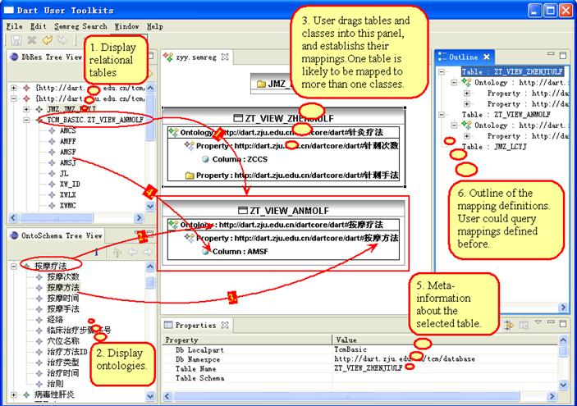
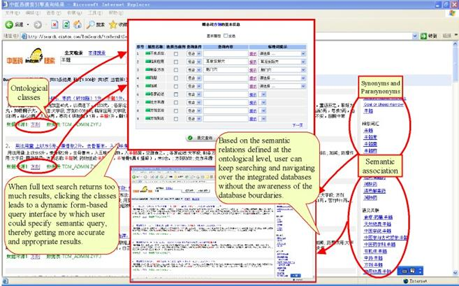
Integrate knowledge for Chinese Medicine
Integration of a large number of TCM databases
  around 80 databases, around 200,000 records each
Courtesy of Huajun Chen, Zhejiang University, (SWEO Case Study)
Notes:
The various databases around the country are handled by independent bodies. A visual query generator creates a SPARQL query, this is then decomposed to access the individual databases, on-the-fly transformed into SQL queries, the result are in RDF and recombined for the answer. The system is uses in the Chinese Academy of Sciences' Research institute on traditional Chinese medicine.
The university is also working on a nation-wide ontology on traditional Chinese Medicine that can be combined with the search to improve it. Still in development. That ontology might be bound to western medical ontologies, too (eventually).

Slide 100
Vocabularies

Slide 101
Vocabularies
Data integration needs agreements on
  terms
    “translator”, “author”
  categories used
    “Person”, “literature”
  relationships among those
    “an author is also a Person…”, “historical fiction is a narrower term than fiction”
    ie, new relationships can be deduced

Slide 102
Vocabularies
There is a need for “languages” to define such vocabularies
  to define those vocabularies
  to assign clear “semantics” on how new relationships can be deduced

Slide 103
But what about RDFS?
Indeed RDFS is such framework:
  there is typing, subtyping
  properties can be put in a hierarchy
  datatypes can be defined
RDFS is enough for many vocabularies
But not for all!

Slide 104
Three technologies have emerged
To re-use thesauri, glossaries, etc: SKOS
To define more complex vocabularies with a strong logical underpinning: OWL
Generic framework to define rules on terms and data: RIF

Slide 105
Using thesauri, glossaries
(SKOS)

Slide 106
SKOS
Represent and share classifications, glossaries, thesauri, etc
  for example:
    Dewey Decimal Classification, Art and Architecture Thesaurus, ACM classification of keywords and terms…
    classification/formalization of Web 2.0 type tags
Define classes and properties to add those structures to an RDF universe
  allow for a quick port of this traditional data, combine it with other data

Slide 107
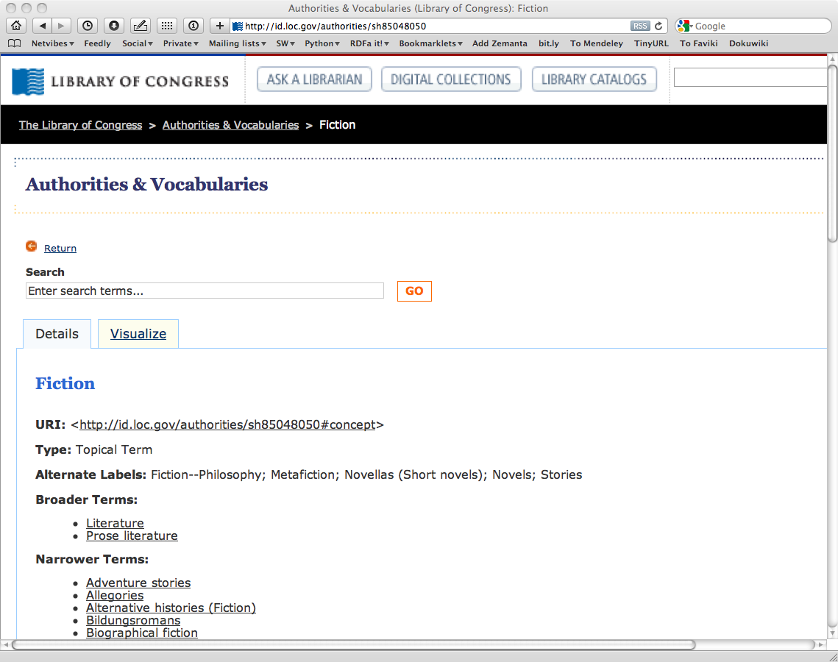
Example: the term “Fiction”, as defined by the Library of Congress

Slide 108
Example: the term “Fiction”, as defined by the Library of Congress

Slide 109
Thesauri have identical structures…
The structure of the LOC page is fairly typical
  label, alternate label, narrower, broader, …
  there is even an ISO standard for such structures
SKOS provides a basic structure to create an RDF representation of these

Slide 110
LOC’s “Fiction” in SKOS/RDF
Literature
skos:Concept
Fiction
skos:prefLabel
rdf:type
skos:prefLabel
skos:broader
http://id.loc.gov/…#concept
skos:altLabel
skos:narrower
Metafiction
skos:altLabel
skos:narrower
skos:prefLabel
Novels
Allegories
Adventure stories
skos:prefLabel

Slide 111
Usage of the LOC graph
Fiction
skos:Concept
Historical Fiction
skos:prefLabel
skos:prefLabel
rdf:type
skos:broader
dc:subject
dc:title
http:.//…/isbn/…
The Glass Palace

Slide 112
Importance of SKOS
SKOS provides a simple bridge between the “print world” and the (Semantic) Web
Thesauri, glossaries, etc, from the library community can be made available
  LOC is a good example
SKOS can also be used to organize tags, annotate other vocabularies, …

Slide 113
Importance of SKOS
Anybody in the World can refer to common concepts
  they mean the same for everybody
Applications may exploit the relationships among concepts
  eg, SPARQL queries may be issued on the merge of the library data and the LOC terms

Slide 114
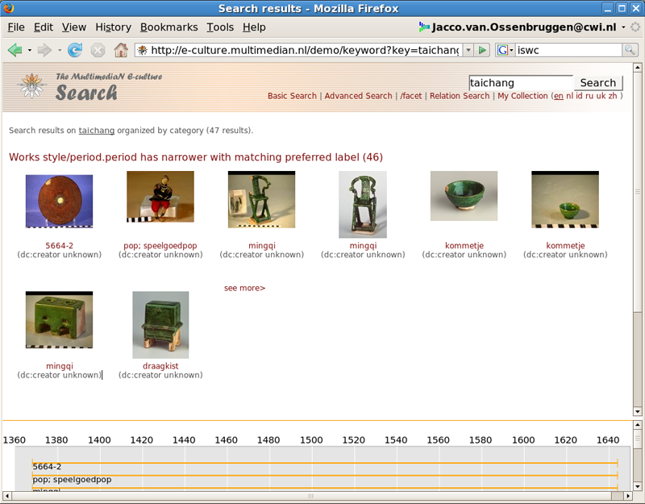
Semantic portal for art collections
Courtesy of Jacco van Ossenbruggen, CWI, and Guus Schreiber, VU Amsterdam
Notes:
The point to note:Taichang is the name of a Ming emperor. There is nothing in the collection to match his name, However, there is an extra information in the knowledge base that:
svcn:Ming_period skos:narrower svcn:Taichang_period
which means that artefacts of the Ming period are also displayed

Slide 115
Ontologies
(OWL)

Slide 116
SKOS is not enough…
SKOS may be used to provide simple vocabularies
But it is not a complete solution
  it concentrates on the concepts only
  no characterization of properties in general
  simple from a logical perspective
    ie, few inferences are possible

Slide 117
Application may want more…
Complex applications may want more possibilities:
  characterization of properties
  identification of objects with different URI-s
  disjointness or equivalence of classes
  construct classes, not only name them
  more complex classification schemes
  can a program reason about some terms? E.g.:
    “if «Person» resources «A» and «B» have the same «foaf:email» property, then «A» and «B» are identical”
  etc.

Slide 118
Web Ontology Language = OWL
OWL is an extra layer, a bit like RDFS or SKOS
  own namespace, own terms
  it relies on RDF Schemas
It is a separate recommendation
  actually… there is a 2004 version of OWL (“OWL 1”)
  and there is an update (“OWL 2”) published in 2009

Slide 119
OWL is complex…
OWL is a large set of additional terms
We will not cover the whole thing here…

Slide 120
Term equivalences
For classes:
  owl:equivalentClass: two classes have the same individuals
  owl:disjointWith: no individuals in common
For properties:
  owl:equivalentProperty
    remember the a:author vs. f:auteur?
  owl:propertyDisjointWith

Slide 121
Term equivalences
For individuals:
  owl:sameAs: two URIs refer to the same concept (“individual”)
  owl:differentFrom: negation of owl:sameAs

Slide 122
Other example: connecting to French
a:author
owl:equivalentProperty
f:auteur
a:Novel
owl:equivalentClass
f:Roman

Slide 123
Typical usage of owl:sameAs
Linking our example of Amsterdam from one data set (DBpedia) to the other (Geonames):
<http://dbpedia.org/resource/Amsterdam>
owl:sameAs <http://sws.geonames.org/2759793>;
This is the main mechanism of “Linking” in the Linked Open Data project

Slide 124
Property characterization
In OWL, one can characterize the behavior of properties (symmetric, transitive, functional, reflexive, inverse functional…)
One property can be defined as the “inverse” of another

Slide 125
What this means is…
If the following holds in our triples:
:email rdf:type owl:InverseFunctionalProperty.

Slide 126
What this means is…
If the following holds in our triples:
:email rdf:type owl:InverseFunctionalProperty.
<A> :email "mailto:a@b.c".
<B> :email "mailto:a@b.c".

Slide 127
What this means is…
If the following holds in our triples:
:email rdf:type owl:InverseFunctionalProperty.
<A> :email "mailto:a@b.c".
<B> :email "mailto:a@b.c".
then, processed through OWL, the following holds, too:
<A> owl:sameAs <B>.

Slide 128
Keys
Inverse functional properties are important for identification of individuals
  think of the email examples
But… identification based on one property may not be enough

Slide 129
Keys
“if two persons have the same emails and the same
homepages then they are identical”
Identification is based on the identical values of two properties
The rule applies to persons only

Slide 130
Previous rule in OWL
:Person rdf:type owl:Class;
owl:hasKey (:email :homepage) .

Slide 131
What it means is…
If:
<A> rdf:type :Person ;
:email "mailto:a@b.c";
:homepage "http://www.ex.org".
<B> rdf:type :Person ;
:email "mailto:a@b.c";
:homepage "http://www.ex.org".
then, processed through OWL, the following holds, too:
<A> owl:sameAs <B>.

Slide 132
Classes in OWL
In RDFS, you can subclass existing classes… that’s all
In OWL, you can construct classes from existing ones:
  enumerate its content
  through intersection, union, complement
  etc

Slide 133
Enumerate class content
:Currency
rdf:type owl:Class;
owl:oneOf (:€ :£ :$).
I.e., the class consists of exactly of those individuals and nothing else

Slide 134
Union of classes
:Novel rdf:type owl:Class.
:Short_Story rdf:type owl:Class.
:Poetry rdf:type owl:Class.
:Literature rdf:type owl:Class;
owl:unionOf (:Novel :Short_Story :Poetry).
Other possibilities: owl:complementOf, owl:intersectionOf, …

Slide 135
For example…
If:
:Novel rdf:type owl:Class.
:Short_Story rdf:type owl:Class.
:Poetry rdf:type owl:Class.
:Literature rdf:type owl:Class;
owl:unionOf (:Novel :Short_Story :Poetry).
<myWork> rdf:type :Novel .
then the following holds, too:
<myWork> rdf:type :Literature .

Slide 136
It can be a bit more complicated…
If:
:Novel rdf:type owl:Class.
:Short_Story rdf:type owl:Class.
:Poetry rdf:type owl:Class.
:Literature rdf:type owlClass;
owl:unionOf (:Novel :Short_Story :Poetry).
fr:Roman owl:equivalentClass :Novel .
<myWork> rdf:type fr:Roman .
then, through the combination of different terms, the following still holds:
<myWork> rdf:type :Literature .

Slide 137
What we have so far…
The OWL features listed so far are already fairly powerful
E.g., various databases can be linked via owl:sameAs, functional or inverse functional properties, etc.
Many inferred relationship can be found using a traditional rule engine

Slide 138
However… that may not be enough
Very large vocabularies might require even more complex features
  some major issues
    the way classes (i.e., “concepts”) are defined
    handling of datatypes like intervals
OWL includes those extra features but… the inference engines become (much) more complex

Slide 139
Example: property value restrictions
New classes are created by restricting the property values on a class
For example: how would I characterize a “listed price”?
  it is a price that is given in one of the “allowed” currencies (€, £, or $)
  this defines a new class

Slide 140
But: OWL is hard!
The combination of class constructions with various restrictions is extremely powerful
What we have so far follows the same logic as before
  extend the basic RDF and RDFS possibilities with new features
  define their semantics, ie, what they “mean” in terms of relationships
  expect to infer new relationships based on those
However… a full inference procedure is hard
  not implementable with simple rule engines, for example

Slide 141
OWL “species” or profiles
OWL species comes to the fore:
  restricting which terms can be used and under what circumstances (restrictions)
  if one abides to those restrictions, then simpler inference engines can be used
They reflect compromises: expressiveness vs. implementability

Slide 142
OWL Species
OWL Full
OWL DL
OWL EL
OWL RL
OWL QL

Slide 143
OWL RL
Goal: to be implementable with rule engines
Usage follows a similar approach to RDFS:
  merge the ontology and the instance data into an RDF graph
  use the rule engine to add new triples (as long as it is possible)

Slide 144
What can be done in OWL RL?
Many features are available:
  identity of classes, instances, properties
  subproperties, subclasses, domains, ranges
  union and intersection of classes (but with some restrictions)
  property characterizations (functional, symmetric, etc)
  property chains
  keys
  some property restrictions
All examples so far could be inferred with OWL RL!

Slide 145
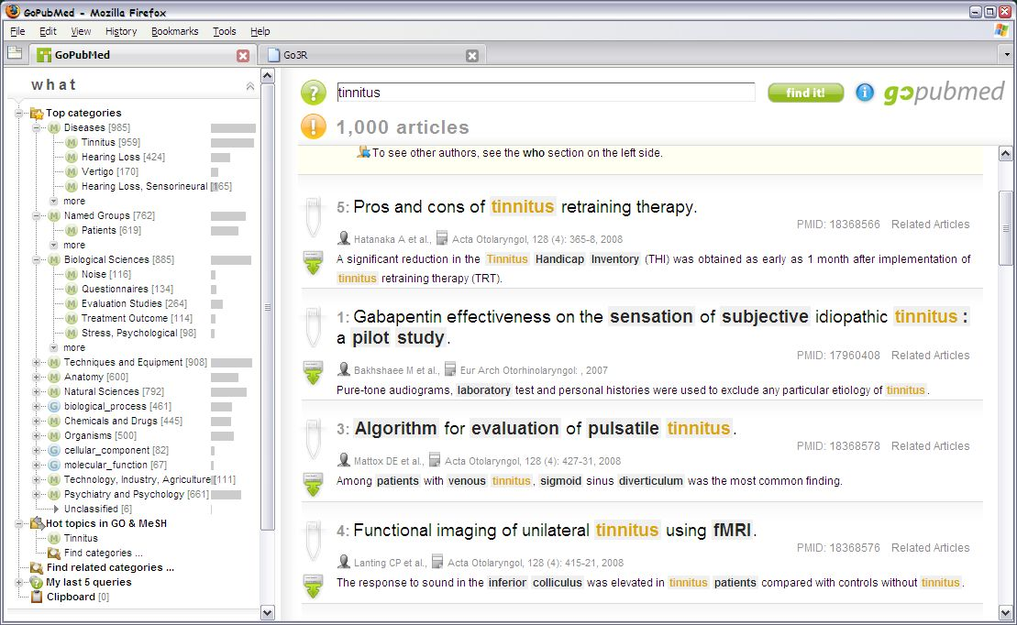
Improved Search via Ontology (GoPubMed)
Search results are re-ranked using ontologies
  related terms are highlighted
Notes:
Pubmed.org is the 'google' of the medical profession. The result of a search is re-ranked, a better interface is provided, and related terms are also shown based on public medical ontologies. The left hand side refers to the Gene Ontology and Mesh ontologies; actually (red highlight on the screen) and the user is able to follow up related terms, too.
Produced by a German company (transinight)

Slide 146
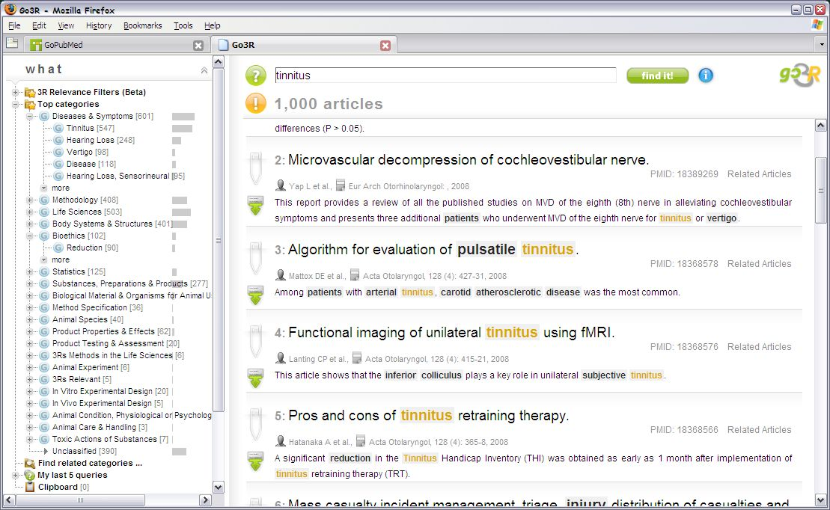
Improved Search via Ontology (Go3R)
Same dataset, different ontology
  (ontology is on non-animal experimentation)
Notes:
Pubmed.org is the 'google' of the medical profession. The result of a search is re-ranked, a better interface is provided, and related terms are also shown based on public medical ontologies. The left hand side refers to the Gene Ontology and Mesh ontologies; actually (red highlight on the screen) and the user is able to follow up related terms, too.
Produced by a German company (transinight)

Slide 147
Rules
(RIF)

Slide 148
Why rules on the Semantic Web?
Some conditions may be complicated in ontologies (ie, OWL)
  eg, Horn rules: (P1 & P2 & …) → C
In many cases applications just want 2-3 rules to complete integration
Ie, rules may be an alternative to (OWL based) ontologies

Slide 149
Things you may want to express
An example from our bookshop integration:
  “I buy a novel with over 500 pages if it costs less than €20”
  something like (in an ad-hoc syntax):
{
?x rdf:type p:Novel;
p:page_number ?n;
p:price [
p:currency :€;
rdf:value ?z
].
?n > "500"^^xsd:integer.
?z < "20.0"^^xsd:double.
}
=>
{ <me> p:buys ?x }

Slide 150
Things you may want to express
p:Novel
rdf:type
p:page_number
?n
?n>500
?x
me
p:buys
?x
p:price
p:currency
:€
rdf:value
?z
?z<20

Slide 151
RIF (Rule Interchange Format)
The goals of the RIF work:
  define simple rule language(s) for the (Semantic) Web
  define interchange formats for rule based systems
RIF defines several “dialects” of languages
RIF is not bound to RDF only
  eg, relationships may involve more than 2 entities
  there are dialects for production rule systems

Slide 152
RIF Core
The simplest RIF “dialect”
A Core document is
  directives like import, prefix settings for URI-s, etc
  a sequence of logical implications

Slide 153
RIF Core example
Document(
Prefix(cpt http://example.com/concepts#)
Prefix(person http://example.com/people#)
Prefix(isbn http://…/isbn/)
Group
(
Forall ?Buyer ?Book ?Seller (
cpt:buy(?Buyer ?Book ?Seller):- cpt:sell(?Seller ?Book ?Buyer)
)
cpt:sell(person:John isbn:000651409X person:Mary)
)
)
This infers the following relationship:
cpt:buy(person:Mary isbn:000651409X person:John)

Slide 154
Expressivity of RIF Core
Formally: definite Horn without function symbols, a.k.a. “Datalog”
  eg, p(a,b,c) is fine, but p(f(a),b,c) is not
Includes some extra features
  built-in datatypes and predicates
  “local” symbols, a bit like blank nodes

Slide 155
Expressivity of RIF Core
There are also “safeness measures”
  eg, variable in a consequent should be in the antecedent
  this secures a straightforward implementation strategy (“forward chaining”)

Slide 156
RIF Syntaxes
RIF defines
  a “presentation syntax”
  a standard XML syntax to encode and exchange the rules
  there is a draft for expressing Core in RDF
    just like OWL is represented in RDF

Slide 157
What about RDF and RIF?
Typical scenario:
  the “data” of the application is available in RDF
  rules on that data is described using RIF
  the two sets are “bound” (eg, RIF “imports” the data)
  a RIF processor produces new relationships

Slide 158
To make RIF/RDF work
Some technical issues should be settled:
  RDF triples have to be representable in RIF
  various constructions (typing, datatypes, lists) should be aligned
  the semantics of the two worlds should be compatible
There is a separate document that brings these together

Slide 159
Remember the what we wanted from Rules?
{
?x rdf:type p:Novel;
p:page_number ?n;
p:price [
p:currency :€;
rdf:value ?z
].
?n > "500"^^xsd:integer.
?z < "20.0"^^xsd:double.
}
=>
{ <me> p:buys ?x }

Slide 160
The same with RIF Presentation syntax
Document (
Prefix …
Group (
Forall ?x ?n ?z (
<me>[p:buys->?x] :-
And(
?x rdf:type p:Novel
?x[p:page_number->?n p:price->_abc]
_abc[p:currency->:€ rdf:value->?z]
External( pred:numeric-greater-than(?n "500"^^xsd:integer) )
External( pred:numeric-less-than(?z "20.0"^^xsd:double) )
)
)
)
)

Slide 161
Discovering new relationships…
Forall ?x ?n ?z (
<me>[p:buys->?x] :-
And(
?x # p:Novel
?x[p:page_number->?n p:price->_abc]
_abc[p:currency->:€ rdf:value->?z]
External( pred:numeric-greater-than(?n "500"^^xsd:integer) )
External( pred:numeric-less-than(?z "20.0"^^xsd:double) )
)
)

Slide 162
Discovering new relationships…
Forall ?x ?n ?z (
<me>[p:buys->?x] :-
And(
?x # p:Novel
?x[p:page_number->?n p:price->_abc]
_abc[p:currency->:€ rdf:value->?z]
External( pred:numeric-greater-than(?n "500"^^xsd:integer) )
External( pred:numeric-less-than(?z "20.0"^^xsd:double) )
)
)
combined with:
<http://…/isbn/…> a p:Novel;
p:page_number "600"^^xsd:integer ;
p:price [ rdf:value "15.0"^^xsd:double ; p:currency :€ ] .

Slide 163
Discovering new relationships…
Forall ?x ?n ?z (
<me>[p:buys->?x] :-
And(
?x # p:Novel
?x[p:page_number->?n p:price->_abc]
_abc[p:currency->:€ rdf:value->?z]
External( pred:numeric-greater-than(?n "500"^^xsd:integer) )
External( pred:numeric-less-than(?z "20.0"^^xsd:double) )
)
)
combined with:
<http://…/isbn/…> a p:Novel;
p:page_number "600"^^xsd:integer ;
p:price [ rdf:value "15.0"^^xsd:double ; p:currency :€ ] .
yields:
<me> p:buys <http://…/isbn/…> .

Slide 164
RIF vs. OWL?
The expressivity of the two is fairly identical
  the emphasis are a bit different
Using rules vs. ontologies may largely depend on
  available tools
  personal technical experience and expertise
  taste…

Slide 165
What about OWL RL?
OWL RL stands for “Rule Language”…
OWL RL is in the intersection of RIF Core and OWL
  inferences in OWL RL can be expressed with RIF rules
  RIF Core engines can act as OWL RL engines

Slide 166
Inferencing and SPARQL
Question: how do SPARQL queries and inferences work together?
  RDFS, OWL, and RIF produce new relationships
  on what data do we query?
Answer: in current SPARQL, that is not defined
But, in SPARQL 1.1 it is…

Slide 167
SPARQL 1.1 and RDFS/OWL/RIF
SPARQL Engine with entailment
RDF Data
RDFS/OWL/RIF data
entailment
SPARQL Pattern
RDF Data with extra triples
SPARQL Pattern
Query result
pattern matching

Slide 168
What have we achieved?
(putting all this together)

Slide 169
Remember the integration example?
Applications
Manipulate
Query
…
Map,
Expose,
…
Data represented in abstract format
Data in various formats

Slide 170
Same with what we learned
Applications
SPARQL,
Inferences
…
RDB ⬄ RDF,
GRDL, RDFa,
…
Data represented in RDF with extra knowledge (RDFS, SKOS, RIF, OWL,…)
Data in various formats

Slide 171
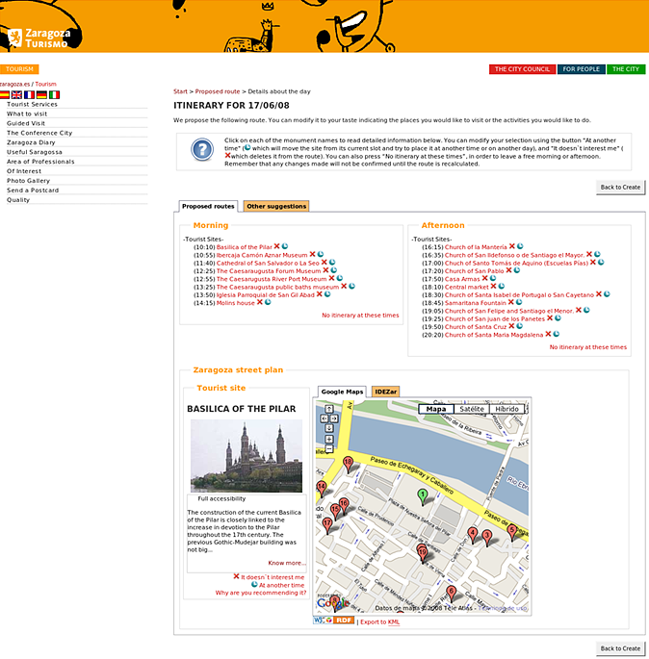
eTourism: provide personalized itinerary
Integration of relevant data in Zaragoza (using RDF and ontologies)
Use rules on the RDF data to provide a proper itinerary
Courtesy of Jesús Fernández, Mun. of Zaragoza, and Antonio Campos, CTIC (SWEO Use Case)
Notes:
The system has been developed and tested for Statoil, which is the largest oil company on the Norwegian Continental Shelf, and covers experiences with over 2,500 drilling operations since the early 90s.
The objective of the reuse improvements is to discover relevant experiences that could affect current or planned drilling operations. The shared domain ontology is used for semantic annotation, and for retrieval of information. It is developed collaboratively by the discipline advisors, and covers operations, equipment, events and failure states in drilling operations. It also includes relations between these concepts, for example, to indicate that a particular event may result in a failure state.

Slide 172
Available documents, resources

Slide 173
Available specifications:
Primers, Guides
The “RDF Primer” and the “OWL Guide” give a formal introduction to RDF(S) and OWL
SKOS has its separate “SKOS Primer”
GRDDL Primer and RDFa Primer have been published
The W3C Semantic Web Activity Wiki has links to all the specifications

Slide 174
“Core” vocabularies
There are also a number “core vocabularies”
  Dublin Core: about information resources, digital libraries, with extensions for rights, permissions, digital right management
  FOAF: about people and their organizations
  DOAP: on the descriptions of software projects
  SIOC: Semantically-Interlinked Online Communities
  vCard in RDF
  …
One should never forget: ontologies/vocabularies must be shared and reused!

Slide 175
Some books
J. Pollock: Semantic Web for Dummies, 2009
G. Antoniu and F. van Harmelen: Semantic Web Primer, 2nd edition in 2008
D. Allemang and J. Hendler: Semantic Web for the Working Ontologist, 2008
P. Hitzler, R. Sebastian, M. Krötzsch: Foundation of Semantic Web Technologies, 2009
…
See the separate Wiki page collecting book references

Slide 176
Lots of Tools (not an exhaustive list!)
Categories:
  Triple Stores
  Inference engines
  Converters
  Search engines
  Middleware
  CMS
  Semantic Web browsers
  Development environments
  Semantic Wikis
  …
Some names:
  Jena, AllegroGraph, Mulgara, Sesame, flickurl, …
  TopBraid Suite, Virtuoso environment, Falcon, Drupal 7, Redland, Pellet, …
  Disco, Oracle 11g, RacerPro, IODT, Ontobroker, OWLIM, Talis Platform, …
  RDF Gateway, RDFLib, Open Anzo, DartGrid, Zitgist, Ontotext, Protégé, …
  Thetus publisher, SemanticWorks, SWI-Prolog, RDFStore…
  …

Slide 177
Further information
Planet RDF aggregates a number of SW blogs:
  http://planetrdf.com/
Semantic Web Interest Group
  a forum developers with archived (and public) mailing list, and a constant IRC presence on freenode.net#swig
  anybody can sign up on the list
    http://www.w3.org/2001/sw/interest/

Slide 178

Thank you for your attention!
These slides are also available on the Web:
http://www.w3.org/2010/Talks/0622-SemTech-IH/

