Slide 1
Semantic Web, Linked Data, and Semantic 3D Media Ivan Herman, W3C FOCUS 3D Conference, Sophia Antipolis, France 2010-02-11
Notes:
This is just a generic slide set. Should be adapted, reviewed, possibly with slides removed, for a specific event. Rule of thumb: on the average, a slide is a minute…

Slide 2
Significant buzz…
There is quite a buzz around “Semantics”, “Semantic Technologies”, “Semantic Web”, “Web 3.0”, “Data Web”, etc, these days
New applications, companies, tools, etc, come to the fore frequently

Slide 3
Significant buzz…
It is, of course, not always clear what these terms all mean:
“Semantic Web” is a way to specify data and data relationships; it is also a collection of specific technologies (RDF, OWL, GRDDL, SPARQL, …)
“Semantic Technologies”, “Web 3.0” often mean more, including intelligent agents, usage of complex logical procedures, etc

Slide 4
Lots of Tools (not an exhaustive list!)
Categories:
Triple Stores
Inference engines
Converters
Search engines
Middleware
CMS
Semantic Web browsers
Development environments
Semantic Wikis
…
Some names:
Jena, AllegroGraph, Mulgara, Sesame, flickurl, …
TopBraid Suite, Virtuoso environment, Falcon, Drupal 7, Redland, Pellet, …
Disco, Oracle 11g, RacerPro, IODT, Ontobroker, OWLIM, Talis Platform, …
RDF Gateway, RDFLib, Open Anzo, DartGrid, Zitgist, Ontotext, Protégé, …
Thetus publisher, SemanticWorks, SWI-Prolog, RDFStore…
…

Slide 5
The main lesson:
Anybody can start developing Semantic Web applications

Slide 6
There is a great community
There are lots of tutorials, overviews, and books around
some of them good, some of them bad, just as with any other areas…
Active developers’ communities
blogs, IRC channels, mailing lists, various fora: more than what one person can oversee…
Some measures claim that there are over 10⁷ Semantic Web documents on the Web

Slide 7
Some deployment communities
Major communities pick the technology up: digital libraries, defence, eGovernment, energy sector, financial services, health care, oil and gas industry, life sciences, social web applications …

Slide 8
So what is the Semantic Web?

Slide 9
There is a growing number of application patterns referring to the Semantic Web:
data integration using RDF, SKOS, OWL, …
knowledge engineering with complex ontologies
using, e.g., OWL and/or rule based reasoning
better data management, archiving, cataloguing, etc
e.g., digital library applications
managing, coordinating, combining Web services
intelligent software agents
improving search (usually using domain specific vocabularies…)
etc

Slide 10
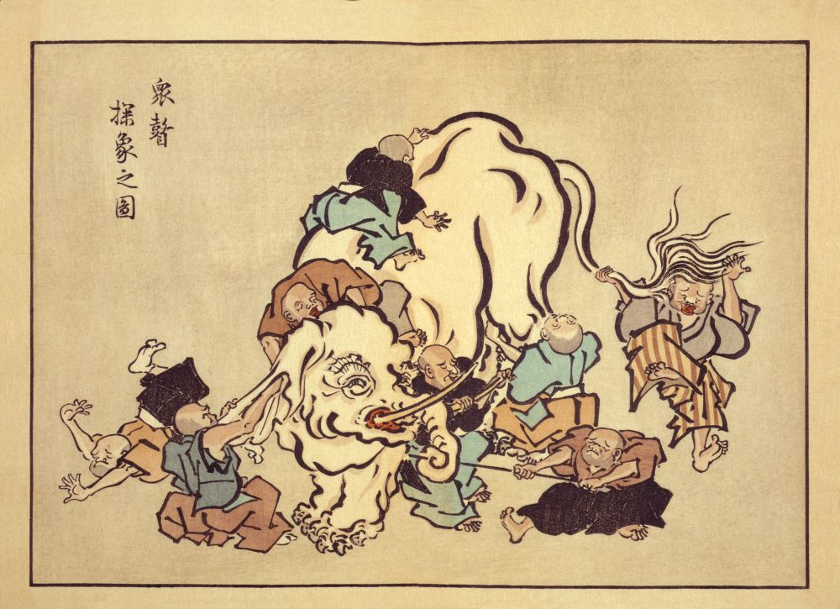
Is this where we are?

Slide 11
Maybe, but being an elephant is not necessary bad!
it shows that the Semantic Web is a mature technology
that there is lots of interest, applications
various application areas pick what they need…
e.g., some need sophisticated knowledge management, so they go for complex ontology’s…
some concentrate on semantically simpler vocabularies but large volume of data
…and that is fine, there is room for many!

Slide 12
But it is good to (re-)emphasize some principles
The Semantic Web:
extends the principles of the Web from documents to data; create a Web of data

Slide 13
It is the Semantic Web, and not only Semantics!
data, ontologies, vocabularies, etc, can (and should!) be shared, reused, potentially on Web scale
the “network effect” on data
The major importance of RDF is that it provides an abstract integration layer for data on the Web

Slide 14
Applications are not always very complex…
Eg: simple semantic annotations of data provides easy integration (eg, with MusicBrainz, Wikipedia, geographic data sets, etc)
What is needed: some simple vocabularies, simple annotation
annotation an be generated by a server automatically, or
added by the user via some user interface
This extra data can be in some microformats, in RDFa, …
Notes:
The application: bind the data on CD-s automatically with public music data. The annotations on the page help in quickly making such links

Slide 15
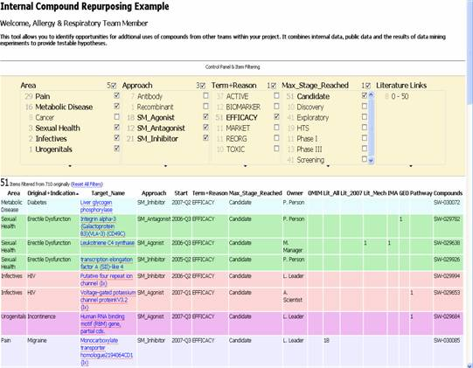
A relatively simple application
Goal: reuse of older experimental data
Keep data in databases or XML, just export key “fact” as RDF
Use a faceted browser to visualize and interact with the result
Courtesy of Nigel Wilkinson, Lee Harland, Pfizer Ltd, Melliyal Annamalai, Oracle (SWEO Case Study)
Notes:
Various types of databases are accessed having an RDF transformation of (part of the data) on the fly. Some of the data may be simple tables, some are the result of continuous background processing analysing the literature (not directly related to the Semantic Web per se).
The integration of the data is done on the RDF level, and is viewed via an off-the-shelf (though experimental) faceted browser (Exhibit). Ie, the Semantic Web portion is very simple but allows for a very quick integration of the data on the screen.

Slide 16
But is there already a Web of Data out there?

Slide 17
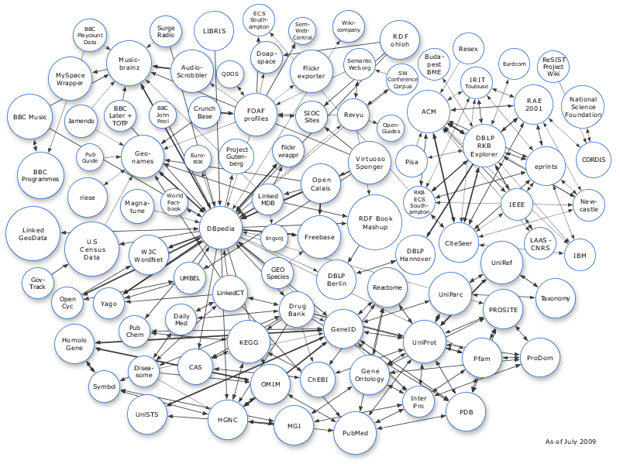
Linking Open Data Project
Goal: “expose” open datasets in RDF
Set RDF links among the data items from different datasets
Set up query endpoints
Billions triples, millions of “links”
Notes:
The important point here is that (1) the data becomes available to the World via a unified format (ie, RDF), regardless on how it is stored inside and (2) the various datasets are interlinked together, ie, they are not independent islands. Dbpedia is probably the most important 'hub' in the project.

Slide 18
Example data source: DBpedia
DBpedia is a community effort to
extract structured (“infobox”) information from Wikipedia
provide a SPARQL endpoint to the dataset
interlink the DBpedia dataset with other datasets on the Web

Slide 19
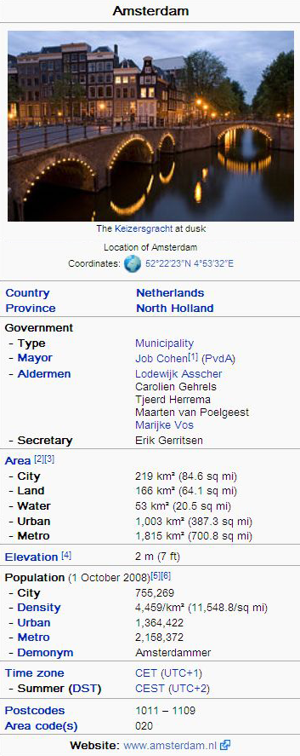
Extracting structured data from Wikipedia
@prefix dbpedia <http://dbpedia.org/resource/>.
@prefix dbterm <http://dbpedia.org/property/>.
dbpedia:Amsterdam dbterm:officialName “Amsterdam” ; dbterm:longd “4” ;
dbterm:longm “53” ;
dbterm:longs “32” ;
... dbterm:leaderName dbpedia:Job_Cohen ;
...
dbterm:areaTotalKm “219” ;
...
dbpedia:ABN_AMRO
dbterm:location dbpedia:Amsterdam ;
...
Notes:
The right hand portion of the wiki side is what is referred to as 'infobox'. The left side is the dbpedia content as made available.

Slide 20
Automatic links among open datasets
<http://dbpedia.org/resource/Amsterdam> owl:sameAs <http://rdf.freebase.com/ns/...> ;
owl:sameAs <http://sws.geonames.org/2759793> ;
...
<http://sws.geonames.org/2759793>
owl:sameAs <http://dbpedia.org/resource/Amsterdam>
wgs84_pos:lat “52.3666667” ;
wgs84_pos:long “4.8833333” ;
geo:inCountry <http://www.geonames.org/countries/#NL> ;
...
Processors can switch automatically from one to the other…
Notes:
This is the important point: this is why this is Linking open data. What the community does (and this is a community project) is to make agreements on how the different datasets can be linked and then the linkage is done automatically by the 'bridges' that map the public datasets into RDF. Eg, geonames is a public dataset by geonames.org and dbpedia is, well... wikipedia:-)

Slide 21
The real value is in the links!
Notes:
The important point here is that (1) the data becomes available to the World via a unified format (ie, RDF), regardless on how it is stored inside and (2) the various datasets are interlinked together, ie, they are not independent islands. Dbpedia is probably the most important 'hub' in the project.

Slide 22
Accessing the cloud
Applications can access the data directly (via the URI-s)
There are several “instantiations” of part of the cloud that user can access
these store copies of several “blobs”
possibly with some inferred triples based on, eg, OWL
often offering a SPARQL endpoint to query to cloud

Slide 23
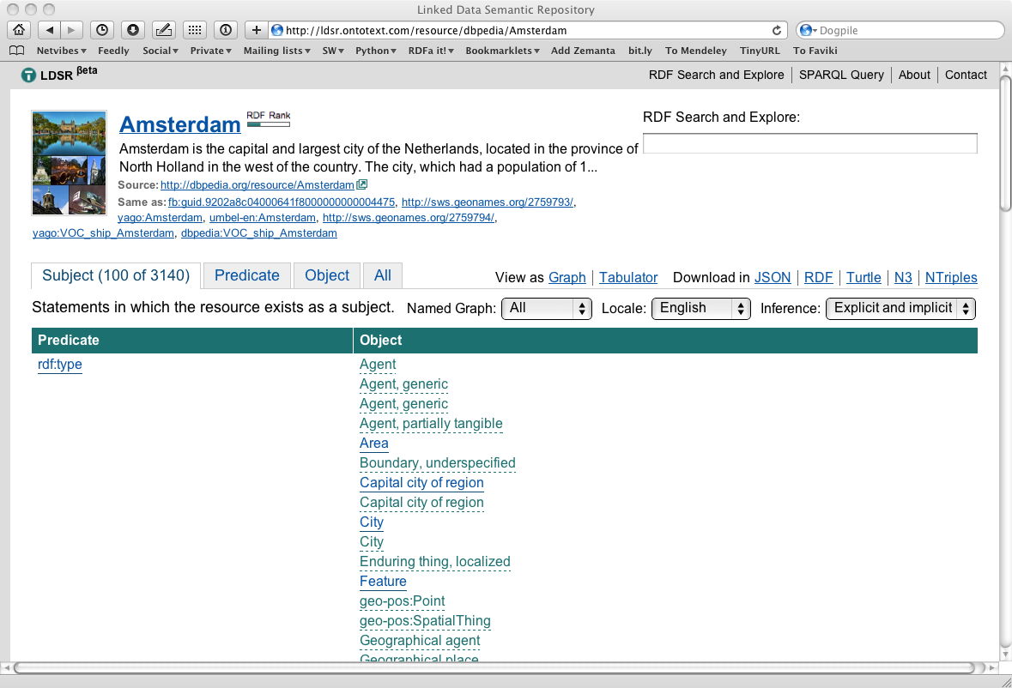
Example for cloud exploration

Slide 24
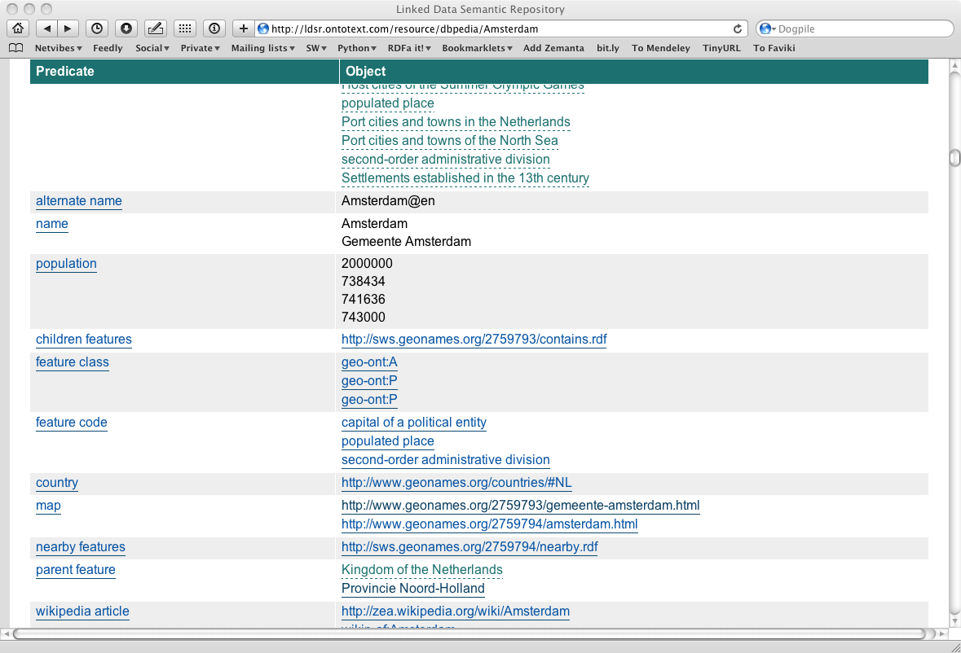
Example for cloud exploration

Slide 25
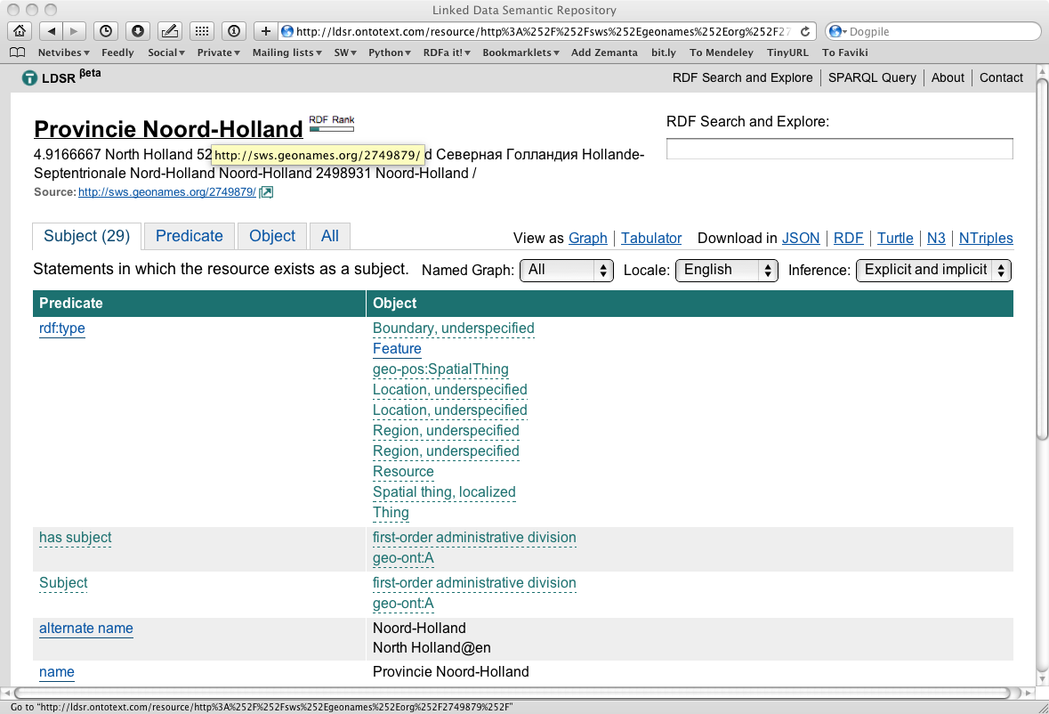
Example for cloud exploration

Slide 26
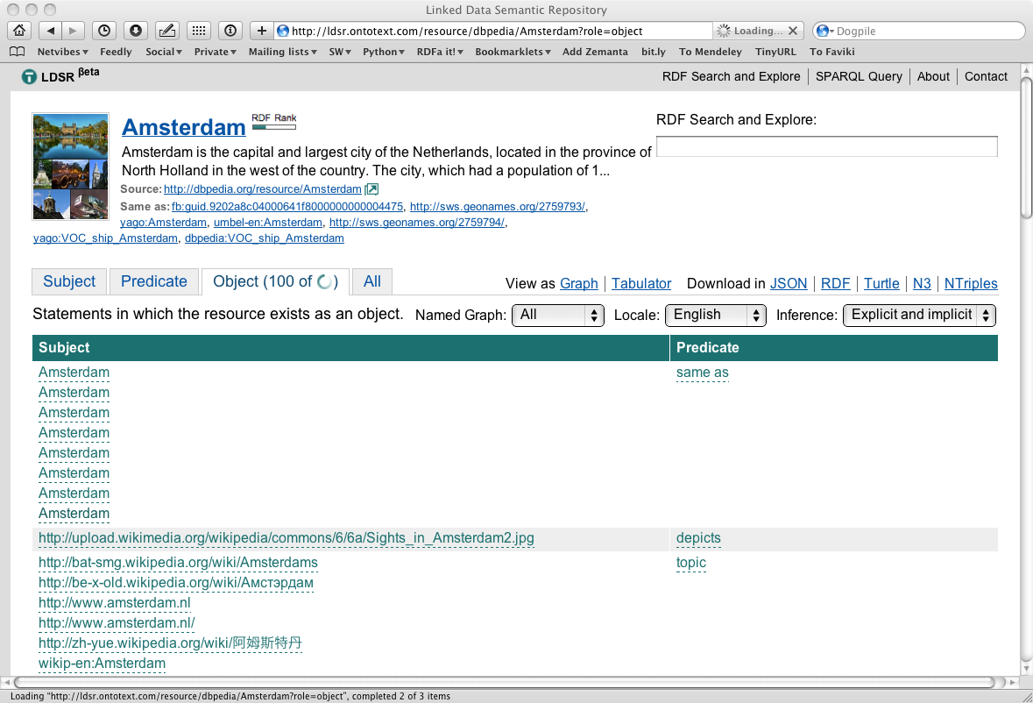
Example for cloud exploration

Slide 27
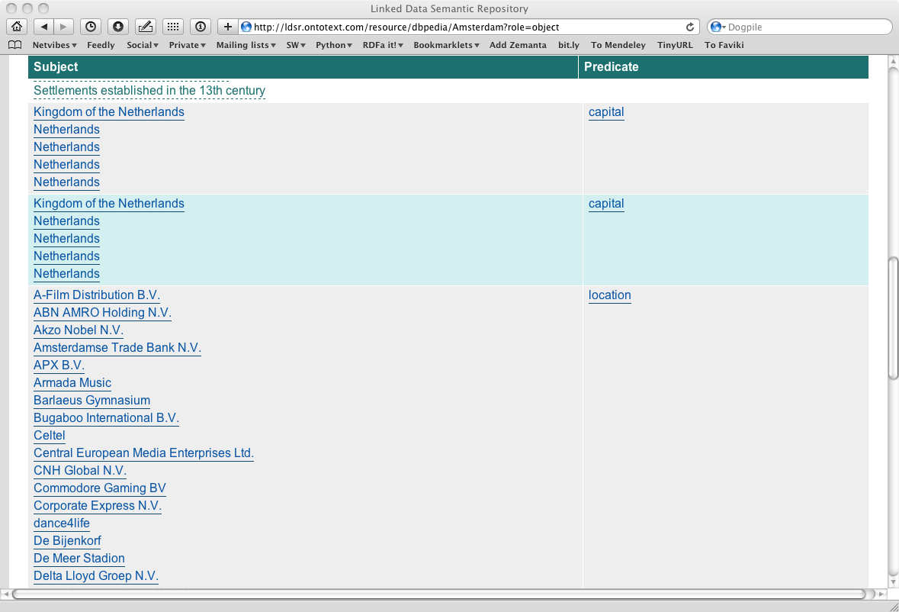
Example for cloud exploration

Slide 28
Linking Open Data Project (cont)
This is a major community project
anybody can participate; to subscribe to the list:
http://lists.w3.org/Archives/public/public-lod/
or look at the project site:
http://esw.w3.org/topic/SweoIG/TaskForces/CommunityProjects/LinkingOpenData
if you know of open data sets: contact the project to incorporate it with the rest!
Notes:
JOIN THE CLUB!

Slide 29
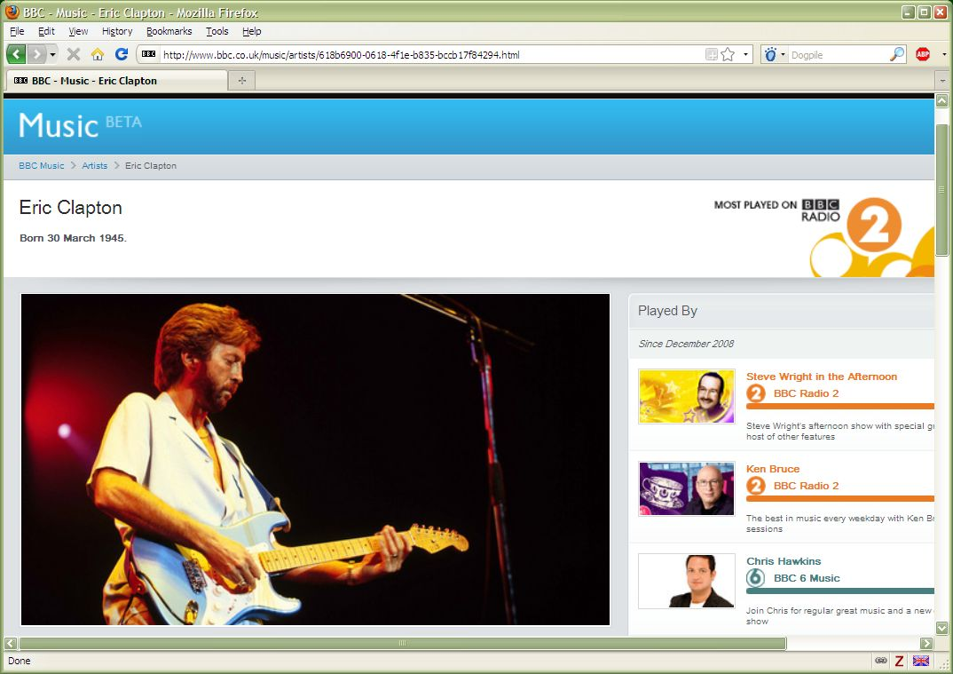
Using the LOD to build Web site: BBC

Slide 30
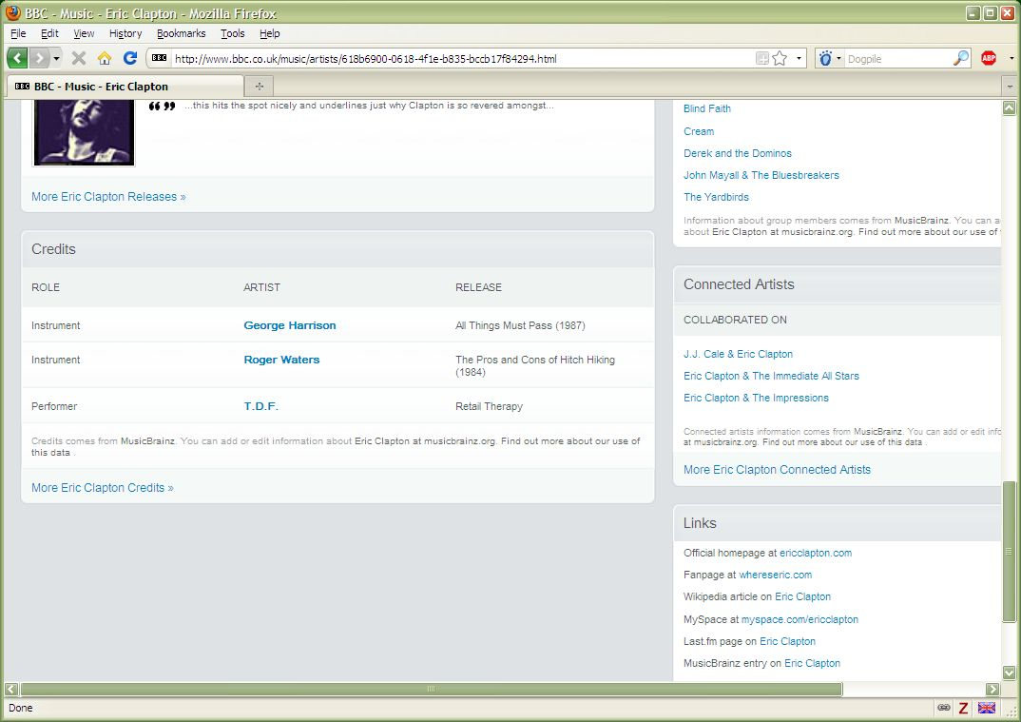
Using the LOD to build Web site: BBC

Slide 31
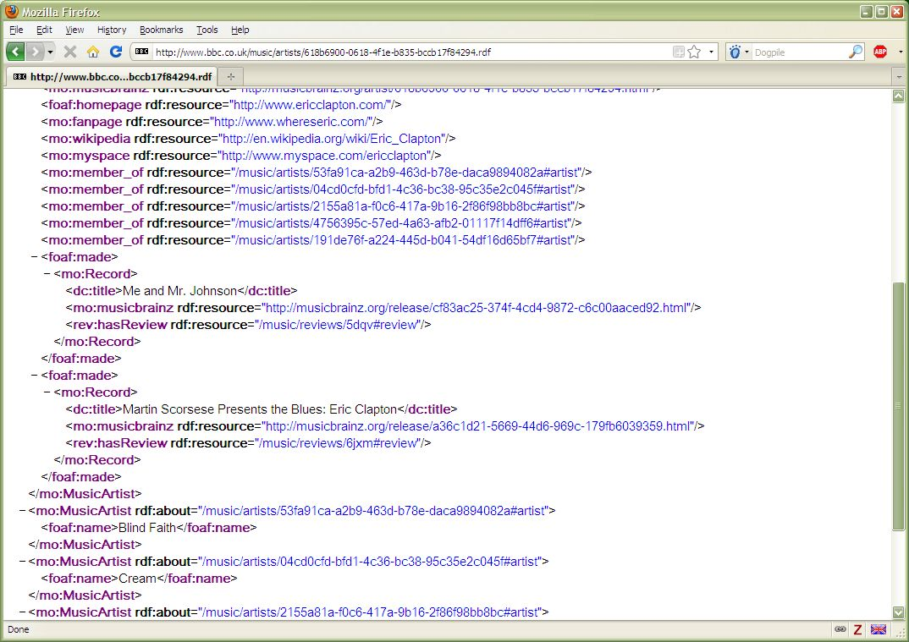
Using the LOD to build Web site: BBC

Slide 32
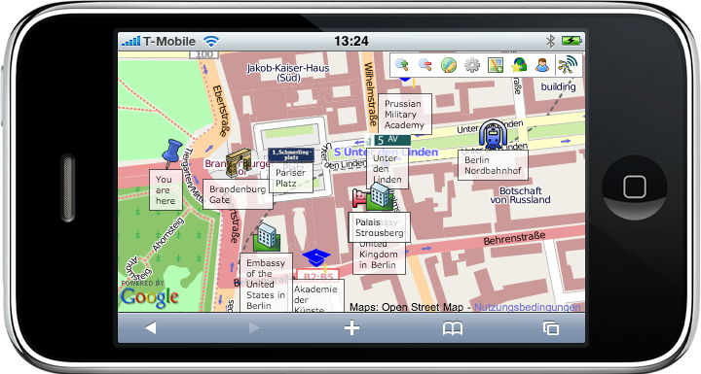
Using the LOD cloud on an iPhone
Courtesy of Chris Bizer and Christian Becker, Freie Universität, Berlin

Slide 33
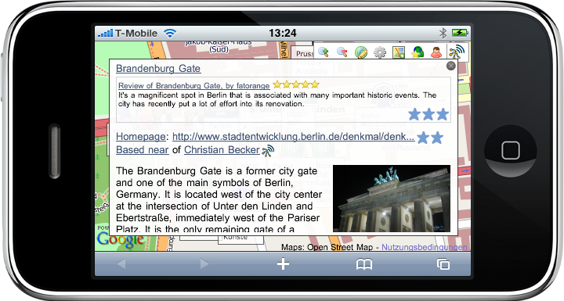
Using the LOD cloud on an iPhone
Courtesy of Chris Bizer and Christian Becker, Freie Universität, Berlin

Slide 34
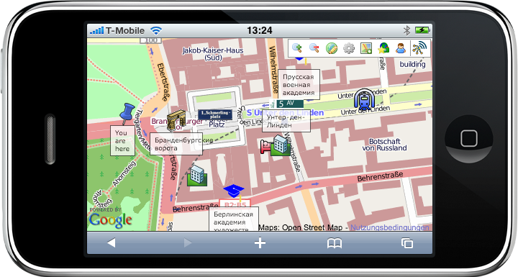
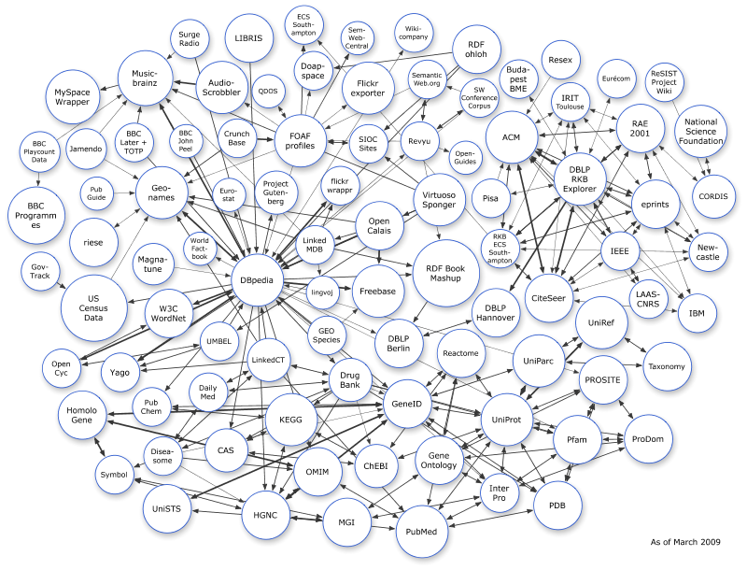
Using the LOD cloud on an iPhone
Search Engines
Amazon EC2
Marbles Engine
Sindice
Shared Cache
HTTP GET
FalconS
Linked Data on the Web
Courtesy of Chris Bizer and Christian Becker, Freie Universität, Berlin

Slide 35
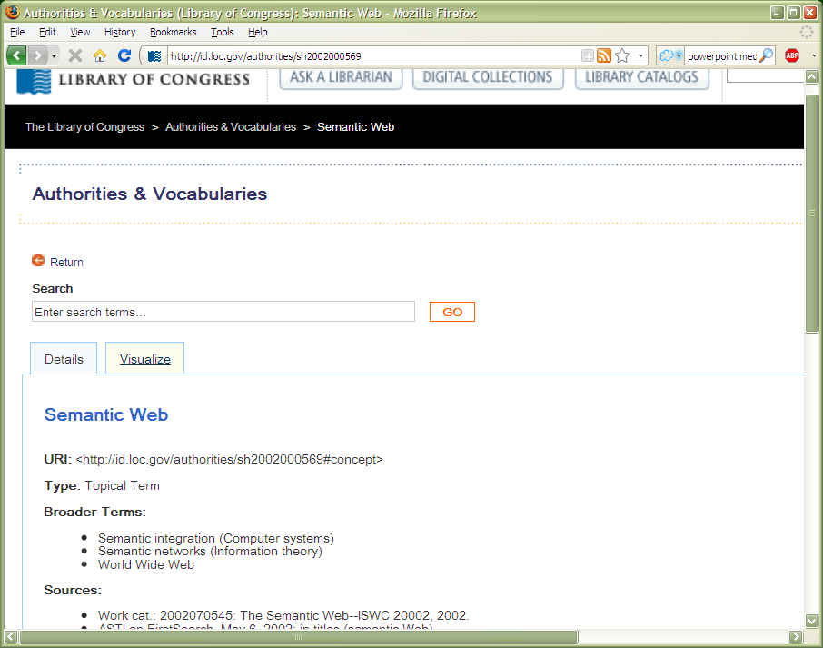
Publication of data: Library of Congress Subject Headings

Slide 36
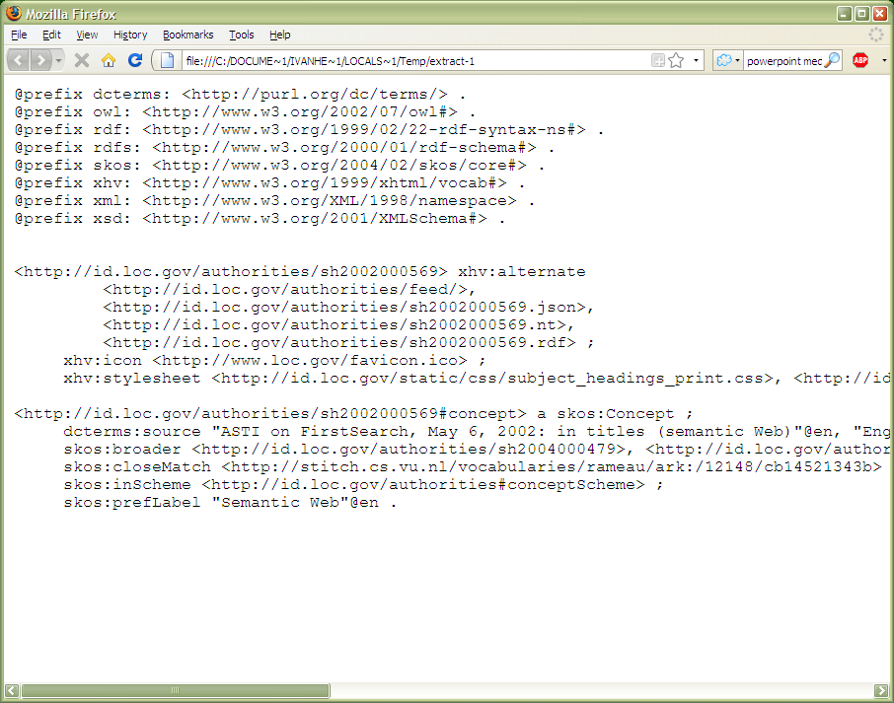
Publication of data: Library of Congress Subject Headings

Slide 37
And what about ontologies?
I.e.: where does, e.g., OWL comes into the LOD picture?
Ontologies are necessary to properly integrate data
“term used in this dataset relates to the term used there this and this way…”
OWL, Rules, RDF vocabularies are vital

Slide 38
And what about ontologies?
But…
Ontologies/vocabularies can be very simple (few terms)
Expressivity vs. complexity of management and usage has always be balanced
You are perfectly decent Semantic Web citizen even if you do not use complex OWL (or not use OWL at all…)

Slide 39
How does this apply to Semantic 3D?

Slide 40
Caveat: I am an outsider, sorry if I bang on open doors…

Slide 41
Think of the data out there from the start!
Modeling 3D objects with Semantic technologies (OWL, SKOS, etc) is important
(and looks fairly complex from where I stand…)
But… think of the data out there!
applications may use this in many different ways…
Also: contribute if you can, make your data widely available!

Slide 42
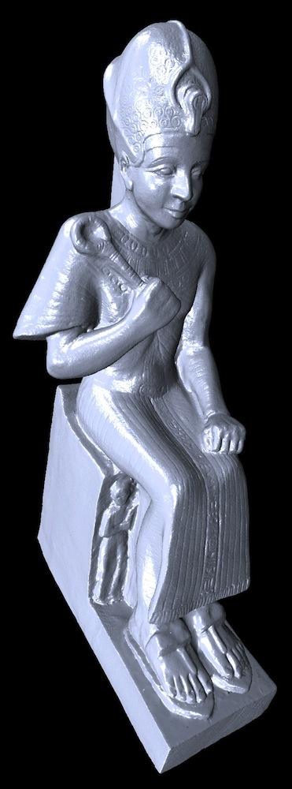
An artificial example
There is, of course, the 3D modeling aspect
But there may be, also, additional data on the artifact
This can be connected to the outside world

Slide 43
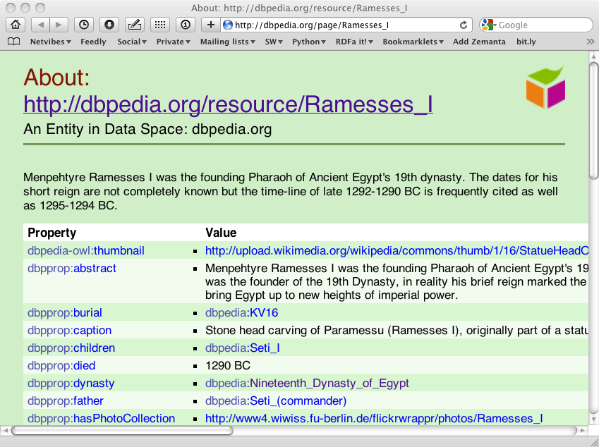
An artificial example

Slide 44
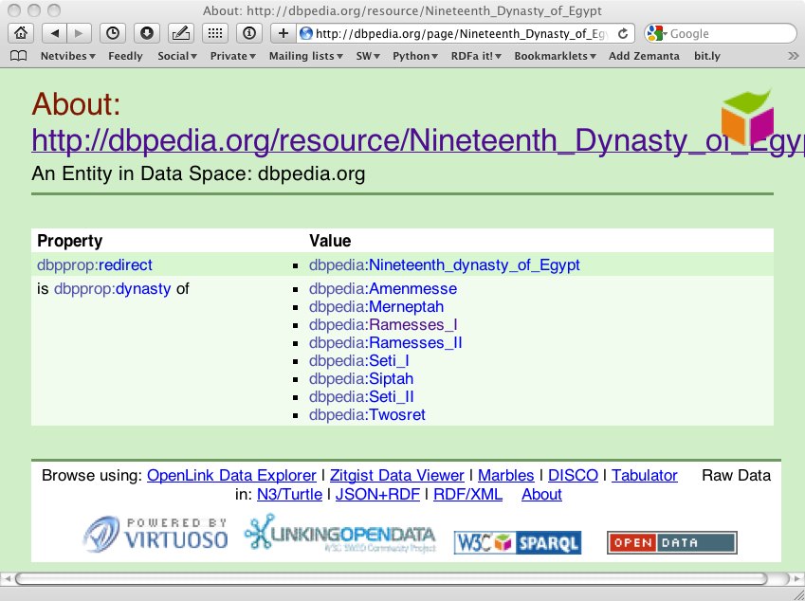
An artificial example

Slide 45
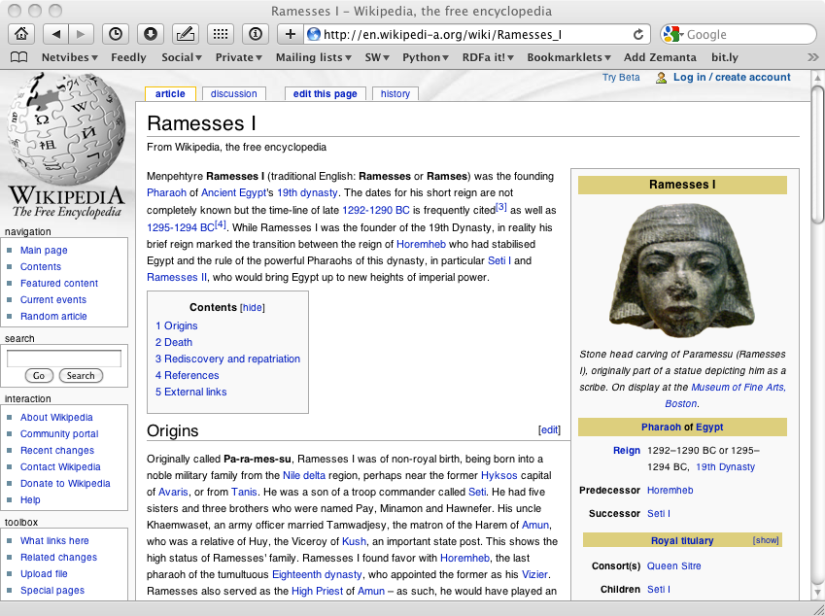
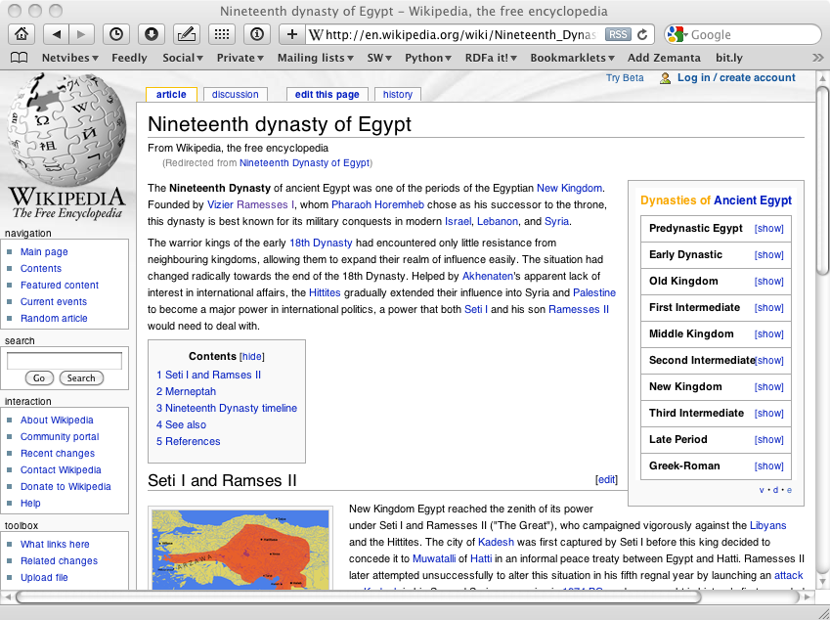
You can of course make it nicer…

Slide 46
Obviously, there are other datasets
Use Geodata for precise information on Egypt
Use the LOC data to give precise subject descriptions
…

Slide 47
Make the data available!
Make the data available to others!
Wouldn’t it be cool to see your data appear on an iPhone?

Slide 48
What does it mean in practice?
Add (meta)data to your artifacts
use http URI-s
use public vocabularies if possible
Add links to other public datasets
that is how others will find you!
Make your data and vocabularies public
If you can: set up a SPARQL endpoint

Slide 49
Practice in other areas
I used a very “webby” example with Wikipedia
Of course other areas have their own datasets that can be used

Slide 50
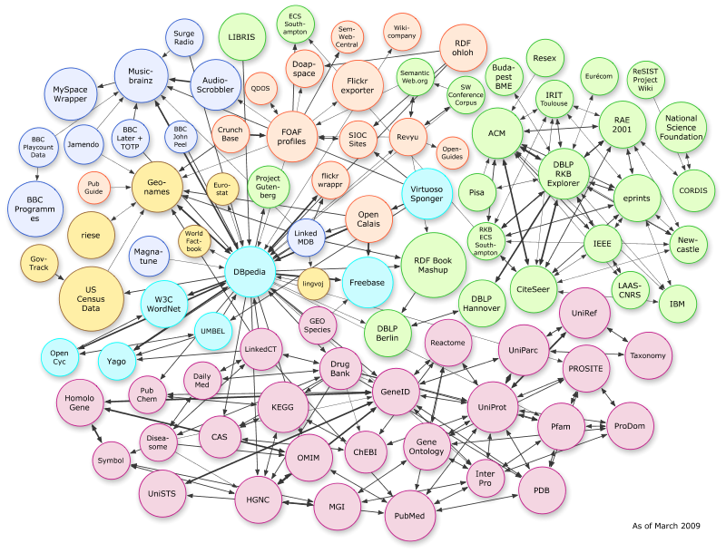
Colored LOD cloud…

Slide 51
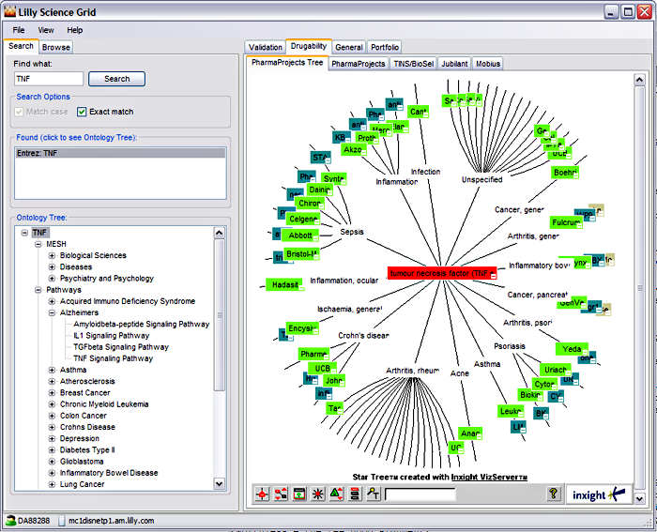
Eli Lilly’s Target Assessment Tool
Courtesy of Susie Stephens, Eli Lilly (SWEO Case Study)

Slide 52
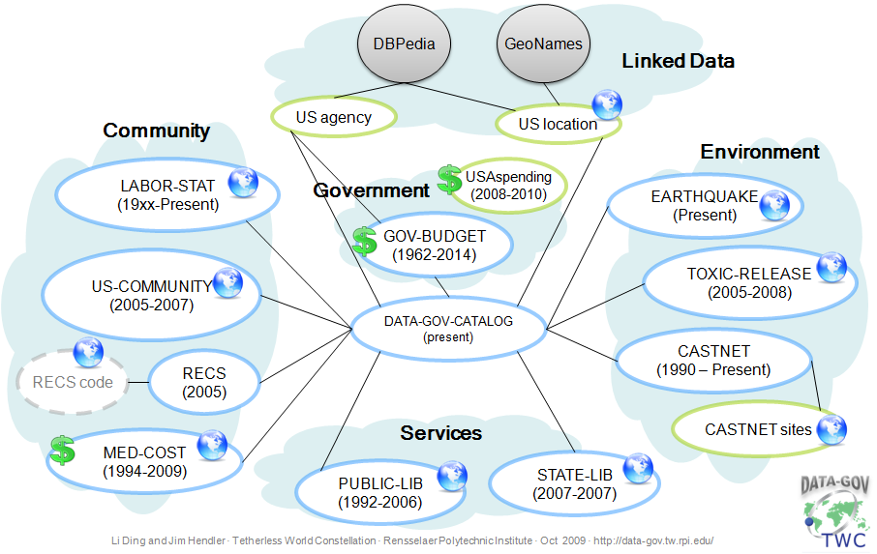
Linked Open eGov Data (US example)

Slide 53
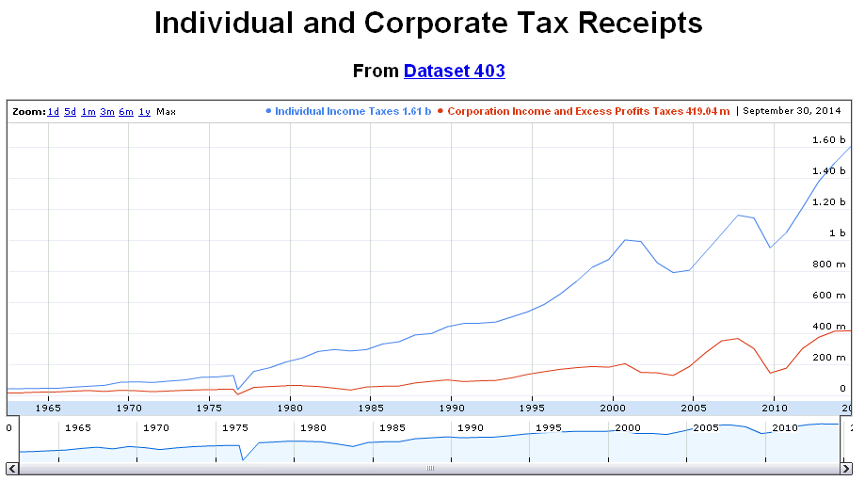
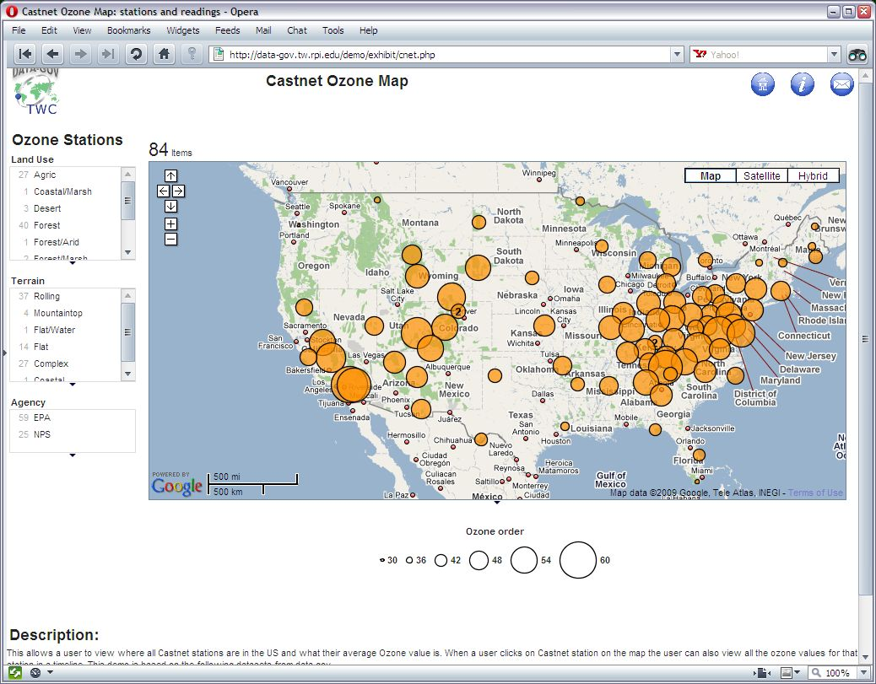
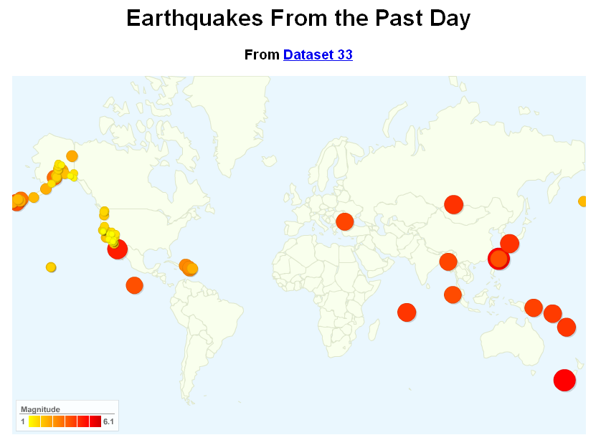
You publish the raw data, others use it…
Examples from RPI’s Data-gov Wiki, Jim Hendler & al.

Slide 54
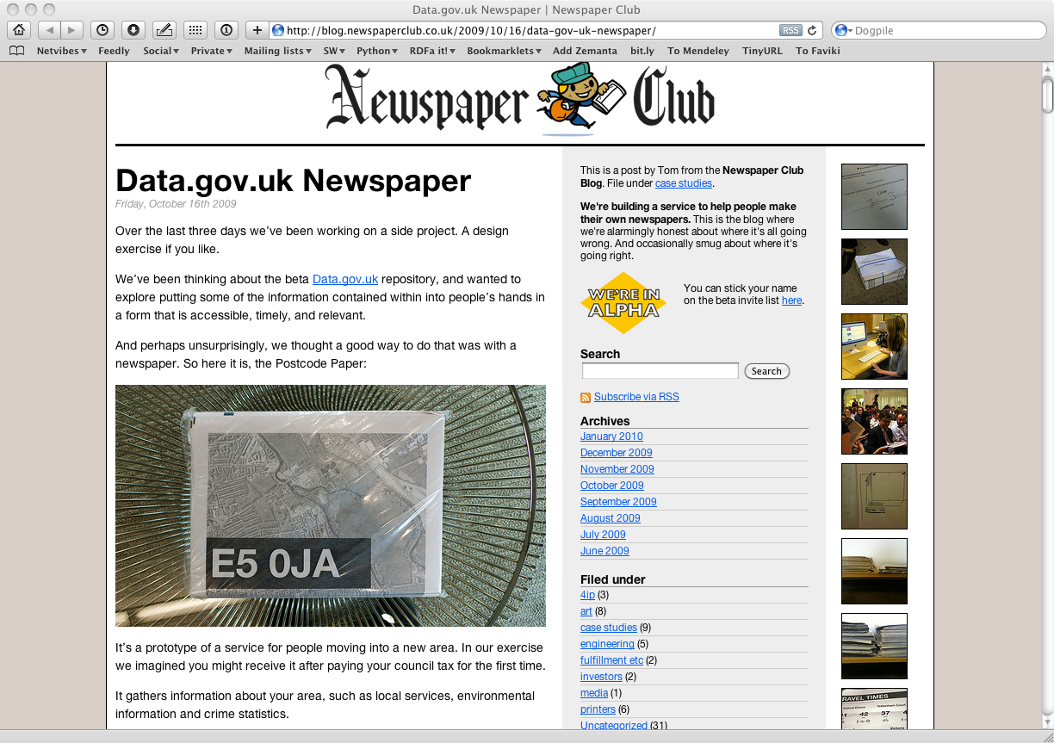
An example with UK government data
Notes:
The point is: they combine data drawn from data.gov.uk to produce, traditional, printed paper to be distributed in the neighborhood providing practical information like doctors, pharmacies, etc, in an up-to-date fashion

Slide 55
Conclusions
The Semantic Web is, primarily a Web of Data
Think of the out there when looking at 3D Media
use data out there
link your data to the rest of the Web of Data
Making these available opens up nice application facilities!

Slide 56
Thank you for your attention!
These slides are publicly available on:
http://www.w3.org/2010/Talks/0211-Sophia-IH/

