Slide 2
Semantics Offers a New Paradigm
Bending the line requires a new paradigm, e.g.
1980’s - PC’s & Networks
1990’s - The Internet
2000’s - Semantics
No Go
No One Cares
Cost (to build or buy)
Innovators Get the Advantage Usually in the form of:
Revenue Increase
Cost containment
Risk Mitigation
Yesterday’s Game Change is Today’s Basic IT
Basic IT
Game
Change
Bare Minimum
Useable Information
Wish for

Slide 3
A New Paradigm for Responsiveness and Agility
Users describe what they need and get answers
On-the-fly integration
Real-time insight
Collaborate on any data
Pre-PC’s
Time to Get Answers
Today’s traditional data structures
Semantic Fabric
IT Pros
Power
Users
Analysts
Executives
Investors
Citizens
Reduced Time, Increased Reach

Slide 4
Information Challenge: Limited Visibility
Limiting Factors: Format, Location, Timeliness & Understanding
Pension Funds, Mutual Funds, Endowments…
Change the Game
Asset Owners
100%
Wiki’s, Web, Emails, Other
Enterprise Data
Wiki’s, Web, Emails, Other
Comp. Analysis
Sales Updates
Business Plans
Quarterly Updates
Wiki’s, Web, Other
Comp. Analysis
Sales Updates
Business Plans
Quarterly Updates
Hard to: Find/Access Hard to reuse
Business Plans
Status reports
Business Plans
Contracts
PowerPoint
Comp. Analysis
Customer Presentations
Business Plans
Sales Updates
Business Plans
Status reports
Business Plans
Contracts
Opportunity
Analysis
Customer Interactions
Research
Contracts
RFP Responses
MSWord
Lead tracking
Deviations
Production/Sales Reports
Lead tracking
Deviations
Production/Sales Reports
Excel
Illiquid securities
Side Pockets for Hedge Funds
PE Waterfall Calculations
Data Warehouse
Data Warehouse
BI Database
Document Mgmt
Middle Office
Mutual Funds
Hedge Funds
Data Warehouses
Data Warehouse
Data Warehouse
BI Database
Document Mgmt
Accounting
Billing
Scheduling
Inventory
Easy to access
Hard to reuse
Accounting
Billing
Scheduling
Inventory
Accounting
Custody Analysis & Research
Asset Management
Global Markets
Formal
Bus. Apps
Improve Access

Slide 5
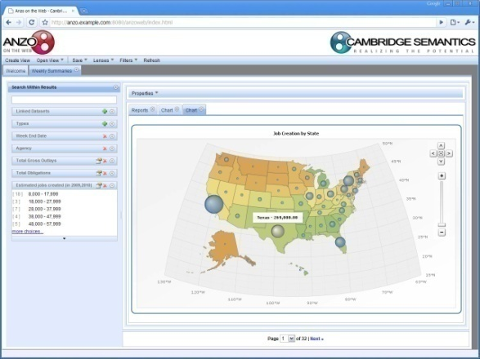
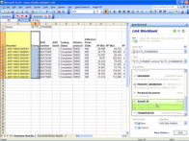
The Power of a Semantic Fabric: Data lives at the source, anyone can leverage it
1. Virtualize it to be location and format independent
2. Establish common meaning across data
3. Let the user (partners, customers…) create the view they want
4. Fill the picture with the desired data
5. Updates anywhere …update everywhere
RDF
RDBMS

Slide 6
XBRL Meets Semantic Standards
A Case of Compliance?
A Case of Internet Dating?
XBRL adds structure to data
Semantic standards attach meaning to the data
Structured data with meaning is consumable, re-usable, agile
Much Greater Insight into Financial Reporting Data

Slide 7
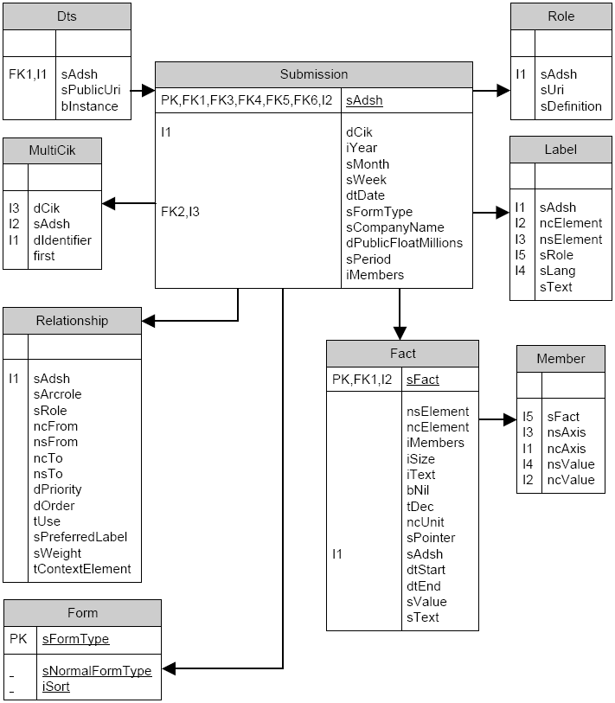
A Word (Picture) on Structure
Meaning is not Obvious

Slide 8
Add tools for non-technical users and anyone can answer their own questions quickly
Combine financial reporting data with any other data
Create live mashups that stay linked to the source
Share the result with others who can add to it…

Slide 9
Scenario
Identify potential cases of naked short selling by semantically linking XBRL filings with fails-to-deliver reports found at: http://www.sec.gov/foia/docs/failsdata.htm
10-Q and 10-K Interactive Data
Fail-To-Deliver Data

Slide 10
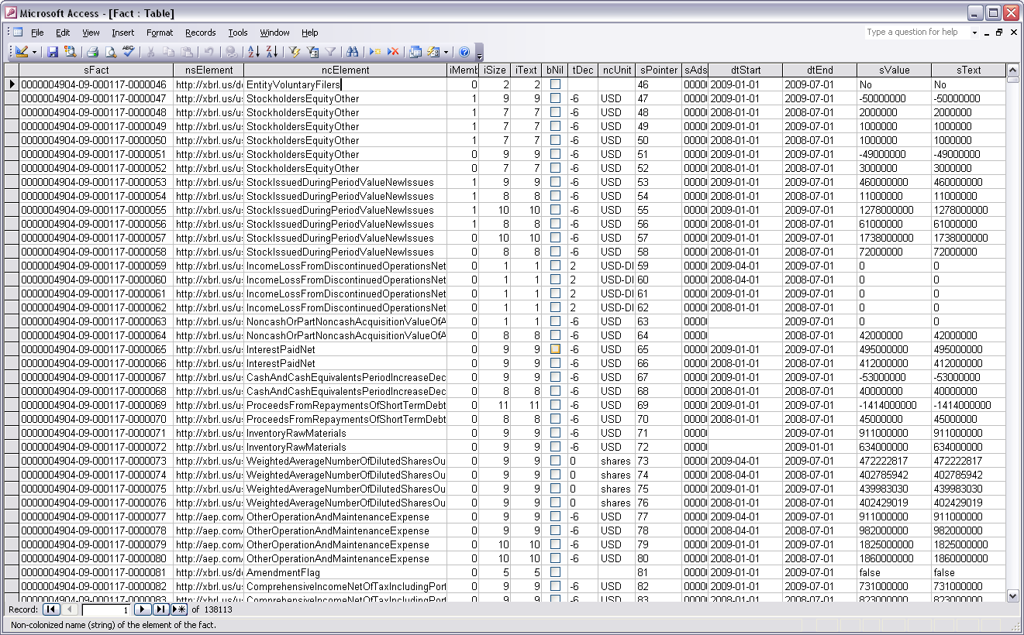
Financial Statement Facts
435 filings → 138,000 facts

Slide 11
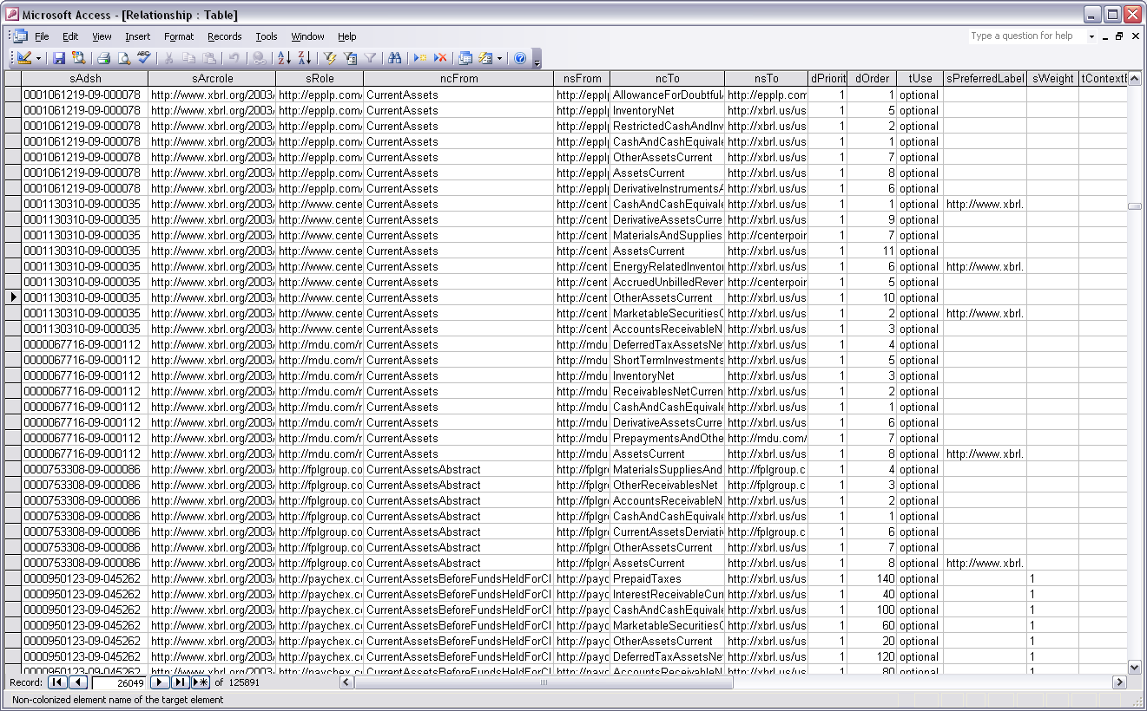
Interactive Data Relationships
435 filings → 126,000 relationships

Slide 12
Ratings
100 months → 53,000 ratings

Slide 13
Fail-to-Deliver
60 months → 3.5m fails

Slide 14
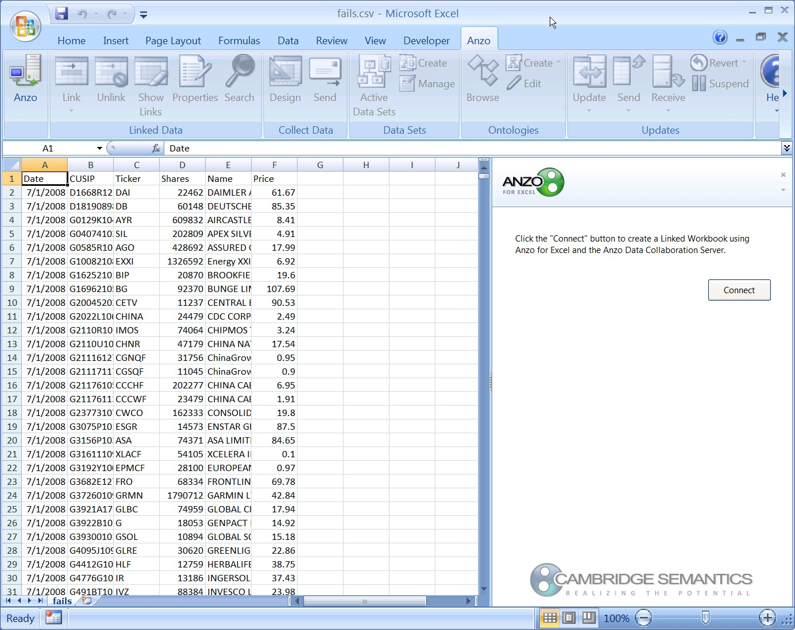
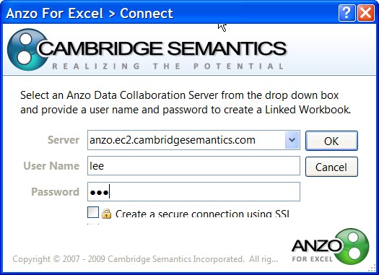
Fails-to-Deliver Data Provided by Brokers Published as a CSV File by the SEC
The Anzo for Excel Plug in allows linking of spreadsheet data

Slide 15
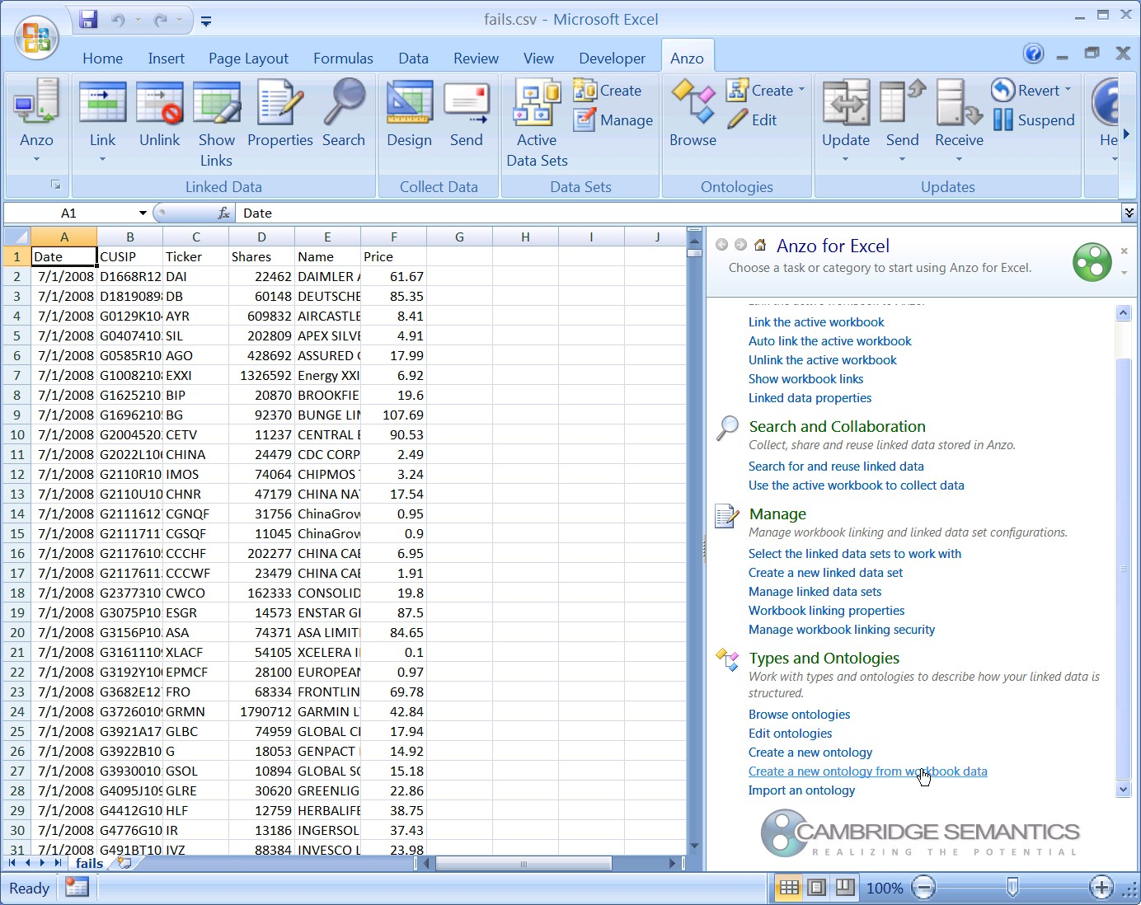
An ontology can be created directly from spreadsheet data…

Slide 16
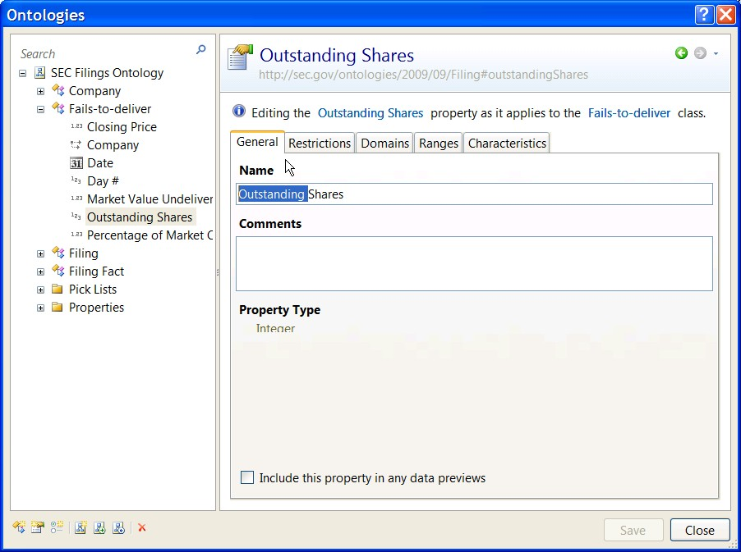
Links to existing ontologies
New Fails to Deliver ontology

Slide 17
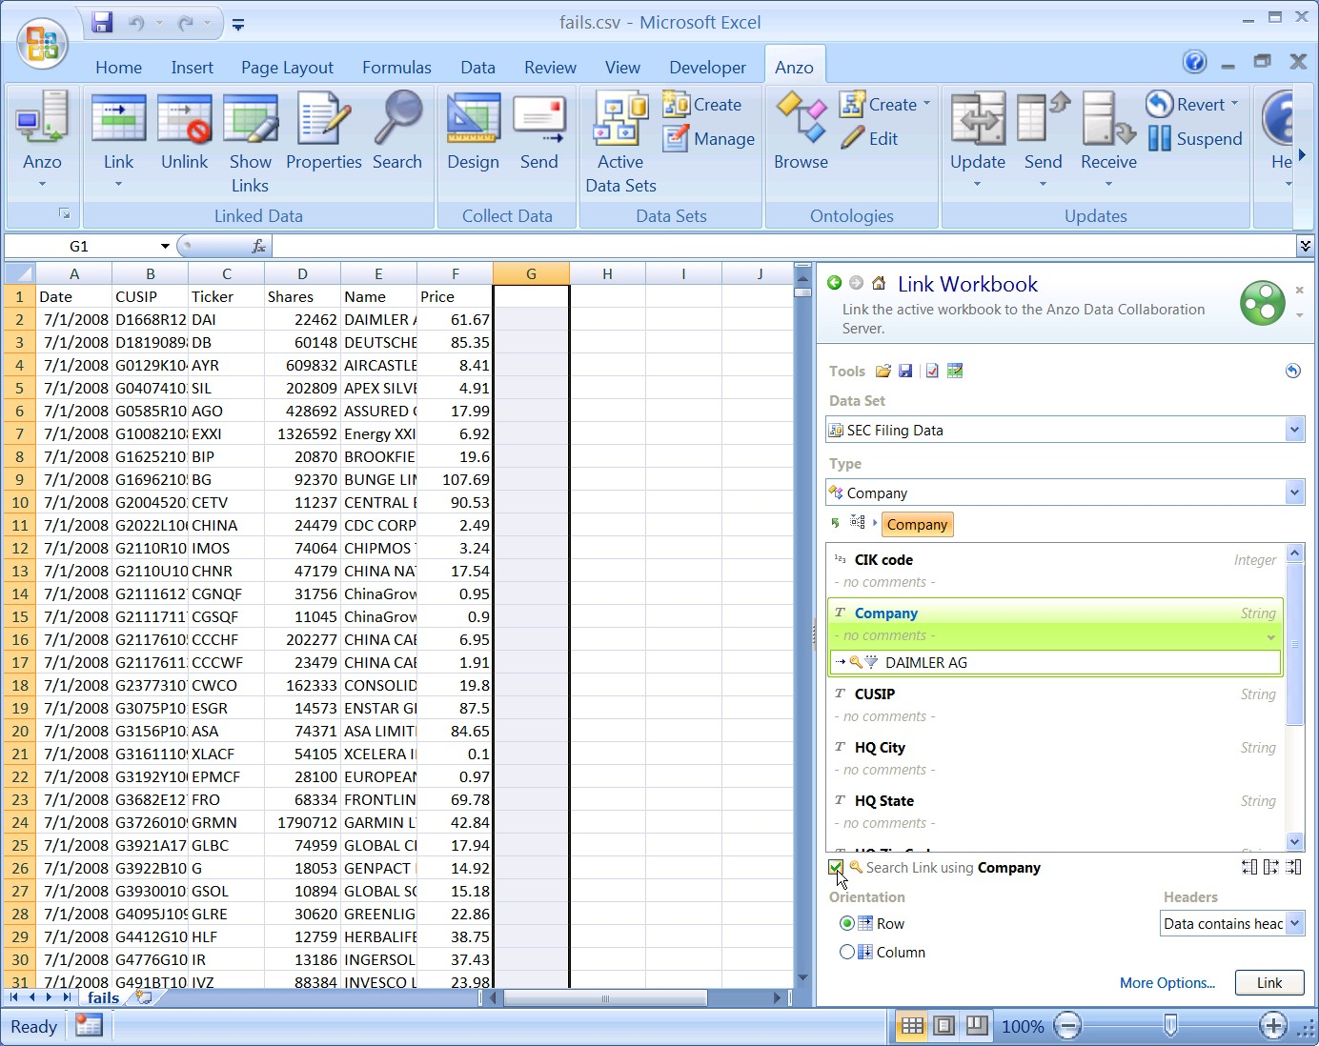
Link Fails data to the XBRL reports data
Specify data in common

Slide 18
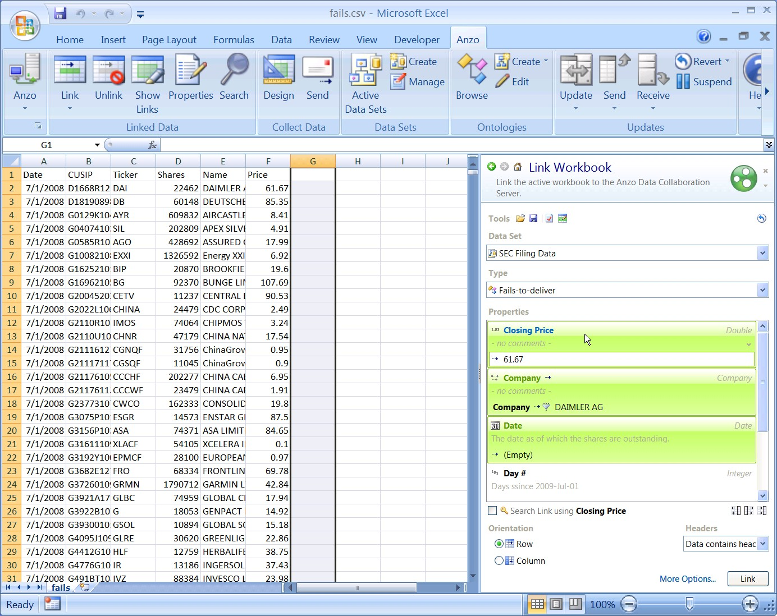
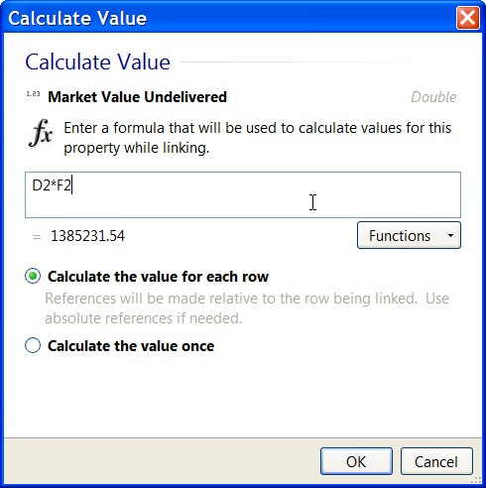
Calculate new values using data from the spreadsheet

Slide 19
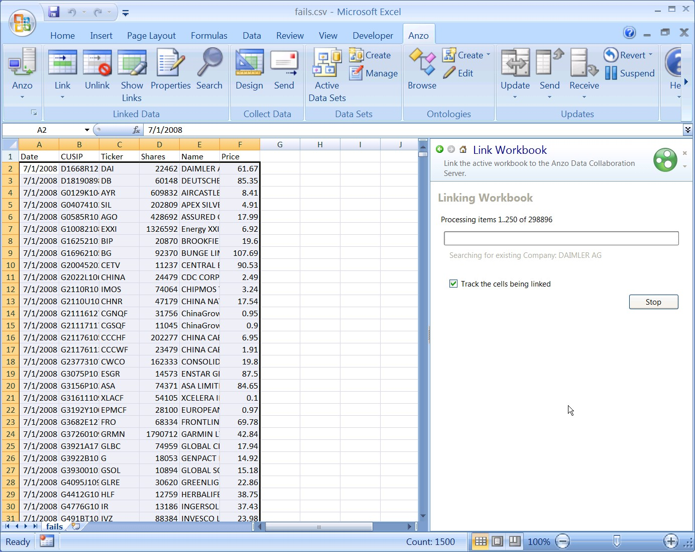
Linking the workbook makes the fails-to-deliver data part of the semantic fabric along with the XBRL filing data

Slide 20
Data Linked To A Semantic Fabric Can Be Better Understood
Anzo on the Web enables non-technical search, combine and view linked data

Slide 21
The ontology guides the user in creating a summary table

Slide 22
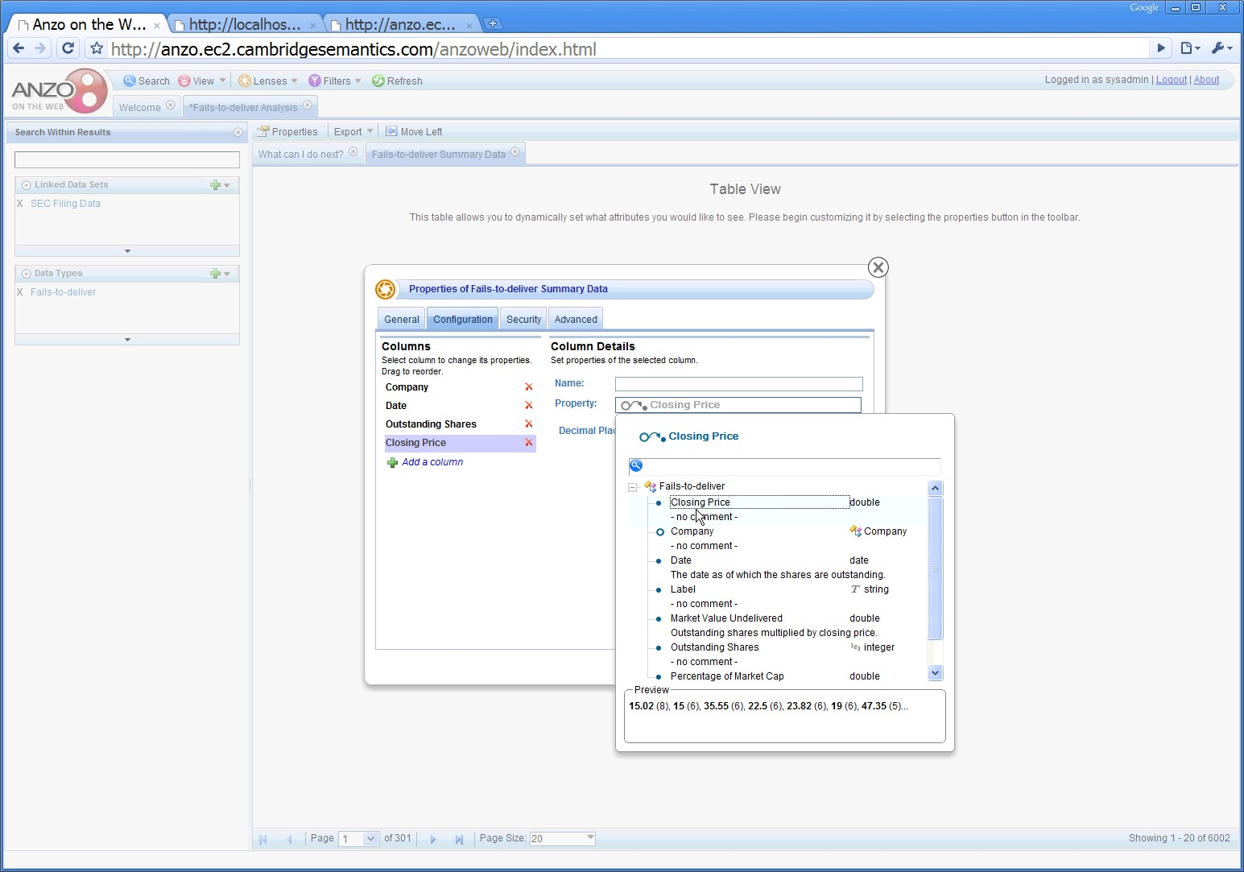
Choose whatever information is relevant to your needs

Slide 23
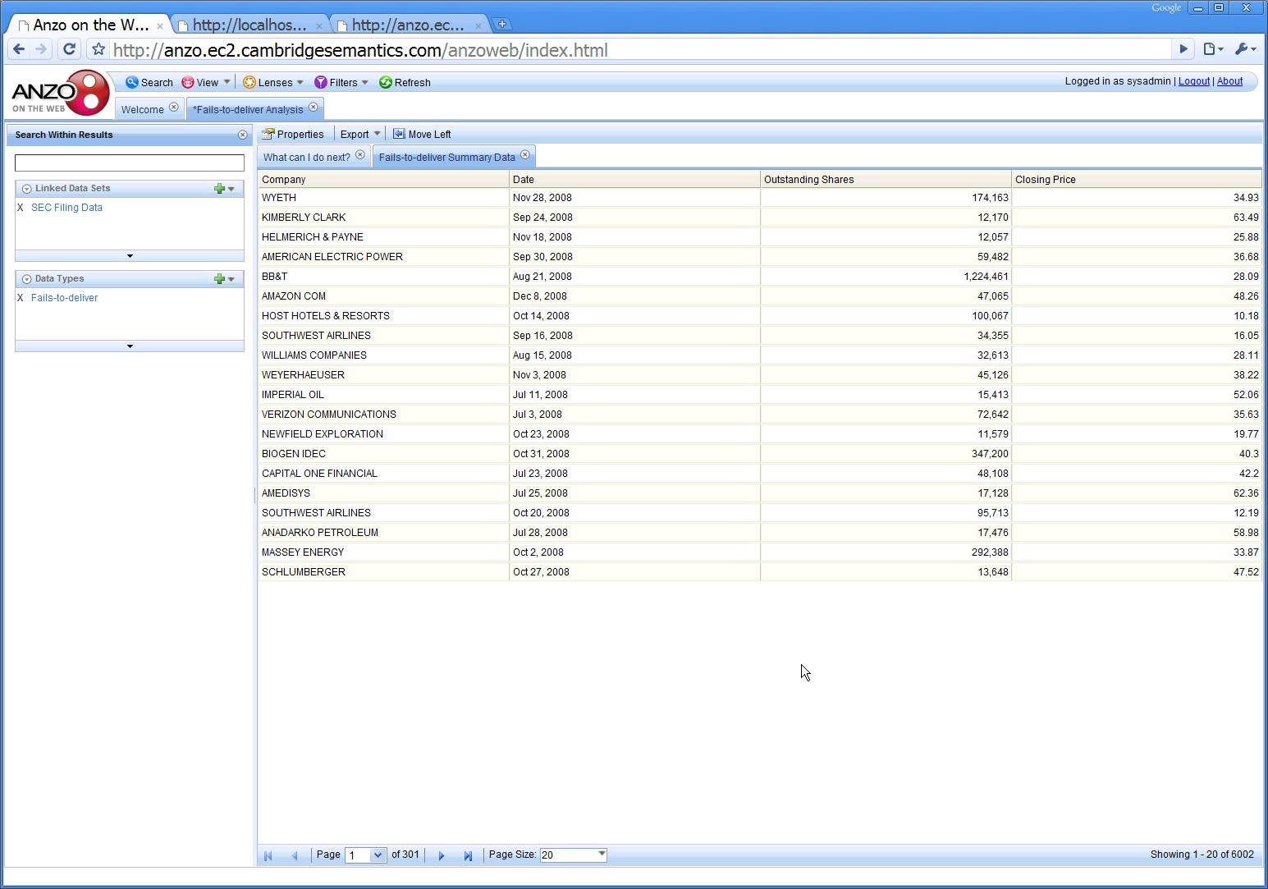
The data fills in the view immediately…

Slide 24
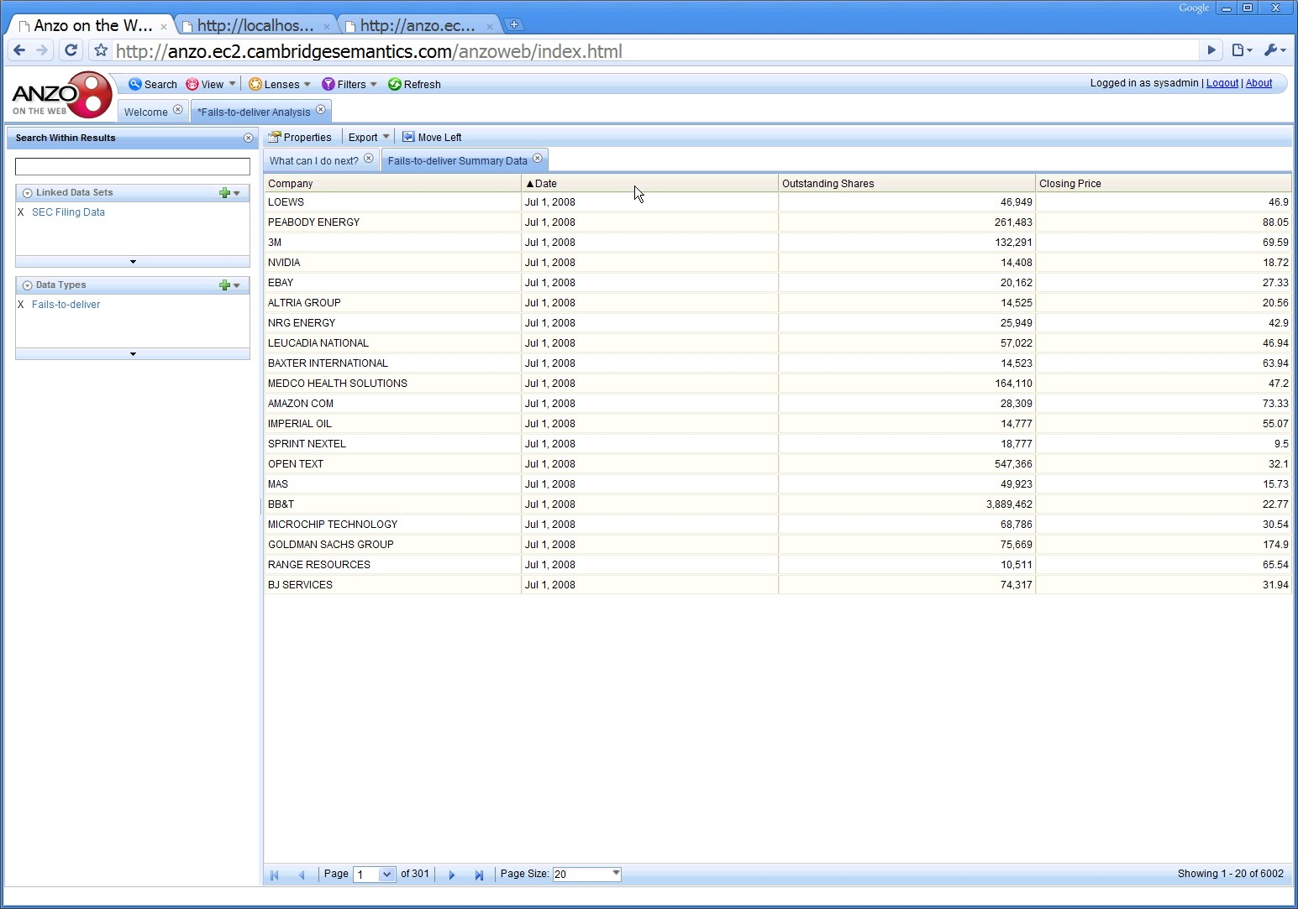
…and can be sorted…

Slide 25
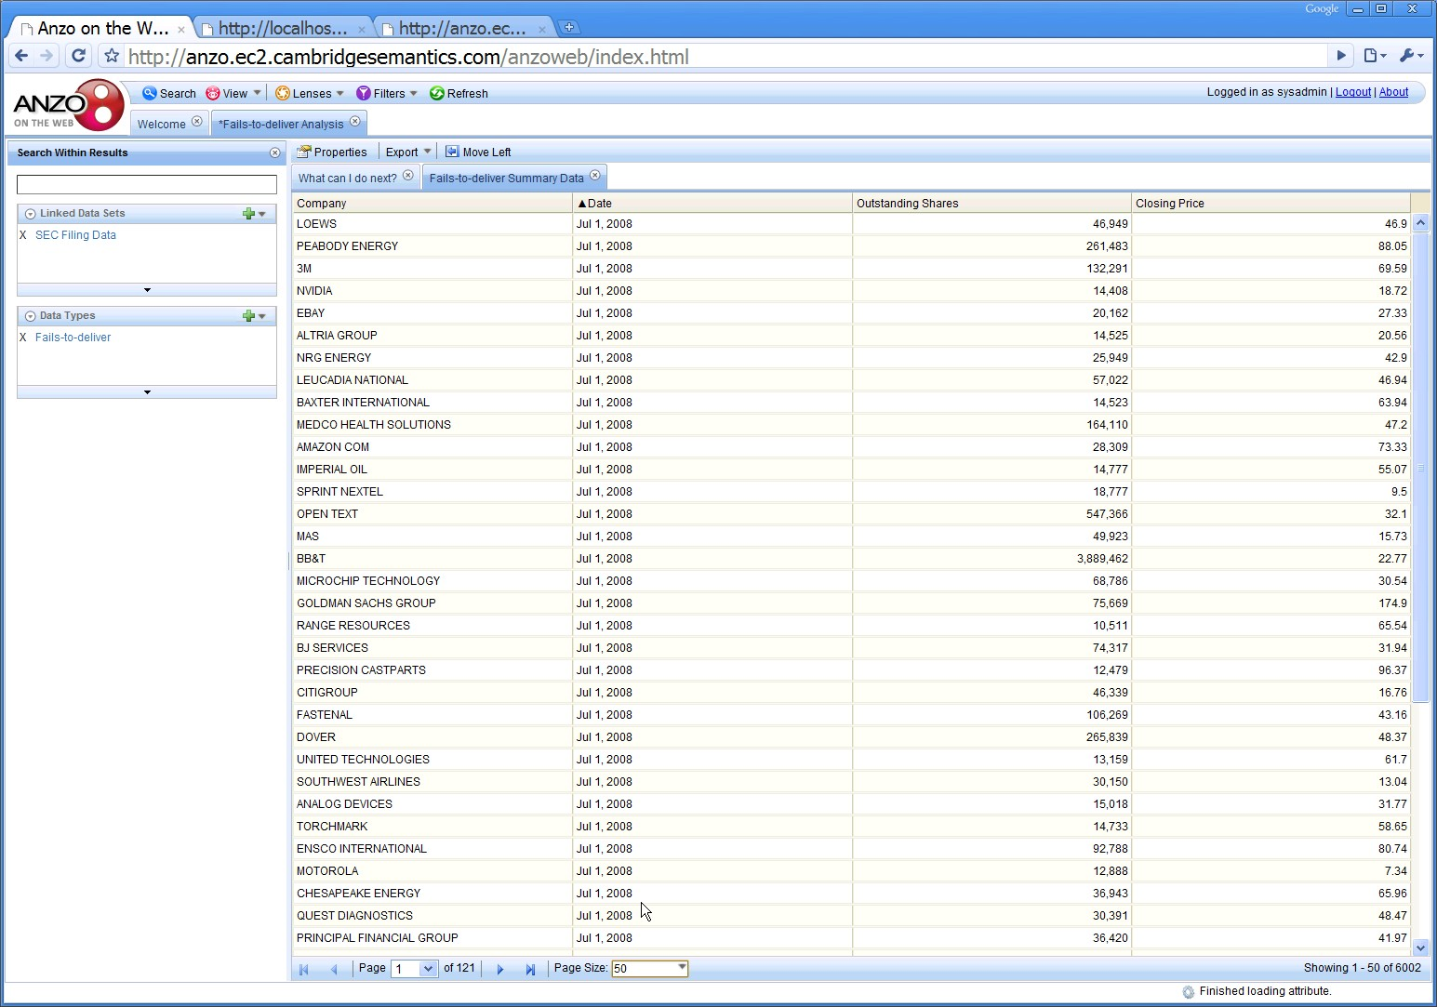
…reformatted…

Slide 26
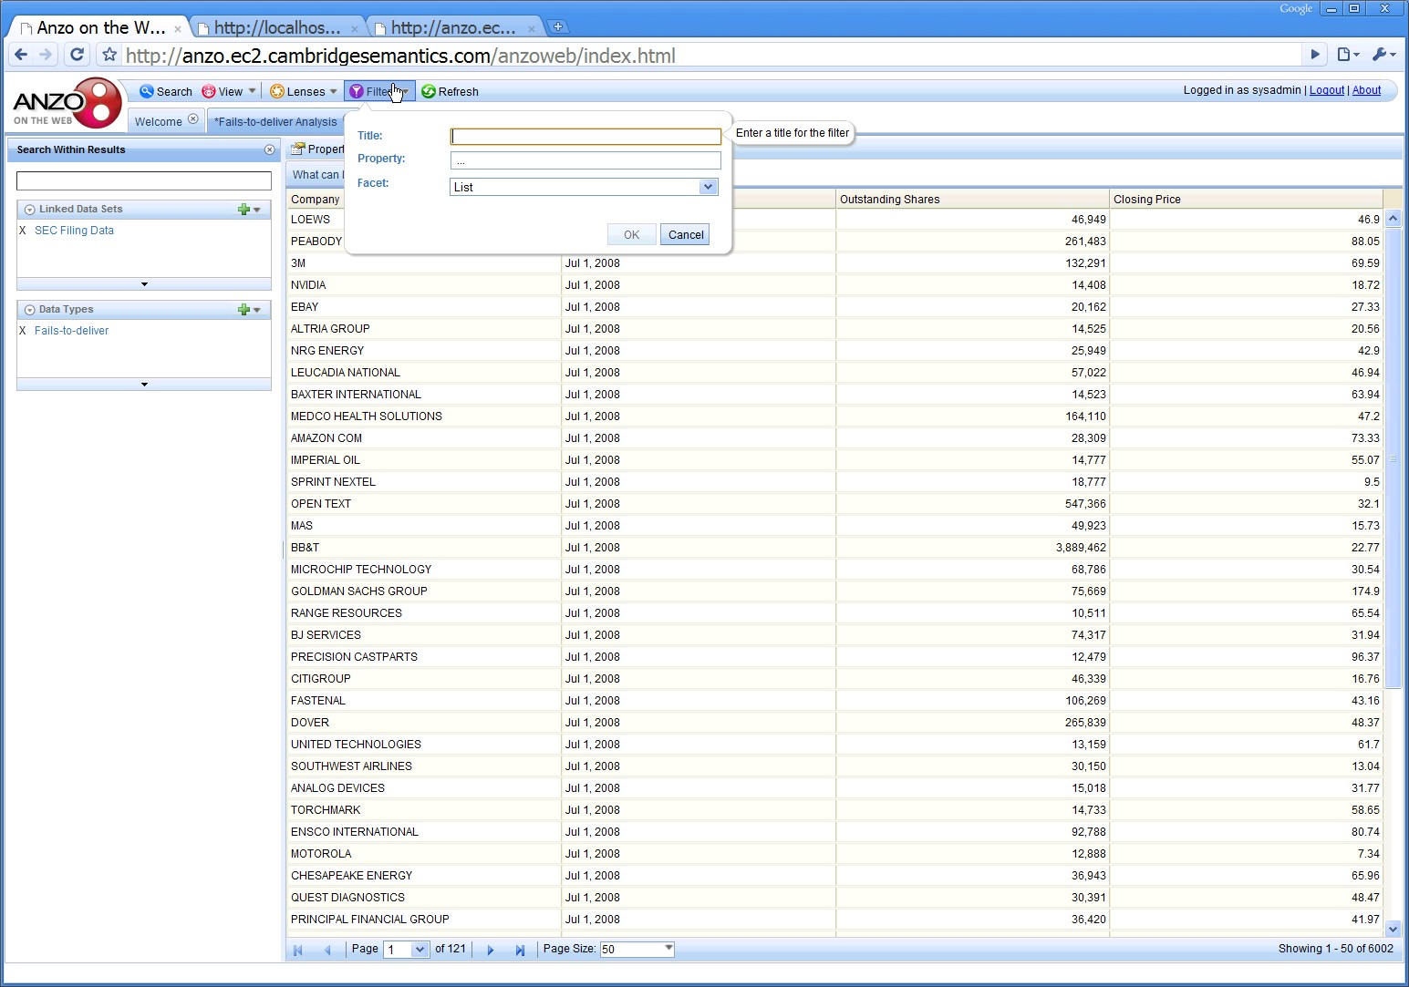
…and filtered.

Slide 27
Anyone can define filters (facets) that let you drill through the data via any property in the ontology.

Slide 28
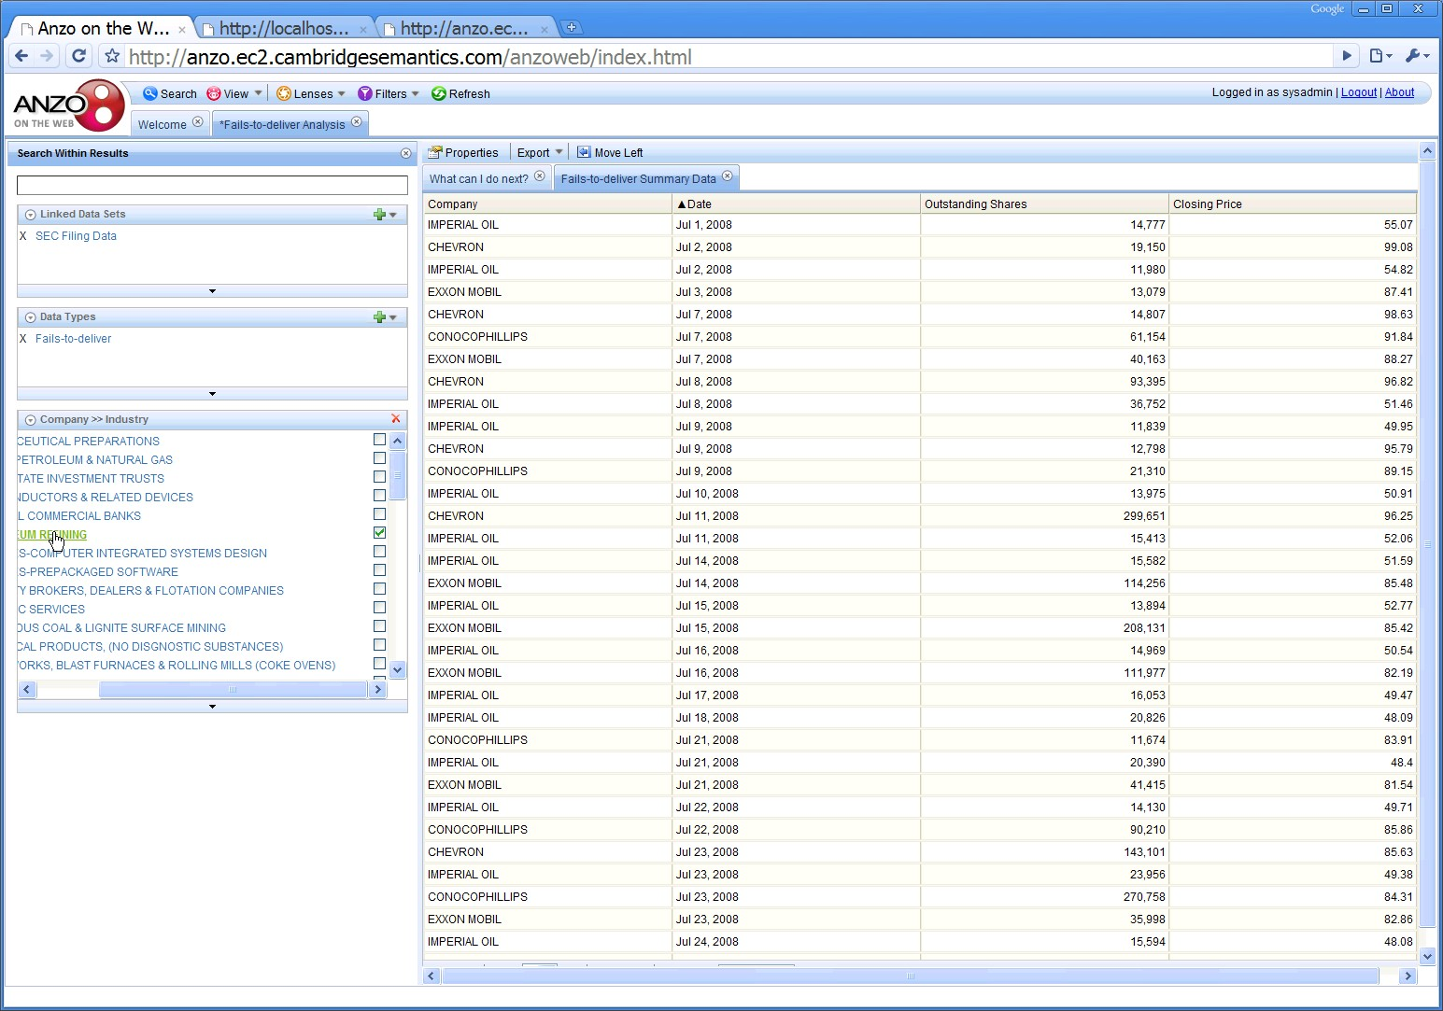
Clicking the facet filters the data set
Here, the industry facet from the XBRL filing data is used to drill through the fails-to-deliver data.

Slide 29
Filter numeric values using ranges.

Slide 30
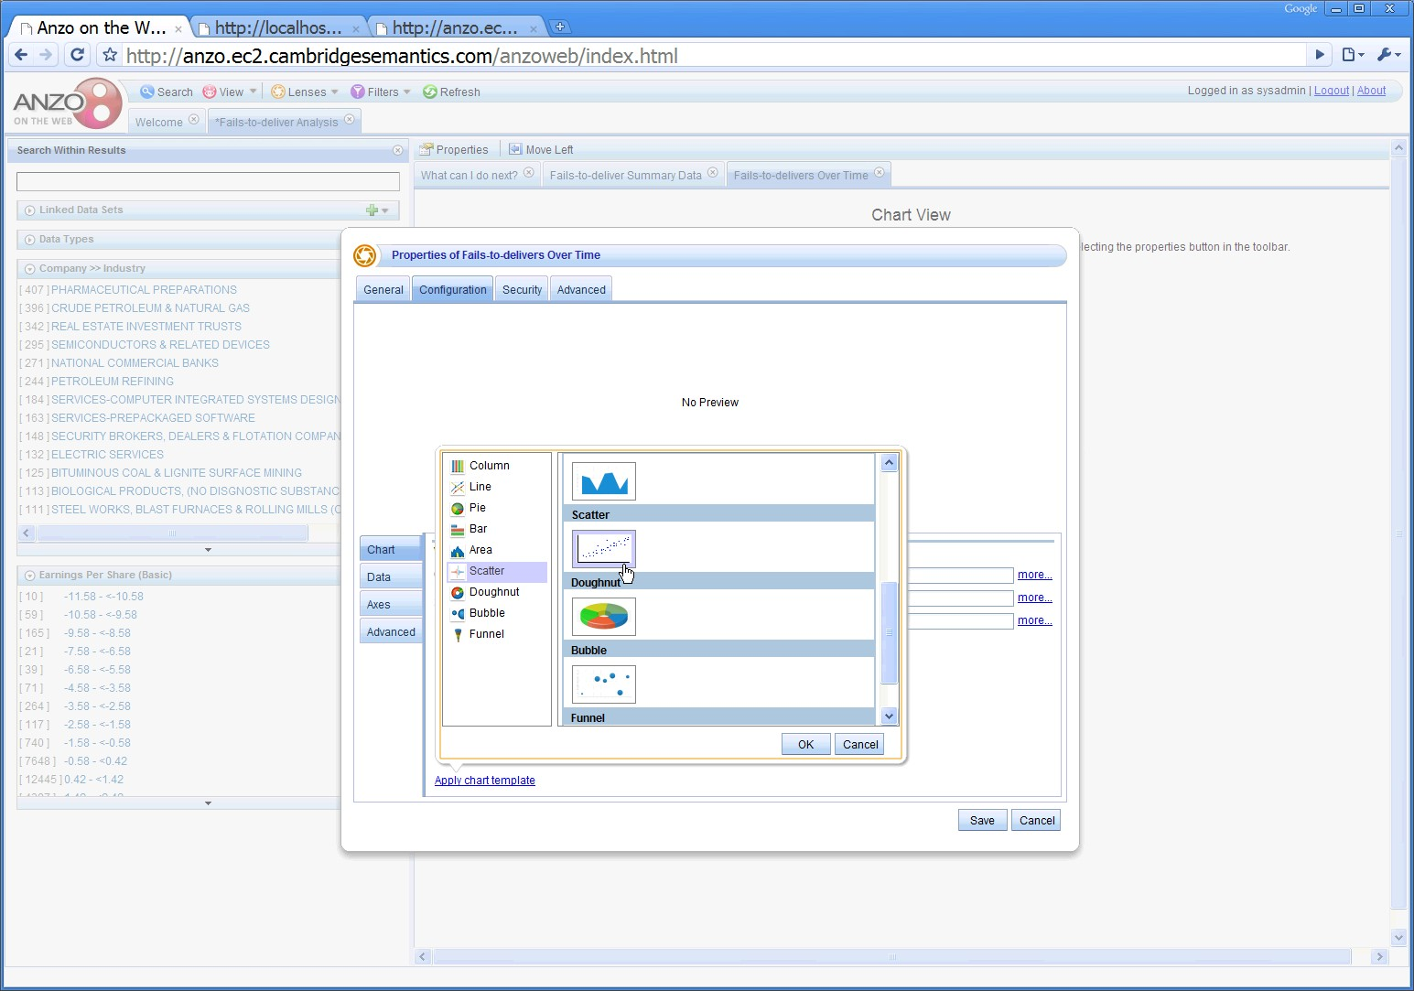
Create a wealth of visualizations on the fly.

Slide 31
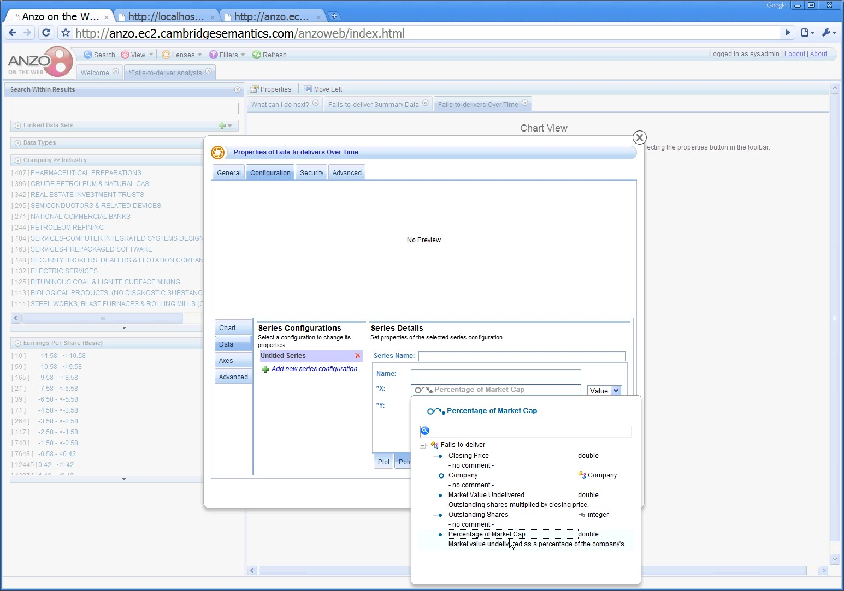
Chart fails-to-deliver over time as a % of market cap.
Market cap. data comes from XBRL filings.

Slide 32
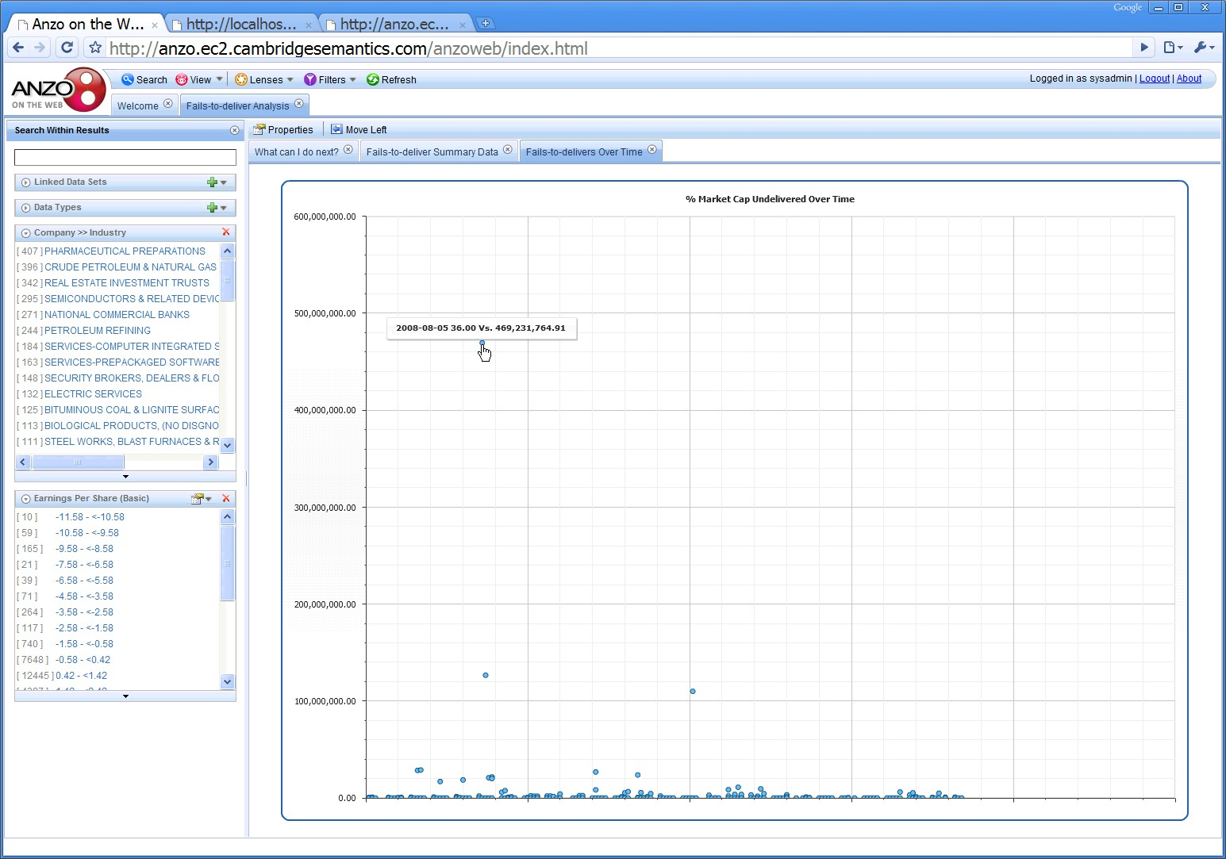
Notice that the data is wrong. What happened?

Slide 33
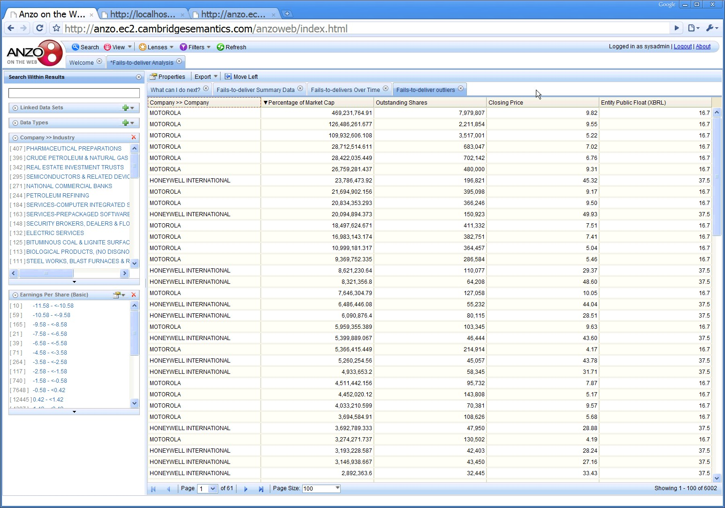
Create a new view on-the-fly and sort it to find the source of the bad data.

Slide 34
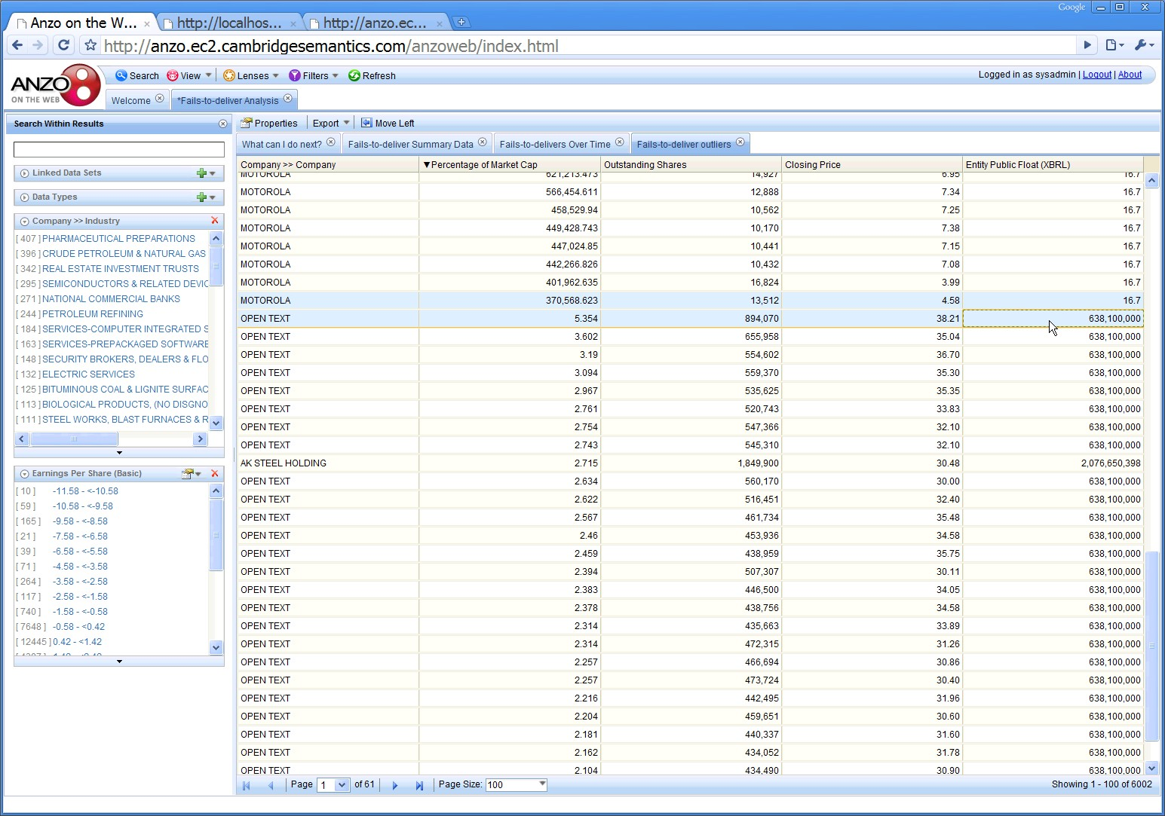
A new view identifies the source of the bad data.

Slide 35
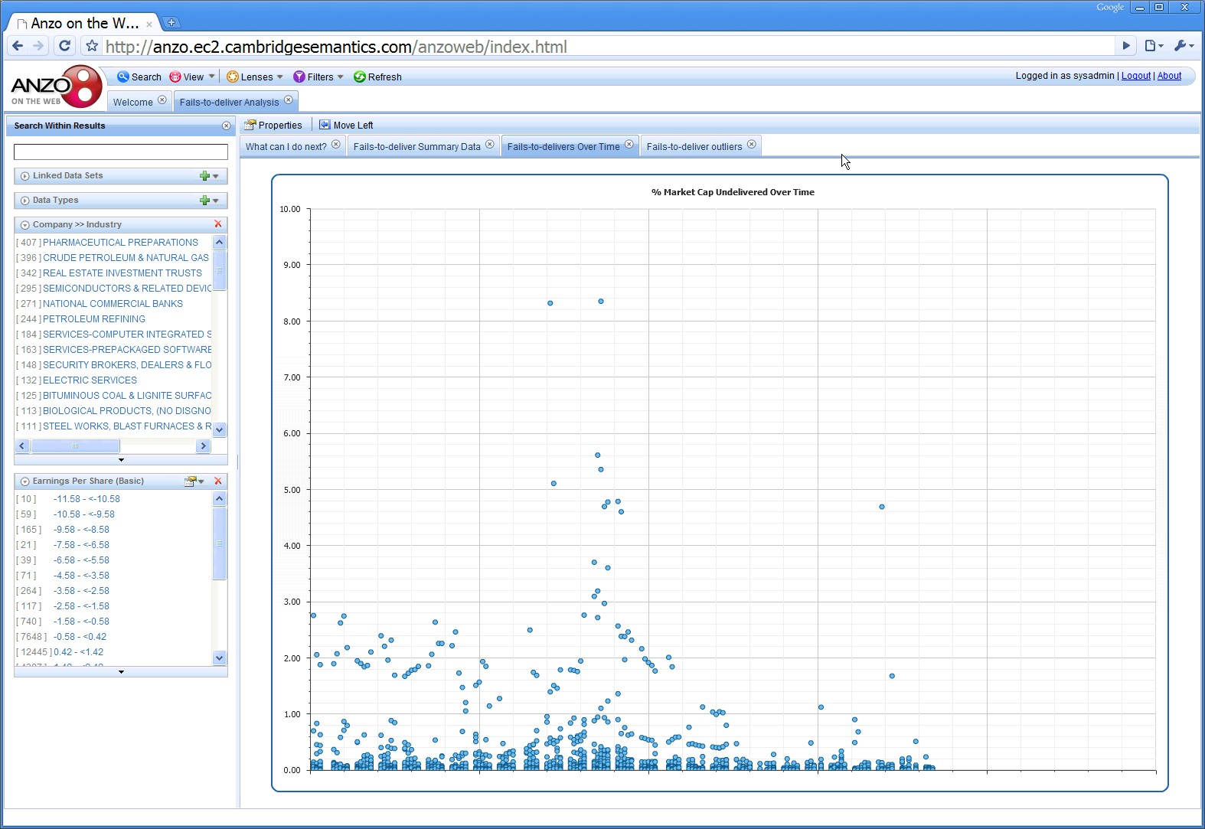
A proper graph shows a region of increased fails-to-deliver.

Slide 36
Note that the increased fails-to-deliver are clustered around September 2008, the height of the subprime crisis.

Slide 37
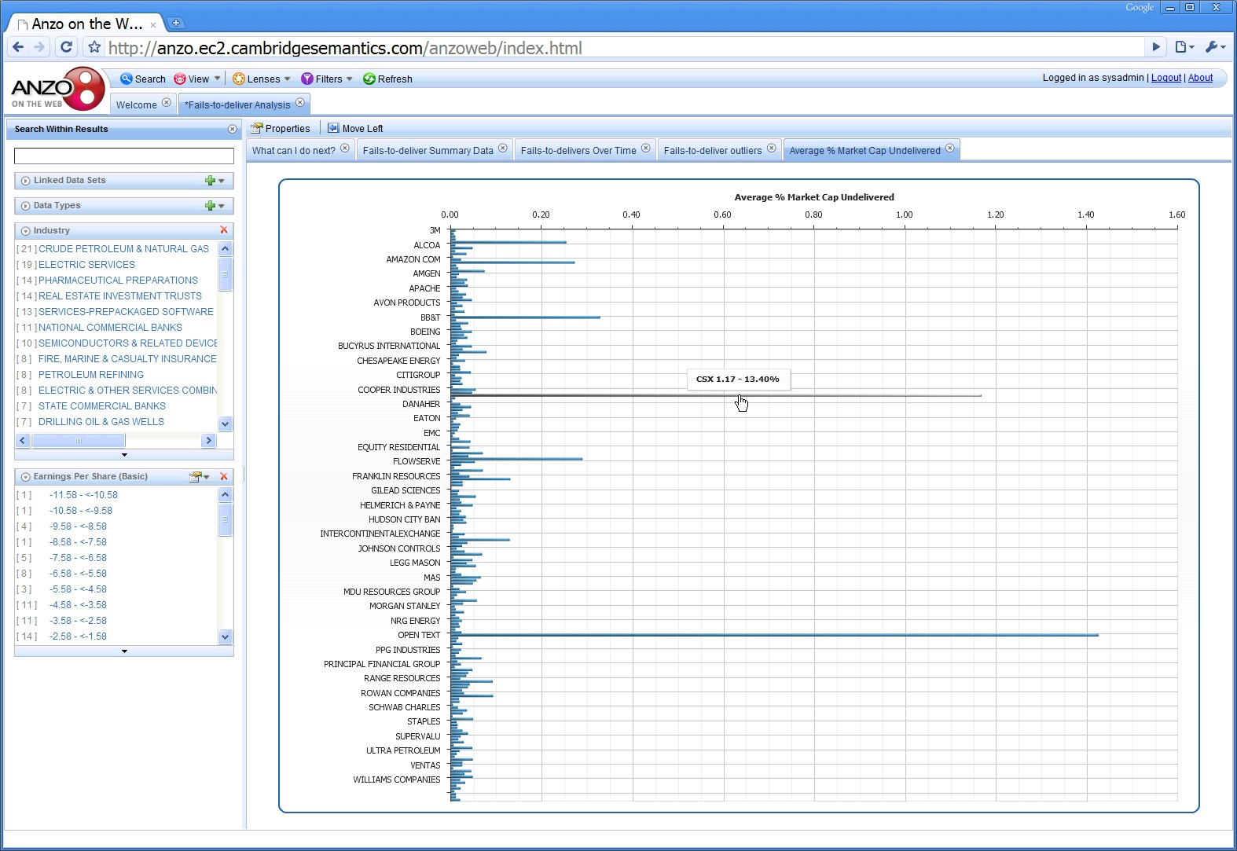
Create other views such as average fails-to-deliver rate by company.

Slide 38
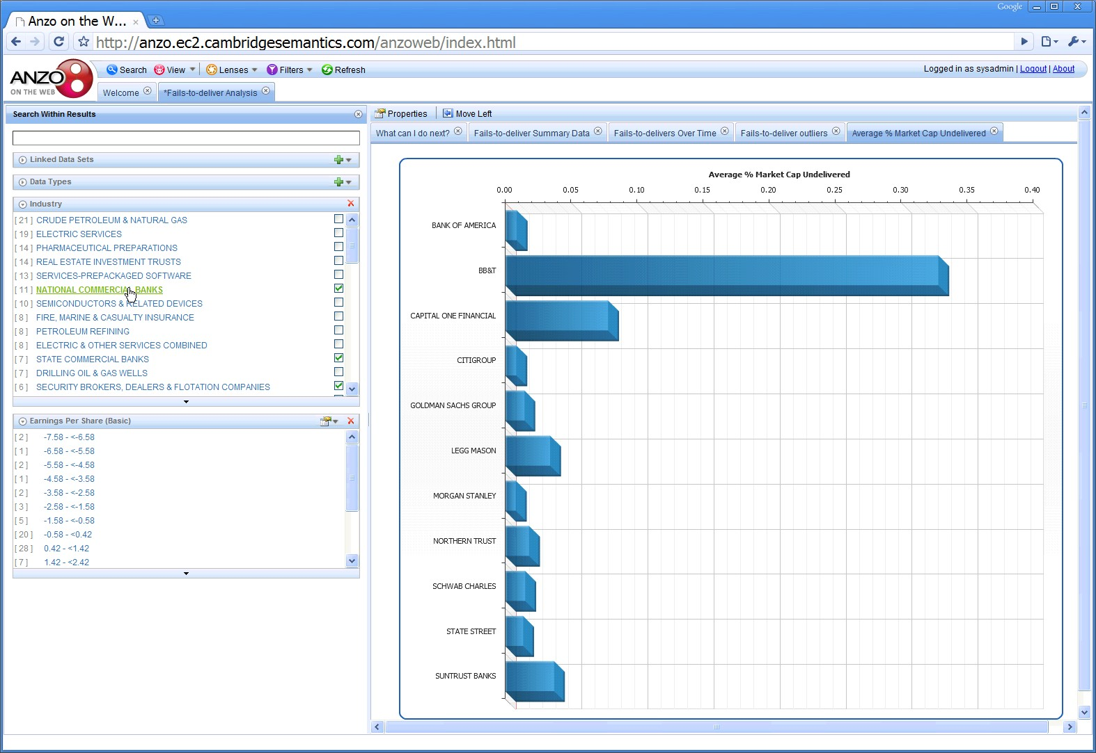
Create and apply an new facets to look only at financial companies…

Slide 39
XBRL Meets Semantic Standards
Love at First Sight?
Structure + Meaning = Understanding
Reusable Data
Collaboration
Agility…
At Least a Great Match

Slide 40
Practical Semantics Applied to Recovery.gov

Slide 41
Simple Questions, Hard to Answer
Example:
Is there a correlation between geographic distribution of recovery dollars, population and new jobs created?
To get the answer, you need to know:
Recovery spending by state
Population by state
New jobs by state
Recovery.gov alone cannot answer this question
Notes:
Is there a correlation between geographic distribution of recovery dollars, population and new jobs created?
This is a fairly straightforward question, however of the three things that you need to know to answer this question, only one is available on recovery.gov. The other two are on separate government websites. Under traditional circumstances, one would have to do quite a bit of searching, cutting, pasting and calculating to get the desired answer.
Just to make the point, let’s look at where one might find the answers….

Slide 42
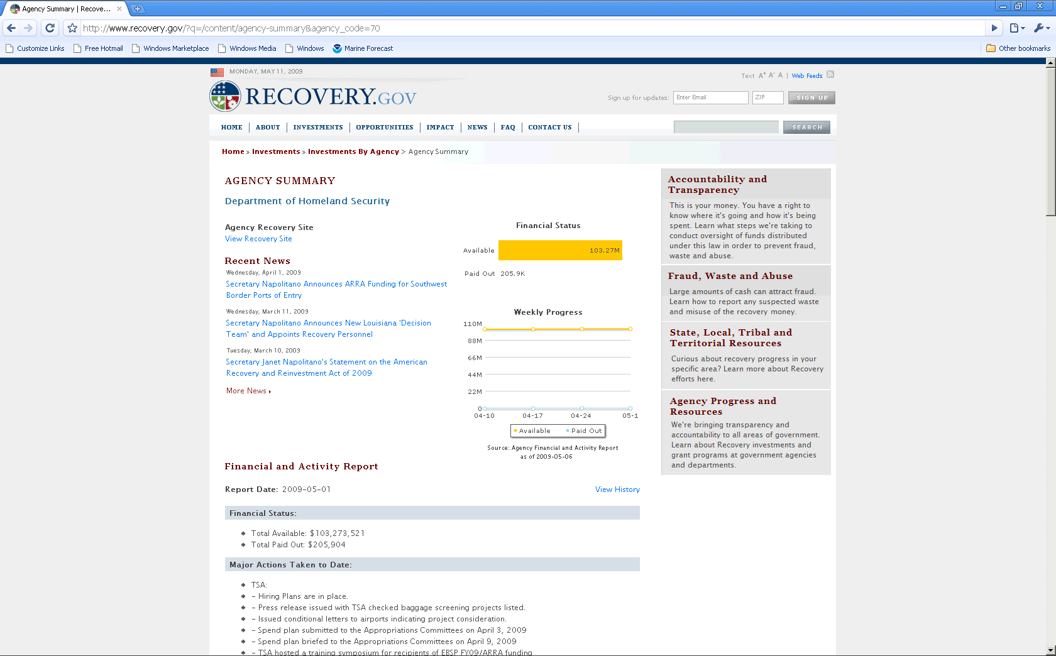
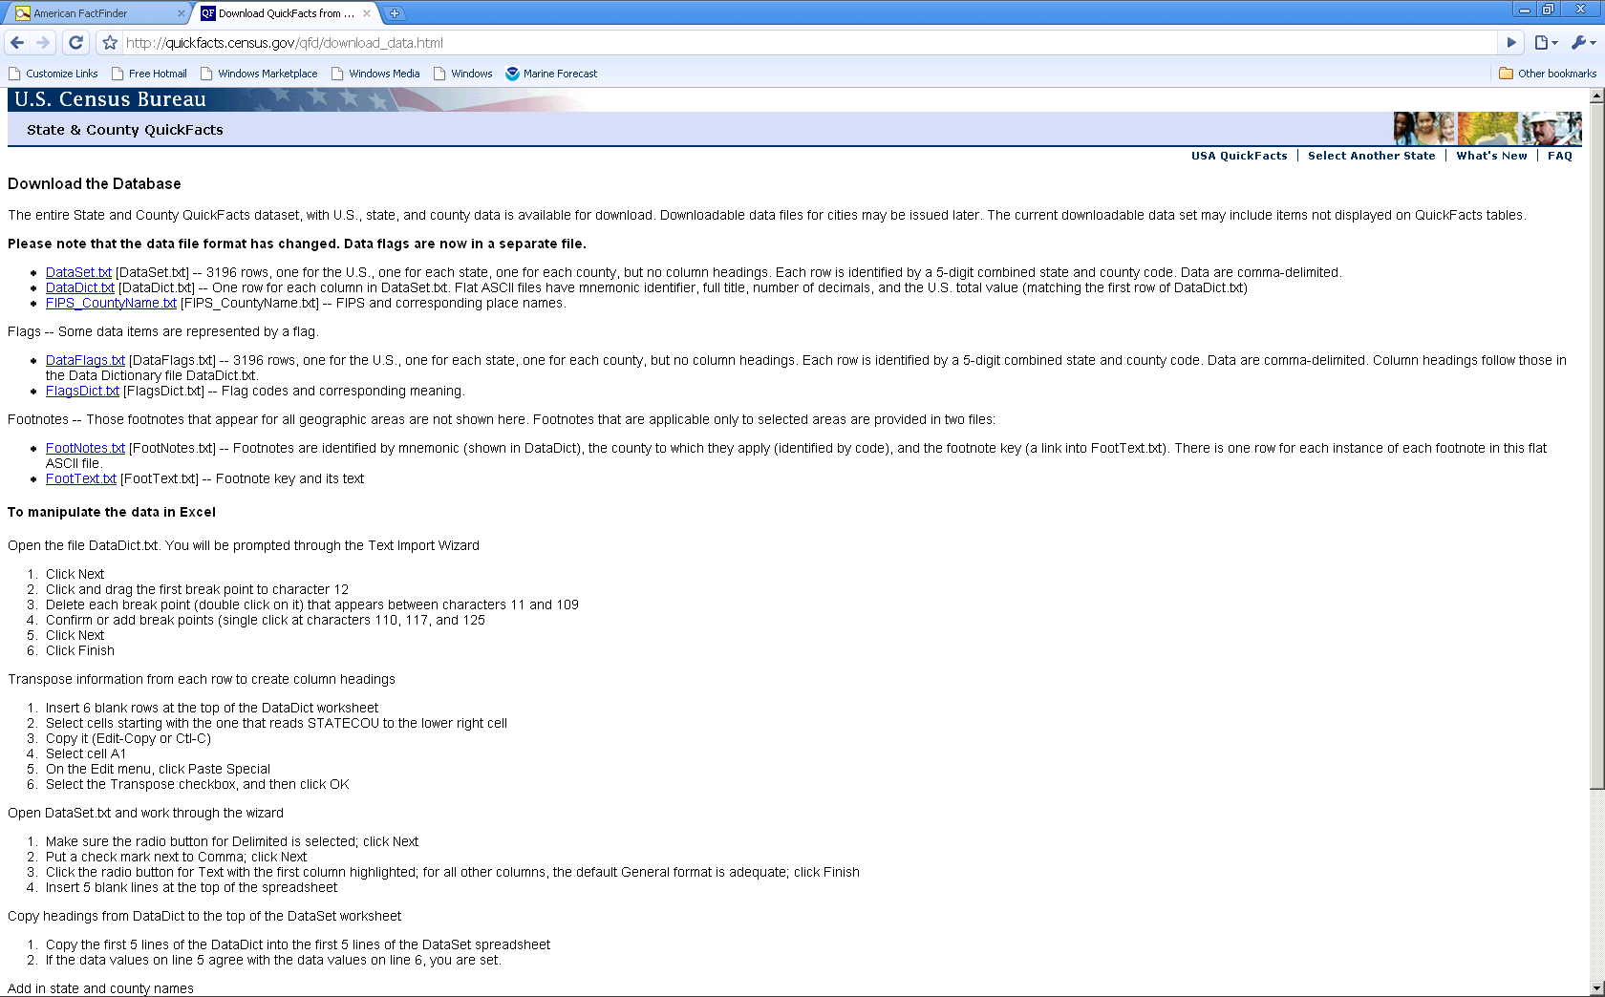
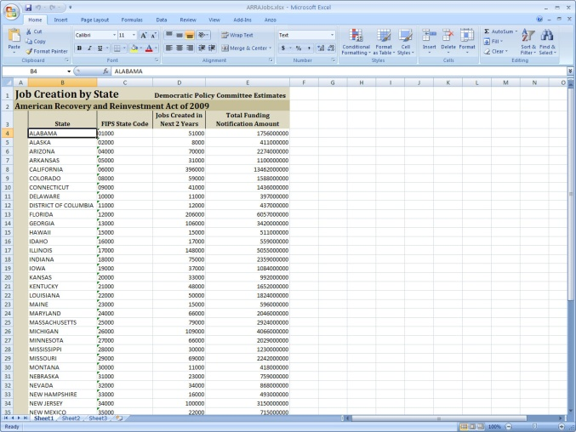
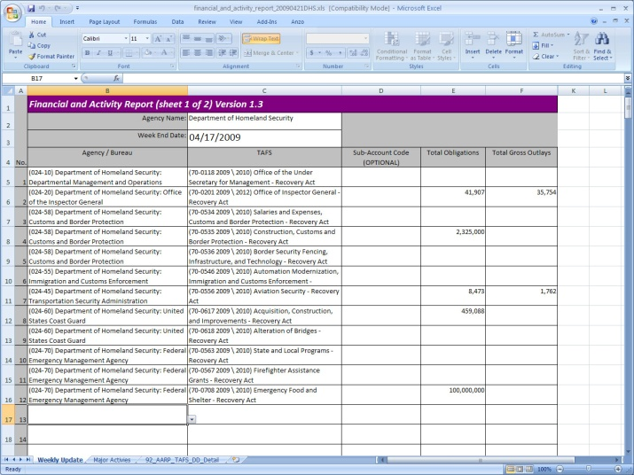
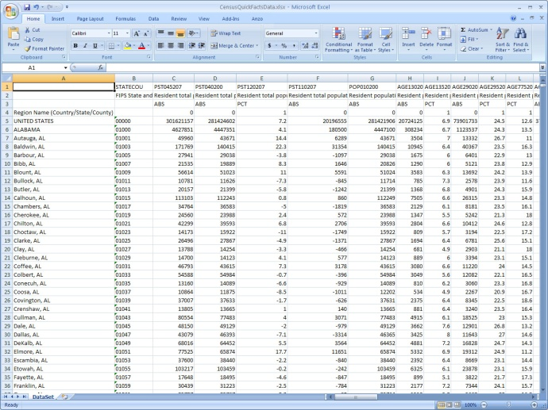
The Answers Live in Three Sources
Show the answer graphically…
Notes:
The answer our sample question can be found by combining data from three government websites, Recovery.gov, the US Census Bureau and the DPC site.
Note to presenter: Sequence through the screens. Each example shows the home screen to identify the source site and then the screen within the site that contains the data that is needed to answer the question.
First, Recovery.gov shows actual allocations of recovery dollars.
Second, the US census bureau site shows population information
Third, the DPC site contains data on job creation by state
To emphasize the point of the flexible nature of the tool, we will show how the results can be displayed graphically.

Slide 43
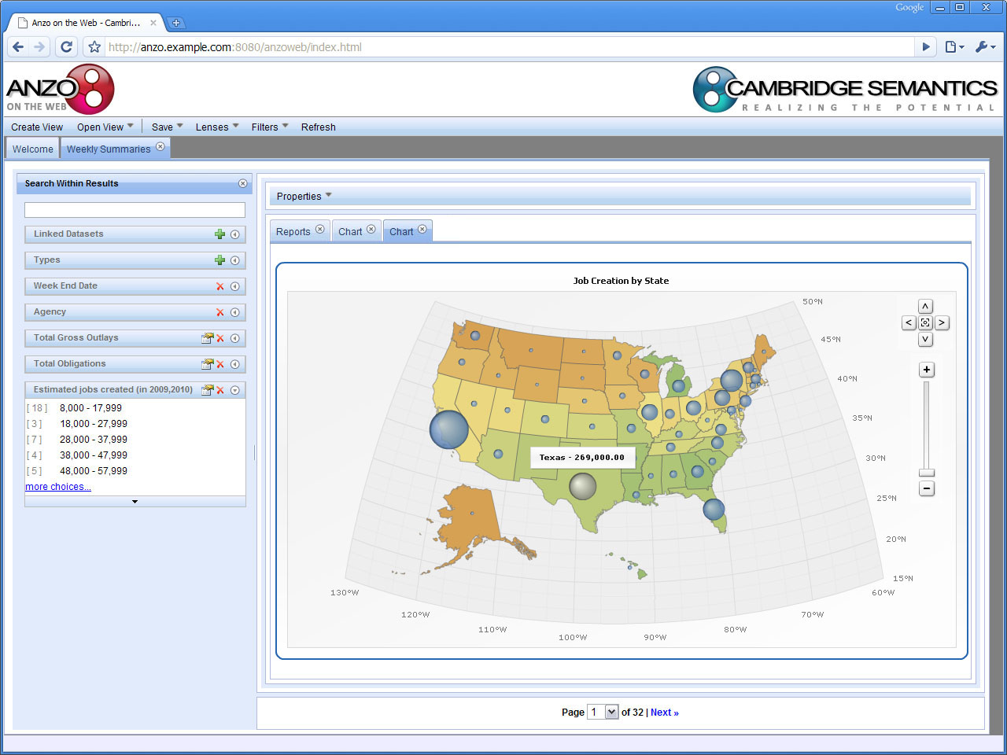
Like This…
Notes:
As you can see, the question is answered here in a graphic form where the expected number of jobs created is represented by the size of the bubble. Details can be viewed by clicking on any one of the bubbles. The point of using this graphic is to emphasize the flexibility that that the user has in deciding how they would like to view the data. The source data in this case is all in spreadsheets that were easily accessed from government websites. Keep in mind that source data could also come fro any application database that is linked to the Anzo Data collaboration Server.

Slide 44
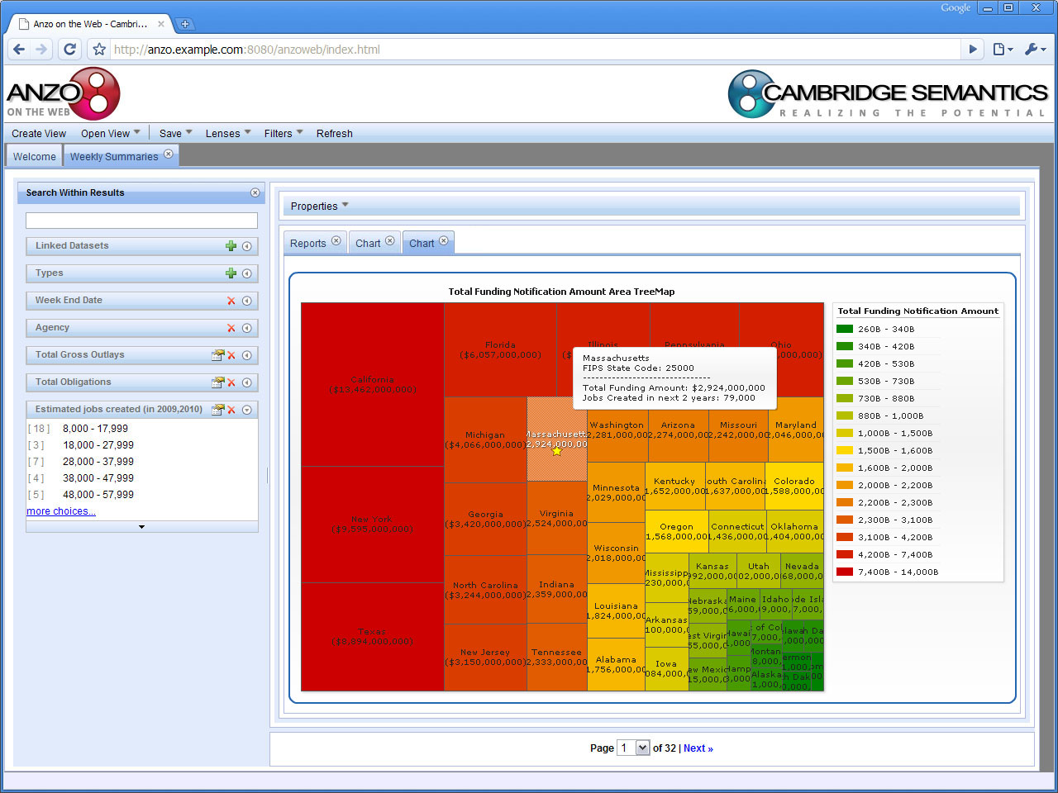
Or this…
Notes:
Here the same data is shown as a tree map where the size of the box corresponds to the amount of the allocation and each box displays a call out when selected that provides additional data on the given state. Once again, the point is to demonstrate the flexibility built into the lensing capabilities of Anzo on the Web.

Slide 45
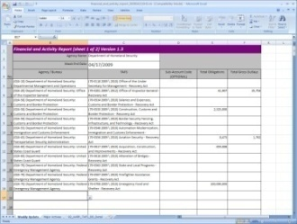
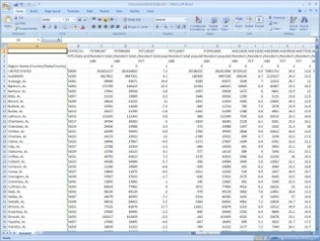
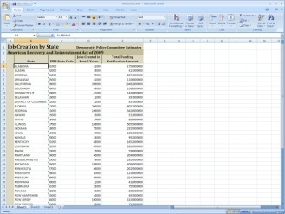
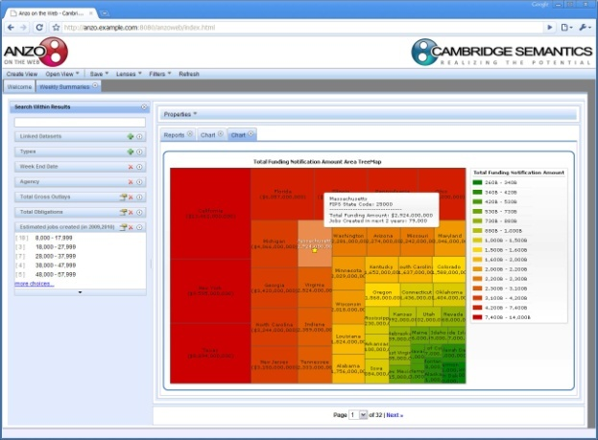
How it’s Done: Leave Data Where it Lives and…
1. Link Source Data to the Anzo Data Collaboration Server
RDBMS
2. Let the user “draw” a picture of what they want
Anzo Data Collaboration Server
3. Fill the picture with the appropriate data
Notes:
There is a surprisingly straight forward process behind all this.
First, each of the data sources were linked to the Anzo data collaboration Server from Cambridge Semantics. In this case, it was all spreadsheet data but could just as easily include data from any relational database.
Once these sources are linked, the data is accessible through Anzo on the Web where the user is provided with tools that allow them to create various views of the data. In effect, the user is able to draw a picture of what they want and the system fills it in with the appropriate data.
Perhaps most important is the ease with which one can link data to the Data Collaboration Server.

Slide 46
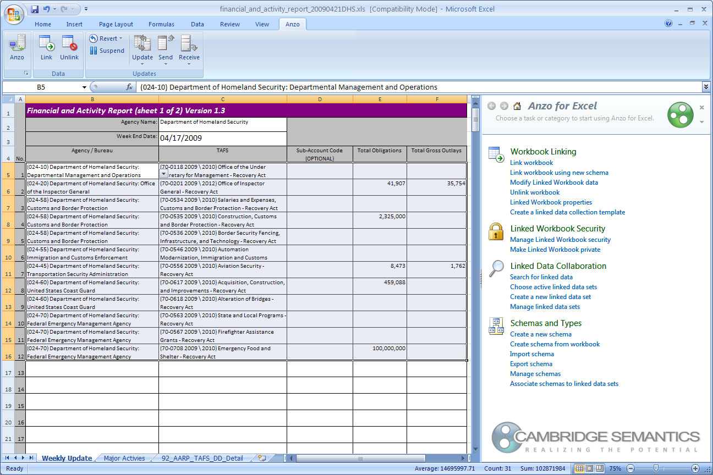
Linking Source Data is Simple
Anzo for Excel Plug in
Notes:
As I mentioned earlier, most of the source data for Recovery.gov is from Excel spreadsheets. Cambridge Semantics Excel mapping tool, Anzo for Excel, makes capturing spreadsheet data a simple and straightforward process. As you can see here, Anzo for Excel appears as an option with in the Excel workbook that the user selects to display the linking tool.

Slide 47
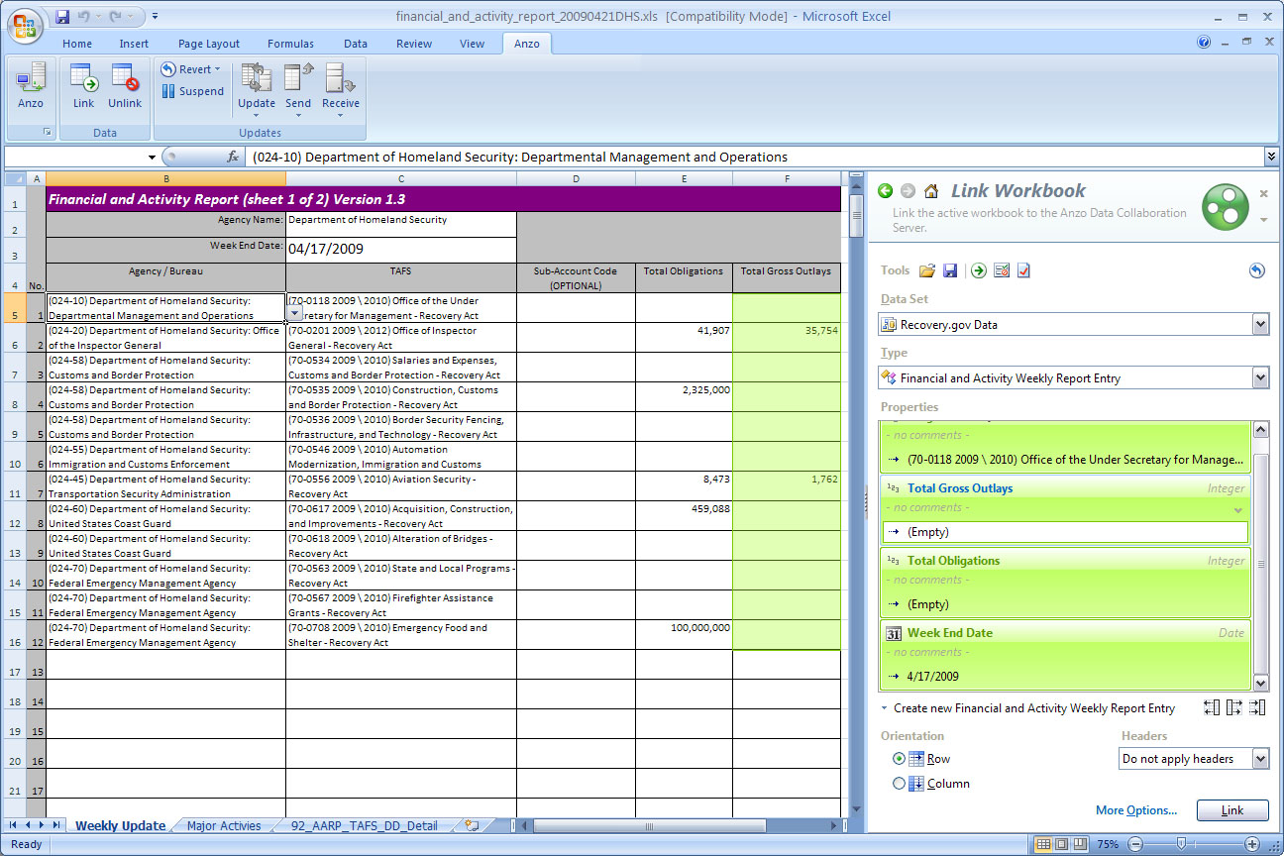
Linking Source Data is Simple
Link data (columns in the spreadsheet) to classes and properties in an ontology exposed in the plug in
Notes:
To link a data set, the user highlights a column, in this case, Total Gross Outlays, and then selects the appropriate property on the right. The properties on the right are relate to an ontology, so what we are doing is mapping spreadsheet regions to classes and properties in an ontology. Once this process is completed for all of the desired data in the spreadsheet, the job is complete. The spreadsheet data is now linked and accessible to other systems attached to the Anzo Data Collaboration Server and/or Anzo on the web.

Slide 48
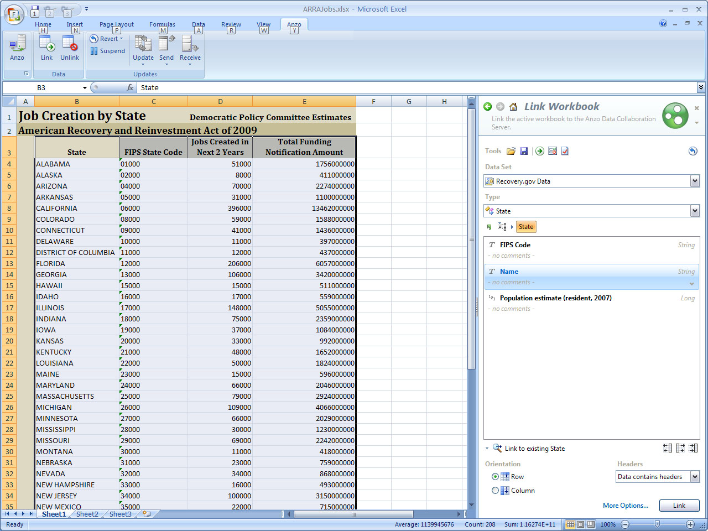
Different Source, Same Process
Notes:
Here you see the spreadsheet with the job creation data. As you will see, all of this data can be linked in seconds.

Slide 49
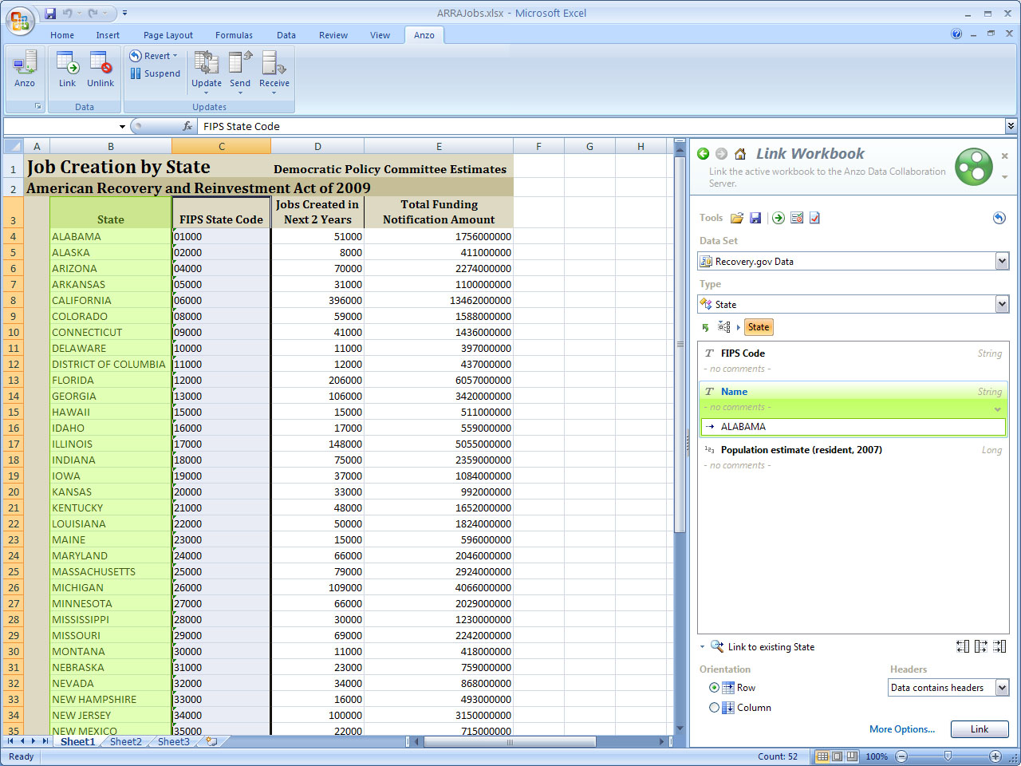
Select a Data Set
Select a description
Notes:
As we saw before, I simply select a column of data and a corresponding property on the right. The selection moves to the next column and...

Slide 50
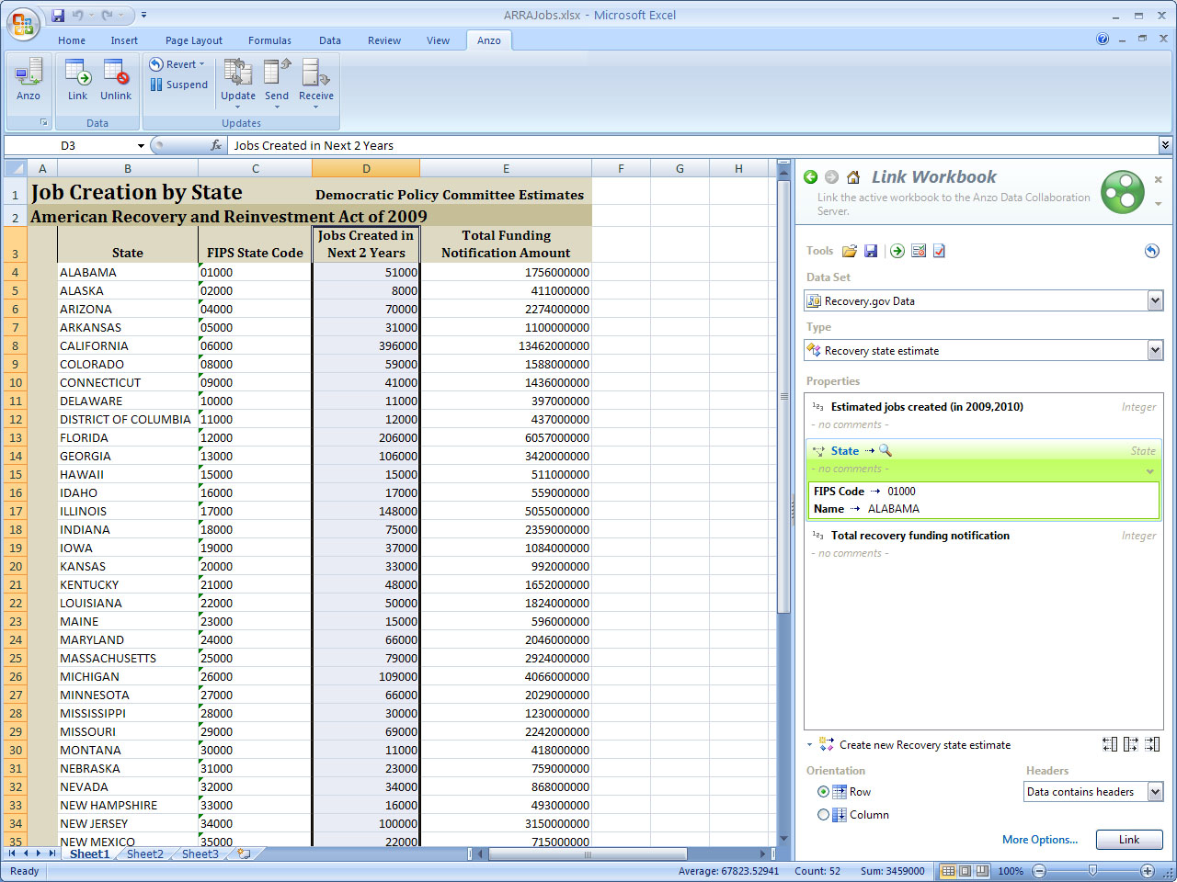
Repeat the Process
Notes:
we select the correct property for that column…

Slide 51
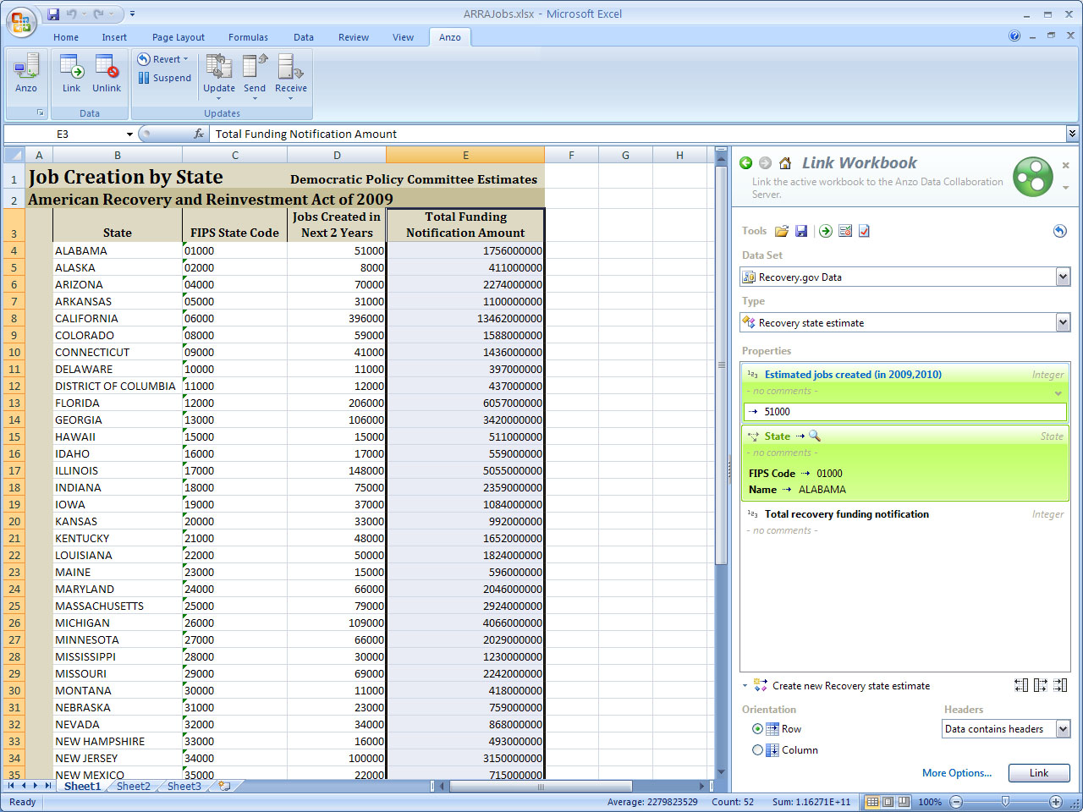
Repeat the Process
Now that the data is linked…
Notes:
And so on…

Slide 52
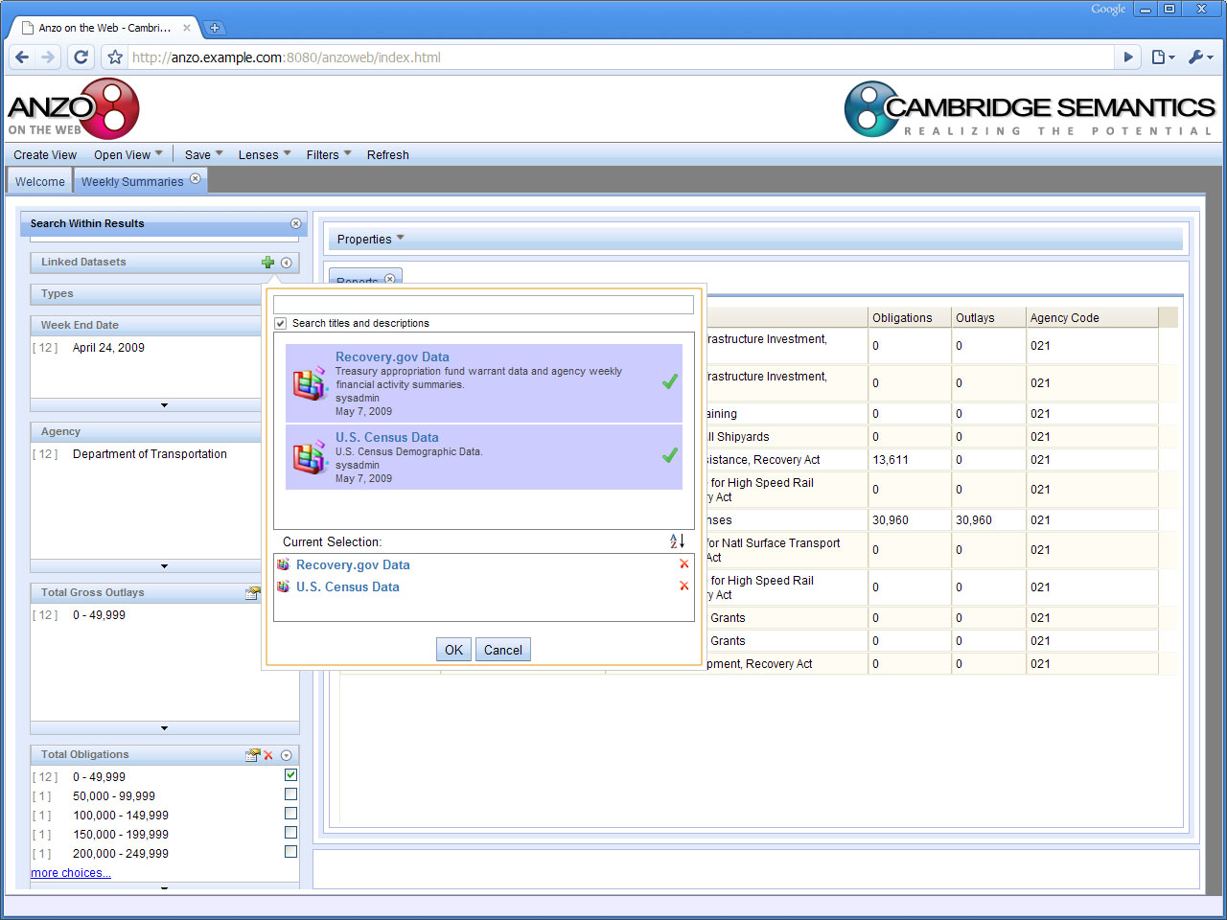
Anzo on the Web Can Work With It
Select from Linked Data Sets
Notes:
This screen shows how all of the data that we linked using Anzo for Excel, is immediately available to Anzo on the web. A simple dropdown menu allows me to see the available linked data sets. All I do is check off the one(s) I would like to use for this exercise.

Slide 53
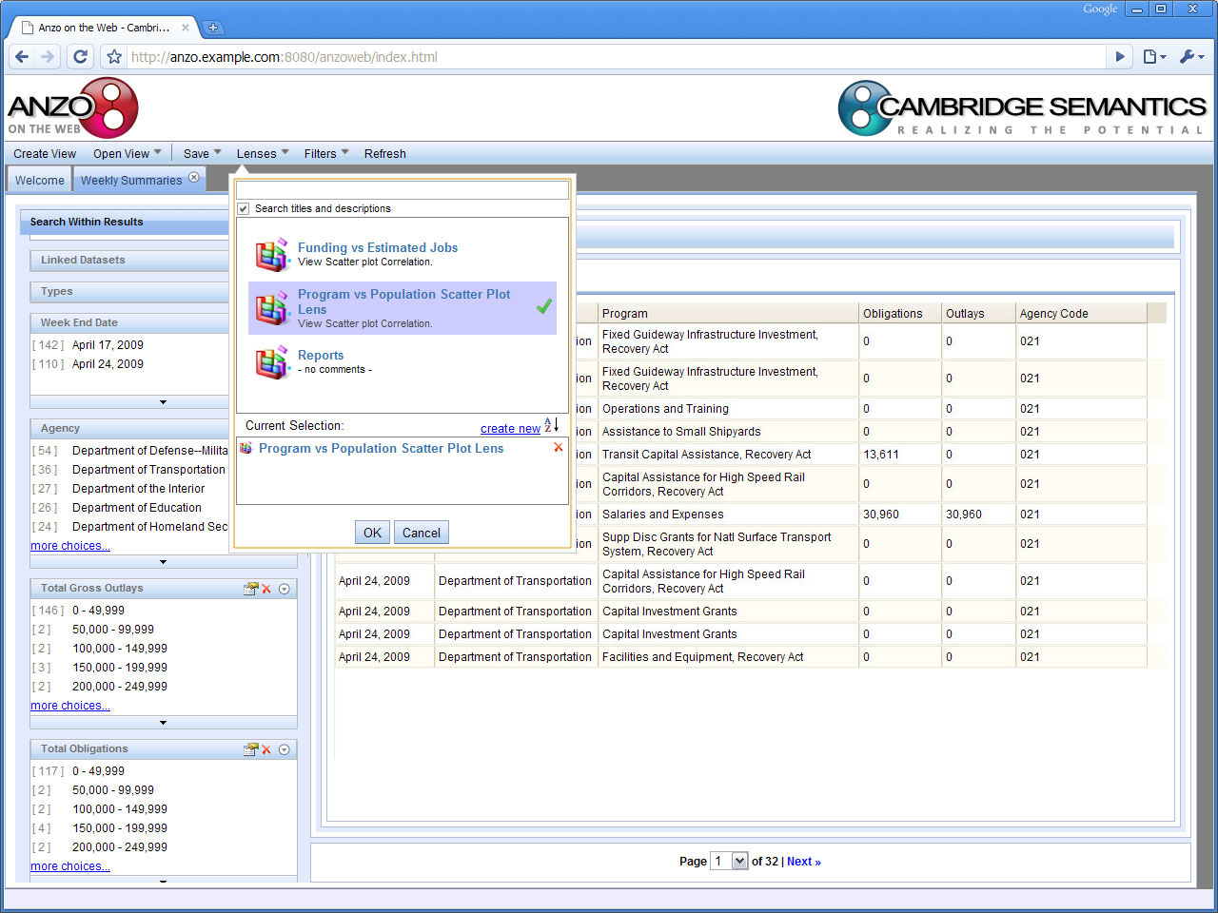
Lenses Allow Various Views
Choose a Lens
Notes:
Then I choose a lens from a list of available lenses. A lens is simply a previously created, view of some set of data. The view can be a chart, grid, timeline, etc. Once a lens has been created, it can be saved, modified, shared with other users, whatever you like.

Slide 54
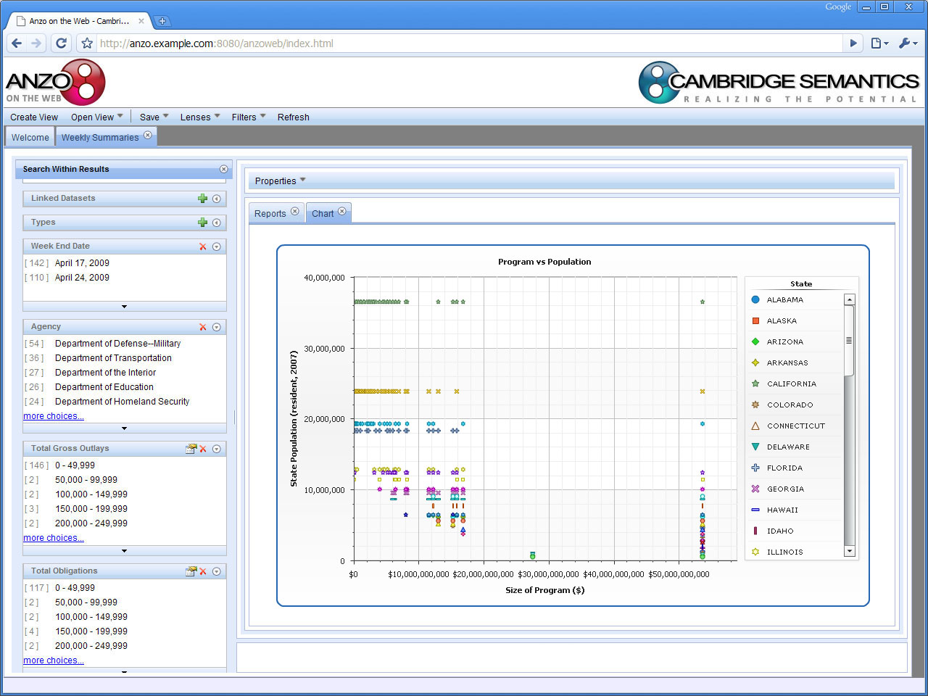
Combined Data Displayed Graphically
Notes:
This lens renders data a scatter plot. This particular lens compares the population of a state from the census website to the size of recovery program expenditures mane din that state.

Slide 55
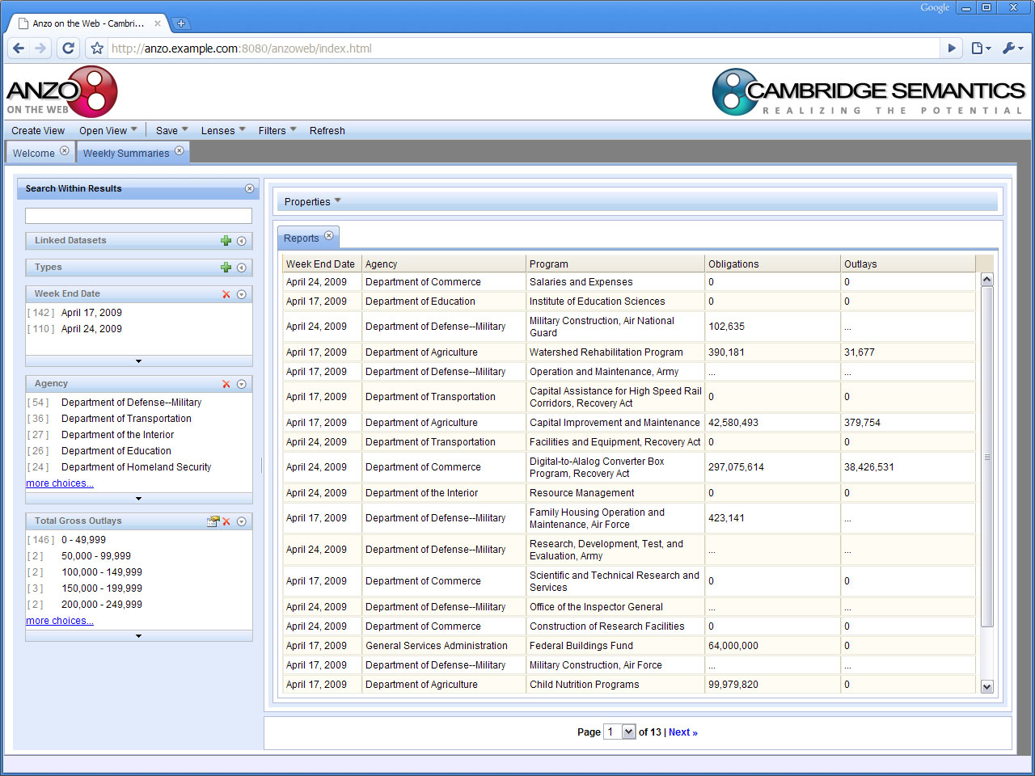
Another Option… Combining and Filtering Data
Notice multiple sources (agencies)
Notes:
This shows data from individual agency weekly reports grouped together into one display. As you can see, in this case we are looking at a simple grid view.

Slide 56
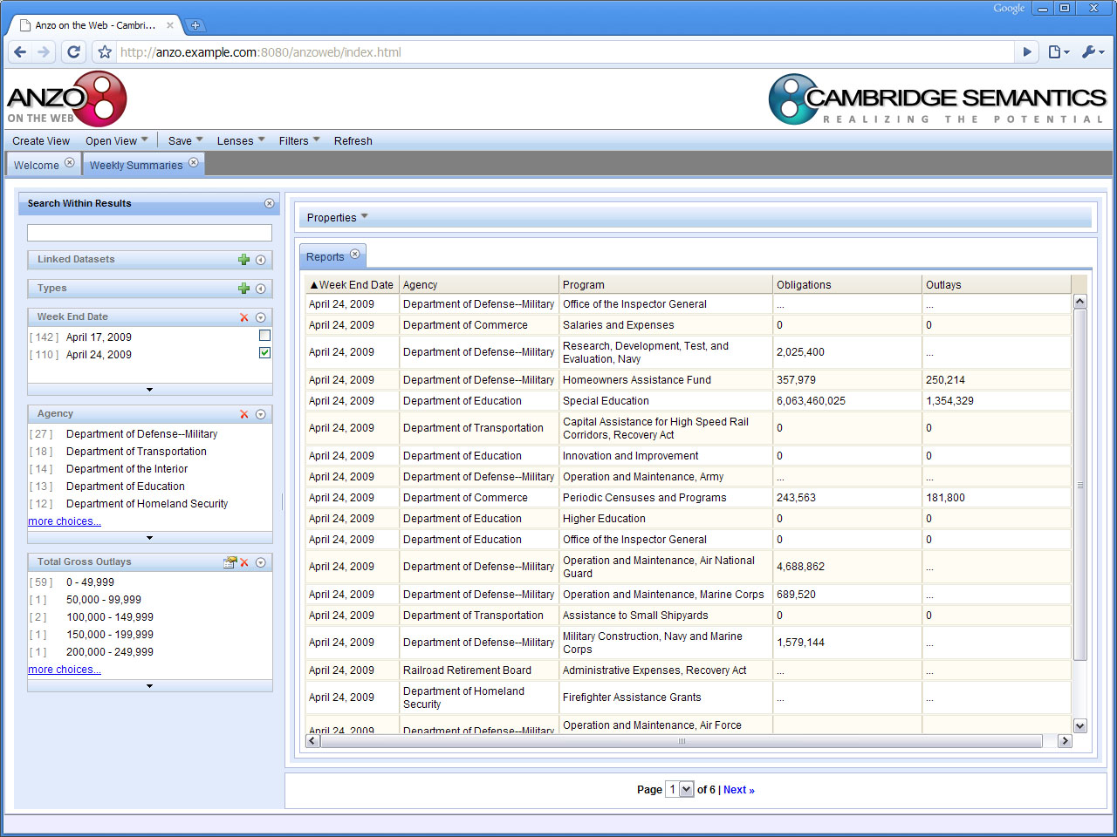
Manipulate As Desired
Click to sort and filter the data to on-the-fly
Notes:
Here we see how the system supports faceted browsing or using filters to drill down into only the data we want. It’s as simple as checking off the desired filter on the left-hand side of the screen. The more boxes that are checked the finer the filter.

Slide 57
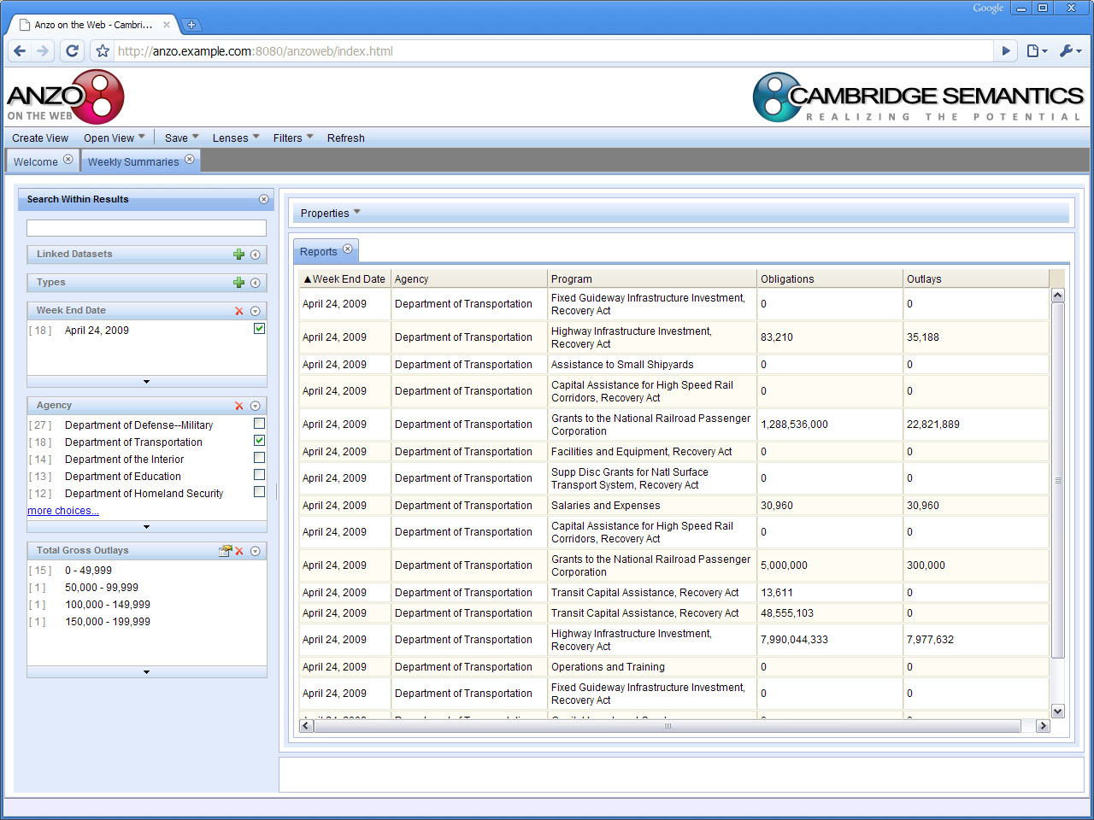
Apply a Finer Filter
Check the desired filter
Notes:
In this case we add another filter to see just the data from the Department of Education.

Slide 58
Add More Data to Your View
The ontology guides users as they explore relationships
Notes:
If I decide I would like to add more information to the view, I simply choose what I want form the list of available data. Once I select what I want…

Slide 59
The New Data is Immediately Available
Notes:
It is immediately added to my view. As you can see, this is very simple and no programming is required. Virtually anyone can create a lens...

Slide 60
Add Filters on the Fly
The system Guides the User Just click and add
Notes:
Or in this case, add a filter.

Slide 61
The Filter is Added
The new filter
appears here

Slide 62
…and Works Immediately
The view is narrowed further

