Slide 1
W3C Library Linked Data Incubator Group
Preliminary results
2 June 2011

Slide 2
W3C Library Linked Data Incubator Group
Chartered May 2010 thru August 2011
Members here at LOD-LAM:
Antoine Isaac (co-chair), Tom Baker (co-chair), Jodi Schneider, Hideaki Takeda, Uldis Bojars, Asaf Bartov, Karen Coyle, Kevin Ford, Marcia Zeng
Links
http://lists.w3.org/Archives/Public/public-lld/
http://lists.w3.org/Archives/Public/public-xg-lld/
http://www.w3.org/2005/Incubator/lld/
Draft report
http://www.w3.org/2005/Incubator/lld/wiki/DraftReportWithTransclusion

Slide 3
LLD XG Final Report – draft – outline
Executive Summary
1. "Library Linked Data": Scope of this report
2. Benefits of the Linked Data approach
3. Available Vocabularies and Datasets
4. Relevant Technologies
5. Implementation challenges and barriers to adoption
6. Recommendations

Slide 4
1. "Library Linked Data": Scope of this report
“Library”
A collection
A place where the collection is located
An agent that curates the collection
“Library data” – types based on typical use:
Datasets: collection of structured descriptions
Element sets: used to describe dataset items
Value vocabularies: concept ass’d with elements as values
“Linked Data”: published in form that facilitates linkages (URIs and RDF)
“Library Linked Data”: either natively maintained, or merely exposed, as RDF triples to facilitate linking

Slide 5
2. Benefits of the Linked Data approach
Data sharable, extensible, easily reusable.
Supports internationalization of data and services
Through rich linkages, increases value of data
Trusted identifiers for works, places, people, events, subjects, concepts… citable anywhere
Researchers, students, patrons: richer search and pathways for browsing
“Recombinational” data designed to be excerpted and re-mixed
Library data better-integrated into larger Web

Slide 6
2. Benefits of the Linked Data approach
Improved value proposition of resource description
Mainstream, non-library specific data mgt
First step towards cost-effective cloud approach
Institutions gain visibility
“The best uses for your data will be thought of by someone else.”

Slide 7
2. Benefits of the Linked Data approach
Open, global pool of shared data will reduce redundant cataloging effort
Developers freed from library-specific protocols, formats, and software
Generic tools, often open-source, for retrieving and re-mixing data.

Slide 8
3. Available Vocabularies and Datasets
A side deliverable
An attempt to identify a set of useful resources for creating or consuming linked data in the library domain.
Intended for:
novices seeking an overview of the library linked data domain, and
experts in search of a quick look-up or refresher
Listed in three categories (may overlap) for convienient access:
Dataset --a collection of structured metadata
Value vocabulary – defines resources (topics, art styles, authors) that are used as values of elements in metadata records
Metadata element set -- defines classes of entities and attributes (elements) of entities.
http://www.w3.org/2005/Incubator/lld/wiki/Vocabulary_and_Dataset
Notes:
Issues will be discussed during the introduction of each slide.
Or a new slide for the issues.

Slide 9
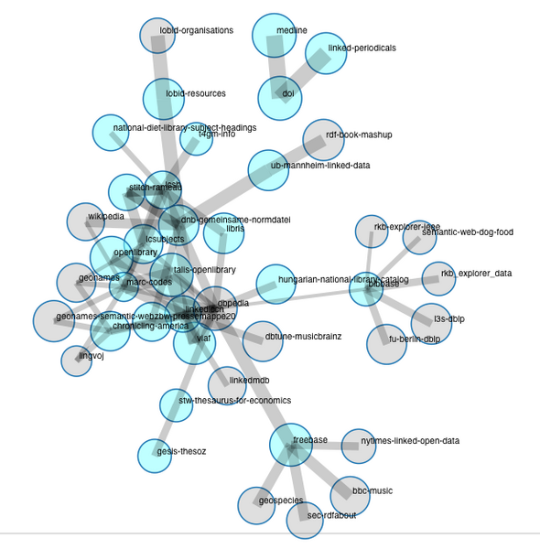
^{Datasets -- LLD@CKAN}
CKAN is a metadata registry for datasets.
Library Linked Data group in CKAN: http://ckan.net/group/lld
brightly coloured circles: -- datasets that are part of the LLD group.
grey circles – datasets connected to but are not members of LLD group (they typically are members of the LOD Cloud group).
size of the circles -- size of the dataset
thickness of the lines -- the number of outward links (logarithmic) respectively.
Notice that:
the majority are actually connected through datasets that are not necessarily library data in themselves -- DBPedia and Geonames figuring prominently.
linking to other datasets that do not have this central character is quite common.
http://semantic.ckan.net/group/?group=http://ckan.net/group/lld
Notes:
Datasets : A dataset is a collection of structured metadata -- descriptions of things, such as books in a library. Library records consist of statements about things, where each statement consists of an element ("attribute" or "relationship") of the entity, and a "value" for that element. The elements that are used are usually selected from a set of standard elements, such as Dublin Core. The values for the elements are either taken from value vocabularies such as LCSH, or are free text values. Similar notions to "dataset" include "collection" or "metadata record set". Note that in the Linked Data context, Datasets do not necessarily consist of clearly identifiable "records". Examples:
a record from a dataset for a given book could have a Subject element drawn from Dublin Core, and a value for Subject drawn from LCSH.
the same dataset may contain records for authors as first-class entities that are linked from their book, described with elements like "name" from FOAF
a dataset may be self describing in that it contains information about itself as a distinct entity for example with a modified date and maintainer/curator elements drawn from Dublin Core

Slide 10
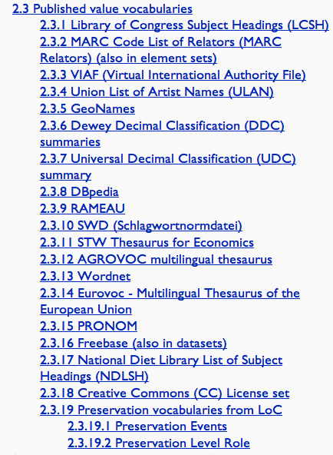
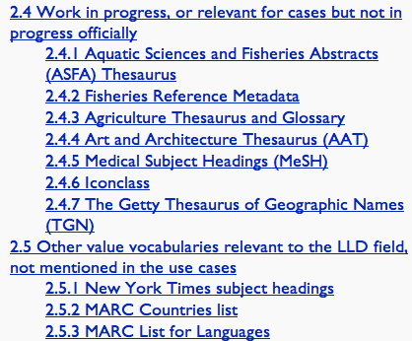
Published value vocabularies
Notes:
Value vocabularies : A value vocabulary defines resources (topics, art styles, authors) that are used as values of elements in metadata records. Typically a value vocabulary does not define bibliographic resources such as books but concepts related to bibliographic resources (persons, languages, countries, etc.). They are "building blocks" with which metadata records can be built. Many libraries require specific value vocabularies as mandatory for selecting values for a particular metadata element. A value vocabulary thus represents a "controlled list" of allowed values for an element. Resources that can be considered as value vocabularies include: thesaurus, code list, term list, classification scheme, subject heading list, taxonomy, authority file, digital gazetteer, concept scheme, and other types of knowledge organisation system. Note however, that value vocabularies often have http URIs assigned to the value, which would appear in a metadata record instead of or in addition to the literal value. Examples:
LCSH defines topics of books
Art and Architecture Thesaurus defines a.o. art styles
VIAF defines authorities
GeoNames defines geographical locations (e.g. cities).

Slide 11
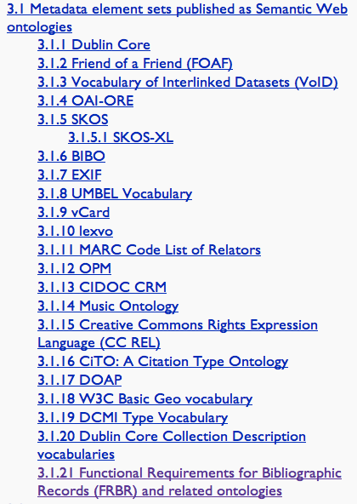
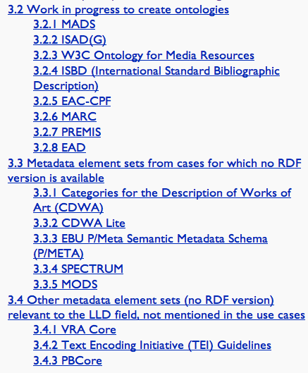
Relevant LLD Metadata Element Sets
Source: http://www.w3.org/2005/Incubator/lld/wiki/Vocabulary_and_Dataset
Notes:
http://www.w3.org/2005/Incubator/lld/wiki/Vocabulary_and_Dataset
Metadata element sets or element sets: A metadata element set defines classes of entities and attributes (elements) of entities. In the linked data terminology, such element sets are materialized through (RDF) schemas or (OWL) ontologies, the term "RDF vocabulary" being sometimes used as an umbrella for these. Usually a metadata element set does not define bibliographic entities, rather it provides elements to be used by others to describe such entities.
Examples: Dublin Core defines elements such as Creator and Date (but DC does not define bibliographic records that use those elements).
FRBR defines entities such as Work and Manifestation and elements that link and describe them.
MARC21 defines elements (fields) to describe bibliographic records and authorities.
FOAF and ORG define elements to describe people and organisations as might be used for describing authors and publishers

Slide 12
In addition to ‘L’ …
For ‘A’ and ‘M’
The list of Value Vocabularies included various that are popular in the museums and visual resources domains, e.g., ICONclass, AAT, VIAF, preservation vocabularies, UMBEL vocabularies, dbpedia.
The list of Metadata Element Sets introduced standards in ‘A’ and ‘M’ no matter if there is an official LD version of is in progress, e.g., EAD and LOCAH’s RDF vocabulary, EXIF, CIDOC CRM, CDWA Lite, VRA core, TEI, PREMIS OWL, etc.
LLD group at CKAN is for ‘L’ now, but could be used as a model for ‘A’ and ‘M’. May extend to include them, or have separate groups.
Notes:
"How about Archives and Musea, now?". Something that would try to provoke them into jumping onboard--maybe not contributing directly to our report, but check whether our report includes stuff relevant to As and Ms.

Slide 13
4. Relevant Technologies

Slide 14
5. Implementation challenges and barriers to adoption General challenges
Library technology designed for long-term stability, not rapid change
Data sharing among libraries and interdependence make change a whole community coordination issue
Very large set of legacy data makes idea of data format change daunting
Cost-Benefit analysis is difficult, so it may be hard to promote particular changes

Slide 15
5. Implementation challenges and barriers to adoption Technology challenges
Libraries currently use library-specific data formats
Libraries have a small cadre of technology developers, often isolated

Slide 16
5. Implementation challenges and barriers to adoption Legal challenges
Rights in bibliographic data are often unclear

Slide 17
6. Recommendations
Design
Translate library data, and data standards, into forms appropriate for Linked Data
Develop and disseminate best-practices design patterns tailored to LLD
Design user stories and exemplar user interfaces
Identify and link
Assign unique identifiers (URIs) for all significant things in library data
Create URIs for the items in library datasets
Create explicit links from library datasets to other well-used datasets
Directly use, or map to, commonly understood Linked Data vocabularies

Slide 18
6. Recommendations
Assess
Identify sets of data as possible candidates for early exposure as LD
For each set of data, determine ROI of current practices, and costs and ROI of exposing as LD
Consider migration strategies
Foster a discussion about open data and rights
Facilitate
Cultivate an ethos of innovation
Identify Linked Data literacy needed for different staff roles in the library
Include metadata design in library and information science education
Increase library participation in Semantic Web standardization

Slide 19
6. Recommendations
Prepare
Develop best practices and design patterns for LLD
Commit to best-practice policies for managing and preserving RDF vocabularies
Identify tools that support the creation and use of LLD
Curate
Apply library experience in curation and long-term preservation to Linked Data datasets
Preserve Linked Data vocabularies

