Slide 1




PROV-O: The PROV Ontology
Tutorial
Daniel Garijo
Ontology Engineering Group
Universidad Politécnica de Madrid
(with Slides from Luc Moreau, Ivan Herman, Paul Groth and Timothy Lebo)
Date: 01/09/2013

Slide 2



About me
  Daniel Garijo
  PhD student at the
  Ontology Engineering Group
  Universidad Politécnica de Madrid
  (http://delicias.dia.fi.upm.es/members/dgarijo/)
  Member of:
  W3C Provenance Incubator Group
  W3C Provenance Working Group
  DCMI Metadata Provenance Task Group
Download this presentation here:
http://www.slideshare.net/dgarijo/provo-tutorial-dc2013-conference
DC-2013, Lisbon, Portugal

Slide 3
Agenda
Plan for the afternoon
Introduction: The Provenance Working Group
From DC to PROV: An example
PROV-O: An Overview
PROV-O part 1
Coffee Break
PROV-O part 2
Mapping PROV-O to Dublin Core
DC-2013, Lisbon, Portugal

Slide 4
Introduction
Introduction: The Provenance Working Group
DC-2013, Lisbon, Portugal

Slide 5

The Provenance Working Group: Goals
We aim to express how data has evolved:
  Who played a role when creating the data?.
  Who owned the data?.
  Who contributed to the data?.
  How data was modified from its first revision?.
  How other data affected the current data?.
  Which tools where used to generate each version of the data?
  etc.
Image from : http://www.psmag.com/science/the-background-on-your-bytes-40220/
DC-2013, Lisbon, Portugal

Slide 6
…but it is not that easy!
The Provenance Working Group: Goals (2)
Requires a complete model describing the various constituents (actors, revisions, etc.)
The model should be usable with RDF to be used on the Semantic Web
Has to find a balance between provenance granularities
  simple (“scruffy”) provenance: easily usable.
  complex (“complete”) provenance: allows for a detailed reporting of origins, versions, etc.
DC-2013, Lisbon, Portugal

Slide 7
Example: Editing a blog post
Scruffy provenance vs complete provenance: an example
Scruffy provenance
Complete provenance
:Daniel
createdBy, modifiedBy
:Daniel
myBlogPost
createdBy
createdBy,
modifiedBy
myBlogPostv1
versionOf
used
myBlogPost
:editingPost
wasGeneratedBy
createdBy
myBlogPostv2
versionOf
DC-2013, Lisbon, Portugal

Slide 8
Applications of provenance
The Provenance Working Group: Motivation
Art
  Ownership of pieces of art
Open Information Systems
  origin of the data, who was responsible for its creation
Science applications
  how the results of a publication were obtained (scientific workflows)
News
  origins and references of blogs, news items
Law
  licensing attribution of documents, data
  privacy information
Etc.
DC-2013, Lisbon, Portugal

Slide 9
The Provenance Working Group: Definition of Provenance
“Provenance is defined as a record that describes the people, institutions, entities, and activities involved in producing, influencing, or delivering a piece of data or a thing”.
  W3C Provenance Incubator Group
“Provenance assertions are a form of contextual metadata and can themselves become important records with their own provenance.”
DC-2013, Lisbon, Portugal

Slide 10
The Provenance Working Group: Definition of Provenance (2)
Provenance is Metadata, but not all metadata is provenance:
  The title or format of a book is metadata, but it is not part of its provenance.
  The date of creation, the author, the publisher or the license of a book are part of its provenance.
DC-2013, Lisbon, Portugal
Notes:
Title and format are not part of the evolution of the book. They describe just the current state.
The rest are part of the provenance because they described how the book has reached its current state.

Slide 11
Provenance is not a new subject !
A lot of work has been done in
  Workflow management systems
    Reproducibility, repeatability and attribution
  Databases
    Who modified a record? How?
  knowledge representation
    How was an entity affected?
  information retrieval
    Who is responsible for this information?
DC-2013, Lisbon, Portugal

Slide 12
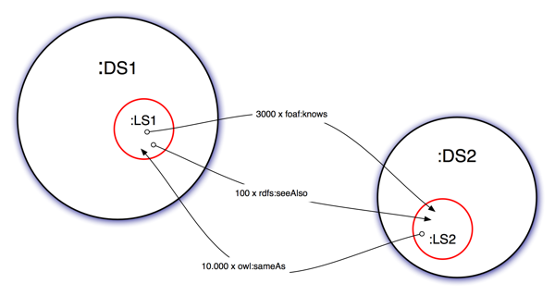



Provenance is not a new subject!
Communities and vocabularies are already in use:
  Dublin Core (Documents and resources)
  Open Provenance Model (OPM) and extensions
  Provenir ontology (Sensor networks)
  Provenance vocabulary (Linked Data)
  SWAN provenance ontology (Neuromedicine resources)
  SIOC (Online blogs and forums)
  VOID (Datasets)
  etc.
VoID
…
DC-2013, Lisbon, Portugal

Slide 13
How do we interchange provenance?
The existing models track provenance at different granularities in different domains.
  How do we make the provenance descriptions interchangeable?
  How do we integrate these heterogeneous provenance data?
DC-2013, Lisbon, Portugal

Slide 14
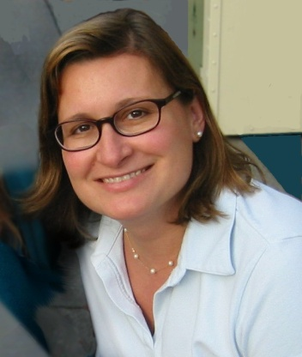
The W3C’s Provenance Incubator Group
Worked in 2009-2010 (Chaired by Yolanda Gil)
Issued a final report
  “Provenance XG Final Report”
    http://www.w3.org/2005/Incubator/prov/XGR-prov/
  provides an overview of the various existing approaches and vocabularies
  proposes the creation of a dedicated W3C Working Group
    A set of terms is recommended for initial discussion
DC-2013, Lisbon, Portugal

Slide 15
The W3C’s Provenance Incubator Group (2)
Introduces requirements for the provenance in the web:
http://www.w3.org/2005/Incubator/prov/wiki/User_Requirements
Maps different existing vocabulary approaches to OPM: http://www.w3.org/2005/Incubator/prov/wiki/Provenance_Vocabulary_Mappings
Defines three common use case scenarios for provenance
  News Aggregator
  Disease Outbreak
  Business Contract
DC-2013, Lisbon, Portugal

Slide 16
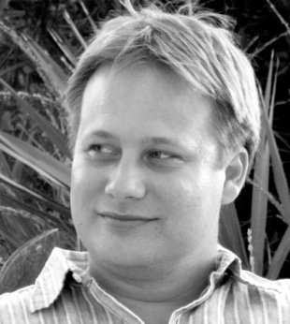
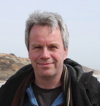

The W3C’s Provenance Working Group
Set up in April 2011
  (co-chaired by Paul Groth and Luc Moreau)
Goal is to define a standard way to interchange provenance on the web.
Focused on the Semantic Web.
DC-2013, Lisbon, Portugal

Slide 17
Participants
DERI Galway
European Broadcasting Union
FORTH
Financial Services Technology Consortium
DFKI
IBBT
IBM
Library of Congress
Mayo Clinic
NASA
OCLC
Open Geospatial Consortium
OpenLink Software
Oracle
Pacific Northwest National Laboratory
Rensselaer Polytechnic Institute
Revelytix, Inc
Newcastle University
The National Archives
TopQuadrant
Universidad Politécnica de Madrid
University of Aberdeen
University of Edinburgh
University of Manchester
University of Oxford
University of Southampton
VU University Amsterdam
Wright State University
+ Invited Experts
DC-2013, Lisbon, Portugal
Notes:
Institutions which deal with many different aspects of provenance:
Workflows, libraries, sensors, etc.

Slide 18
Documents published by the group
Main documents:
  PROV Overview (http://www.w3.org/TR/prov-overview/)
  PROV Primer (http://www.w3.org/TR/prov-primer/)
  PROV Data Model(*) (http://www.w3.org/TR/prov-dm/)
  PROV Constraints(*) (http://www.w3.org/TR/prov-constraints/)
  PROV Semantics (http://www.w3.org/TR/prov-sem/)
  PROV Notation(*) (http://www.w3.org/TR/prov-n/)
  PROV Ontology(*) (http://www.w3.org/TR/prov-o/)
  PROV XML Serialization (http://www.w3.org/TR/prov-xml/)
  PROV Access and Query (http://www.w3.org/TR/prov-aq/)
  PROV DC Mapping (http://www.w3.org/TR/prov-dc/)
  PROV Links (http://www.w3.org/TR/prov-links/)
  PROV Dictionary (http://www.w3.org/TR/prov-dictionary/)
  PROV Implementations (http://www.w3.org/TR/prov-implementations/)
  ^{(*)}Rec-track documents
DC-2013, Lisbon, Portugal

Slide 19
PROV is not just a model
Main documents:
  PROV Overview (http://www.w3.org/TR/prov-overview/)
  PROV Primer (http://www.w3.org/TR/prov-primer/)
  PROV Data Model(*) (http://www.w3.org/TR/prov-dm/)
  PROV Constraints(*) (http://www.w3.org/TR/prov-constraints/)
  PROV Semantics (http://www.w3.org/TR/prov-sem/)
  PROV Notation(*) (http://www.w3.org/TR/prov-n/)
  PROV Ontology(*) (http://www.w3.org/TR/prov-o/)
  PROV XML Serialization (http://www.w3.org/TR/prov-xml/)
  PROV Access and Query (http://www.w3.org/TR/prov-aq/)
  PROV DC Mapping (http://www.w3.org/TR/prov-dc/)
  PROV Links (http://www.w3.org/TR/prov-links/)
  PROV Dictionary (http://www.w3.org/TR/prov-dictionary/)
  PROV Implementations (http://www.w3.org/TR/prov-implementations/)
  ^{(*)}Rec-track documents
Model
Serializations
Extensions
DC-2013, Lisbon, Portugal
Notes:
PROV is not just a model! It is a family of specifications for creating and exchanging provenance in the web.

Slide 20
PROV and types of users
Main documents:
  PROV Overview (http://www.w3.org/TR/prov-overview/)
  PROV Primer (http://www.w3.org/TR/prov-primer/)
  PROV Data Model(*) (http://www.w3.org/TR/prov-dm/)
  PROV Constraints(*) (http://www.w3.org/TR/prov-constraints/)
  PROV Semantics (http://www.w3.org/TR/prov-sem/)
  PROV Notation(*) (http://www.w3.org/TR/prov-n/)
  PROV Ontology(*) (http://www.w3.org/TR/prov-o/)
  PROV XML Serialization (http://www.w3.org/TR/prov-xml/)
  PROV Access and Query (http://www.w3.org/TR/prov-aq/)
  PROV DC Mapping (http://www.w3.org/TR/prov-dc/)
  PROV Links (http://www.w3.org/TR/prov-links/)
  PROV Dictionary (http://www.w3.org/TR/prov-dictionary/)
  PROV Implementations (http://www.w3.org/TR/prov-implementations/)
  ^{(*)}Rec-track documents
Users
Advanced
Developers
DC-2013, Lisbon, Portugal

Slide 21
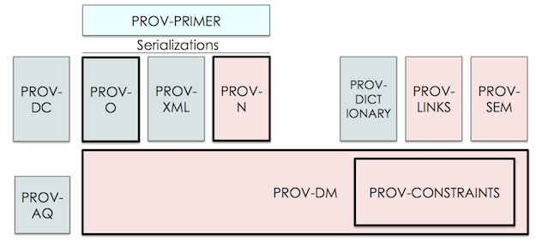
PROV dependencies
DC-2013, Lisbon, Portugal

Slide 22
Working Group Status
The Rec Track documents have been released as CR (candidate recommendations)
Group has finished:
  Official Wiki (frozen): http://www.w3.org/2011/prov/wiki/Main_Page
  Active Semantic Wiki: http://www.w3.org/2001/sw/wiki/PROV
  FAQ: http://www.w3.org/2001/sw/wiki/PROV-FAQ
DC-2013, Lisbon, Portugal

Slide 23
Introduction
From Dublin Core to PROV-O
An example
K-CAP 2013. Banff, Canada

Slide 24
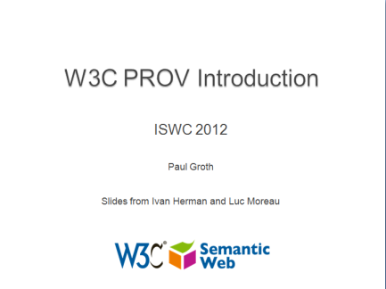
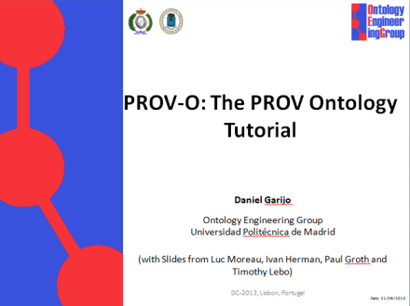

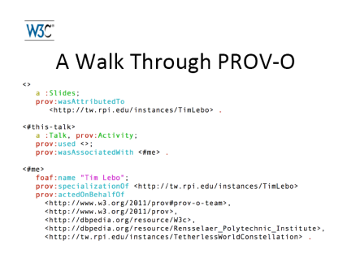
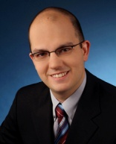
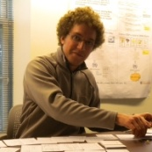
Example
This presentation
  Created by Daniel.
  Kai contributed with feedback.
  Used previous tutorials as references.
  Refinement of previous presentation draft.
draft
DC-2013, Lisbon, Portugal

Slide 25
The example using Dublin Core Terms
:dcProvTutorial a foaf:Document;
dct:title “PROV-O Tutorial" ;
dct:creator :daniel ;
dct:contributor :kai;
  dct:created "2013-08-25" ;
dct:replaces :tutorialDraft;
dct:references :iswcProvTutorial, :iswcProvIntro.
:kai a dct:Agent.
:daniel a dct:Agent.
:tutorialDraft a foaf:Document;
dct:creator :daniel.
:iswcProvTutorial a foaf:Document;
...
DC-2013, Lisbon, Portugal

Slide 26
Graphical representation
:daniel
:kai
dct:creator
:dcProvTutorial
dct:contributor
dct:created
“2013-02-28”
dct:replaces
dct:references
:tutorialDraft
dct:references
:iswcProvTutorial
:iswcProvIntro
DC-2013, Lisbon, Portugal

Slide 27
PROV-O: A very simple attribution
:daniel
dct:creator
:dcProvTutorial
DC-2013, Lisbon, Portugal

Slide 28
PROV-O: A very simple attribution (2)
:daniel
dct:creator
:dcProvTutorial
prov:wasAttributedTo
prov:Agent
prov:Entity
DC-2013, Lisbon, Portugal

Slide 29
PROV-O: Making the activity explicit
:daniel
dct:creator
:dcProvTutorial
prov:wasAttributedTo
prov:Agent
prov:Entity
prov:wasAssociatedWith
prov:wasGeneratedBy
:makingTheTutorial
prov:Activity
DC-2013, Lisbon, Portugal

Slide 30
PROV-O: Adding metadata of the activity
:daniel
dct:creator
:dcProvTutorial
prov:wasAttributedTo
prov:Agent
prov:Entity
dct:created
prov:wasAssociatedWith
prov:wasGeneratedBy
:makingTheTutorial
prov:startedAtTime
“2013-08-1"”
prov:Activity
prov:endedAtTime
“2013-08-25"”
DC-2013, Lisbon, Portugal

Slide 31
PROV-O: Adding metadata of the activity
dct:replaces
dct:contributor
:daniel
dct:creator
:dcProvTutorial
prov:wasAttributedTo
prov:Agent
prov:Entity
dct:created
prov:wasAssociatedWith
prov:wasGeneratedBy
:kai
:makingTheTutorial
prov:startedAtTime
“2013-08-1"”
prov:wasAssociatedWith
prov:Activity
prov:endedAtTime
prov:used
“2013-08-25"”
:tutorialDraft
DC-2013, Lisbon, Portugal

Slide 32
PROV-O: Basics
This example shows the fundamental notions of PROV-O
  Entity :
    the resources whose provenance we want to describe
  Activity:
    describes how entities are created and how they changed.
  Agent:
    responsible for the actions affecting entities.
  Usage, generation, derivation, attribution,..
    connections describing how entities, agents, and activities interact.
DC-2013, Lisbon, Portugal

Slide 33
Making the example a little more complex
A couple of things are still missing in the example:
  The creation process of the draft of the tutorial.
  The tutorial is a revision of the draft (a second version).
  The creation process of the referenced tutorials
  …
DC-2013, Lisbon, Portugal
Notes:
We could go on forever tracking the provenance chain.

Slide 34
PROV-O: Making the example a little more complex (2)
:daniel
dct:creator
:dcProvTutorial
prov:wasAttributedTo
prov:Agent
prov:Entity
prov:wasAssociatedWith
prov:wasGeneratedBy
:kai
:makingTheTutorial
prov:wasAssociatedWith
prov:Activity
prov:used
:tutorialDraft
prov:wasRevisionOf
prov:wasDerivedFrom
:makingTheDraft
:iswcProvTutorial
prov:wasGeneratedBy
prov:used
prov:wasAssociatedWith
prov:used
:iswcProvIntro
prov:wasDerivedFrom
DC-2013, Lisbon, Portugal

Slide 35
Introduction
PROV-O: An Overview
DC-2013, Lisbon, Portugal

Slide 36
Categories of PROV terms
Starting Point classes and properties: the basics.
Expanded classes and properties: additional terms around the starting point terms for richer descriptions.
Qualified classes and properties: for advanced provenance descriptions.
DC-2013, Lisbon, Portugal
Notes:
We could go on forever tracking the provenance chain.

Slide 37
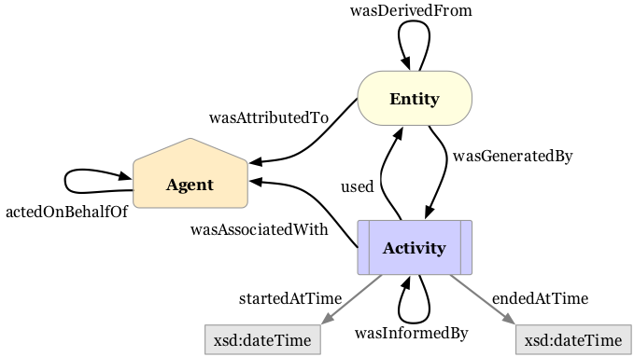
Categories of PROV terms: Starting points
DC-2013, Lisbon, Portugal
Notes:
We could go on forever tracking the provenance chain.

Slide 38
Categories of PROV terms: Expanded classes
Some common specific types of agents:
  Organization, Person, SoftwareAgent.
Extra properties for describing versioning, influencing, invalidation, creation of entities, etc.
Extension of the Starting points to cover generic necessities in many use cases.
  If needed, applications may further extend this terms to their domain specific needs.
DC-2013, Lisbon, Portugal
Notes:
We could go on forever tracking the provenance chain.

Slide 39
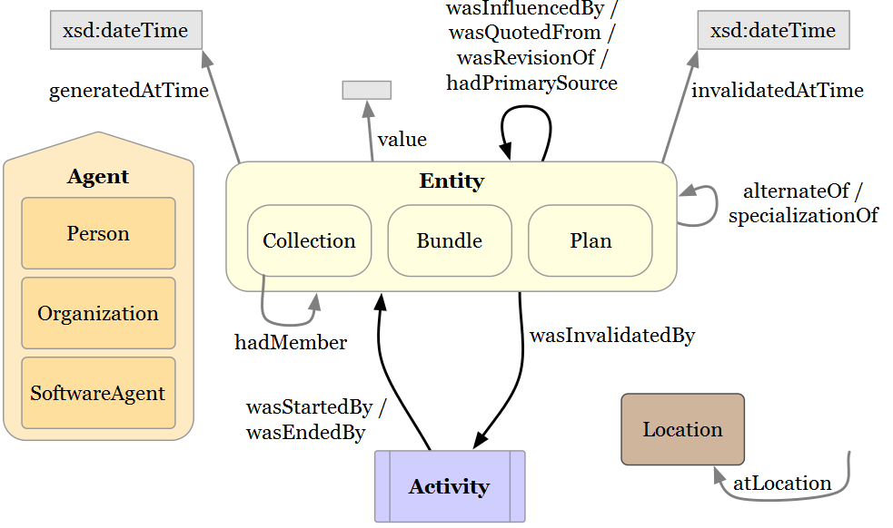
Categories of PROV terms: Starting points
DC-2013, Lisbon, Portugal
Notes:
We could go on forever tracking the provenance chain.

Slide 40
Categories of PROV terms: Qualified classes
Sometimes we need to further describe the properties we have used:
  At what time was a particular resource used?
  What is the role of an agent in an association?
  Where was an entity generated?
  …
Qualified classes provide the means for enabling such descriptions.
  Turn relationships into classes
DC-2013, Lisbon, Portugal
Notes:
We could go on forever tracking the provenance chain.

Slide 41
Categories of PROV terms: Qualified classes
  Example: At what time was the tutorial draft used?
:tutorialDraft
prov:entity
Usage
prov:atTime
“2013-08-1"”
prov:used
:makingTheTutorial
prov:qualifiedUsage
DC-2013, Lisbon, Portugal
Notes:
We could go on forever tracking the provenance chain.

Slide 42
Introduction
PROV-O: The PROV Ontology
Part 1
DC-2013, Lisbon, Portugal

Slide 43
PROV-O
<http://www.w3.org/ns/prov#>
A lightweight OWL ontology for interchanging provenance information
– “Simple”
– Domain neutral
– Meant to be extended
– Encodes PROV-DM’s “abstract model” in RDF
– There are alternate encodings for XML, etc.
DC-2013, Lisbon, Portugal

Slide 44
How to access PROV-O?
Final W3C recommendation: http://www.w3.org/TR/prov-o/
PROV in LOV: http://lov.okfn.org/dataset/lov/details/vocabulary_prov.html
Content negotiation is enabled:
Turtle
  curl -sH "Accept: text/turtle" -L http://www.w3.org/ns/prov
RDF/XML
  curl -sH "Accept: application/rdf+xml" -L http://www.w3.org/ns/prov
XSD
  curl -sH "Accept: application/xml" -L http://www.w3.org/ns/prov
DC-2013, Lisbon, Portugal

Slide 45
Prefixes
• @prefix rdfs: <http://www.w3.org/2000/01/rdf-schema#> .
• @prefix xsd: <http://www.w3.org/2001/XMLSchema#> .
• @prefix owl: <http://www.w3.org/2002/07/owl#> .
• @prefix dct: <http://purl.org/dc/terms/> .
• @prefix prov: <http://www.w3.org/ns/prov#> .
• @prefix : <http://example.com/> .
When in doubt, prefix.cc.” (http://prefix.cc/prov)
DC-2013, Lisbon, Portugal

Slide 46
PROV-O at a glance
Starting point terms (“Simple”)
  The basics for the rest of the ontology.
  3 classes + 9 properties
  Simple binary relationships
Expanded terms (“Advanced”)
  7 classes + 18 properties
  Extension of the starting point terms
Qualifying relationships (“Complex”)
  Elaborate of the 14 Starting and expanded relationships
Agent
Entity
Activity
DC-2013, Lisbon, Portugal

Slide 47
PROV-O: Starting Points
DC-2013, Lisbon, Portugal

Slide 48
Starting Points: Entities
Entities Anything that we want to describe:
  A document.
  A part of a document.
  An idea.
  A rumor.
  A product.
  A contract.
  A news article.
  A result.
  Etc.
Entity
“An entity is a physical, digital, conceptual, or other kind of thing with some fixed aspects; entities may be real or imaginary”.
DC-2013, Lisbon, Portugal

Slide 49
Starting Points: Activities
Activities are any processes that used or generated entities:
  Computing a result.
  Making a request.
  Writing a book.
  Giving a presentation.
  Creation of car.
  Etc.
Activities are NOT entities.
Activity
“An activity is something that occurs over a period of time and acts upon or with entities; it may include consuming, processing, transforming, modifying, relocating, using, or generating entities”.
DC-2013, Lisbon, Portugal
Notes:
Clarify that entities are not activities: activities have a beginning and at end while some entities could just be permanent.
If you want to state the provenance of an activity, that can be done.

Slide 50
Starting Points: Agents
Agents receive attribution for entities and are responsible for activities:
  Creator of a document.
  Web service accepting requests.
  Tool or managing system.
  An organization.
  The student acting on behalf of the organization.
  Etc.
Agents can be entities.
Agent
“An agent is something that bears some form of responsibility for an activity taking place, for the existence of an entity, or for another agent's activity”.
DC-2013, Lisbon, Portugal
Notes:
Clarify that entities are not activities: activities have a beginning and at end while some entities could just be permanent.
If you want to state the provenance of an activity, that can be done.

Slide 51
Starting Points: Full example
Music example
  2 bloggers write posts about song tracks by Led Zeppelin and Frank Zappa. We know, thanks to the Music Ontology, that
    Tracks are publications of Signals.
    Signals are produced by recordings.
    Recordings are made from sounds, which are realizations of a Musical Work during a musical Performance.
  At a given point both bloggers claim their respective groups to be the authors of two songs, “A stairway to heaven”.
  Are they referring to the same work? Which one is right?
DC-2013, Lisbon, Portugal

Slide 52
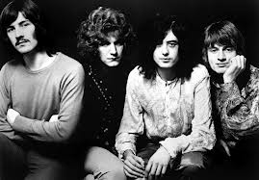
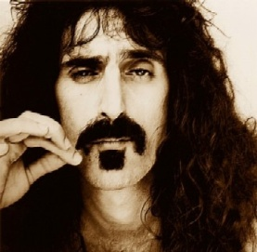
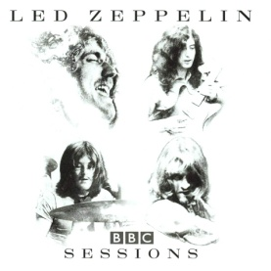
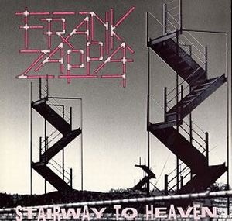



Full example: How would you do it?
Stair way to heaven
(MusicalWork)
Recording1841
Recording999
SignalLed
Towson-March1988
Performance in 1971
SignalZappa
SoundZappa
SoundLed
LedZeppelinTrack
FrankZappa Track
Fan 1
Fan 2
Blog post 1
Blog post 2
http://diymusician.cdbaby.com/wp-content/uploads/2013/06/Millenial-282x300.jpg
DC-2013, Lisbon, Portugal

Slide 53
Full example: How would you do it?
Entity
Stair way to heaven
(MusicalWork)
Recording1841
Recording999
Entity
SignalB
SignalLed
Entity
Towson-March1988
Performance in 1971
SignalZappa
SignalA
Entity
Entity
Entity
Entity
SoundA
SoundB
SoundLed
SoundZappa
LedZeppelinTrack
Entity
FrankZappa Track
Entity
Fan 1
Fan 2
Blog post 1
Blog post 2
http://diymusician.cdbaby.com/wp-content/uploads/2013/06/Millenial-282x300.jpg
DC-2013, Lisbon, Portugal

Slide 54
Full example: How would you do it?
Entity
Stair way to heaven
(MusicalWork)
Recording1841
Agent
Agent
Recording999
Entity
SignalB
SignalLed
Entity
Towson-March1988
Performance in 1971
SignalZappa
SignalA
Entity
Entity
Entity
Entity
SoundA
SoundB
SoundLed
SoundZappa
LedZeppelinTrack
Entity
FrankZappa Track
Entity
Agent
Agent
Fan 1
Fan 2
Blog post 1
Blog post 2
http://diymusician.cdbaby.com/wp-content/uploads/2013/06/Millenial-282x300.jpg
DC-2013, Lisbon, Portugal

Slide 55
Full example: How would you do it?
Entity
Stair way to heaven
(MusicalWork)
Activity
Recording1841
Agent
Activity
Agent
Recording999
Entity
SignalB
SignalLed
Entity
Activity
Activity
Towson-March1988
Performance in 1971
SignalZappa
SignalA
Entity
Entity
Entity
Entity
SoundA
SoundB
SoundLed
SoundZappa
LedZeppelinTrack
Entity
FrankZappa Track
Entity
Agent
Agent
Fan 1
Fan 2
Blog post 1
Blog post 2
http://diymusician.cdbaby.com/wp-content/uploads/2013/06/Millenial-282x300.jpg
DC-2013, Lisbon, Portugal

Slide 56
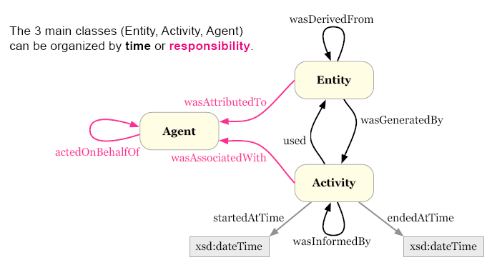
Starting Points: Class View
DC-2013, Lisbon, Portugal

Slide 57
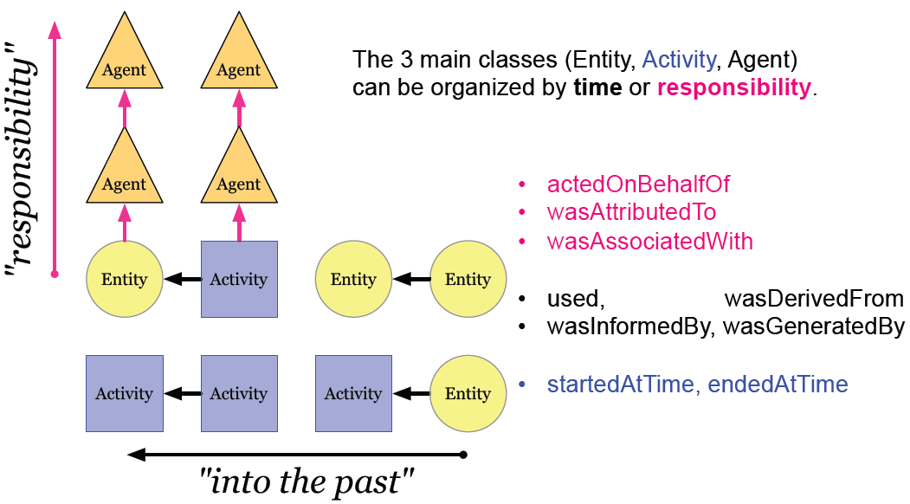
Starting Points: Class View
Agent
Agent
Agent
Agent
DC-2013, Lisbon, Portugal

Slide 58
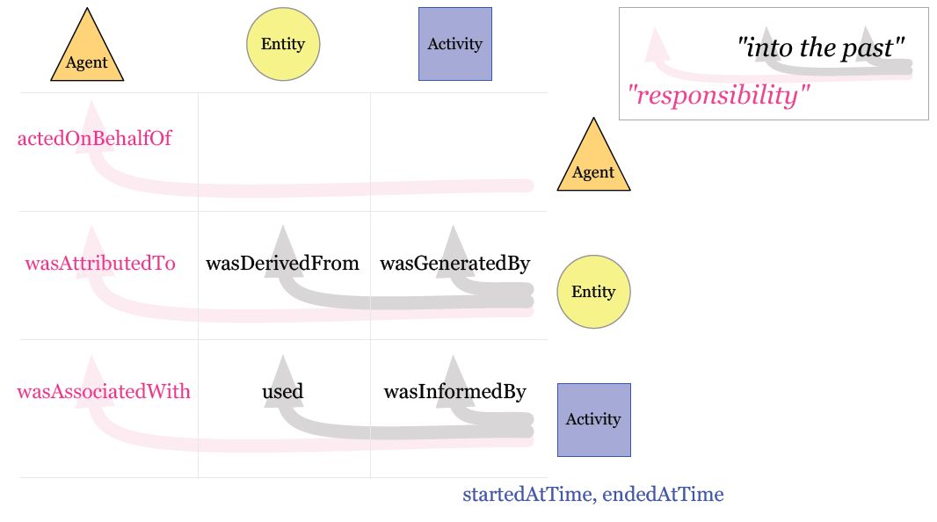
Starting Points: Grid View
Agent
Agent
DC-2013, Lisbon, Portugal

Slide 59
Usage is crucial for describing the entities which participated in an activity:
  The references used for creating a document.
  The query used to obtain a result.
  The inputs of a computational process.
  Etc.
Starting Points: Usage
Entity
prov:used
Activity
“Usage is the beginning of utilizing an entity by an activity. Before usage, the activity had not begun to utilize this entity and could not have been affected by the entity”.
DC-2013, Lisbon, Portugal

Slide 60
Full example: Usage
Music example
  2 bloggers write posts about song tracks by Led Zeppelin and Frank Zappa. We know, thanks to the Music Ontology, that
    Tracks are publications of Signals.
    Signals are produced by recordings.
    Recordings are made from sounds, which are realizations of a Musical Work during a musical Performance.
DC-2013, Lisbon, Portugal

Slide 61
Full example: Usage
Stair way to heaven
(MusicalWork)
Recording1841
Recording999
SignalB
SignalLed
Towson-March1988
Performance in 1971
SignalZappa
SignalA
SoundA
SoundB
SoundLed
SoundZappa
LedZeppelinTrack
FrankZappa Track
Fan 1
Fan 2
Blog post 1
Blog post 2
http://diymusician.cdbaby.com/wp-content/uploads/2013/06/Millenial-282x300.jpg
DC-2013, Lisbon, Portugal

Slide 62
Full example: Usage
Stair way to heaven
(MusicalWork)
Recording1841
prov:used
prov:used
Recording999
SignalB
SignalLed
prov:used
Towson-March1988
prov:used
Performance in 1971
SignalZappa
SignalA
SoundA
SoundB
SoundLed
SoundZappa
LedZeppelinTrack
FrankZappa Track
Fan 1
Fan 2
Blog post 1
Blog post 2
http://diymusician.cdbaby.com/wp-content/uploads/2013/06/Millenial-282x300.jpg
DC-2013, Lisbon, Portugal

Slide 63
Association is crucial for assigning responsibility:
  Who is the responsible for a document?
  Who is the responsible for the creation of a result of
  a computational experiment?
  Who is responsible for the development of a product/contract, etc?
  Etc.
Starting Points: Association
Agent
prov:wasAssociatedWith
Activity
“An activity association is an assignment of responsibility to an agent for an activity, indicating that the agent had a role in the activity. It further allows for a plan to be specified, which is the plan intended by the agent to achieve some goals in the context of this activity”.
DC-2013, Lisbon, Portugal

Slide 64
Full example: Association
Stair way to heaven
(MusicalWork)
Recording1841
Recording999
SignalB
SignalLed
Towson-March1988
Performance in 1971
SignalZappa
SignalA
SoundA
SoundB
SoundLed
SoundZappa
LedZeppelinTrack
FrankZappa Track
Fan 1
Fan 2
Blog post 1
Blog post 2
http://diymusician.cdbaby.com/wp-content/uploads/2013/06/Millenial-282x300.jpg
DC-2013, Lisbon, Portugal

Slide 65
Full example: Association
Stair way to heaven
(MusicalWork)
Recording1841
Recording999
SignalB
SignalLed
prov:wasAssociatedWith
prov:wasAssociatedWith
Towson-March1988
Performance in 1971
SignalZappa
SignalA
SoundA
SoundB
SoundLed
SoundZappa
LedZeppelinTrack
FrankZappa Track
Fan 1
Fan 2
Blog post 1
Blog post 2
http://diymusician.cdbaby.com/wp-content/uploads/2013/06/Millenial-282x300.jpg
DC-2013, Lisbon, Portugal

Slide 66
Starting Points: Generation
Generation is crucial for describing entities and their origin:
  How was a document generated?.
  How is a computational result created?.
  How has an entity been modified?.
  How was a result validated?
  Etc.
Activity
prov:wasGeneratedBy
Entity
“Generation is the completion of production of a new entity by an activity. This entity did not exist before generation and becomes available for usage after this generation”.
DC-2013, Lisbon, Portugal

Slide 67
Full example: Generation
Music example
  2 bloggers write posts about song tracks by Led Zeppelin and Frank Zappa. We know, thanks to the Music Ontology, that
    Tracks are publications of Signals.
    Signals are produced by recordings.
    Recordings are made from sounds, which are realizations of a Musical Work during a musical Performance.
DC-2013, Lisbon, Portugal

Slide 68
Full example: Generation
Stair way to heaven
(MusicalWork)
Recording1841
Recording999
SignalB
SignalLed
Towson-March1988
Performance in 1971
SignalZappa
SignalA
SoundA
SoundB
SoundLed
SoundZappa
LedZeppelinTrack
FrankZappa Track
Fan 1
Fan 2
Blog post 1
Blog post 2
http://diymusician.cdbaby.com/wp-content/uploads/2013/06/Millenial-282x300.jpg
DC-2013, Lisbon, Portugal

Slide 69
Full example: Generation
Stair way to heaven
(MusicalWork)
Recording1841
prov:wasGeneratedBy
Recording999
SignalB
SignalLed
prov:wasGeneratedBy
Towson-March1988
Performance in 1971
SignalZappa
SignalA
SoundA
SoundB
SoundLed
SoundZappa
LedZeppelinTrack
FrankZappa Track
Fan 1
Fan 2
Blog post 1
Blog post 2
http://diymusician.cdbaby.com/wp-content/uploads/2013/06/Millenial-282x300.jpg
DC-2013, Lisbon, Portugal

Slide 70
Starting Points: Derivation
Derivation is used for describing dependencies among entities:
  Are the contents of a document based on other entities?.
  How does a computational result depend on external databases?.
  Which resources have influenced at some
  point this entity?.
  Etc.
Entity
prov:wasDerivedFrom
Entity
“A Derivation is a transformation of an entity into another, an update of an entity resulting in a new one, or the construction of a new entity based on a pre-existing entity”.
DC-2013, Lisbon, Portugal

Slide 71
Full example: Derivation
Music example
  2 bloggers write posts about song tracks by Led Zeppelin and Frank Zappa. We know, thanks to the Music Ontology, that
    Tracks are publications of Signals.
    Signals are produced by recordings.
    Recordings are made from sounds, which are realizations of a Musical Work during a musical Performance.
DC-2013, Lisbon, Portugal

Slide 72
Full example: Derivation
Stair way to heaven
(MusicalWork)
Recording1841
Recording999
SignalB
SignalLed
Towson-March1988
Performance in 1971
SignalZappa
SignalA
SoundA
SoundB
SoundLed
SoundZappa
LedZeppelinTrack
FrankZappa Track
Fan 1
Fan 2
Blog post 1
Blog post 2
http://diymusician.cdbaby.com/wp-content/uploads/2013/06/Millenial-282x300.jpg
DC-2013, Lisbon, Portugal

Slide 73
Full example: Derivation
Stair way to heaven
(MusicalWork)
Recording1841
Recording999
SignalB
SignalLed
Towson-March1988
Performance in 1971
SignalZappa
SignalA
prov:wasDerivedFrom
prov:wasDerivedFrom
SoundA
SoundB
SoundLed
SoundZappa
LedZeppelinTrack
FrankZappa Track
Fan 1
Fan 2
Blog post 1
Blog post 2
http://diymusician.cdbaby.com/wp-content/uploads/2013/06/Millenial-282x300.jpg
DC-2013, Lisbon, Portugal

Slide 74
Starting Points: Communication
Communication is used for describing dependencies between activities:
  Which activities precede the current one?.
  What are the steps required for executing the
  current query?.
  Etc.
Activity
prov:wasInformedBy
Activity
“Communication (wasInformedBy) is the exchange of some unspecified entity by two activities, one activity using some entity generated by the other”.
DC-2013, Lisbon, Portugal

Slide 75
Starting Points: Attribution
Attribution is key for giving credit to someone:
  Who is the author of a particular document?.
  Which tool/Software has been used to generate a result?.
  Who has created a this dataset?
  Etc.
Agent
prov:wasAttributedTo
Entity
“Attribution is the ascribing of an entity to an agent”.
DC-2013, Lisbon, Portugal
Notes:
This in particular is the reason why people assert provenance. To get credit.

Slide 76
Full example: Attribution
Stair way to heaven
(MusicalWork)
Recording1841
Recording999
SignalB
SignalLed
Towson-March1988
Performance in 1971
SignalZappa
SignalA
SoundA
SoundB
SoundLed
SoundZappa
LedZeppelinTrack
FrankZappa Track
prov:wasAttributedTo
prov:wasAttributedTo
Fan 1
Fan 2
Blog post 1
Blog post 2
http://diymusician.cdbaby.com/wp-content/uploads/2013/06/Millenial-282x300.jpg
DC-2013, Lisbon, Portugal

Slide 77
Starting Points: Delegation
Delegation is used to specify responsibility between agents:
  Who is the responsible for the generation of the result of a computational experiment (acting on behalf of UPM?).
  Which user activated the tool to generate the report?.
  Etc.
Agent
prov:actedOnBehalfOf
Agent
“Delegation (actedOnBehalfOf) is the assignment of authority and responsibility to an agent (by itself or by another agent) to carry out a specific activity as a delegate or representative, while the agent it acts on behalf of retains some responsibility for the outcome of the delegated work”.
DC-2013, Lisbon, Portugal
Notes:
If this presentation were to be an activity associated with me (as I am the presenter), you could consider that I am acting on behalf of UPM.

Slide 78
Full example
prov:wasAttributedTo
prov:wasAttributedTo
Fan 1
Fan 2
Blog post 1
Blog post 2
http://diymusician.cdbaby.com/wp-content/uploads/2013/06/Millenial-282x300.jpg
DC-2013, Lisbon, Portugal

Slide 79
Full example
Track barcode: 5016583610128
Track ISRC:
US-AT2-99-00620
prov:wasDerivedFrom
prov:wasDerivedFrom
prov:wasAttributedTo
prov:wasAttributedTo
Fan 1
Fan 2
Blog post 1
Blog post 2
http://diymusician.cdbaby.com/wp-content/uploads/2013/06/Millenial-282x300.jpg
DC-2013, Lisbon, Portugal

Slide 80
Full example
SignalZappa
SignalLed
Tracks are publications of Signals
prov:wasDerivedFrom
prov:wasDerivedFrom
Track barcode: 5016583610128
Track ISRC:
US-AT2-99-00620
prov:wasDerivedFrom
prov:wasDerivedFrom
prov:wasAttributedTo
prov:wasAttributedTo
Fan 1
Fan 2
Blog post 1
Blog post 2
http://diymusician.cdbaby.com/wp-content/uploads/2013/06/Millenial-282x300.jpg
DC-2013, Lisbon, Portugal
80

Slide 81
Full example
Information from
recording not
available
Recording 1841 in
Playhouse Theatre,
Northumberland Av
Recording999
Recording1841
prov:wasGeneratedBy
prov:wasGeneratedBy
SignalLed
SignalZappa
SignalB
SignalA
Tracks are publications of Signals
prov:wasDerivedFrom
prov:wasDerivedFrom
Track barcode: 5016583610128
Track ISRC:
US-AT2-99-00620
prov:wasDerivedFrom
prov:wasDerivedFrom
prov:wasAttributedTo
prov:wasAttributedTo
Fan 1
Fan 2
Blog post 1
Blog post 2
http://diymusician.cdbaby.com/wp-content/uploads/2013/06/Millenial-282x300.jpg
DC-2013, Lisbon, Portugal

Slide 82
Full example
SoundZappA
SoundLed
Realisation of a
MusicalWork during a
musical Performance
prov:used
prov:used
Information from
recording not
available
Recording999
Recording1841
Recording 1841 in
Playhouse Theatre,
Northumberland Av
DC-2013, Lisbon, Portugal

Slide 83
Full example
Towson-March1988
Performance in 1971
prov:wasGeneratedBy
prov:wasGeneratedBy
SoundZappA
SoundLed
Realisation of a
MusicalWork during a
musical Performance
SoundA
SoundB
prov:used
prov:used
Information from
recording not
available
Recording999
Recording1841
Recording 1841 in
Playhouse Theatre,
Northumberland Av
DC-2013, Lisbon, Portugal

Slide 84
Full example
Towson-March1988
Performance in 1971
prov:wasGeneratedBy
prov:wasGeneratedBy
SoundZappA
SoundLed
Realisation of a
MusicalWork during a
musical Performance
SoundA
SoundB
prov:wasInformedBy
prov:wasInformedBy
prov:used
prov:used
Information from
recording not
available
Recording999
Recording1841
Recording 1841 in
Playhouse Theatre,
Northumberland Av
DC-2013, Lisbon, Portugal

Slide 85
Full example
Stair way to heaven
(MusicalWork)
http://musicbrainz.org/work/
968ee3c5-21fa-35de-88f9-bd1c300ac3ee
prov:used
prov:used
Towson-March1988
Performance in 1971
prov:wasGeneratedBy
prov:wasGeneratedBy
SoundZappA
SoundLed
Realisation of a
MusicalWork during a
musical Performance
SoundA
SoundB
prov:wasInformedBy
prov:wasInformedBy
prov:used
prov:used
Information from
recording not
available
Recording999
Recording1841
Recording 1841 in
Playhouse Theatre,
Northumberland Av
DC-2013, Lisbon, Portugal

Slide 86
Full example
Stair way to heaven
(MusicalWork)
Led Zeppelin
Frank Zappa
http://musicbrainz.org/work/
968ee3c5-21fa-35de-88f9-bd1c300ac3ee
prov:wasAssociatedWith
prov:wasAssociatedWith
prov:used
prov:used
Towson-March1988
Performance in 1971
prov:wasGeneratedBy
prov:wasGeneratedBy
SoundZappA
SoundLed
Realisation of a
MusicalWork during a
musical Performance
SoundA
SoundB
prov:wasInformedBy
prov:wasInformedBy
prov:used
prov:used
Information from
recording not
available
Recording999
Recording1841
Recording 1841 in
Playhouse Theatre,
Northumberland Av
DC-2013, Lisbon, Portugal

Slide 87
Full example
Stair way to heaven
(MusicalWork)
Led Zeppelin
Frank Zappa
http://musicbrainz.org/work/
968ee3c5-21fa-35de-88f9-bd1c300ac3ee
prov:wasAssociatedWith
prov:wasAssociatedWith
prov:used
prov:used
Towson-March1988
Performance in 1971
prov:wasGeneratedBy
prov:wasGeneratedBy
SoundA
SoundB
Realisation of a
MusicalWork during a
musical Performance
SoundZappA
SoundLed
prov:wasInformedBy
prov:wasInformedBy
prov:used
prov:used
Information from
recording not
available
Recording999
Recording1841
Recording 1841 in
Playhouse Theatre,
Northumberland Av
DC-2013, Lisbon, Portugal

Slide 88
Introduction
PROV-O: The PROV Ontology
Part 2
DC-2013, Lisbon, Portugal

Slide 89
Expanded Terms: Overview
Part 2
PROV-O Expanded terms
PROV-O Qualification terms
DC-2013, Lisbon, Portugal

Slide 90
PROV-O: Expanded Terms
DC-2013, Lisbon, Portugal

Slide 91
Expanded terms
Extension of the Starting Point Terms.
Generic definitions to remain as domain independent as possible.
Allow for richer descriptions of resources.
DC-2013, Lisbon, Portugal

Slide 92
Expanded Terms
DC-2013, Lisbon, Portugal

Slide 93
Expanded Terms: Agent specializations
Software Agent, Organization and Person are similar to foaf agents (http://xmlns.com/foaf/spec/#term_Agent).
These types of Agents are commonly found in the Web:
  Software tools used to create resources.
  Organizations publishing a document report.
  Specific authors of a paper.
  Etc.
“A SoftwareAgent is running software”.
“An Organization is a social or legal institution such as a company, society, etc”.
“Person agents are people”.
DC-2013, Lisbon, Portugal

Slide 94
Expanded Terms: Location
Locations may be bound to all types of prov resources:
  Location of a file within a file system.
  Location where a resource was used or generated.
  Location where an activity took place.
  Etc.
The relationship prov:atLocation binds resources to locations
“A Location can be an identifiable geographic place (ISO 19112), but it can also be a non-geographic place such as a directory, row, or column. As such, there are numerous ways in which location can be expressed, such as by a coordinate, address, landmark, and so forth”.
DC-2013, Lisbon, Portugal

Slide 95
Expanded Terms: Plans
A plan can be anything that indicates how to achieve a goal:
  A script program.
  A set of instructions written on a napkin.
  A food recipe.
  A scientific workflow template.
  An algorithm.
  Best practice guidelines.
  Etc.
“A plan is an entity that represents a set of actions or steps intended by one or more agents to achieve some goals”.
DC-2013, Lisbon, Portugal

Slide 96
Expanded Terms-Plans: Example
Plans are associated to Activities and executed by an Agents:
Chef
Association
Recipe
(plan)
prov:wasAssociatedWith
prov:hadPlan
Bake Cake
prov:wasGeneratedBy
Cake
DC-2013, Lisbon, Portugal

Slide 97
Expanded Terms: Collections
There is a complete PROV extension for structured collections (dictionaries) : http://www.w3.org/TR/prov-dictionary/
Members of a collection are asserted with the prov:hadMember relationship.
Examples: the collection of authors who participated in a publication, the members of a research group, etc.
“A collection is an entity that provides a structure to some constituents that must themselves be entities. These constituents are said to be member of the collections. An empty collection is a collection without members”.
DC-2013, Lisbon, Portugal

Slide 98
Expanded Terms: Bundles
Bundles can be any kind of container:
  Files containing provenance descriptions.
  Named graphs.
  Repositories.
  Etc.
This document defines how entities could be identified across bundles: http://www.w3.org/TR/prov-links/
“A bundle is a named set of provenance descriptions, and is itself an entity, so allowing provenance of provenance to be expressed.”
DC-2013, Lisbon, Portugal

Slide 99
Expanded Terms-Bundles: an Example
Describing the provenance of provenance of this presentation
(first example)
:daniel
dct:creator
:dcProvTutorial
prov:Agent
prov:wasAttributedTo
prov:Entity
prov:wasAssociatedWith
prov:wasGeneratedBy
:kai
:makingTheTutorial
prov:wasAssociatedWith
prov:used
prov:Activity
:tutorialDraft
prov:wasRevisionOf
:makingTheDraft
prov:wasDerivedFrom
prov:wasGeneratedBy
prov:used
:iswcProvTutorial
prov:wasAssociatedWith
prov:used
:iswcProvIntro
prov:Bundle
prov:wasDerivedFrom
prov:wasAttributedTo
:daniel
dct:format
“RDF”
DC-2013, Lisbon, Portugal

Slide 100
Expanded Terms: Primary Source
The determination of primary sources can be up to interpretation.
Determining the primary source is key for attribution:
  What is the primary source for a blog post?
  What is the primary source of a news article?
  What are the primary sources for a research result?
  Etc.
Entity
prov:hadPrimarySource
Entity
“A primary source relation is a kind of a derivation relation from secondary materials to their primary sources“.
DC-2013, Lisbon, Portugal

Slide 101
Expanded Terms: Quotation
Quotation is key for giving credit:
  The quote in this slide was quoted from the prov-dm definition of quotation: http://www.w3.org/TR/prov-dm/#term-quotation
  Quotes from people in news articles.
  Etc.
Quotation is expressed with the relationship prov:wasQuotedFrom.
Entity
prov:wasQuotedFrom
Entity
“A quotation is the repeat of (some or all of) an entity, such as text or image, by someone who may or may not be its original author”.
DC-2013, Lisbon, Portugal

Slide 102
Expanded Terms: value
Used when entities have a string or numeric value:
  A string representing the quote in a document.
  The value of the parameter being used as input for an experimental activity.
  Etc.
“prov:value provides a value that is a direct representation of an entity”.
DC-2013, Lisbon, Portugal

Slide 103
Expanded Terms-value and quotation: Example
Quoting a news article in a blog post
newsArticle
“According to the number of registrations in the website,
DC2013 conference was a great success”…
prov:wasQuotedFrom
Summary of the DC conference.
As this article states:
“According to the number of registrations in the website,
DC2013 conference was a great success”
….
blogPost
DC-2013, Lisbon, Portugal

Slide 104
Expanded Terms-value and quotation: Example
Quoting a news article in a blog post
newsArticle
The blog post is not a quote! The wasQuotedFrom
relationship should be only for the quotes.
prov:wasQuotedFrom
blogPost
DC-2013, Lisbon, Portugal

Slide 105
Expanded Terms-value and quotation: Example
Quoting a news article in a blog post
newsArticle
newsArticle
prov:wasQuotedFrom
prov:wasQuotedFrom
blogPost
quoteInBlogpost
“According to the number of registrations…”
prov:value
prov:hadPrimarySource,
prov:wasDerivedFrom
dc:isPartOf
blogPost
DC-2013, Lisbon, Portugal

Slide 106
Expanded Terms: Start and End
The starter/ender of the activity may be an entity or an agent.
Useful for assigning responsibility:
  The cause for the failure of an execution.
  The email who started a discussion.
  Etc.
Entity
prov:wasStartedBy
Activity
“Start is when an activity is deemed to have been started by an entity, known as trigger. The activity did not exist before its start“.
“End is when an activity is deemed to have been ended by an entity, known as trigger. The activity no longer exists after its end”.
DC-2013, Lisbon, Portugal

Slide 107
wasInvalidatedBy is used to point at the activity responsible for the invalidation of the entity:
  A piece of art being damaged by a fire.
  A paper being withdrawn after a discussion
  with the authors.
  An information invalidated by an automatic
  process because of its expiry date.
  Etc.
Expanded Terms: Invalidation
Activity
prov:wasInvalidatedBY
Entity
“Invalidation is the start of the destruction, cessation, or expiry of an existing entity by an activity. The entity is no longer available for use (or further invalidation) after invalidation”.
DC-2013, Lisbon, Portugal

Slide 108
Expanded Terms: Revision
Revision is used for asserting a strong dependency between two entities:
  A final report is a revision of a previous version.
  A result is a refinement of previous results.
  Etc.
Similar to dct:isVersionOf.
Entity
prov:wasRevisionFrom
Entity
“A revision is a derivation for which the resulting entity is a revised version of some original”.
DC-2013, Lisbon, Portugal

Slide 109
Expanded Terms: Specialization
Specialization is used for defining abstractions and contextualized entities:
  Entities during a period of time (a weather report
  being a specialization of today’s weather report).
  An agent during a trip is a specialization of that
  agent.
  Two different versions of a document can be specializations of the general entity representing the document
  Etc.
Entity
prov:specializationOf
Entity
“An entity that is a specialization of another shares all aspects of the latter, and additionally presents more specific aspects of the same thing as the latter. In particular, the lifetime of the entity being specialized contains that of any specialization.”
DC-2013, Lisbon, Portugal

Slide 110
Expanded Terms: Alternate Of
Alternate describe entities that specialize the same resource:
  Two different versions of a document are
  alternates of each other.
  A tool designed for mobile devices is an
  alternate of a desktop application.
  Etc.
Similar to owl:sameAs, but not the same.
Entity
prov:alternateOf
Entity
“Two alternate entities present aspects of the same thing. These aspects may be the same or different, and the alternate entities may or may not overlap in time.”
DC-2013, Lisbon, Portugal

Slide 111
Expanded terms-specialization and alternate: The music example
Stair way to heaven
(MusicalWork)
Led Zeppelin
Frank Zappa
http://musicbrainz.org/work/
968ee3c5-21fa-35de-88f9-bd1c300ac3ee
prov:wasAssociatedWith
prov:wasAssociatedWith
prov:used
prov:used
Towson-March1988
Performance in 1971
prov:wasGeneratedBy
prov:wasGeneratedBy
SoundA
SoundB
prov:used
prov:used
Recording999
Recording1841
DC-2013, Lisbon, Portugal

Slide 112
Expanded terms-specialization and alternate: The music example
Stair way to heaven
(MusicalWork)
Led Zeppelin
Frank Zappa
http://musicbrainz.org/work/
968ee3c5-21fa-35de-88f9-bd1c300ac3ee
prov:wasAssociatedWith
prov:wasAssociatedWith
prov:used
prov:used
prov:specializationOf
prov:specializationOf
Towson-March1988
Performance in 1971
prov:wasGeneratedBy
prov:wasGeneratedBy
SoundA
SoundB
prov:used
prov:used
Recording999
Recording1841
DC-2013, Lisbon, Portugal

Slide 113
Expanded terms-specialization and alternate: The music example
Stair way to heaven
(MusicalWork)
Led Zeppelin
Frank Zappa
http://musicbrainz.org/work/
968ee3c5-21fa-35de-88f9-bd1c300ac3ee
prov:wasAssociatedWith
prov:wasAssociatedWith
prov:used
prov:used
prov:specializationOf
prov:specializationOf
Towson-March1988
Performance in 1971
prov:wasGeneratedBy
prov:wasGeneratedBy
prov:alternateOf
SoundA
SoundB
prov:alternateOf
Both Sounds are
expressions of the
same musical work
prov:used
prov:used
Recording999
Recording1841
DC-2013, Lisbon, Portugal

Slide 114
PROV-O: Qualifying terms
DC-2013, Lisbon, Portugal

Slide 115
Qualifying terms
Starting and expanded terms are binary.
But we may want to further describe these relationships:
  Where was an entity generated?
  What were the roles of the associated to the activity?
  When was an entity used?
  Etc.
Towson-March1988
SoundA
Led Zeppelin
prov:wasGeneratedBy
prov:used
prov:wasAssociatedWith
SoundA
Towson-March1988
Towson-March1988
DC-2013, Lisbon, Portugal

Slide 116
Qualifying terms: Usage
Qualifying usage:
Stair way to heaven
(MusicalWork)
prov:entity
“1988”
Usage
prov:atTime
prov:used
prov:atLocation
prov:qualifiedUsage
Towson
Towson-March1988
…
DC-2013, Lisbon, Portugal

Slide 117
Qualifying terms: Association
Qualifying association:
Frank
Zappa
“1988”
prov:agent
prov:atTime
Association
prov:atLocation
Towson
prov:wasAssociatedWith
prov:hadRole
prov:qualifiedAssociation
Performer
prov:hadPlan
Towson-March1988
Song Lyrics
…
DC-2013, Lisbon, Portugal

Slide 118
Qualifying terms: Generation
Qualifying generation:
Towson-March1988
prov:activity
“1988”
Generation
prov:atTime
prov:wasGeneratedBy
prov:atLocation
prov:qualifiedGeneration
Towson
SoundA
…
DC-2013, Lisbon, Portugal

Slide 119
Encoding qualified relationships in RDF
N-ary relationship pattern:
http://www.w3.org/TR/swbp-n-aryRelations/
Example for the usage qualifying pattern:
:towsonRecording a prov:Activity;
prov:used :musicalWork;
prov:qualifiedUsage [ a prov:Usage;
prov:entity :musicalWork ;
prov:hadRole :used-musicalWork;
prov:atTime “1988-03-23T20:40:40"^^xsd:dateTime;
prov:atLocation :towson.
];
.
:musicalWork a prov:entity;
dc:title “A stairway to heaven”.
:used-musialWork a prov:Role.
:towson a prov:Location.
DC-2013, Lisbon, Portugal

Slide 120
Qualifying terms: Qualified relationships
The following starting point relationships and expanded terms relationships have qualified versions:
  Usage (used)
  Generation (wasGeneratedBy)
  Association (wasAssociatedWith)
  Derivation (wasDerivedFrom)
  Quotation (wasQuotedFrom)
  Revision (wasRevisionOf)
  PrimarySource (hadPrimarySource)
  Influence (wasInfluencedBy)
  Start (wasStartedBy)
  End (wasEndedBy)
  Communication (wasInformedBy)
  Invalidation (wasInvalidatedBy)
  Attribution (wasAttributedTo)
  Delegation (actedOnBehalfOf)
Stair way to heaven
(MusicalWork)
prov:entity
“1988”
Usage
prov:atTime
prov:used
prov:atLocation
prov:qualifiedUsage
Towson
Towson-March1988
…
DC-2013, Lisbon, Portugal

Slide 121
Introduction
PROV-O: Summary
DC-2013, Lisbon, Portugal

Slide 122
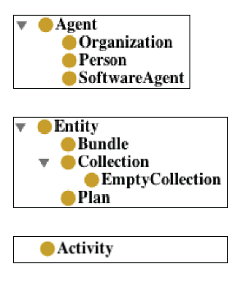
3 main classes
Agent
Entity
Activity
DC-2013, Lisbon, Portugal

Slide 123
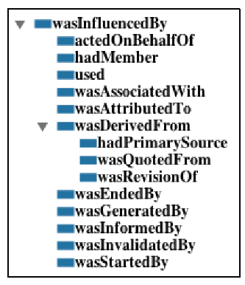
Relating the main 3 classes
DC-2013, Lisbon, Portugal

Slide 124
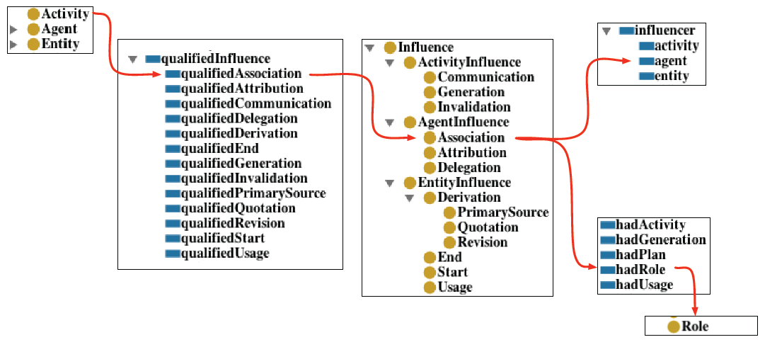
Qualifying patterns
DC-2013, Lisbon, Portugal

Slide 125

Mapping PROV-O to Dublin Core
http://allfaaraa.com/wp-content/uploads/2013/02/puzzle.jpg
DC-2013, Lisbon, Portugal

Slide 126
Mapping PROV-O to Dublin Core: Outline
Preliminaries
    Provenance and DC
    Entities in PROV and DC
Direct mappings
PROV-O Extensions
Complex mappings
DC-2013, Lisbon, Portugal

Slide 127
Mapping PROV-O to Dublin Core: Provenance in DC
Many DC terms hold provenance information
  Who affected a resource
    Creator, contributor, publisher, etc..
  How the resource was affected
    Access rights, license, hasFormat, etc.
  When the resource was affected
    Created, issued, dateSubmitted, etc.
The rest of the terms hold metadata about the resource
  Date, description, abstract, language, etc.
DC-2013, Lisbon, Portugal

Slide 128
Mapping PROV-O to Dublin Core- Provenance in DC: Who
Properties with dct:Agents as range:
  creator
  contributor
  publisher
  rightsHolder
Resource
dct property
dc:Agent
DC-2013, Lisbon, Portugal

Slide 129
Mapping PROV-O to Dublin Core- Provenance in DC: When
available
created
date
dateAccepted
dateCopyrighted
dateSubmitted
issued
modified
valid
Resource
dct property
dc date
DC-2013, Lisbon, Portugal

Slide 130
Mapping PROV-O to Dublin Core- Provenance in DC: How
accessRights
hasFormat
hasVersion
isFormatOf
isVersionOf
license
isReferencedBy
isReplacedBy
references
replaces
rights
source
Resource
dct property
dct resource
DC-2013, Lisbon, Portugal

Slide 131
Mapping PROV-O to Dublin Core: Resources in DC vs entities in PROV
Resources in Dublin Core have “scruffy” provenance…
dct:creator
author
book
dct:publisher
editorial
DC-2013, Lisbon, Portugal
Notes:
The creation date (dc:created) could be different from the date when the book was published (dc:issued)

Slide 132
Mapping PROV-O to Dublin Core: Entities in DC vs entities in PROV (2)
But in PROV we aim for “complete“ provenance:
dc:creator
author
book
dc:publisher
editorial
createBook
prov:wasAssociatedWith
prov:wasGeneratedBy
prov:
specializationOf
authorCopy
prov:wasAttributedTo
prov:used
publishBook
prov:wasAssociatedWith
prov:wasGeneratedBy
prov:
specializationOf
editorialCopy
prov:wasAttributedTo
DC-2013, Lisbon, Portugal

Slide 133
Mapping PROV-O to Dublin Core: Direct mappings
Direct mappings
  Simple equivalences between PROV terms and DC terms.
  Described in terms of rdfs:subClassOf, rdfs:subPropertyOf, owl:equivalentClass.
  The mappings uses prov starting points and prov expanded terms.
DC-2013, Lisbon, Portugal

Slide 134
Mapping PROV-O to Dublin Core: Direct mappings (terms)
DC Term | Mapping | PROV Property
created | subPropertyOf | generatedAtTime
dateAccepted | subPropertyOf | generatedAtTime
dateCopyRighted | subPropertyOf | generatedAtTime
dateSubmitted | subPropertyOf | generatedAtTime
issued | subPropertyOf | generatedAtTime
modified | subPropertyOf | generatedAtTime
creator | subPropertyOf | wasAttributedTo
contributor | subPropertyOf | wasAttributedTo
publisher | subPropertyOf | wasAttributedTo
rightsHolder | subPropertyOf | wasAttributedTo
source | subPropertyOf | wasDerivedFrom
hasFormat | subPropertyOf | alternateOf
isFormatOf | subPropertyOf | alternateOf, wasDerivedFrom
DC-2013, Lisbon, Portugal

Slide 135
Mapping PROV-O to Dublin Core: Direct mappings (terms)
DC Term | Mapping | PROV Property
created | subPropertyOf | generatedAtTime
dateAccepted | subPropertyOf | generatedAtTime
dateCopyRighted | subPropertyOf | generatedAtTime
dateSubmitted | subPropertyOf | generatedAtTime
issued | subPropertyOf | generatedAtTime
modified | subPropertyOf | generatedAtTime
creator | subPropertyOf | wasAttributedTo
contributor | subPropertyOf | wasAttributedTo
publisher | subPropertyOf | wasAttributedTo
rightsHolder | subPropertyOf | wasAttributedTo
source | subPropertyOf | wasDerivedFrom
hasFormat | subPropertyOf | alternateOf
isFormatOf | subPropertyOf | alternateOf, wasDerivedFrom
Generation dates
DC-2013, Lisbon, Portugal

Slide 136
Mapping PROV-O to Dublin Core: Direct mappings (terms)
DC Term | Mapping | PROV Property
created | subPropertyOf | generatedAtTime
dateAccepted | subPropertyOf | generatedAtTime
dateCopyRighted | subPropertyOf | generatedAtTime
dateSubmitted | subPropertyOf | generatedAtTime
issued | subPropertyOf | generatedAtTime
modified | subPropertyOf | generatedAtTime
creator | subPropertyOf | wasAttributedTo
contributor | subPropertyOf | wasAttributedTo
publisher | subPropertyOf | wasAttributedTo
rightsHolder | subPropertyOf | wasAttributedTo
source | subPropertyOf | wasDerivedFrom
hasFormat | subPropertyOf | alternateOf
isFormatOf | subPropertyOf | alternateOf, wasDerivedFrom
Generation dates
Agents
DC-2013, Lisbon, Portugal

Slide 137
Mapping PROV-O to Dublin Core: Direct mappings (terms)
Some DC terms generalize PROV properties:
PROV property | Mapping | DC Term
hadPrimarySource | subPropertyOf | source
wasRevisionOf | subPropertyOf | isVersionOf
DC-2013, Lisbon, Portugal

Slide 138
Mapping PROV-O to Dublin Core: Main Direct mappings (classes)
DC Term | Mapping | PROV Property
Agent | equivalentClass | Agent
BibliographicResource | subClassOf | Entity
LicenseDocument | subClassOf | Entity
LinguisticSystem | subClassOf | Plan
Location | equivalentClass | Location
MethodOfAccrual | subClassOf | Plan
MethodOfInstruction | subClassOf | Plan
RightsStatement | subClassOf | Entity
PhysicalResource | subClassOf | Entity
Policy | subClassOf | Plan
ProvenanceStatement | subClassOf | Bundle
DC-2013, Lisbon, Portugal

Slide 139
Mapping PROV-O to Dublin Core: PROV refinements
To properly represent DC activities and roles, we have extended PROV:
Extended Term | Relation to PROV | PROV extended Term
Publish | subClassOf | Activity
Contribute | subClassOf | Activity
Create | subClassOf | Activity, Contribute
RightsAssignment | subClassOf | Activity
Modify | subClassOf | Activity
Accept | subClassOf | Activity
Copyright | subClassOf | Activity
Submit | subClassOf | Activity
Replace | subClassOf | Activity
Publisher | subClassOf | Role
Contributor | subClassOf | Role
Creator | subClassOf | Role, Contributor
RightsHolder | subClassOf | Role
DC-2013, Lisbon, Portugal

Slide 140
Mapping PROV-O to Dublin Core: Complex mappings
Complex mappings
  Defined to generate qualified PROV statements from DC statements.
  More complete than simple mappings.
  May be refined depending on the use case scenario where applied.
  Provided in the form of SPARQL construct queries.
DC-2013, Lisbon, Portugal

Slide 141
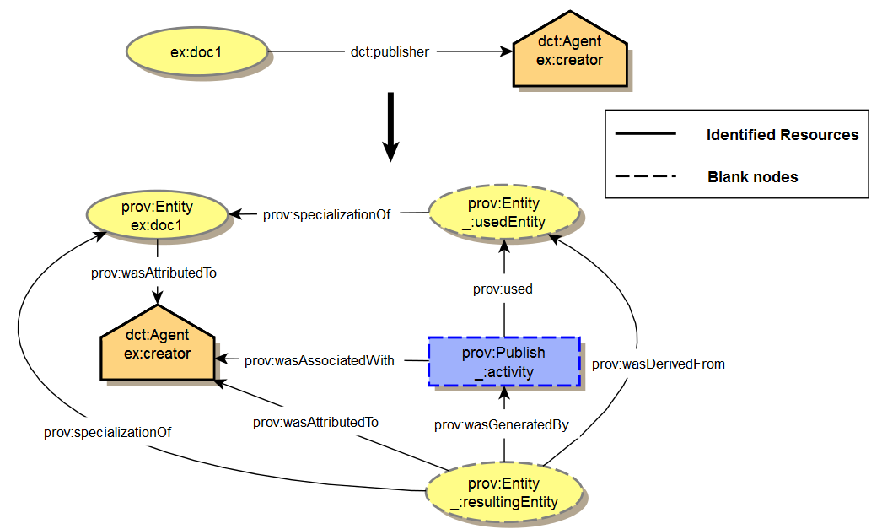
Mapping PROV-O to Dublin Core-Complex mappings: an example
Transformation of dc:publisher to PROV
DC-2013, Lisbon, Portugal

Slide 142
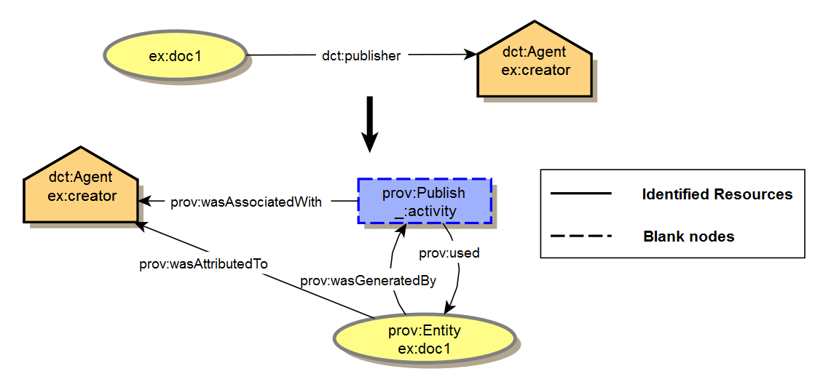
Mapping PROV-O to Dublin Core-Complex mappings: an example
Why can’t we follow DC’s approach?
Publish would generate doc1 and then use it.
  It is not what we want to represent!
DC-2013, Lisbon, Portugal

Slide 143
Mapping PROV-O to Dublin Core-Complex mappings: an Example
CONSTRUCT {
?document a prov:Entity;
prov:wasAttributedTo ?agent.
?agent a prov:Agent.
_:usedEntity a prov:Entity;
prov:specializationOf ?document.
_:activity a prov:Activity, prov:Publish;
prov:used _:usedEntity;
prov:wasAssociatedWith ?agent;
prov:qualifiedAssociation [
a prov:Association;
prov:agent ?agent;
prov:hadRole [a prov:Publisher].
].
_:resultingEntity a prov:Entity;
prov:specializationOf ?document;
prov:wasDerivedFrom _:usedEntity;
prov:wasGeneratedBy _:activity;
prov:wasAttributedTo ?agent.
} WHERE { ?document dct:publisher ?agent. }
DC-2013, Lisbon, Portugal

Slide 144
Mapping PROV-O to Dublin Core-Complex mappings: an Example
CONSTRUCT {
?document a prov:Entity; (GENERAL ENTITY)
prov:wasAttributedTo ?agent. (DIRECT MAPPING)
?agent a prov:Agent.
_:usedEntity a prov:Entity;
prov:specializationOf ?document.
_:activity a prov:Activity, prov:Publish;
prov:used _:usedEntity;
prov:wasAssociatedWith ?agent;
prov:qualifiedAssociation [
a prov:Association;
prov:agent ?agent;
prov:hadRole [a prov:Publisher].
].
_:resultingEntity a prov:Entity;
prov:specializationOf ?document;
prov:wasDerivedFrom _:usedEntity;
prov:wasGeneratedBy _:activity;
prov:wasAttributedTo ?agent.
} WHERE { ?document dct:publisher ?agent. }
DC-2013, Lisbon, Portugal

Slide 145
Mapping PROV-O to Dublin Core-Complex mappings: an Example
CONSTRUCT {
?document a prov:Entity; (GENERAL ENTITY)
prov:wasAttributedTo ?agent. (DIRECT MAPPING)
?agent a prov:Agent.
_:usedEntity a prov:Entity; (SPECIALIZATION OF THE GENERAL ENTITY)
prov:specializationOf ?document.
_:activity a prov:Activity, prov:Publish;
prov:used _:usedEntity;
prov:wasAssociatedWith ?agent;
prov:qualifiedAssociation [
a prov:Association;
prov:agent ?agent;
prov:hadRole [a prov:Publisher].
].
_:resultingEntity a prov:Entity; (SPECIALIZATION OF THE GENERAL ENTITY)
prov:specializationOf ?document;
prov:wasDerivedFrom _:usedEntity;
prov:wasGeneratedBy _:activity;
prov:wasAttributedTo ?agent.
} WHERE { ?document dct:publisher ?agent. }
DC-2013, Lisbon, Portugal

Slide 146
Mapping PROV-O to Dublin Core-Complex mappings: an Example
CONSTRUCT {
?document a prov:Entity; (GENERAL ENTITY)
prov:wasAttributedTo ?agent. (DIRECT MAPPING)
?agent a prov:Agent.
_:usedEntity a prov:Entity; (SPECIALIZATION OF THE GENERAL ENTITY)
prov:specializationOf ?document.
_:activity a prov:Activity, prov:Publish; (ACTIVITY EXTENDING PROV)
prov:used _:usedEntity;
prov:wasAssociatedWith ?agent;
prov:qualifiedAssociation [
a prov:Association;
prov:agent ?agent;
prov:hadRole [a prov:Publisher].
].
_:resultingEntity a prov:Entity; (SPECIALIZATION OF THE GENERAL ENTITY)
prov:specializationOf ?document;
prov:wasDerivedFrom _:usedEntity;
prov:wasGeneratedBy _:activity;
prov:wasAttributedTo ?agent.
} WHERE { ?document dct:publisher ?agent. }
DC-2013, Lisbon, Portugal

Slide 147
Mapping PROV-O to Dublin Core-Complex mappings: an Example
CONSTRUCT {
?document a prov:Entity; (GENERAL ENTITY)
prov:wasAttributedTo ?agent. (DIRECT MAPPING)
?agent a prov:Agent.
_:usedEntity a prov:Entity; (SPECIALIZATION OF THE GENERAL ENTITY)
prov:specializationOf ?document.
_:activity a prov:Activity, prov:Publish; (ACTIVITY EXTENDING PROV)
prov:used _:usedEntity;
prov:wasAssociatedWith ?agent;
prov:qualifiedAssociation [ (QUALIFIED ASSOCIATION TO BIND THE ACTIVITY TO THE ROLE)
a prov:Association;
prov:agent ?agent;
prov:hadRole [a prov:Publisher].
].
_:resultingEntity a prov:Entity; (SPECIALIZATION OF THE GENERAL ENTITY)
prov:specializationOf ?document;
prov:wasDerivedFrom _:usedEntity;
prov:wasGeneratedBy _:activity;
prov:wasAttributedTo ?agent.
} WHERE { ?document dct:publisher ?agent. }
DC-2013, Lisbon, Portugal

Slide 148
Mapping PROV-O to Dublin Core: Cleanup
The complex mapping lead to the proliferation of blank nodes.
  Binding URIs for the blank nodes may solve the problem
  Is there a way to reduce the number of blank nodes?
    Conflate properties referring to the same state of the resource
    Sort activities by their logical order
DC-2013, Lisbon, Portugal

Slide 149
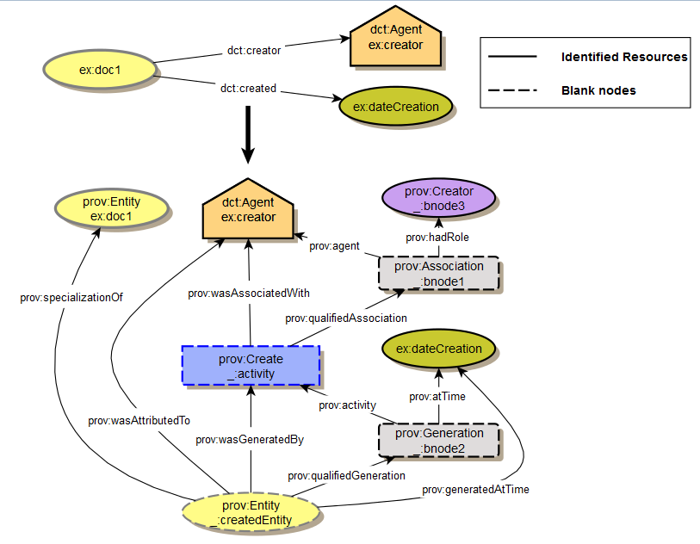
Mapping PROV-O to Dublin Core: Cleanup 1
DC-2013, Lisbon, Portugal

Slide 150
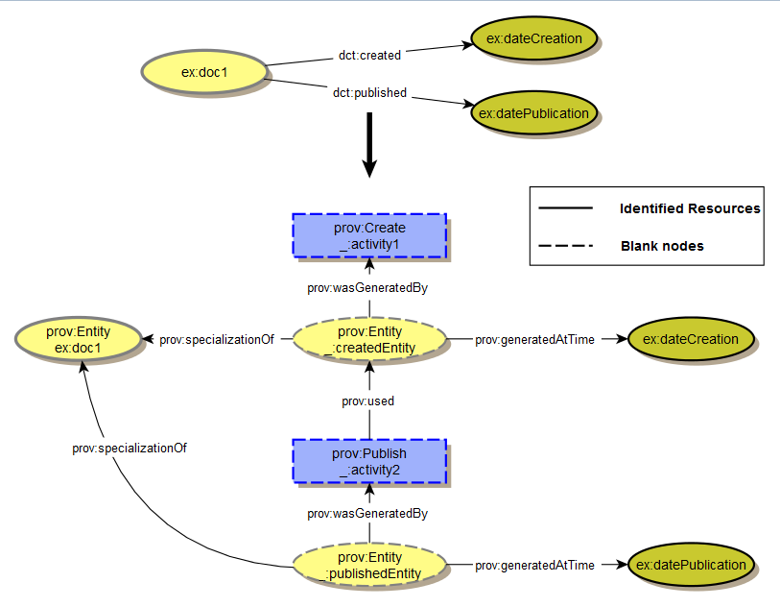
Mapping PROV-O to Dublin Core: Cleanup 2
DC-2013, Lisbon, Portugal

Slide 151
Mapping PROV-O to Dublin Core: Summary
Direct mappings
PROV-O Extensions
Complex mappings
DC-2013, Lisbon, Portugal

Slide 152
Acknowledgements
Luc Moreau, Ivan Herman, Paul Groth and Timothy Lebo for creating some of the materials used for this presentation:
  http://www.w3.org/2001/sw/wiki/OutreachInformation
Victor Rodriguez Doncel for providing the sources to the music ontology example.
Kai Eckert, María Poveda, Oscar Corcho and Daniel Nüst for providing feedback.
PROV-O team: http://www.w3.org/2011/prov#prov‐o‐team
DC-2013, Lisbon, Portugal

Slide 153

Introduction
Questions?
http://thumbs.dreamstime.com/x/question-mark-five-w-s-18903552.jpg
DC-2013, Lisbon, Portugal

Slide 154
PROV-O: The PROV Ontology
Tutorial
Daniel Garijo
Ontology Engineering Group
Universidad Politécnica de Madrid
(with Slides from Luc Moreau, Ivan Herman, Paul Groth and Timothy Lebo)
Date: 01/09/2013

